Slide 1
AMOC recent trends: A crucial role for the oceanic resolution and Greenland melting?
Didier Swingedouw
Marion Devilliers, Marie-Noelle Houssais, Christophe Herbaut, Anne-Cécile Blaizot, Juliette Mignot, Julie Deshayes, Gilles Garric, Mohamed Ayache

Slide 2

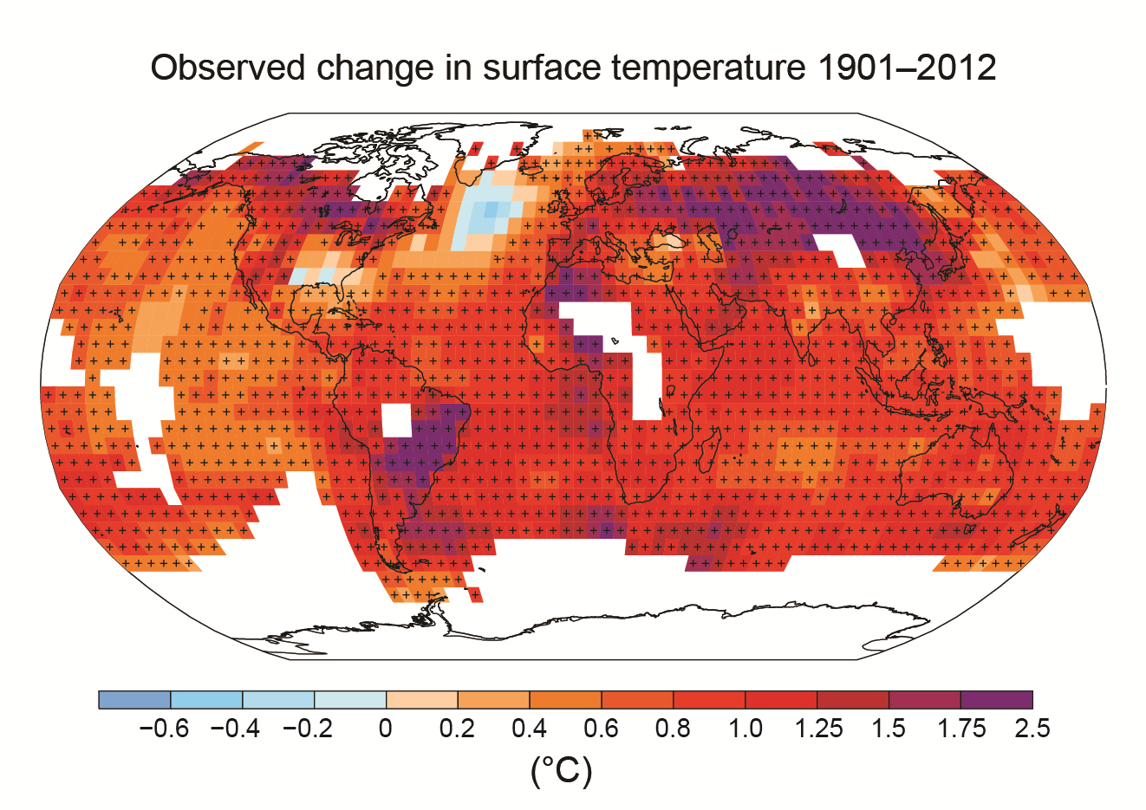
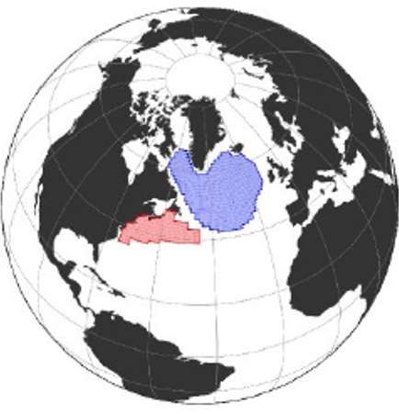
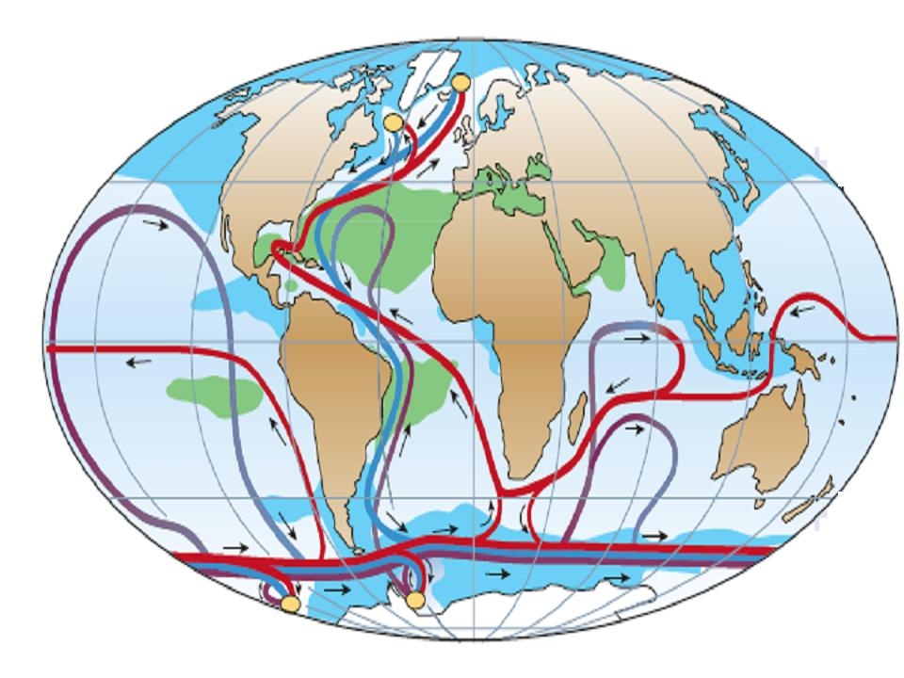
A change in the ocean circulation?
There is an observed cooling and freshening of the subpolar gyre (SPG) over the last century (IPCC SROCC 2019)
This could be a fingerprint of an on-going weakening of the Atlantic ocean circulation (by about 15% according to Caesar et al. 2018)
SPG
IPCC 2013
Caesar et al. 2018

Slide 3
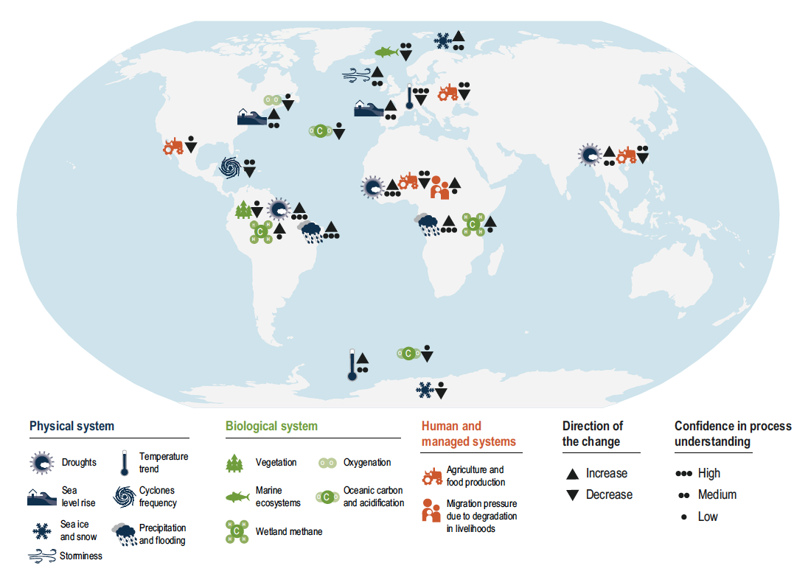
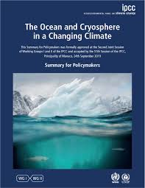
Large-scale impact of a substantial weakening in the Atlantic circulation
Fig. 6.10 from IPCC SROCC report, 2019
Notes:
SROCC picture: focus on marine life, Sahel, European heat waves, storms and viticulture/agriculture

Slide 4
Risk of AMOC substantial weakening
Fig. 6.9 from IPCC SROCC report, 2019

Slide 5
Low probability-high impact event
Sutton 2018

Slide 6
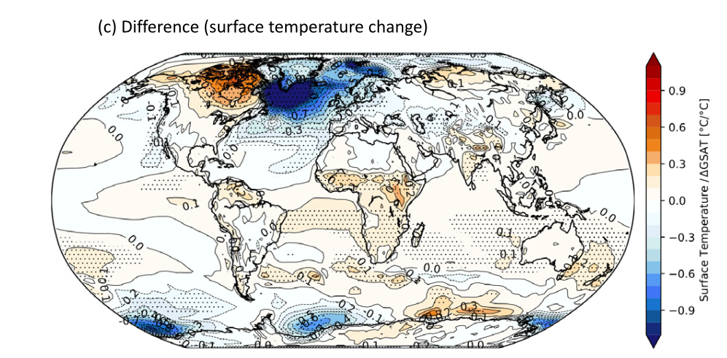
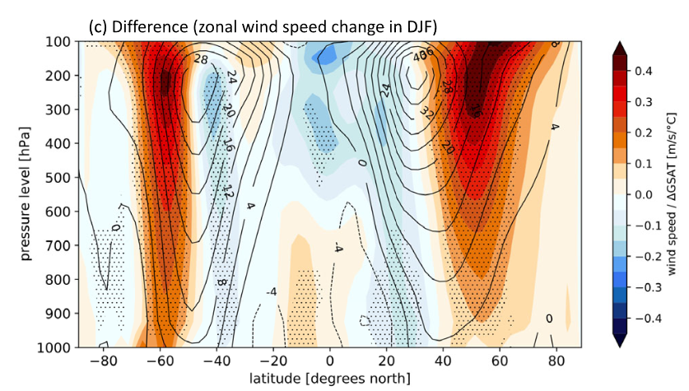
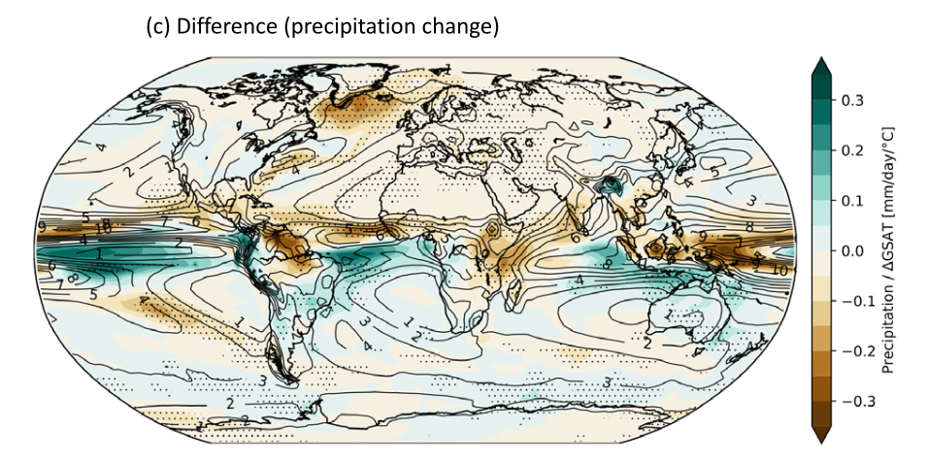
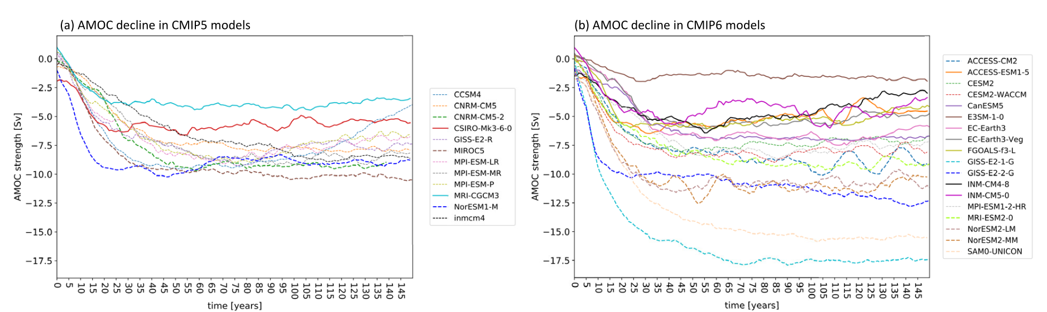
Still so much AMOC uncertainty in CMIP6
Bellomo et al. 2021

Slide 7
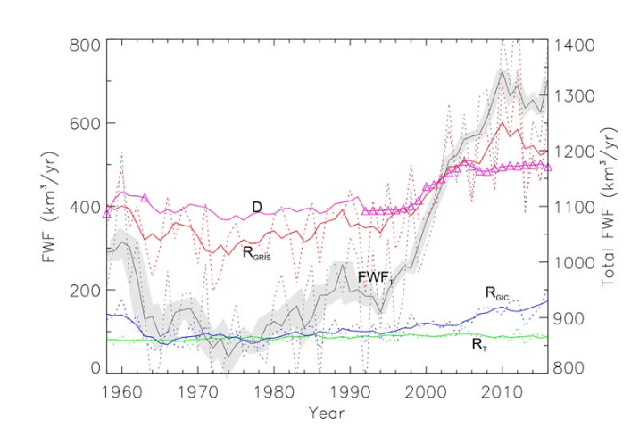
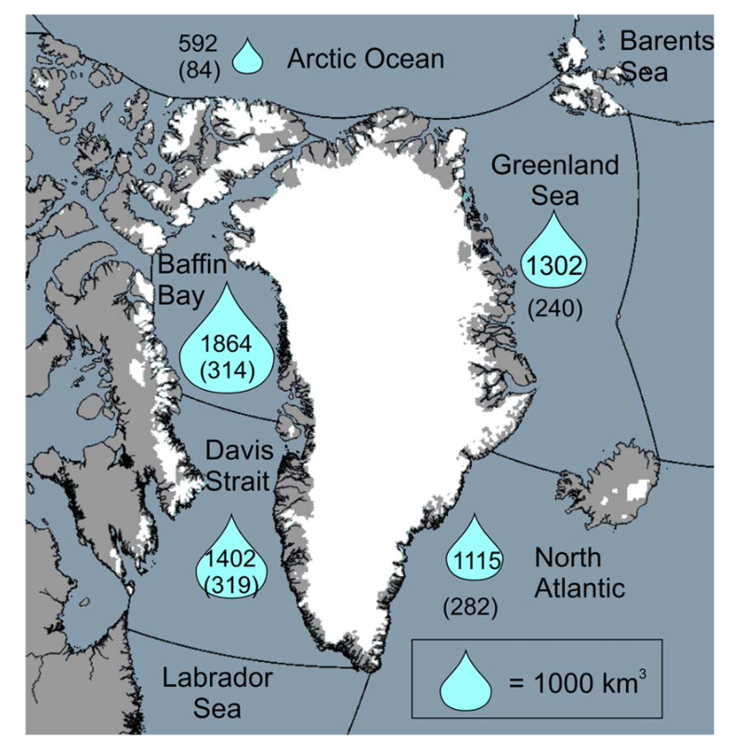

What about GrIS melting?
Land-ice freshwater components from Greenland region (km³/yr).
Greenland ice sheet melting is usually neglected in CMIP historical and future simulations
Its on-going melting has recently accelerated, but is poorly reproduced in ice sheet models due to the complexity of the processes involved
This melting might have impacted convection in the Labrador Sea since ~2010 (Boning et al. 2016)
It is only slightly (further) weakening the AMOC in CMIP5 projections (<10% in 2100, Bakker et al. 2016)
Estimate from Bamber et al. (2018) show stronger melting rate than in their previous estimates (Bamber et al. 2014)
Model resolution can play a crucial on the way GrIS melting is spread in the North Atlantic
Has Greenland melting already impacted the North Atlantic Ocean circulation and in which proportion?
Cumulative freshwater from land-ice since 1958 refered to 1960-1990 (km³).
Bamber et al. 2018

Slide 8
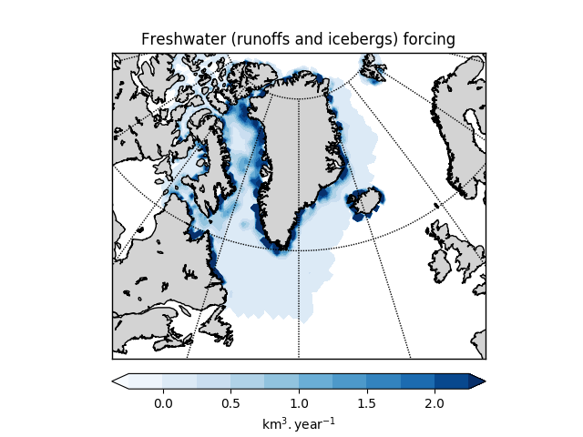
Materials and methods (1/2)
Use of Bamber et al. (2018) recent reconstruction
Extension back to 1840 following Box and Colgan (2013)
Overwrite runoff and calving in the the Greenland region by those observation-based fluxes
Use of 20 members of IPSL-CM6A-LR historical simulations (low resultion, LR) including this melting since 1920 (Melting ensemble)
Comparison with historical simulations from IPSL-CM6A-LR starting from same initial conditions (historical Control ensemble)
Devilliers et al. 2021

Slide 9
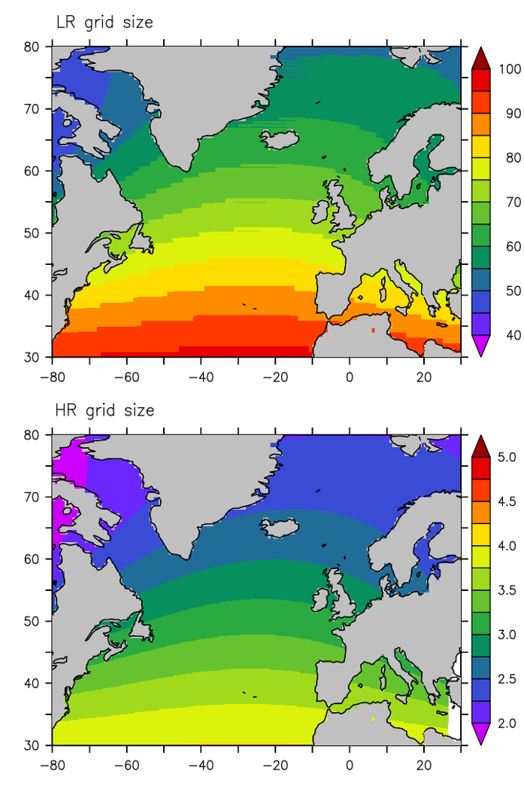
Materials and methods (2/2)
High resolution (HR) model (2-3 km in the North Atlantic) ocean-only model is also integrated from 2004
There is no salinity restoring at all in this model (to avoid removing the freshwater perturbation signal)
Twin simulations, one (named Melting) with observed GrIS melting and the other (named Control) without (plus a few additionnal freshwater sources from the Arctic. Effect under evaluation, but weak apparently)
Only 13 years of simulation due to high CPU cost (but planning to continue them)
km
Swingedouw et al. 2022

Slide 10
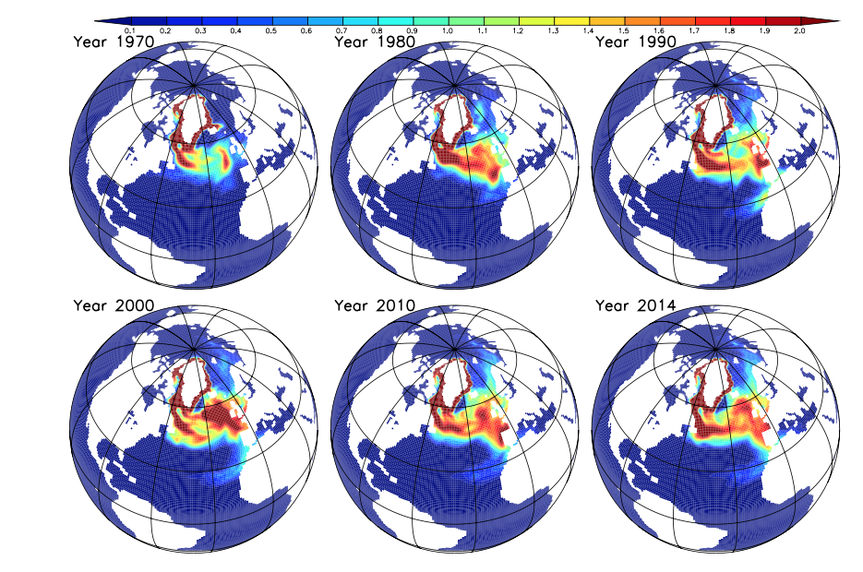
Propagation of the perturbation in LR simulations
Passive tracer spread in IPSL-CM6A-LR

Slide 11
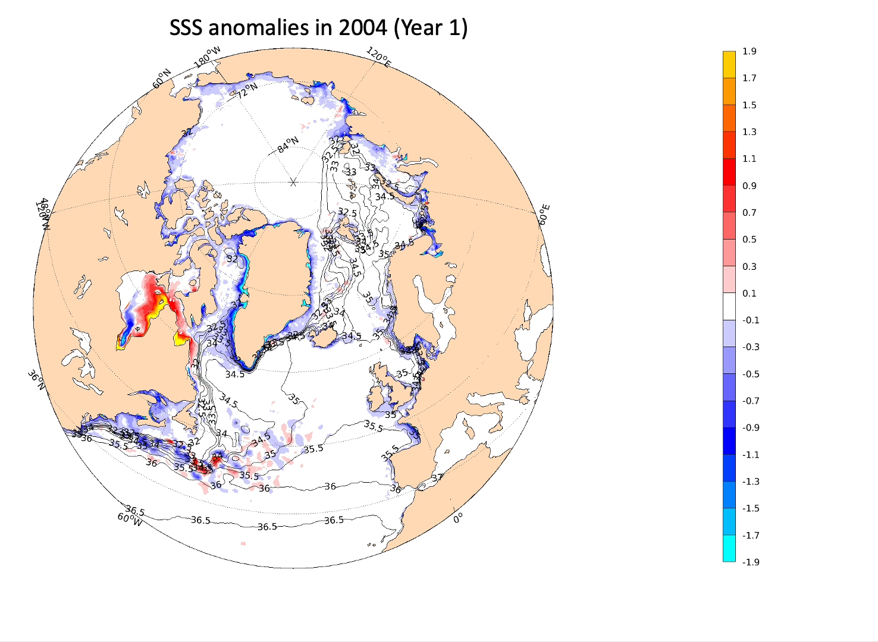
Propagation of the perturbation in HR simulations

Slide 12
Impacts on the AMOC in IPSL-CM6A-LR model
The AMOC is slightly affected by the additional freshwater input (need for a large ensemble to go beyond internal variability…)
It weakens by 0.20 ± 0.39 Sv at 45°N
Far less than the 3 ± 1 Sv estimated by Caesar et al. (2018)
Devilliers et al. 2021

Slide 13
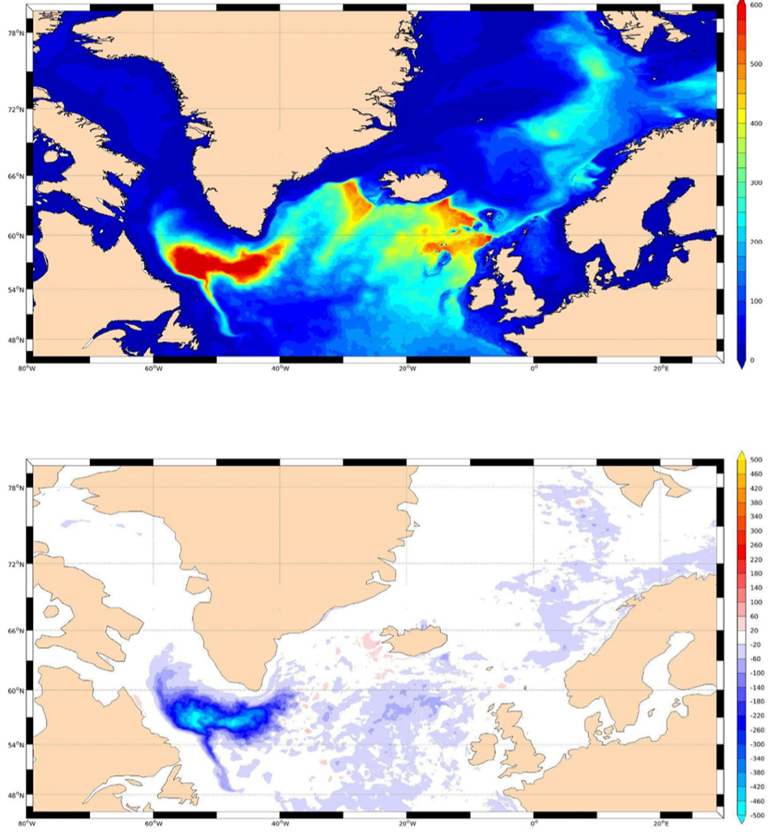
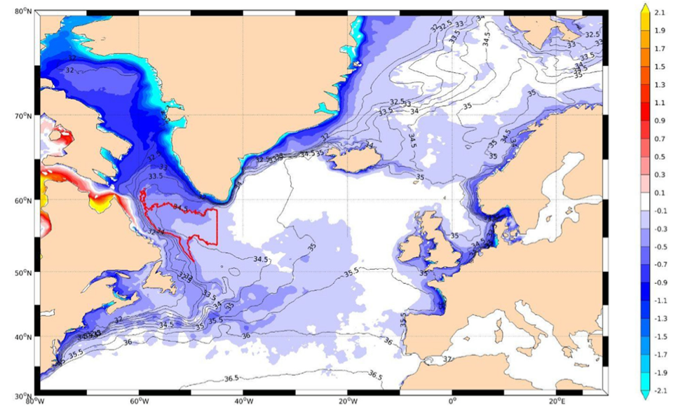
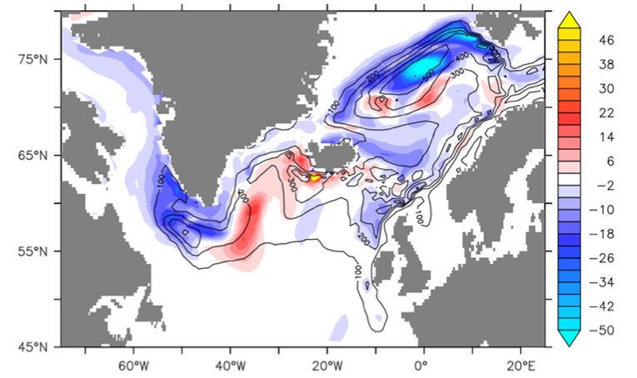
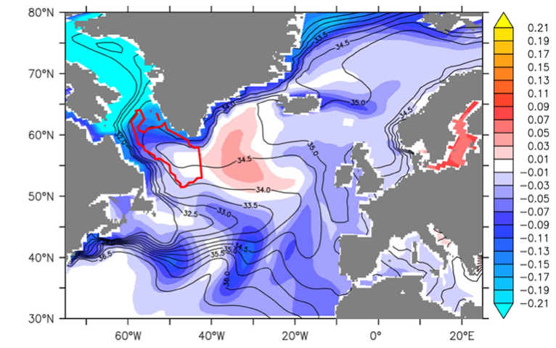
Impacts of oceanic resolution on GrIS impact
SSS anomalies
Mixed layer depth anomalies
We compare IPSL-CM6A Low Resolution (LR, 50-60 km) run with very High Resolution (HR, 2-3 km) simulations from an ocean-only model
Similar impact on salinity, but one of order of magnitude larger (while shorter simulation, and only slightly larger perturbation)
The same is true for mixed layer depth: one order of magnitude stronger weakening of Labrador Sea convective activity in HR simulations
HR simulations
500
400
300
200
100
0
-100
-200
-300
-400
-500
2.1
1.9
1.7
1.5
1.3
1.1
0.9
0.7
0.5
0.1
-0.1
-0.3
-0.5
-0.7
-0.9
-1.1
-1.3
-1.5
-1.7
-1.9
-2.1
LR simulations
Swingedouw et al. (2022)

Slide 14
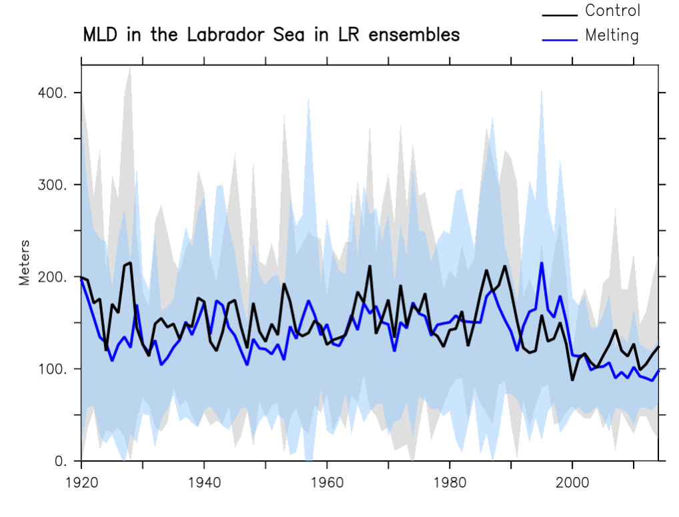
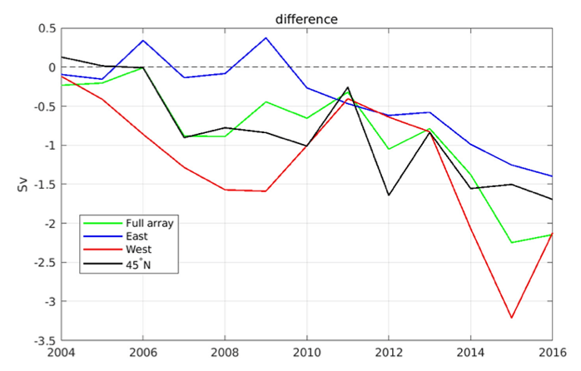
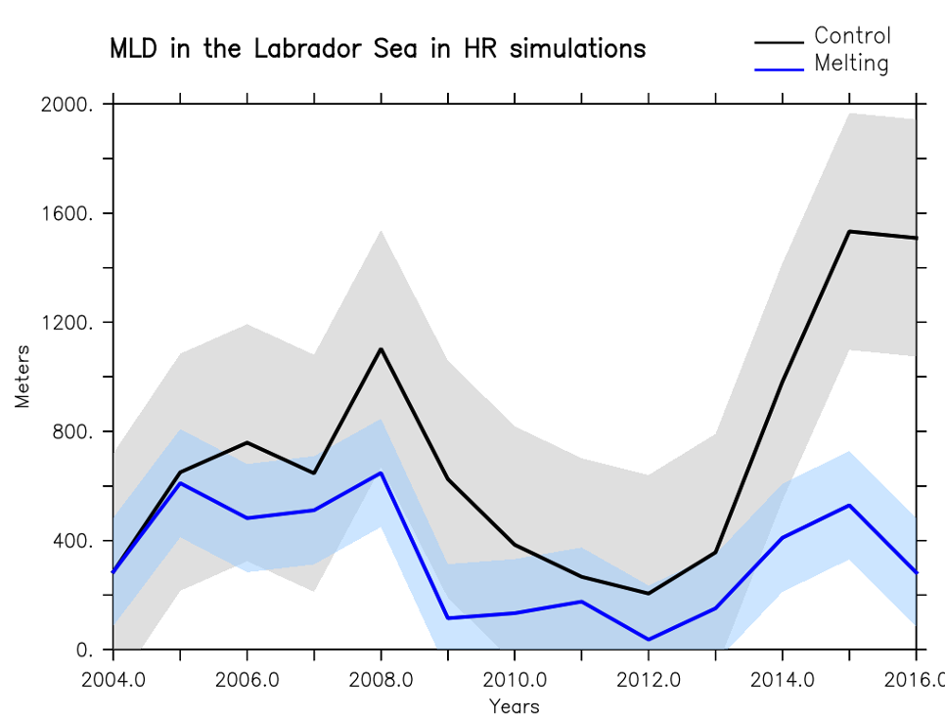
Impacts of oceanic resolution on GrIS impact
Higher impact of Greenland melting on the Labrador Sea
And on the AMOC
Anomalies of AMOC indices
(in density space) in HR simulations

Slide 15
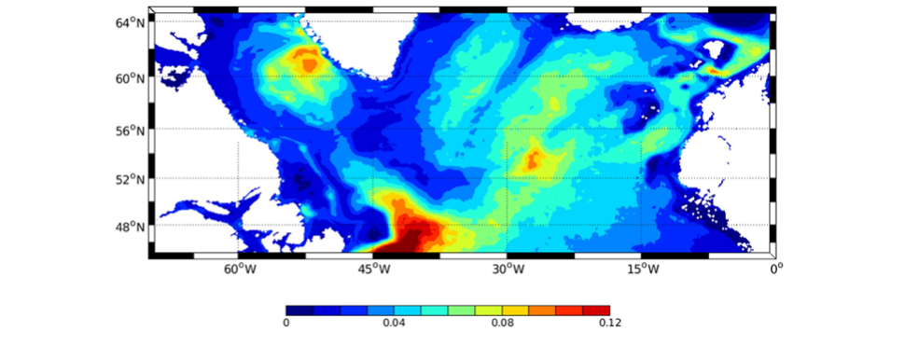
What can explain the differences ?
Eddy Kinetic energy in HR simulation
The currents around Greenland are fine-scale (a few thenth of kilometers) and are too wide in the LR simulations
There is a hotspot of eddy formation just west of the Greenland tip, bringing directly the melt water collected around Greenland into the Labrador Sea center
m²/s²

Slide 16
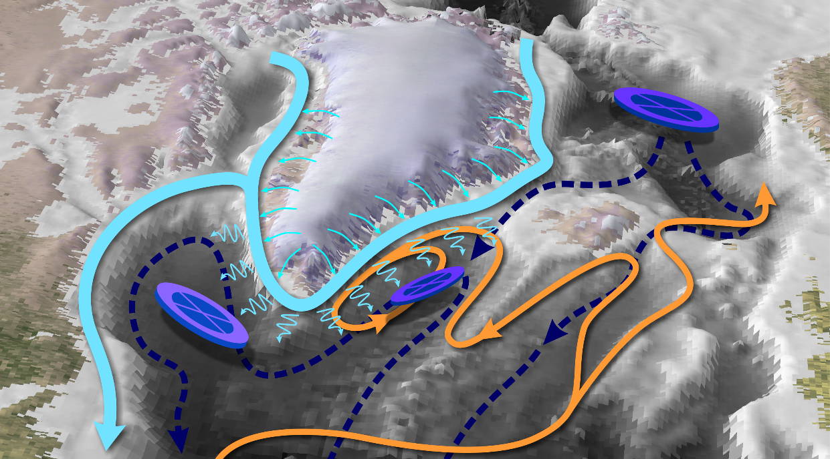
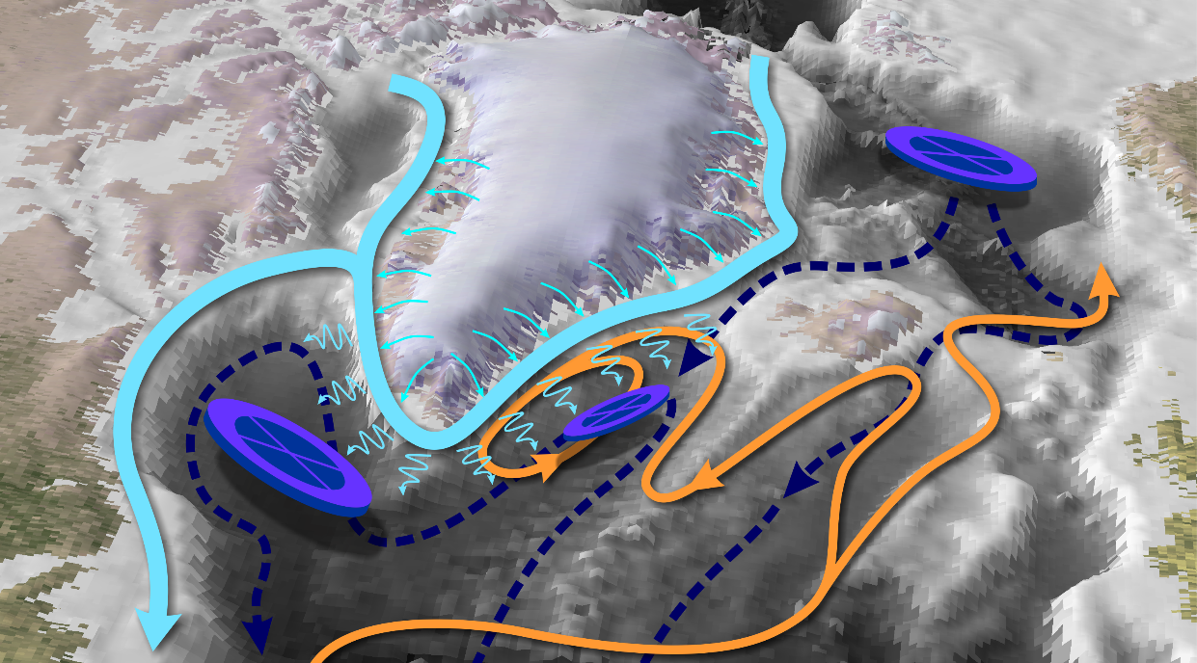
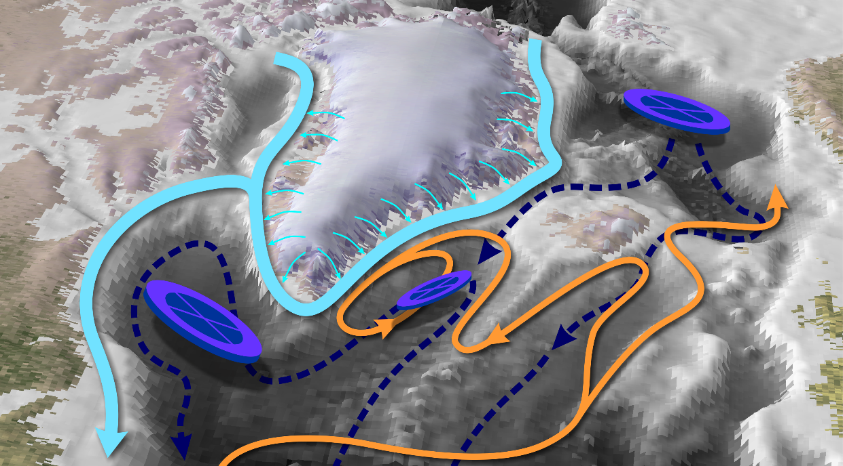
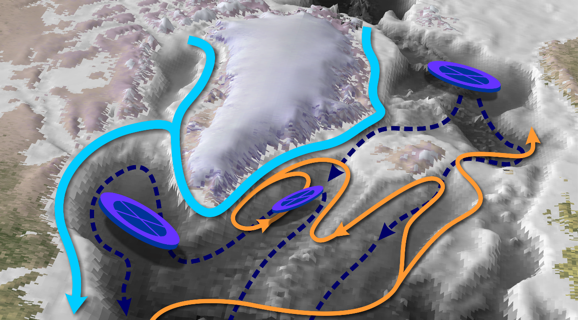
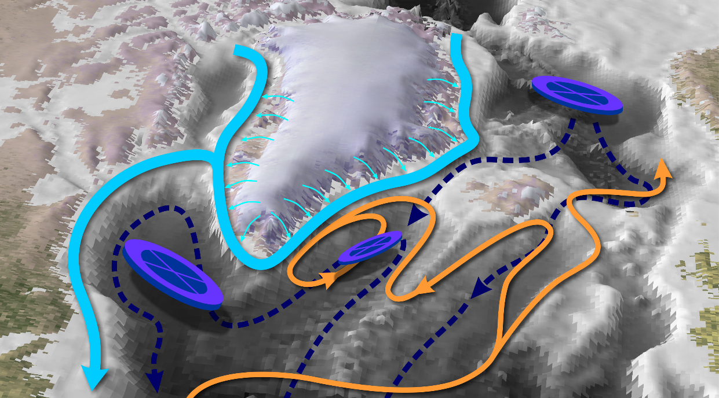
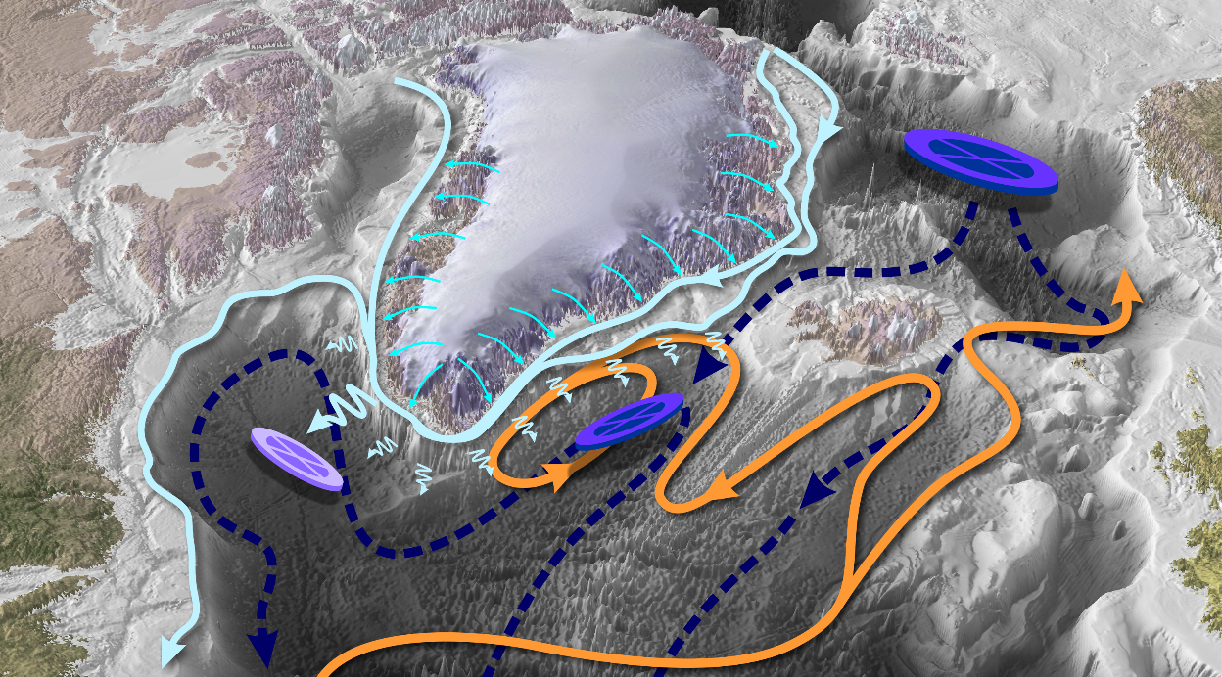
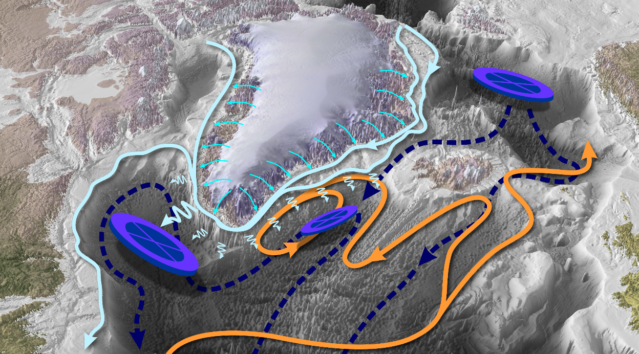
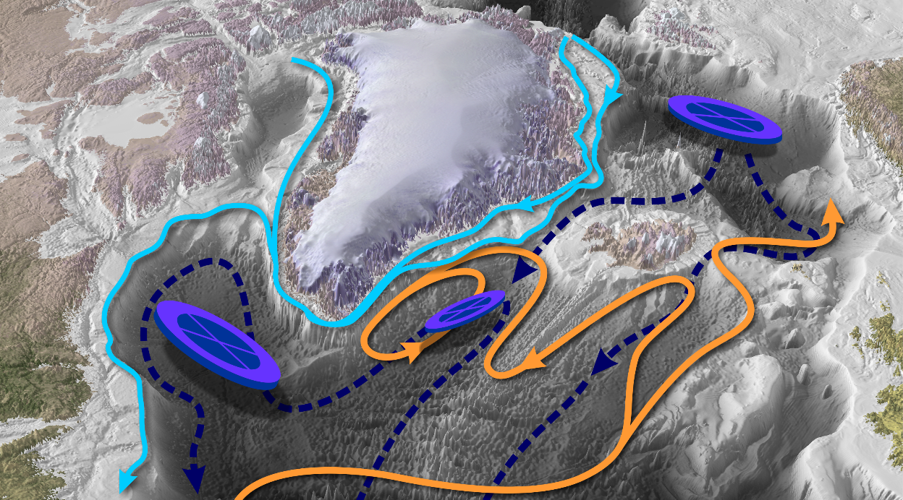
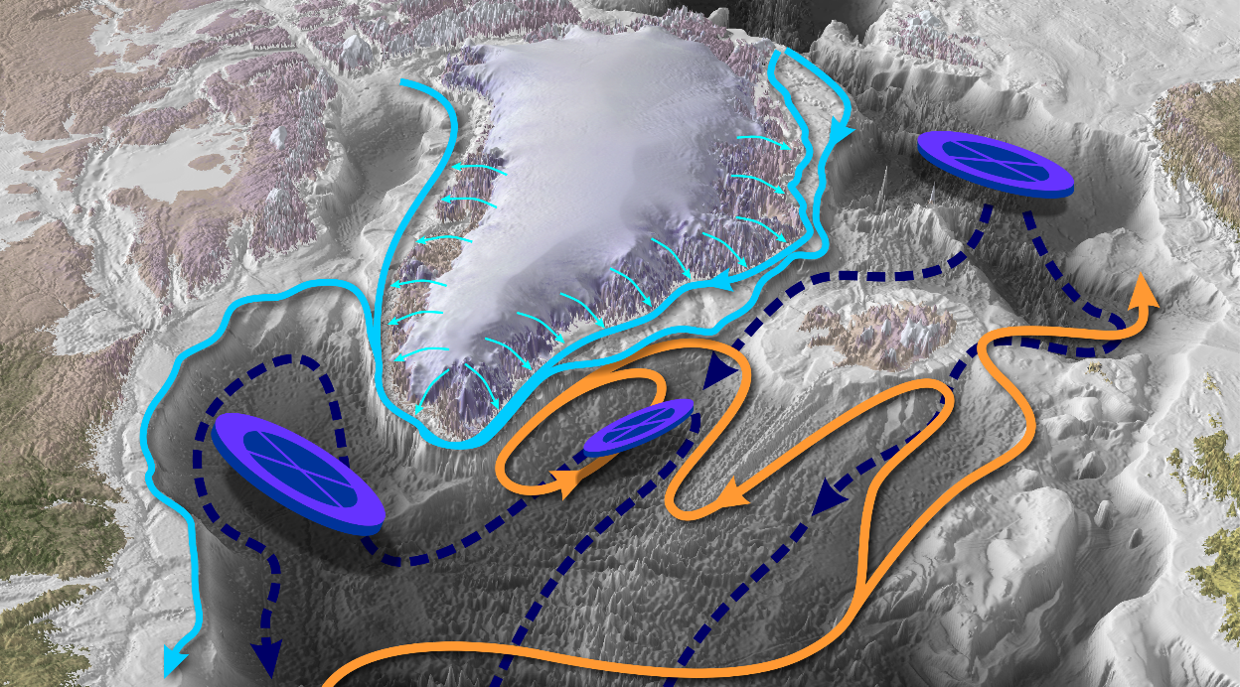
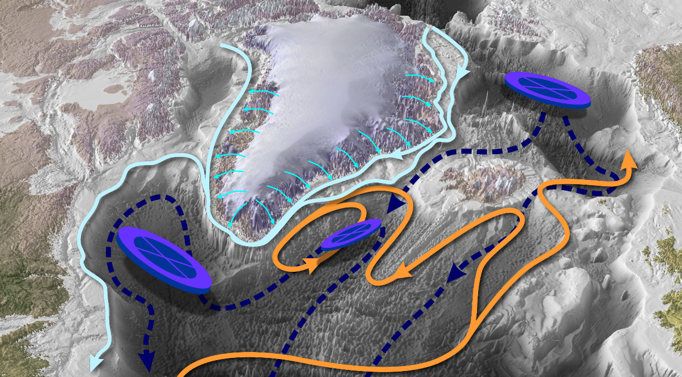
Low Resolution
High Resolution
High Resolution
High Resolution
High Resolution
High Resolution
Courtesy of Vincent Hanquiez

Slide 17
Key take-home messages
Large uncertainty in future AMOC fate, whose impacts might be worldwide
  Adaptation plans should include such low probability – high impact scenarios
Potential on-going changes in the AMOC and SPG have not been well attributed yet using CMIP6 models
It seems that in the CMIP6-type models, on-going land-ice melting in the Greenland regions have a minor impact in terms of AMOC weakening
This melting has a far stronger impacts in a high resolution (HR) model than in a CMIP6-type one (and could explain potential on-going AMOC weakening)
This might be related with fine-scale processes that are not properly parametrized (e.g. eddy mixing, size of boundary currents)
Given the computing cost of HR, there is a need to improve those parametrizations

Slide 18


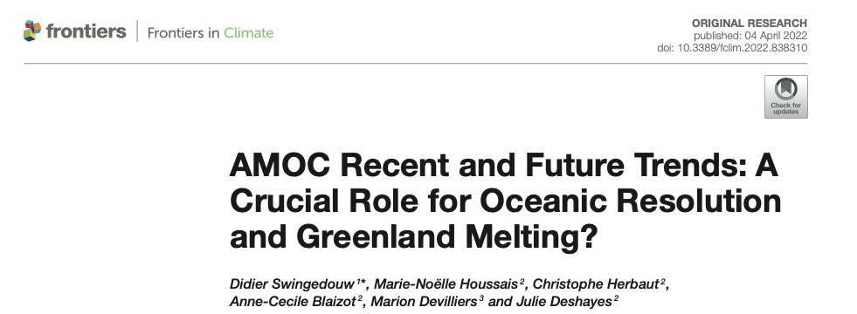
Thank you!
didier.swingedouw@u-bordeaux.fr
@DidierSwing

Slide 19
