Slide 1
Enhanced discoverability and download of the ESO science data content via programmatic access
Magda Arnaboldi, Daniel Brandt, Nausicaa Delmotte, Vincenzo Forchi’, Alberto Micol, Laura Mascetti, Stanislaw Podgorski, Joerg Retzlaff, Martino Romaniello, Felix Stoehr, Stefano Zampieri

Slide 2
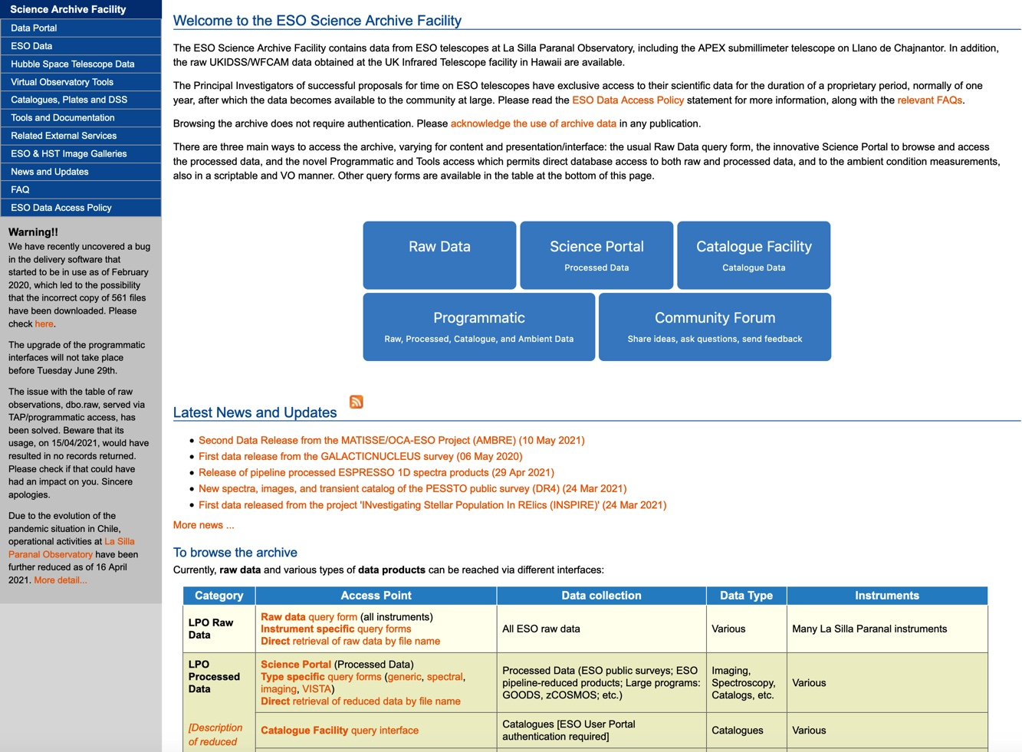
archive.eso.org

Slide 3
Programmatic in a nutshell: What can a user do?
Discover data of interest: custom queries to the archive content (measurements, data files)
Associated data: calibration files, ancillary data, provenance (originating files, derived products)
Downlaod data: entire files or cutouts
Anonymously or authenticated to activate specific user’s permissions
Script it all (cronjobs, workflows, jupyter notebooks)
Perform the above using public domain tools

Slide 4
Programmatic: Queries
What can be queried?
  Raw Data
  Reduced Data (Phase 3)
    Well-characterised coverage and resolution of spectral, spatial and temporal axes
    Well-characterised depth: SNR (spectra), limiting magnitudes
  Provenance information
    Which science files were used to create this product?
    This file participated into the creation of which products?
  Source catalogues (Phase 3)
  Ambient conditions (seeing, precipitable water vapour, isoplantic angle, atmospheric profiles of humidity and temperature, etc)

Slide 5
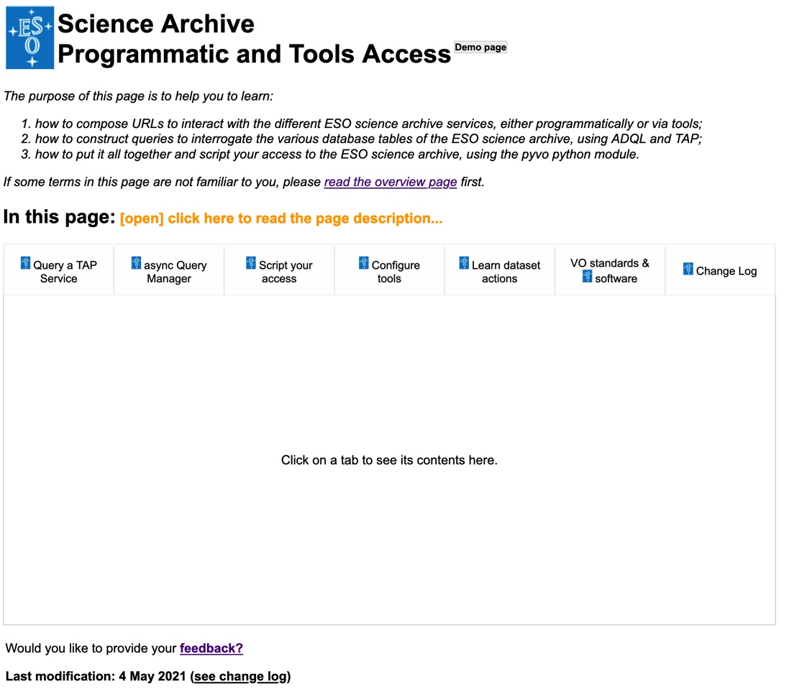
ESO programmatic page: semi-live tutorial
http://archive.eso.org/programmatic

Slide 6
Programmatic: Custom queries
Users can perform custom queries for their specific needs:
  The databases are directly exposed to the users
  Direct database access allows user to formulate queries that a user interface, with its fixed query model, cannot perform
  Query language: ADQL := SQL92 + spatial queries
  Standard interface: send query&receive results using Tabular Access Protocol (TAP)

Slide 7
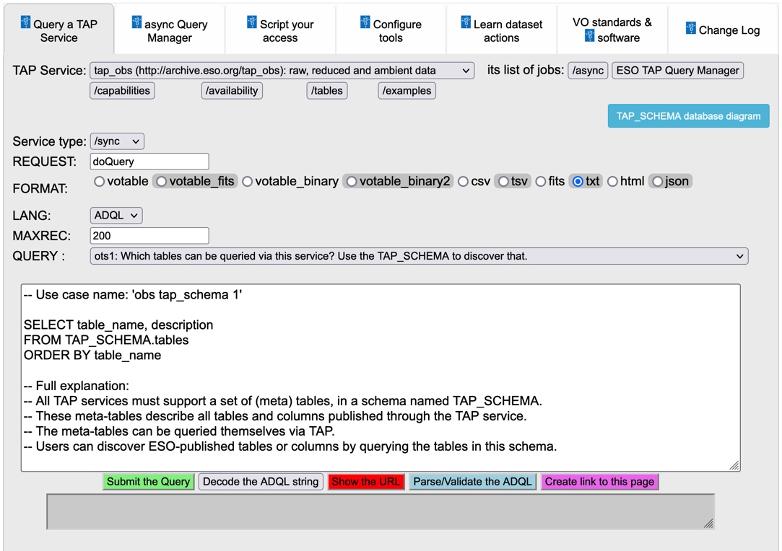
Queries via TAP (1)
Pulldown menu with a list of TAP services to choose from.
First two are the ESO ones:
TAP_OBS
- To query for ESO observational data (ambient, raw, processed data, provenance information)
TAP_CAT
- To query the ESO community-generated catalogs (phase 3)
http://archive.eso.org/programmatic

Slide 8
Programmatic: Spatial queries
Spatial queries (based on footprints), to spatially match any data product in the archive
  Cone search
  Footprint based queries (for data products, not raw)
    Find data products whose footprints intersect, contain, or are contained in, a given circle, or a given polygon…
    … or even in other products’ footprints !

Slide 9
Spatial queries: examples
  Find all ESO 1d spectra of objects lying within the HUGS (CANDELS UDS & GOOD-S) footprints
    and while you are at it, compute the histogram of the SNR of those spectra
  Find footprints of images in different bands (J & H) overlapping by at least a certain extent (80% of the area)

Slide 10
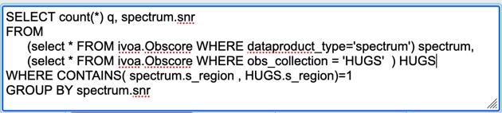
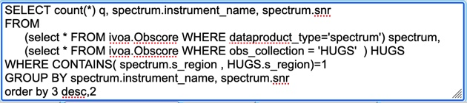
Query example 1: spectra in HUGS
Histogram of SNRs of all ESO spectra for objects lying within the HUGS (CANDELS UDS & GOOD-S) footprints
Or also showing the instrument and sorting results by snr descending:
q instrument_name snr
--- --------------- -------
12 FORS2 131.9
4 FORS2 82.9
6 FORS2 73.9
8 FORS2 64.4
8 FORS2 61.8
8 FORS2 55.8
8 FORS2 52.7
6 FORS2 50.9
8 FORS2 49.2
4 FORS2 49.1
...
135 FORS2 0.5
214 FORS2 0.4
14 XSHOOTER 0.4
149 FORS2 0.3
33 XSHOOTER 0.3
123 FORS2 0.2
62 XSHOOTER 0.2
89 FORS2 0.1
4 GIRAFFE 0.1
164 XSHOOTER 0.1

Slide 11
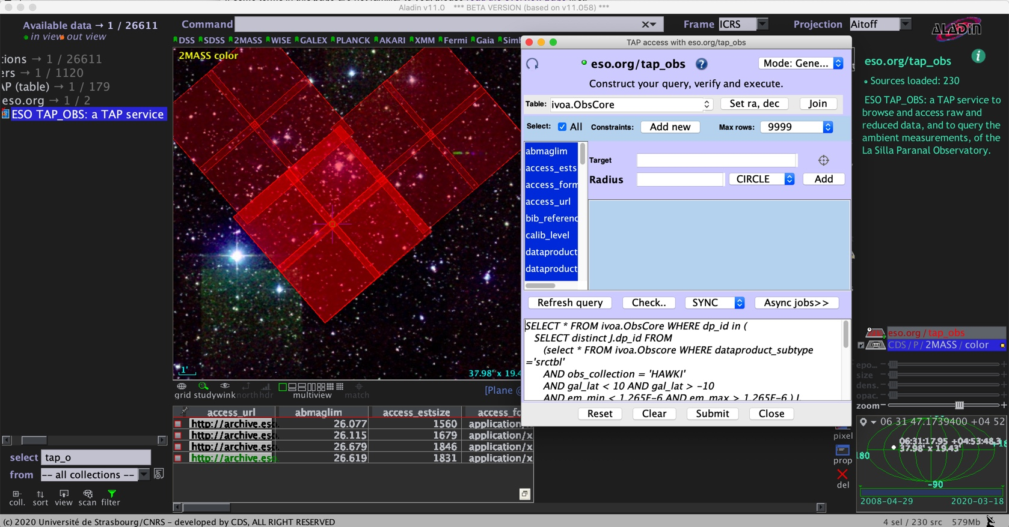
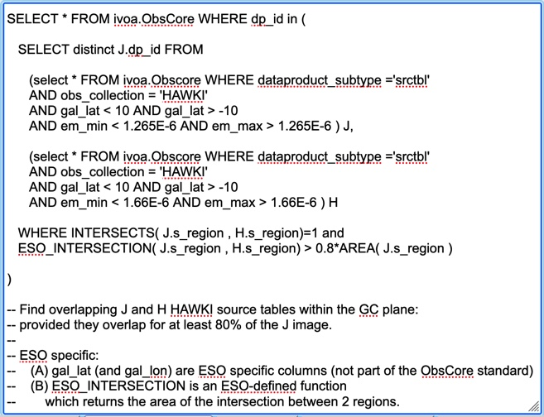
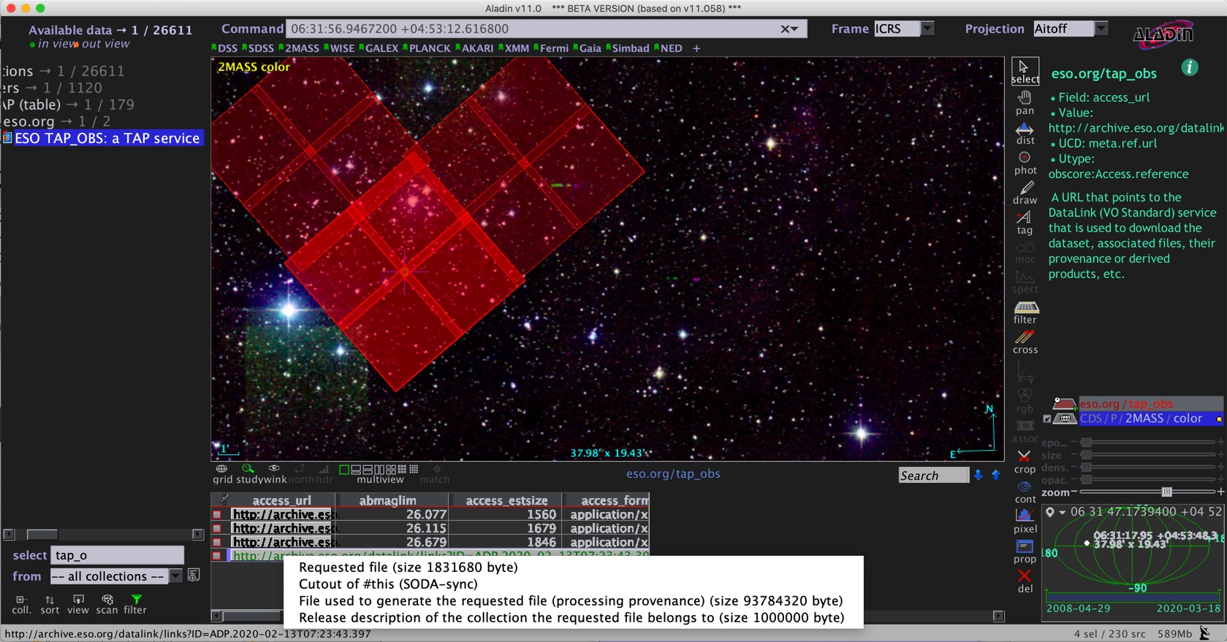
Query example 2: colour-colour studies
Find footprints of images in different bands overlapping by at least a certain extent

Slide 12
Programmatic: Associated data
The Datalink service can be invoked onto one (or more) files to find all existing associated data files
Given a raw file:
  find its calibration files
  find reduced data that might have been generated out of it
Given a reduced dataset:
  Find accompanying ancillary files (e.g. a weightmap, a 2d spectrum, etc.)
  Find which files were used to generate this product
  Find further products generated from this product

Slide 13
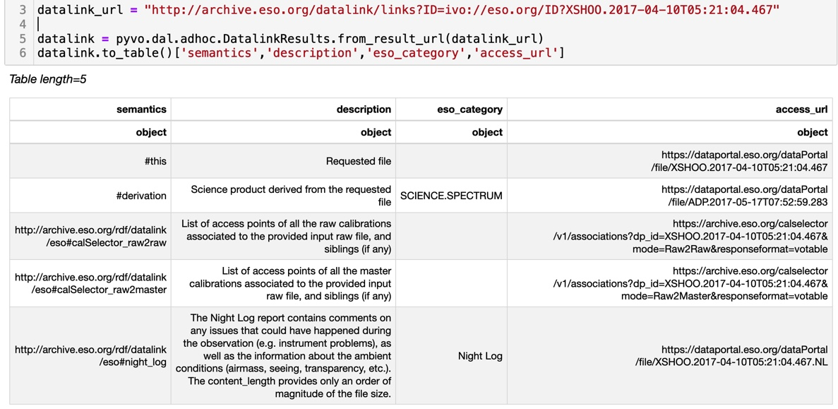
Using datalink to find associated data
Find calibrations associated to a (set of) raw file(s)
  A query to the table of raw data returns a column called datalink_url, which can be used to find associated files

Slide 14
Download
Download files
  Anonymously
  With authentication
    Authentication needed for files under proprietary period
    Token authentication using ESO User Portal credentials
  Example scripts provided

Slide 15
Cutouts
Download cutouts of large datasets instead of wasting time and network resources to download entire datasets
  Slicing spectra, images, source tables, catalogue tiles, cubes:
    around lines of interest
    around objects of interest
    or both
  Ancillary files (e.g. weightmap) are also cutout on the same spatial coordinates as the science file
Cutouts available only for reduced data (not for raw)
Cutout activatable via Datalink

Slide 16
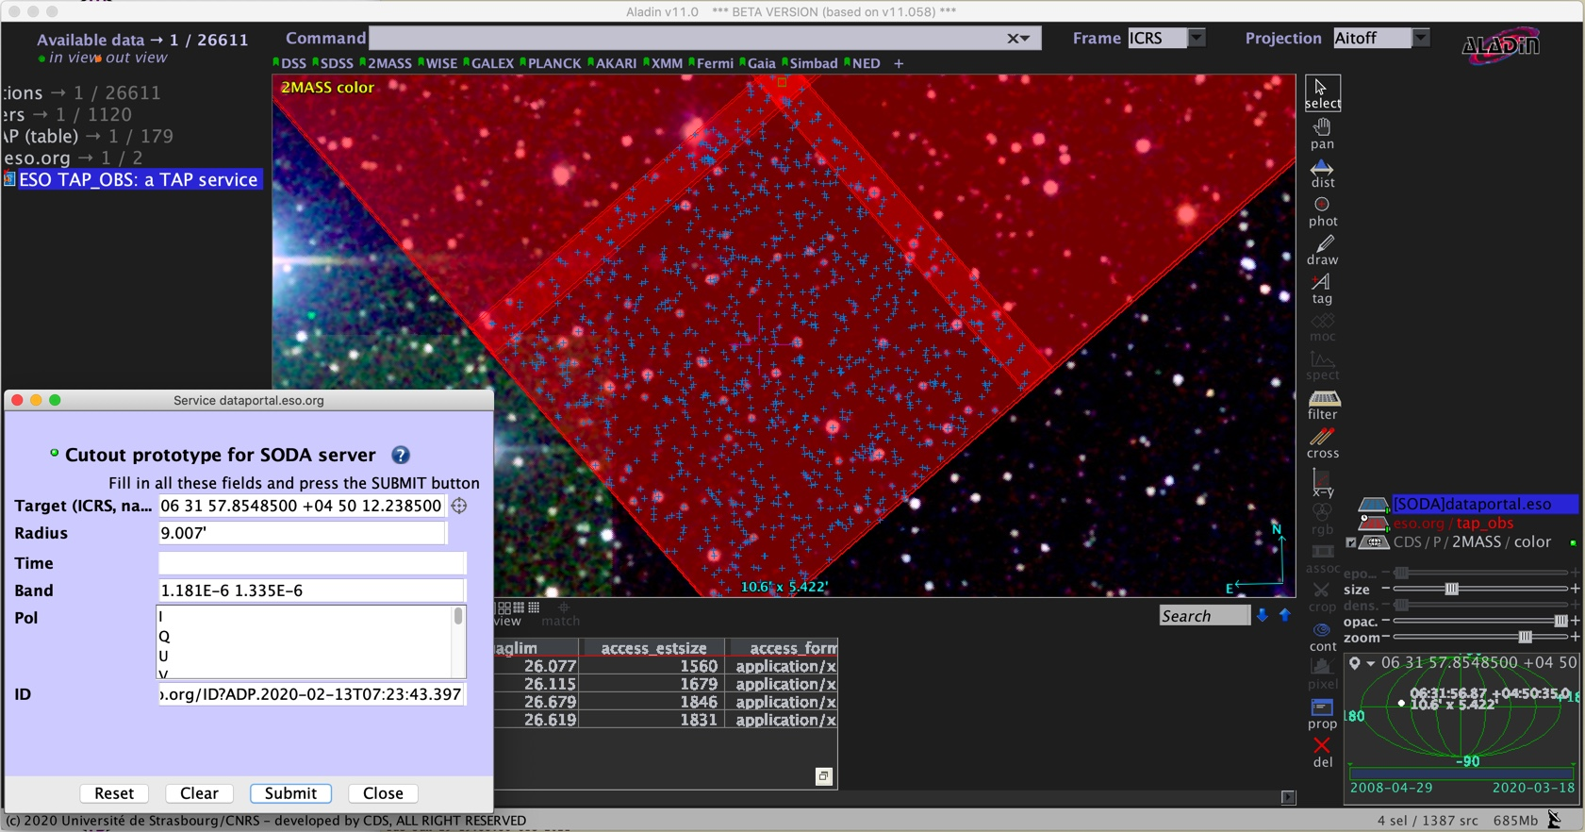
Cutout via Datalink
Datalink
Using a VO-based tool (CDS/Aladin) to access directly the databases and the data using VO standards: TAP, ADQL, footprints, DataLink, cutouts, etc.

Slide 17
VO-aware Tools
Aladin/CDS
  images, source tables, catalogues, etc.
TOPCAT, Mark Taylor
  tables, catalogues, TAP
SPLAT-VO, ARI
  Simple Spectral Access
CASSIS, IRAP
  Simple Spectral Access
http://archive.eso.org/ssap?POS=...&SR=...

Slide 18
Scripting
Script your cronjob to routinely identify and download new data of interest
Script your workflow to identify, download, and analyse the data (jupyter notebook)
Use the astropy pyvo module!
  User's imagination is the limit (and ability to translate a scientific question in an efficient workflow, if unsure ask!)

Slide 19
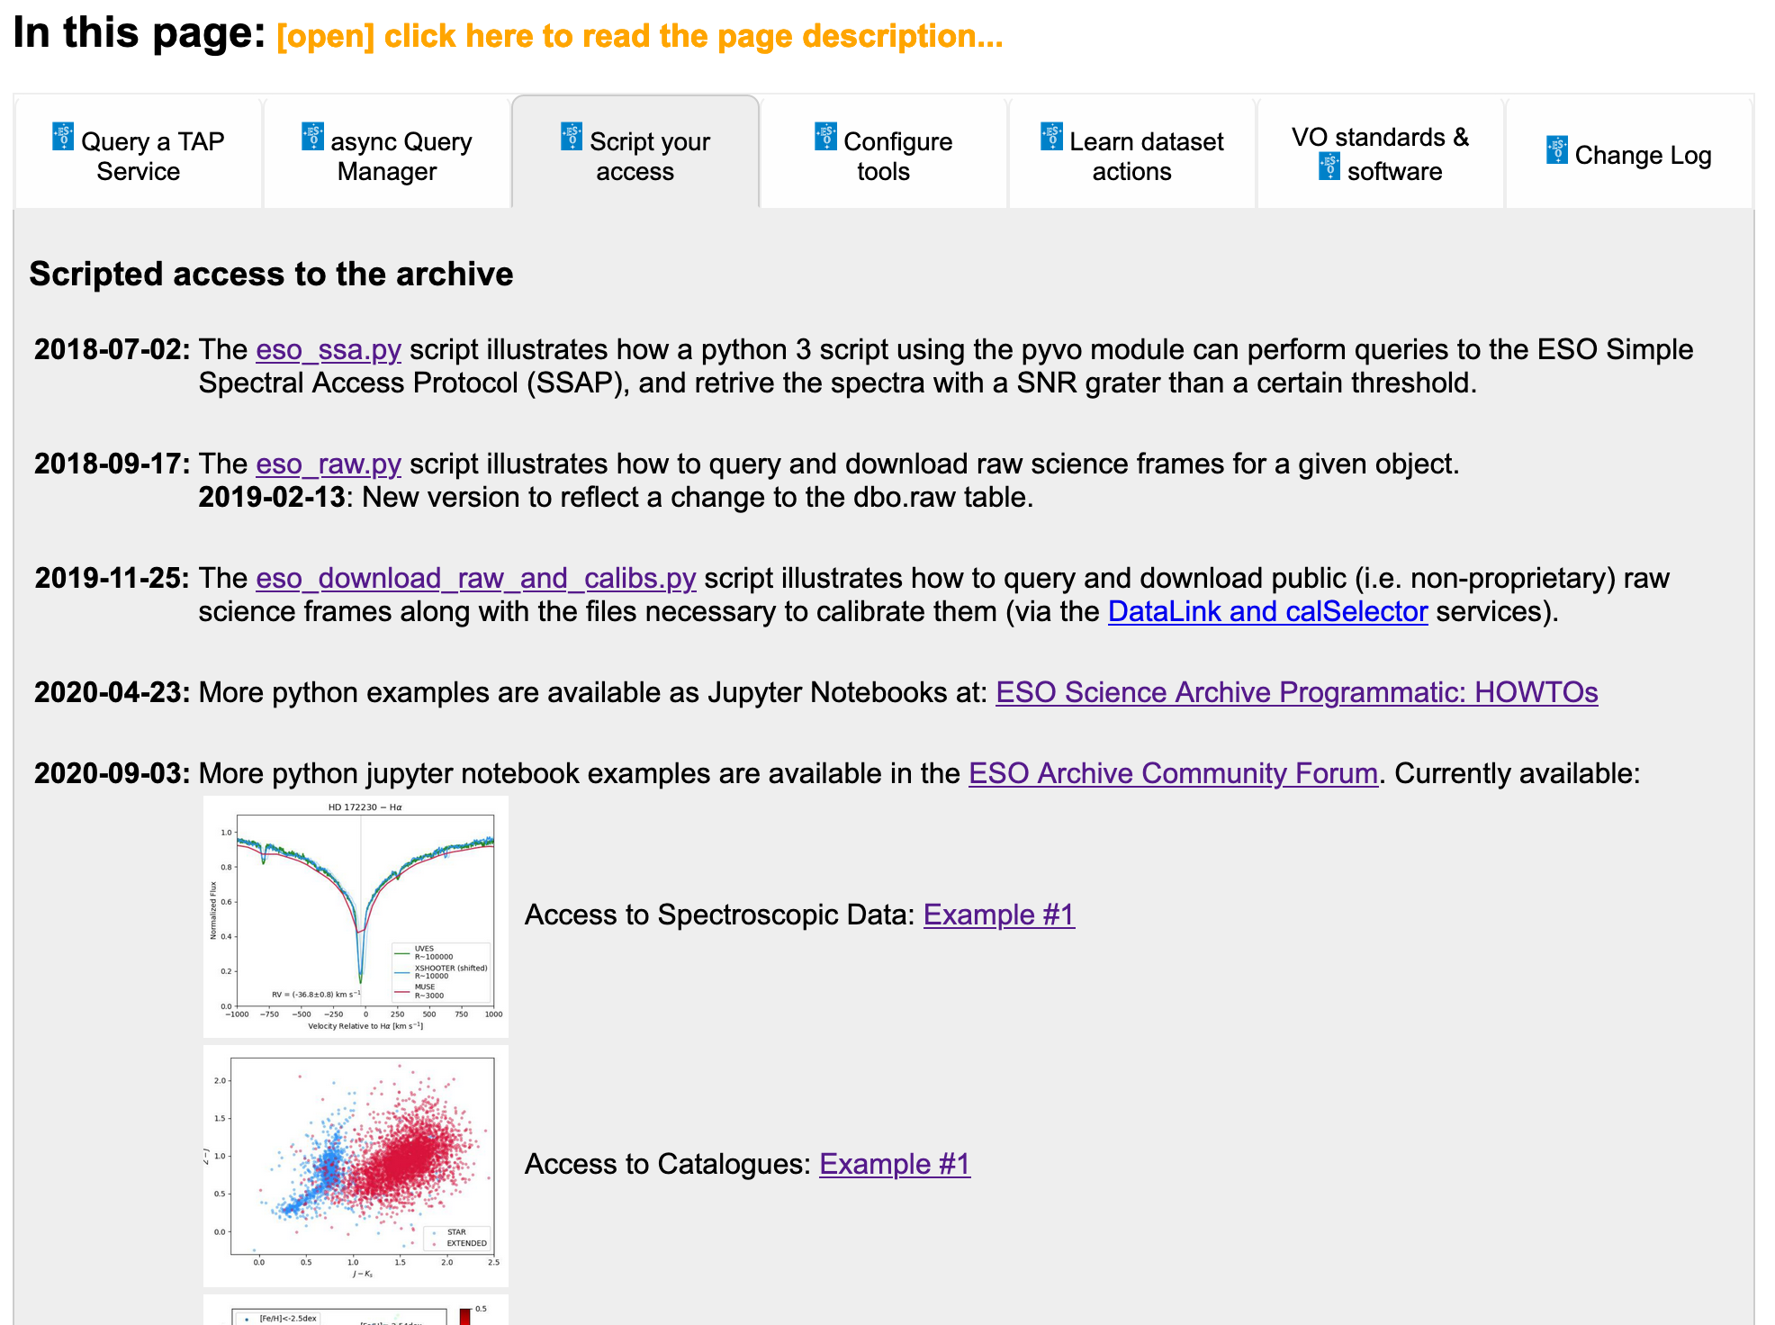
http://archive.eso.org/programmatic

Slide 20
Based on mature standards
ESO programmatic interfaces implement VO standards, and this is in the interests of the users because:
  Standard interfaces: no need to learn ESO-specific interfaces
  Existing software libraries can be used, e.g. pyvo python package part of astropy
  Tools based on the VO standards can be used to access the archive directly (e.g. Aladin, Topcat, Splat-VO, CASSIS, etc)

Slide 21
Privileged authenticated metadata access
Privileged authenticated metadata access for special programmes whose metadata are covered by a confidentiality agreement (e.g. special GTO programmes, or during the commissioning, SV, operational rehearsal phases of new instruments, etc.)
Examples: 4MOST, TRAPPIST, SPECULOOS, … Authorised users are able to perform the same actions listed above (search, download) also on metadata/data with access rights http://archive.eso.org/cms/eso-data/programmatic-access/authentication-and-authorisation.html

Slide 22
http://archive.eso.org/programmatic
End!

