Slide 1
DeepGNN, A Framework For Training Machine Learning Models On Large Scale Graph Data
Alex Samylkin (alsamylk@microsoft.com)
Atul Gupta (atul.gupta@microsoft.com)
Chaoyin Li
Cole Dieckhaus
Qiang Zhang
Tiantian Wang
Xuhui Liu

Slide 2
Agenda
DeepGNN Overview
How to use DeepGNN
GraphEngine Overview

Slide 3
GNN ZOO
Company | Product | Framework | Year | Open Source
Amazon | DGL | MxNet/PyTorch/TF | 2018 | Yes
Facebook | PGB | PyTorch | 2019 | Yes
Alibaba | Euler/GraphLearn | TF | 2019/20 | Yes
Twitter | TDN | PyTorch | 2020 | Yes
Uber | Networkx/Spark | TF | 2020 | No
Google | TF-GNN | TF | 2020 | Yes

Slide 4
Highlights
DeepGNN
Bing
External 3P Users
Office
MSR
LinkedIn
Highly optimized for graph data loading and processing
High-performance distributed GNN training on multiple infrastructures
Support different graph APIs, customized algorithms, and multiple training frameworks
Microsoft-wide adoption

Slide 5
Stack
Link Prediction
Node Embedding
Node Classification
Community Detection
Application
Scenario
Unsupervised/ Supervised Training
Model Inferencing
GraphSAGE
GCN
HetGNN
KGE
BERT Encoder
Algorithm
Node2Vec
GAT
HAN
Pytorch Geometric
Customer Algos
TensorFlow
PyTorch
Training
Framework
API (Sampling/Feature Extraction)
Homogeneous/Heterogeneous Graph
Graph Engine
DeepGNN GE
External GE (RedisGraph, Neo4j)
Azure ML
ADLS
Private Cluster
HDFS
Singlebox
Customer Infra
Backend Infra

Slide 6
DeepGNN in Bing.
Most common task: link prediction between an ad and a user query
Unusual task: extract tri-letter nodes from a dictionary graph to generate better word embeddings.
Graphs typically scale to tens of billions of edges.
Limited resources. Store graph features on disk instead of memory.

Slide 7
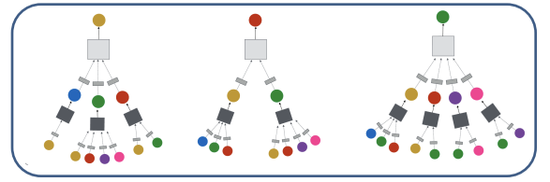
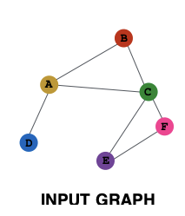
DeepGNN in LinkedIn.
Scenarios: skill hierarchy prediction, job title prediction, member-attribute, etc.
100B edges graphs with 10-20 edge types
16x times faster then training on an original spark pipeline
LinkedIn Kubernetes Training Platform
ML Trainer
HDFS
Spark
HDFS
Compute graphs
LinkedIn Kubernetes Training Platform
DeepGNN Trainer
DeepGNN GraphEngine
HDFS
Sampled neighborhoods

Slide 8




DeepGNN in Office.
Scenarios: Teams News Feed, File Recommendations, Topics AI: Who Knows What, etc.
Hundreds of 10M edges graphs must be isolated in a compliant environment
Compliant AML (Eyes-off)
Training
Convert Graph
raw format to
bin format
Trainer-0
Trainer-1
Trainer-2
Graph Engine
DeepGNN pip package
Compliant Python Feed and
Docker Registry

Slide 9
Agenda
DeepGNN Overview
How to use DeepGNN
GraphEngine Overview

Slide 10


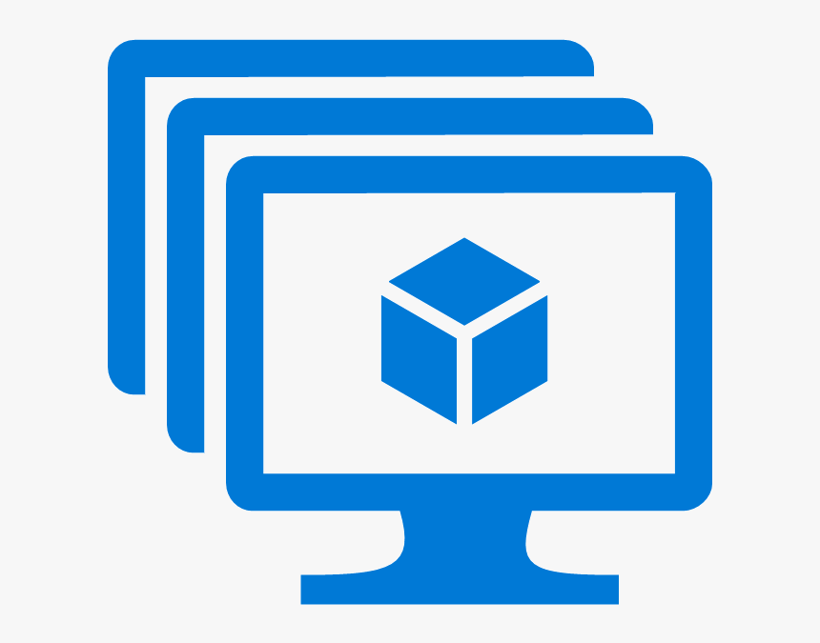

Infrastructure Supported
Singlebox
Single GE on local machine
Single and multiple workers on local machine
Worker 0
graph
client
mini
batch
Model
Azure Machine Learning
Distributed GE on K8S cluster or AML CT
Multi-workers on AML CT
Graph Engine 0
(partial graph data)
Worker 1
VM Cluster
Distributed GE on training nodes
Multi-workers on training nodes
graph
client
mini
batch
Model
Graph Engine 1
(partial graph data)
Worker 2
Private Kubernetes Cluster
Distributed GE on private k8s
Multi-workers on private k8s
Graph data
mini
batch
Model
graph
client

Slide 11
How to use DeepGNN
Fetch package from PyPi:
  deepgnn-tf
  deepgnn-torch
  deepgn-ge
Install from source:
  https:/github.com/microsoft/DeepGNN

Slide 12
How to use DeepGNN
Initialize Graph Engine
Start Training
Create Dataset
Implement GNN Model
Implement Training task

Slide 13
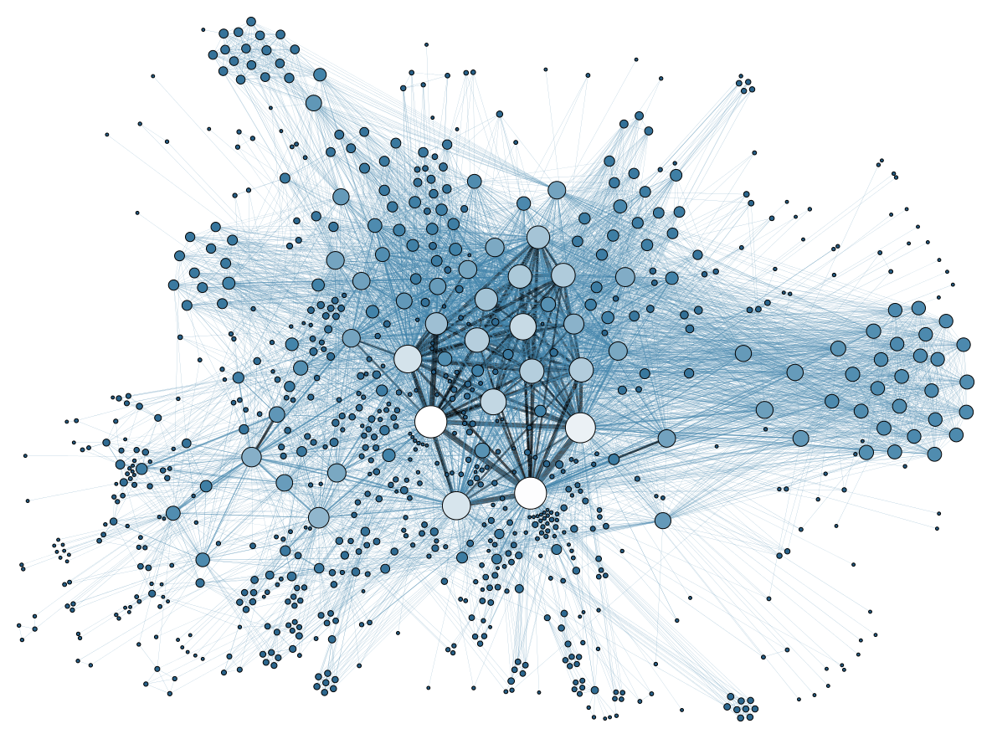

Initialize Graph Engine
Initialize Graph Engine
Start Training
Create Dataset
Implement GNN Model
Implement Training task
  Encapsulate complexity among different infrastructures
  Initialize graph engine(s) in different infra with unified API
graph = Backend(Local, options, data_dir).graph
graph = Backend(Compute_Cluster, options, data_dir).graph
graph = Backend(Kubernetes, options, data_dir).graph
Backend
Graph Engine 0
Binary
Format
Graph Engine 1
Generate graph
Start Graph Engine
(local, cluster, K8s)
Graph Engine 2
Graph (JSON/text format)

Slide 14
Create Graph Dataset
Initialize Graph Engine
Start Training
Create Dataset
Implement GNN Model
Implement Training task
NLP: load corpus/tokenization → dataset
CV: load image/transform → dataset
Graph: load graph/query → DeepGraphDataset
Step 1: define graph query
def query(graph, seed_nodes):
nodes, adjacency = sub_graph(graph, seed_nodes, …)
feature = graph.node_features(nodes, feat_metadata)
label = graph.node_features(seed_nodes, label_metadata)
graph_tensor = (nodes, feature, adjacency, label)
return graph_tensor
Mini-batch
Step 2: create graph dataset
graph_dataset = DeepGraphDataset(query, backend_option, ...)
for step, batch in enumerate(graph_dataset):
# ...
Graph API
g.sample_nodes() | g.neighbors()
g.sample_edges() | g.node_features()
g.sample_neighbors() | g.edge_features()
g.random_walk() | g.node|edge_count()
Seed nodes

Slide 15
Implement GNN Algorithm
Initialize Graph Engine
Start Training
Create Dataset
Implement GNN Model
Implement Training task
Develop your own GNN algorithm (TensorFlow, PyTorch)
Leverage PyTorch Geometric
  A geometric deep learning extension library
  Implemented lots of GNN Conv layers
  EGConv, TransformerConv, GATConv…
Implement your own layer
## Write your own GNN algorithm
class GraphAttentionNetwork(BaseModel):
def __init__(self, head_num=[8, 1], hidden_dim=8...):
# ...
self.gat_layer0 = GATConv(head_num[0], …)
self.gat_layer1 = GATConv(head_num[1], …)
# ...
def call(self, inputs, training=True):
nodes, feat, mask, labels, adj = inputs
out = self.gat_layer0([feat, adj], training)
out = self.gat_layer1([out, adj], training)
# ...
return out
Use PyTorch Geometric layer
import torch_geometric
self.gat_layer0 = torch_geometric.nn.GATConv(head_num[0], …)
self.gat_layer1 = torch_geometric.nn.GATConv(head_num[1], …)
out = self.gat_layer0(feat, edge_index)
out = self.gat_layer1(out, edge_index)

Slide 16
Implement Training Task
Initialize Graph Engine
Start Training
Create Dataset
Implement GNN Model
Implement Training task
Traditional training task
  Implement training logic
    Iterate dataset: forward, update model
    Logging steps and loss.
    Visualize training metric curve.
    Manage checkpoints.
  Local/distributed training
  Optimization
DeepGNN Trainer
  Support different distributed training strategies
    TensorFlow: ParameterServer, Horovod
    PyTorch: DistributedDataParallel, Horovod
  Built-in Optimizations
    PyTorch: FP16, Automatic Mixed Precision(APEX), DeepSpeed
    TensorFlow2: control tracing (tf.function)
dataset = DeepGraphDataset(backend_options, data_dir, query)
model = GAT(...)
for step, batch in enumerate(dataset):
loss, metric = model.forward(...)
## logging/debugging metrics
## profiling
loss.backward()
optimizer.step()
# ...
save_checkpoint(model)
# more code - evaluation & inferencing
dataset = DeepGraphDataset(backend_options, data_dir, query)
model = GAT(...)
trainer = HorovodTrainer(...)
trainer.train(model, dataset, ...)

Slide 17
Start Training
Initialize Graph Engine
Start Training
Create Dataset
Implement GNN Model
Implement Training task
Single box (DSVM, or local machine)
> python /examples/gat/main.py –data_dir … –batch_size … --learning_rate …
Cluster
> python cluster_script.py –Trainer Horovod –MAIN /examples/gat/main.py –data_dir … –batch_size …
Azure Machine Learning (AML)
config = ScriptRunConfig(source_directory='/examples/gat', script='main.py', arguments=…)
run = experiment.submit(config)

Slide 18
Agenda
DeepGNN Overview
How to use DeepGNN
GraphEngine Overview

Slide 19
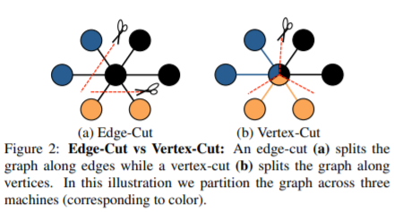
Existing graph engines
DGL: edge list. Hard to optimize sampling with message passing paradigm.
Neo4j: list of properties(edges, nodes). Slow string-based clients.
Pregel: MapReduce for nodes, no explicit edges. Intermediate results stored in a file instead of memory.
GraphX(Spark): vertex-cut, evenly split high-degree vertices across partitions.

Slide 20
Graph Engine API
API | Description
random_walk | Random walk from initial seeds
sample_(node|edge) | Sample nodes/edges by type
get_(node|edge)_features | Feature extraction
get_all_neighbors | Query full set of neighbors by type
sample_neighbors | Sample node neighbors by type
This API set is sufficient to support existing algorithms
We can expand APIs if necessary
Implemented in C++ as statically linked shared library.
  Python <-> C via ctypes module.

Slide 21
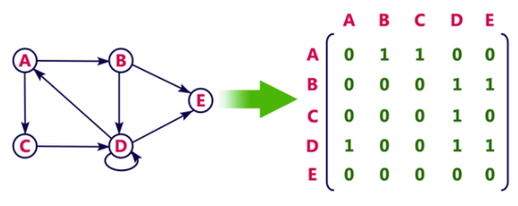
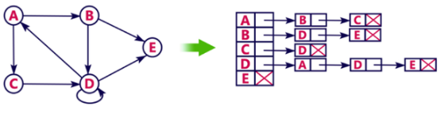
Graph representation
Sparse matrix
Adjacency list

Slide 22
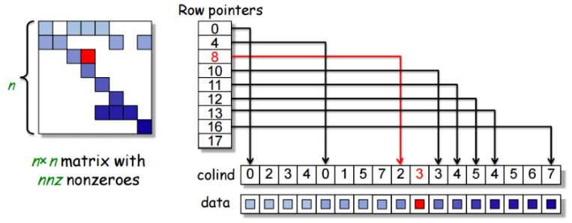
Compressed sparse format
Coordinates list storage:
  #edges * (source + destination + data pointer)
  24 bytes/edge
CSC storage:
  #edges * (destination + data) + #nodes * (source)
  16 bytes/edge + 8 bytes/node
# nodes << # edges !

Slide 23
DeepGNN Binary format
Unroll graph to list of ints(indices):
  Can easily shard graph horizontally
  Better latency
  Fast loading time
Indices everywhere:
  Node features: map node id->feature offset
  Neighbors: map node id-> node list offset -> edge type offset -> destination id
  Edge features: map node id->edge type offset -> destination offset-> feature offset

Slide 24
Memory footprint
Adjacency lists
CSR
Graph
Node 1
Node 2
Node 3
Feature 30
Feature 21
Feature 20
Feature 10
Feature 11
Feature 22
Graph
Metadata
Nodes
Features
Node 1
Node 2
Node 3
Feature 10
Feature 11
Feature 20
Feature 21
Feature 30
Feature 22
Memory used for 10 dimensional float features
672 bytes vs 312 bytes
Memory used for 100 dimensional float features
2832 bytes vs 2472 bytes

Slide 25
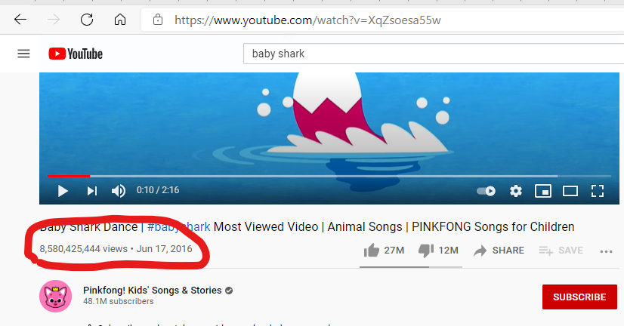
Data partitioning
Adjacency lists
CSR
Partition 1
Node 1
Node 2
Node 3
Neighbor1
Neighbor2
Neighbor1
Neighbor1
Neighbor2
Neighbor3
Partition 2
Partition 1
Metadata
Nodes
Neighbors
Node 1
Node 2
Neighbor1
Neighbor2
Neighbor1
Partition 2
Metadata
Nodes
Neighbors
Node 2
Node 3
Neighbor2
Neighbor3
Neighbor1

Slide 26
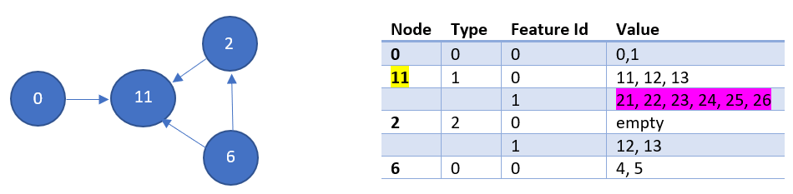
Feature extraction
0 | 11 | 2 | 6
0 | 1 | 3 | 5
Node.map
0 | 2 | 5 | 11 | 11 | 13 | 15
Feature.index
0 | 1 | 11 | 12 | 13 | 21 | 22 | 23 | 24 | 25 | 26 | 12 | 13 | 4 | 5
Feature.data

Slide 27
Graph Sampling
Shard 1
Shard 2
Shard 3
Node 1..10
Node 11..30
Node 31..60
Client
The number of items to sample from each shard is determined from the client. For example:
  3 shards have total number of nodes [10, 20, 30] and the request is to sample 5 nodes
  Toss a coin 5 times with values inside interval [0; 1)
  Number of times the value is less than 10/60 is number of samples from shard#1
  Number of times the value is between than [1/6; 1/2) is number of samples from shard #2
  The rest will come from shard #3

Slide 28
Graph Sampling(cont)
Pattern: weights don’t change between tosses. Steps 2-4 can be replaced with sampling from a multinomial distribution with weights [1/6, 1/3, 1/2].
Batch size | Sequential(ns) | Binomial(ns) | Improvement
8 | 660 | 918 | -30%
32 | 2546 | 2211 | 14%
128 | 10705 | 6665 | 38%
512 | 39613 | 24493 | 38%

Slide 29
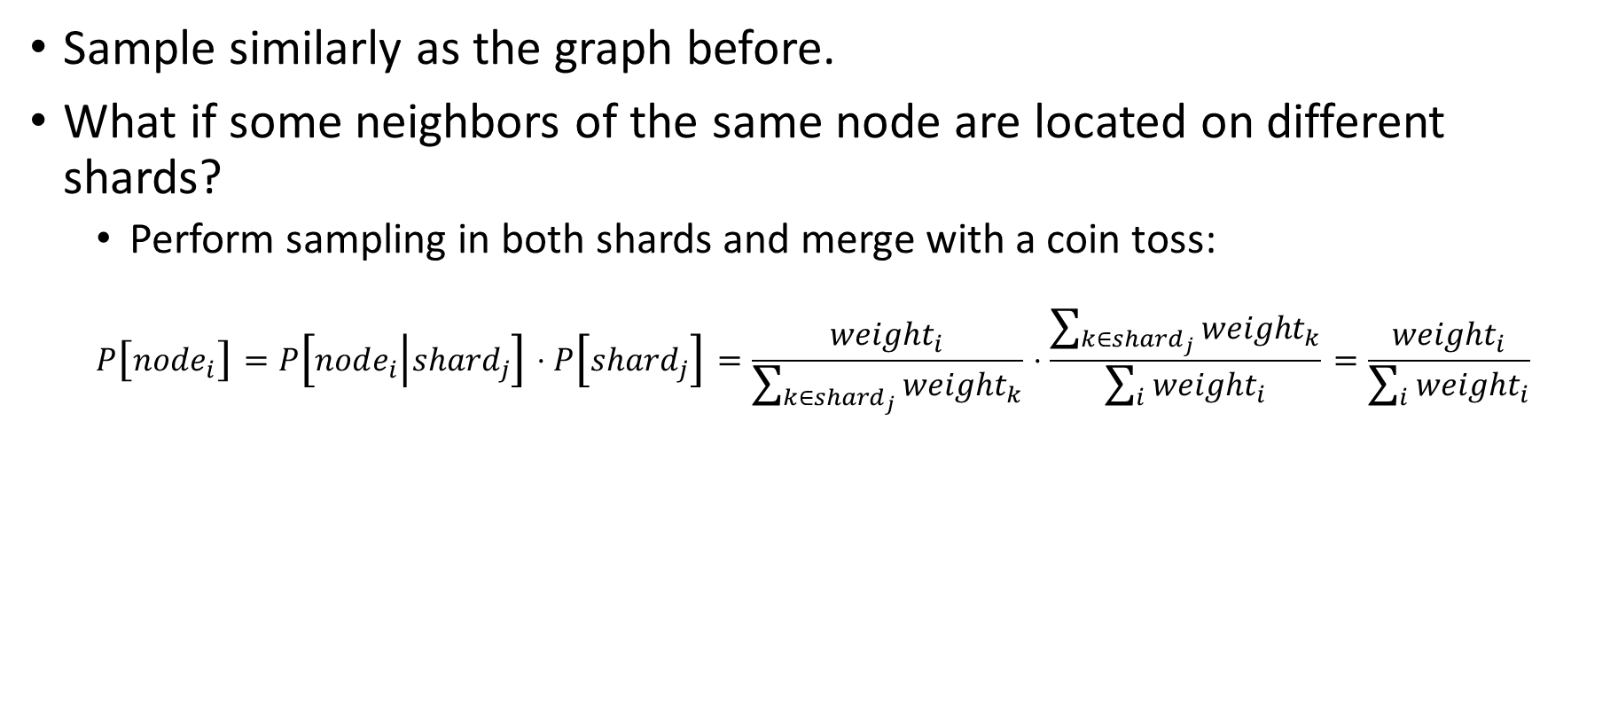
Neighbor Sampling
Sample similarly as the graph before.
What if some neighbors of the same node are located on different shards?
  Perform sampling in both shards and merge with a coin toss:
  $$P\left[node_{i}\right]=P\left[node_{i} | shard_{j}\right]⋅P\left[shard_{j}\right]=\frac{weight_{i}}{\sum_{k∈shard_{j}}{weight_{k}}}⋅\frac{\sum_{k∈shard_{j}}{weight_{k}}}{\sum_{i}{weight_{i}}}=\frac{weight_{i}}{\sum_{i}{weight_{i}}}$$

Slide 30
Thank you!

