Slide 1





Riformare la valutazione della ricerca in ottica Scienza aperta
Chi ha paura dell’Open Science?
“ISA Topic 2021 – Di chi sono le idee?”
DATE: 05 APRIL 2022 from 14:30 to 16:30
Francesca Di Donato
Istituto di Linguistica Computazionale “A. Zampolli” - CNR
francesca.didonato@ilc.cnr.it
orcid.org/0000-0003-0144-8934
Queste slide possono essere scaricate qui:

Slide 2
Di che cosa parleremo
Il contesto politico internazionale
Prossimi passi: L’accordo e la coalizione per la riforma del sistema di valutazione
Open Science e valutazione in Horizon Europe

Slide 3
OS e processo di riforma della valutazione
in Europa (e oltre)

Slide 4
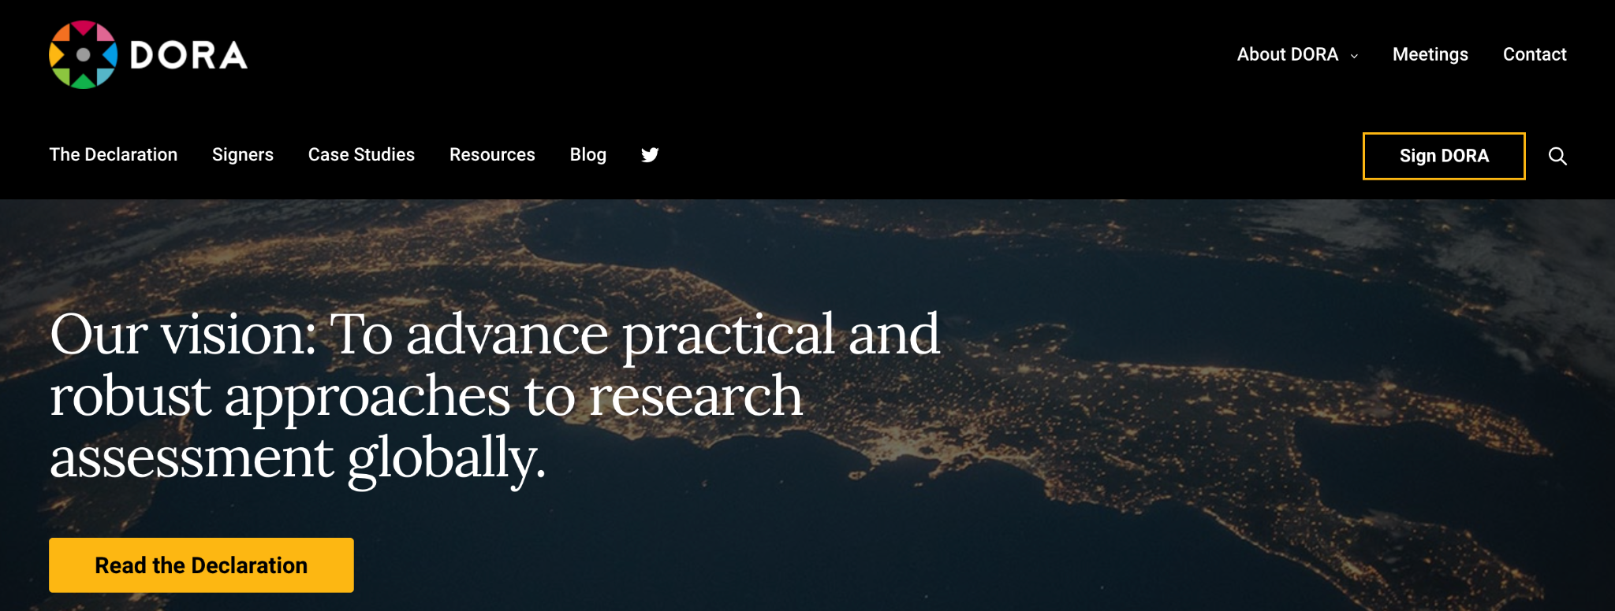
The Declaration on Research Assessment (DORA)
2012:
“There is a pressing need to improve the ways in which the output of scientific research is evaluated by funding agencies, academic institutions, and other parties”.
https://sfdora.org/read/
2022:
sottoscritta da 21.343 individui e organizzazioni in 156 paesi
Notes:
Raccomandazioni:
non usare gli indici bibliometrici basati sui journal (JIF) come indicatori di qualità.
valutare tanti output diversi (bibliodiversità)
valutare impatto in diverse forme (anche socio-eco)
incoraggiare pratiche di ricerca responsabile
criteri e processi di valutazione devono essere trasparenti

Slide 5
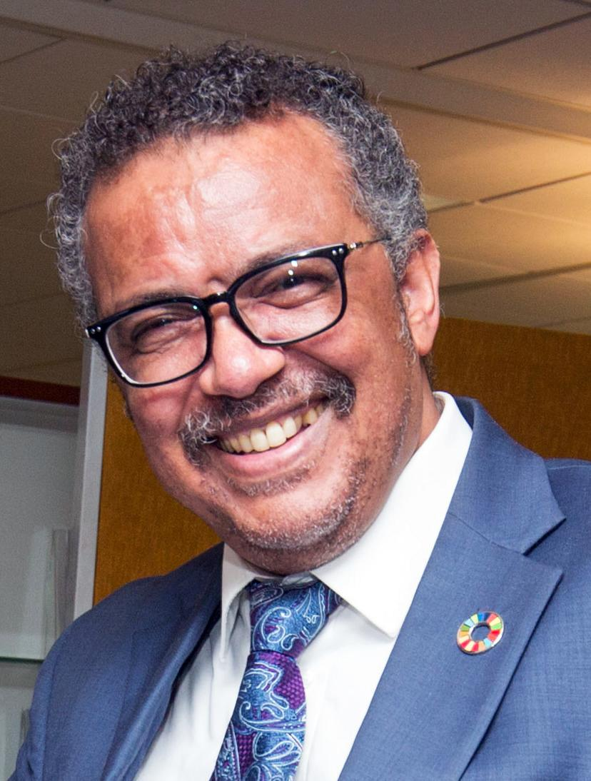
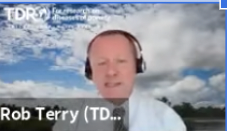
Perché una riforma della valutazione è necessaria?
“I call on all countries, companies and research institutions to support open data, open science, and open collaboration so that all people can enjoy the benefits of science and research”
T.A. Ghebreyesus, ‘WHO Director-General’s Opening Remarks at the Media Briefing on COVID-19 - 6 April 2020
Meno del 25% del materiale scientifico incluso nelle Linee guida dell'OMS sul COVID proviene da pubblicazioni tradizionali. "They proved useless, just when we needed them most"
R. Terry, Time to unlock the potential of the digital age, OpenScienceFair2021, settembre 2021, slides
https://wellcome.ac.uk/press-release/publishers-make-coronavirus-covid-19-content-freely-available-and-reusable

Slide 6
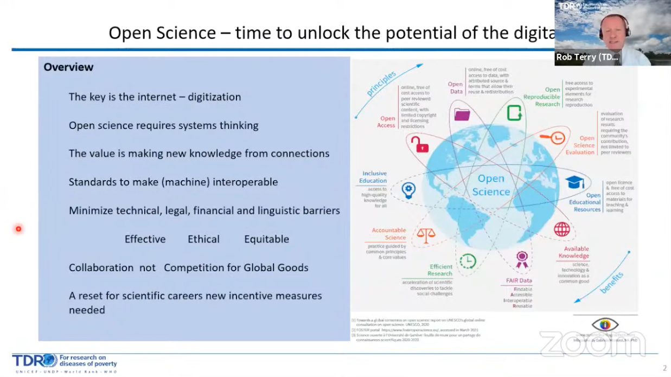
R. Terry, Time to unlock the potential of the digital age, OpenScienceFair2021, settembre 2021, slides

Slide 7
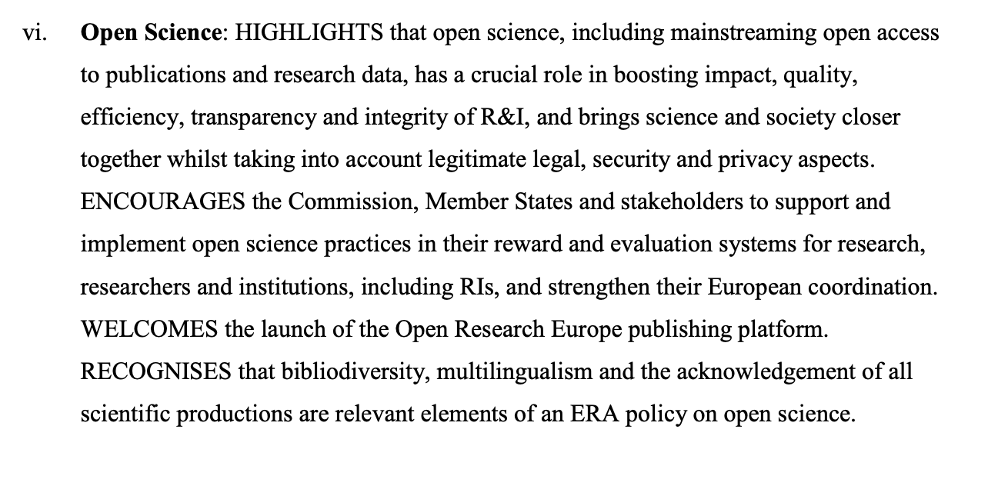
Il processo di riforma in Europa
Commission Recommendation (EU) 2018/790 of 25 April 2018
Commission Communication COM(2020) 628
Council Conclusions on the new European Research Area of 1 December 2020
Council conclusions on attractive and sustainable researchers’ careers …
ERA Policy Agenda 2022-2024
Notes:
2018: Commission Recommendation (EU) 2018/790 of 25 April 2018
La CE raccomanda agli Stati membri di definire e mettere in atto policy per riconoscere la cultura della collaborazione e condivisione della conoscenza e dei dati.
2020: ’ Open Science Policy Platform final Report
il sistema di gestione delle carriere per i ricercatori, in particolare all'inizio della carriera, deve valorizzare e promuovere una gamma diversificata di risultati, attività e direzioni di carriera, facilitando anche la mobilità tra il mondo accademico e industria e tra paesi.
2020: Commission Communication COM(2020) 628 on a new European Research Area for Research and Innovation
Ha come come obiettivo strategico il miglioramento del sistema di valutazione della ricerca
2021: Council conclusions on the European Universities initiative of 17 May 2021
E' necessario trovare modi nuovi e attraenti per l'assunzione, la valorizzazione, la valutazione e la professionalizzazione di docenti, ricercatori e altro personale di supporto, adoperandosi per un migliore riconoscimento ed equilibrio tra attività di formazione, di ricerca, e altri risultati legati alle missioni delle istituzioni.
2021: Council conclusions on attractive and sustainable researchers’ careers and working conditions of 28 May 2021
Incoraggia gli Stati membri, le organizzazioni di finanziamento della ricerca, le organizzazioni che svolgono attività di ricerca e la Commissione a collaborare per una una revisione del sistema di valutazione della ricerca.
2021: ERA Policy Agenda 2022-2024, annexed to the Council Conclusions on the future governance of the European Research Area of 26 November 2021
Comprende un'azione prioritaria per riformare il sistema di valutazione per la ricerca, i ricercatori e le istituzioni al fine di migliorarne la qualità, le prestazioni e l'impatto.

Slide 8
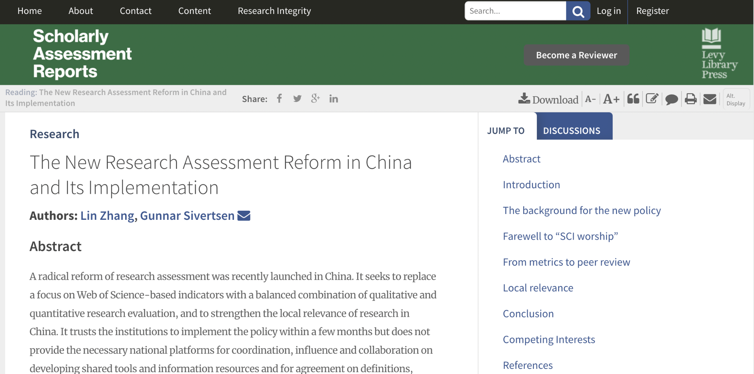
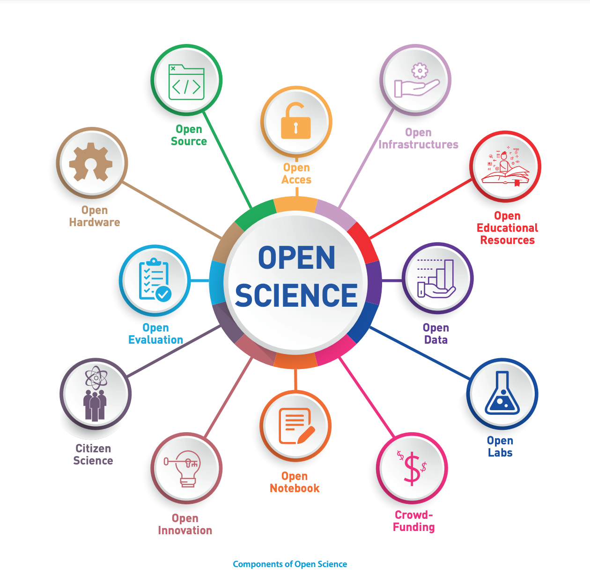

Oltre l’Europa
2020: La riforma in Cina
Lin Zhang, Gunnar Sivertsen, The New Research Assessment Reform in China and Its Implementation, Scholarly Assessment Reports, 2020.
2021: UNESCO Recommendation on Open Science
2021: G7 Research Compact
Notes:
2021: G7 Research Compact
2021: Recommendation on Open Science from UNESCO
La raccomandazione riconosce la necessità di rivedere i sistemi di valutazione della ricerca per allinearli ai principi della scienza aperta.
2021: The Global Research Council (GRC)
ha organizzato nel 2020 una conferenza sulla valutazione responsabile della ricerca e ha istituito nel 2021 un gruppo di lavoro dedicato all'argomento.
2020: La riforma in Cina
Lin Zhang, Gunnar Sivertsen, The New Research Assessment Reform in China and Its Implementation, Scholarly Assessment Reports, 2020.

Slide 9
Due strategie
Open Science in Horizon Europe
Verso un agreement per una riforma della valutazione della ricerca

Slide 10
Open Science e valutazione
in Horizon Europe

Slide 11
Risultati
Metodologia
Ricercatore e Consorzio
Cosa
Come
Chi
In Horizon Europe tutto viene valutato sotto la prospettiva Open Science, fin dalla proposta di progetto

Slide 12
I punti principali
Ex-ante
Ex-post
Si valutano diverse tipologie di output (bibliodiversità)
Devono essere Open Access, con DOI
L’impatto è descritto (no indicatori)
Le pratiche OA sono embedded nella metodologia
E’ richiesta la gestione dei dati della ricerca secondo i principi FAIR e “as open as possible, as closed as necessary” (con DMP)
L’impatto è descritto (no indicatori)
E’ richiesta la gestione dei dati della ricerca secondo i principi FAIR e “as open as possible, as closed as necessary” (con DMP)
OA obbligatorio se la proposta è finanziata

Slide 13
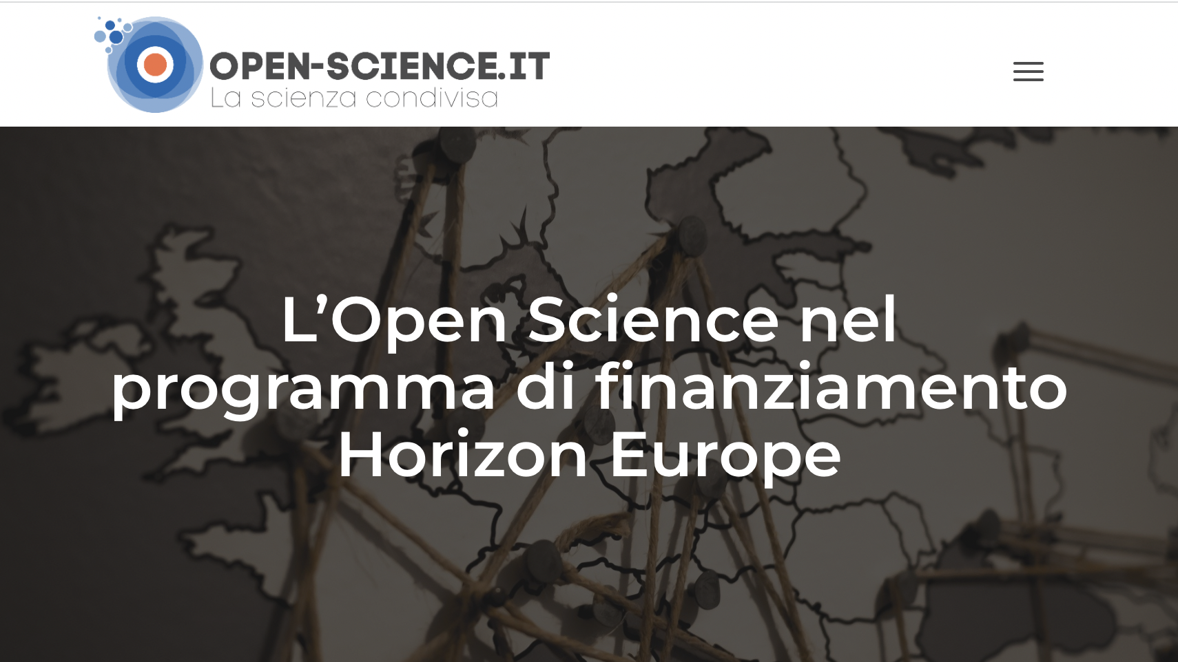
Per saperne di più
Vedi anche: Giglia, E, Guida all'Open Science in Horizon Europe, Zenodo, 2021, 10.5281/zenodo.4826663

Slide 14
Verso uno European agreement per la riforma della valutazione della ricerca

Slide 15
Il percorso
Consultazione
Incontri bilaterali
01
degli stakeholder (marzo - novembre 2021)
tra la commissione e i rappresentanti degli Stati membri e delle Agenzie di valutazione
02
Research
assessment
Report
Stakeholder
Meeting
03
Novembre 2021
Towards a reform of the research assessment system”
04
Dicembre 2021

Slide 16
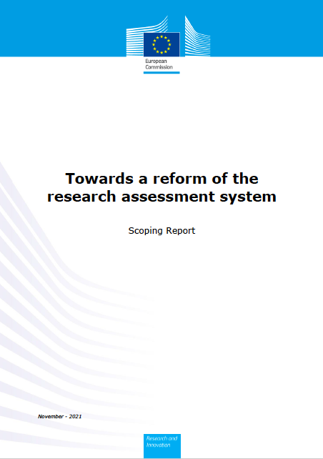
Lo scoping report di novembre 2021
Obiettivo: facilitare e accelerare il processo di riforma di valutazione della ricerca
Verso una riforma del sistema di valutazione della ricerca che:
  Promuova la valutazione qualitativa basata sul peer review, supportata da un uso più responsabile degli indicatori qualitativi
  Consideri il valore e l’impatto di una pluralità di output di ricerca (bibliodiversità) e il multilinguismo
  Riconosca la diversità delle attività svolte da un ricercatore, e supporti la scienza collaborativa (team science)
  Incentivi la collaborazione aperta e la condivisione di risultati e dati preliminari
EC, Towards a reform of the research assessment system, Scoping report, 29 novembre 2021.
Notes:
“A European initiative should aim to facilitate and speeding up changes to research assessment. The objective would be to have research proposals, researchers, research units and research institutions evaluated on their intrinsic merits and performance rather than on the number of publications and where they are published, promoting qualitative judgement with peer-review, supported by responsible use of quantitative indicators”.
“The Commission proposes to move towards a common understanding through an agreement to be signed by individual research funding organisations, research performing organisations, and national/regional assessment authorities or agencies, as well as by their associations, all willing and committed to reform the current research assessment system”

Slide 17
Le tappe: Verso un accordo europeo
16 dicembre: pubblicazione di un invito a manifestare interesse a far parte di una coalizione del processo di redazione dell'accordo
Fine dicembre-gennaio: inizio del processo di redazione da parte del drafting team.
1 Febbraio: Paris Call on Research Assessment
4-5 Febbraio: Paris Open Science European Conference (OSEC)
7 & 18 Febbraio: incontri con il Core Group per discutere gli elementi dell'accordo
Marzo-maggio: processo di consultazione degli stakeholder, ERAC e ERA Forum
Giugno (tbc): Pubblicazione dell'agreement

Slide 18
“Drafting process”
European University Association (EUA)
Science Europe
Dr. Karen Stroobants, in her individual capacity as researcher with expertise in research on research
European Commission, also acting as facilitator
Drafting team
Closely contribute to the iterative review process
« Core group »
& Potential coalition members
MS representatives
Draft agreement
Input & comments
ERAC and ERA Forum
20 members, representing the diversity of the research community across Europe. List here
More than 250 organisations from 33 countries (+ international organisations) already expressed interest in joining the drafting process. List here
Final agreement

Slide 19
E l’Italia?
Nel processo europeo
13 istituzioni italiane (tra cui Unibo, CNR, MUR e ANVUR) hanno sottoscritto l’interesse e partecipano al processo di stesura dell’accordo
Il CNR è parte del core-group
Inoltre
  Programma Nazionale per la Ricerca 2021-2027
  Piano nazionale per le infrastrutture di ricerca: potenziamento e al consolidamento del complesso delle infrastrutture di ricerca di livello nazionale ed europeo. Le RIs sono intese come promotrici dell’Open Science: danno accesso a dati FAIR e open e contribuiscono allo European Open Science Cloud
  Piano nazionale per la scienza aperta (in corso di pubblicazione).

Slide 20
Grazie!
francesca.didonato@ilc.cnr.it
This presentation is released under a CC-BY 4.0 license. To cite this presentation, please copy and paste:
Lazzeri, Emma & Di Donato, Francesca. (2022, April 05). Chi ha paura dell’Open Science?. ISA Topic 2021 – Di chi sono le idee?, Bologna. Zenodo. https://doi.org/10.5281/zenodo.6473494.

Slide 21
Riferimenti bibliografici
Ghebreyesus TA, ‘WHO Director-General’s Opening Remarks at the Media Briefing on COVID-19 - 6 April 2020’
UNESCO recommendation on open science, November 2021
R. Terry, Time to unlock the potential of the digital age, OpenScienceFair2021, settembre 2021, slides
Diana Hicks, Paul Wouters, Ludo Waltman, Sarah de Rijcke & Ismael Rafols, Bibliometrics: The Leiden Manifesto for research metrics
22 April 2015, https://www.nature.com/articles/520429a
Lin Zhang, Gunnar Sivertsen, The New Research Assessment Reform in China and Its Implementation, Scholarly Assessment Reports, 2020 https://www.scholarlyassessmentreports.org/articles/10.29024/sar.15/
Council Conclusions on the new ERA of December 1st 2020
EC, Towards a reform of the research assessment system, Scoping report, 29 novembre 2021.
European Commission Recommendation 2005/251 of 11 March 2005 on “The European Charter for Researchers” and on “A Code of Conduct for the Recruitment of Researchers” https://euraxess.ec.europa.eu/sites/default/files/am509774cee_en_e4.pdf
“San Francisco Declaration on Research Assessment” – DORA (2013) https://sfdora.org/
UNESCO Recommendation on Open Science (2021) https://unesdoc.unesco.org/ark:/48223/pf0000379949.locale=en
G7 Research Compact (2021) https://www.g7uk.org/wp-content/uploads/2021/07/G7-2021-Research-Compact-PDF-356KB-2-pages.pdf
European Commission proposal COM(2021) 407 of 16 July 2021 for a Council Recommendation on a “Pact for Research and Innovation in Europe” https://ec.europa.eu/info/sites/default/files/research_and_innovation/strategy_on_research_and_innovation/documents/ec_rtd_pact-for-research-and-innovation.pdf
Council conclusions (adopted on 17/05/2021) on “the European Universities initiative - Bridging higher education, research, innovation and society: Paving the way for a new dimension in European higher education” https://eur-lex.europa.eu/legal-content/EN/TXT/PDF/?uri=CELEX:52021XG0610(02)&from=EN
Council conclusions (adopted on 28/05/2021) on “Deepening the European Research Area: Providing researchers with attractive and sustainable careers and working conditions and making brain circulation a reality” https://data.consilium.europa.eu/doc/document/ST-9138-2021-INIT/en/pdf
ERA)”

Slide 22
Hicks D, Wouters P, Waltman L, de Rijcke S, Rafols I (2015) “Bibliometrics: The Leiden Manifesto for research metrics.” Nature 520, 429 https://doi.org/10.1038/520429a
Wilsdon J et al. (2015) “The Metric Tide: Report of the Independent Review of the Role of Metrics in Research Assessment and Management” https://doi.org/10.13140/RG.2.1.4929.1363
Council conclusions (adopted on 27/05/2016) on “The transition towards an Open Science system” https://data.consilium.europa.eu/doc/document/ST-9526-2016-INIT/en/pdf
Revised edition by All European Academies – ALLEA (2017) of the “European Code of Conduct for Research Integrity” https://www.allea.org/wp-content/uploads/2017/05/ALLEA-European-Code-of-Conduct-for-Research-Integrity-2017.pdf
European Commission working group report (2017) “Evaluation of research careers fully acknowledging Open Science practices. Rewards, incentives and/or recognition for researchers practicing Open Science” https://doi.org/10.2777/75255
European Commission working group report (2017) “Providing researchers with the skills and competencies they need to practice Open Science” https://doi.org/10.2777/121253
Advice paper of the League of European Research Universities - LERU (2018) “Open Science and its role in Universities: A roadmap for cultural change” https://www.leru.org/files/LERU-AP24-Open-Science-full-paper.pdf
European Commission high-level advisory group report (2018) “Open Science Policy Platform recommendations” https://doi.org/10.2777/958647
European Commission Recommendation (EU) 2018/790 of 25 April 2018 on “Access to and preservation of scientific information” https://eur-lex.europa.eu/legal-content/EN/TXT/?uri=CELEX%3A32018H0790
Opinion of ERAC Standing Working Group on Open Science and Innovation (SWG OSI) (2018) “Recommendations on open science and innovation” http://data.consilium.europa.eu/doc/document/ST-1216-2018-INIT/en/pdf
Policy Support Facility – Mutual Learning Exercise (2018) on “Open Science - Altmetrics and Rewards” https://rio.jrc.ec.europa.eu/en/policy-support-facility/mle-open-science-altmetrics-and-rewards
Moher D, et al (2019) “Hong Kong principles for assessing researchers: Fostering research integrity”. OSF Preprints. https://doi.org/10.31219/osf.io/m9abx
Report of the European University Association – EUA (2019) “Research assessment in the transition to Open Science – 2019 EUA Open Science and Access Survey results” https://eua.eu/downloads/publications/research%20assessment%20in%20the%20transition%20to%20open%20science.pdf

Slide 23
Briefing of the European University Association – EUA (2019) “Reflections on University Research Assessment: Key concepts, issues and actors” https://eua.eu/resources/publications/825:reflections-on-university-research-assessment-key-concepts,-issues-and-actors.html
Agreement of the Dutch public knowledge institutions and funders of research (2019) “Room for everyone’s talent – towards a new balance in recognising and rewarding academics” https://www.scienceguide.nl/wp-content/uploads/2019/11/283.002-Erkennen-en-Waarderen-Position-Paper_EN_web.pdf
European Commission expert group report (2019) “Indicator frameworks for fostering open knowledge practices in science and scholarship” https://doi.org/10.2777/445286
European Commission high-level advisory group report (2020) “Progress on open science: Towards a shared research knowledge system. Final report of the Open Science Policy Platform”. https://doi.org/10.2777/00139
Curry S, de Rijcke S, Hatch A, Pillay D, van der Weijden I and Wilsdon J (2020) “The changing role of funders in responsible research assessment: progress, obstacles & the way ahead”. RoRI Working Paper No. 3. https://doi.org/10.6084/m9.figshare.13227914
Revised version by the Magna Charta Observatory (2020) of the “Magna Charta Universitatum”. http://www.magna-charta.org/magna-charta-universitatum/mcu-2020
Position statement of Science Europe (2020) “Recommendations on research assessment processes” https://www.scienceeurope.org/media/3twjxim0/se-position-statement-research-assessment-processes.pdf
Position paper of the Initiative for Science in Europe - ISE (2020) “Position on precarity of academic careers” https://initiative-se.eu/wp-content/uploads/2021/02/Research-Precarity-ISE-position.pdf
European Commission Communication COM(2020) 628 of 30 September 2020 on “A new European Research Area for Research and Innovation” https://eur-lex.europa.eu/legal-content/EN/TXT/?uri=CELEX%3A52020DC0628&qid=1614808291158
Council conclusions (adopted on 01/12/2020) on “The New European Research Area” https://data.consilium.europa.eu/doc/document/ST-13567-2020-INIT/en/pdf
De Herde V, Björnmalm M, Susi T (2021) “Game over: empower early career researchers to improve research quality”. Insights 34 (1): 15. http://doi.org/10.1629/uksg.548
Saenen B, Hatch A, Curry S, Proudman V, Lakoduk A (2021) “Reimagining Academic Career Assessment: Stories of innovation and change”. Case study report by DORA,
20

Slide 24
EUA, and SPARC Europe https://eua.eu/resources/publications/952:reimagining-academic-career-assessment-stories-of-innovation-and-change.html
Guidance document by the International Network of Research Management Societies - INORMS (2021) “The SCOPE Framework: A five-stage process for evaluating research responsibly” https://inorms.net/wp-content/uploads/2021/08/scope-overview-2021.pdf
Conference Report 2021 from the Global Research Council (GRC) Conference held in November 2020 on “Responsible Research Assessment” https://www.globalresearchcouncil.org/fileadmin/documents/GRC_Publications/GRC_RRA_Conference_Summary_Report.pdf
Guideline Paper from the joint ERAC Standing Working Groups Task Force on researchers’ training, incentives and evaluation in Open Science and Open Innovation - Triangle Task Force (2021) “Research evaluation in a context of Open Science and gender equality” https://data.consilium.europa.eu/doc/document/ST-1201-2021-INIT/en/pdf
Council Recommendation of 26/11/2021 on a “Pact for Research and Innovation in Europe”
Council conclusions (adopted on 26/11/2021) on ”the future governance of the European Research Area (

