Slide 1


Using an accessibility checker to increase the accessibility of your work
Kim Ferguson, Research Data Management Specialist at DANS-KNAW
@kfergy
March 29, 2022; LCRDM Networking Day; Muntgebouw, Utrecht
DOI: 10.5281/zenodo.6391146
Notes:
Hands-on session delivered twice at the LCRDM Networking Day, in person, on March 29th, 2022. Drop-in audience, and there are slides in the middle of the presentation that will be different after one go-through of the session, so I use two saved versions for the walk-thru. Note: there are inaccessible slides in this presentation for teaching purposes.
The licence is CC by SA 4.0 https://creativecommons.org/licenses/by-sa/4.0/

Slide 2
What is accessibility in this context?
Toegankelijkheid in Dutch
Accessibility is the practice of making your communication accessible and usable by as many people as possible – things such as presentations, documents, and emails all fall under this.
Rather than focus on the impairment, instead consider the mode of access:
  What are the options for accessing my work and results?
  Is my work able to be understood by those who are not viewing the screen?
  How do I check for things like this if I’m not sure what is necessary?

Slide 3
Why is accessibility important?
→ Ethically, morally, and in some cases, legally
→ Accessibility is about equality & equity
    An example of digital/web accessibility:
    Screen readers can be used by those with visual impairments as well as those with dyslexia or ADHD to access or better understand the information you are sharing. These tools rely on image descriptions and proper slide order to tell the story of your presentation. Adding these elements do not interfere with other aspects of the document.
If your images don’t have an attached description or alt-text, they have no impact for those audience members – you’re limiting the reach of your efforts.
If you’re communicating important information via a visual aide, there should also be text (on-screen or in the image attributes/metadata) – provide options and everyone wins!

Slide 4
Accessibility Checkers – the tool you’ve always had
Microsoft Accessibility Checkers
built-in tool throughout MS Office Suite (Powerpoint, Word, Outlook, Excel, Visio, etc.)
Chiefly elements for visual impairments where screen reader software would benefit
Additional contrast/colour checking elements
Give you Errors, Warnings, Tips, and AI-powered Suggestions
Don’t use Microsoft?
This walkthrough can help guide you through things to consider
Helpful with existing documentation for Google, Apple, Adobe, Latex, and Apache products (links in end slide)

Slide 5
Hands-on experience
Using the accessibility checker in this powerpoint file

Slide 6
Using the accessibility checker
First, let’s turn it on.
Notes:
The next 6 slides are simplistic representations of what the check can detect. As such, they are not accessible in this form. However, there is not any useful information embedded in the material. The lesson from each slide is in the note section.

Slide 7



Adding images
Adding alt-text or image description (slightly different)
How to make useful image descriptions? Checker has tips
When to mark as decorative
Watch out for grouping
Notes:
This slide is the first slide to talk about images, and we have some returning images, such as the DANS logo and the twitter icon, as well as a Powerpoint generated arrow shape, and two emojis. Here specifically, we can consider marking the twitter logo and the dans log as being docorative – for logos that appear on each slide, or something that comes up again, it can be marked as decorative, that is, it’s presence is not informative or referred to within the presentation. Often, what I do in the alt text is give the description of the logo, and then state that it will be marked as decorative in subsequant slides.
The arrow needs a quick description that should include what items it is routed to, and the emojis can get simple descriptions where necessary.

Slide 8
Header? | Formatted as such? | This allows it to be read | As you intended
Notes:
This slide, aside from not have a title, also goes into Tables and making sure that they have headers. This is done by designating the header as such. If you don’t like the header formatting (a different colour) then change that in the cell or row settings, not by turning off the header.
Note: you could add alt-text to this table, it is possible, but it won’t be prompted by the accessibility checker because it’s not a standard feature of table to have alt-text in addition to what is in the table. You would do this if you’re using the table function for creating a shape and not entering any text.

Slide 9
Here’s an explanation title
Slide order is about what appears when
  Make sure this is in accordance with any animations, or else it won’t make sense
If you’re explaining a concept and want to use the same slide title more than once,
Does
This
Need
Alt
Text?
Notes:
This slide triggers the slide order warning, as well as showing that elements created within Powerpoint, such as the smart art arrow on the left or the pie chart on the right, needs alt text. For graphs and scientific figures, better to describe the y and x axis and what the graph is showing rather than be very detailed about each element – there is a page with tips for this in the Microsoft documents, found in the links slide

Slide 10

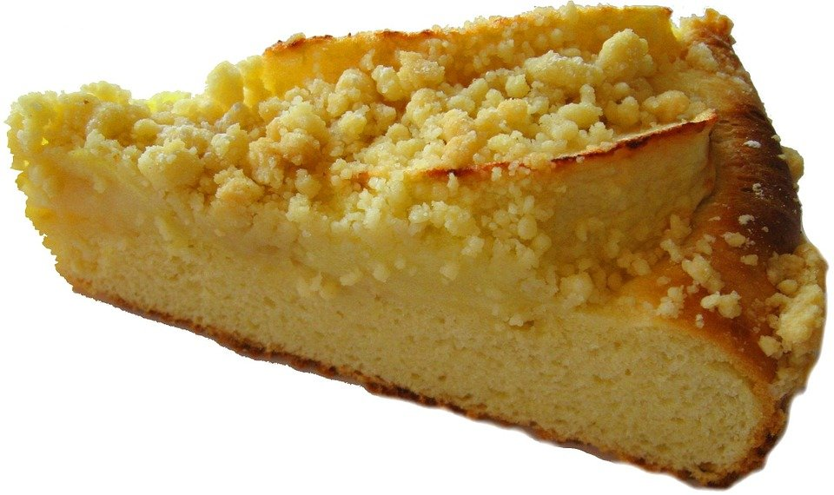
Here’s an explanation title
You should consider slightly changing it up
Grouped images?
Notes:
This slide shows 1) the tip triggered by two similar slide titles and 2) that group created by the two images wants an alt-text description. This is important to consider - if you gave both individual images alt-text but then grouped then, there is no trigger for a screenreader to read them as two separate images, but rather as one group. So the alt-text should apply to the group, or be marked as decorative if it’s more for a grouping of similar elements that are more decorative

Slide 11
Colour choices – not so straightforward
This text is light grey on a white background – will it trip the checker?
This is also pretty poor contrast, but will it trip the checker?
What about this?
Testing like this can give you a better sense of what is being detected
This is a text box, it behaves differently
Notes:
This slide is about colour choices, and how the checker is not as smart as we wish it was. If there is existing formatting in your prompt box (so the box that each empty slide starts with that could be text, and image, a list, a chart, etc., the checker will not check the contrast with the background colour. The colour of all four bullet points of this slide is not really readible – the contrast is not enough, but that is not triggering the accessibility checker. However, the back box is a text box that has had formatting to colour the background black and the text dark grey. As it is a distinct Text Box item, it is checked for the contrast of the text to the background, and so this triggers the accessibility checker, which will offer alternative colours or highlighting of the text.

Slide 12
Accessibility Checkers – what they cannot do
Design → Will not tell you if your slide is too busy
Images → it’s not AI
Decisions related to colour or contrast only work for text and background objects, not images or infographics imported
Captions → Video cannot be captioned in Powerpoint
Additional considerations are necessary
Exporting → Exporting to .pdf
can be done accessibly, but it can be tricky (tips from Microsoft and Adobe in links)

Slide 13
When to use the accessibility checkers?
Are you:
Sharing your slides with colleagues or students?
Uploading or publishing a presentation externally?
Likely to re-use elements of an internal presentation?
Collection of infographics or logos?
Then I suggest using it – soon it becomes second nature
But, if you’re:
→ Making a presentation that is one-time and/or won’t be shared
Then it’s less important, but again, practice will make it quicker to use

Slide 14
When you’re trying it out for yourself:
The Microsoft documentation is online and very helpful (links)
The first time you use it, you can select to always have it on
→ Checkers can be used retro-actively on existing documents
All additions (like alt-text or slide order) carry over when you re-use slide decks or images
Check images that you import from the internet, they might have useless alt-text
Locking a document to editing means that a screen reader cannot work

Slide 15
But keep in mind…
There is no perfect accessibility
  An accommodation for one person can be an impediment for another, so having options and avenues to access the information is key
→ Learn from feedback you receive
→ These skills take time, intent, and practice
→ Accessibility checkers are there to help with some aspects, but they are not perfect or complete
→ Interested in other ways to be more accessible? Check out 2nd link slide

Slide 16
Resources & Links, part 1
Microsoft Accessibility Checker:
  All programs overview
  Word processor details
  Powerpoint details
  Exporting .doc to .pdf with properties intact
  Writing effective alt-text
Google Docs: details on all aspects
LibreOffice: Documentation
Latex users: A resource guide
Adobe Creative Cloud: details by program
Apache OpenOffice: … no documentation/guides.

Slide 17
Resources & Links, part 2 – additional resources for accessibility
Colour & contrast
Color Oracle Simulator (colourblindness + contrast, all operating systems)
Visolve (simulate and alter colours, web/PC/Mac/mobile)
EDF and VIVID:T selection of toolkits for:
Word Documents
Powerpoint
Social Media
Online Meetings
Videos
All emojis designed by OpenMoji – the open-source emoji and icon project. License: CC BY-SA 4.0

Slide 18
Thanks for your attention!
kim.ferguson@dans.knaw.nl
@dans_knaw_nwo and @kfergy
Web: dans.knaw.nl/
Notes:
This slide also intentionally gets the reading order notice, in order to be able to fix it

