Slide 1
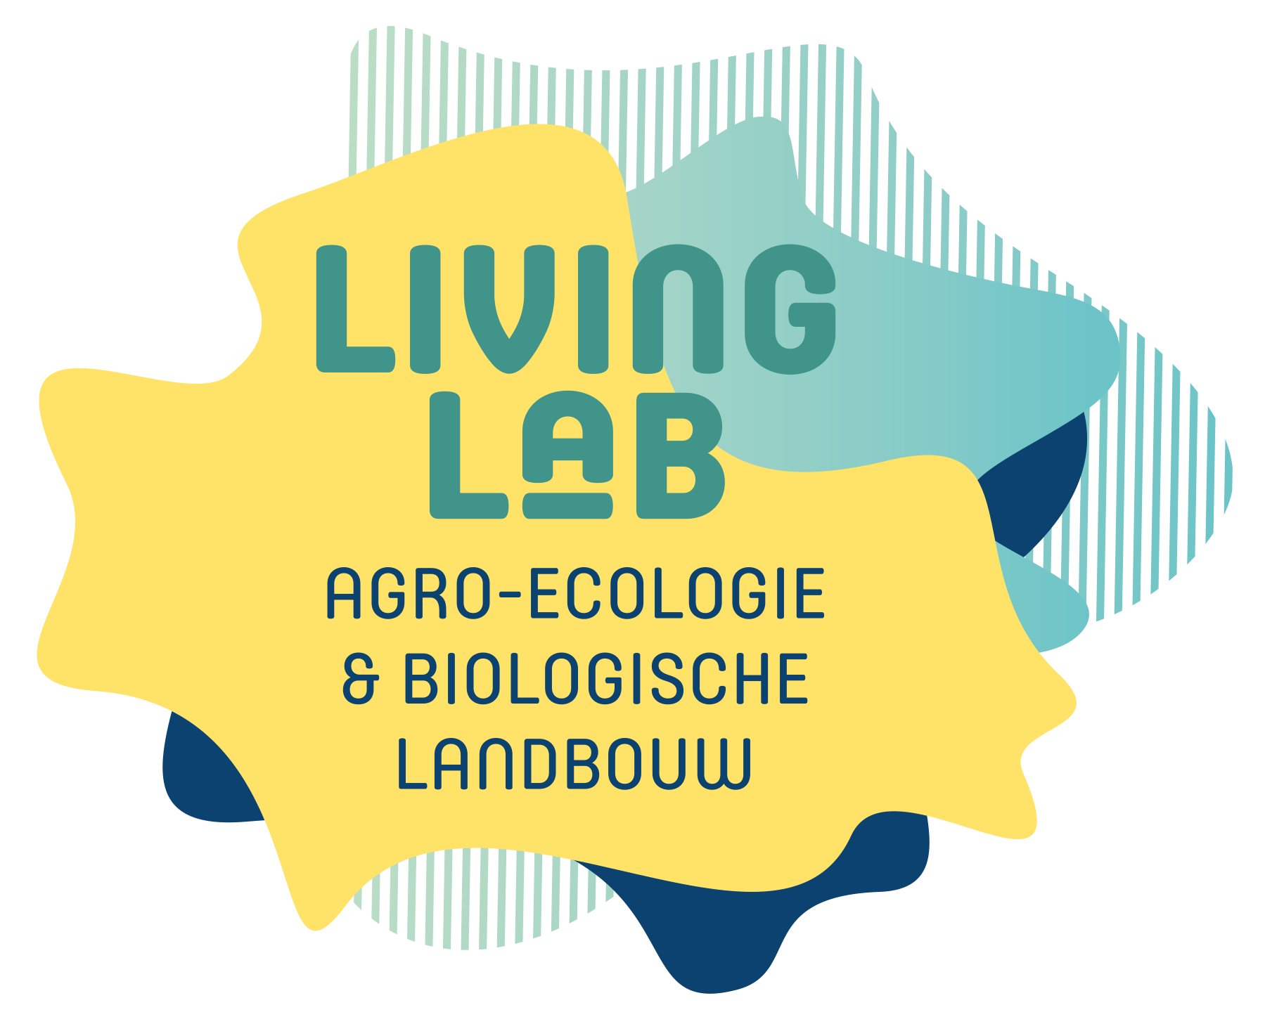
Living Lab Agroecology and Organic Agriculture
Flanders – BE
LLAEBIO
ALL-READY 1st Pilot meeting, 13 – 14 December 2021

Slide 2
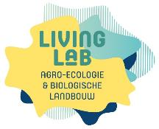
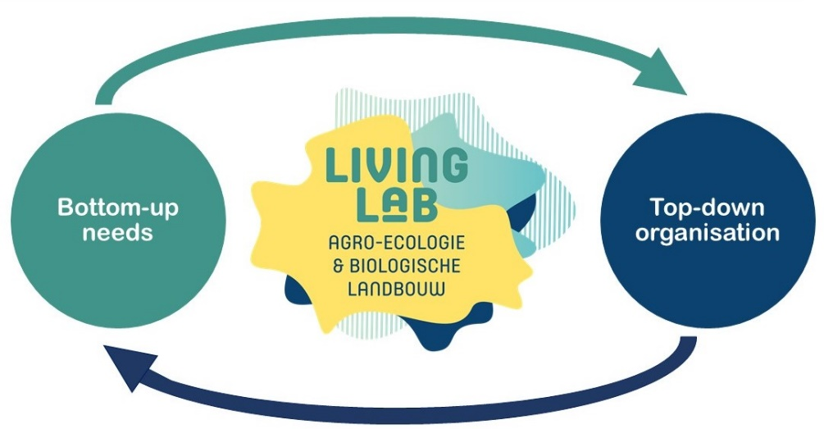
The initiative
The very beginning of the initiative 2017-2018
  request from the organic sector for more participatory research
  more research started from the farmers’ needs and carried out with the farmers
  the Flemish government asked ILVO to set up a living lab on organic farming
  increasing societal demand to take the concept agroecology as a guiding concept
  the living lab was broadened to Living lab Agroecology and Organic farming
First steps 2019
  set up LL in close collaboration with other institutes and relevant actors
  first real activity with farmers to define future actions end 2019
  Officially launched in February 2020
Notes:
we are a very young living lab, we started the preparation of the LL in 2019, and the end of 2019 we had our first real activities with farmers, in February 2020 we launched it officially in the press,
It started from bottom-up needs, there was a request from the organic sector for more participatory research, about 3 years ago, they argued for more research on organic agriculture that started from the needs of the farmers and would be carried out with the farmers. They discussed this with several actors and national policy officers.
The government listen to this request As such, it was taken up in the strategic plans of the government, ILVO was requested to set up a living lab on organic farming anda there was also quite a lot of societal demand, also from other ngo’s, to take the concept agroecology as a guiding concept. because of the relevance of the concept, the living lab was broadened to Living lab Agroecology and Organic farming.
We of course immediately decided to look for close collaborations with other institutes and relevant actors

Slide 3
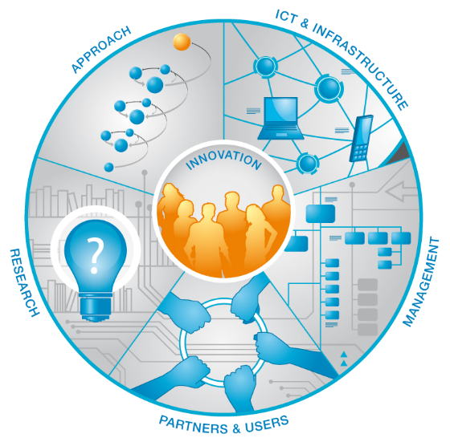
Living Lab
ENoLL principles
5 components

Slide 4


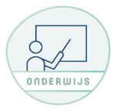
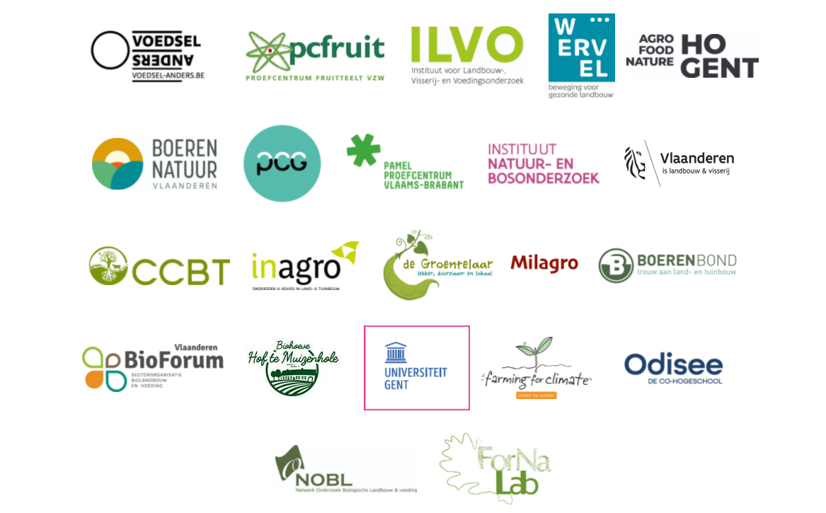
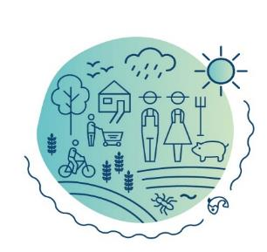





Partners and users
FARMERS
RESEARCH
EDUCATION
AGRO-FOOD-SYSTEM
GOVERNMENT
INDUSTRY
EXTENSION
NGO’S
CITIZENS

Slide 5
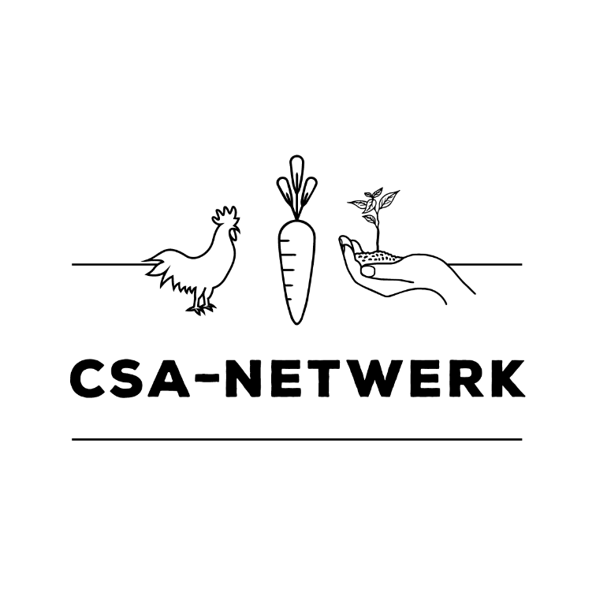





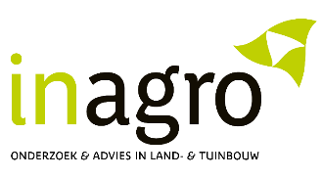

Partners
‘Healthy agriculture for
involved local communities’
‘As a research and extension centre we support growers in sustainable and innovative vegetable culture. In the living lab we share knowledge and get inspired on organic and agro-ecological techniques in other sectors’
‘Open knowledge exchange in co-creation with (organic) farmers as driver for of an agroecological food and farming system’
An Jamart
‘Practice-driven research and tailored knowledge exchange are key for development of agro-ecological innovations with farmers’
Carmen Landuyt
“We believe that system approaches are necessary to address the challenges of our today’s food system. Researchers need to take up a new role in society and this living lab will learn us a lot about this.”
Fleur Marchand
‘Thanks to agro-ecological thinking, we look beyond the optimization of cultivation’.
‘On farm innovation and technical progress are vital drivers in the transition to a more agro-ecological approach’
Dieter Depraetere
‘Increasing biodiversity is a corner stone in modern fruit production and the basis for agro ecology’’
Renske Petré

Slide 6
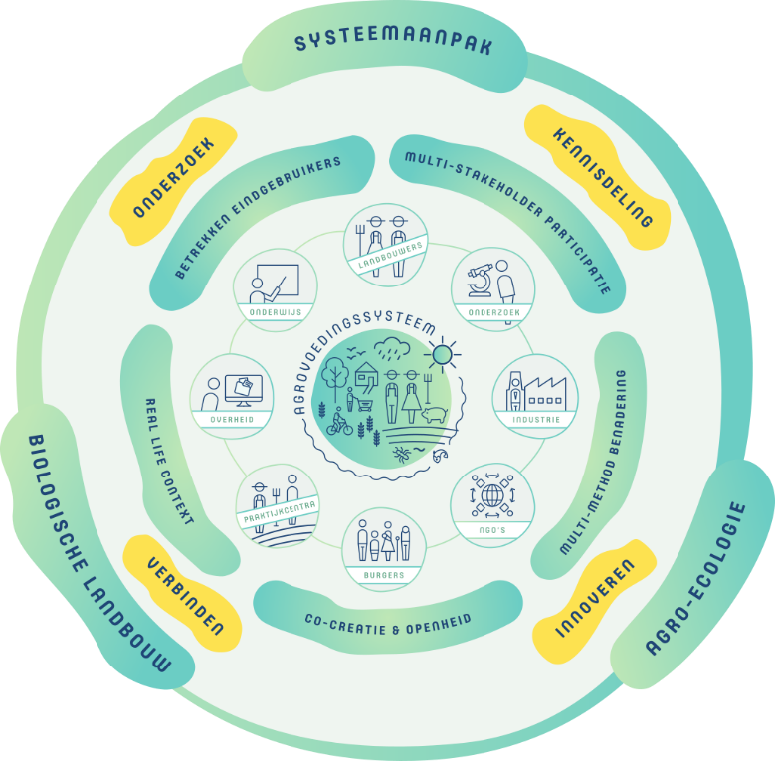
Vision and mission
WHY? We support agroecological innovation as a lever in the transition from organic and conventional agriculture to a sustainable food and agricultural ecosystems.
WHAT? The living lab brings together partners from the agrifood system and facilitates innovative research and knowledge sharing on agroecology and organic agriculture.
To this end, we connect people, organisations, science and practice. The LLAEBIO is continuously looking for partnerships to develop its activities together.

Slide 7
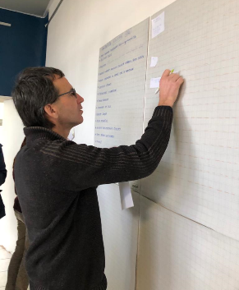
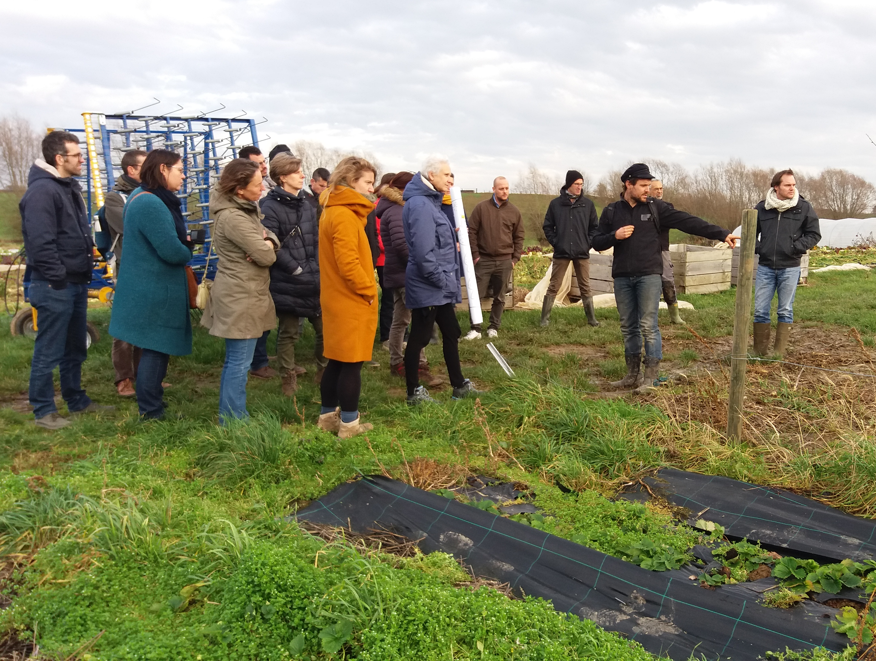
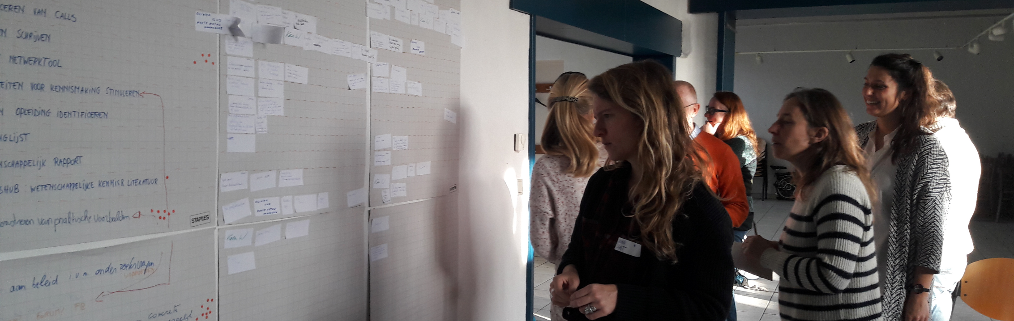
Management
Facilitation and coordination of the living lab by ILVO
  coordination: 1 FTE from the Social Sciences unit
  Supported by core team together with researchers from all ILVO units
Coordination through participation:
  Participative and demand driven:
    gathering point for ad hoc questions llaebio@ilvo.vlaanderen.be
    interactive workshops to determine actions and activities
  Working groups: activities together with stakeholders, variable membership, linked to specific goal, temporary

Slide 8
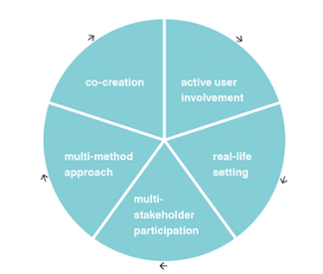
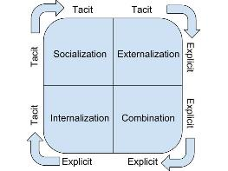
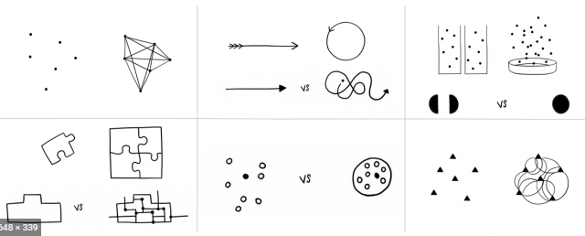
Approach
Guided by 3 elements
+
+
Nonaka et al. 2000
Enoll approach
co-creation
active user involvement
multi-method approach
multi stakeholder participation
real life setting
Integrating practical and scientific knowledge
System thinking

Slide 9
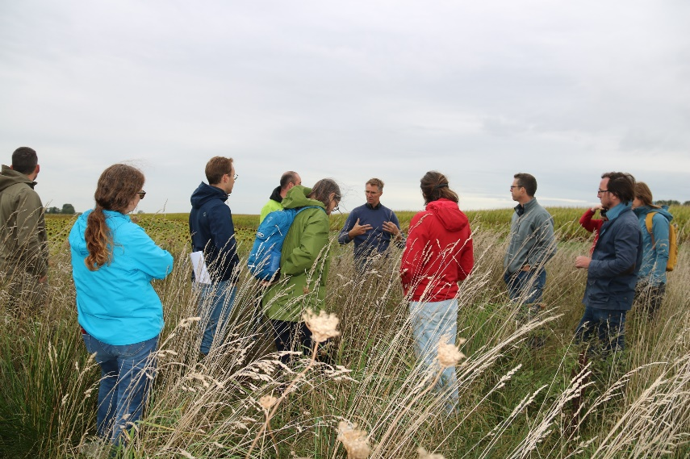
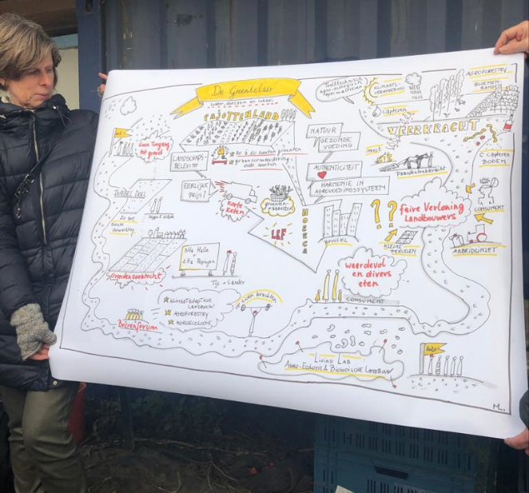
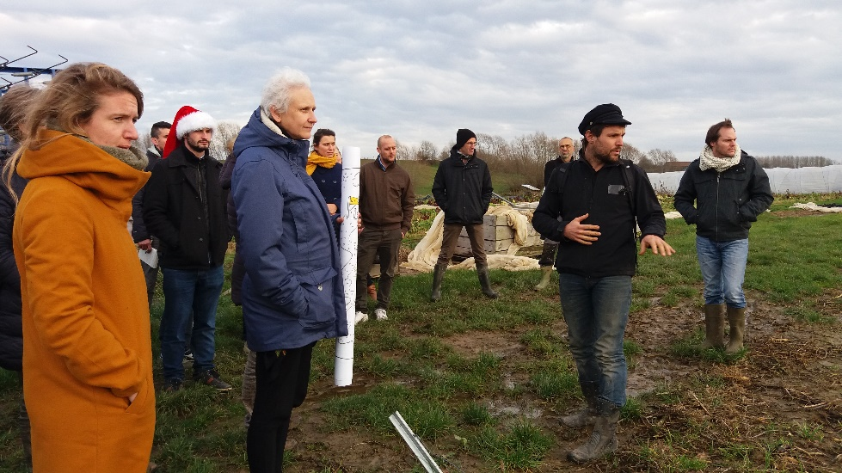
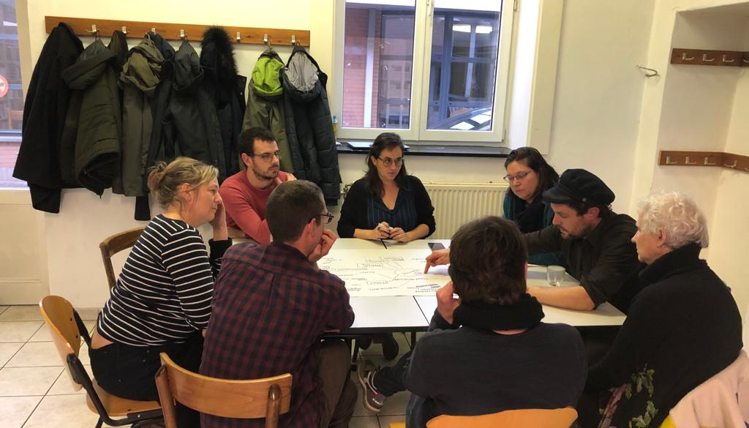
Activities
Knowledge sharing
  Knowledge exchange - connecting people
  Make knowledge and information visible: website, learning networks, …
Innovative research:
  Determination of knowledge gaps
  Facilitation of development of project proposal

Slide 10
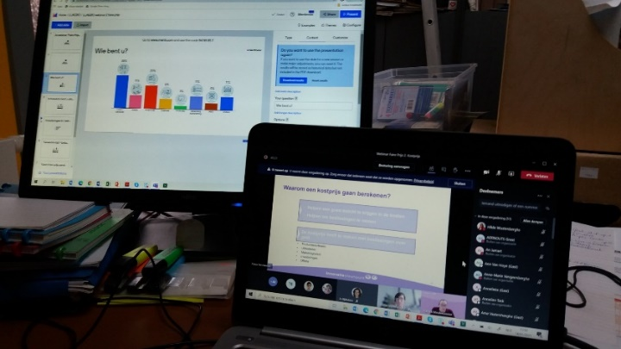
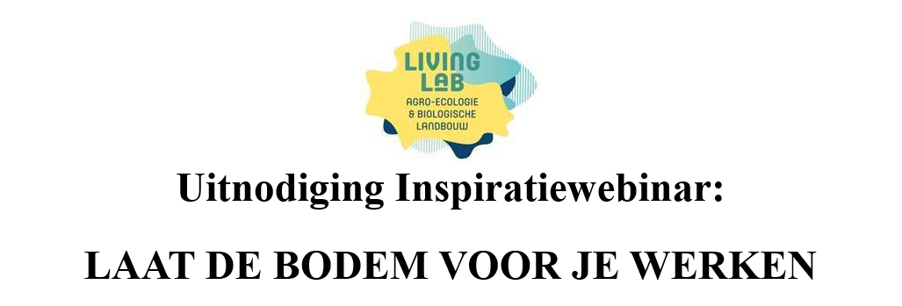
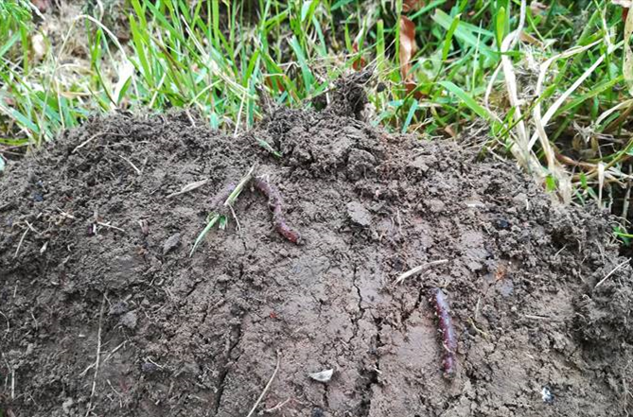
Some examples:
Knowledge sharing and connecting
  Webinar serie: ‘fair pricing’ :
  Initiated by a specific question of a farmer
  ‘Business models’, ‘cost price calculation’, ‘market price’
  Exchange theoretical and practical knowledge
    Inspiration seminar ‘Laat de bodem voor je werken’
      Short video’s with testimonies of farmers about sustainable soil management on their farm (together with partners of TRANSAE project)
      Connecting farmers interested in agroecology for a healthier soil and looking for colleagues to network and share knowledge with

Slide 11
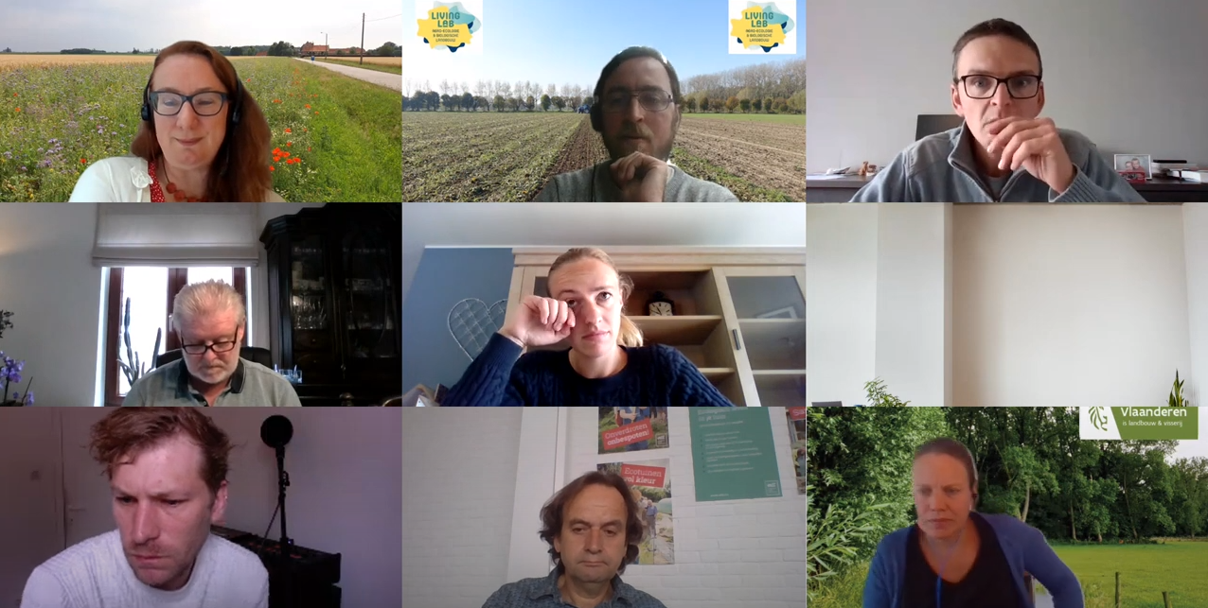
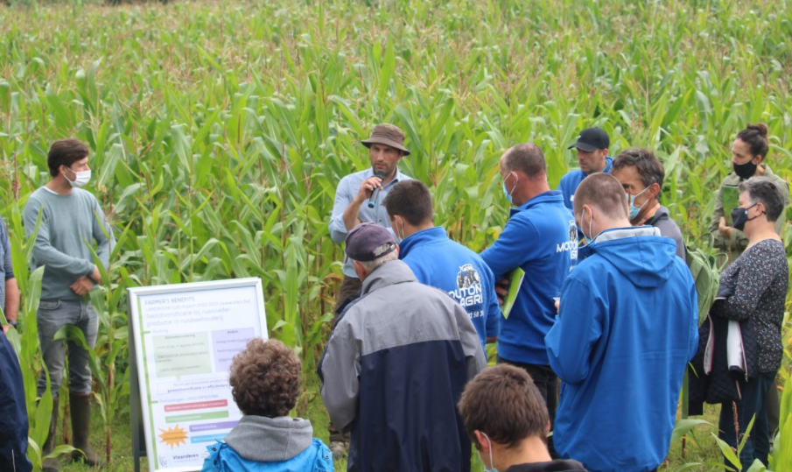
Some examples
Inspiration seminar about agroecology for teachers of secondary agricultural schools
‘LLAEBIO draait door’ - event
  Every 3rd -4th month update about LLAEBIO and exchange of information about projects and activities between partners
  Field day on the Experimental platform for Agroecology – Hansbeke
  www.ppaehansbeke.be
  Demonstration day ‘Composting on the farm’

Slide 12
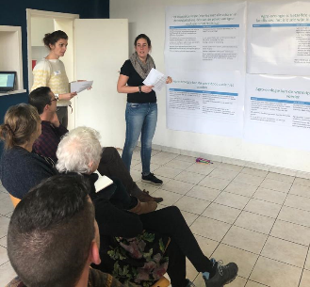
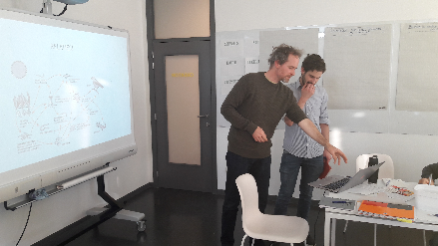
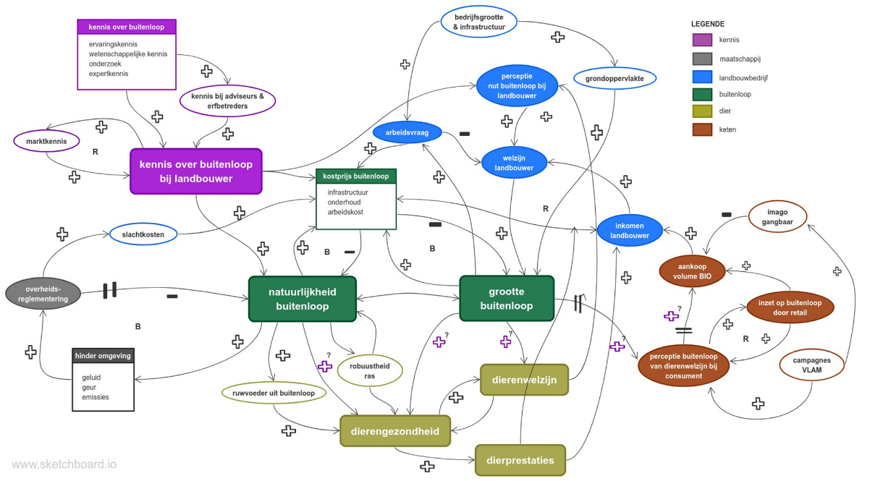
Some examples: Innovative research
  Organisation of round tables to define research priorities together with the organic sector
  Facilitating and writing of a project proposal
  Learning networks on rotational grazing and other agro ecological practices
  Scientific grounding of the concept agroecology

Slide 13
Current participation in activities
Notes:
+/-213 participants in activities

Slide 14
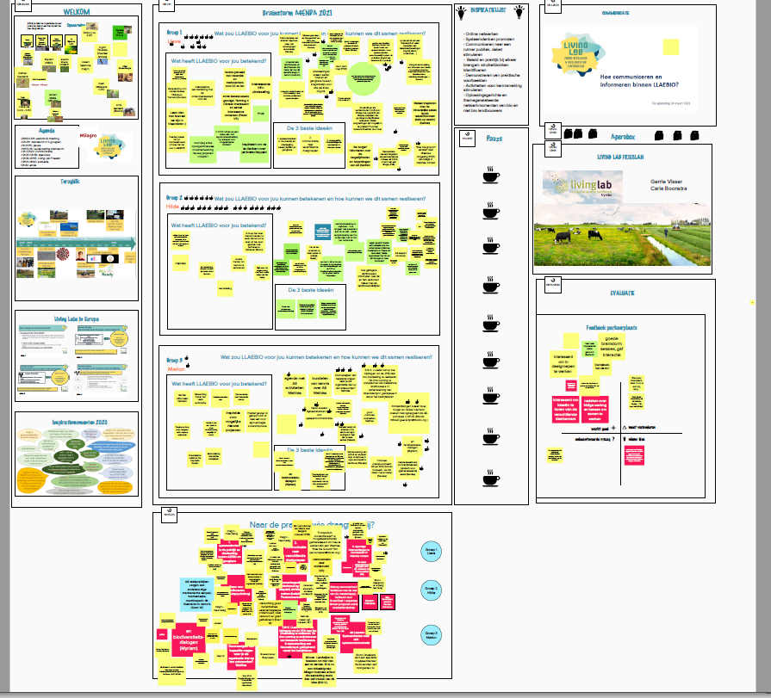
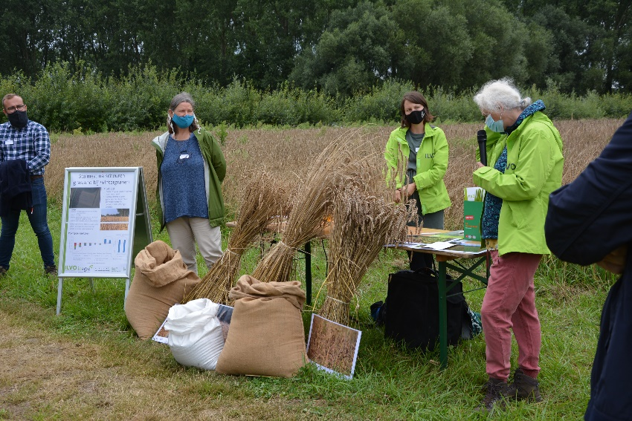
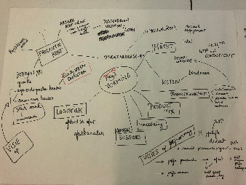
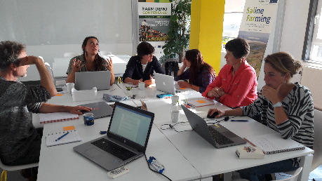
Actions for the future
System thinking
Communication: to a not polarizing debate, how do you do that?
Inspired by Flemish pioneers in agroecology and organic farming, a movie
Expertise in agroecology and organic farming in the picture
Transition to agroecology: values and norms
Bundling and sharing information on specific themes
Agroecology and organic farming in education.

Slide 15
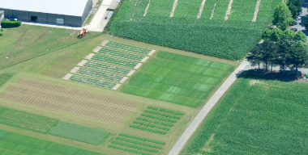
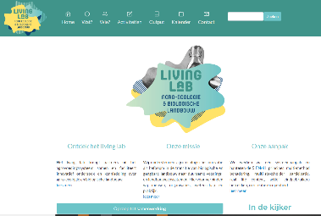
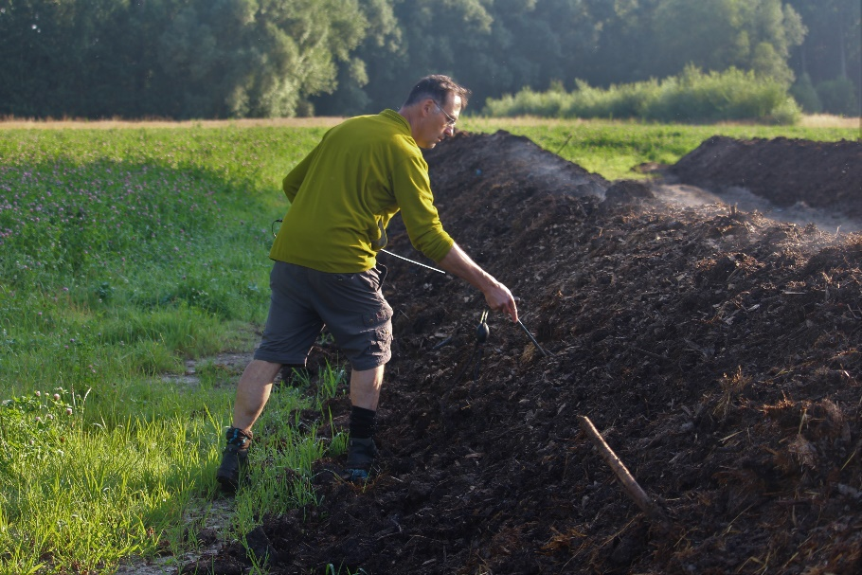
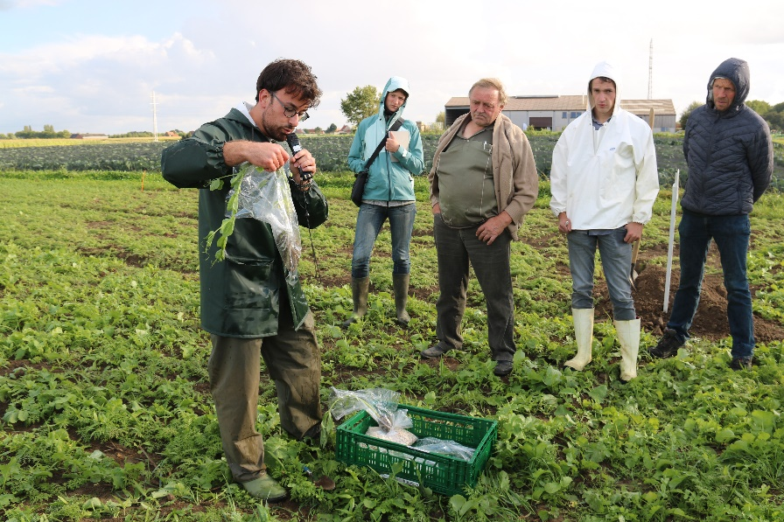
ICT and infrastructure
Website: www.llaebio.be
Newsletters and social media of partners
Linkedin group: https://www.linkedin.com/groups/12393194
Farmland for future projects
both on research sites of participants as on real farms

Slide 16
Ambitions
Grow as a living lab to boost co-creation between all actors
More farmers on board
More research funded for agroecological and organic research
Networking on EU level
Statement of a farmer about how living labs Agroecology can support agriculture
https://www.youtube.com/watch?v=Wm6bKTJ5W64&t=14s
Notes:
Youtube De groentelaar: Question of fair pricing 0:53 – 1:47
Importance of living labs: 11:47 – 3:41

Slide 17
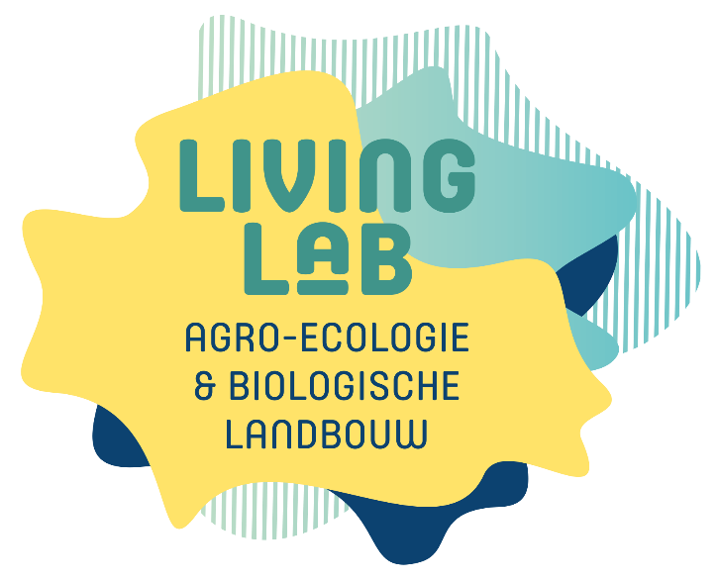






Instituut voor Landbouw-, Visserij-, en Voedingsonderzoek
Burg. Van Gansberghelaan 92
9820 Merelbeke – België
T + 32 (0)9 272 25 00
F +32 (0)9 272 25 01
www.ilvo.vlaanderen.be
llaebio@ilvo.vlaanderen.be
https://www.linkedin.com/groups/12393194
www.llaebio.be

