Slide 1
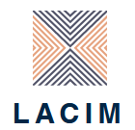



Maria Petrou
glottothèque
languages of Anatolia, Caucasus, Iran, Mesopotamia
Western Thrace Turkish
Introduction
Justus-Liebig-University of Giessen
Giessen, March, 2022
visit glottothèque at: https://spw.uni-goettingen.de/projects/lacim/

Slide 2
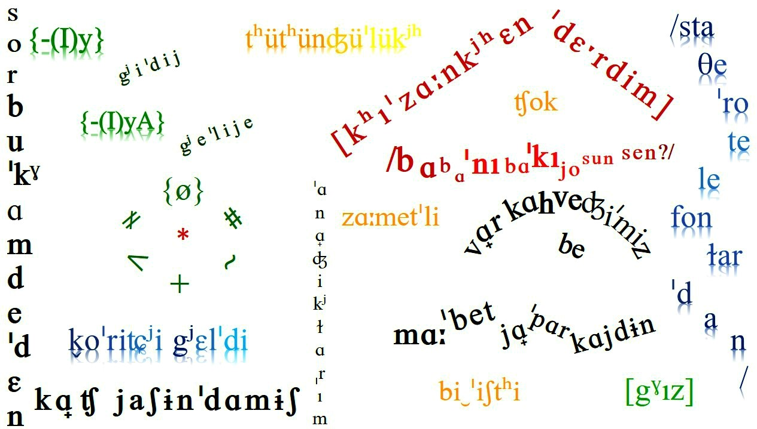
1 Introduction
2 Phonology and Phonetics
3 Morphology
4 Syntax

Slide 3
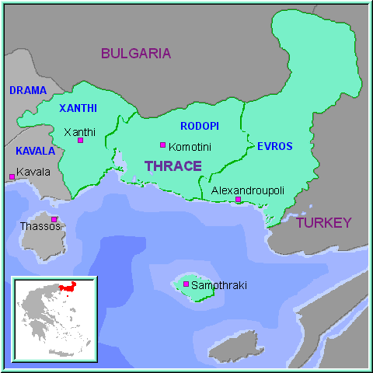
Geographical region

Slide 4
Balkan Turkish / Rumelian Turkish
West Rumelian
NW Bulgaria
N Romania
Macedonia
Kosovo
Bosnia
East Rumelian
Eastern Thrace
Western Thrace
NE + S Bulgaria
SE Romania
+ Gagauz

Slide 5
Western Thrace Turkish (WTT)
Balkan Turkish dialects
West Rumelian dialects
East Rumelian dialects
WTT
Regional varieties = Basilect
Town varieties
= Acrolect
Mesolect

Slide 6
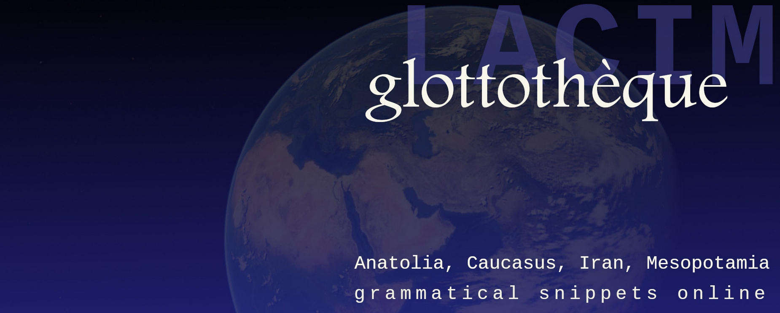
this lecture
is part of the series Glottothèque: Languages of the Anatolia, Caucasus, Iran, Mesopotamia; grammatical snippets online, ed. by. C. Bulut, A. Donabédian-Demopoulos, G. Haig, G. Khan, P. Samvelian, S. Skopeteas, N. Sumbatova. Bamberg/Cambridge/Göttingen/Moskow/Nicosia/Paris: LACIM network.
You may find related lectures and further information at the Glottothèque website at:
https://spw.uni-goettingen.de/projects/lacim/

