Slide 1



Introduction to Metadata for Research Data management: The DDI Perspective
The DDI Training Working Group
29 April 2021
This work is licensed under Creative Commons Attribution 4.0 International License.

Slide 2
Some Obvious Questions…
Why should we care so much about metadata?
Isn’t it just “data about data”?
Shouldn’t we be focused on the data?

Slide 3
If You Care about Data, You Care about Metadata!
Metadata is what allows people to discover, assess, and navigate through collections of data
Metadata is what allows people to understand data
Metadata is what allows machines to process and manage data
Metadata is what allows people to harmonize, integrate, and reuse data
If you want FAIR data, you need metadata!

Slide 4
Metadata is the Limiting Factor
Your data is only as good as the metadata which describes it
Traditionally, research has focused on data supporting specific research
Now, the demand for larger, cross-cutting research projects places an emphasis on better data management
The answer to providing this is to have good, well-managed metadata!

Slide 5
Different Understandings and Definitions
Across research domains, the term “metadata” means many different things
We need to respect these differences…
We also need a shared understanding
The DDI community has spent decades understanding metadata, using it to manage data, and modelling it for implementation in systems
We do not have the only perspective – but we do have a proven, useful one!

Slide 6
Understanding Metadata

Slide 7
Contents
Defining Metadata
Data or Metadata?
Examples
Roles
Usage
Management
Summary

Slide 8
Defining Metadata

Slide 9
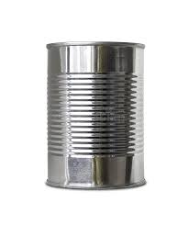
What is in this can?

Slide 10
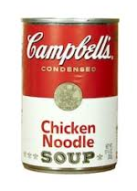
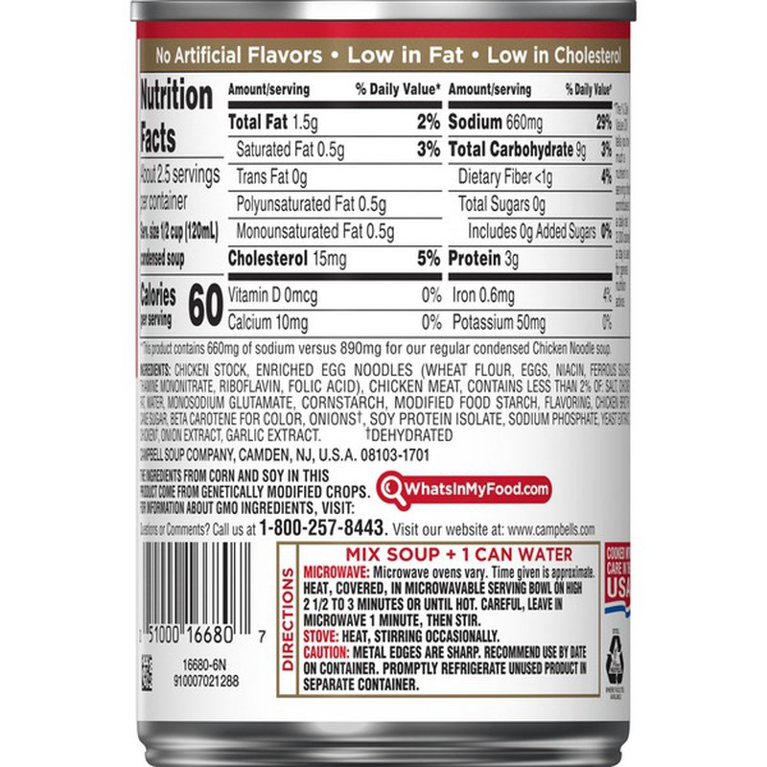
Now you know!

Slide 11
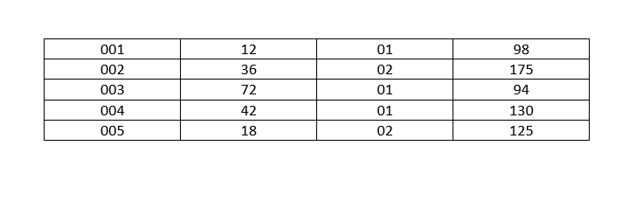
What do the numbers in this table mean?

Slide 12
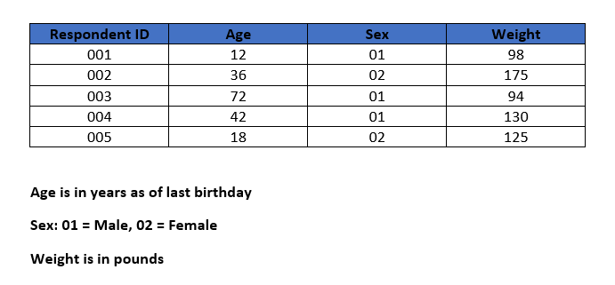
Metadata tells us!
Metadata

Slide 13
What Does “Meta” Mean, Anyway?
Metadata are descriptions or information about some thing(s)
Greek: μετά- is a prefix meaning
    Beyond
    After
    Transcending
Literally – metadata are beyond the thing(s) being described

Slide 14
Metadata Clarification
The numeric table –
  Metadata are
    Headings for the columns
    Descriptions of the values in each column
  They describe the table and the data in the cells
People define it as “data about data”, but…
The food can –
  Metadata are what is written in the label on the can
  They describe the contents of the can
Let’s look at this in more detail …

Slide 15
Metadata Defined – Not Just Data about Data
Metadata may be about data
  Numeric table example
Metadata may be about some other “things”
  Food can example
Requires broad view of metadata
  “Data about some resource”
Enhanced definition
  Metadata <-> data intended to be used for describing some object(s)

Slide 16
Data or Metadata?

Slide 17
Metadata or Data? It Depends!
Question – How do we intend to use the data?
  Microdata – data used to represent a population
    Not each individual respondent, but for producing statistics
  Administrative data – data used to manage a social program
    Data used to monitor eligibility and results
  Primary purpose of data is not to describe
Metadata are intended to describe
Data are intended to measure

Slide 18
Metadata versus Data
Consider microdata or administrative data
  Microdata –
    data collected from respondents in a statistical survey
    collected data are a description of each respondent
  Administrative data –
    data acquired as a result of managing some social program
    managed data are a description of each program participant
Why aren’t these metadata?
  In each case, data describe some things, but…
    Survey responses are used to measure characteristics of a population
    Administrative data are used to measure characteristics of the program participants

Slide 19
Metadata – A Role
Metadata is a role for data
No data are always metadata
  Data are metadata when they are used that way
Most (if not all) data can be used as metadata
Sometimes, data could be both metadata and data
  Depends on usage
  Same data, different perspective

Slide 20
Examples

Slide 21
Dublin Core Metadata Example
Dublin Core
  Commonly used metadata standard
  Dublin Core Metadata Element Set
    Originally 15 core elements
    Over 40 additional elements
  Developed by
    Online Computer Library Center – Dublin, OH
  Used in many digital libraries
    Museums, Book libraries
  Objects of interest:
    Museums – paintings, bones, pictures, documents, tools – not data
    Book libraries – books and magazines

Slide 22
Telephone Call Example (1)
Another example – telephone company data
  Telephone company knows
    Who called whom
    Whether connection is made or why it failed
    Length of connection
  But they don’t have the content of each conversation
Telephone data contains:
  One number was used to call another
    Including subscriber information of caller
  Date/time this occurred
  Whether a connection was made
  How long connection lasted

Slide 23
Telephone Call Example (2)
Use as data
  Build network of calls
    Nodes are phone number / subscribers
Use as metadata
  Part of the description of a particular phone call
The role the data play is crucial for making the distinction

Slide 24
Classification Scheme Example
Classification scheme entry
    Concept, code, definition, description, relationships
  Data for a classification database
  Data for construction of n-cubes, as element of a dimension
  Data for construction of stratified sample
  Metadata for user of a table as description (meaning) of a cell
  Metadata for user of data based on the stratified sample

Slide 25
Roles

Slide 26
Roles of Metadata
Metadata supports 3 main uses:
  Discovery - find relevant resources (e.g., data)
  Understandability - convey the semantics of resources
  Usage - describe limits of reasonable use
Above uses are roles
  Variables apply in all three cases
  So do data sets
  Therefore, structures of data do as well
But these are definitely not the only roles

Slide 27
Usage

Slide 28
What Do We Want to Describe?
Metadata may be used to describe …
Data
Variables
Segments
Value Domains
Classification schemes
Code lists
Questions
Questionnaires
Instruments
Collection process
Sample design
Weighting
Data transformations
Editing procedures
Machine Learning methods
Allocation
Estimation
Disclosure control

Slide 29
Uses of Metadata - Simple
Document descriptions of statistical objects
  Promote records management
Provide means of comparison across
  Objects (e.g., classification schemes)
  Programs, experiments, studies
  Time
  Organizations
  Subject areas (including within broad domains)
  Cultures (especially languages)
  Political entities (e.g., countries)

Slide 30
Uses of Metadata - Enhanced
Create new descriptions of more complex objects
  Descriptions of variables used to describe each data set
  Descriptions of questions used to describe question form or questionnaire
Promote reuse – “describe once, use many”
  Increase comparability
  Reduce inconsistency
    Avoid gratuitous differences
  Increase quality
  Reduce future burden
  Reduce costs

Slide 31
Uses of Metadata - Advanced
Promote machine-readable metadata
  Avoid using long prose documents
  Implement machine-readable formats (e.g., XML, JSON)
  Strive towards metadata-driven processing
  Machine-actionable metadata
Promote concept management
  Note how and where concepts are used
    E.g., Concept, Universe, Category, Variable
  Link similar meanings
  For definitions, use principles defined in
    ISO 704 (Terminology – Principles and methods)
    ISO/IEC 11179-4 (Information technology — Metadata registries (MDR) — Part 4: Formulation of data definitions)
  For terminological approach to data and metadata, based on ISO 704

Slide 32
Management

Slide 33
Managing Metadata
Metadata are data
  Metadata can be managed in a database
    A metadata repository is a database of metadata
    Metadata is also often stored in data repositories
Relational, Object-oriented, Graph / Network, Other?
  Depends on several factors
    Available software
    Current expertise
    Integration with other systems
    Time frame
    Costs
    Risks

Slide 34
Benefits of Managed Metadata
More consistency in the production and dissemination of data
  More comparable data
  More understandable data
  More FAIR data
Assessing and ensuring data quality
Organizational efficiency
  Reuse of metadata assets
  Better design, implementation, and execution of processes
  Increased automation

Slide 35
Summary
Definition of metadata
  data intended to be used for describing some object(s)
Compare with data
  When are data metadata? It depends.
Roles
  Metadata can be used for multiple purposes (administrative, semantic, etc.)
Uses
  Human readable documentation
  Sharing metadata and reusable descriptions
  Concept management and machine-readable metadata
Management
  Metadata are data, so they may be managed similarly

Slide 36
DDI Products and Evolution

Slide 37
DDI Metadata – Evolution
DDI has been producing specifications for metadata in RDM for more than 2 decades
Our understanding of metadata has evolved
Our suite of products has grown to support more aspects of RDM
The evolution is ongoing

Slide 38
DDI: Major Specifications
DDI Codebook (aka “DDI 1.0”, “DDI 1.2”, “DDI 2.5”, etc.)
DDI Lifecycle (aka “DDI 3.0”, “DDI 3.1”, “DDI 3.3”, etc.)
DDI Cross Domain Integration (aka “DDI-CDI”)

Slide 39
DDI Codebook
An XML description of a “codebook” (a data dictionary)
  Rectangular files
  No concept of metadata reuse
  Based on models in existing analysis tools (Stata, SPSS, SAS, etc.)
Included Dublin Core and descriptive “study-level” metadata
Machine-readable (slightly machine-actionable…)
Described data for a single study (one point in time)
After-the-fact description to support archiving and reuse

Slide 40
DDI Lifecycle
Major expansion
  Describe multiple waves for longitudinal/repeat data collection
  Describe comparison and harmonization
  Describe data collection and survey instruments
  Describe the entire data lifecycle
Reuse of metadata was central to these functions
  Support for centralized metadata management
Focus still primarily on rectangular data
XML encoding
  Machine-readable
  Machine-actionable

Slide 41
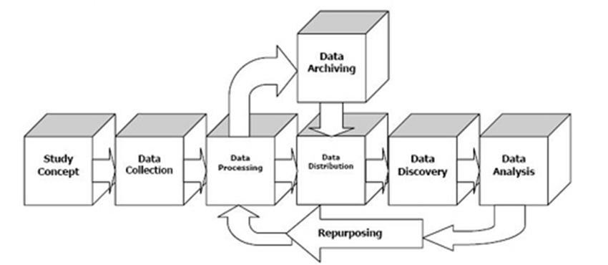
The DDI Lifecycle Diagram (Original Version)

Slide 42
An Important Change…
DDI Codebook allowed you to reference Concepts from variable descriptions
DDI Lifecycle provided full-blown support for describing Concepts and reusing them
  Referenced by Variables
  Referenced by Categories in Classifications/Codelists
  Referenced by Units/Populations/Universes
With the popular “semantic” technologies, Concepts become central
  SKOS is the most-used vocabulary in the RDF world
  Basis of sematic mapping between organizations/domains

Slide 43
DDI Cross-Domain Integration (DDI-CDI)
An extension of the metadata set found in DDI-C and DDI-L
  Not a replacement!
  Will be released Summer 2021
Provides support for additional types of data
  Long data/sensor data/event data
  Multi-dimensional data/data “cubes”
  Key-Value data/No SQL data/”big” data
Provides support for describing process and provenance across data sets as data is reused/harmonized/integrated
Very Concept-rich
Focus is on individual “Datums”
Model-based (UML), not just XML
  Emphasis on machine-actionable metadata!

Slide 44
Contact
E-Mail:
ddi-train@googlegroups.com
Contact form:
https://ddialliance.org/learn/request-a-training-session

Slide 45
Questions?

Slide 46
Credits: DDI Training Working Group
  Florio Orocio Arguillas
  Alina Danciu
  Adrian Dusa
  Jane Fry
  Martine Gagnon
  Dan Gillman
  Arofan Gregory
  Taras Günther
  Lea Sztuk Haahr
  Chifundo Kanjala
  Kaia Kulla
Kathryn Lavender
Amber Leahey
Jared Lyle
Alexandre Mairot
Laura Molloy
Lucie Marie
Hayley Mills
Hilde Orten
Anja Perry
Knut Wenzig

