Slide 1
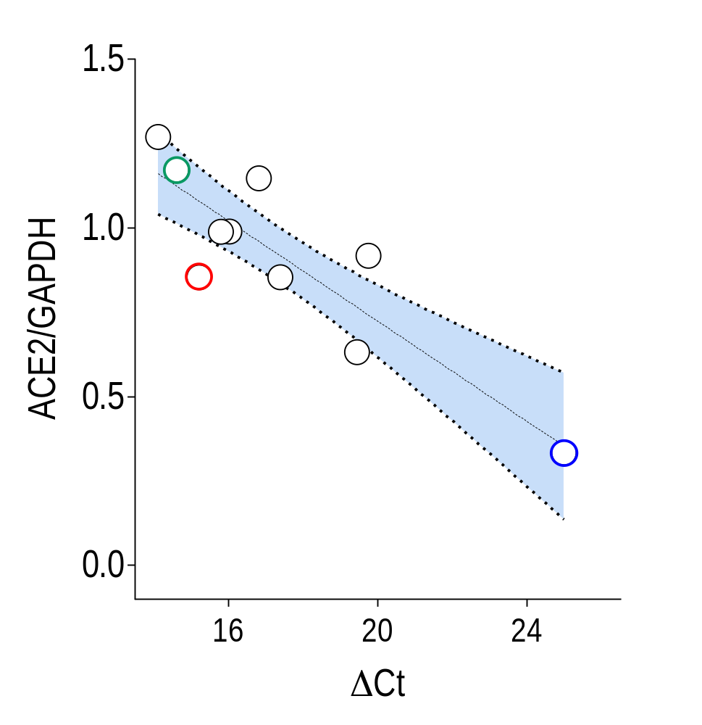
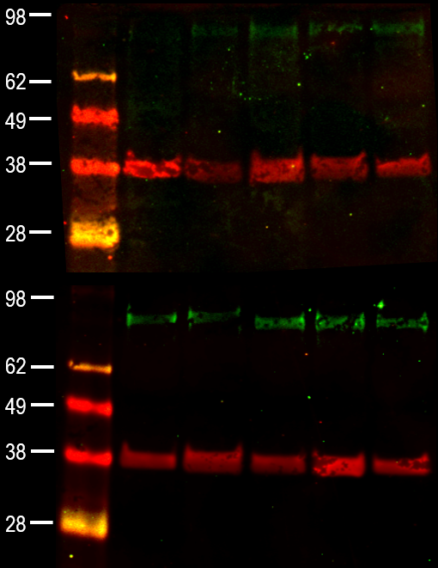
A
Lo
kDa
1
2
3
4
5
Mid
86
Hi
37
86
r_{p}= - 0.87
P = 0.0008
37
6
7
8
9
10

Slide 2
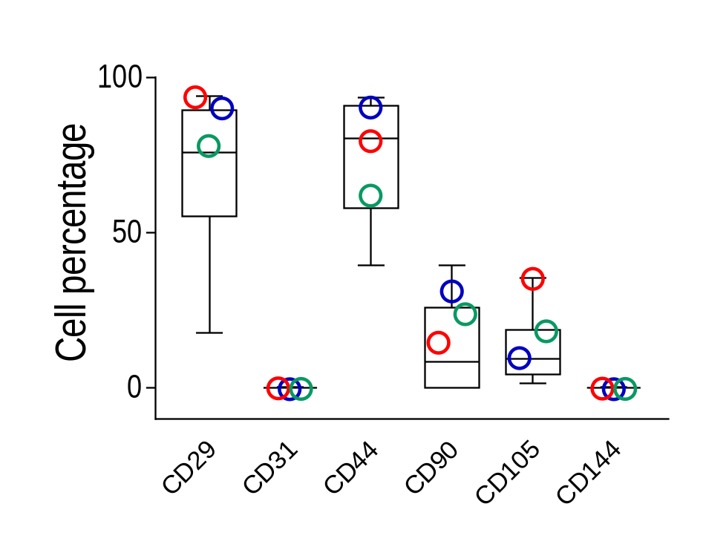
B
1000
80
80
Counts
Counts
SSC
0
0
0
0
FSC
1000
0
CD29
10⁶
0
CD44
10⁶
Lo
80
100
Mid
Hi
Counts
Counts
0
0
0
CD90
10⁶
0
CD105
10⁶

Slide 3
C
CTRL - ACE2 ‘Hi’ – 72hr
MOI 1 – ACE2 ‘Hi’ – 72hr
200µm
200µm
100µm

Slide 4
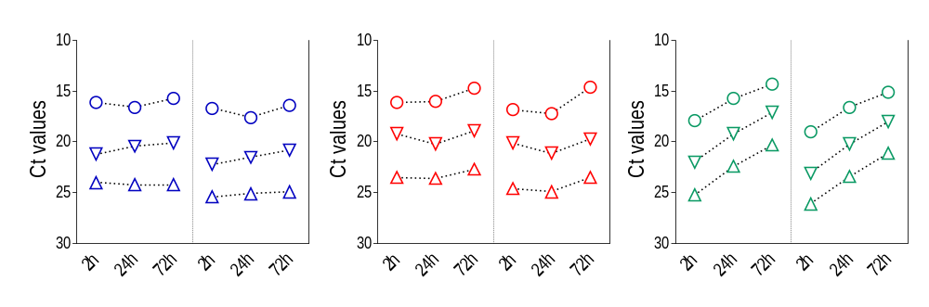
D
0.1 MOI
1 MOI
10 MOI
Spike
ORF-1
Spike
ORF-1
Spike
ORF-1

Slide 5
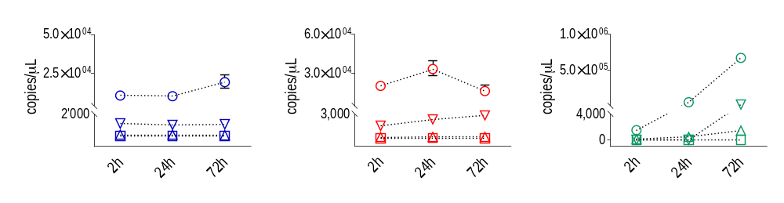
E
CTRL
0.1 MOI
1 MOI
10 MOI
N2
N2
N2

Slide 6
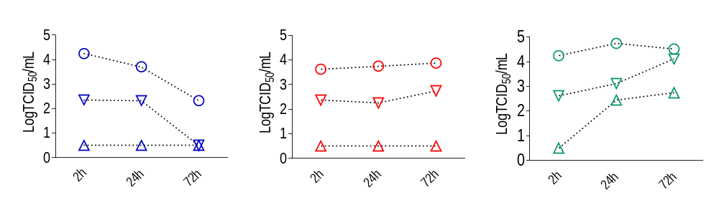
F

Slide 7
S1
CTR
2h – moi 1 SN ‘Hi’
24h – moi 1 SN ‘Hi’
72h – moi 1 SN ‘Hi’

Slide 8
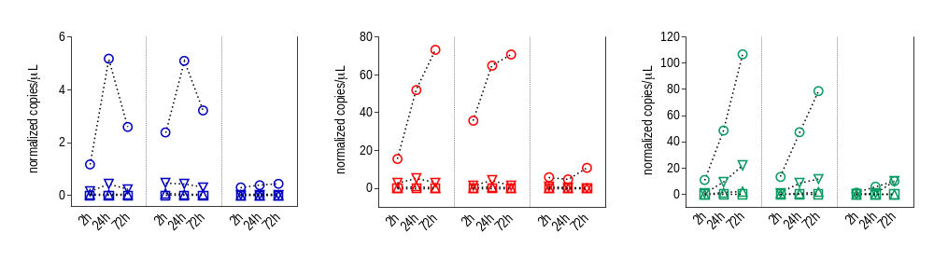
A
CTRL
0.1 MOI
1 MOI
10 MOI
N2
E
RdRP
N2
E
RdRP
N2
E
RdRP

Slide 9
B
DAPI
αSMA
SARS-CoV-2
Collagen1
DAPI
αSMA
ACE2 ‘Lo’ - CTRL
50µm
ACE2 ‘Hi’ - CTRL
50µm

Slide 10
C
DAPI
αSMA
SARS-CoV-2
50µm
50µm
50µm
ACE2 ‘Lo’
ACE2 ‘Hi’
ACE2 ‘Hi’

Slide 11
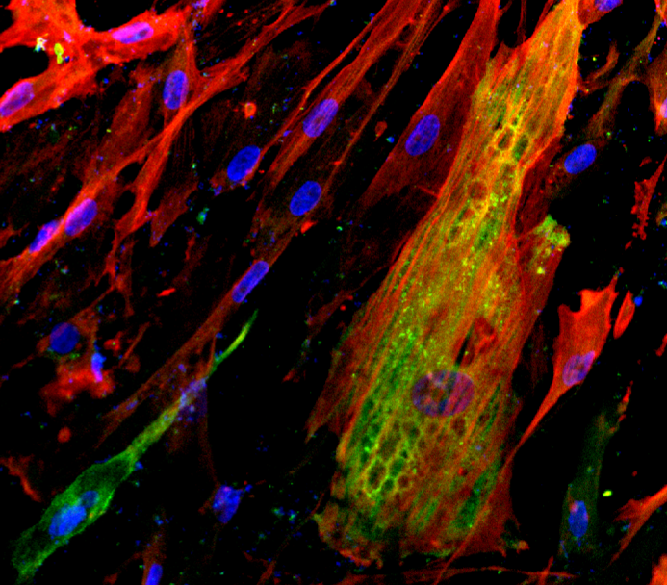
D
DAPI
αSMA
SARS-CoV-2
50 µm
10 µm
ACE2 ‘Hi’

Slide 12
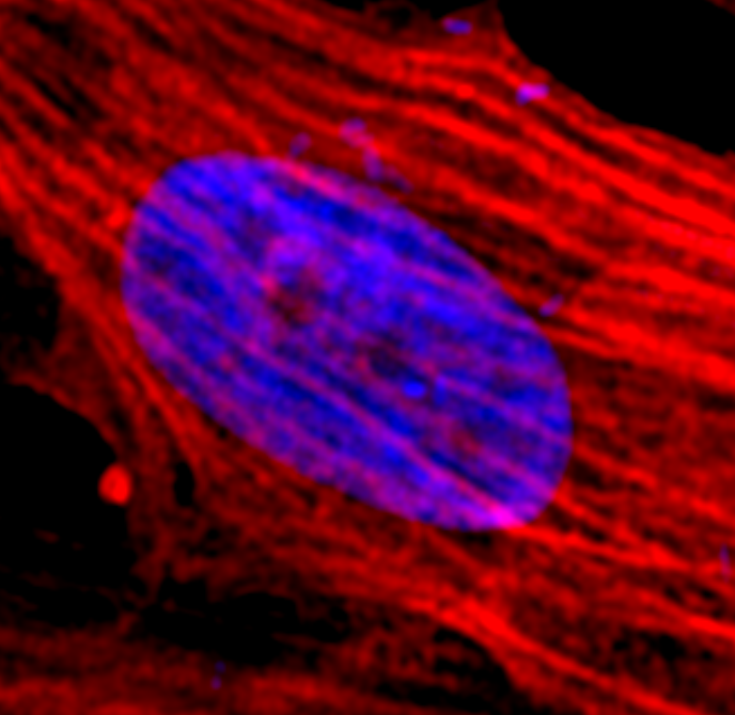
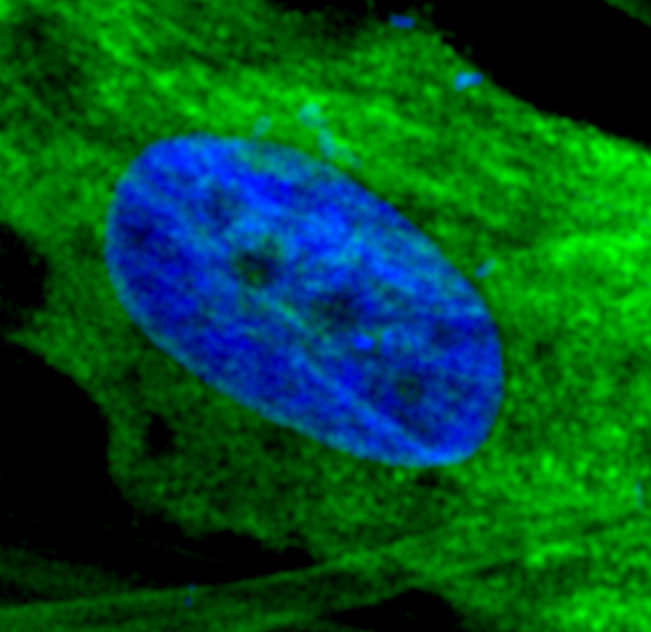
E
DAPI
αSMA
SARS-CoV-2
ACE2 ‘Hi’
ACE2 ‘Hi’
5µm
5µm

Slide 13
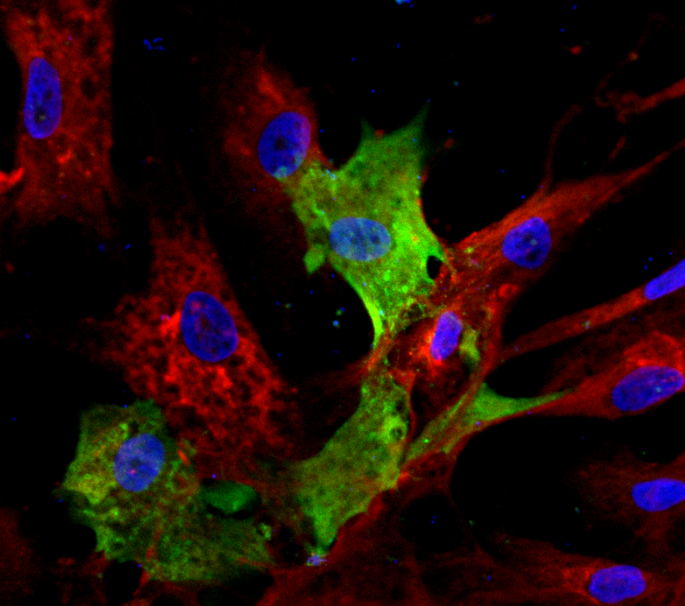
F
DAPI
Collagen1
SARS-CoV-2
DAPI
αSMA
SARS-CoV-2
0µm
3.5µm
ACE2 ‘Hi’
50µm
0µm

Slide 14
A
-1.5
1.5
‘Mid’
‘Lo’
‘Hi’
‘Lo’
‘Mid’
‘Hi’
‘Mid’
‘Lo’
‘Hi’
2hr
24hr
72hr

Slide 15
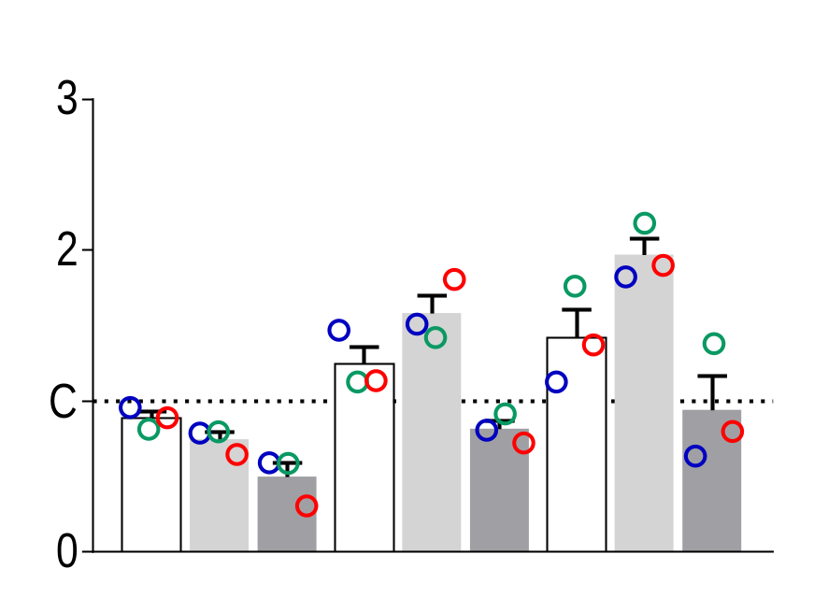
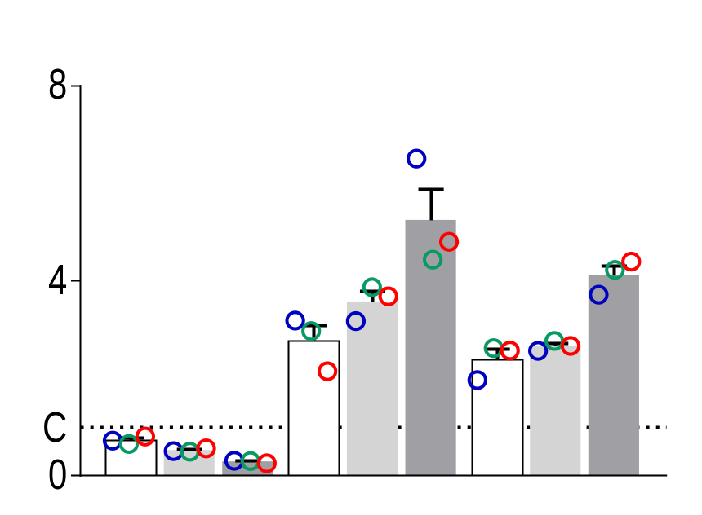
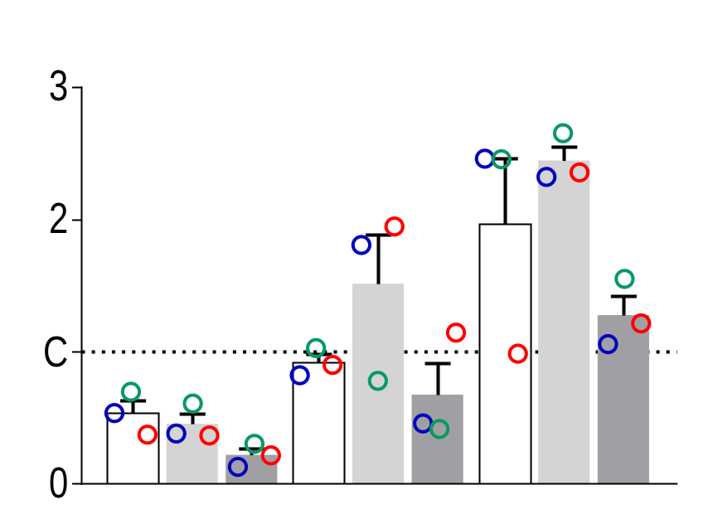
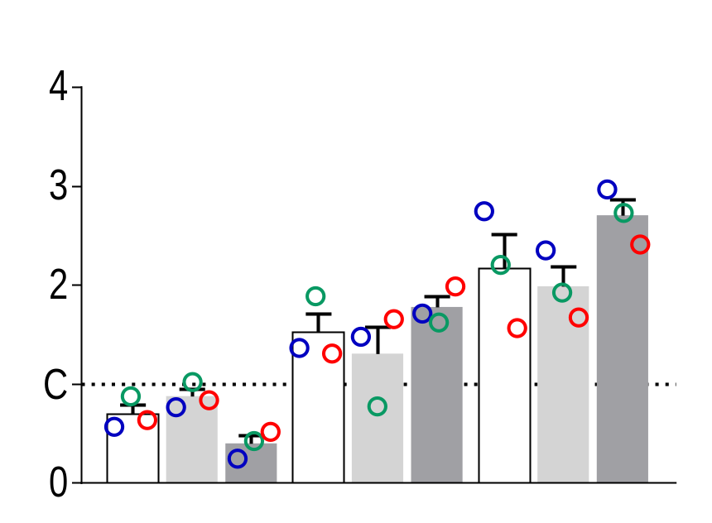
B
CTGF
ACTA-2
*
*
0.1
*
0.1
*
1
1
*
*
10
10
*
*
Fold Change (2^{-ΔΔCt})
Fold Change (2^{-ΔΔCt})
2h
24h
72h
2h
24h
72h
Col1A
*
Col3A
*
*
*
0.1
0.1
1
1
Fold Change (2^{-ΔΔCt})
10
Fold Change (2^{-ΔΔCt})
10
2h
24h
72h
2h
24h
72h

Slide 16
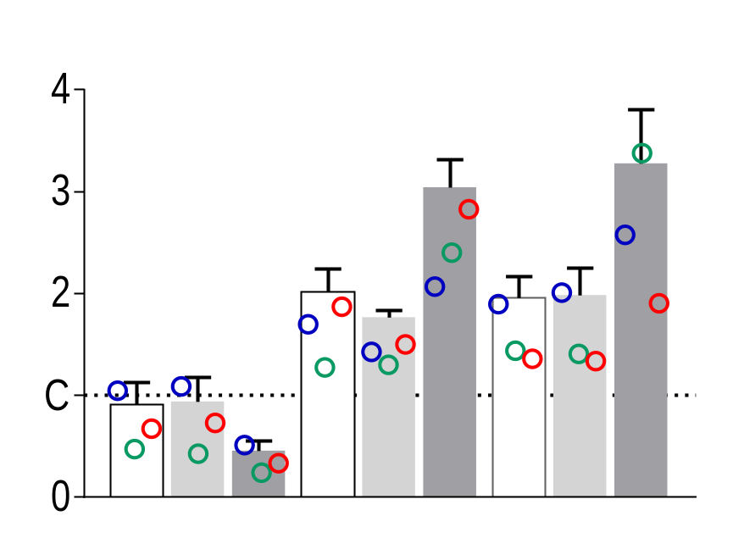
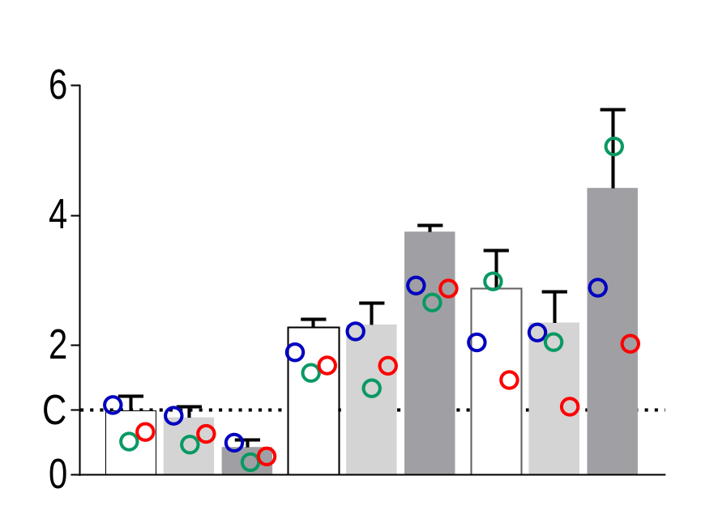
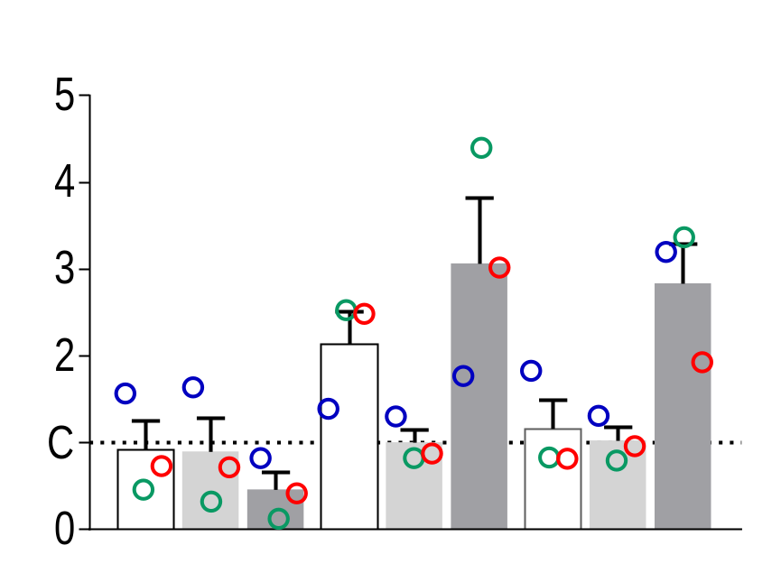
C
IL-1β
*
*
*
CCL2/MCP1
IL-6
0.1
*
*
0.1
*
*
*
0.1
*
1
*
*
1
1
10
10
*
*
10
*
Fold Change (2^{-ΔΔCt})
Fold Change (2^{-ΔΔCt})
Fold Change (2^{-ΔΔCt})
2h
24h
72h
2h
24h
72h
2h
24h
72h

