Slide 1

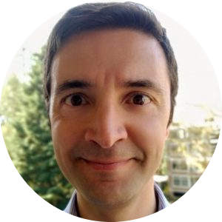
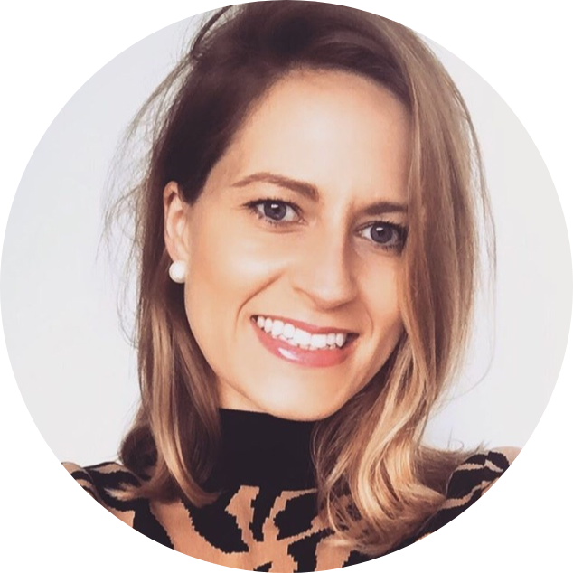
JupyterFAIR
Rewarding Open Science, Team Science and Collaborative Approaches
Serkan Girgin
Head of the Center of Expertise in Big Geodata Science, ITC
University of Twente
s.girgin@utwente.nl
Connie Clare
Community Manager
4TU.ResearchData
c.e.clare@tudelft.nl
4th February 2022
Rewards and Recognition Festival
Notes:
Storyset colour: FF9200
Serkan to start - should we introduce ourselves at the beginning

Slide 2
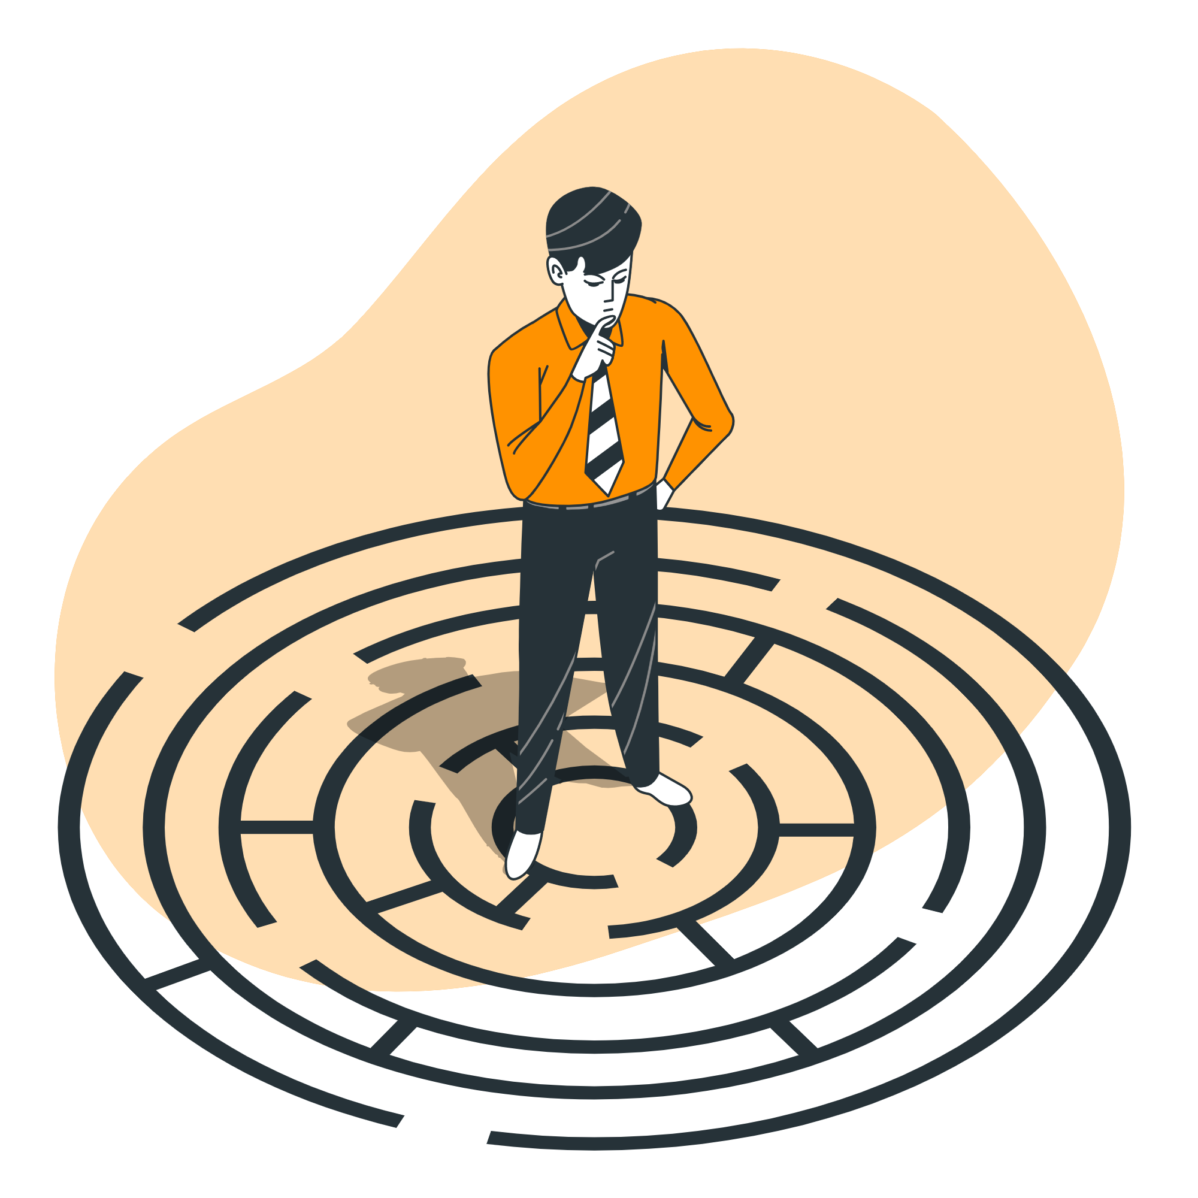
The problems
Research data are produced during the whole research lifecycle
Data publication and sharing happens mostly at the end
Lacks important metadata
Manual data publication takes time and effort!
VREs facilitate research and research data production
They are well connected to some infrastructure, e.g. code repositories
VREs are not connected to data repositories
https://storyset.com/

Slide 3

The solution
Seamless integration of VREs and data repositories
Direct data transfer from VRE
Less data input through forms
Automatic metadata generation
Onsite data quality checks
Less time & effort for publishing
More frequent data sharing at various stages of research lifecycle
Improved quality of shared data
https://storyset.com/

Slide 4
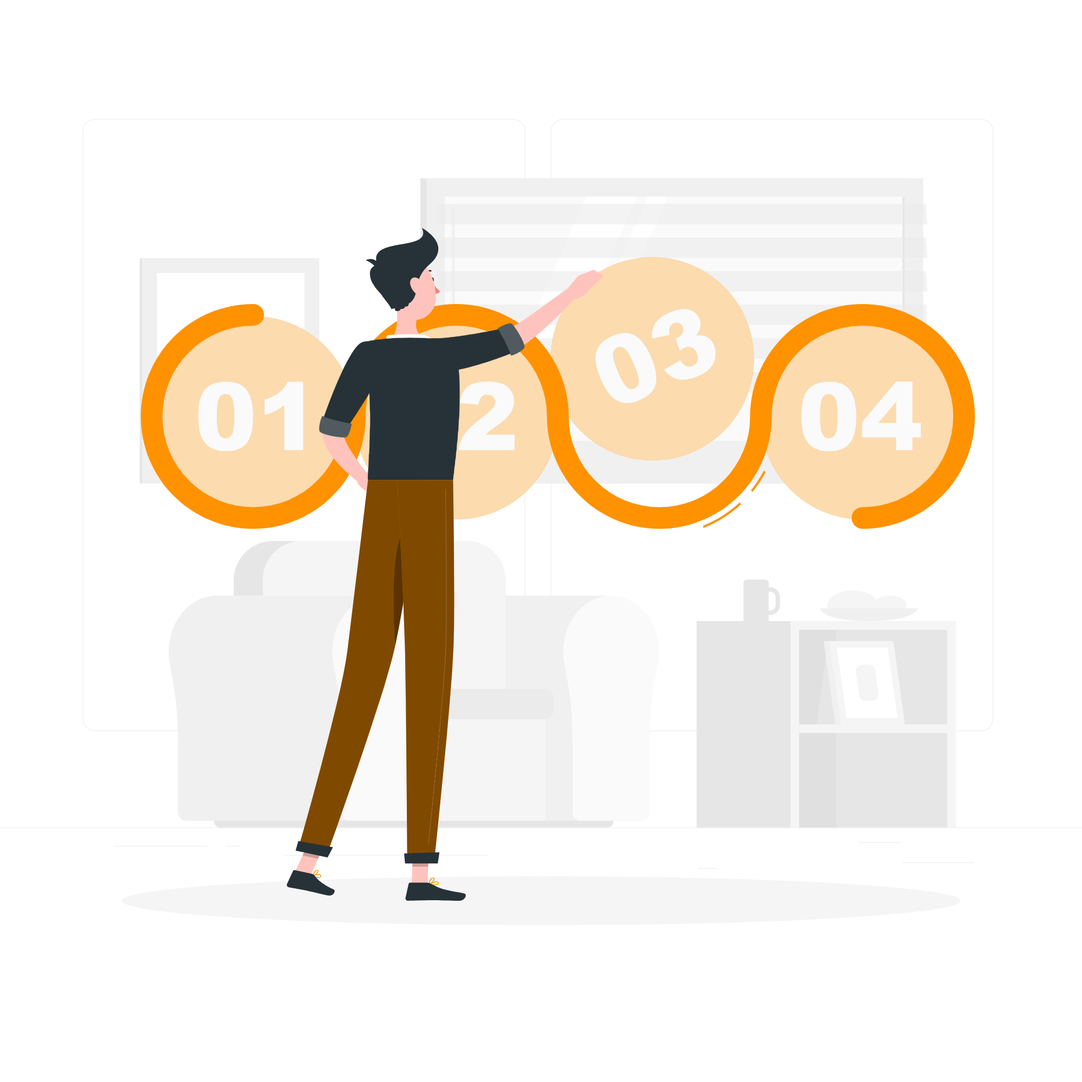

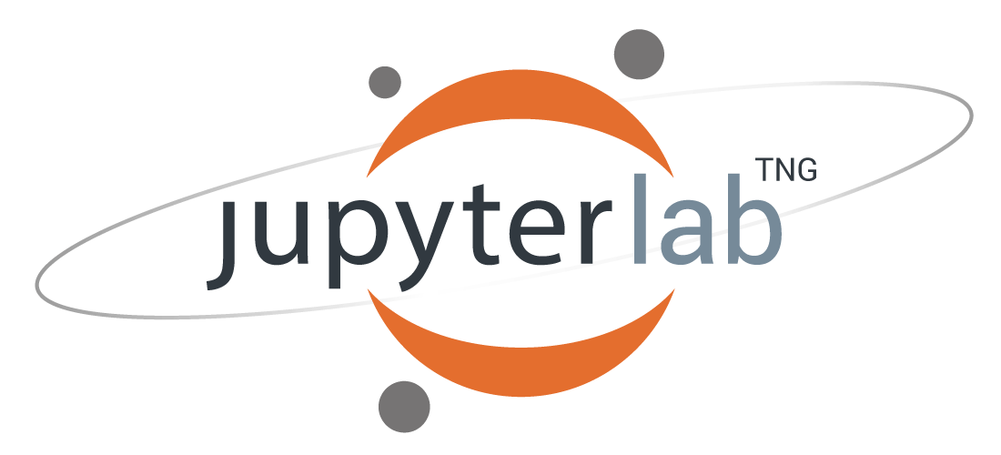
The project
Development of a JupyterLab extension that allows taking snapshot of research data and publishing it in a Data Repository
A methodology to integrate VREs to research data repositories
JupyterFAIR: A modular and expandable open-source software that implements the methodology
Demonstration at 4TU.ResearchData and ITC Geospatial Computing Platform
Technical and practical documentation and end-user training
https://storyset.com/

Slide 5

Collaboration and ‘team science’
We are lowering the barrier for researchers to create FAIR data.
BUT…
Good infrastructure on its own is not enough to make research data FAIR.
We need to work with people
(so they use it!)
https://storyset.com/
Notes:
Connie
Various aspects of our project are centered around collaboration and team science. We realise that we are developing a technical integration between JupyterLab and 4TU.ResearchData which will lower the barriers and the labour intensive manual steps to make their research data FAIR.. BUT, we must also appreciate that having this good technical infrastructure alone is not enough to make research data FAIR - we need to work with people… we need to work with different data supporters and researchers to make this integration a success.

Slide 6
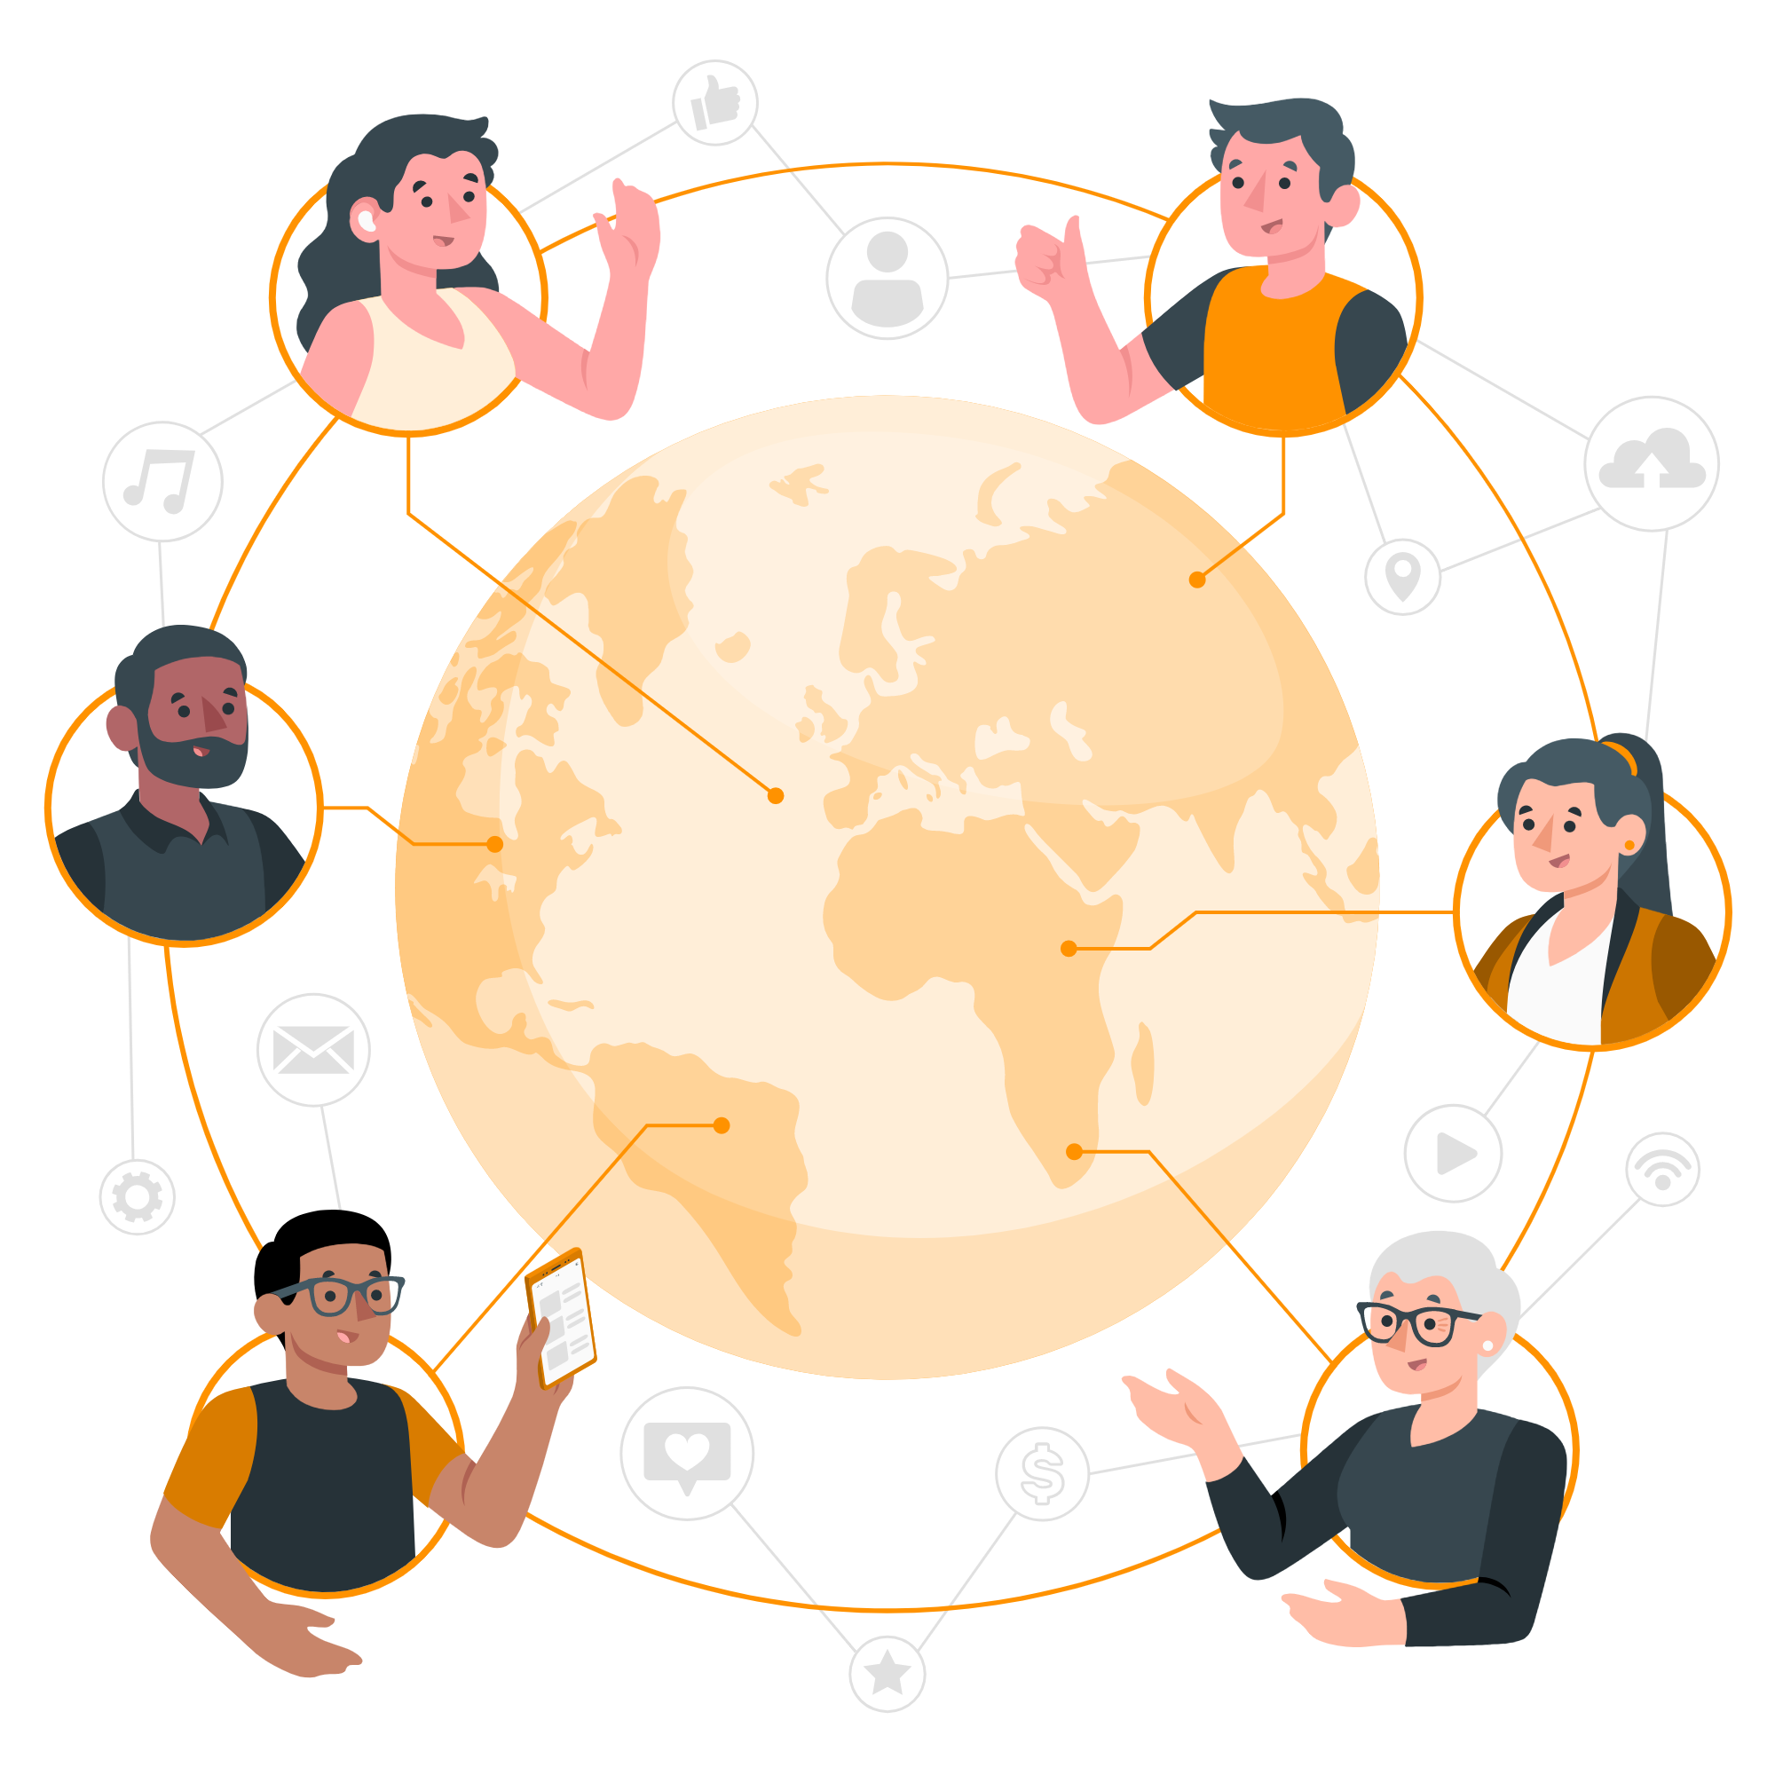
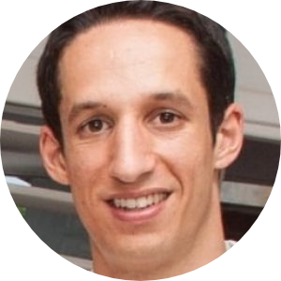
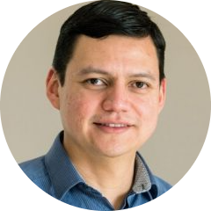
Our team
José Carlos Urra Llanusa
Research Software Engineer
TU Delft Digital Competence Centre
Connie Clare
Community manager
4TU.ResearchData
Researchers
User community Geospatial Computing Platform (GCP)
& 4TU.ResearchData
Data Supporters
4TU.ResearchData technical team, data stewards & other orgs!
Manuel Garcia
Research Software Engineer
TU Delft Digital Competence Center
Serkan Girgin
Assistant Professor
U/Twente ITC CRIB
https://storyset.com/
Notes:
Connie
And when it comes to people, a good place to start is by introducing our cross-institutional and multidisciplinary team who are collaborating as part of this project.
One of the reasons we believe our project was successful in receiving an NWO Open Science Fund is because we are four members who each contribute diverse and valuable skills and expertise to solve a scientific challenge. We have myself and Serkan here today, but we also work with Jose and Manuel who are research software engineers working at TU Delft’s Digital Competence Centre. And our collaboration moves broader as this teams since it aims to involve the research community; who are users of Jupyter Lab and interested in making their data FAIR, and also data stewards from the 4TU.ResearchData community who can help us with various testing and engaging the researchers, too. So this really will be a significant community effort.

Slide 7
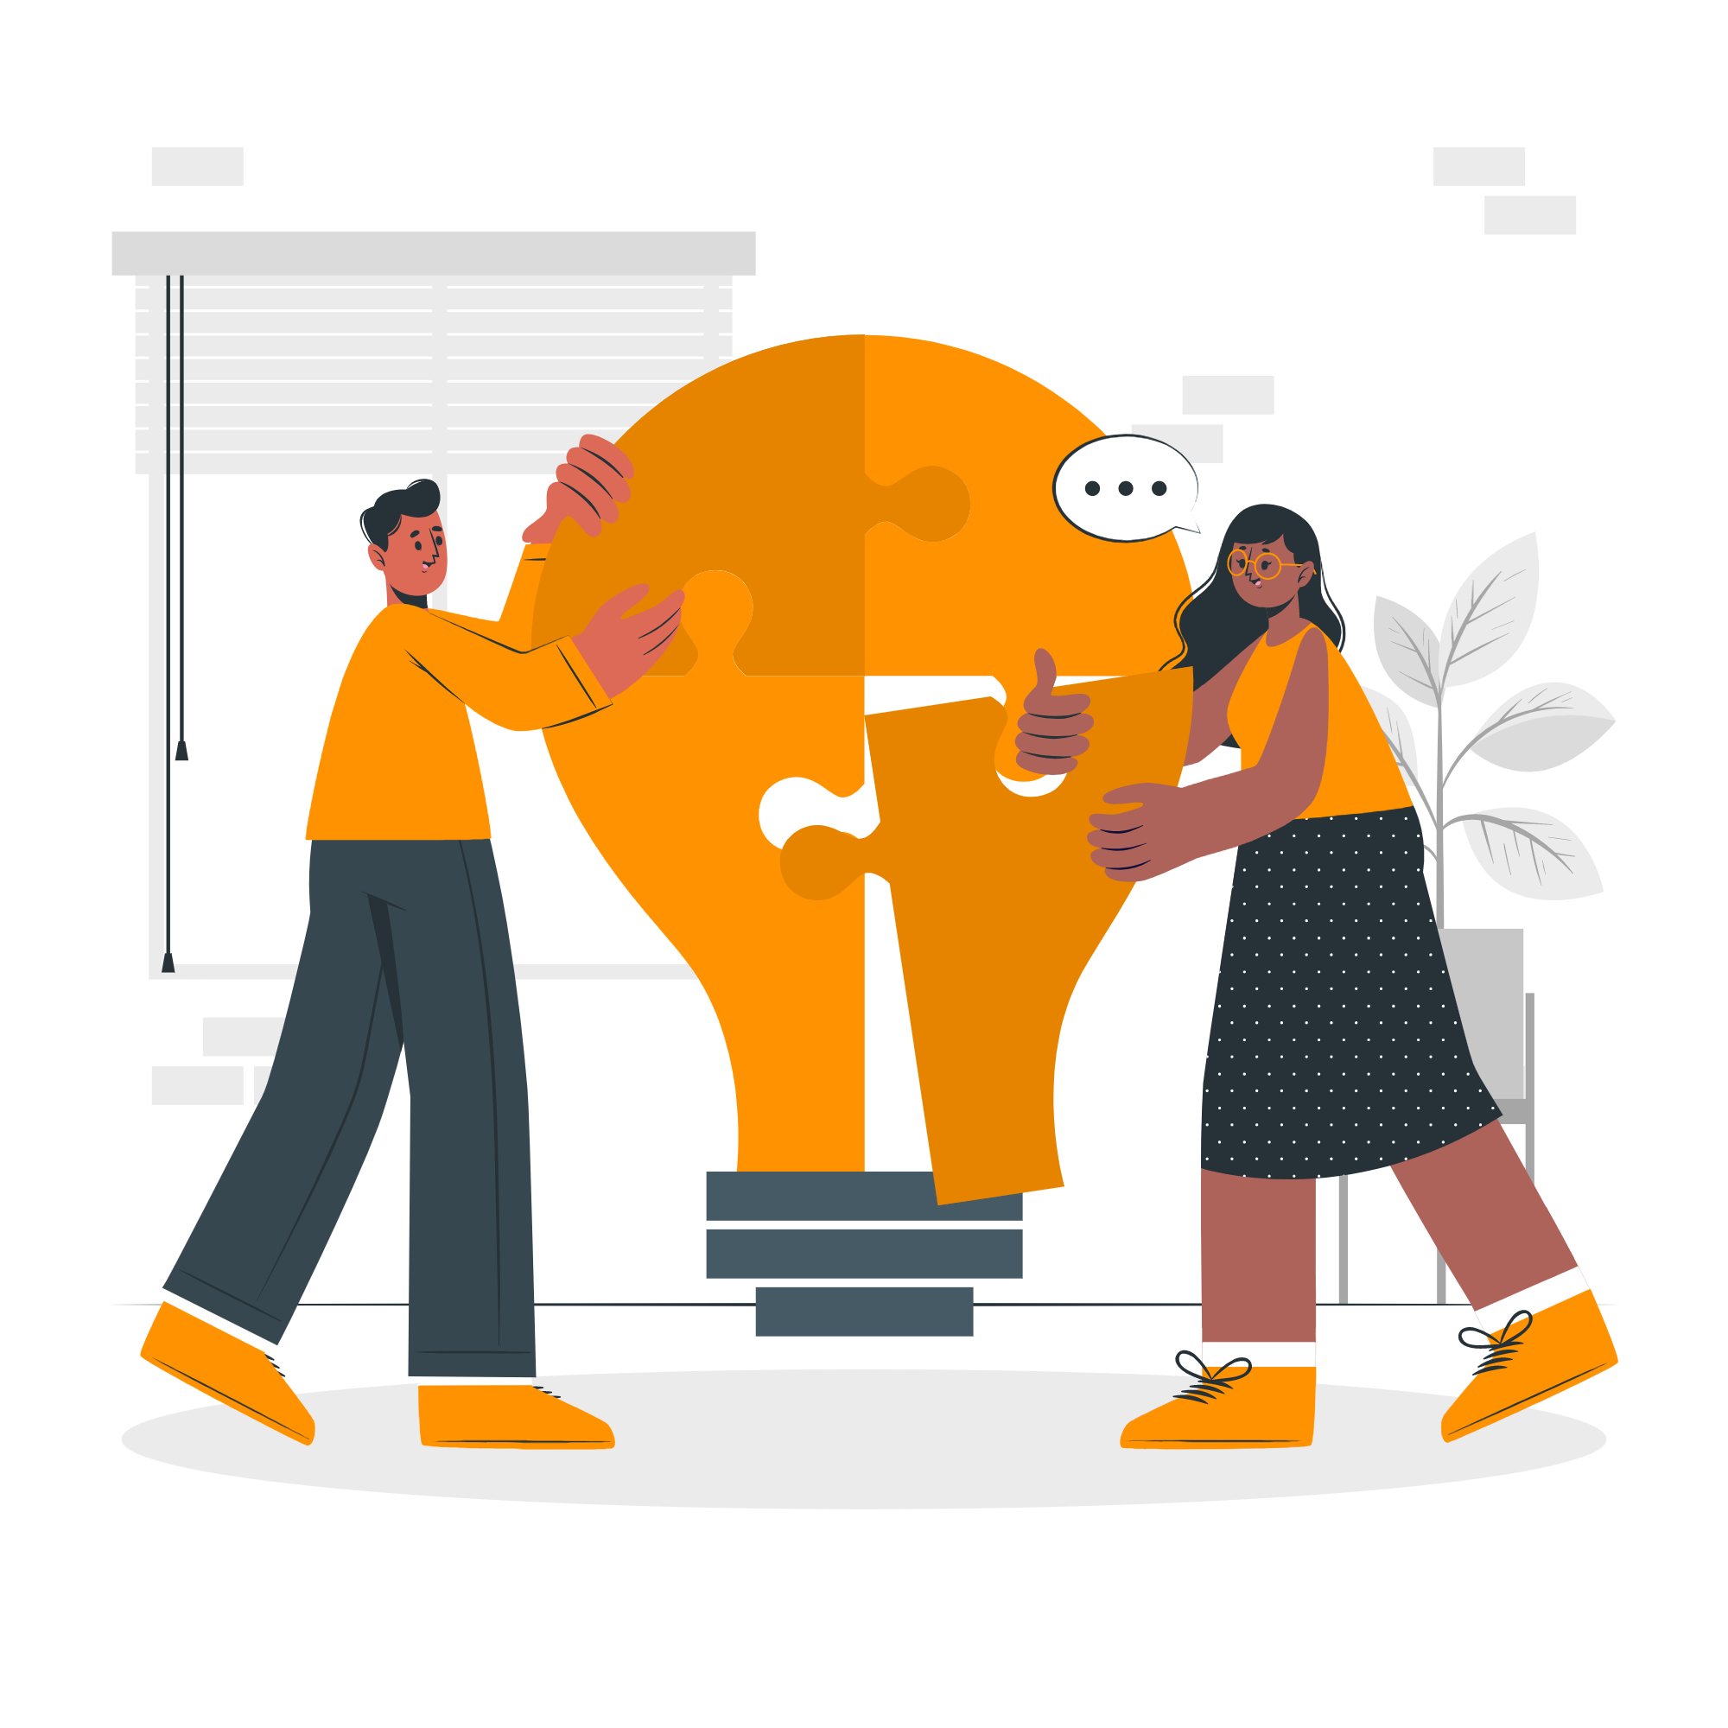
Why is community so important?
System design & analysis
  Methodology driven by the user needs for reuse and reproducibility by various communities.
System deployment & test-driven development
  Receive direct user feedback, correct problems and improve features from the onset!
Dissemination
  Provide user documentation, tutorials, training workshops, and blogs to educate, support widespread use and long-term sustainability.
Community will continue the project after funding ends!
https://storyset.com/
Notes:
Connie
So, why is community so important for this project?
You can see that community building is critical for various stages of our project. During the system design and analysis phase, we will create a generic open-source methodology of the integration so that various communities can reuse and reproduce our work. This will require a collaboration between software developers within our team with inputs from the 4TU.ResearchData technical team since we will need to access the API and create an interoperable integration that is modular and extendable across various platforms.
The system will then be deployed within the geospatial computing platform within the Geoinformation science and earth observation faculty at the university of twente where there are already more than 700 users; we will also invite researchers and data support staff within the 4TU.ResearchData community to participate in the test-driven development whereby they test the integration during various phases to provide direct user feedback and help to correct problems and improve features.
During the dissemination phase it will be important that we engage with the community by providing user documentation, tutorials, training workshops, conferences and blogs to educate users, encourage widespread use and promote long-term sustainability. The community will continue the project after the funding ends…

Slide 8
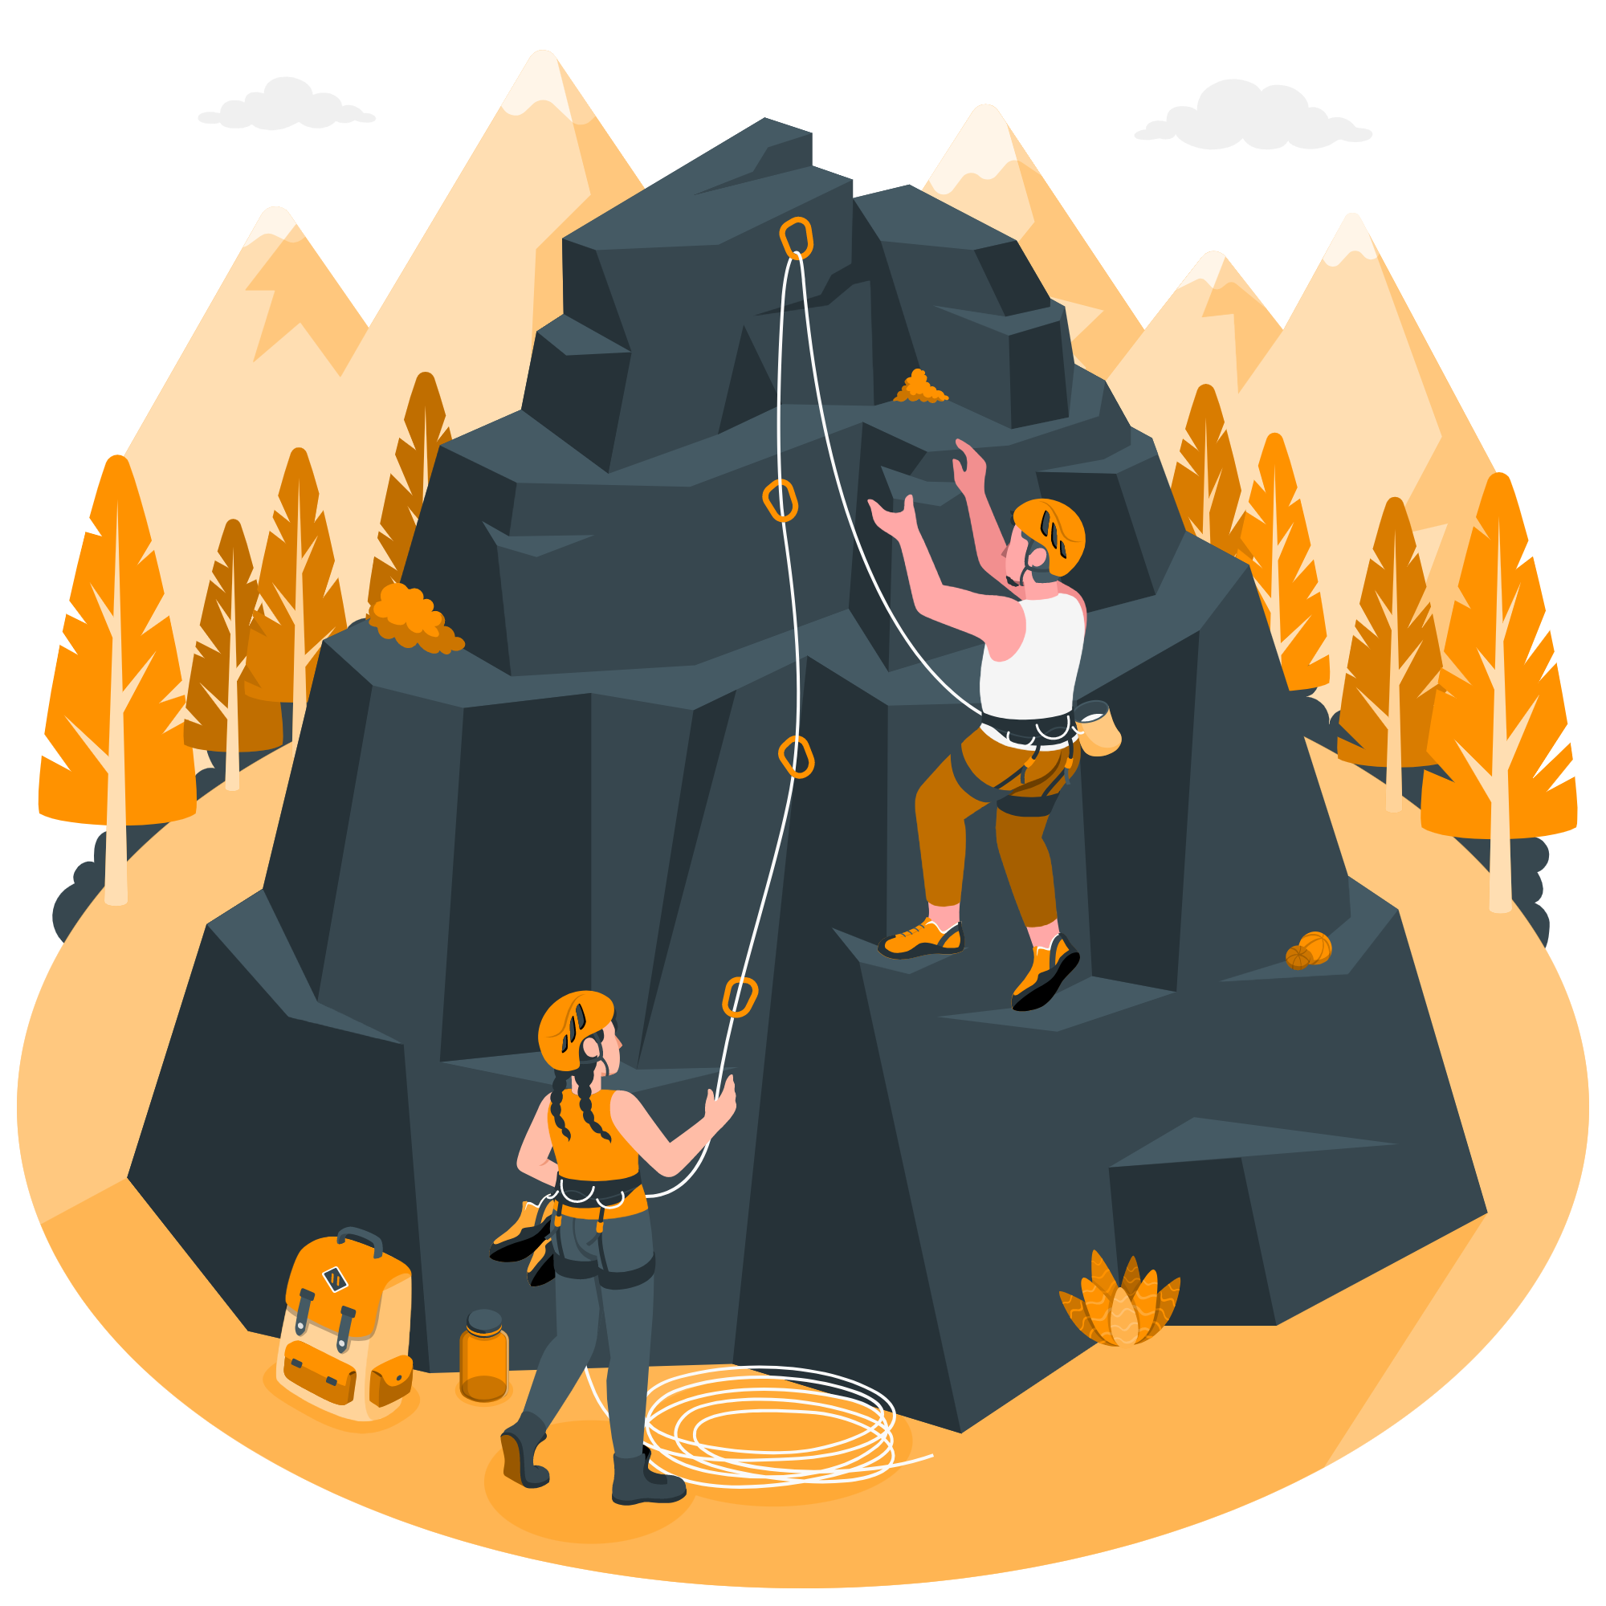
The road ahead…
Community building…
Collaboration…
Team science…
It’s a challenge!
BUT…
It’s the way forward for Open Science!
https://storyset.com/
Notes:
Connie
As a final slide to share my own personal perspective is that community building, multidisciplinary collaboration and team science is a challenge.. But, its the way forward for OS!

Slide 9
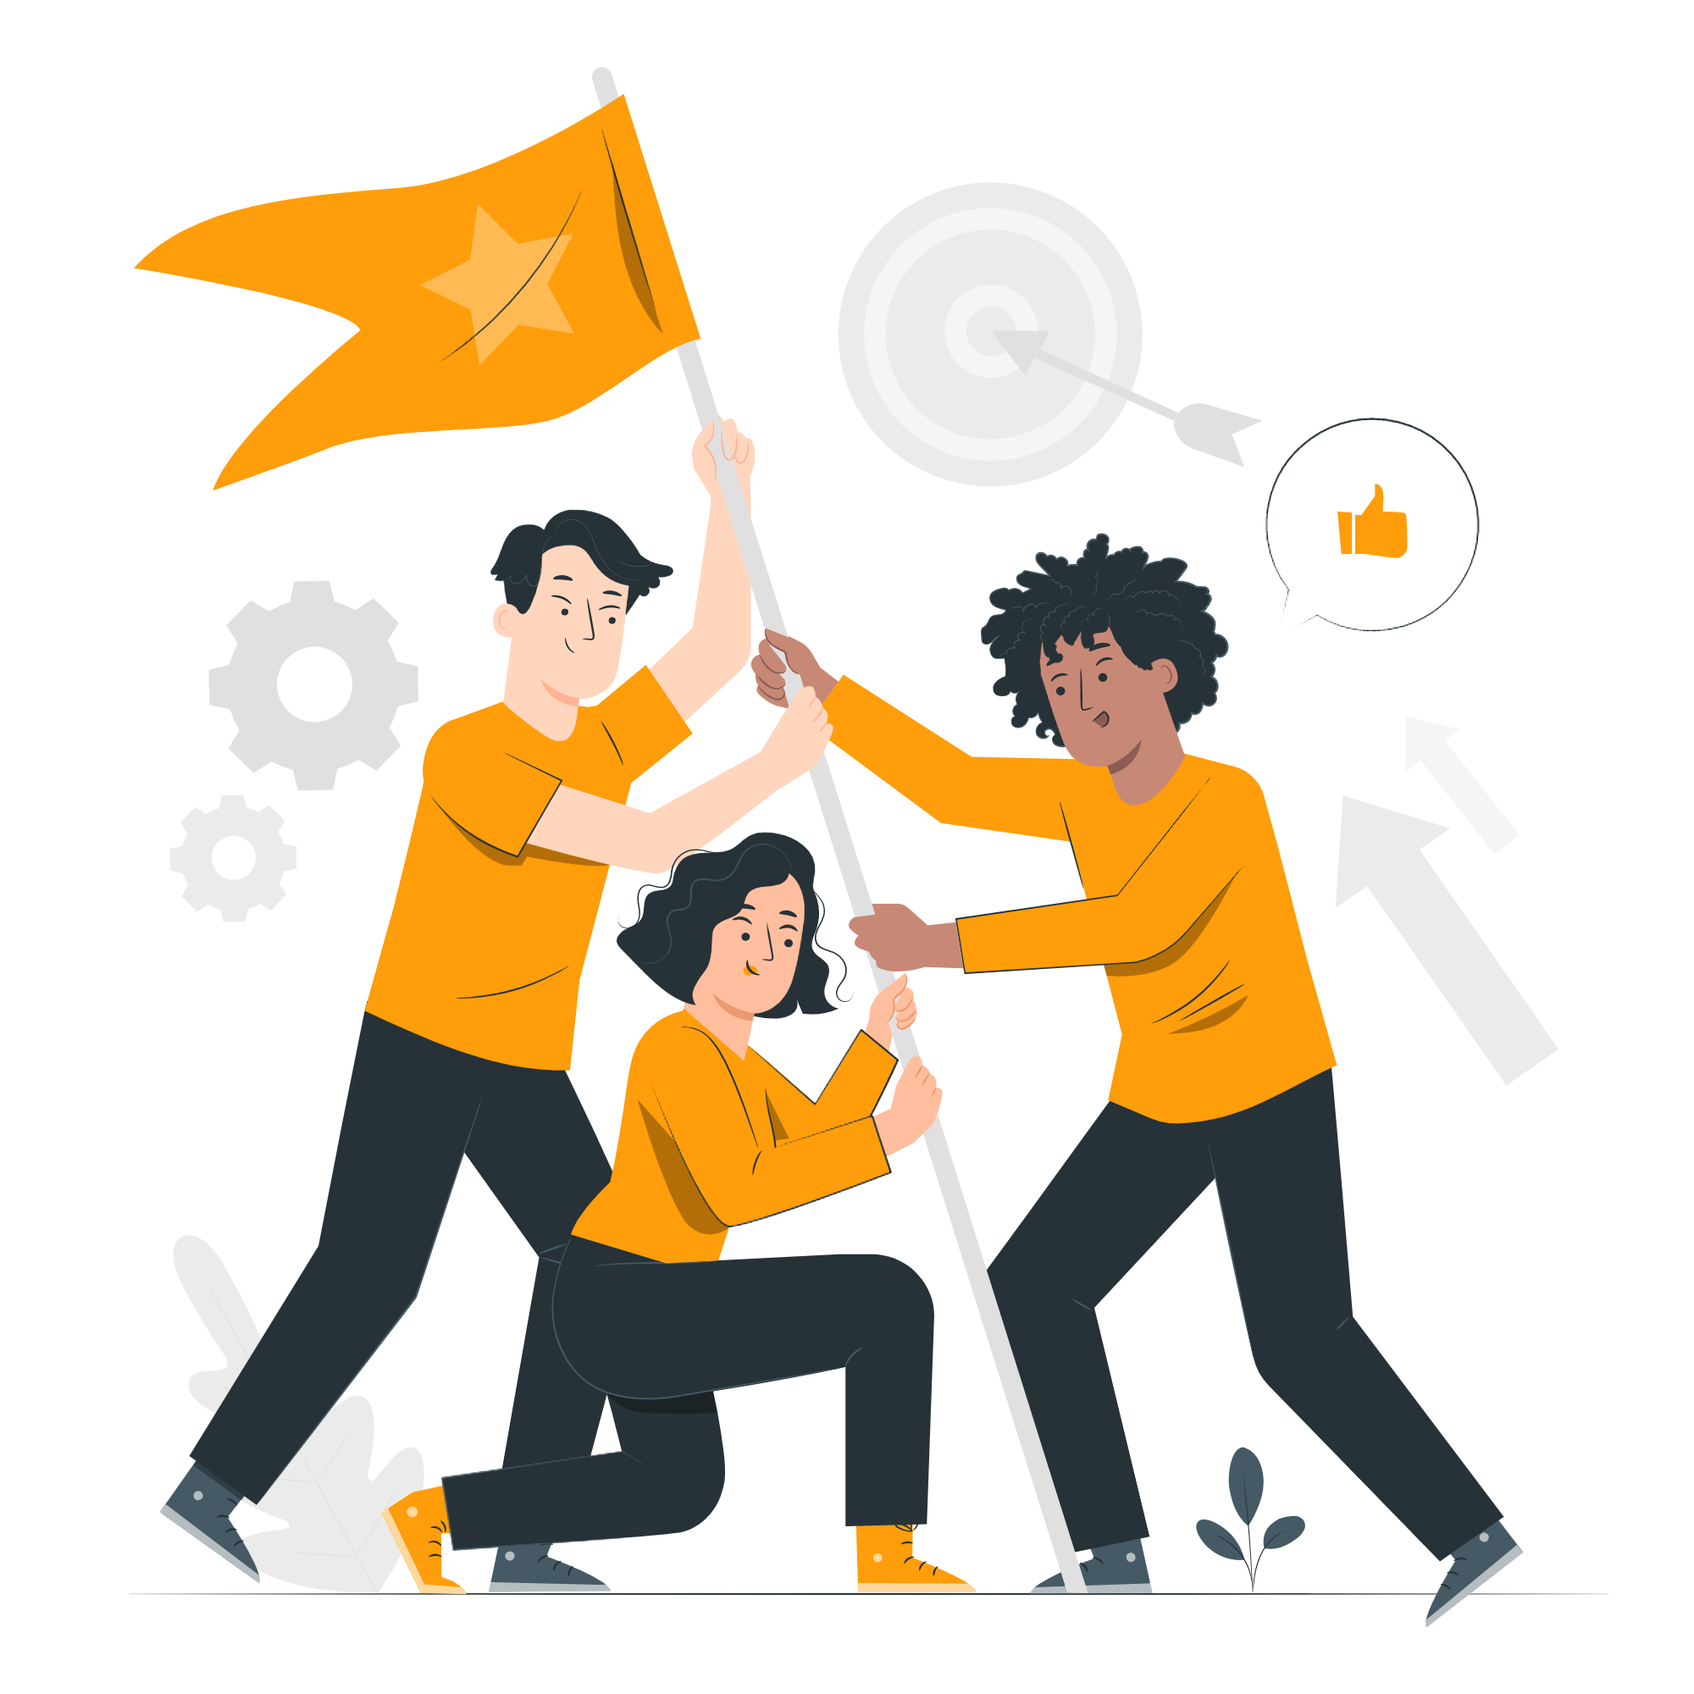
Thank you for your attention!
https://storyset.com/
Notes:
(4 mins)

Slide 10
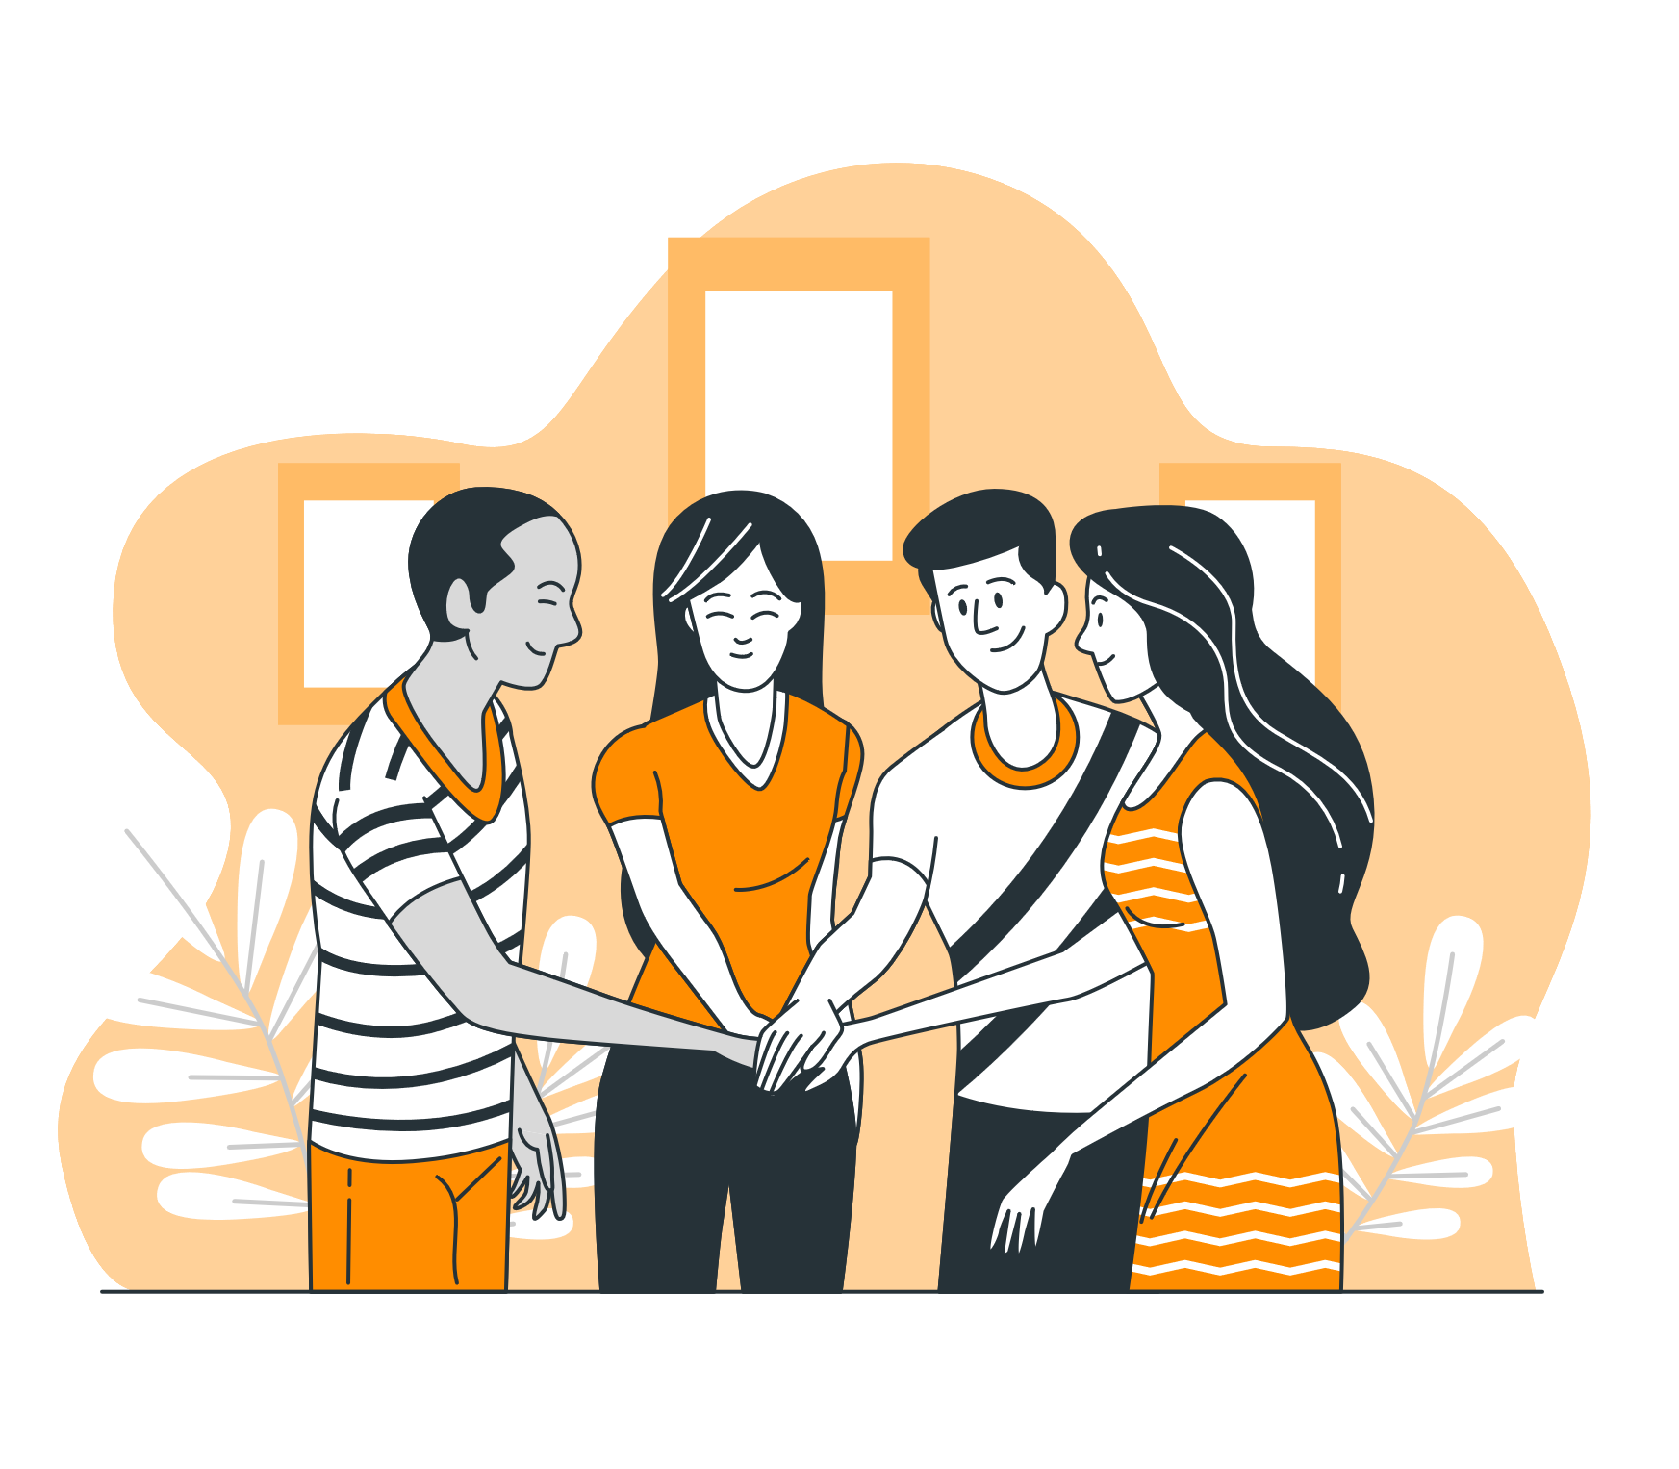
Suggestions for Research Proposals
Do not underestimate community building activities in your proposals!
Involve the community as early as possible!
Partner with institutions which can support the initiative once the project ends!
Lobby for funding after the end of the project to support the community activities!
https://storyset.com/
Notes:
The project team should reflect the people needed to build the community and grow it in time.
The community can not only provide feedback about what you designed and implemented, but also contribute to that if you give the chance. This may mean more "social" work for you, but don't forget - we have a community which is very qualified and talented. Let them support the initiative by being part of it.
A self motivated volunteer community can de a lot, but still you may need resources (e.g. infrastructure, budget to organize events, etc.). Partner institutions can help with this. In fact they can be a part of the community - it is better if you consider them as such.
Current funding schemas do not consider community activities after the end of the project. By providing a special budget, which can only be used for such purposes, they can in fact support these activities easily. We should lobby for it, so that the rules can be changed accordingly.

