Slide 1
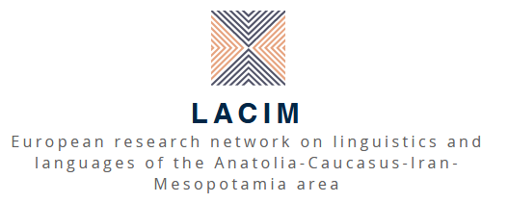
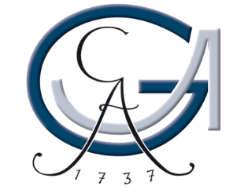

Hossep Dolatian
glottothèque
languages of Anatolia, Caucasus, Iran, Mesopotamia
Armenian
Morphology
Stony Brook University
21.01.2022
visit glottothèque at: https://spw.uni-goettingen.de/projects/lacim/

Slide 2
Overview of morphology
Morphology is primarily suffixing (Derivational and Inflectional) and agglutinative.
Few prefixes, and compounding with linker –a – (very Hellenic)
The entire word gets regular stress and forms a prosodic word
R | [kʰɑʁɑkʰ] | ‘country’ քաղաք
R + D | [kʰɑʁɑkʰ-ɑˈtsʰi] | ‘citizen’ քաղաքացի
R + D + I | [kʰɑʁɑkʰ-ɑtsʰi-ˈneɾ] | 'citizen-PL’ քաղաքացիներ
R + D + I + I | [kʰɑʁɑkʰ-ɑtsʰi-neˈɾ-ov] | 'citizen-PL-INS’ քաղաքացիներով
D + R | [ɑŋ-kʰɑˈʁɑkʰ] | ‘countryless’ անքաղաք
R + L + R | [kʰɑʁɑkʰ-ɑ-ˈmɑjɾ] | ‘capital’ քաղաքամայր (lit. country + mother)

Slide 3
Nominal inflection
Regular nouns have agglutinative inflection for Number+Case+Det
  Nom/Acc and Gen/Dat are syncretic in nouns (not pronouns)
  Abl is /-e/ in Western, /-its^{h}/ in Eastern. Loc /-um/ in Eastern only.
  Det is definite, 1SG/2SG possessive, and (Western) indefinite
  Oblique cases (Gen, Abl,…) can‘t take Def in Eastern
 | N + K | N + PL + K | N + PL + K + Det
 | ՝country’ քաղաք | ՝countries’ քաղաքներ | ‘my countries’ քաղաքներս
Nom/Acc | kʰɑʁɑkʰ | kʰɑʁɑkʰ-neɾ | kʰɑʁɑkʰ-neɾ -əs
Gen/Dat | kʰɑʁɑkʰ -i | kʰɑʁɑkʰ-neɾ -u | kʰɑʁɑkʰ-neɾ -u -s
Abl | kʰɑʁɑkʰ -e WA kʰɑʁɑkʰ -itsʰ EA | kʰɑʁɑkʰ-neɾ -e kʰɑʁɑkʰ-neɾ-itsʰ | kʰɑʁɑkʰ-neɾ -e -s kʰɑʁɑkʰ-neɾ -itsʰ -əs
Inst | kʰɑʁɑkʰ -ov | kʰɑʁɑkʰ-neɾ -ov | kʰɑʁɑkʰ-neɾ -ov -əs
Loc | kʰɑʁɑkʰ -um | kʰɑʁɑkʰ-neɾ -um | kʰɑʁɑkʰ-neɾ -um -əs

Slide 4
Nominal inflection and recursion
Nouns are inflected for PL+Case+Det
But ellipsis can create sequences of stacked inflection
Common in Turkic
mɑɾjɑm | -i-n | seʁɑn | -neɾ-ov-ə
Mariam | -Gen-Def | table | -PL-Inst-Def
‘With Mariam’s tables’ Մարիամին սեղաններովը
mɑɾjɑm | -i-n | -neɾ-ov-ə
Mariam | -Gen-Def | -PL-Inst-Def
‘With Mariam’s’ Մարիամիններովը

Slide 5
Allomorphy in nominal inflection
Phonologically-conditioned allomorphy
  Def is /-ə/ after C, /-n/ after V
  Possessives are /-əs/ and /-ət^{(h)}/ after C, /-s/ and /-t^{(h)}/ after V
  PL is /-eɾ/ after monosyllables, /-neɾ/ after poylsyllables
Morphologically-conditioned allomorphy
  Dat/Gen is /-u/ after some morphemes, but generally /-i/
  A few words have special PL or Dat/Gen allomorphs – next up
 |  | +Def | +1SG.Poss | +PL
‘rose’ վարդ | vɑɾt^{h} | vɑɾt^{h}-ə | vɑɾt^{h}-əs | vɑɾt^{h}-eɾ
`wind’ քամի | kʰɑmi | kʰɑmi-n | kʰɑmi-s | kʰɑmi-neɾ
 |  | +Dat
West. | vɑɾt^{h}-eɾ | vɑɾt^{h}-eɾ-u | `roses’ վարդեր
East. | vɑɾt^{h}-eɾ | vɑɾt^{h}-eɾ-i | `roses’ վարդեր

Slide 6
Irregularity in nominal inflection
Some high-frequency words have special root allomorphs or suffix allomorphs for Dat/Gen
Oblique cases repeat this special allomorph, sometimes with a linker morph. Patterns of oblique stems is common in the Caucuses
 | Regular | Irregular suffix | Irregular ablaut
 | ‘rose’ վարդ | ‘friend’ ընկեր | ’mother’ մայր
Nom/Acc | vɑɾt^{h} | WA: əŋɡeɾ EA: əŋkeɾ | mɑjɾ
Dat/Gen | vɑɾt^{h}-i | WA: əŋkeɾ-otʃʰ EA: əŋkeɾ-odʒ | moɾ
Abl | vɑɾt^{h}-e | WA: əŋɡeɾ-otʃʰ-m-e EA: əŋkeɾ-odʒ -itsʰ | WA: moɾ-m-e EA: moɾ -itsʰ
Inst | vɑɾt^{h}-ov | WA: əŋɡeɾ-otʃʰ-m-ov EA: əŋɡeɾ-odʒ -ov | WA: moɾ-m-ov EA: moɾ -ov

Slide 7
Verbal conjugation classes
Morphologically, verbs are either simplex or complex
Simplex: root + theme vowel + inflection (infinitive)
  Theme vowel is either /-e-/, /-i-/, /-ɑ-/. Very IE.
  /-i-/ is absent in Eastern. Archaic forms of Western also had /-u-/
Complex verb includes a valency-changing suffix
Complex verbs can be derived from non-verbs hear [uɾɑχ] ‘happy’
ləs-e-l | WA χos-i-l / EA χos-e-l | ɑʁ-ɑ-l | R-Th-Inf
’to hear’ | ’to speak’ | ‘to grind’
Causative | Passive | Inchoative
'to make s.o. hear’ | 'to be spoken’ | 'to become happy’
ləs-e-tsʰən-e-l | WA χos-v-i-l / EA χos-v-e-l | uɾɑχ-ɑ-n-ɑ-l
R-Th-Caus-Th-Inf | Root-Pass-Th-Inf | R-L-Inch-Th-Inf
լսեցնել | խօսուիլ / խոսվել | ուրախանալ

Slide 8
Verbal inflection
In finite verbs, verbs inflect for tense, aspect, and subject agreement. Past tense and perfective aspect are overt.
For mood, verbs inflect for imperatives and prohibitive
 | ‘to hear | ‘to grind’
Inf. | ləs-e-l լսել | ɑʁ-ɑ-l աղալ | R-Th-Inf
Subj. Pres. 1PL | ləs-e-nk^{h} | ɑʁ-ɑ-nk^{h} | R-Th-IPL
Subj. Pst. Impf. 1PL | ləs-e-ji-nk^{h} | ɑʁ-ɑ-ji-nk^{h} | R-Th-Pst-IPL
Pst. Perf. 1PL | ləs-e-tsʰ-i-nk^{h} | ɑʁ-ɑ-tsʰ-i-nk^{h} | R-Th-Pfv-Pst-IPL

Slide 9
Synthesis and periphrasis
Both Western and Eastern have synthetic and periphrastic inflection, but Eastern has more periphrasis.
Indicative present is formed by adding a prefix to the subjunctive in Western. But Eastern uses a special converb + finite aux
 | Western | Eastern
‘to hear’ | ləs-e-l | ləs-e-l
Subj. Pres. 1PL | ləs-e-nk^{h} | ləs-e-nk^{h}
Indc. Pres. 1PL | ɡə-ləs-e-nk^{h} | ləs-um e-nk^{h}
 | Indc-R-Th-IPL | R-CVB aux-1PL

Slide 10
Synthesis and periphrasis
Both lects show split behaviors in periphrasis.
In Western, negation is formed via a prefix /ɡ-/ for subjunctive. But with periphrasis for indicative.
Verb is in connegative form, while inflection is on a negative auxiliary. Very Finno-Ugric
In Eastern, optative is a prefix /k-/ to subjunctive. The negative form is periphrastic.
‘to hear’ | Subj. Pres. 1PL | Indc. Pres. 1PL
Positive | ləs-e-nk^{h} | ɡə-ləs-e-nk^{h}
Negative | tʃʰə-ləs-e-nk^{h} | tʃʰ-e-nk^{h} ləs-e-ɾ
 | Neg-R-Th-IPL | Neg-aux-1PL R-Th-CN

Slide 11
Verbal stems and morphomes
Armenian utilizes ‘aorist’ stems in way that’s similar to Romance morphomic stems
The aorist suffix –tsʰ– canonically marks past perfectivity. But it is meaninglessly used in some constructions and classes.
Some verbs have allomorphs wherever we expect this aorist.
 | /e/ theme | /ɑ/ theme | Suppletive
 | ‘to hear’ | ‘to grind’ | ‘to arrive’
Inf. | ləs-e-l լսել | ɑʁ-ɑ-l աղալ | WA kʰ-ɑ-l / EA ɡ-ɑ-l գալ
Pst. Perf. 2PL | ləs-e-tsʰ-i-kʰ | ɑʁ-ɑ-tsʰ-i-kʰ | jeɡ-ɑ-kʰ / jek-ɑ-kʰ
Imp. 2PL | ləs-e-tsʰ-ekʰ | ɑʁ-ɑ-tsʰ-ekʰ | jeɡ-ekʰ / jek-ekʰ
Subject Ptcp. | ləs-oʁ | ɑʁ-ɑ-tsʰ-oʁ | jeɡ-oʁ / jek-oʁ

Slide 12
references
General paradigms
Dum-Tragut, J. 2009. Armenian: Modern Eastern Armenian (Vol. 14). John Benjamins Publishing.
Boyacioglu N., and Dolatian, H. 2020. Armenian Verbs: Paradigms and verb lists of Western Armenian conjugation classes (v.1.0.0). Zenodo. https://doi.org/10.5281/zenodo.4397423
Theoretical discussion
Donabédian, A. 1997. Neutralisation de la diathèse des participes en-acde l’arménien mod-erne occidental.Studi italiani di linguistica teorica ed applicata26(2):327–339.
Daniel, M., and Khurshudian V.. 2015. Valency classes in Eastern Armenian. InValencyClasses in the World’s Languages, ed. by Andrej Malchukov and Bernard Comrie, 483–540
Dolatian, D. and Guekguezian P. 2021. Relativized Locality: Phases and Tiers in Long-Distance Allomorphy in Armenian. Linguistic Inquiry

Slide 13
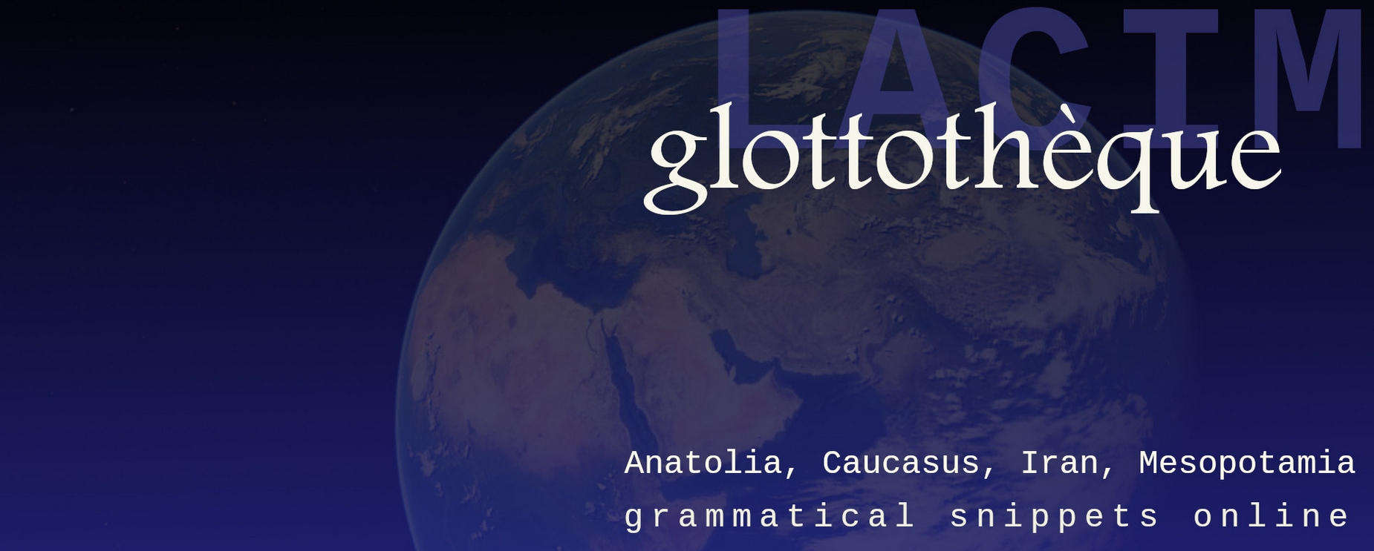
this lecture
is part of the series Glottothèque: Languages of the Anatolia, Caucasus, Iran, Mesopotamia; grammatical snippets online, ed. by. C. Bulut, A. Donabédian-Demopoulos, G. Haig, G. Khan, P. Samvelian, S. Skopeteas, N. Sumbatova. Bamberg/Cambridge/Göttingen/Moskow/Nicosia/Paris: LACIM network.
You may find related lectures and further information at the Glottothèque website at:
https://spw.uni-goettingen.de/projects/lacim/

