Slide 1
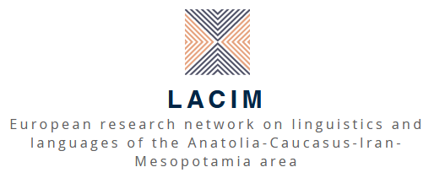

Katherine Hodgson
glottothèque
languages of Anatolia, Caucasus, Iran, Mesopotamia
Armenian
Noun phrase structure and determination
University of Cambridge
21.02.2022
visit glottothèque at: https://spw.uni-goettingen.de/projects/lacim/

Slide 2
General properties
The noun phrase in modern Armenian is head-final, generally showing the order Dem Num A N (cf. Greenberg‘s Universal 20):
(1) ays yerku gełecʿik nkar-ner-ə
DEM1 two beautiful picture-PL-DEF
‘these two beautiful pictures’
The definite article is enclitic, always on the head noun. It is obligatory with demonstratives and/or possessives, and may agree with the latter in person (and with the former in some dialects):
(2) im nkar-s kʿo nkar-d nra nkar-ə
my picture-DEF1 your picture-DEF2 his/her picture-DEF(3)
(3) as oiv-əs ‘this shepherd-DEF1’ (Hamshen, Vaux 2007: 266)

Slide 3
Parallels between noun phrase and clause
The ‘agree’ relationship between the possessor and the definite article suggests parallels with that between the subject and the inflected verb/auxiliary in the clause (Donabédian-Demopoulos 2010, Hodgson 2019). Similar syntactic and semantic parallels have been drawn at least since Chomsky (1972):
John destroyed the city.
John’s destruction of the city.
The role of demonstratives could be compared to that of Tense in the clause (as expressed by temporal adverbs and verb morphology): both have deictic properties, the former locating the referent in space, the latter anchoring the event in time. In generative terms, D would be parallel to T.

Slide 4
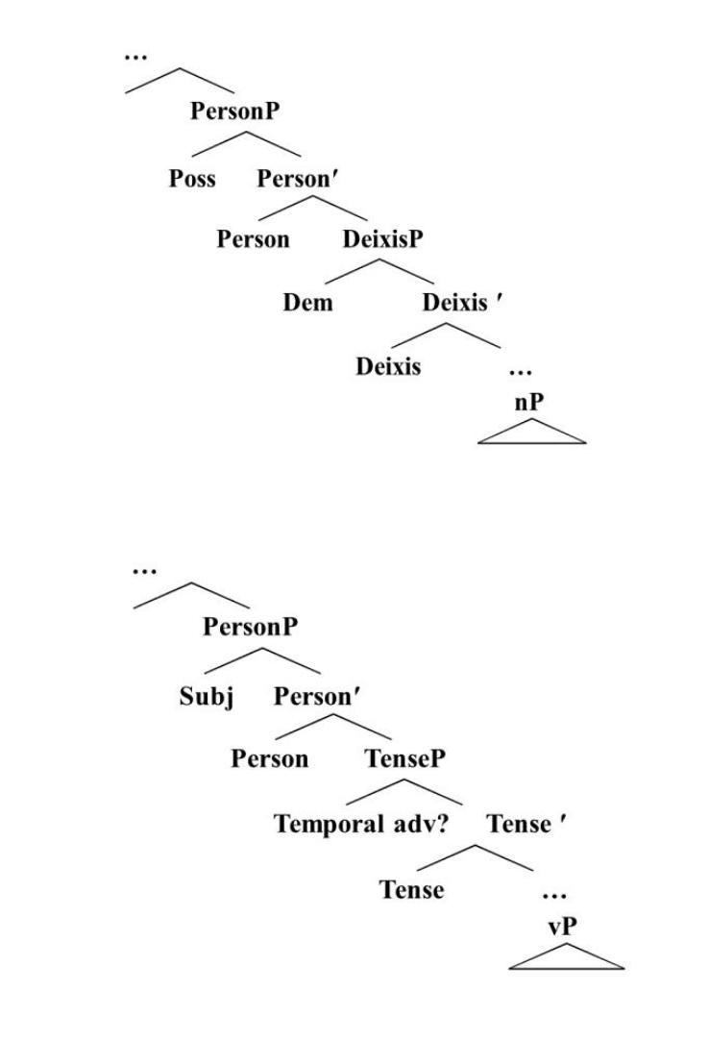
Inflectional domain of DP and clause

Slide 5
Noun phrase structure and clause structure
Clause: [CP…[CP [FPadv1…[FPadv2 [vP…[VP]]]]]]
Noun phrase: [DP…[DP [FPadj1…[FPadj2 [nP…[NP]]]]]]
Discourse domain Inflectional domain Thematic domain
Ihsane (2008: 17) (cf. also Cinque 2002, Belletti 2004, Rizzi 2004, etc.)
Armenian also provides some evidence for movement of modifiers to a peripheral ‘discourse domain’ in the noun phrase (see Hodgson 2019 for more details):
(4) Օr haykakan kusakcʿutʿyun-ner-n en gorcum Avstralia-yum?
which Armenian party-PL-DEF be.3PL.PRS operate.IPT Australia-LOC
‘Which Armenian parties operate in Australia?’ (unmarked)
(5) Haykakan OR kusakcʿutyunnern en gorcum Avstraliayum?
‘Armenian’ is unstressed: topic of discourse = Armenian things or parties.

Slide 6
Definite article and specificity
The definite article in Armenian occurs in certain contexts that cannot be defined as ‘definite’ in the usual sense of ‘identifiable by the addressee’. Sigler (1996: 113ff) describes it as a marker of specificity, as it is said to be obligatory with genitives (6) and partitives (7):
(6) (a) egełeci-i-n tanikʿ-*(ə) (b) egełeci-i-mə tanikʿ-*(ə)
church-GEN-DEF roof-DEF church-GEN-IND roof-DEF
‘the church’s roof’ (def) ‘a church’s roof’ (indef)
(7) Ôto-ner-e-n yerekʿ hat-*(ə) gołcʿvecʿan.
Car-PL-ABL-DEF three piece-DEF steal.PASS.3PL.AOR
‘Three of the cars were stolen’

Slide 7
Definite article and specificity
However, this is best interpreted as a syntactic operation where the article is used when the noun is modified by certain categories of elements usually associated with definiteness or specificity, rather than being associated with the semantic property of specificity itself:
(a) Ostikan em pʿntrum, baycʿ čʿem karoł gtnel.
policeman be.1SG.PRS search.IPF, but NEG.be.3SG.PRS able find.INF
‘I’m looking for a policeman, but I can’t find one.’ (non-specific)
(b) Mi ostikan-i(-*n) em pʿntrum, or-i anun-ə
IND policeman-DAT(-*DEF) be.1SG.PRS search.IPF, which-GEN name-DEF
Połos ê.
Poghos be.3SG.PRS
‘I’m looking for a policeman, whose name is Poghos.’ (specific)

Slide 8
Definite article and nominalization
Asatryan (2004: 96) states that the definite article may be used simply as a marker of nominalization, converting non-nominal parts of speech to nominal use. In this role it is not necessarily associated with definiteness, or even specificity, as seen in the following example:
(9) Etʿe mtadrvel es mekʿena gnel, aveli lav k-lini
If decide.PPT be.2SG.PRS car buy.INF, more good FUT-be.3SG
nor-ə gnel.
new-DEF buy.INF
‘If you have decided to buy a car, it will be better to buy a new one.’

Slide 9
Definite article and argument status
There is some evidence that the definite article in cases such as (9) is better understood as a marker of (core) argument status. One possible piece of evidence is that in standard Eastern Armenian, it may not be used with cases associated with non-core arguments (genitive, ablative, instrumental, locative), even if the referent is definite:
(10) (a) kʿałakʿ-i(*-n) kentron-ə
town-GEN(*-DEF) centre-DEF
‘the centre of the town’
(b) kʿałakʿ-icʿ(*-ə) ‘the town (ABL)’
(c) kʿałakʿ-ov(*-ə) ‘the town (INS)’
(d) kʿałakʿ-um(*-ə) ‘the town (LOC)’

Slide 10
Definite article and argument status
Another piece of evidence comes from certain other essentially adverbial elements that take nominative (zero) case, but do not receive the definite article even if semantically definite, notably elements denoting location (11) and destination (12):
(11) Vardan-ə Erevan(*-ə) / xanutʿ(*-n) ê.
Vardan-DEF Yerevan(*-DEF) / shop(*-DEF) be.3SG.PRS
‘Vardan is in Yerevan / at the shop.’
(12) Vardan-ə gnum ê Erevan(*-ə) / xanutʿ(*-ə).
Vardan-DEF go.IPT be.3SG.PRS Yerevan(*-DEF) / shop(*-DEF)
‘Vardan is going to Yerevan / the shop.’

Slide 11
Typological parallels
Donabédian-Demopoulos (2010) states that when bare nouns appear to be arguments (object or subject), their main function is actually to modify or complete the meaning of the verb (see also Kalomoiros 2021 for semantics of bare nouns), as an adjective modifies a noun. Both immediately precede the modified element. She draws typological parallels with other languages of the area.
The distribution of the definite article in Armenian has parallels with that of the ‘articulated’ case forms in Kartvelian (Harris 1985), suggesting similar developments in the history of these languages.

Slide 12
ideas
Look for parallels between noun phrase structure and clause structure in other languages you know. How far do these parallels go? What are the differences between the structure of the noun phrase and that of the clause?
Investigate the functions of the definite article in other languages you know. Are there any instances where it functions as something other than a marker of semantic definiteness? Are there any restrictions on its use with semantically definite referents?

Slide 13
references
Asatryan, M. E. 2004. Žamanakakic῾ hayoc῾ lezu։ J̌evabanut῾yun․. [Modern Armenian language: Morphology]. Yerevan: Yerevan State University Press.
Belletti, Adriana. 2004. Aspects of the low IP area. In Luigi Rizzi (ed.). The Structure of IP and CP. The Cartography of Syntactic Structures vol.2. Oxford: OUP.
Chomsky, Noam. 1972. Remarks on Nominalisation. In Noam Chomsky, Studies on Semantics in Generative Grammar. The Hague: Mouton.
Cinque, Guglielmo (ed.). 2002. Functional Structure in DP and IP: The Cartography of Syntactic Structures, vol. 1: 54-90. New York: Oxford University Press.
Donabédian-Demopoulos, Anaïd, 2010. Nom nu et tropisme typologique: le cas de l’arménien. In Essais de typologie et de linguistique générale, mélanges offerts à Denis Creissels, Floricic F. 9Ed.). 403-416.
Greenberg, Joseph H. 1963. Some universals of grammar with particular reference to the order of meaningful elements. In J.H. Greenberg (ed.) Universals of Language, 73-113. Cambridge, Mass: MIT Press.
Harris, Alice C. 1985. Diachronic Syntax: The Kartvelian Case. Academic Press.
Hodgson, Katherine. 2019. Discourse Configurationality and the Noun Phrase in Eastern Armenian. Faits de Langues 50:2 137-166.
Ihsane, Tabea. 2008. The Layered DP. Form and meaning of French indefinites. Amsterdam/Philadelphia: John Benjamins.
Kalomoiros, Alexandros. 2021. Bare singulars and pseudo-incorporation in Western Armenian. Proceedings of SALT 31. 365–384.
Rizzi, Luigi (ed.). 2004. The structure of CP and IP: the cartography of syntactic structures, vol. 2 (Oxford Studies in Comparative Syntax). Oxford: Oxford University Press.
Sigler, Michele. 1996. Specificity and Agreement in Standard Western Armenian. Cambridge, MA: MIT PhD thesis.
Vaux, Bert .2007. Homshetsma. The language of the Armenians of Hamshen. In H. Simonian (ed.) The Hemshin. Abingdon & New York: Routledge. 257-278.

Slide 14
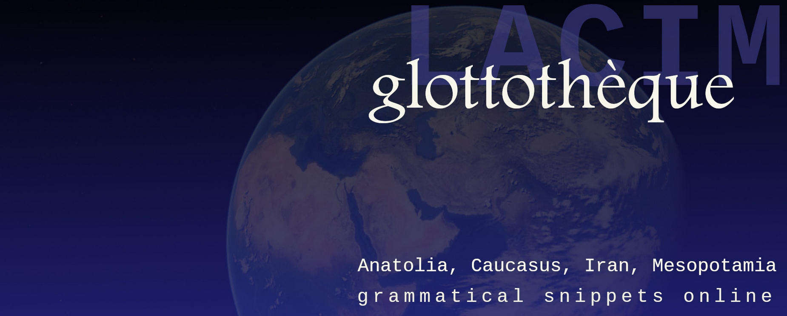
this lecture
is part of the series Glottothèque: Languages of the Anatolia, Caucasus, Iran, Mesopotamia; grammatical snippets online, ed. by. C. Bulut, A. Donabédian-Demopoulos, G. Haig, G. Khan, P. Samvelian, S. Skopeteas, N. Sumbatova. Bamberg/Cambridge/Göttingen/Moskow/Nicosia/Paris: LACIM network.
You may find related lectures and further information at the Glottothèque website at:
https://spw.uni-goettingen.de/projects/lacim/

