Slide 1
Soft linking EnergyPLAN and Python - user manual
Luka Herc,
University of Zagreb, Faculty of Mechanical Engineering and Naval Architecture, Croatia

Slide 2
CURRENT CAPACITIES, DEMAND AND GENERATION
THEORETICAL CAPACITIES
EXCEL TABLE WITH THE VALUES FOR DIFFERENT CASES
PERMUTATION OF INPUTS USING EXCEL POWER QUERY
MODEL A TEMPLATE CASE IN EnergyPLAN
RUN PYTHON SCRIPT TO SOLVE CASES
INSERT DATA IN NEW EXCEL TABLE WHICH SERVES AS AN INPUT FOR EnergyPLAN
IF THERE ARE ERRORS
EXTRACT DATA INTO SINGLE .XLSX TABLE
CHECK FOR ERRORS
CREATE CHARTS
IF THERE ARE NO ERRORS

Slide 3
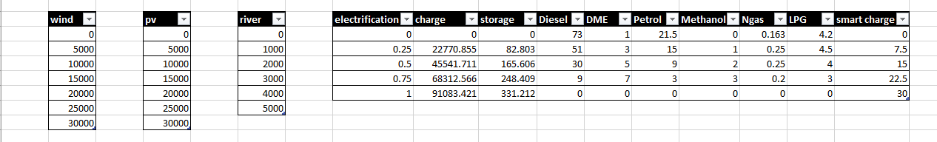
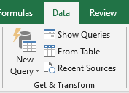
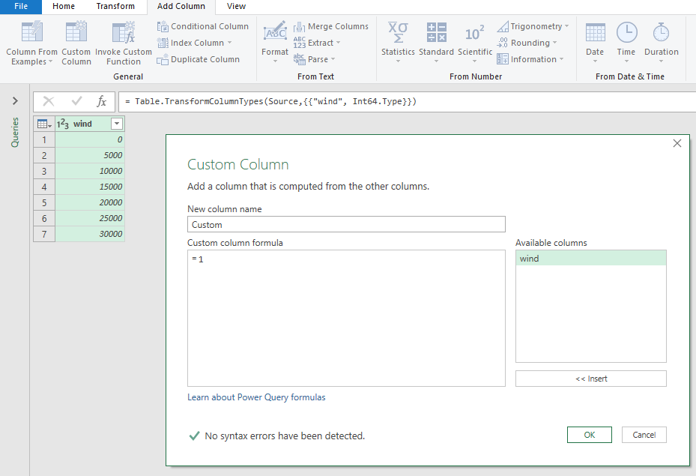
Create set of data in excel
Example of the set of input data
Create queries
Repeat for each variable

Slide 4
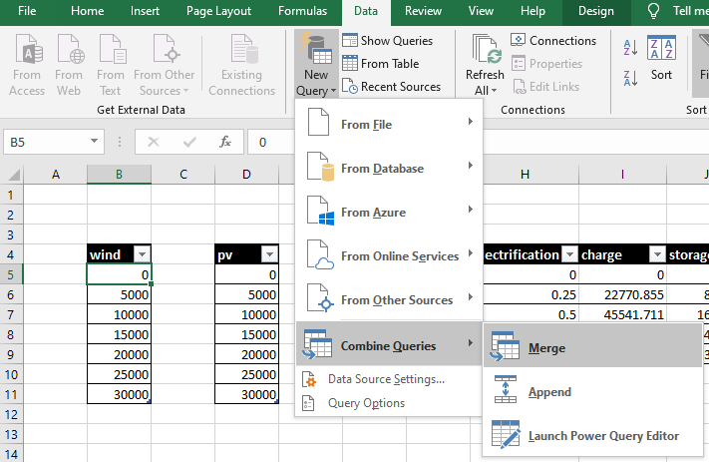
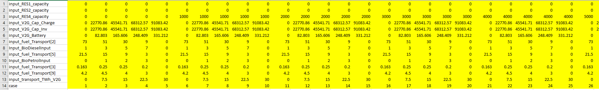
Merge queries to create all combinations
Create table

Slide 5
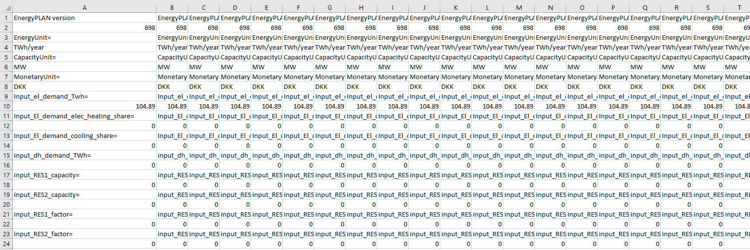
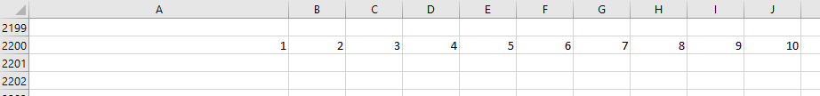
Import data from EnergyPLAN base case scenario input data into new excel table
At row 2200 paste the numbering of cases (from 1 to n where n is the number of cases)
Spread base case input to all n columns
Use VLOOKUP function to replace corresponding rows with data from previous excel table (example is uploaded as well)
Save excel table (later referred as “input data table”)
Create new excel file with the same case number data in row 1 and save excel table (later referred as “case name table”)

Slide 6
Python code
Create “csv” titled folder for the results
Run python code
Navigate the dialog questions for EnergyPLAN base folder, input data table, case name table and desired .csv files output location.
Parameters in the code are adjusted for EnergyPLAN opening position at upper left corner of the screen and screen resolution of 1920 x 1080 at the scale of 125 %. – adjust if the setup is different
Wait for the code to finish (duration can be adjusted, limited by the RAM speed) and do not touch mouse or keyboard during execution
The process can be sped up by running parallel windows sessions

Slide 7
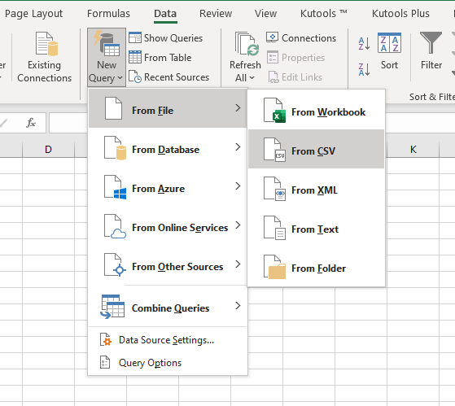
Create tables with results
Open Microsoft excel
Insert new query from CSV
Select required data points
Create tables
Check for errors – check if the saved values of file names inside solution files differ from the file names
If there are errors, create new table with a list of file names with errors in line 1 and run these cases again – if necessary, readjust the timings between the steps in python code

Slide 8
Used python version and required plugins
Python 3.8, 64 bit
Pycharm Community Edition 2019.3.2, 64 bit
Plugins: - tkinter
- openpyxl
- subprocess
- os
- time
- pyautogui

