Slide 1


SECONDARY PUBLISHING RIGHT
in the Netherlands
Workshop 9th of December 2021
Erna Sattler | Centre for Digital Scholarship | Leiden University Library
1
Notes:
1

Slide 2
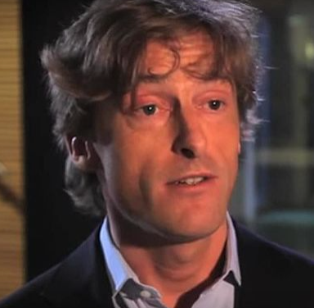
How did it all start?
Dutch Copyright Act (DCA, Auteurswet)
In January 2014 Member of Parliament
Joost Taverne submitted an amendment to
the DCA regarding secondary publishing right
In February 2015 the final amendment was submitted
Now known as the Taverne Amendment
It was approved by Parliament and the Senate
Later in 2015 it became art. 25fa DCA
Source: wikipedia.org
2
Notes:
2

Slide 3
Article 25fa Dutch Copyright Act
Art. 25fa DCA:
The maker of a short scientific work for which the research has been financed in whole or in part with Dutch public funds shall have the right to make the work available to the public free of charge after a reasonable period following its first publication, provided that the source of the first publication is clearly indicated.
Translation by Erna Sattler
The Dutch original:
De maker van een kort werk van wetenschap waarvoor het onderzoek geheel of gedeeltelijk met Nederlandse publieke middelen is bekostigd, heeft het recht om dat werk na verloop van een redelijke termijn na de eerste openbaarmaking ervan, om niet beschikbaar te stellen voor het publiek, mits de bron van de eerste openbaarmaking daarbij op duidelijke wijze wordt vermeld.
3
Notes:
3

Slide 4

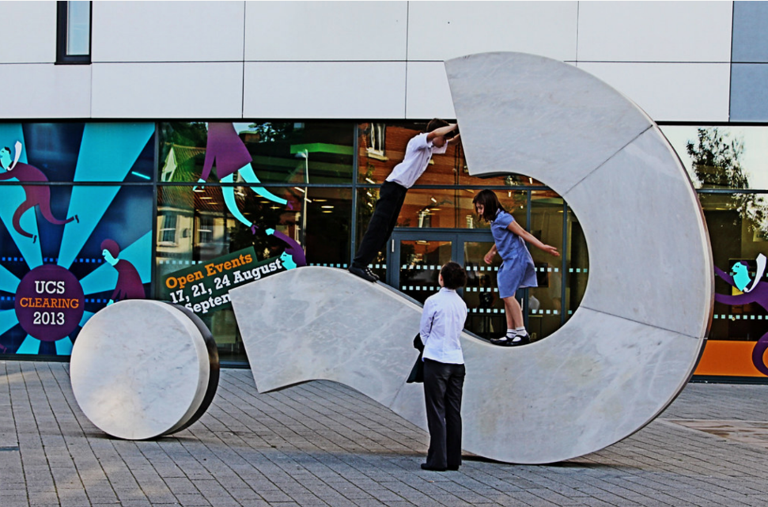
How did Researchers React?
At first researchers at Dutch universities were hesitant, most did not republish
Universities came to their aid and asked a reputable expert for advice
Questions raised by art. 25fa needed to be answered….
Questions like ….
By WingedWolf CC BY-NC-ND 2.0
Source: search.creativecommons.org
By Leo Reynolds CC BY-NC-SA 2.0
Source: search.creativecommons.org
4
Notes:
4

Slide 5
Article 25fa Dutch Copyright Act
Art. 25fa DCA:
The maker of a short scientific work for which the research has been financed in whole or in part with Dutch public funds shall have the right to make the work available to the public free of charge after a reasonable period following its first publication, provided that the source of the first publication is clearly indicated.
How is a short scientific work defined?
5
Notes:
5

Slide 6
Article 25fa Dutch Copyright Act
Art. 25fa DCA:
The maker of a short scientific work for which the research has been financed in whole or in part with Dutch public funds shall have the right to make the work available to the public free of charge after a reasonable period following its first publication, provided that the source of the first publication is clearly indicated.
How much or how little does ‘in part’ have to be to comply with the requirement of this article 25fa DCA?
6
Notes:
6

Slide 7
Article 25fa Dutch Copyright Act
Art. 25fa DCA:
The maker of a short scientific work for which the research has been financed in whole or in part with Dutch public funds shall have the right to make the work available to the public free of charge after a reasonable period following its first publication, provided that the source of the first publication is clearly indicated.
What is a reasonable period?
7
Notes:
7

Slide 8
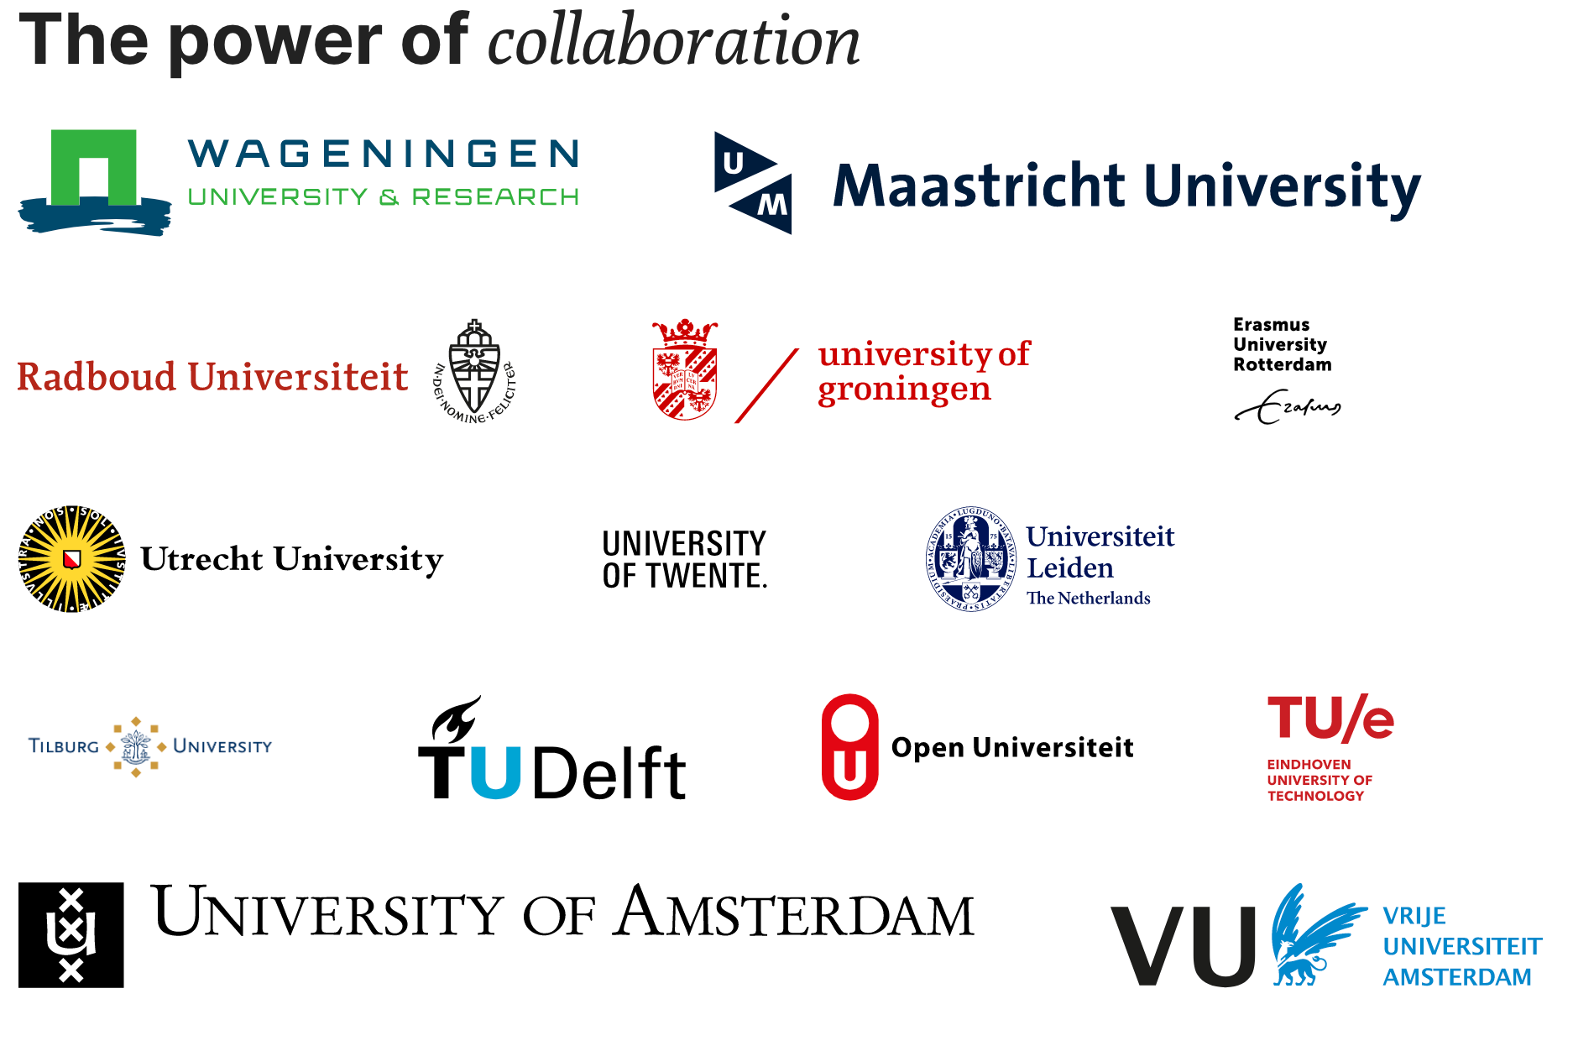
National Project Group Taverne
Dutch universities
and their libraries
decided to collaborate
and formed the
National Project Group Taverne
Each university
had its own local
Project Leader Taverne
Developing a way of working
for universities,
their scholars
and their libraries
Their answers?
8
Notes:
8

Slide 9
Article 25fa DCA: short scientific work
Short scientific work, definition:
- Journal articles
- Book chapters in multi-authored books
- Conference papers
For the avoidance of doubt: it does NOT include (chapters of) monographs
The work will be republished in the final published version/
version of record
9
Notes:
9

Slide 10
Article 25fa DCA: in whole or in part
Financed in whole or in part with Dutch public funds: how much is too little?
What if an article is multi-authored? What if only a small fraction or even just one of the co-authors has been funded by Dutch public funds?
The inclusion of a researcher as co-author implies that his/her contribution is of substantial value to the final product and therefor has been financed in part with Dutch public funds
So yes, the work may be republished
10
Notes:
10

Slide 11
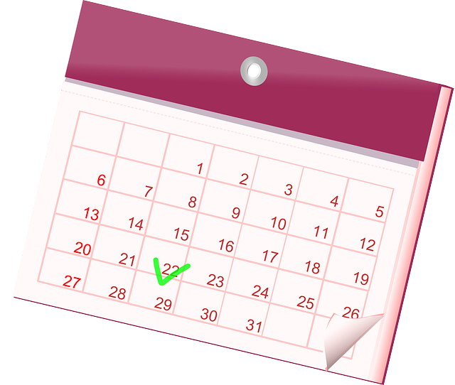
Article 25fa DCA: a reasonable period
What is a reasonable period following first publication?
Project Group Taverne concluded that
six months is a reasonable period
First publication is the date the published
version is made available online
Publishers will have sufficient time to earn back
their investments
No expectations that libraries will cancel journal
subscriptions due to republishing
By OpenClipart-Vectors
with Pixabay License
11
Notes:
11

Slide 12
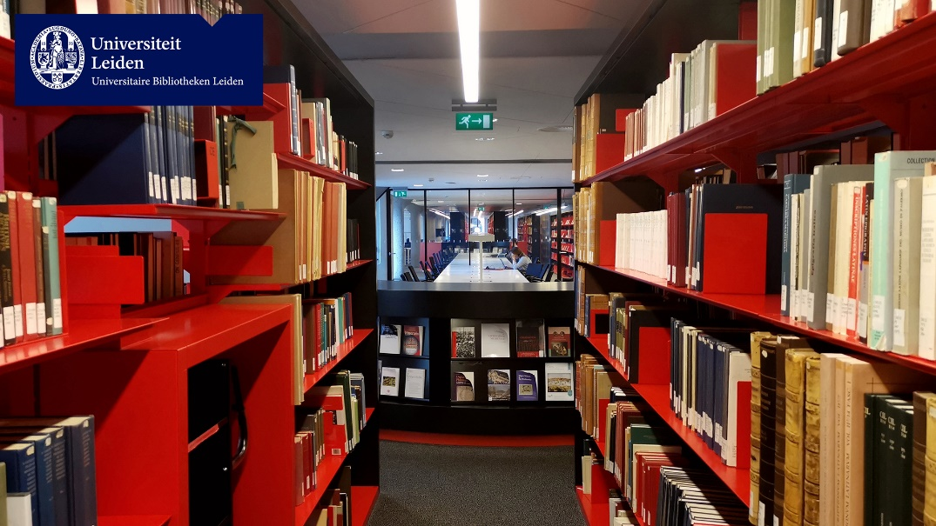
How did we move on?
Project Group Taverne presented its findings to the boards of all universities
Nationwide Taverne Pilot started in early 2019
Scholars employed by all (14) Dutch universities could participate
Intended candidates needed to contact
their university’s library
Library checked if publications were
eligible
Participants signed a license to give
their consent
Slogan: “you share we take care”
12
Notes:
12

Slide 13
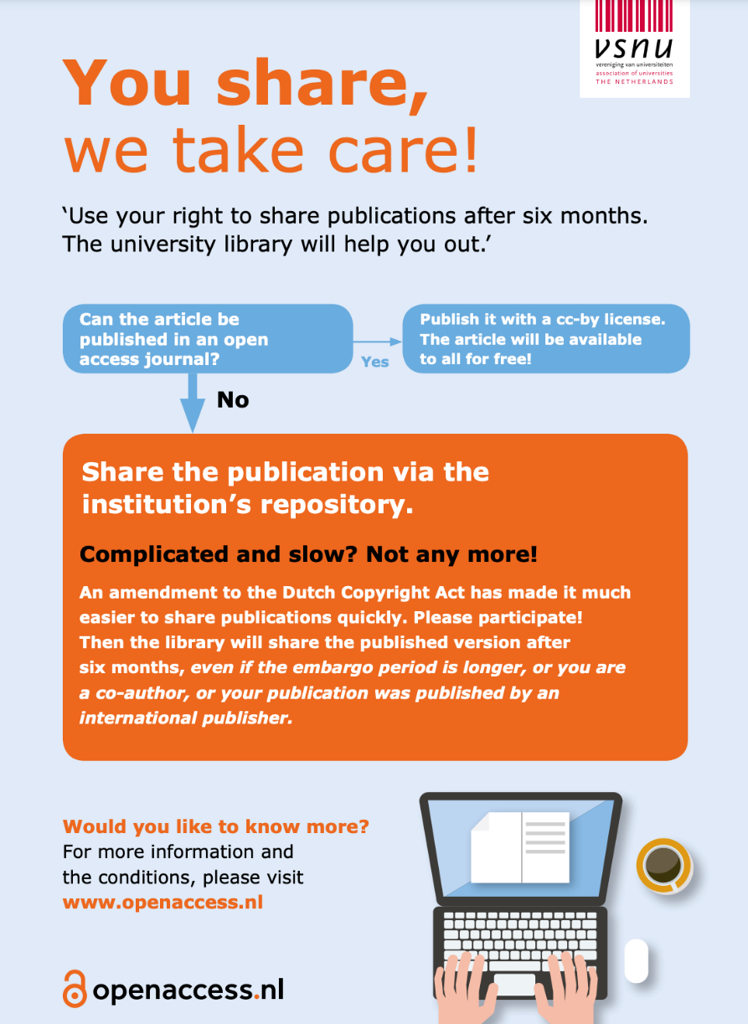
You share, we take care!
You share: you, the scholar will give permission for your article(s) to be published in open access in your university repository
We take care: libraries do the administration and:
if any publisher were to undertake legal action, universities jointly will pay the legal fees
13
Notes:
13

Slide 14





What About the Publishers?
Before the Pilot started …
Publishers were informed about the Pilot indicating:
This is the law
This is how we interpret it
This is what we are going to do
14
Notes:
14

Slide 15
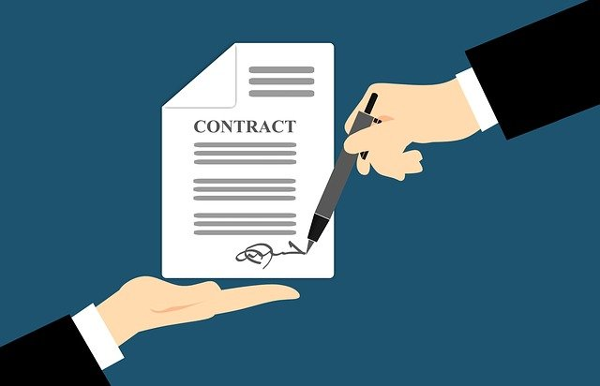

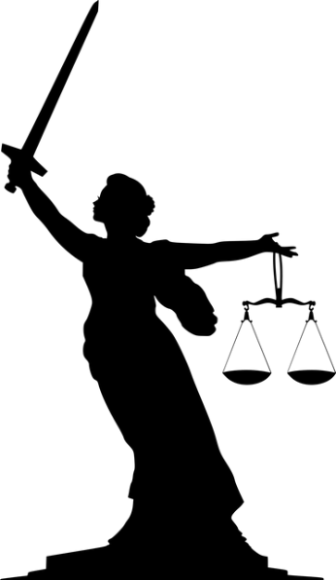
The Results of the Pilot
7 months pilot
all 14 universities participated
600 researchers signed license
2800 publications were shared including
2100 articles and 350 book chapters
0 legal incidents
More information on the pilot:
https://liberquarterly.eu/article/view/10915
Source images: Pixabay.com
15
Notes:
15

Slide 16
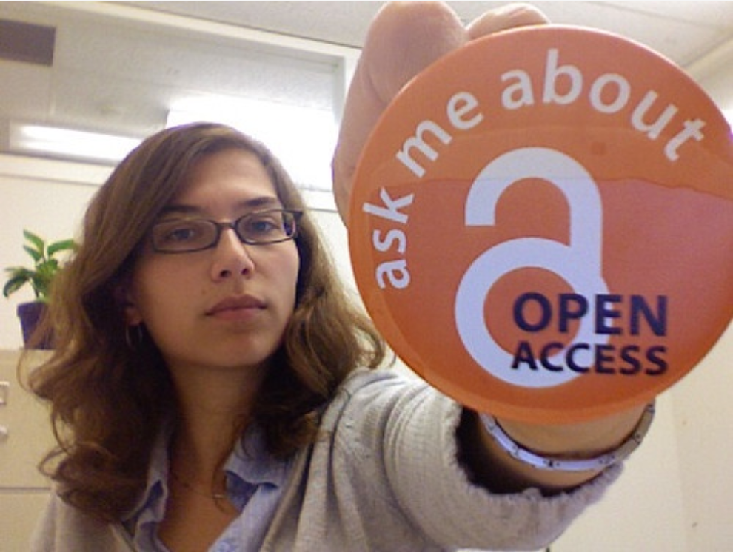
Where are we now?
Pilot is completed and proved to be a success
Universities are now in the process of implementing the Taverne Amendment for all their scholars/employees
Leiden University has amended its existing Labour Agreement with all employees involved and has incorporated these changes in its standard Labour Agreement with new employees,
stating:
- Leiden expects you to upload your ‘short works’ in the
university repository 6 months after first publication
- You may opt out, but motivate your opting out
By mollyali, search.creativecommons.org, CC BY-NC 2.0
16
Notes:
16

Slide 17

What about Europe?
LIBER (Ligue des Bibliothèques Européennes de Recherche – Association
of European Research Libraries) is the voice of Europe’s research library
community
About 450 national, university and other libraries are part of LIBER and its
wider network includes partnerships with other European organisations such as IFLA and SPARC Europe
https://libereurope.eu/
LIBER has dedicated working groups, such as
LIBER Copyright & Legal Matters Working Group
LIBER Open Access Working Group
17
Notes:
17

Slide 18
Pan-European Model Law
Both Working Groups (Copyright & Legal Matters and Open Access)
worked on a Pan-European Model Law for the Use of Publicly Funded
Scholarly Publications
Model Law was approved by LIBER’s Executive Board and can be found here:
https://libereurope.eu/zeroembargo/
Aim: zero embargo on open access for Publicly Funded Scholarly Publications
While some European countries in recent years have passed legislation allowing publicly funded
short scholarly works to be placed online in open access after a certain period, most have not (yet)
In the Model Law secondary publishing rights are the rights of authors, their employers and funders (and these rights cannot be waived via contracts with publishers)
It allows for immediate republication:
majority publicly funded: publicly funded 50% or more : full use/re-use by the end user is permitted
minority publicly funded: publicly funded less than 50%: allow only reading by the end user
It causes equity of access to scientific output across Europe
18
Notes:
18

Slide 19
Thank you for your attention
Erna Sattler
e.w.sattler@library.leidenuniv.nl
19

