Slide 1



This study has received funding from European Regional Development Fund (project No 01.2.2-LMT-K-718-03-0059) under grant agreement with the Research Council of Lithuania (LMTLT).
Socio-economic gaps in achievement among students & schools in the context of rural-urban divide
ECER 2021, 6-10 SEPTEMBER GENEVA (ONLINE)
R. Erentaitė, R. Vosylis, V. Morkevičius, B. Simonaitienė, G. Žvaliauskas
Kaunas University of Technology, Lithuania

Slide 2
1
BACKGROUND & AIMS
ECER 2021, 6-10 SEPTEMBER GENEVA (ONLINE)

Slide 3
BACKGROUND
Some recent meta studies suggest that links between students’ social-economic-cultural background (SEC) may have become stronger over recent decades (Chmielevski, 2019; Harwell et al., 2017).
However, there is a large variation in reported strength of this association and discussions regarding the role of SEC in achievement (Harwell et al., 2017).

Slide 4
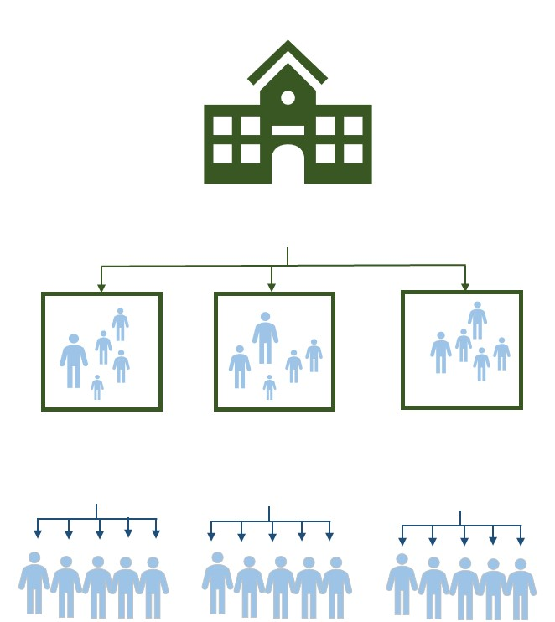
Hierarchical nature of SEC-achievement links
SEC as a student’s personal characteristic (SEC_{ind});
SEc as an aggregate characteristic of a school/ class/ educational system (SEC_{agg}).
Student
achievement

Slide 5
Variations of SES-achievement link
The strength of SEC_{ind}-achievement link varies considerably across different educational contexts (country, domain, etc.) (Chmielevski, 2019; Harwell et al., 2017).
The strength of SEC_{agg}- achievement link varies from null to strong across different educational contexts (Holzberger et al., 2020; Van Ewijk & Sleegers, 2010).
Moreover, in some contexts SEC_{agg} moderates SEC_{ind}- achievement link, but the effect varies from negative (compensatory) to positive (anti-compensatory)(Gustafsson et al., 2018).

Slide 6
SES and achievement in Lithuania
Over the recent decades, socio-economic inequalities have sharpened in the Lithuanian society and could be considered among the highest in the EU (Lazutka, Juška, & Navickė, 2018).
SEC-achievement link is stronger in Lithuania compared to the neighbouring countries (Zabulionis, 2020).
SEC-achievement link partly overlaps with rural-urban divide in achievement: students with similar SES have different achievement depending on the type of location (Zabulionis, 2020).
Some indications that educational system is compensatory with respect to SEC, i.e., in schools with a high SEC_{agg}, the SEC_{ind}-achievement link is weaker than in low-SEC_{agg} schools (Gustafsson et al., 2018).

Slide 7
STUDY AIMS
Considering the need for a contextualized understanding of SEC-achievement link we aimed:
To estimate SEC-achievement link among 8th grade Lithuanian students
  On an individual (student) level;
  On an aggregate (school) level;
  And test for a SES cross-level interaction;
To take into account potential SEC-achievement link variations across urban and non-urban locations in Lithuania.

Slide 8
2
METHOD
ECER 2021, 6-10 SEPTEMBER GENEVA (ONLINE)

Slide 9
SAMPLE
Data come from the National Survey of Student Achievement (NSSA) (open-access data collected by the National Examination Center);
Nationally representative cross-sectional surveys during 2012 – 2016;
Random classes within random schools (nested random sampling);
2014 cohort of Lithuanian 8th grade students used in current study:
 | N students | N schools
OVERALL | 3763 | 148
City | 1221 | 45
Town | 1801 | 64
Village | 741 | 39

Slide 10
INSTRUMENTS
Assessment of school functioning aspects |  | Number of items | Coefficient α 2014
Construct | Measure
Math achievement | Standardized math test | 5 | .86-.93
Reading achievement | Standardized reading test | 4 | .71-.86
Social sciences | Standardized social sc. test | 4 | -
Social-economic-cultural index (SEC) | Home material, cultural & educational possessions, free school meals, paid tutors | 9 | 65 (ω)
Location | City/ town/ village | 1 | -

Slide 11
ANALYTIC APPROACH
Multilevel regression (MLR) with Mplus 8.4
Estimator – maximum likelihood robus (MLR)
Latent variable aggregation (to school level)
Separate models for math, reading & social sciences
Estimation – full information maximum likelihood (FIML) to deal with missing data (MCAR by design)

Slide 12
3
RESULTS
ECER 2021, 6-10 SEPTEMBER GENEVA (ONLINE)

Slide 13
SEC-achievement correlations
ICC | SEC | MATH | READ | SOC
SEC | .197 | .893 | .804 | .794
MATH | .207 | .157 | .844 | .870
READ | .237 | .599 | .166 | .881
SOC | .280 | .761 | .727 | .175
Note. All correlations are statistically significant at p<.001; Correlations at individual level are presented below diagonal; Correlations at school level are presented above diagonal; ICC estimates are presented on the diagonal

Slide 14
SEC-achievement link WITHIN/ BETWEEN
Share of variance explained by SEC_{ind}
Share of variance explained by SEC_{agg}

Slide 15
SEC-achievement link WITHIN by location
Share of variance in achievement explained by SEC_{ind}

Slide 16
SEC-achievement link BETWEEN by location
Share of variance in achievement explained by SEC_{agg}

Slide 17
Slopes and compositional effects by location
LOCATION | MATH | READING | SOCIAL SCIENCES
 | SLOPE AT INDIVIDUAL
CITY | 133.60*** | 89.738*** | 139.885***
TOWN | 84.66*** | 125.975*** | 116.089***
VILLAGE | 51.652* | 98.933*** | 94.508*
 | SLOPE AT SCHOOL LEVEL
CITY | 442.776*** | 284.031*** | 404.114***
TOWN | 325.892** | 330.622*** | 309.713*
VILLAGE | 245.517ns | 360.578* | 285.236ns
 | COMPOSITIONAL (BB-BW)
CITY | 309.173*** | 194.293*** | 264.229***
TOWN | 241.232* | 204.647* | 193.625ns
VILLAGE | 193.864ns | 261.645ns | 190.728ns
Note. *p<0.05; **p<0.01; ***p<0.001.

Slide 18
SEC-achievement cross-level interactions
Subject | Parameter |  | FIML
MATH |  | N | 3763
 | RANDOM SLOPE | MEAN | 92.97***
 |  | VARIANCE | 851.81**
 | SEK CROSS LEVEL INTERACTION | SLOPE | 116.079*
READING |  | N | 3763
 | RANDOM SLOPE | MEAN | Model did not converge
 |  | VARIANCE | Model did not converge
 | SEK CROSS LEVEL INTERACTION | SLOPE | Model did not converge
SOCIAL SCIENCES |  | N | 3763
 | RANDOM SLOPE | MEAN | Model did not converge
 |  | VARIANCE | Model did not converge
 | SEK CROSS LEVEL INTERACTION | SLOPE | 251.25***

Slide 19
4
CONCLUSIONS AND IMPLICATIONS
ECER 2021, 6-10 SEPTEMBER GENEVA (ONLINE)

Slide 20
CONCLUSIONS
SEC accounts for a very large share of differences in achievement among Lithuanian schools, particularly, among the city schools.
When school-level SEC is controlled for, individual student SEC accounts for a very small share of differences in achievement among students, regardless of location.
Thus, school SEC composition plays a major role in SEC-achievement gap in Lithuania.

Slide 21
IMPLICATIONS FOR EDUCATIONAL POLICIES
Social equity policies in education should be complemented with special measures to reduce SEC role in achievement among schools in cities;
School-level SEC correlates should be identified, including educational resources, school climate, instructional quantity and quality, but also admission procedures reviewed;
This requires targeted school-based assessments, which include not only measures of achievement, but also social-economic-cultural student background, as well as a range of school processes & characteristics, assessed on an individual and school level.

Slide 22
IMPLICATIONS FOR RESEARCH
Continue searching for appropriate approaches to deal with planned random missingness in NSSA data:
  multiple imputation procedure with NSSA data?
Validate current findings with the most recent data from international studies of student achievement (PISA, TIMMS).
Assess SES-achievement link controlling for initial levels of achievement:
  Need for longitudinal data.

Slide 23
REFERENCES
Chmielewski, A. K. (2019). The global increase in the socioeconomic achievement gap, 1964 to 2015. American Sociological Review, 84(3), 517–544. https://doi.org/10.1177/0003122419847165
Gustafsson, J.-E., Nilsen, T., Yang Hansen, K. (2018). School characteristics moderating the relation between student socio-economic status and mathematics achievement in grade 8. Evidence from 50 countries in TIMSS 2011. Studies in Educational Evaluation, 57, 16-30. https://doi.org/10.1016/j.stueduc.2016.09.004
Harwell, M., Maeda, Y., Bishop, K., & Xie, A. (2017). The surprisingly modest relationship between SES and educational achievement. The Journal of Experimental Education, 85(2), 197–214. https://doi.org/10.1080/00220973.2015.1123668
Holzberger, D., Reinhold, S., Lüdtke, O., & Seidel, T. (2020). A metaanalysis on the relationship between school characteristics and student outcomes in science and maths – evidence from large-scale studies. Studies in Science Education, 56(1), 1-34. https://doi.org/10.1080/03057267.2020.1735758
Lazutka, R., Juška, A., & Navickė, J. (2018). Labour and capital under a neoliberal economic model: Economic growth and demographic crisis in Lithuania. Europe-Asia Studies, 70(9), 1433–1449. https://doi.org/10.1080/09668136.2018.1525339
Van Ewijk, R., & Sleegers, P. (2010). The effect of peer socioeconomic status on student achievement: A meta-analysis. Educational Research Review, 5, 134–150. https://doi.org/10.1016/j.edurev.2010.02.001
Zabulionis, A. (2020). Tarptautinio švietimo tyrimo OECD PISA Lietuvos ir kaimyninių šalių duomenų tikslinė antrinė analizė. ŠMSM, NŠA, Vilnius.

Slide 24

This study has received funding from European Regional Development Fund (project No 01.2.2-LMT-K-718-03-0059) under grant agreement with the Research Council of Lithuania (LMTLT).
ECER 2021, 6-10 SEPTEMBER GENEVA (ONLINE)
THANK YOU FOR YOUR ATTENTION!
Contact: rasa.erentaite@ktu.lt

