Slide 1
The Near Future Growth Expectations Of The City Gas Covering The Historical Sites In Jakarta-Indonesia
Andry Prima, Wildan Tri Koesmawardani, Arinda Ristawati, Riskaviana Kurniawati,
Harin Widiyatni, Pauhesti, Dwi Atty Mardiana
Corresponding E-mail;
andry.prima@trisakti.ac.id
Faculty of Earth Technology and Energy
Universitas Trisakti, Jakarta, Indonesia

Slide 2
OUTLINES
INTRODUCTION
RESEARCH METHODOLOGY
RESULTS AND DISCUSSION
CONCLUSION

Slide 3
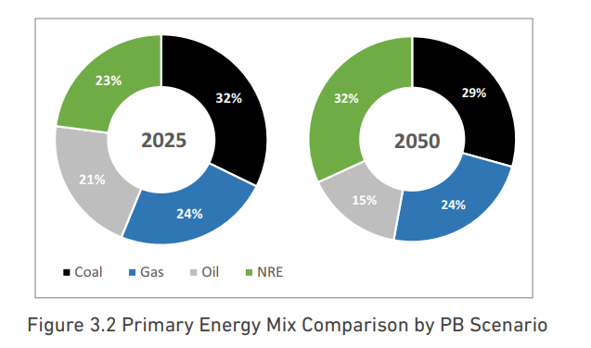
1
INTRODUCTION
“The National Energy Policy captured the basis for renewable energy development in Indonesia and also specified a national target for the optimal energy mix.” IEO (2019)

Slide 4
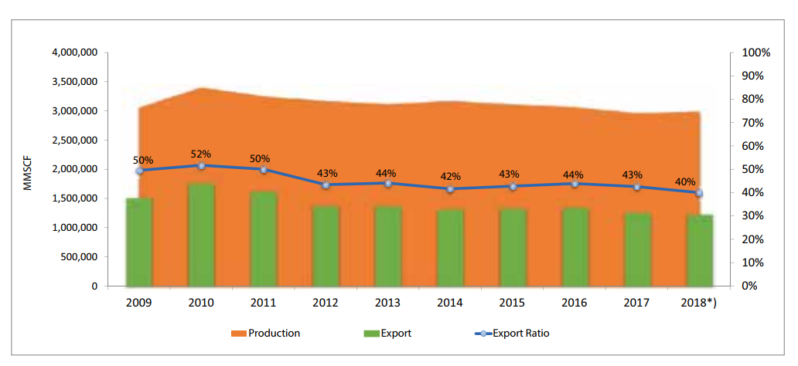
Gas Production vs Export
Source IEO(2019)

Slide 5
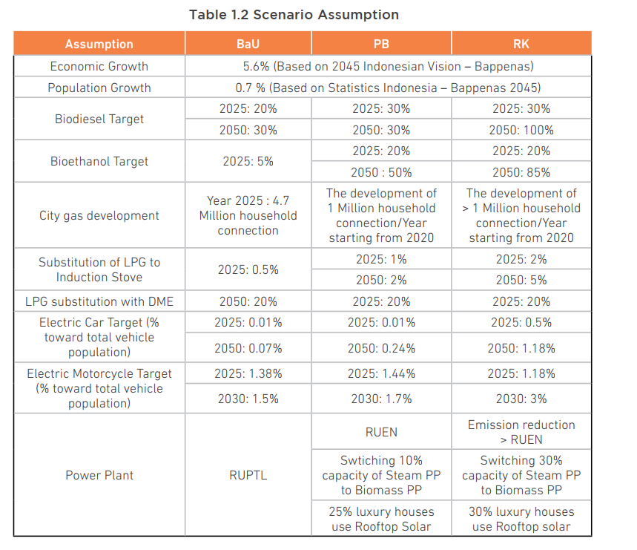
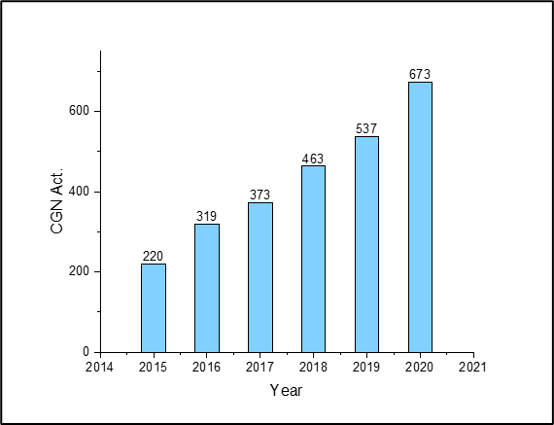
Scenario Assumption
Source IEO(2019)

Slide 6
The Development of City Gas
“The unexpected pandemic necessitated a thorough review of key policies relating to the proposed construction. As a result, the realization of the initial project phase during the Covid-19 outbreak in 2020 was declined and further adjusted to 127,864. Surprisingly, the achievement surpassed the reviewed proposal by over 6% or was approximately 135,286. These figures obviously indicated 50.84% of the total projects were halted, contrary to earlier intention of building a minimum of 10 million city gas pipe connections by 2025”

Slide 7
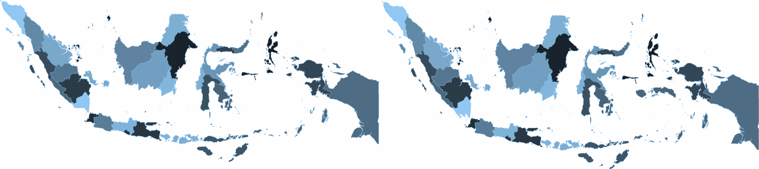
City
Gas Project
p~gn
energy for life
APBN 2020 : 129.861 SR*
A-of-
PGN 2020 : 50.000 SR
-·
.
·~
Jakarta dan
^{24 cities/regencies} Tangerang
Progress:
Progress:
Feasibility Study, FEED-DEDC Initial Business Proposal
Phase
Progress
: 24 cities/regencies
: Construction 82,64 %
*Adjustment to the City Gas Project APBN 2020 due to efficiency policy
from Government, originally 266.070 household connections in 2020
divided into 127.864 in 2020 and 138.206 in 2021.
25

Slide 8
1
INTRODUCTION
2
Goals and Limitations
This study provided a comprehensive description on the impact of certain variables contributing to the reduction of the city gas pipe connections. Moreover, city gas has replaced the LPG, due to effective and collaborative efforts of government related authorities.
The limitations of this investigation was the inability to access real time data, attributed to non-disclosure agreement. Therefore, data published publicly by similar government agencies were utilized, although were inadequate from the metropolitan area. These details are employed to address and interpret the growth conditions of city gas.
The originality of this study aimed at providing a suitable model with potential application by regulators or management of energy organizations, in order to predict the ideal number pertaining to the development of city gas connections during Covid-19 occurrence. Furthermore, the growth data of consumers in certain regions are sufficient for the to predict the projection.

Slide 9
1
INTRODUCTION
2
RESEARCH METHODOLOGY
The commonly known multivariable analysis stated the relationship as the following , Montgomery et al. (2013):
Y= β₀ + β₁X_{1i} + Β₂X_{2i} + e₁
Where;
Y= dependent variable
β = coefficient
X= independent variable

Slide 10
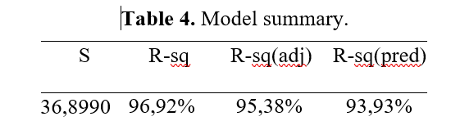
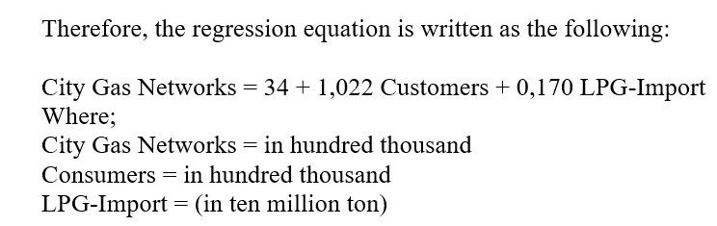
3
RESULTS AND DISCUSSION

Slide 11
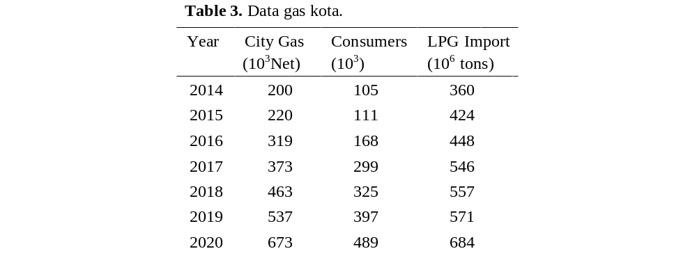

Slide 12
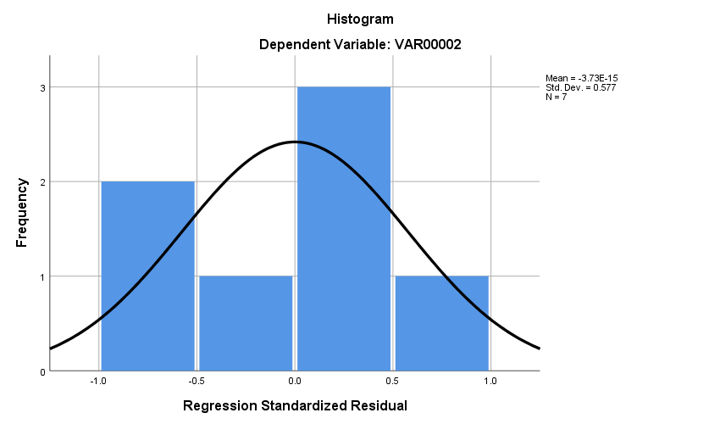
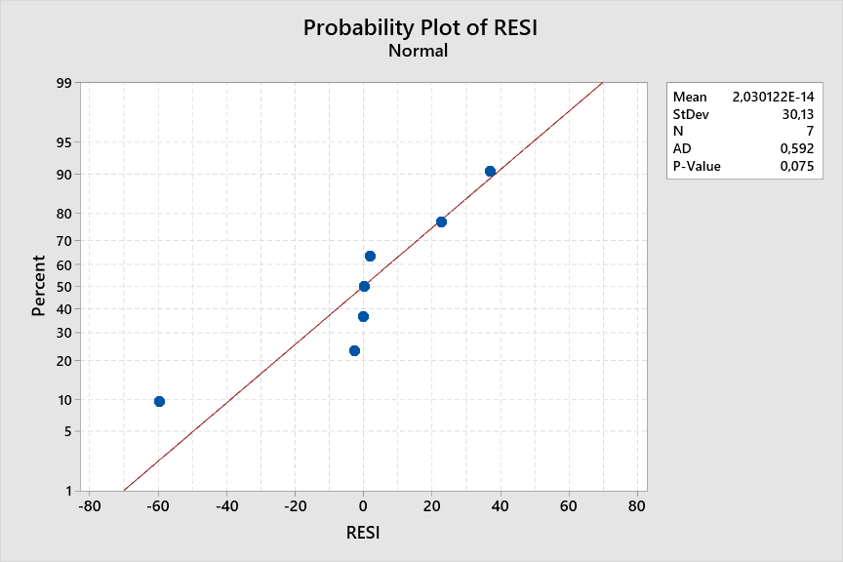
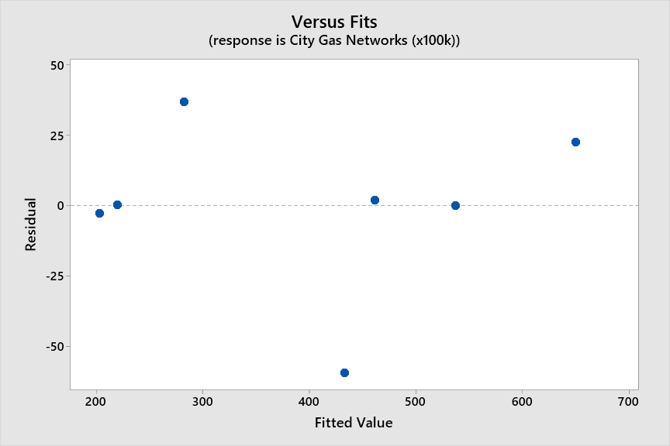
3
RESULTS AND DISCUSSION

Slide 13
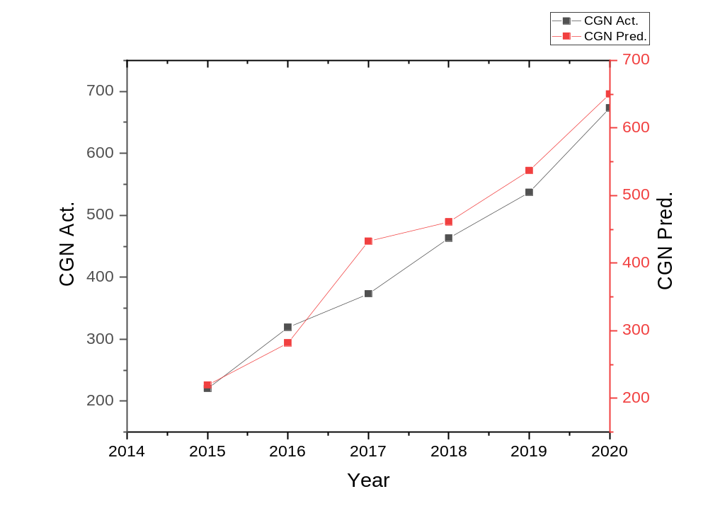
3
RESULTS AND DISCUSSION
the accumulation of city gas growth

Slide 14
4
CONCLUSION
Based on the results and discussion, 96.92% of the data from applied variables were able to describe the linear model developed in this study. The generated histogram pattern was also neither right nor left-skewed, and therefore, was referred as an early indication of normality. Moreover, P-value was estimated at 0.075 slightly higher than α in the regression (0,05), assumed to also prove normality. Evidently, no pattern of heteroskedastic system was discovered in the residual plots, and similarly, no collinearity between variables was identified. Furthermore, linear regression was applied to predict the growth of city gas connections in the metropolitan area, using the derived model. The results showed the projected value was able to describe the deceleration of the development of the city gas connections. Therefore, the model is confirmed to be statistically valid for this prediction study.

Slide 15
ありがとうございました
Arigatōgozaimashita
TERIMA KASIH
THANK YOU

