Slide 1
What is Open Science?
Richard Dennis, University of Copenhagen
Milan Janíček, Charles University Prague
Jochen Apel, Heidelberg University

Slide 2
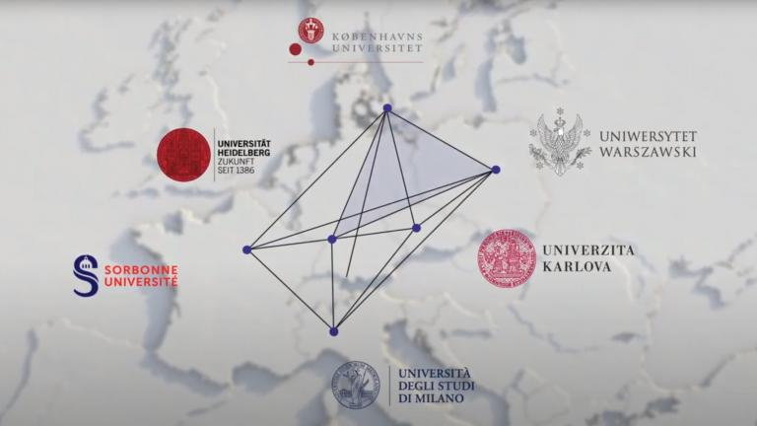
4EU+ Alliance and Open Science
4EU+ is a transnational strategic university association.
Aim: Strengthen the European vision of deepened cooperation and mutual enrichment in research and teaching
Open Science is an integral part of this.
Two 4EU+ projects currently work on Open Science.
„Open for you – an Introduction Series to Open Science“ – 14 session on OS topics!

Slide 3
Agenda
Open Science and the scientific method
Open Access & Future of Scholary Publishing
FAIR Data Principles
Education & Skills
Research Integrity
EOSC
Citizen Science

Slide 4
Open Scholarship

Slide 5
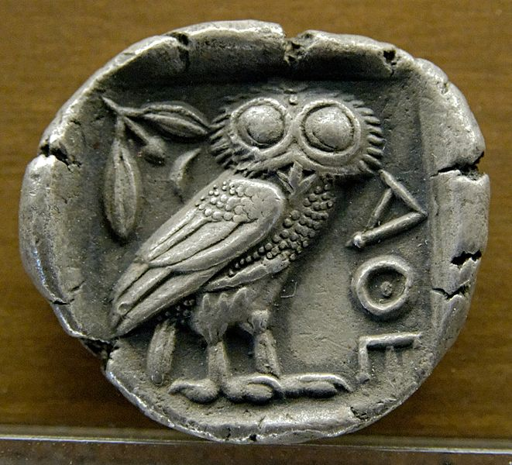
How can research be carried out in a way…
that its results are reliable, transparent and comprehensible?
that it is understandable and accessible?
that there is confidence in its results?
that new insights can be found?
ensuring that scientific progress takes place as quickly as possible?
Museum of Fine Arts of Lyon, CC BY 2.5 <https://creativecommons.org/licenses/by/2.5>, via Wikimedia Commons, https://commons.wikimedia.org/wiki/File:Tetradrachm_Athens_480-420BC_MBA_Lyon.jpg

Slide 6

Aaron Pruzaniec, CC BY 2.0 <https://creativecommons.org/licenses/by/2.0>, via Wikimedia Commons, https://commons.wikimedia.org/wiki/File:Neon_Open_Sign.jpg

Slide 7
Karl Popper
Public nature of scientific methods
Individuals cannot do science, science is always social activity.
Why? Only in this way something like objectivity can emerge.
Individual researchers are in love with their models, methods and theories. They will stick to them with all their strength.
Public control and criticism by third parties is a necessary condition for scientific activity.
Institutions that make this kind of criticism possible: Laboratories, journals, congresses.
How do these institutions change?

Slide 8
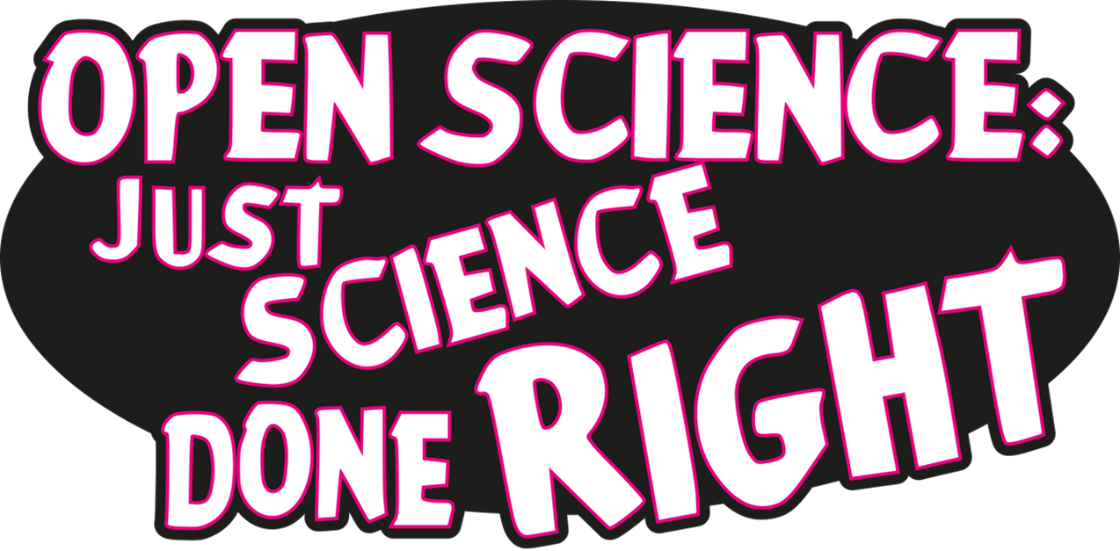
Melanie Imming, & Jon Tennant. (2018). Sticker open science: just science done right (ENG). Zenodo. https://doi.org/10.5281/zenodo.1285575

Slide 9
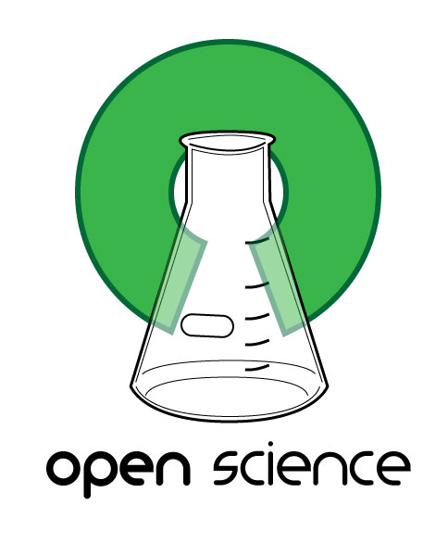
Open Science
Open Access
Open Research Data
Open Source / Open Research Software
Open Methodology
Open Evaluation Practices
Citizen Science
Open Licenses
“Open Science describes an on-going movement in the way research is performed, researchers collaborate, knowledge is shared, and science is organised. It affects the whole research cycle and its stakeholders, enhances science by facilitating more transparency, openness, networking and collaboration.
Open Science opens up scientific processes and products from all levels to everyone. As such it includes Open Access, Open Research Data, Open Methodology, Open Evaluation, Citizen Science.”
https://www.openaire.eu/what-is-open-science
Image: G.emmerich, CC BY-SA 3.0 <https://creativecommons.org/licenses/by-sa/3.0>, via Wikimedia Commons, https://commons.wikimedia.org/wiki/File:Open_Science_Logo.jpg

Slide 10
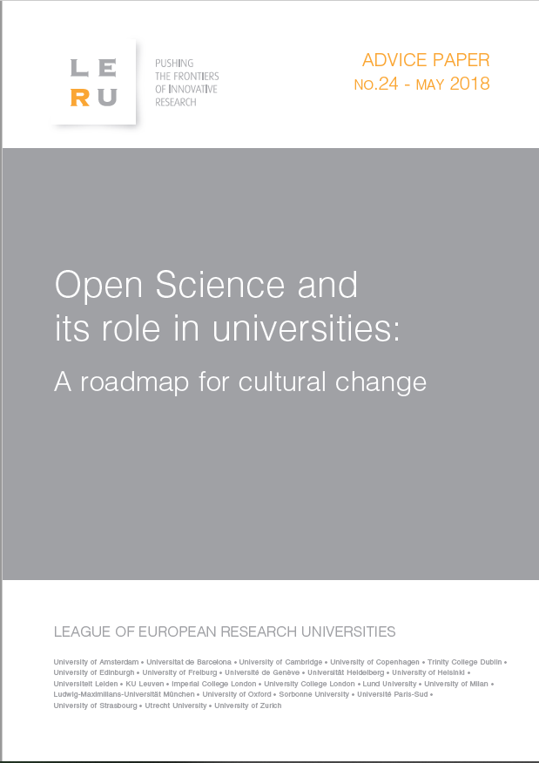
8 Dimension of Open Science
The Future of Scholarly Publishing
FAIR Data Principles
The European Open Science Cloud (EOSC)
Education and Skills
Rewards and Incentives
Next-generation Metrics
Research Integrity
Citizen Science
https://www.leru.org/files/LERU-AP24-Open-Science-full-paper.pdf

Slide 11
8 Dimension of Open Science
The Future of Scholarly Publishing
FAIR Data Principles
The European Open Science Cloud (EOSC)
Education and Skills
Rewards and Incentives
Next-generation Metrics
Research Integrity
Citizen Science
https://www.leru.org/files/LERU-AP24-Open-Science-full-paper.pdf

Slide 12
Open Access
Berlin Declaration on Open Access to Knowledge in the Sciences and Humanities (2003)
“Open access contributions include original scientific research results, raw data and metadata, source materials, digital representations of pictorial and graphical materials and scholarly multimedia material. [...] The author(s) and right holder(s) of such contributions grant(s) to all users a free, irrevocable, worldwide, right of access to, and a license to copy, use, distribute, transmit and display the work publicly and to make and distribute derivative works, in any digital medium for any responsible purpose, subject to proper attribution of authorship.“
https://openaccess.mpg.de/67605/berlin_declaration_engl.pdf
These and other early declarations are the starting point for a multitude of OA policies at local, national, and international levels, up to the point that the European Commission and a series of other funding bodies have made OA the standard for research projects they fund.
Cf. https://www.coalition-s.org/

Slide 13
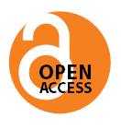
Golden Road
Primary publication is released open access
Green Road (”Self-Archiving“)
Parallel publication of preprints, postprints or publisher‘s version on subject-specific or instituional repository
Manuscript
OA publication (publisher/ repository)
Peer review
Manuscript
Publisher‘s version (closed access)
Preprint
Peer review
Postprint

Slide 14
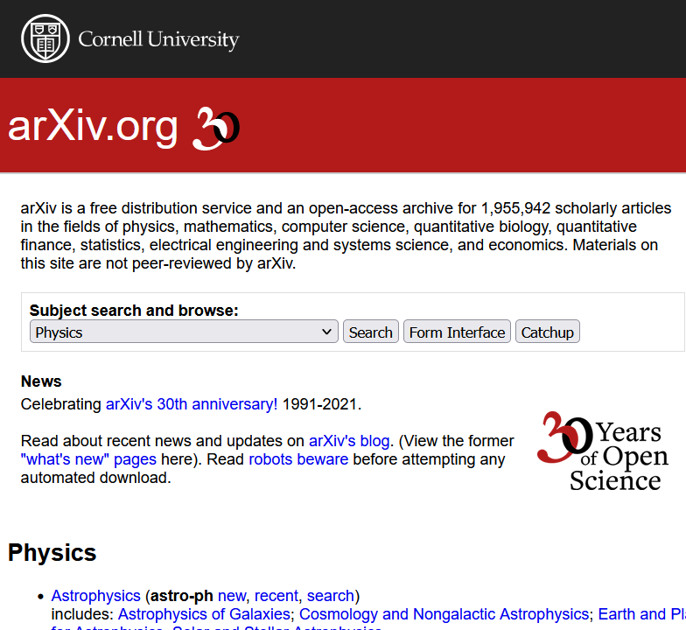
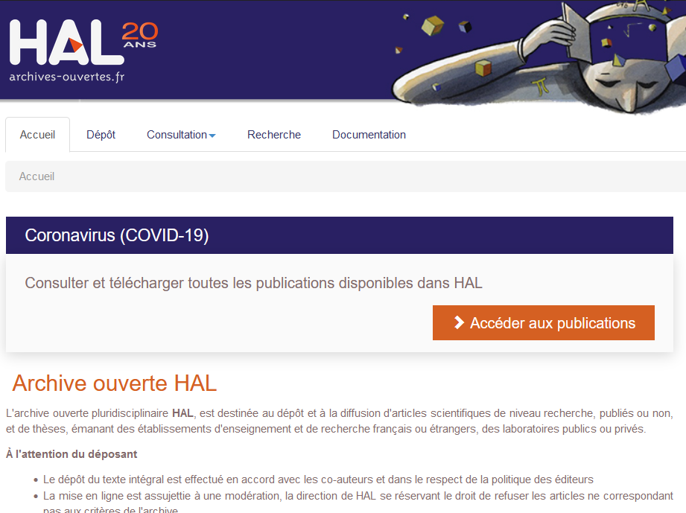
Green Open Access

Slide 15

Gold Open Access
Publishing fees (APC, BPC)
Transformative agreements (transforming subscription budgets to central open access budgets)
Membership models
Pledging/crowdfunding
Non-profit university presses
H.alhajji, CC BY-SA 4.0 <https://creativecommons.org/licenses/by-sa/4.0>, via Wikimedia Commons, https://commons.wikimedia.org/wiki/File:Golden_road.jpg

Slide 16
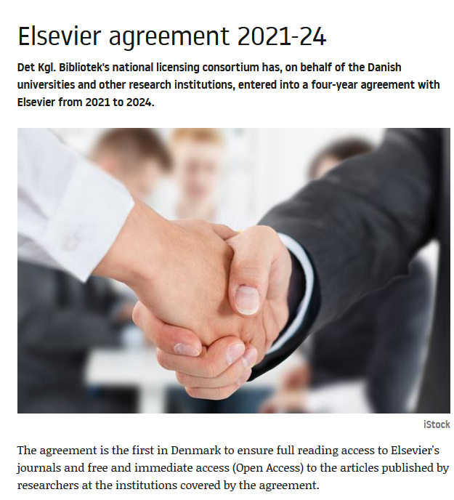
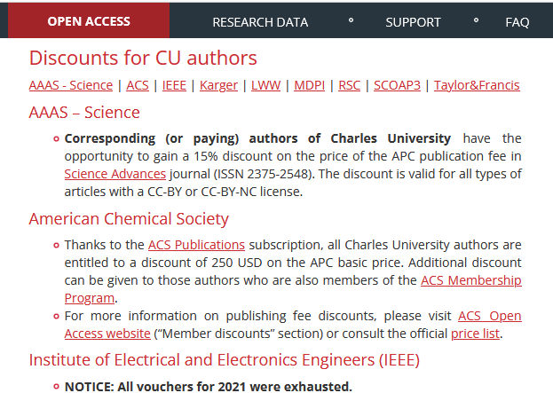
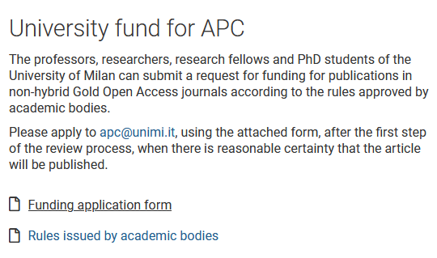
Check your institution's website for information on local support through publication funds, discounts, or umbrella framework agreements covering publishing fees.

Slide 17

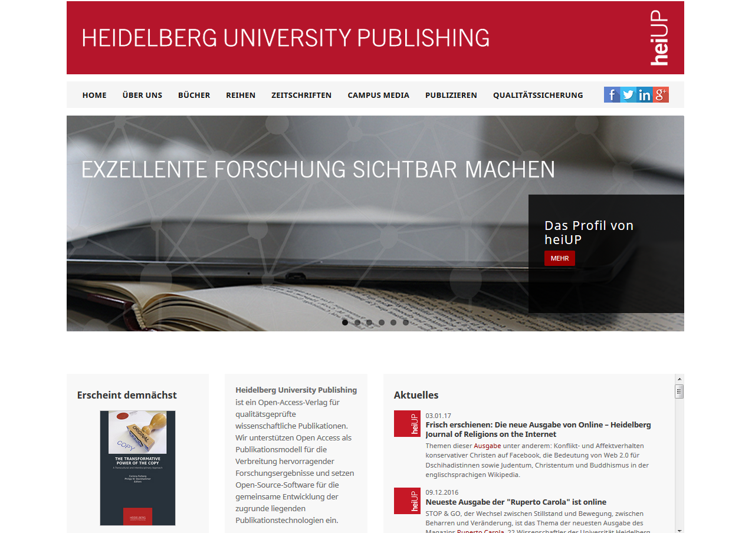
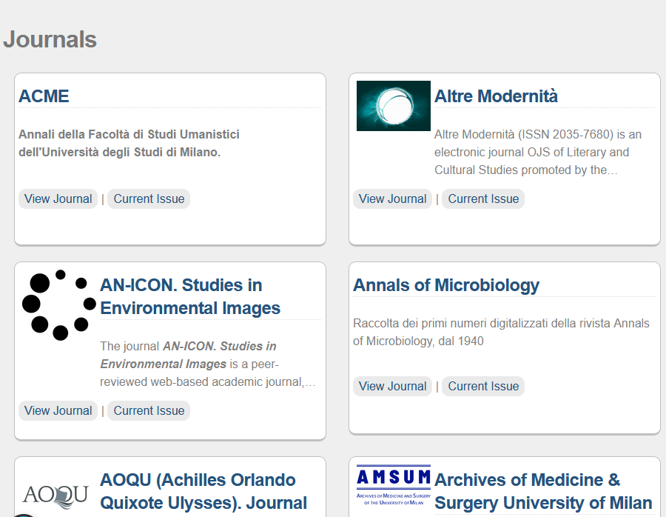

Slide 18

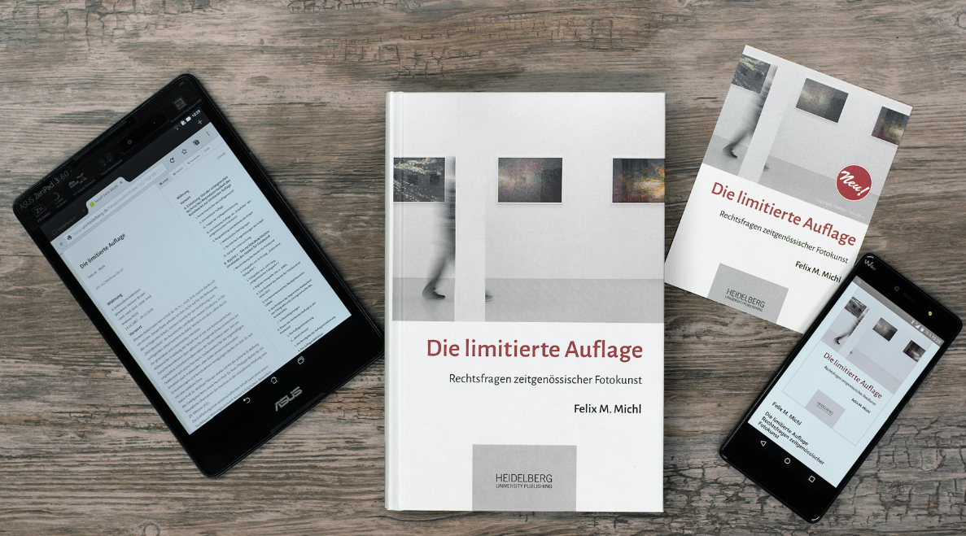

Example: Heidelberg University Publishing
E-Strategy: Open Access online version is the primary publication form, different digital formats (HTML, ePDF, EPUB)
Professional Print on Demand with national and international availability
Strict quality standards: Scientific advisory board and double blind peer review
High quality copy-editing and layout
Enhanced publications: Integration of videos, anmiations and other multimedia assets, application of controlled vocabularies and authority data in the full text, cross-linking with open research data
Sustainability and high visibility
https://heiup.uni-heidelberg.de/

Slide 19
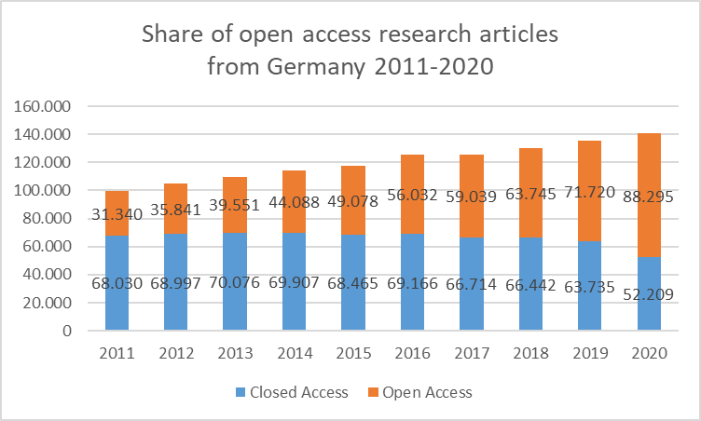
Open Access uptake
Although the numbers may vary from country to country, open access is on its way to become the dominant publishing model for research articles.
Data from Open-Access-Monitor, https://open-access-monitor.de/, data source: Web of Science

Slide 20
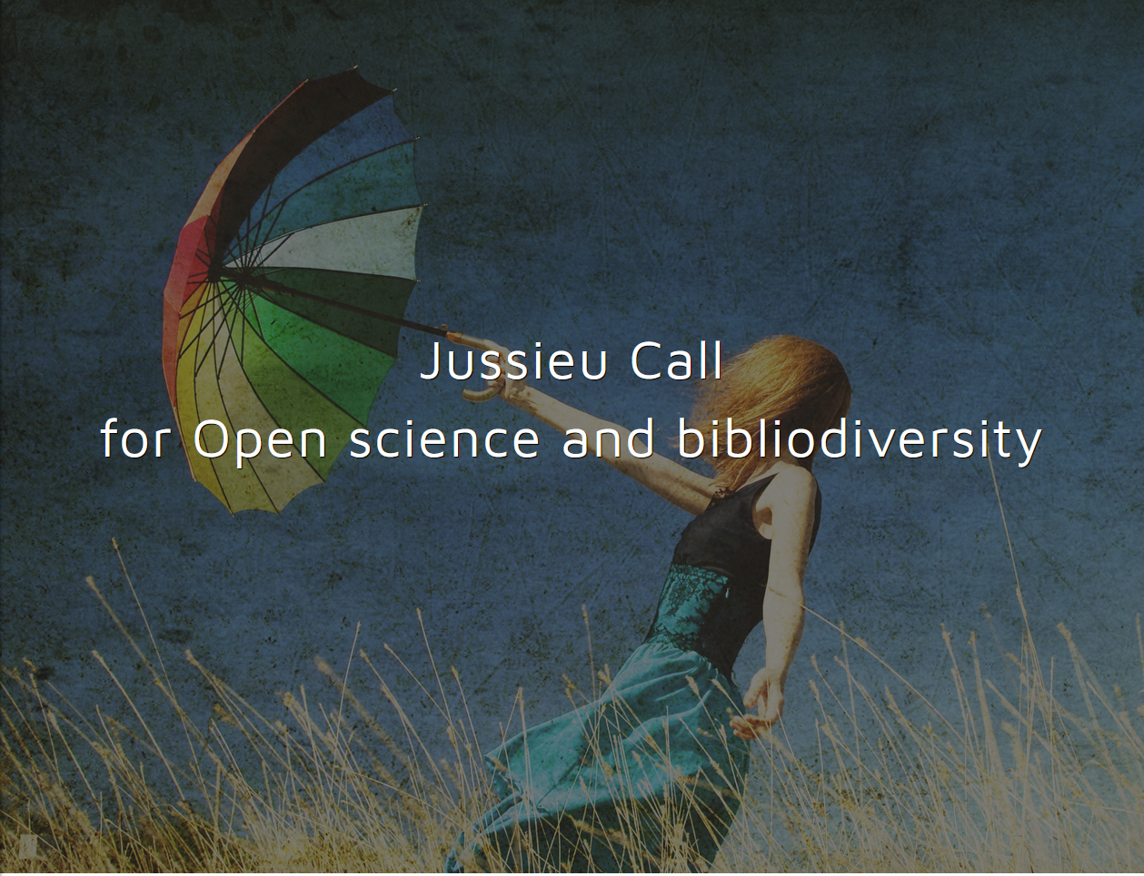
Two decades after the Berlin Declaration, the question is no longer whether to publish in open access, but how to shape the open access publishing system.
Jussieu Call for Open science and bibliodiversity (2017)
„Open Access must be complemented by support for the diversity of those acting in scientific publishing – what we call bibliodiversity […]”
https://jussieucall.org/

Slide 21
8 Dimension of Open Science
The Future of Scholarly Publishing
FAIR Data Principles
The European Open Science Cloud (EOSC)
Education and Skills
Rewards and Incentives
Next-generation Metrics
Research Integrity
Citizen Science
https://www.leru.org/files/LERU-AP24-Open-Science-full-paper.pdf

Slide 22
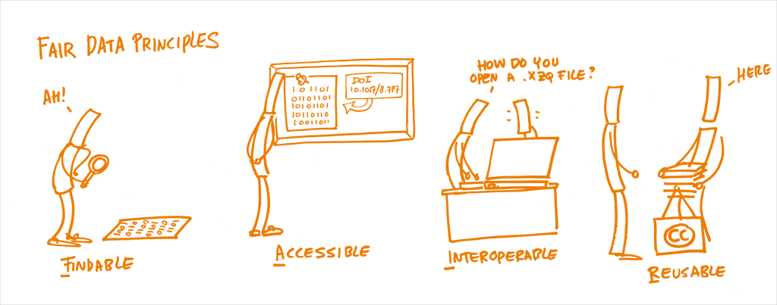
A day in the life of a scientist with FAIR data.
Illustrations: Patrick Hochstenbach (University of Gent, Belgium) The Open Science Training Handbook http://book.fosteropenscience.eu/en/

Slide 23
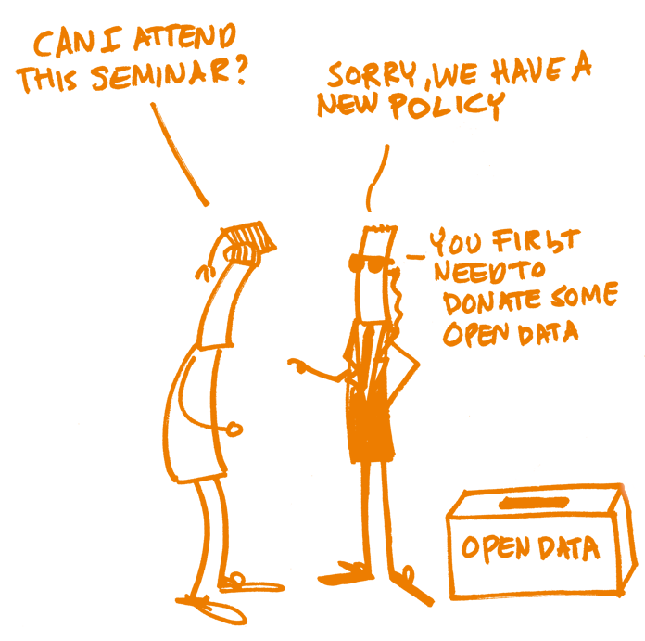
Preserve
Reuse
Share
Dissemination
Preparation
Plan
Research Project
Active
Research
Store
Collect / Create
Process / Analyse
Illustrations: Patrick Hochstenbach (University of Gent, Belgium)
The Open Science Training Handbook http://book.fosteropenscience.eu/en/
Research Data Management Workflow Cycle

Slide 24
FAIR Data Principles
In 2016, the ‘FAIR Guiding Principles for scientific data management and stewardship’ were published in Scientific Data, and since then they have gone on to become a touchstone for the long-term management of research data of all kinds. The FAIR authors intended to provide guidelines to improve the Findability, Accessibility, Interoperability, and Reusability of digital assets.
These principles emphasize machine-actionability (i.e. the ability of automated computational systems to find, access, interoperate, and reuse data with minimal or no human intervention) as humans increasingly rely on computational means to discover and work with data as a result of the increase in volume, complexity, and creation speed of data.

Slide 25
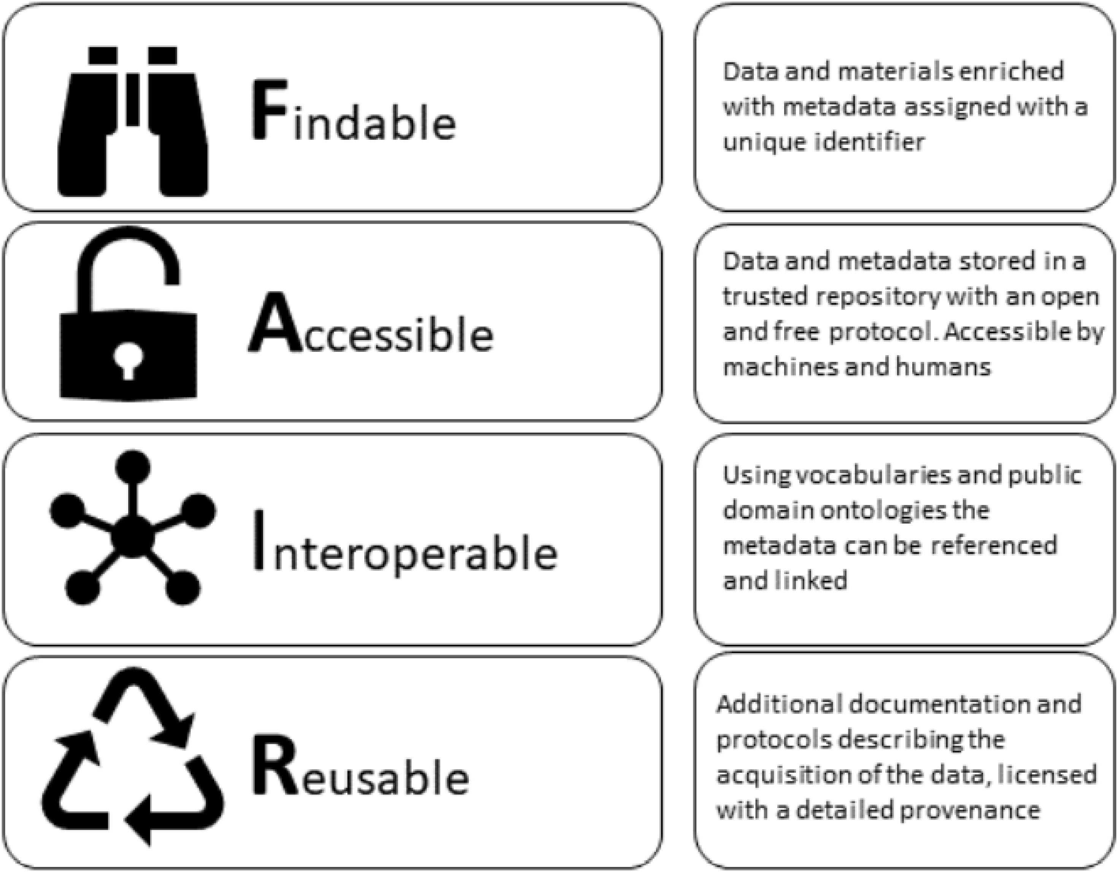
FAIR Data Principles

Slide 26
To Be Findable:
F1 - (meta)date are assigned a globally unique and eternally persistent identifier.
F2 - data are described with rich metadata
F3 - (meta)data are registered or indexed in a searchable resource.
F4 - (meta)data specify the data identifier.
F
To be Accessible:
A1 - (meta)data are retrievable by their identifier using a standardized communications protocol
A1.1. - the protocol is open, free and universally implementable.
A1.2. - the protocol allows for an authentication and authorization procedure where necessary
A2 - metadata are accessible, even when the data are no longer available
A
To be Interoperable:
I1 - (meta)data use a formal, accessible, shared and broadly applicable language for knowledge representation.
I2 - (meta)data use vocabularies that follow FAIR principles
I3 - (meta)data include qualified references in other (meta)data
I
To be Reusable:
R1 - (meta)data have a plurality of accurate and relevant attributes
R1.1. - (meta)data are released with a clear and accessible data usage license
R1.2. - (meta)data are associated with their provenance.
R1.3 - (meta)data meet domain-relevant community standards
R

Slide 27
FAIR Data Principles
In order to properly understand FAIR, you should keep four things in mind:
Both humans and machines are intended as digesters of data.
  This will lead to the creation of an ecosystem that is fast to respond to change and automatically adapts to new findings or changes: the Internet of FAIR Data and Services.
  This is the reason for focusing on standards for data, identification mechanisms, data availability, etc.
The FAIR principles apply to both data and metadata.
  Where metadata are descriptions of or records about data.
  This is why the term “(meta)data” is stated in the principles.
The principles are not necessarily about open data.
  You can work in a FAIR manner with data that is not intended for public availability.
The FAIR principles are not rules or standards.
  The FAIR principles must not be mistaken for rules or standards that you can use to evaluate tools, data, policies, etc. This would soon make the principles out-of-date and inapplicable across research disciplines.
  Adopting the FAIR principles will often be a gradual adaptation of work routines – but it could also be a huge leap, where you replace one type of infrastructure with another. It will be up to the different research areas and research communities to make the FAIR principles work in their respective contexts.

Slide 28
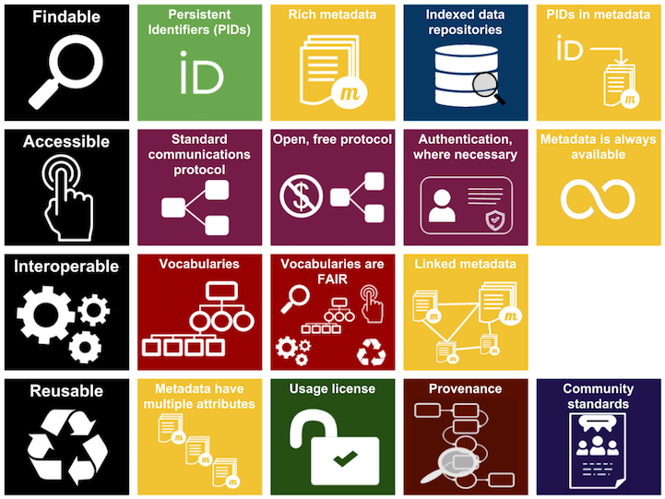
Image Credit: The Magnifying glass, Tap, Gears set, Recycle sig, Storage, Infinity, Discussion, Shield, and Man User icons made by Freepik from www.flaticon.com are licensed by CC 3.0 BY. All other icons made by ARDC. Entire FAIR resources graphic is licensed under a Creative Commons Attribution 4.0 International License

Slide 29
Publish searchable information online
Link and cite published datasets
Manage access to files in published datasets
Define rights for reuse of your data
Describe your research data
Use open file formats

Slide 30
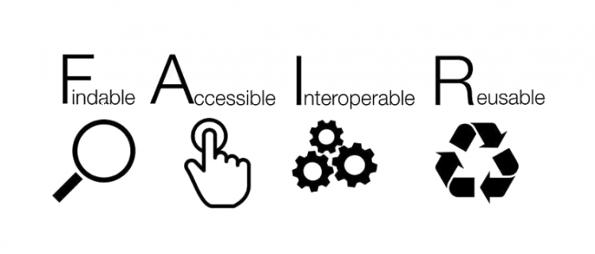
Why is FAIR important?
Publication, outreach and impact are increased by making data FAIR and the possibility of researchers and machines discovering data relevant to their research. For example, there is evidence that articles with Open and FAIR data available receive more citations (SPARC Europe report) **. Moreover, FAIR practices also have a high economic return in the long term and open the door to citizen science, which is an increasingly important policy objective (Collins et al. 2018).

Slide 31
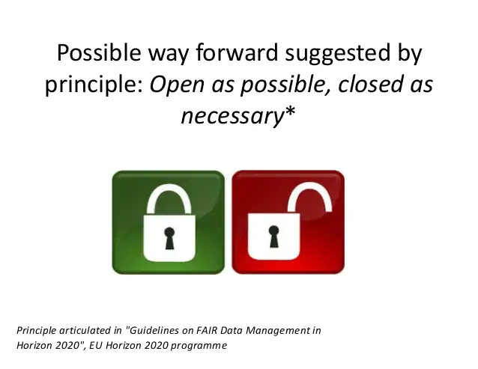
FAIR Data Principles

Slide 32
8 Dimension of Open Science
The Future of Scholarly Publishing
FAIR Data Principles
The European Open Science Cloud (EOSC)
Education and Skills
Rewards and Incentives
Next-generation Metrics
Research Integrity
Citizen Science
https://www.leru.org/files/LERU-AP24-Open-Science-full-paper.pdf

Slide 33
Education and skills
open science brings new opportunities, but also some challenges
it is important to be ready to solve them
new skills on both personal and institutional level
  get new skills yourself (as a researcher)
  get support from your university

Slide 34
Groups of open science skills
Skills related to open access publishing
Skills related to data management and open data
Skills enabling professional research conduct
Citizen science skills

Slide 35
Skills related to open access publishing
where to publish
how to auto-archive
how to improve societal impact
contracts with publishers
new publishing methods
licensing and copyright
bibliometrics and research impact reporting

Slide 36
Skills related to data management
domain specific formats, standards and tools
data management (including planning)
  FAIR data
data analysis
  including reproducibility
data description (metadata)
institution specific workflows
  data protection, availability policies etc
data citation impact

Slide 37
Skills enabling professional research conduct
research management
legal skills
  licensing, intellectual property (both as users and as creators)
research integrity and ethical skills
  avoiding plagiarism
  sensitive data management
  ((most cases are cases of neglect rather than fabrication, falsification or fraud))

Slide 38
Citizen science skills
research design
citizens engagement & communication
relationships & trust

Slide 39
Training or support?
Everyone can’t be expert on everything
  eg Data Stewards can help with keeping the data FAIR
what to do?
  be aware of new requirements
  check support provided by your university in all areas mentioned
  be ready to undertake training in some areas ;-)

Slide 40
8 Dimension of Open Science
The Future of Scholarly Publishing
FAIR Data Principles
The European Open Science Cloud (EOSC)
Education and Skills
Rewards and Incentives
Next-generation Metrics
Research Integrity
Citizen Science
https://www.leru.org/files/LERU-AP24-Open-Science-full-paper.pdf

Slide 41
Research Integrity – 4 principles
Reliability in ensuring the quality of research, reflected in the design, the methodology, the analysis and the use of resources.
Honesty in developing, undertaking, reviewing, reporting and communicating research in a transparent, fair, full and unbiased way.
Respect for colleagues, research participants, society, ecosystems, cultural heritage and the environment.
Accountability for the research from idea to publication, for its management and organisation, for training, supervision and mentoring, and for its wider impacts

Slide 42
Reproducibility crisis?
significant portion of research outputs not reproducible?
  many studies in recent years
are data for this research available / do they even exist??
possible reasons
  too complex experimental design – difficult to recreate
  human related reasons - accidental or malicious
Notes:
Accidental or malicious ((p8,repro-eu))

Slide 43
Reproducibility & Open Science
open science promotes
  sharing methodology
  sharing research data
    including raw data
    FAIR principles (!)
    principle “as open as possible, as closed as necessary”
  sharing research software
  licensing (as open as possible)
  open peer review process
  creating of rewards and incentives regarding:
    creating reproducible research
    testing reproducibility of existing research

Slide 44
What to do?
keep research integrity & reproducibility in your mind when conducting your research
  provide all relevant data and documentation
create and provide FAIR data
  use proper research data management during the research – it is very difficult/impossible to fix it at the end

Slide 45
8 Dimension of Open Science
The Future of Scholarly Publishing
FAIR Data Principles
The European Open Science Cloud (EOSC)
Education and Skills
Rewards and Incentives
Next-generation Metrics
Research Integrity
Citizen Science
https://www.leru.org/files/LERU-AP24-Open-Science-full-paper.pdf

Slide 46
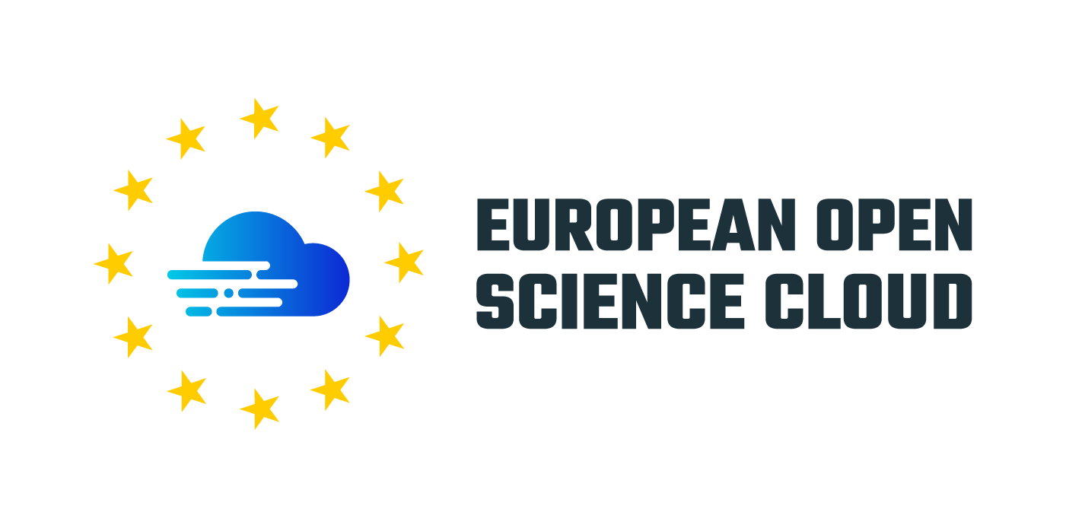
EOSC – What is it?

Slide 47
EOSC – What is it?
The European Open Science Cloud (EOSC) is a European Commission initiative aimed at developing a federated infrastructure providing its users with services promoting Open Science practices
Aims to develop a trusted, virtual, federated environment that cuts across borders and scientific disciplines to store, share, process, and re-use research digital objects (like publications, data, and software) following FAIR Data principles.
Brings together institutional, national and European stakeholders, initiatives, and data infrastructures to develop an inclusive open science ecosystem in Europe.
This is expected to lead towards:
new insights and innovations
higher research productivity and
improved reproducibility in science.

Slide 48
EOSC Portal – What is it?
The EOSC Portal is a gateway to information and resources in EOSC. It is also part of the EOSC implementation roadmap as one of the expected “federating core” (set of services providing the means to discover, share, access and re-use data and services) services contributing to the implementation of the “Access and interface” action line. It has been conceived to provide European delivery channel connecting the demand-side and the supply-side of the EOSC and all its stakeholders.
The EOSC Catalogue & Marketplace acts as an entry point to the multitude of services and resources for researchers.

Slide 49
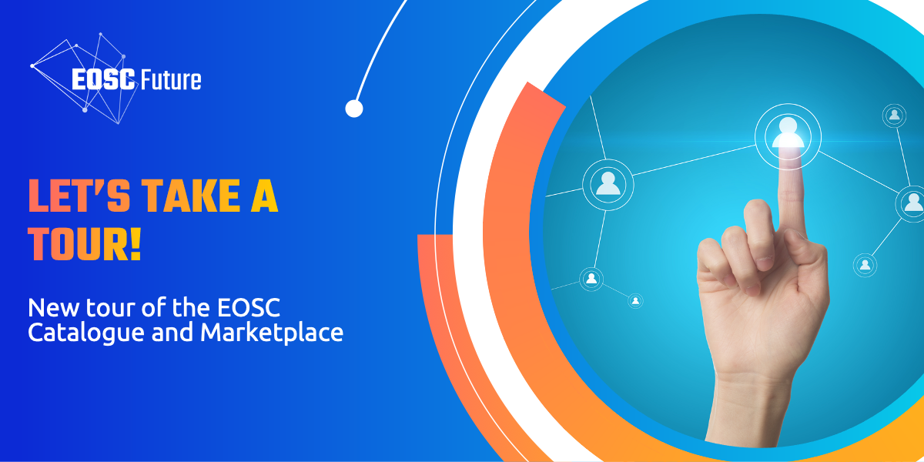
EOSC Catalogue & Marketplace

Slide 50
EOSC – Governance 2021 - 2027
EU countries and countries associated with Horizon 2020, represented in the EOSC Governance
Board, agreed unanimously to run the EOSC as a co-programmed European Partnership
under Horizon Europe from 2021.
EOS Association
The new governance model agreed with
EU countries for the current
EOSC implementation phase
after 2020 is tripartite including:
European Commission
EOSC
Steering Board
EOSC Governance 2021-2027

Slide 51
8 Dimension of Open Science
The Future of Scholarly Publishing
FAIR Data Principles
The European Open Science Cloud (EOSC)
Education and Skills
Rewards and Incentives
Next-generation metrics
Research Integrity
Citizen Science
https://www.leru.org/files/LERU-AP24-Open-Science-full-paper.pdf

Slide 52
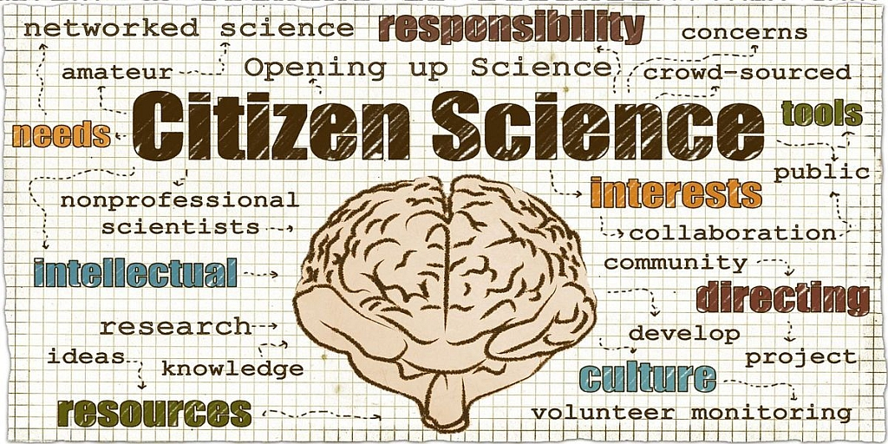
Citizen science involves researchers co-creating with the public in some way during the research process. Illustration by: Lotta W Tomasson/VA CC BY-NC 2.0
Citizen Science

Slide 53
Citizen Science: What is Citizen Science?
Citizen science can be described as the voluntary participation of non-professional scientists in research and innovation at different stages of the process and at different levels of engagement, from shaping research agendas and policies, to gathering, processing and analyzing data, and assessing the outcomes of research.
In very simplified terms, in citizen science, scientific projects are carried out with the assistance or completely by interested amateurs [lat. amator "lover"].
The Citizen Scientists formulate research questions, report observations, carry out measurements, evaluate data and/or write publications.
Compliance with scientific criteria is a prerequisite.
This not only makes new scientific projects and new findings possible, but also enables a dialogue between science and society that is otherwise impossible or very difficult.

Slide 54
Citizen Science: 10 Principles of Citizen Science
Citizen science is a flexible concept which can be adapted and applied within diverse situations and disciplines.
The statements were developed by the ‘Sharing best practice and building capacity’ working group of the European Citizen Science Association, led by the Natural History Museum London with input from many members of the Association, to set out some of the key principles which as a community we believe underlie good practice in citizen science.

Slide 55
Citizen Science:10 Principles of Citizen Science
Citizen science projects actively involve citizens in scientific endeavor that generates new knowledge or understanding. Citizens may act as contributors, collaborators, or as project leader and have a meaningful role in the project.
Citizen science projects have a genuine science outcome. For example, answering a research question or informing conservation action, management decisions or environmental policy
Both the professional scientists and the citizen scientists benefit from taking part. Benefits may include the publication of research outputs, learning opportunities, personal enjoyment, social benefits, satisfaction through contributing to scientific evidence e.g. to address local, national and international issues, and through that, the potential to influence policy.
Citizen scientists may, if they wish, participate in multiple stages of the scientific process. This may include developing the research question, designing the method, gathering and analyzing data, and communicating the results.

Slide 56
Citizen Science: 10 Principles of Citizen Science
Citizen scientists receive feedback from the project. For example, how their data are being used and what the research, policy or societal outcomes are.
Citizen science is considered a research approach like any other, with limitations and biases that should be considered and controlled for. However, unlike traditional research approaches, citizen science provides opportunity for greater public engagement and democratization of science.
Citizen science project data and meta-data are made publicly available and where possible; results are published in an open access format. Data sharing may occur during or after the project, unless there are security or privacy concerns that prevent this.

Slide 57
Citizen Science: 10 Principles of Citizen Science
Citizen scientists are acknowledged in project results and publications.
Citizen science programed are evaluated for their scientific output, data quality, participant experience and wider societal or policy impact.
The leaders of citizen science projects take into consideration legal and ethical issues surrounding copyright, intellectual property, data sharing agreements, confidentiality, attribution, and the environmental impact of any activities.
Source: ECSA (European Citizen Science Association). 2015. Ten Principles of Citizen Science. Berlin. http://doi.org/10.17605/OSF.IO/XPR2N

Slide 58
Active engagement with citizens and society has the potential to improve research and its outcomes and reinforce societal trust in science. It can increase.
Citizen Science: Why it is important?
relevance and effectiveness by ensuring that R&I aligns with needs, expectations and values of society
creativity and quality by enlarging the collective capabilities, the scope of research and the quantity and quality of data
transparency, science literacy and confidence of the public in research

Slide 59
Citizen Science: Examples of Citizen Science
Galaxy Zoo’ (https://www.galaxyzoo.org/) is one of the best-recognized global citizen science projects. Launched in July 2007, it asks participants to participate in astronomy research by classifying images of galaxies online. Originally, the images came solely from the Sloan Digital Sky Survey, an astronomical survey covering a quarter of the sky and over 930,000 galaxies (SDSS, 2013). Now, images from the Cosmic Assembly Near-Infrared Deep Extragalactic Legacy Survey (CANDELS) are also used. Following publicity via BBC radio and the BBC website, tens of thousands of volunteers registered to take part within the first week and by April 2009, more than 100 million galaxy classifications had been. Each galaxy is classified by more than one volunteer, helping to increase confidence in the results. Tens of scientific papers have been published based on data from the Galaxy Zoo project. Volunteers have helped astronomers to make numerous discoveries, such as the first planet with four stars.

Slide 60
Citizen Science: Examples of Citizen Science
The ‘Big Butterfly Count’ (www.bigbutterflycount.org) is a national level citizen science project that takes place in the UK since 2010 between July and August each year and asks members of the public to get involved in monitoring butterfly populations in their area. Volunteers spend 15 minutes recording the numbers of butterflies they see in parks, school grounds, gardens, fields or forests. Butterfly Conservation, an NGO, provides an identification chart to help volunteers to recognize species of interest and they submit their results online via the project’s website, or via a smartphone app (introduced in 2013). The project has several celebrity backers including Sir David Attenborough. Around 27,000 people took part in the 2012 survey, recording over 24,000 counts and more than 223,000 individual butterflies and moths from 21 target species. The results showed several species of butterfly declining by 50% or more since 2011, probably due to poor summer weather. Butterfly Conservation uses the data collected by volunteers across various schemes to assess the effectiveness of ongoing conservation work and direct its future conservation efforts. It also claims that data gathered in its monitoring schemes are used by the UK government to indicate the health of the environment.

Slide 61
Citizen Science: Examples of Citizen Science
An early example of local citizen science is that of Lake Kirkkojärvi near Kangsala in Finland. It was recognized as an important habitat for birds and became part of the EU’s Natura 2000 network of protected sites. However, the lake was in a poor condition due to eutrophication and unpleasant odors from algae, which were affecting local citizens. In 2002, the regional environmental authorities organized a public discussion event addressing the future of the lake. However, following the meeting it was concluded that no action could be taken due to lack of funding and the lake’s protected status. In 2004, local citizens became frustrated with the lack of action and contacted a local environmental official proposing to use an ‘effective micro-organisms’ (EM) solution to purify the water in the lake. The environmental official gave permission without informing the relevant authorities, assuming that the solution would be harmless but ineffective. The citizens’ activity was then covered by local media, after which the regional environmental authorities banned further use of the EM solution in the lake. By 2006, the condition of the water in the lake had markedly improved, but the environmental authorities did not want to acknowledge any connection to the EM solution due to lack of scientific evidence, and offered alternative explanations. In media coverage, citizens were unconvinced by the authorities’ explanations. Interviews with those involved suggest that the authorities felt they were bound to defend norms and regulations, and did not have the resources to nurture the growing interests and activities of local citizens. Citizens viewed the authorities as being inflexible and their expertise as questionable. The case demonstrates the potentially complex nature of interactions between citizens and local authorities.

Slide 62
Bibliography: Education & skills
Directorate-General for Research and Innovation (European Commission) et al. (2017) Providing Researchers with the Skills and Competencies They Need to Practise Open Science. Publications Office of the European Union Retrieved from: https://data.europa.eu/doi/10.2777/121253
Directorate-General for Research and Innovation (European Commission), EOSC Executive Board et al. (2021) Digital Skills for FAIR and Open Science: Report from the EOSC Executive Board Skills and Training Working Group. Publications Office of the European Union Retrieved from: https://data.europa.eu/doi/10.2777/59065
Bibliography: Research Integrity
ALLEA (2017) The European Code of Conduct for Research Integrity Retrieved from: https://www.allea.org/wp-content/uploads/2017/05/ALLEA-European-Code-of-Conduct-for-Research-Integrity-2017.pdf
Directorate-General for Research and Innovation (European Commission), et al. (2020) Reproducibility of Scientific Results in the EU: Scoping Report. Publications Office of the European Union. Retrieved from: https://data.europa.eu/doi/10.2777/341654

Slide 63
Bibliography: Fair Data Principles
Collins, S., Genova, F., Harrower, N. et al. Turning FAIR into reality – Final Report and Action Plan from the European Commission Expert Group on FAIR Data, European Commission (2018), https://ec.europa.eu/info/sites/info/files/turning_fair_into_reality_0.pdf
Dunning, A.C., de Smaele, M.M.E., Böhmer, J.K. (2017). Evaluation of data repositories based on the FAIR Principles for IDCC 2017 practice paper. TU Delft. Dataset.doi:10.4121/uuid:5146dd06-98e4-426c-9ae5-dc8fa65c549f
European Commission. (2017a). What is Horizon 2020? European Commission - Horizon 2020. Retrieved from https://ec.europa.eu/programmes/horizon2020/en/what-horizon-2020#ArticleIJDC
European Commission. (2017b). History of Horizon 2020.European Commission - Horizon 2020. Retrieved from https://ec.europa.eu/programmes/horizon2020/en/history-horizon-2020
European Commission. (2016). Guidelines on FAIR data management in Horizon 2020 (3rd ed.). European Commission - Directorate-General for Research and Innovation. Retrieved from http://ec.europa.eu/research/participants/data/ref/h2020/grants_manual/hi/oa_pilot/h2020-hi-oa-data-mgt_en.pdf
FORCE 11. (2014a). The FAIR data principles. FORCE11. Retrieved from https://www.force11.org/group/fairgroup/fairprinciples
FORCE 11. (2014b). Guiding Principles for findable, accessible, interoperable and re-usable data publishing version b1.0. FORCE11. Retrieved from https://www.force11.org/fairprinciples
Wilkinson, M.D., Dumontier, M., Aalbersberg, I.J., Appleton, G., Axton, M., Baak, A., et al. (2016). The FAIR Guiding Principles for scientific data management and stewardship. Nature. Retrieved from http://www.nature.com/articles/sdata201618#author-information

Slide 64
Bibliography: Citizen Science
Science in Seconds – Citizen Science, 2012: https://www.youtube.com/watch?time_continue=15&v=-OxO0eOnntE
This Thing Called Science Part 6: Citizen Science, 2013: https://www.youtube.com/watch?v=N6eN3Pll4U8
Citizen Science and Scientific Citizenship: same words, different meanings? Talk by Alan Irwin at the Joint Research Centre as part of the STS ‘Contro Corrente’ series of seminars. 15 October 2015: https://www.youtube.com/watch?v=Grhawx5TeBc
Best Practices For Managing Intellectual Property Rights In Citizen Science, A Guide For Researchers And Citizen Scientists, T. Scassa and H. Chung, Commons Lab, Science and Technology Innovation Program, Woodrow Wilson International Center for Scholars: https://www.wilsoncenter.org/sites/default/files/research_brief_guide_for_researchers.pdf
The role of citizens in the future of science, a workshop co-organised by STOA, the Swiss Centre for Technology Assessment (TA-SWISS, STOA’s Swiss counterpart), the Mission of Switzerland to the EU, and SwissCore (May 19, 2017). The event focused on how citizen engagement can help us to respond to key opportunities and challenges in the next EU Framework Programme for Research and Innovation (Horizon Europe), which will succeed the current Horizon 2020 programme. For more details, see: https://epthinktank.eu/2017/05/19/the-role-of-citizens-in-the-future-of-science/
In the framework of its Enlargement and Integration Action, JRC organised in collaboration with the Ministry of Civil Affairs of Bosnia and Herzegovina the ‘Training on citizen engagement in Policy relevant Science, Technology and Innovation’, in Sarajevo on 12–13 October 2017. For more details, see: https://ec.europa.eu/jrc/en/event/trainingcourse/ training-citizen-engagement-policy-relevant-science-technology-and-innovation

Slide 65
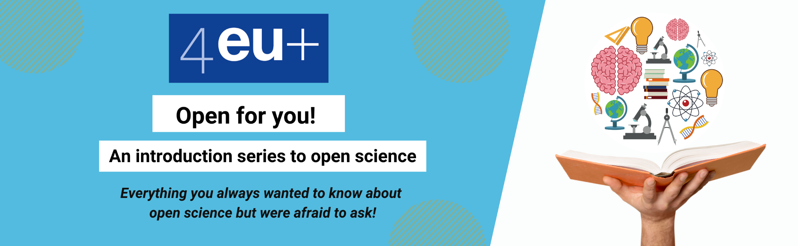
Register for our upcoming events: https://4euplus.eu/4EU-273.html
Next sessions:
“Cycle of scientific publication: an overview” | 15 November 2021, 12:30 - 14:00
“What are my funders requirements on Open Science? A focus on Plan S” | 29 November 2021, 14:00 - 15:30
“Strategies for publishing in Open Access journals” | 13 December 2021, 11:00 - 12:30
10 further session in 2022

Slide 66
Thank you!
Richard Dennis, University of Copenhagen
Milan Janíček, Charles University Prague
Jochen Apel, Heidelberg University

