Slide 1

The 2020 ABRF Beer Study: Beer Proteomics at the Global Scale
Brett Phinney, Andrew Marcus, Glen Fox, Hua Ding, Laura E Herring, Pratik D. Jagtap, Joanna Kirkpatrick, Vikas Kumar, Mukul K Midha, LeRoy Martin, Magnus Palmblad, Baozhen Shan, Paul M Stemmer, Yan Wang, Dan Polasky, Austin Carr, Michael Shortreed, Benjamin A. Neely
Identification of certain commercial equipment, instruments, software or materials does not imply recommendation or endorsement by the National Institute of Standards and Technology, nor does it imply that the products identified are necessarily the best available for the purpose or are consumed by NIST personnel while working, and if they are, they are consumed in precise quantities under laboratory conditions.
The Fundemic Beer Project
Notes:
2 goals for talk. Community =1 Beer =2

Slide 2
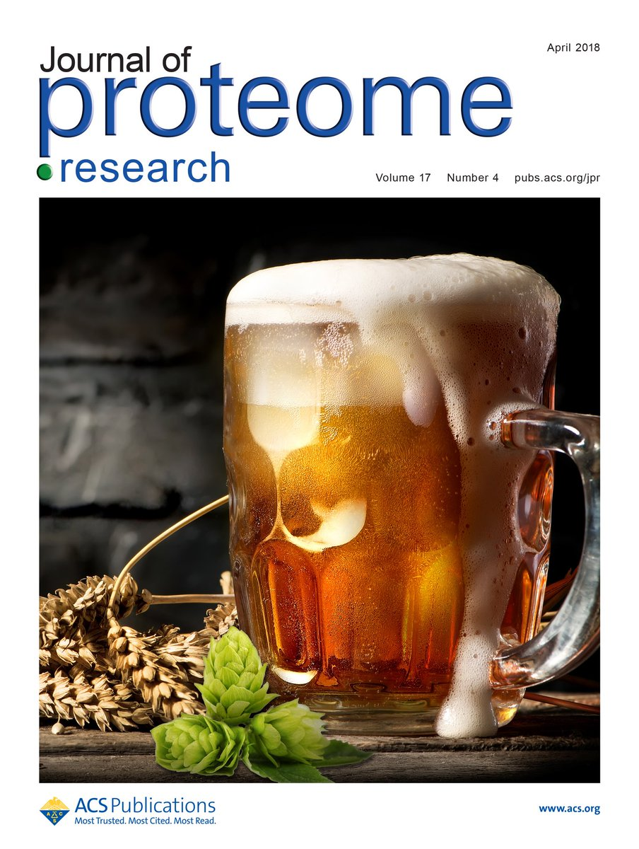
2020 “Bridge” Study: Processing and analyzing a mixed, fermented yeast-plant proteome… The Beer Study.
Beer proteomics isn't "new"
Study Goals:
          Evaluate consistency of experimentally acquired proteome profiles
Compare beer proteomes
Provide data for the community and to other ABRF research groups
Engage with others in the community over a beer or three
2018

Slide 3
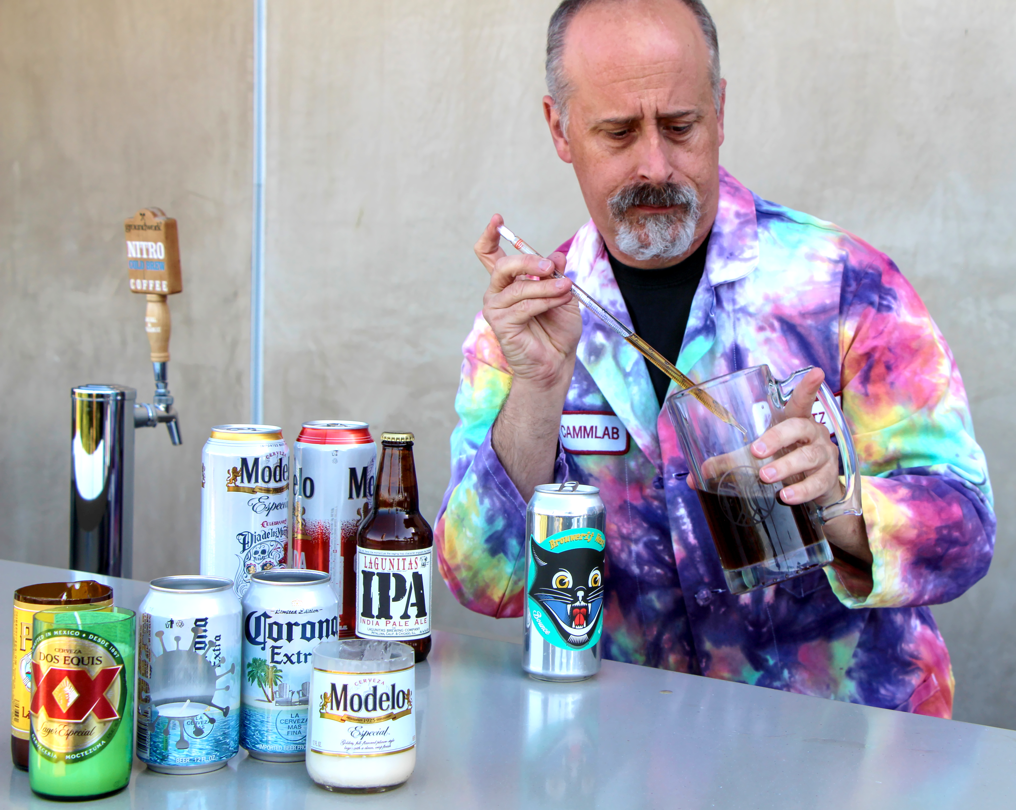
Why easily accessible materials are great for Interlaboratory Studies:
Biofluids, tissues, cell lines, etc. can be expensive and difficult to ship
Everyday items can provide added interest due to relevance (beer, eggs, etc.) and can be purchased anywhere in the world by participants
Just because they are commonplace, doesn't mean their biochemistry isn't interesting
This results in a low cost, relevant, and enjoyable interlaboratory study
Image source: Jonathan Katz

Slide 4
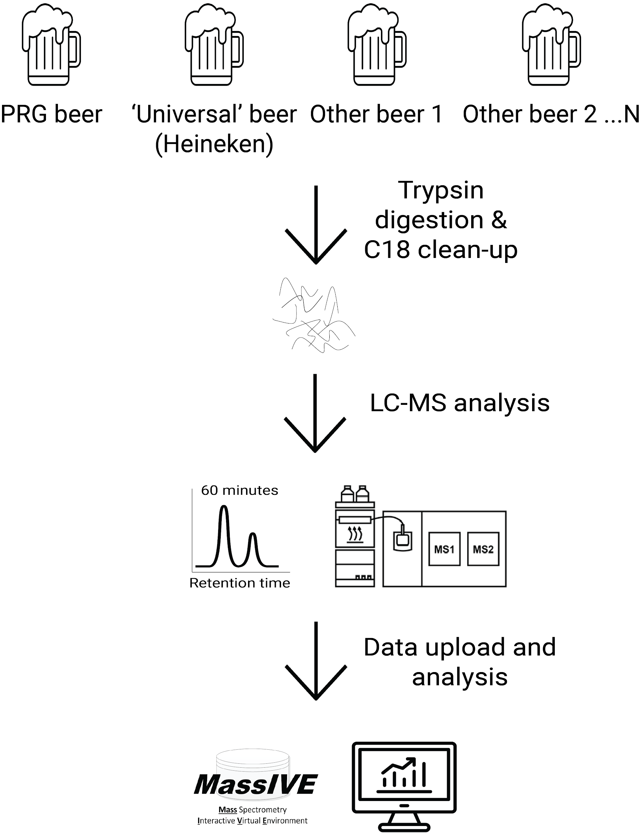
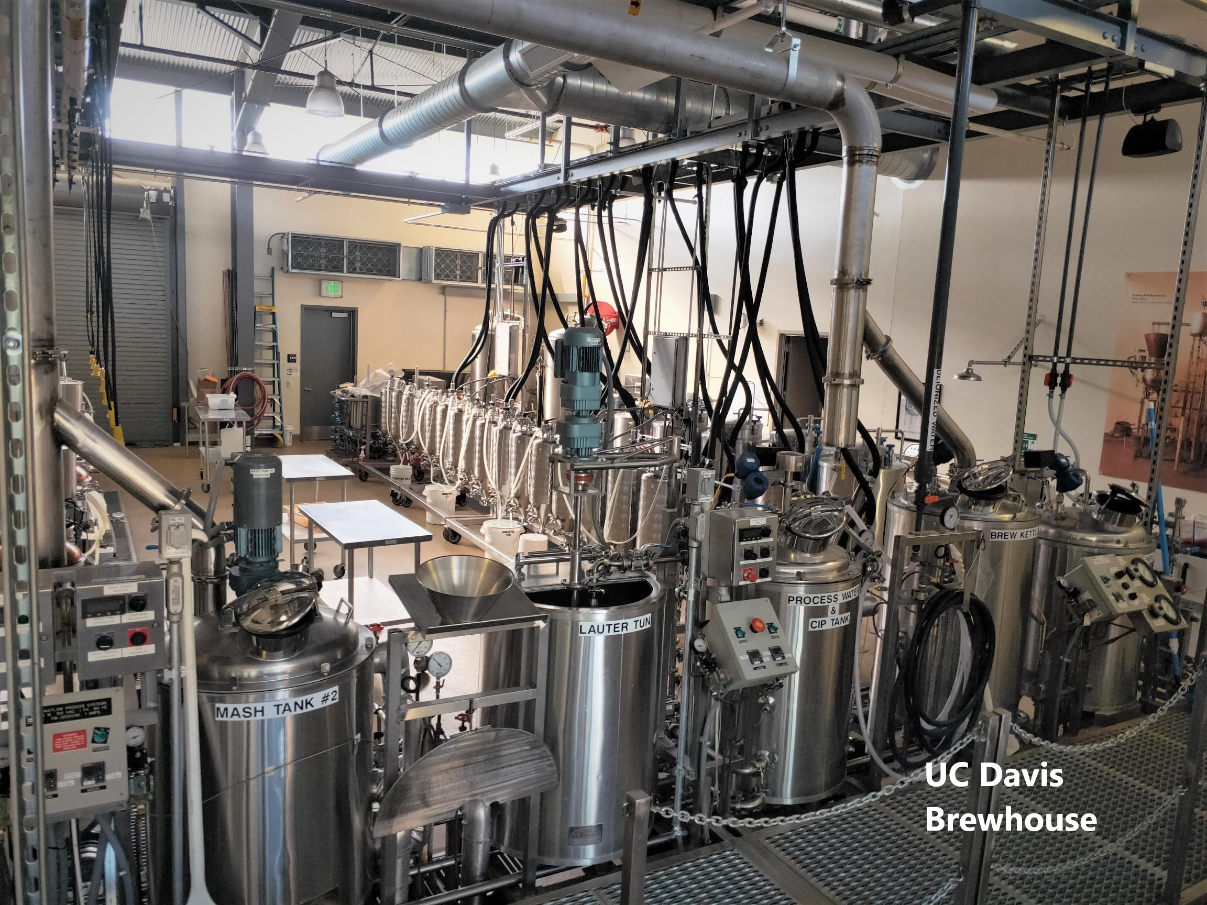
2020 Beer Study: Design
Chosen by participant
≤ 1 h DDA
Notes:
Mention We gave people general guidelines but not specific instructions

Slide 5
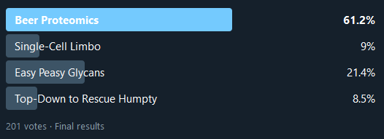
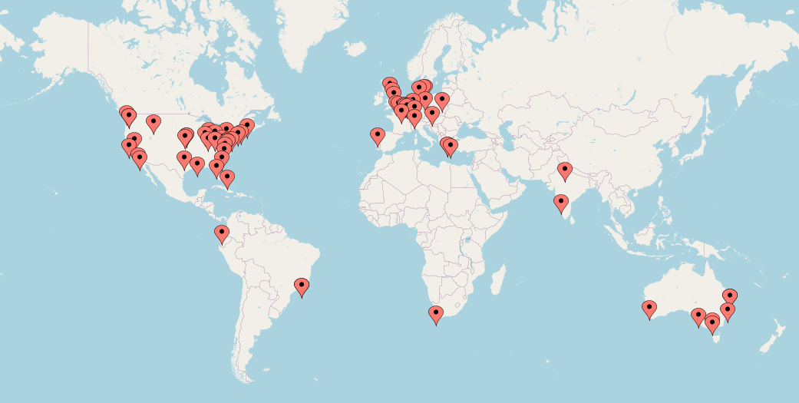
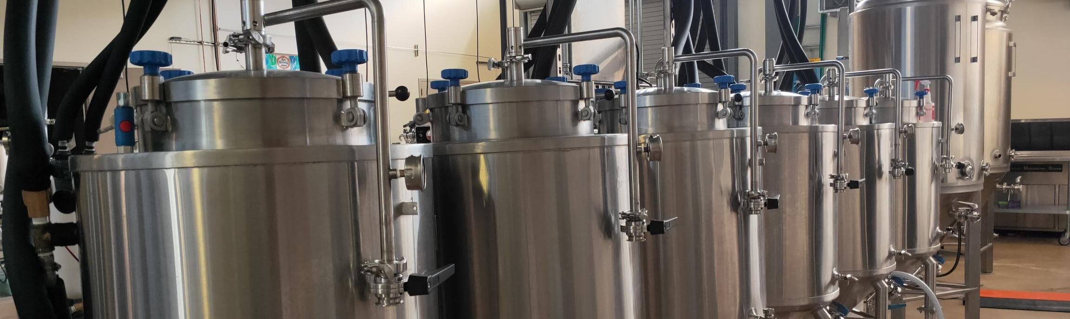
Timeline
July 2020: Glen Fox and Kelly Scott (UC Davis) brewed and bottled the PRG beer
  Pale Ale brewed at UC Davis
August 2020: staged a twitter poll followed by signup
  69 signed up, 32 non-US

Slide 6
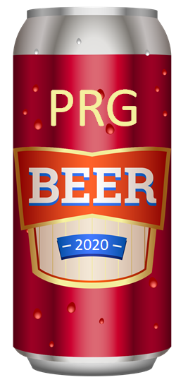
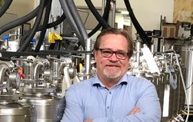
What was in the PRG Brew?
88% Rahr Pale Ale malt
4% Crisp Caramalt
2% Simpsons Caramalt
6% Briess C20 malt
Centennial and Amarillo hops
Used the US-05 SafeAle yeast strain
              The PRG brew was essentially yeast grown with barley (malt) and hops
              Other beers might include rice and wheat, as well as countless other added species
Notes:
FYI: the US-05 genome is sequenced, but annotation was not available and used in this analysis.
The genome of this yeast has been sequenced , but we didn't use this specific genome in our analysis

Slide 7
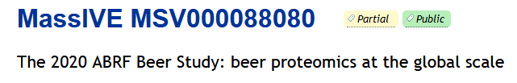
Timeline (continued)
September 2020: sent PRG Beer samples
  Including to the 32 non-US participants
January 2021: Data returned
  35 returned data
  Data made public on MassIVE September 2021
357 injections
Notes:
https://massive.ucsd.edu/ProteoSAFe/dataset.jsp?task=b1d83491073946d3b617b739e9b9f378
This is great return rate. We usually average return rate as much lower. for example the phospho study 10% or lower
People were locked out of their lab
Making project easer and giving people ownership really increases return rates
We didn't give anyone any real instructions.
2 limitations
1 hour gradient
use DDA

Slide 8
Beers around the world
Of 35 participants data:
  32 PRG Beer
  17 Heineken
  14 did both
  26 analyzed another beer
                max was 10 other beers
  There were 78 "other" beers
* some labs did analysis with and without FAIMS, with Participant 7 using two different mass spectrometers
Notes:
Really people to analyze the BRG beer or Heineken and whatever else
Why Heineken, beer friends said the QC on Heineken is very good around the world
10 was the max that someone returned . Data quality didn't seem to suffer on beer 10!
of the 78 beers only one was non unique (stella)
Lab 7 rocked ! Used 2 different mass spec with and without faims in a pandemic

Slide 9
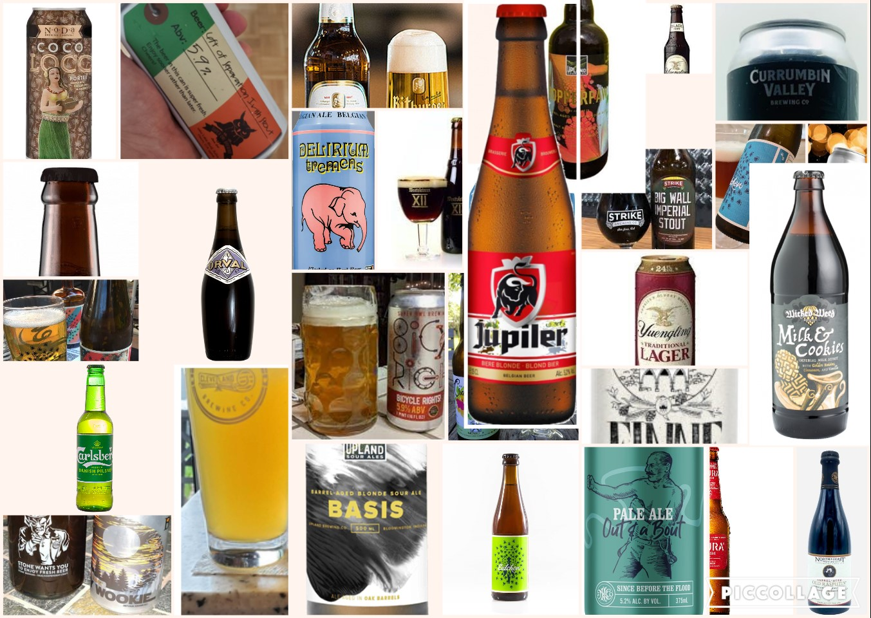
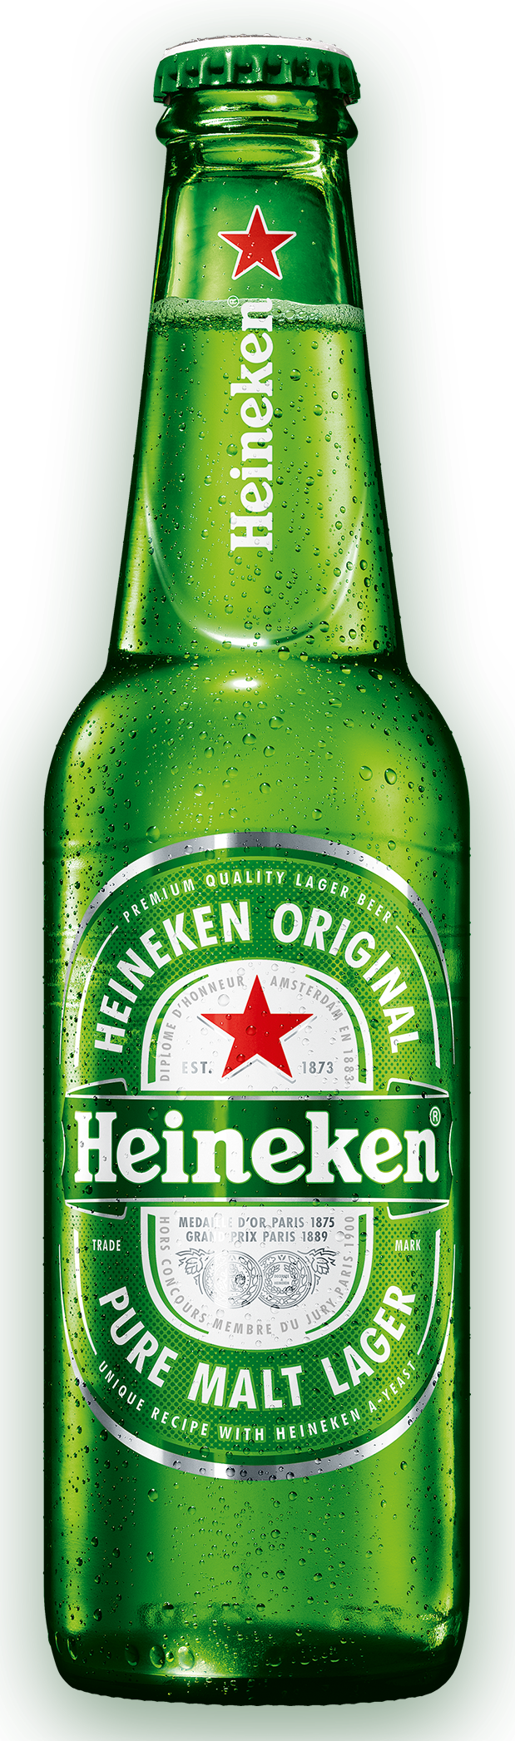
Beers in the Study

Slide 10
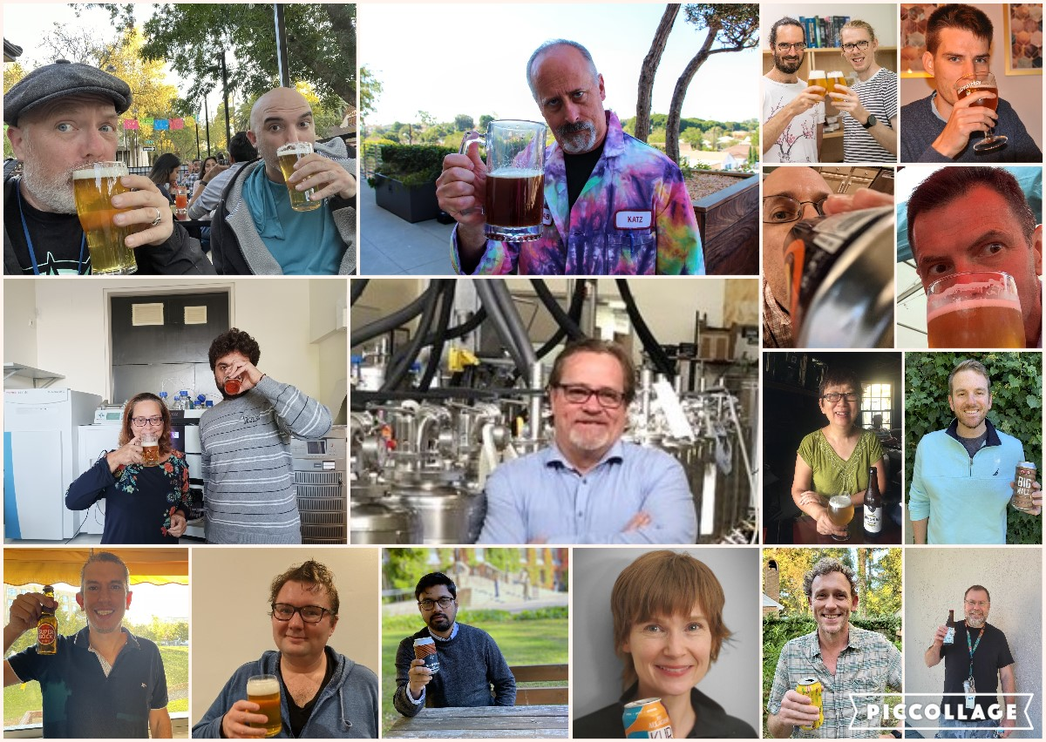
Participants in the Study
Notes:
Say some participants

Slide 11
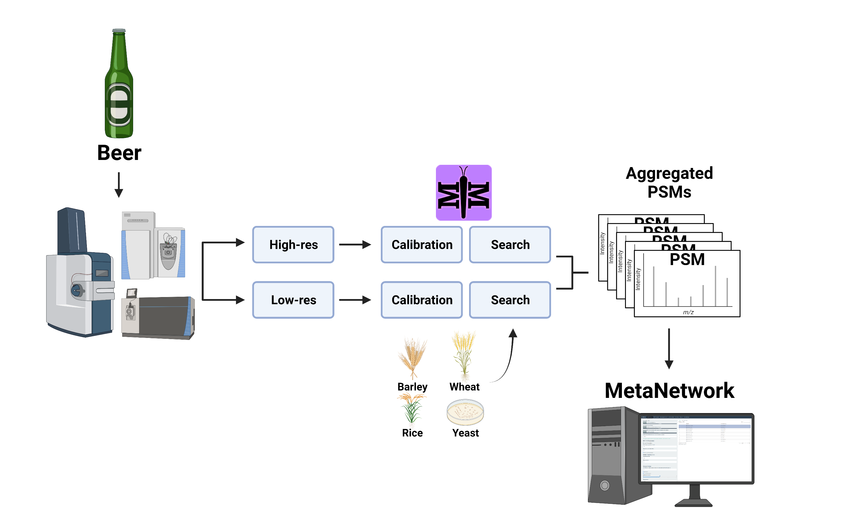

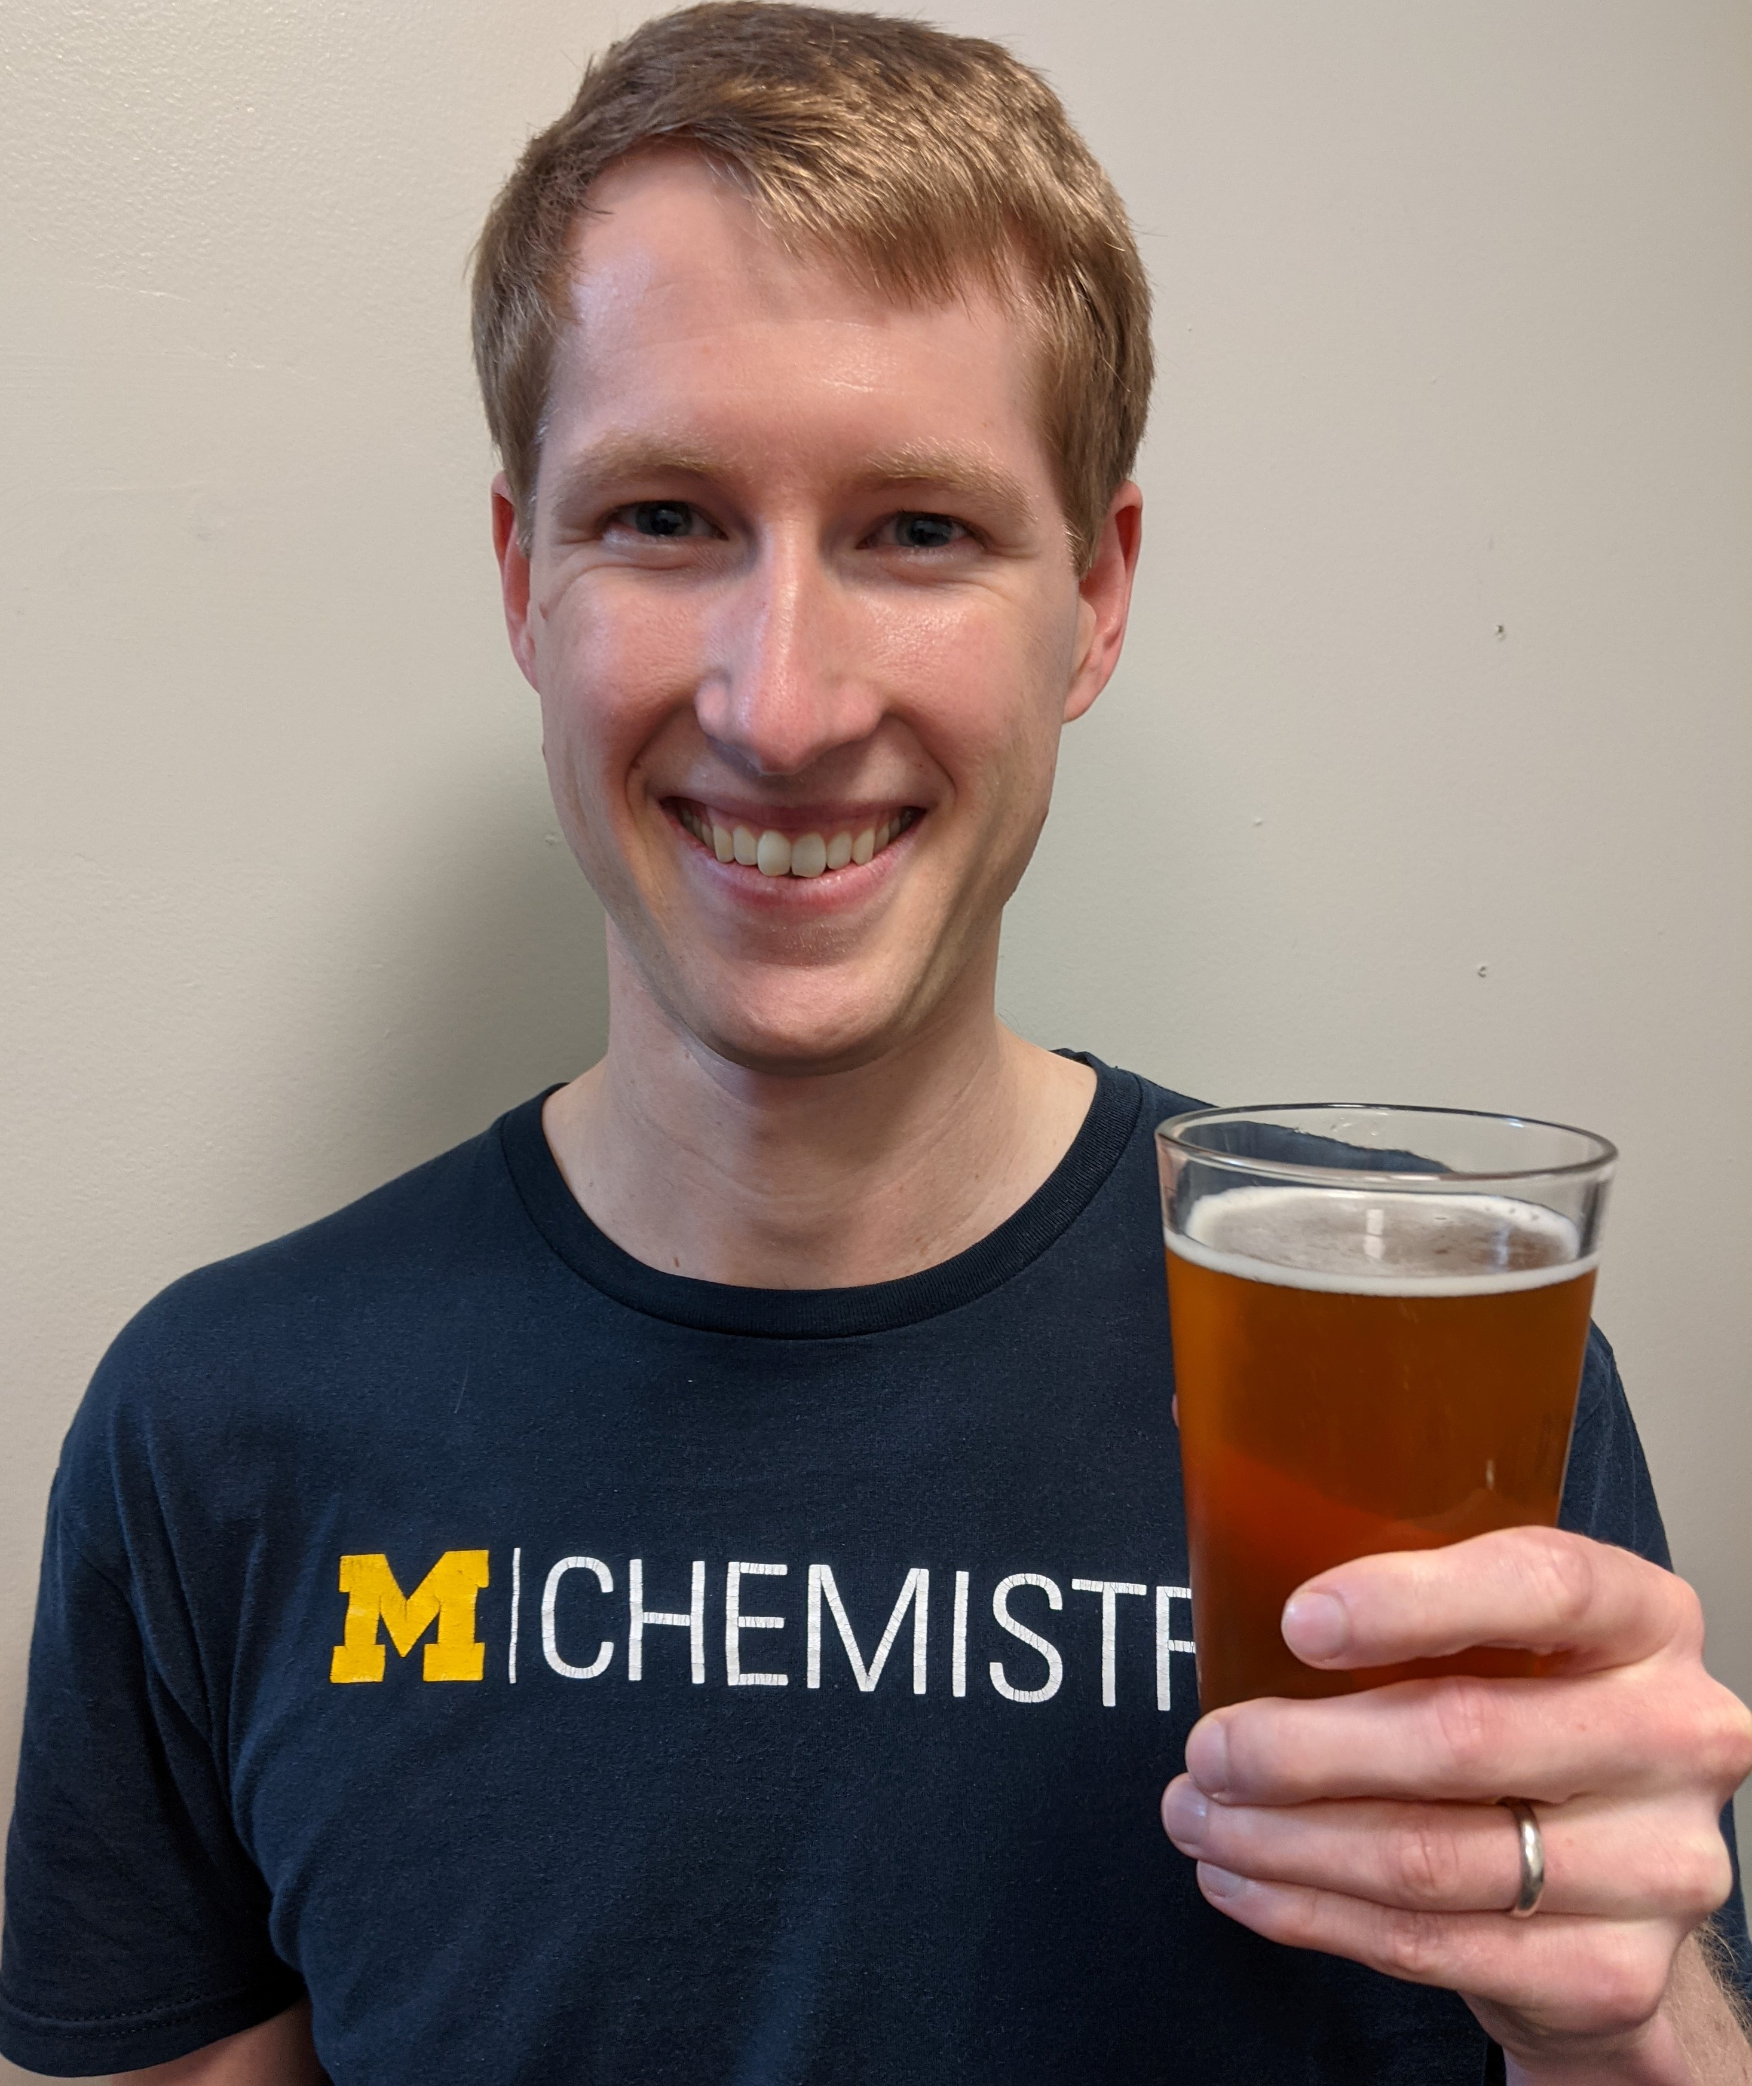
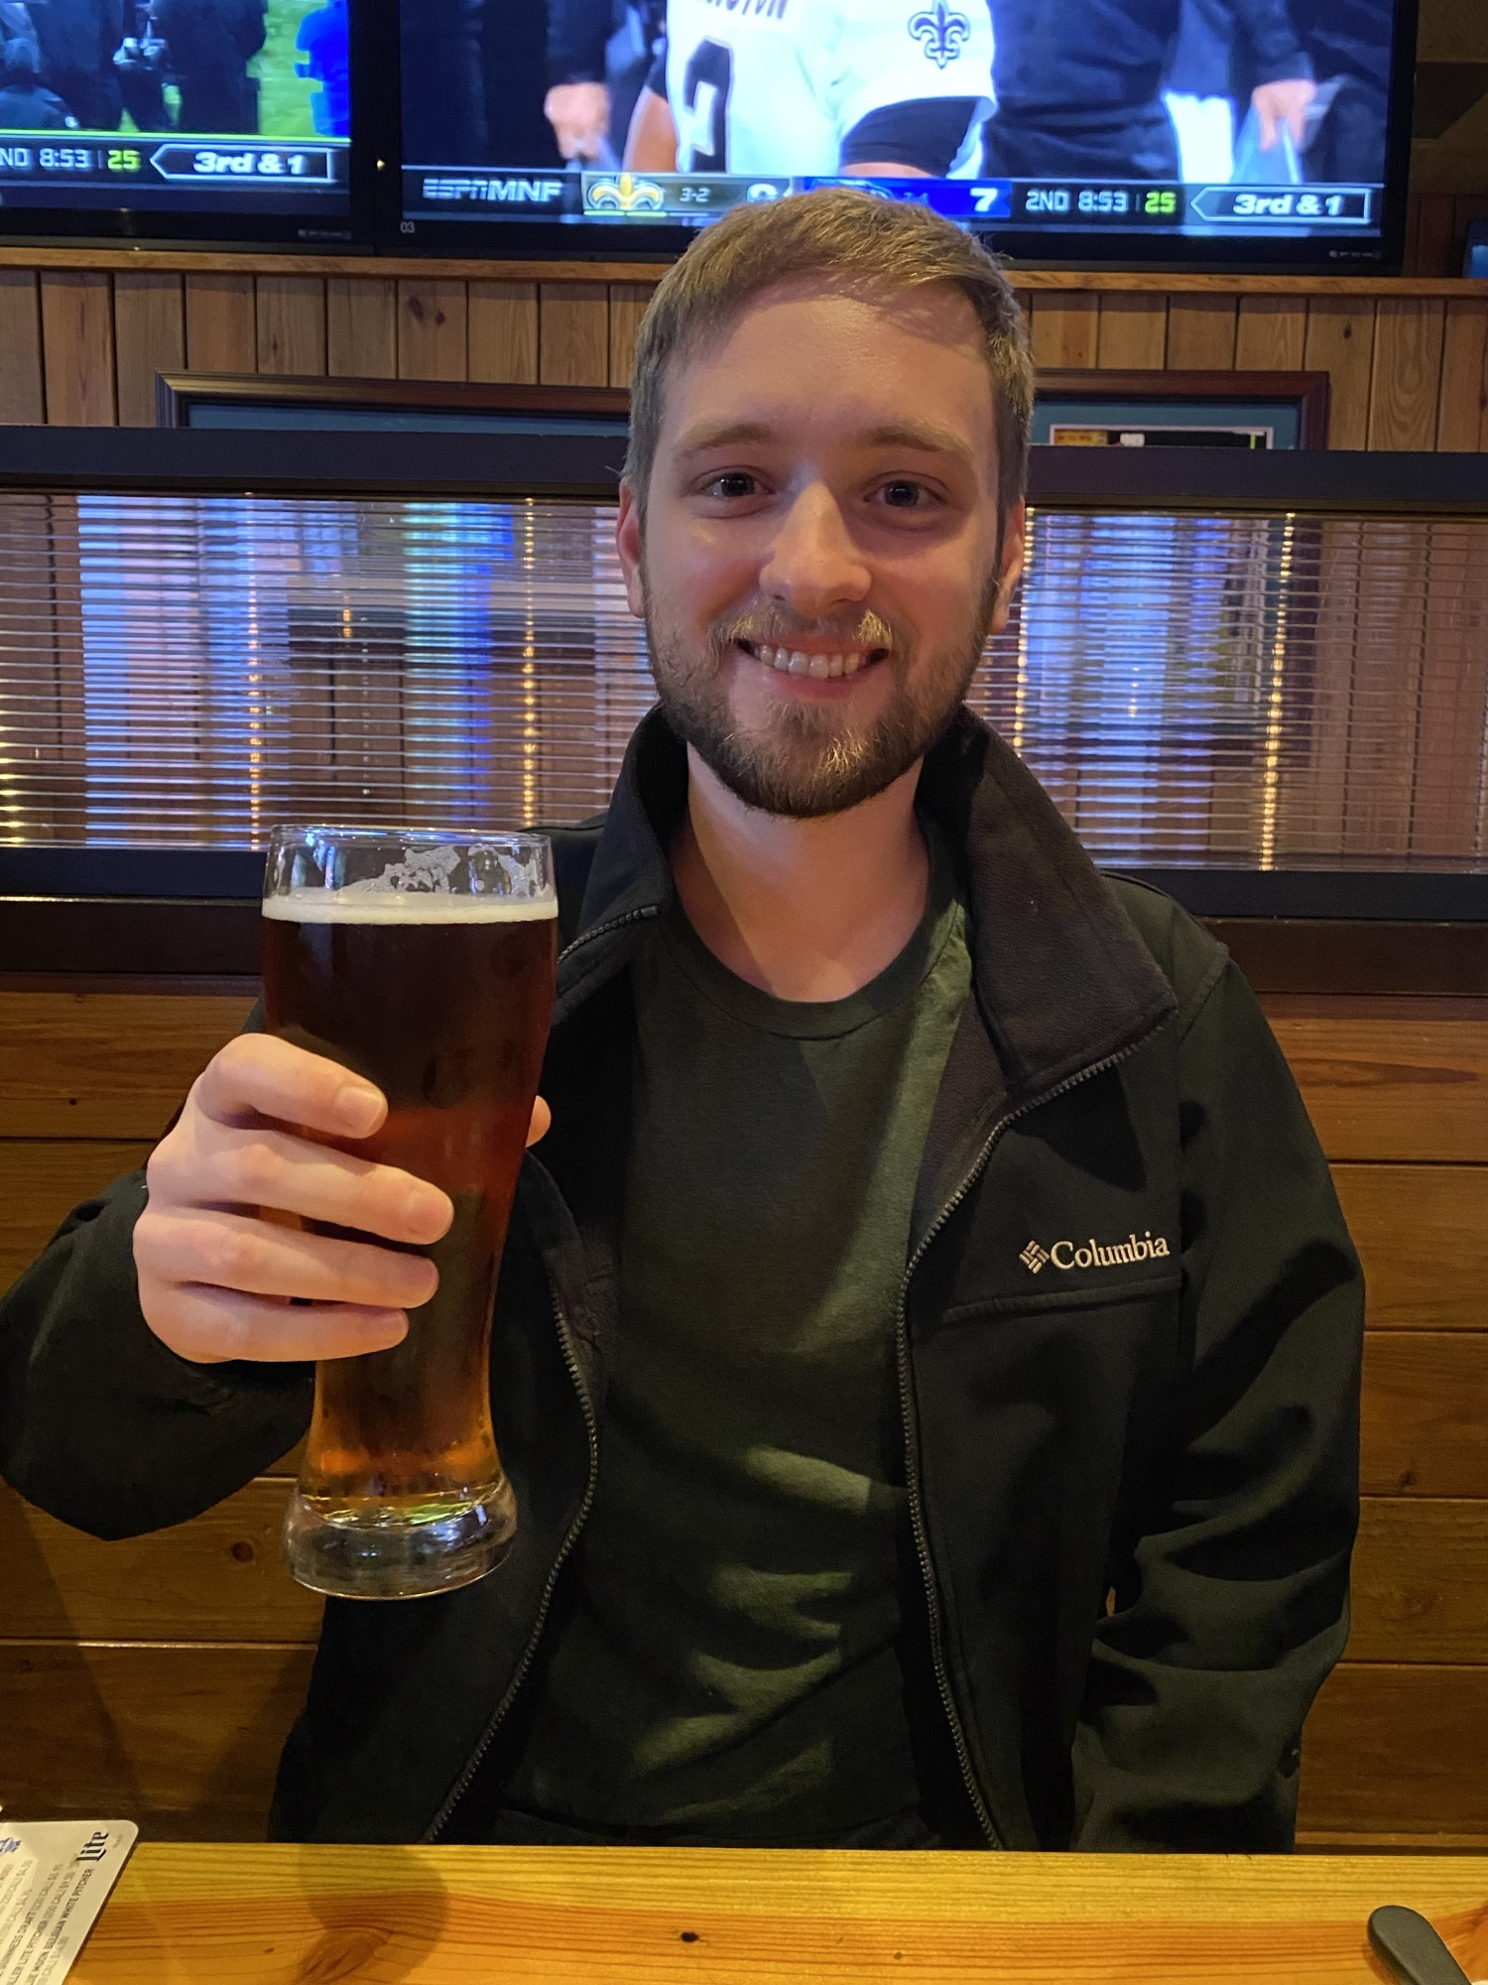


Universal Pipeline
#45 Subset
Glyco
Notes:
Mention Metamorphesus auto cals
Dan = msfragger
and Austin, metanetwork

Slide 12
About databases
Species | Fasta source | # entries | # IDs (experiment wide) | UniProtKB (2021_02) | # entries | # IDs mapped to UniProtKB entries | % IDs matched
Barley | Ensembl | 236,301 | 1451 | 4513 - reviewed only | 368 | 1437 | 99.0%
Hops | HopBase | 91,258 | 778 | 3486 - reviewed and unreviewed | 396 | 762 | 97.9%
Rice | NCBI RefSeq | 42,580 | 275 | 4530 - reviewed only | 5047 | 275 | 100.0%
Wheat | Ensembl | 133,346 | 695 | 4565 - reviewed only | 379 | 692 | 99.6%
Yeast | UniProtKB | 7,905 | 2719 | NA | NA | NA | NA
Used "most complete" fasta if available (ex. HopBase)
  Though large, protein descriptions were poor in HopBase and Ensembl
  Mapped IDs back to UniProtKB via PAW_BLAST
  Majority of IDs were homologous to those in the UniProtKB fastas
Take home: using UniProtKB beer-related databases is likely fine
Notes:
Wheat is also an example of how the IDs in the larger database were redundant, as 692 IDs were mapped to a UniProt database of only 379 entries.
All the things we identified were actually in uniprot . We didn't really need to use the 91K entried in hopsbase . So we recomend using uniprot even though it has small numbers of entries

Slide 13
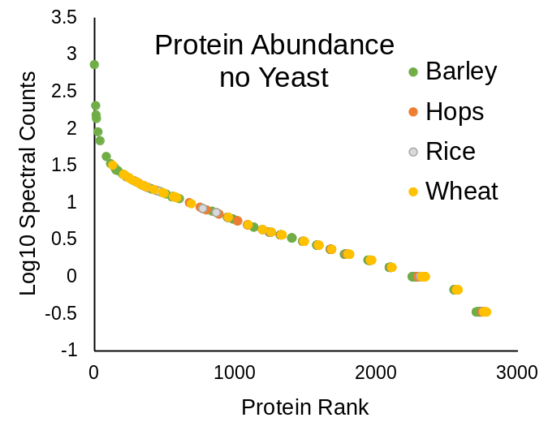
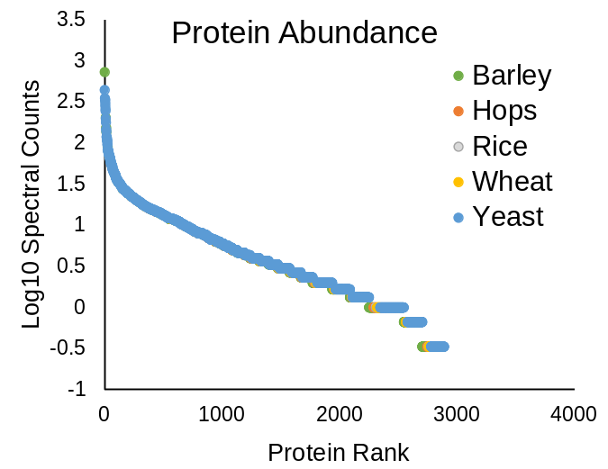
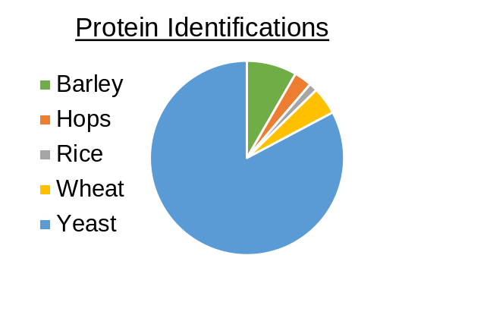
So what proteins are in prgBrew?
Serpin-Z4 (barley)
Non-specific lipid-transfer protein 1 (barley; ranked 40)
2889 proteins across 3 replicates
Participant 23
2391 proteins were yeast
LTP1 will come up later, so remember it.
* wheat and rice aren't in prgBrew malt, and likely an artifact of cereal protein homology.
Notes:
The top protein is Barley Serpin-Z4, and the top yeast protein (ranked 2) is Enolase-1
Of note, Non-specific lipid-transfer protein 1 (Barley) is ranked 40th. This protein will come up more later.

Slide 14
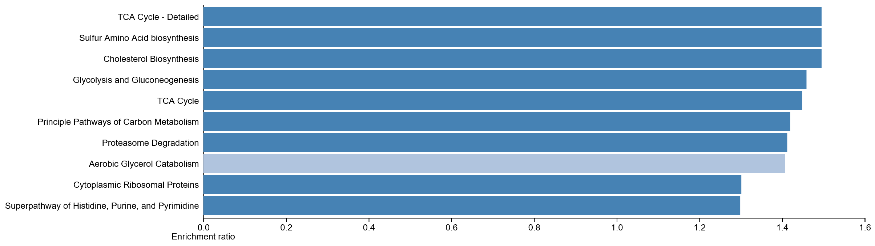
So what is yeast doing in prgBrew?
2719 Yeast Proteins – Overexpression Analysis (WikiPathways via WebGestalt)
It's Growing!
Notes:
Essentially say the yeast are growing are suppose

Slide 15
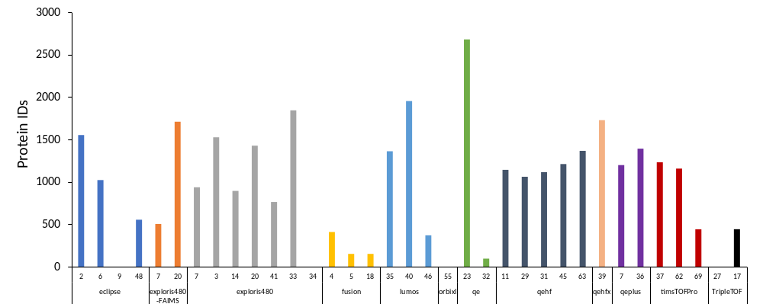
PRG Beer Results
Highest IDs:
Participant 23, QE Classic
SDC SP3 digest
Identified on average 2681 proteins
eclipse
exploris
480
+FAIMS
exploris 480
fusion
lumos
QE
QE-HF
QE-plus
TimsTOF
Pro
Triple
TOF
orbiXL
QE-HFX
Notes:
Mention we have very detailed methods. On the massive site available now and will be on the paper.
Big caveat this was a universal pipeline and not tweaked per platform
Universal pipeline is not perfect

Slide 16
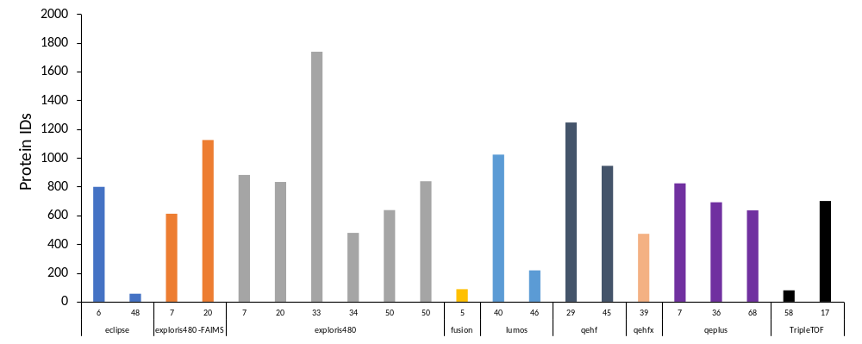
Heineken Results
Highest IDs:
Participant 33, Exploris 480
Precipitate then used urea
Identified on average 1738 proteins
eclipse
exploris
480
+FAIMS
exploris 480
fusion
lumos
QE-HF
QE-plus
TimsTOF
Pro
QE-HFX
Notes:
* 23 didn’t analyze this beer, but for reference participant 33 ID’ed on average 2134 in prgBrew, versus 23's 2681 in prgBrew, so we would have expected 23 to be highest here as well.

Slide 17
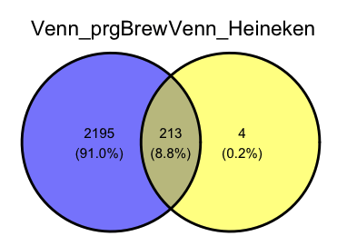
Yeast Heineken vs PRG Brew
Notes:
Across the board data analysis

Slide 18
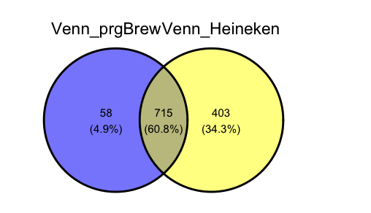
Barley Heineken vs PRG Brew

Slide 19
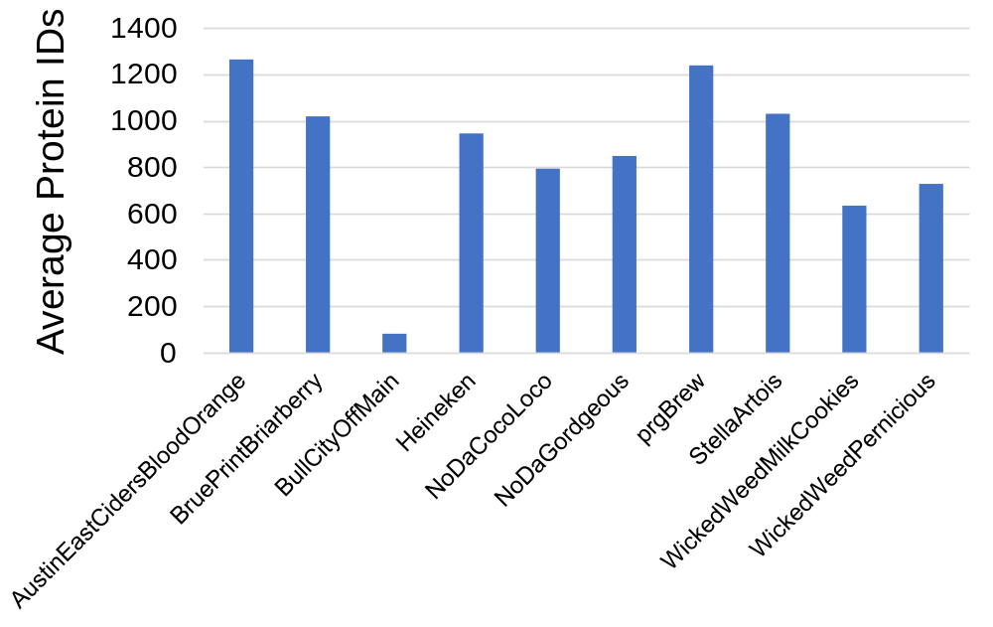
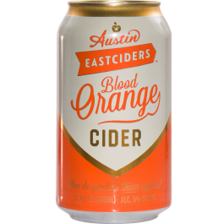
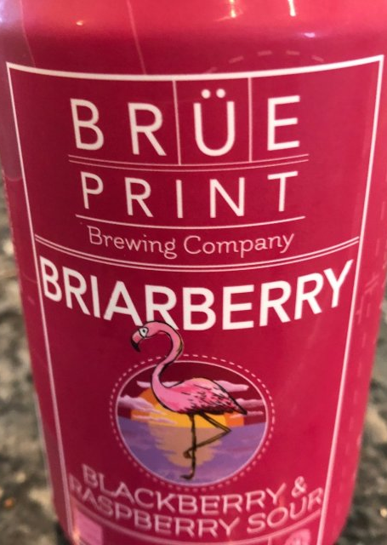
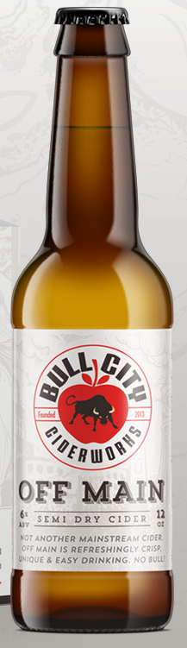
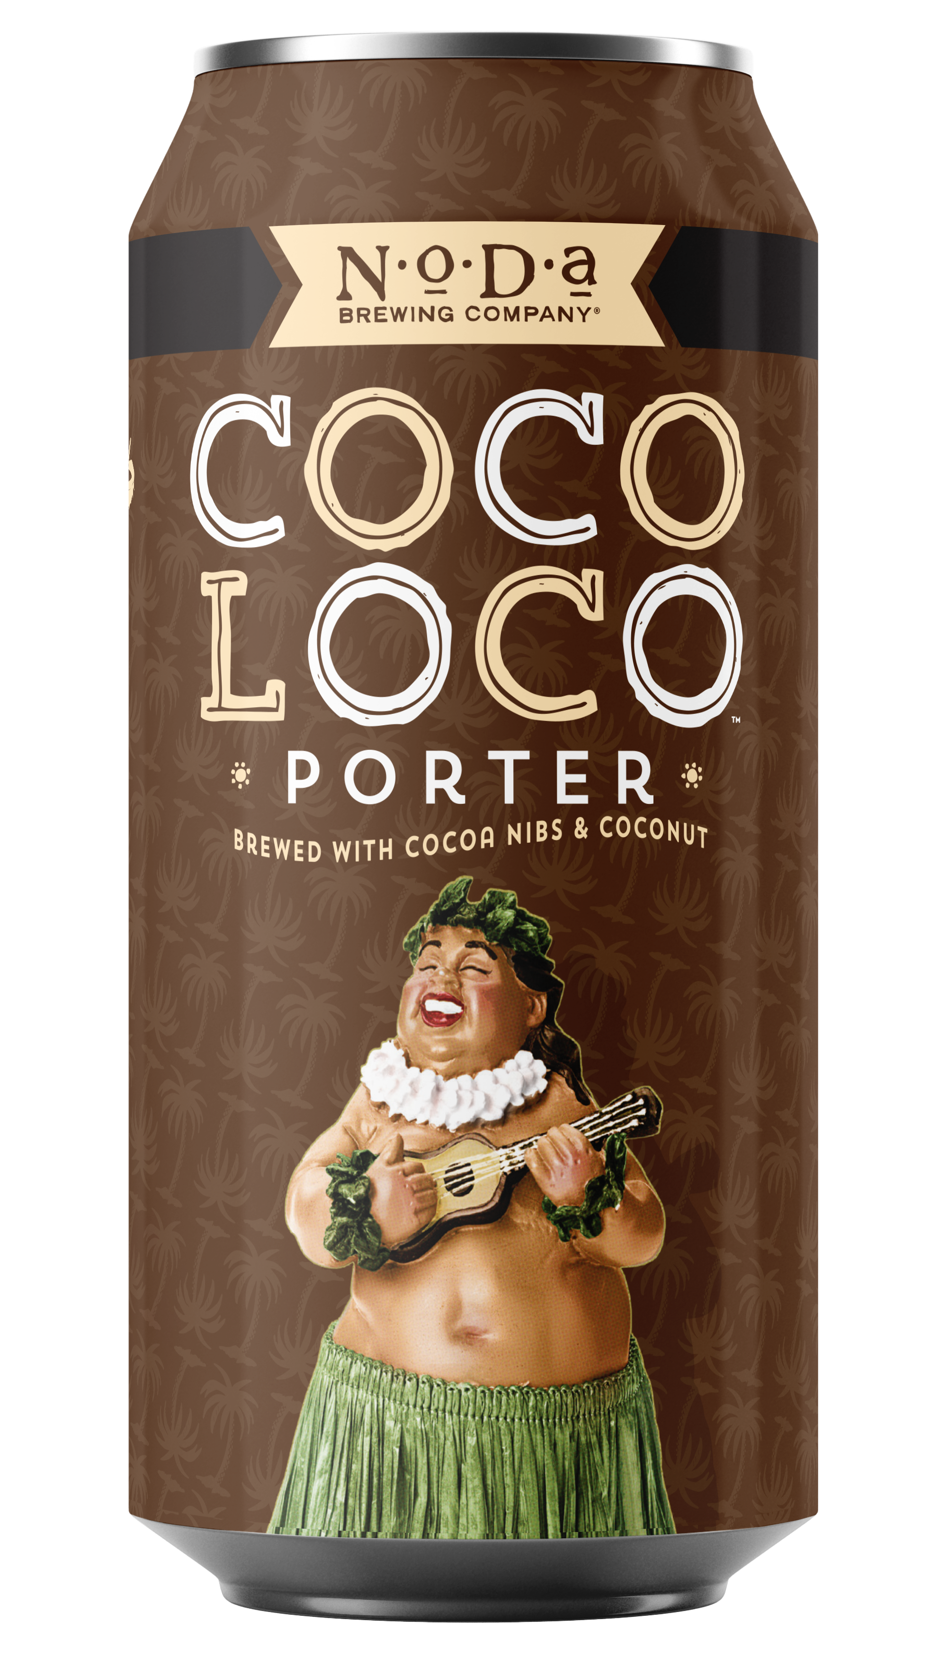
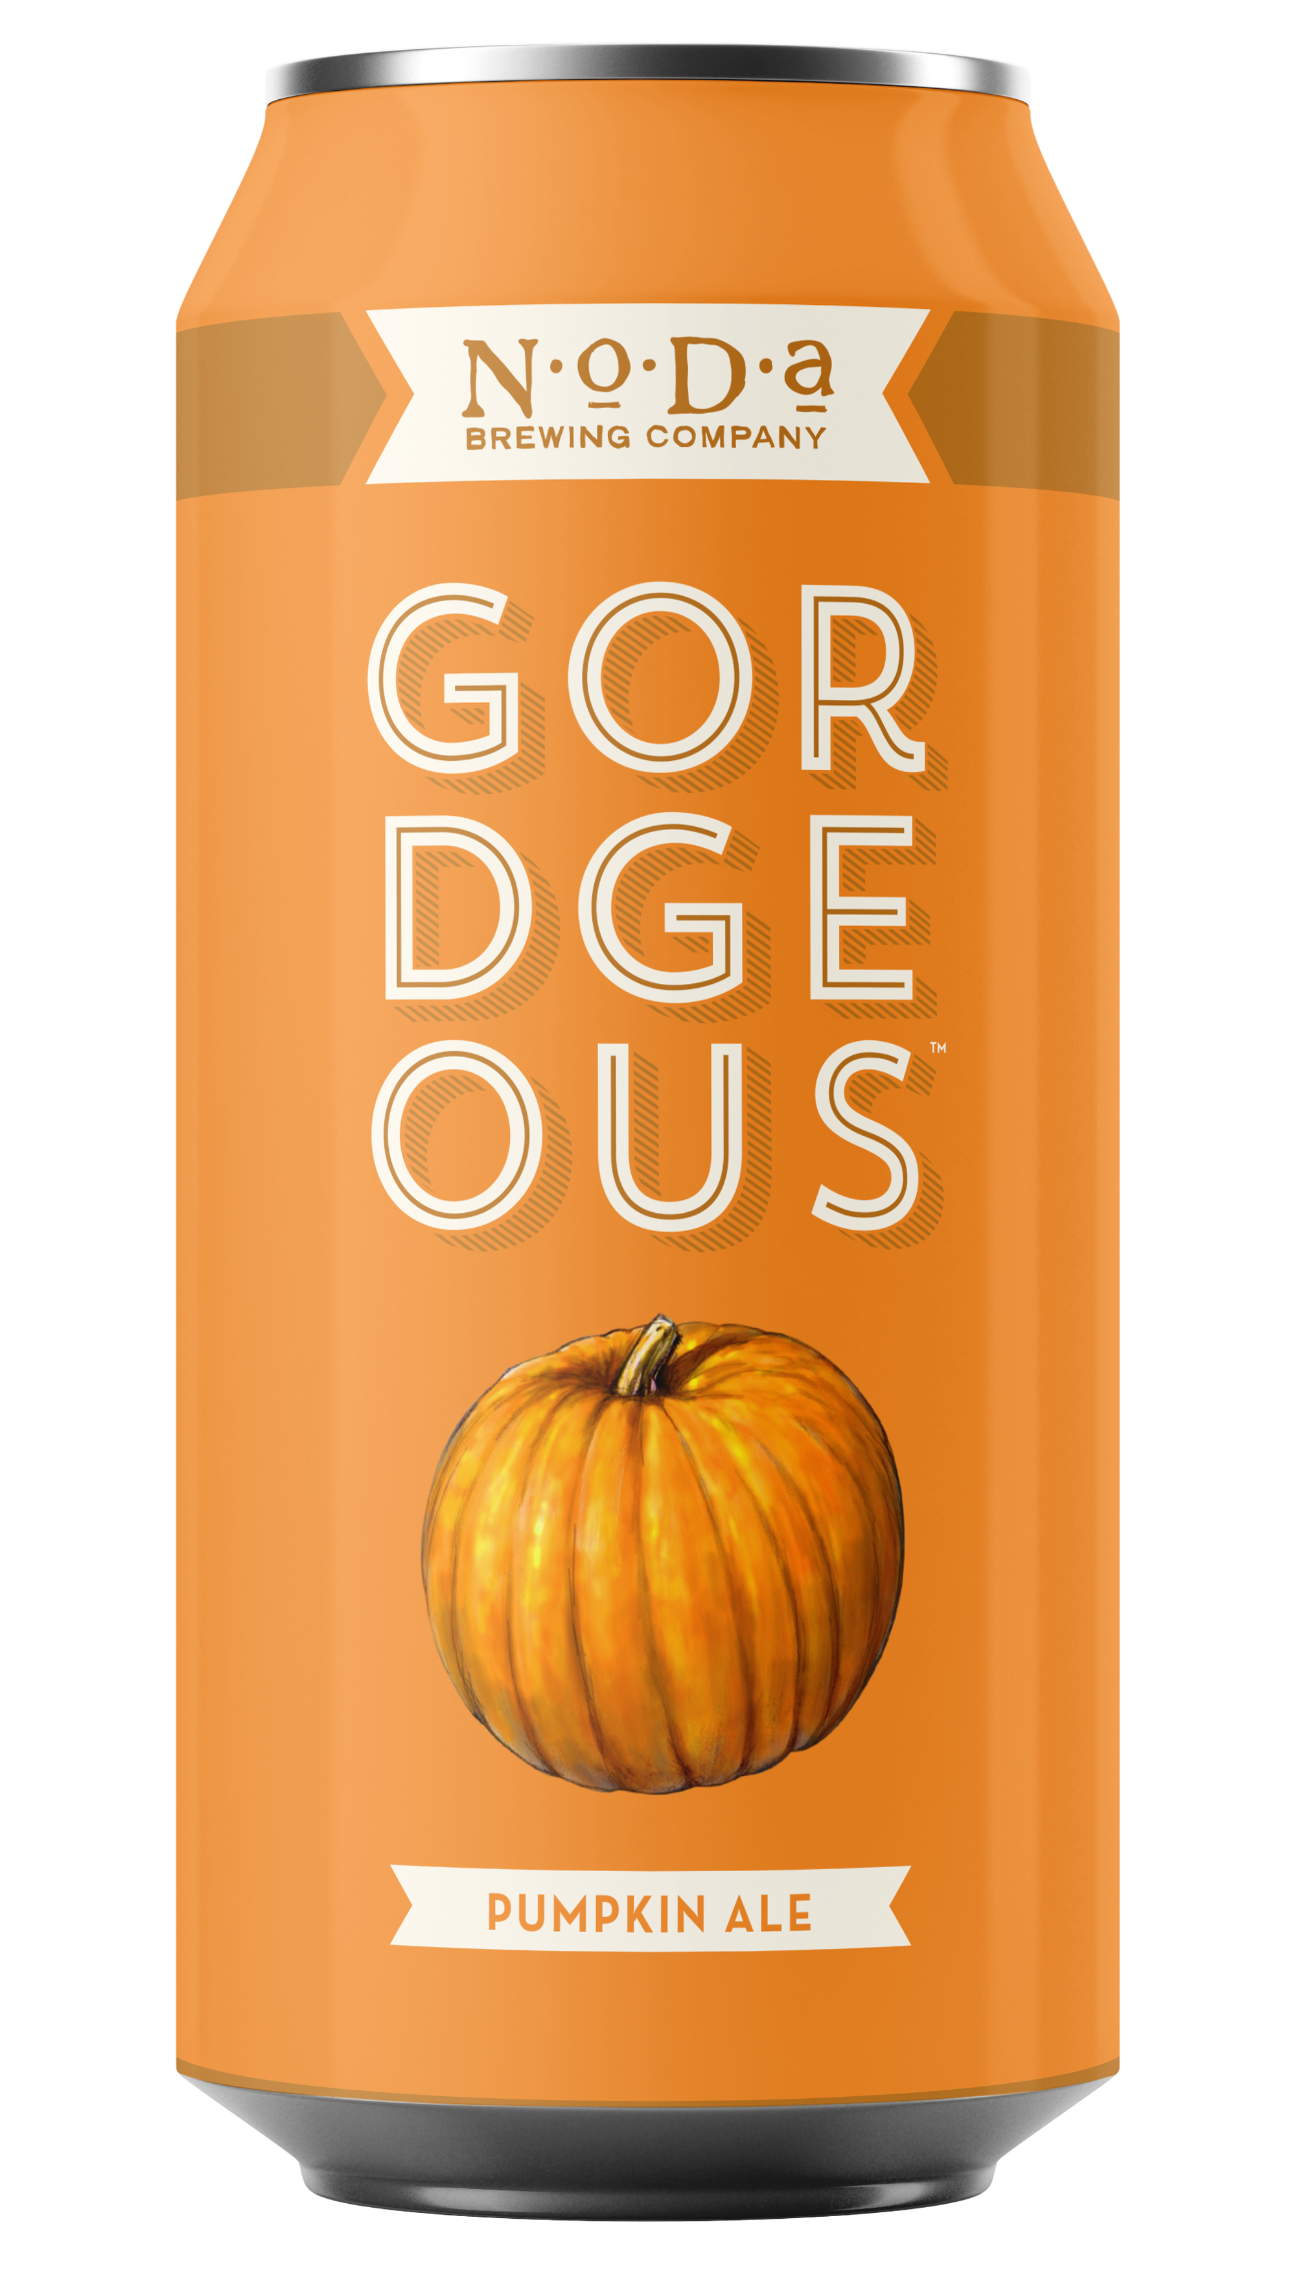
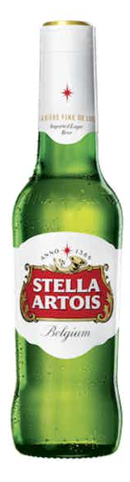
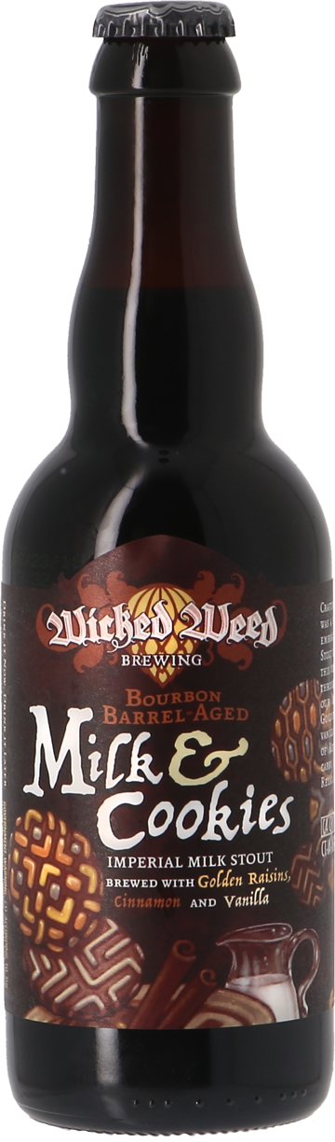
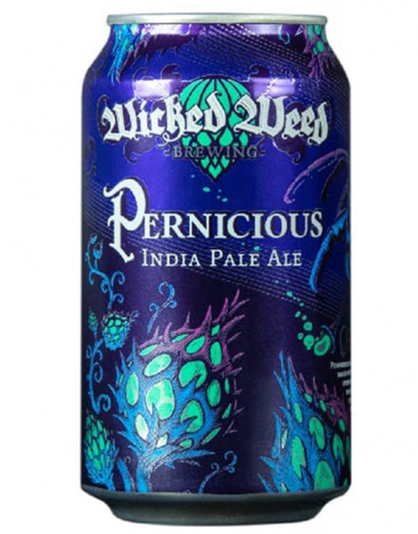

Focus on one participant (#45)
Analyzed the prgBrew, Heineken and 8 other beers
  Same digestion, instrument (QE-HF), etc.
Demonstrate state-of-the-art bioinformatic analysis using this data set
Notes:
Mention this is just one participant and there are 300 other injections!!
The next 4 slides will just participant 45

Slide 20
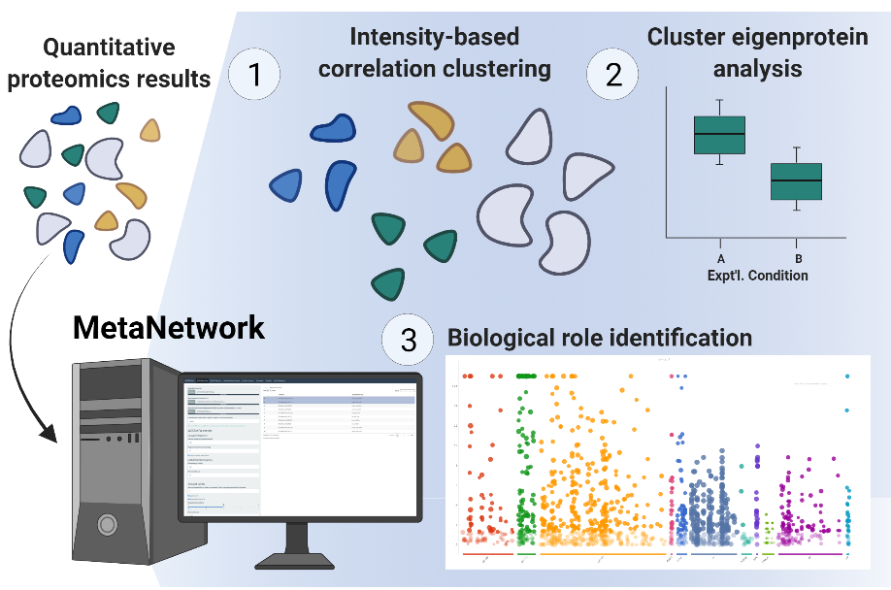
MetaNetwork Analysis of 10 beer proteomes
Notes:
Here’s a tool called MetaNetwork that can help make sense of large proteomics datasets. It works by using a correlation clustering algorithm based on measured protein intensity values. It groups proteins into modules, and then calculates a measure of module expression called the module eigenprotein. We can use module eigenproteins to find up and down regulated groups of proteins across biological samples. MetaNetwork also has a built-in functional annotation enrichment tool.
integrates WGCNA analysis within metamorphesus ecosystem

Slide 21
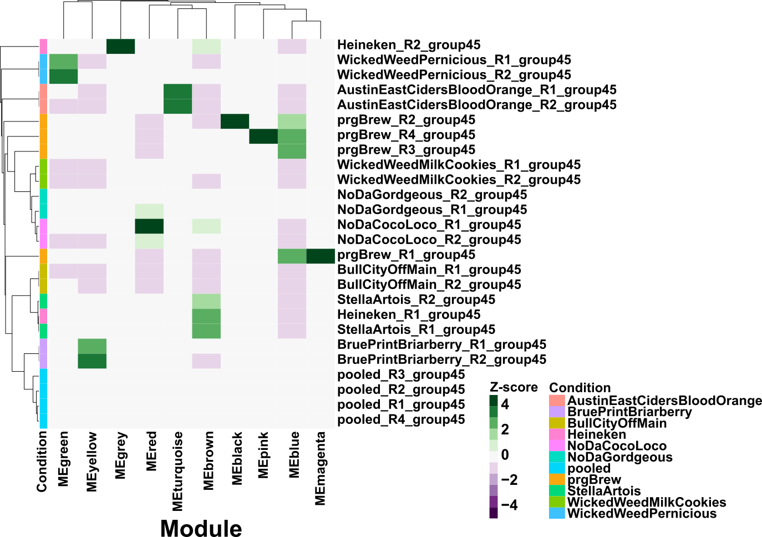
MetaNetwork Analysis of 10 beer proteomes
Notes:
We used MetaNetwork to identify modules and then used the modules to cluster the samples based on their module eigenprotein expression. We found that the clustering worked really well, as most samples clustered with their replicates.
We wondered what is the underlying driving force behind module formation, and hypothesized that it might be the physiochemical properties of the proteins that make up a module. Also, it seems likely that is the case. If we look at the Wicked Weed Pernicious, we see that it’s an outlier in the dendrogram and that it has increased expression of the green module, which has a GRAVY score indicating that the module is composed of more hydrophobic protein, a calculated net charge at pH 5 around 10, and an isoelectric point right around 7. From the GRAVY score, we hypothesize that this beer is hazy.
In the future we plan on correlating module eigenproteins with beer characteristics such as IBU, alcohol content, along with physiochemical properties to see if we can identify larger patterns.
Remove slide 20 and explain it somewhat on this slide.

Slide 22
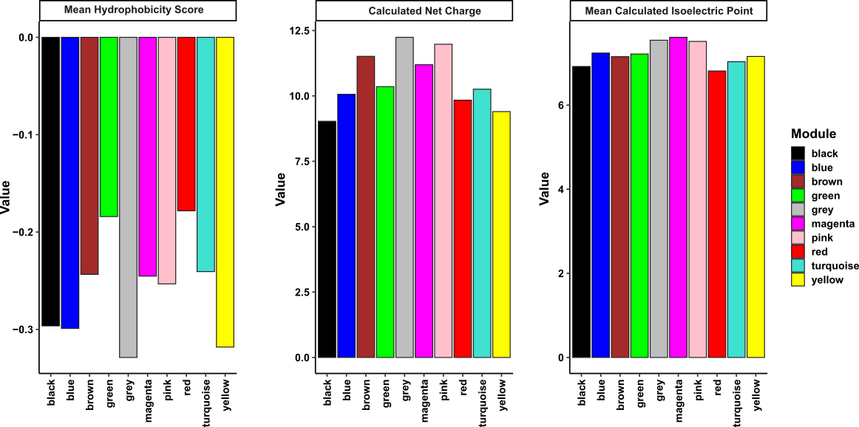
MetaNetwork Analysis of 10 beer proteomes
Notes:
We wondered what is the underlying driving force behind module formation, and hypothesized that it might be the physiochemical properties of the proteins that make up a module. Also, it seems likely that is the case. If we look at the Wicked Weed Pernicious, we see that it’s an outlier in the dendrogram and that it has increased expression of the green module, which has a GRAVY score indicating that the module is composed of more hydrophobic protein, a calculated net charge at pH 5 around 10, and an isoelectric point right around 7. From the GRAVY score, we hypothesize that this beer is hazy.
In the future we plan on correlating module eigenproteins with beer characteristics such as IBU, alcohol content, along with physiochemical properties to see if we can identify larger patterns.

Slide 23
Analysis of Participant 45 data set with MSFragger-Glyco
Beer proteins are glycosylated, with variation between beers
Most glycoPSMs were on barely lipid transfer protein 1, LTP1
  857 LTP1-glycoPSMs in prgBrew!
 | Total PSMs | Glyco PSMs | Unique Glyco Peptides | Unique Glyco Proteins
prgBrew | 27122 | 1689 | 313 | 87
AustinEastCidersBloodOrange | 4745 | 335 | 62 | 25
BruePrintBriarberry | 12319 | 526 | 202 | 76
BullCityOffMain | 1593 | 135 | 54 | 25
Heineken | 9357 | 1146 | 306 | 77
NoDaCocoLoco | 4397 | 186 | 107 | 55
NoDaGordgeous | 5974 | 206 | 102 | 45
StellaArtois | 9429 | 1357 | 376 | 89
WickedWeedMilkCookies | 3886 | 182 | 89 | 41
WickedWeedPernicious | 7737 | 811 | 210 | 54
Pooled beer | 19847 | 1594 | 321 | 97
Total | 106406 | 8167 | 956 | 213
Notes:
Msfragger glycol output

Slide 24
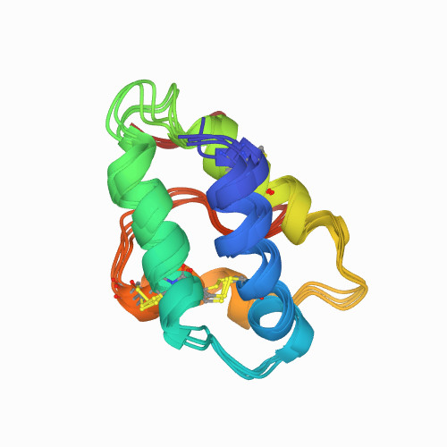
Lipid transfer protein 1
Highly abundant barley protein detected in 319 of 357 injections across study.
Across 10 beers in participant 45, LTP1 seemed differentially glycosylated
LTP1 is associated with foam, but it is unclear if it plays a pivotal role, or is it simply the most abundant protein in beer.
Notes:
Most important proteins in beer are lipid transfer proteins, serpins, amylase/trypsin inhibitors, amylases, proteases, and gluten-storage proteins

Slide 25
Summary
Performed global beer proteomics
The beer proteome is complex (PTMs, proteolysis, etc.)
Coverage of the beer proteome is affected by digestion method, instrument platform/settings, search parameters, and database selection/quality.
These are all constantly being improved, leading to continued improvements in beer proteomic accuracy.
Notes:
If you use the optimal digestion method, optimal databases and select the optimal mods. You will see more of the beer proteome.
You can use this dataset to help tune your beer methods

Slide 26
Next Steps - Beer
Data is public – MassIVE – Open for anyone to mine, like Jordan and Austin below who used the data for their ASMS posters
Has SDRF files for each data set. thanks to Jordan!
Preprint with 74 of co-authors is soon to be out!
Largest beer proteomics resource ever (we think)
Beer Posters at ASMS:
Jordan Burton – WP 120
Austin Carr – ThP 314

Slide 27
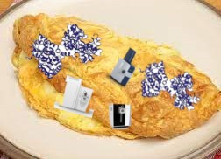
Next Steps - ABRF
Emphasizes how close our global community is
How great using easily accessible materials is
Future PRG studies will use this concept - ProteOmlette

Slide 28
Thanks
Lots of people, etc. Everyone who is involved in the study
ABRF and ABRF PRG
UC Davis Brewing program
MSFragger and MetaMorpheus Groups

