Slide 1
An AI-based approach for decision-making in
Hybrid E-rehabilitation
Oleksandr Palagin, Vitalii Velychko, Kyrylo Malakhov
V. M. Glushkov Institute of Cybernetics
of National Academy of Sciences of Ukraine

Slide 2

Transdisciplinary intelligent information and analytical system for the rehabilitation processes support in a pandemic (TISP)
NATIONAL RESEARCH FOUNDATION OF UKRAINE

Slide 3

Hybrid E-rehabilitation
Wearable devices
Telecommunication technologies
Rich Internet Applications
Telemetry
Virtual assistants
Biofeedback
Artificial Intelligence

Slide 4
Гібридна Е-реабілітація
“Розумні” прилади для носіння
Телекомунікаційні технології
Насичені Інтернет-застосунки
Телеметрія
Інтелектуальні/віртуальні помічники
Біологічний зворотній зв'язок
Штучний інтелект

Slide 5
Intelligence information search based on predictive models of distributional semantics methods
Artificial Intelligence
For Knowledge Discovery and solving the main analytical tasks, such as classification, diagnostics or prediction we use the method called Growing Pyramidal Network (GPN). In GPN inductive training is performed on the basis of precedents sets. The result of training is a regularity in the form of a logical function.
GPN belongs to the class of statistical methods.

Slide 6
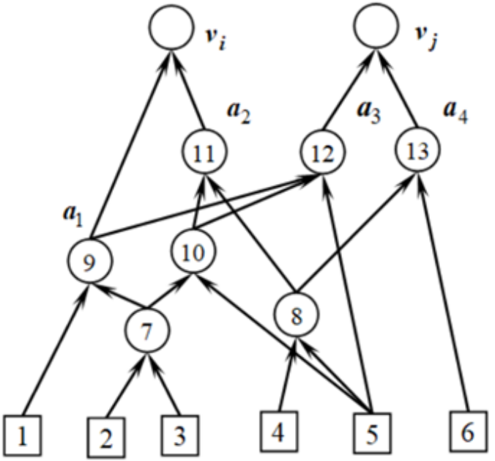
Unique features of GPN based software (1)
Search for all possible combinations of values of objects attributes for allocating the most important combinations of attributes’ values for building the model of classes of objects;
Guaranteed finding the most significant combinations of attributes values using the principle of minimal length of the hypothesis description (logical expression);
Always 100% correct classification of all objects from training set;
Works with data of any complexity and possibility to discover a regularity however complex it be;
Automatic clustering of objects set;

Slide 7
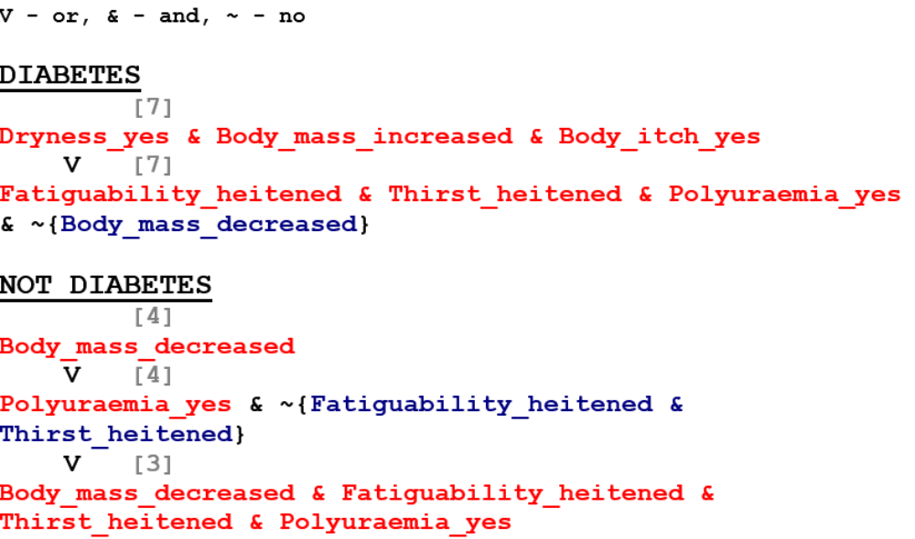
Unique features of GPN based software (2)
Using the logical negation operation [not] to reduce the length of the hypothesis description;
In a pyramidal network, the complexity of decision functions is automatically adjusted to the data from the training set, depending on the compactness of the training set;
There is no need for a test sample to verify the quality of the found logical regularities. In the process of using regularities, the amount of information contained in the logical regularities is counted. If it has changed, then a decision to retrain the system is made;
High speed recognition of new objects (constant, not depending on the volume of stored information);
If no exact solution found - all possible solutions (Including the decision "I do not know“) presented and ranked according to the confidence level for each;
Availability of explanation mode in which explained grounds of the decision for each of the recognizable objects.

Slide 8
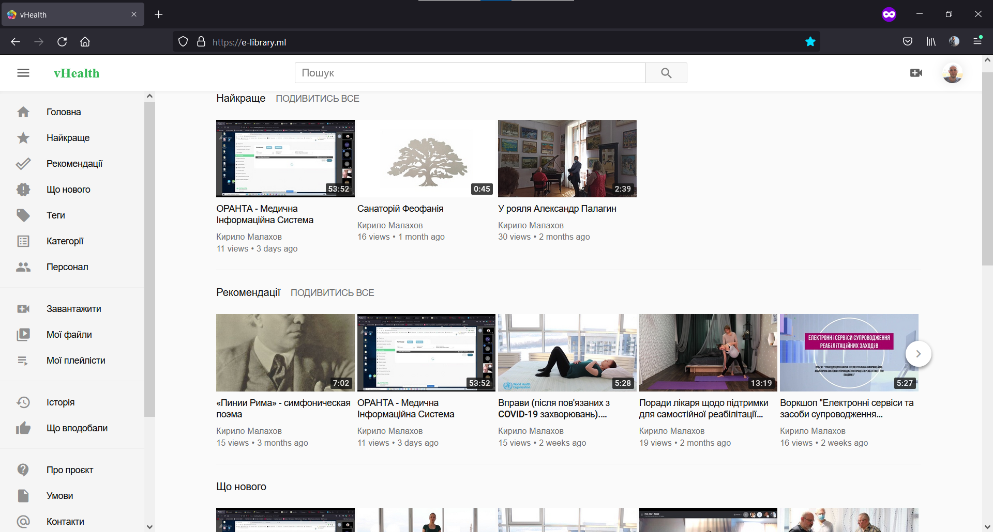
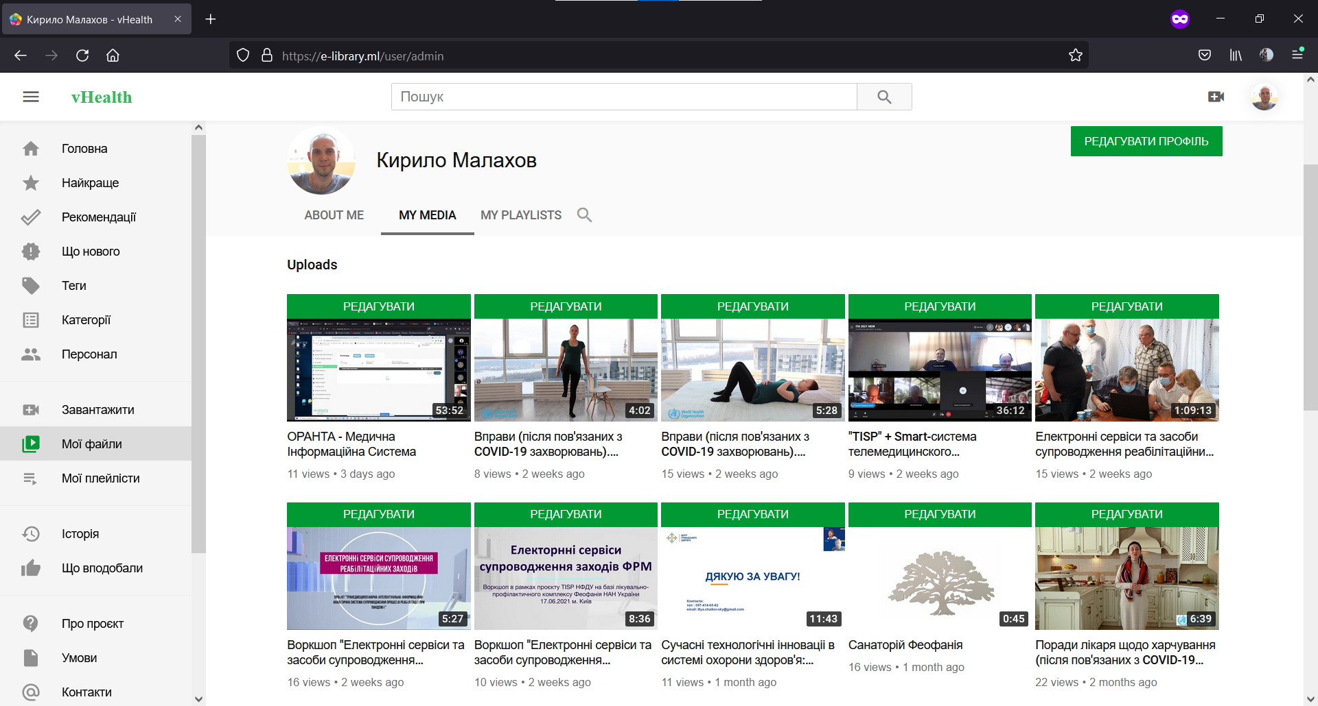
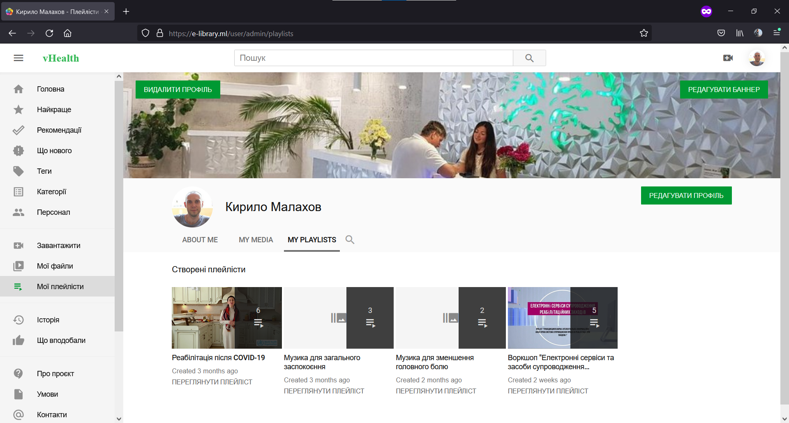
vHealth
Features
Friendly UI with Responsive design: including light and dark themes;
Store, use, share e-documents: Video, audio, text data;
Complete control over your data;
Real-time intelligence information search based on predictive models of distributional semantics (lexical, symbolic, and attribute search);
Support for multiple publishing workflows: public, private, unlisted and custom;
Multiple media types support: video, audio, image, text: pdf, txt, docx;
Multiple media classification options: categories, tags and custom;
Multiple media sharing options: social media share, videos embed code generation;
Playlists for audio and video content: create playlists, add and reorder content;
Advanced users management (user profiles);
Multiple transcoding profiles;

Slide 9
Distributional semantics background
The distributional hypothesis in linguistics is derived from the semantic theory of language usage, i.e. words that are used and occur in the same contexts tend to purport similar meanings.
[Harris, Z. (1954). Distributional structure"]
Tasks
finding semantic similarity between words and multi-word expressions;
word clustering based on semantic similarity;
automatic creation of thesauri and bilingual dictionaries;
word sense disambiguation;
expanding search requests using synonyms and associations;
defining the topic of a document;
document clustering for information retrieval;
data mining and named entities recognition;
creating semantic maps of different subject domains;
sentiment analysis.

Slide 10
Transdisciplinary intelligent information and analytical system for the rehabilitation processes support in a pandemic (TISP)
Acknowledgement
NATIONAL RESEARCH FOUNDATION OF UKRAINE
This research was funded by the National research foundation of Ukraine, grant number 159/01/0245 from 07.05.2021

Slide 11
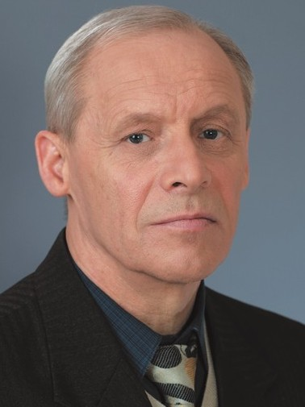
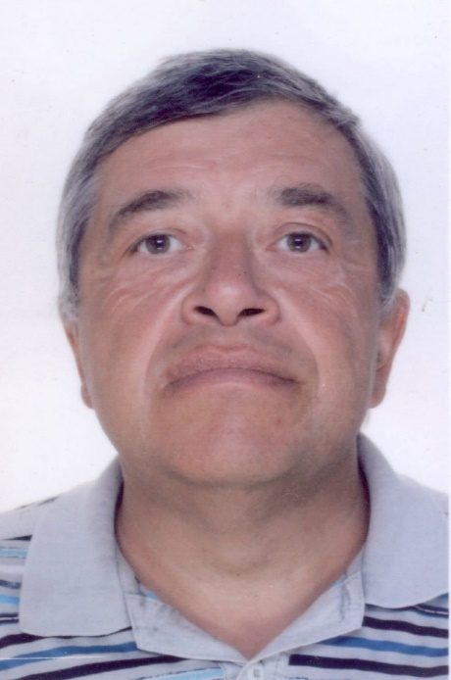
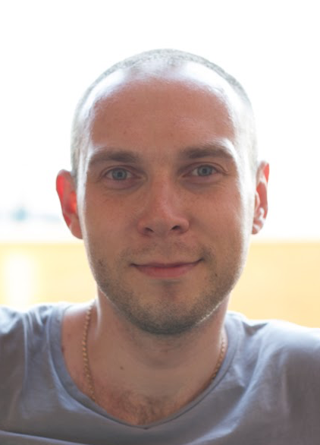
Thank you for your attention!
Q/A
Oleksandr Palagin
Academician of NAS of Ukraine
palagin.o.v@nas.gov.ua
Vitalii Velychko
PhD, Senior Researcher
aduisukr@gmail.com
Kyrylo Malakhov
Researcher
malakhovks@nas.gov.ua
https://malakhovks.github.io/
10

