Slide 1

Challenges with the reuse of data on circular economy: Experience of researchers at the InnoRenew CoE
Dr. Ana Slavec
ana.slavec@innorenew.eu
CESSDA Roadshow series – Circular economy
Online, 28. 10. 2021

Slide 2





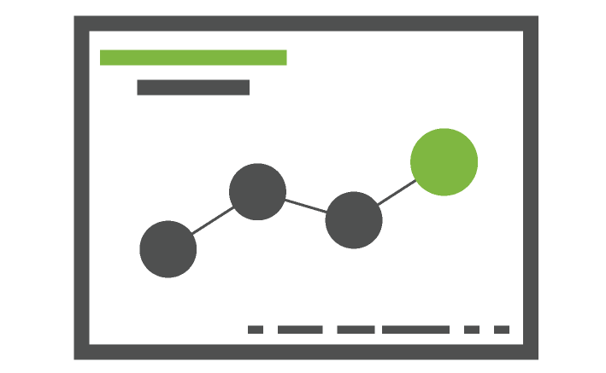
About InnoRenew CoE
Human Health in the Built Environment |  | Wood modification |  | Renewable Materials Composites
Sustainabile Building with Renewable Materials |  | ICT in Renewable Materials and Sustainable Building |  | Experimental Design and Data Analysis

Slide 3
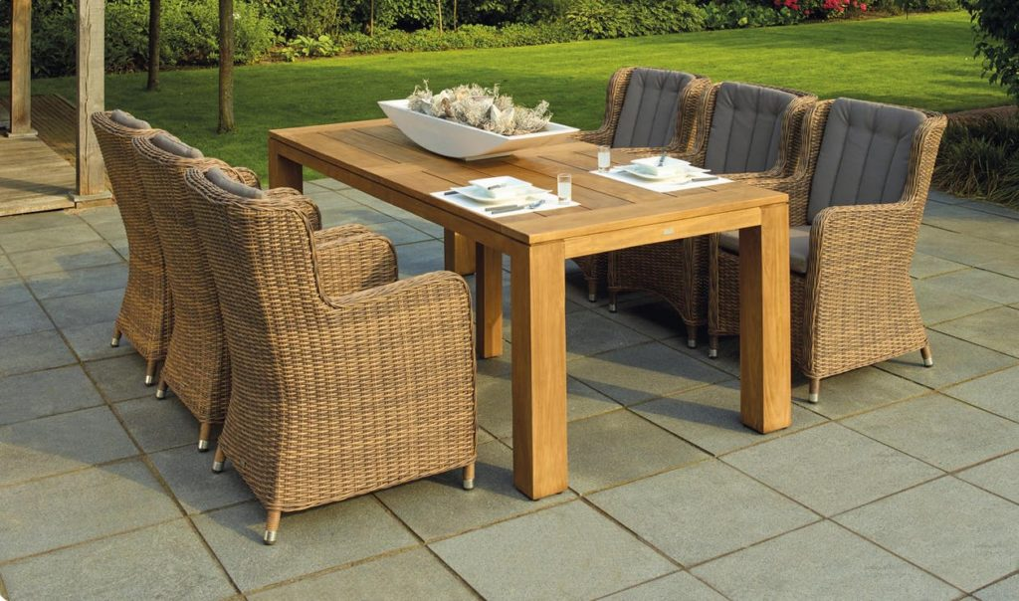

Projects related to circular economy (1/3)
Revitalisation of traditional industry: An open innovation framework for Slovenia‘s furniture sector
Innovation activities of Austrian and Slovenian companies in the wood-value chain

Slide 4

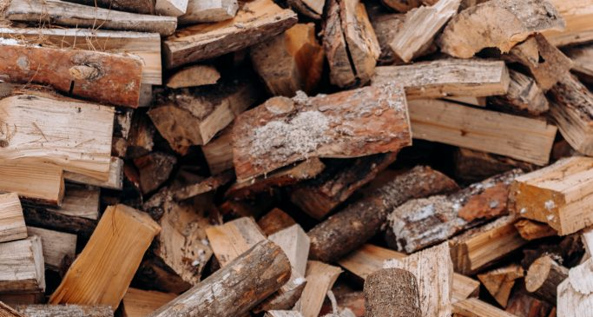

Projects related to circular economy (2/3)
Optimisation for sustainable supply chains
Reverse logistic network of residual wood biomass
Optimisation problems of the residual biomass value chain

Slide 5


Projects related to circular economy (3/3)
Underpinning the vital role of the forest-based sector in the Circular Bio-Economy (WoodCircus)
Wood and wood products over a lifetime (WOOLF)

Slide 6

Secondary data sources
Statistical office(s) and Eurostat
  Community innovation survey
Slovenian Forestry Institute
Data collected directly from enterprises (e.g. waste management data, electrical consumption, water use, salary ranges, materials used)

Slide 7

Issue 1: No data available for certain domains and topics
No data for certain categories of units (e.g. micro-enterprises, farms)
No network data between different actors in the system available so we have to rely on simulations instead of actual data
No data for specific topics (e.g. attitudes towards products made from used wood)
Timeliness issues (data available only up to a certain year, long wait for most recent data)

Slide 8

Issue 2: Only aggregate data available, no microdata
Some data available only on yearly level so it is not possible to analyse seasonality patterns
Only total sum data available, without specific subcategories (e.g. no facilty types for waste data processing data)
Interoperability issues

Slide 9

Issue 3: Data available only under strict protection measures
Company data usually under strict non-disclosure agreements
Inconveniences with the use of official data
  Eurostat microdata can be accessed only through desktop computers, no laptops allowed
  Statistical offices offer possibility to use safe rooms but the amount and frequency of data exports is limited (e.g. exports of values below a certain threshold is not allowed)
  VPN option required rental of equipment
Reproducibility issues

Slide 10

Thank you for your attention.

