Slide 1
List of Supplementary Figures and Tables
Supplementary Figure Legends
Supp. Figure S1: Original, un-fitted data for A, gs and NPQ vs time. Gas exchange data was logged every 10 s. (a) Mean values for A (mmol m⁻² s⁻¹); (b) individual replicates for A; (c) Mean values for gs (mmol m⁻² s⁻¹); (d) individual replicates for gs; (e) Mean values for NPQ; (f) individual replicates for NPQ.
Supp. Figure S2: Correlations between the best linear unbiased predictor (BLUP) values and the original mean. The BLUP value is generated from the linear mixed effect model that was used to account for undesirable variation due to spatial and temporal effects on the phenotype. The BLUP is then used to calculate the adjusted mean value. Here we grouped the plots into trait types: (a) steady state gas exchange and chlorophyll fluorescence; (b) dynamic CO₂ assimilation; (c) dynamic stomatal conductance; (d) dynamic NPQ; (e) plant morphology.
Supp. Figure S3: Correlation matrix of all phenotypic traits measured. R value is indicated by colour, shown in the right-hand scale bar. Stars show the significance between traits; p<0.001***, p<0.01**, p<0.05*.
Supp. Figure S4: Modelled curves for two extreme O. glaberrima accessions and O. sativa IR64, plotted on a log scale, for example A, gs and NPQ induction and relaxation dynamic traits; (a) A_{i rate}, (b) A_{r slope}, (c) gs_{i rate}, (d) gs_{r slope}, (e) NPQ_{i slope} and (f) NPQ_{r slope}. The lines on all plots from the y and x-axes to the curve show the time to reach 50% of the curve maximum.
Supp. Figure S5: Linear regression plots showing strong positive correlations between the actual measurement vs modelled estimate values for (a) A_{max} vs A_{i max}, (b) gs_{max} vs gs_{i max} and (c) NPQ_{max} vs NPQ_{i max}.
Supp. Figure S6: Plots showing the (a) scree plot and (b) trait loadings for the phenotypic data PCA analysis.
Supp. Figure S7: (a) H-clustering dendrogram of 105 O. glaberrima accessions analysed for similarities based on climatic traits, showing 3 distinct clusters. Frequency plots generated from the H-clustering analysis of the phenotypic data from 155 O. glaberrima accessions, showing the frequency of accessions in each cluster for (b) ecological niche and (c) country of origin.
Supp. Figure S8: Correlation matrix for all phenotypic and climatic data, alongside with their principal components. Correlation strength is indicated by colour, shown in the right-hand scale bar. Stars show the significance between traits; p<0.001***, p<0.01**, p<0.05*.
Supplementary Tables:
Supplementary Table S1: List of paramet­­er abbreviations, definitions and units of measurement.
Supplementary Table S2: List of O. glaberrima ID codes, country of origin and ecology.
Supplementary Table S3: S3a: Estimated LL.4 model outputs on carbon assimilation (A) IRGA induction data, showing the 4 replicates for accession IRGC_96726. S3b: Estimated LL.4 model outputs on stomatal conductance (gs) IRGA induction data, showing the 4 replicates for accession MG04.
S3c: Estimated LL.3 model outputs on non-photochemical quenching (NPQ) IRGA induction data, showing the 4 replicates for accession TOG_12188. S3d: Estimated W2.4 model outputs on non-photochemical quenching (NPQ) IRGA relaxation data, showing the 3 replicates for accession EG55. EG55 was one of a small number of accession where only 3 replicates were measured. S3e: Estimated LL.4 model outputs on stomatal conductance (gs) IRGA relaxation data, showing the 4 replicates for accession TOG_5326. S3f: Estimated LL.4 model outputs on carbon assimilation (A) IRGA relaxation data, showing the 4 replicates for accession UG26.

Slide 2
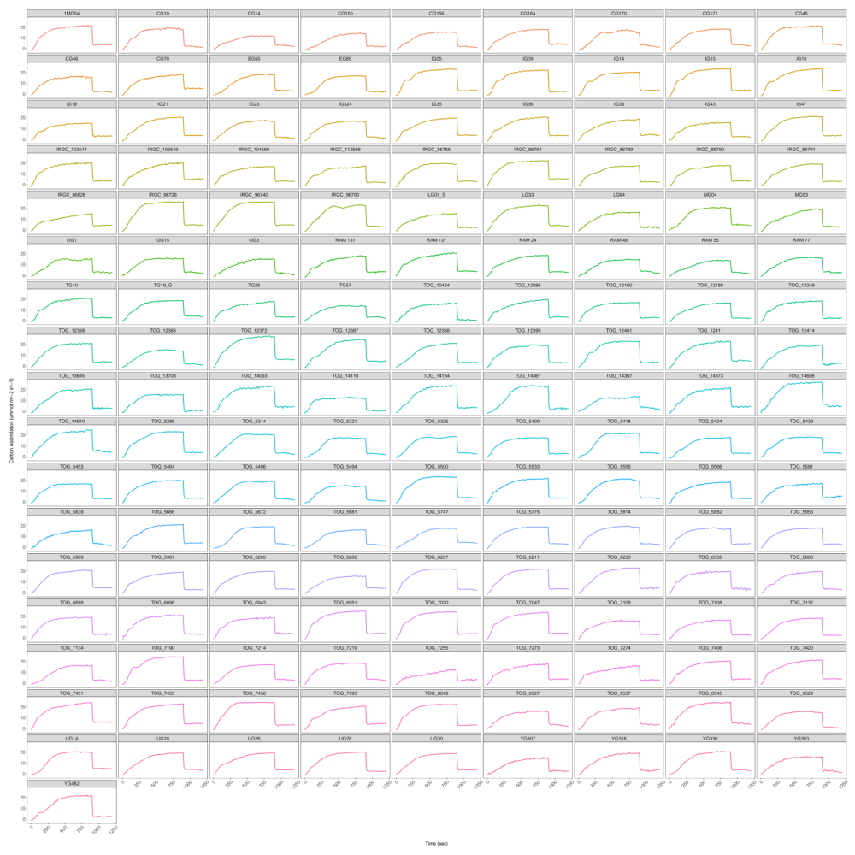
Supp. Figure S1a.
Mean CO₂ assimilation vs time for each accession.

Slide 3
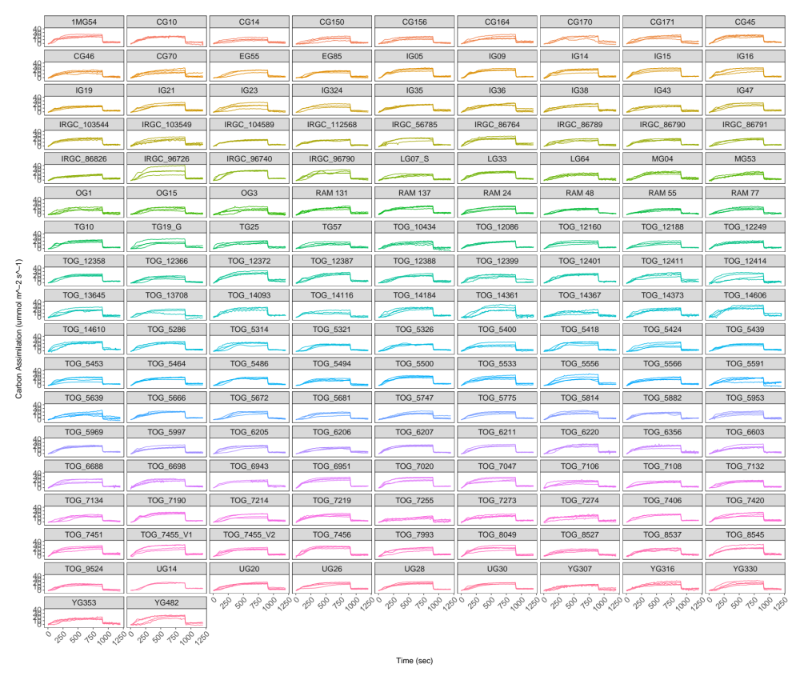
Supp. Figure S1b.
Individual replicate CO₂ assimilation vs time for each accession.

Slide 4
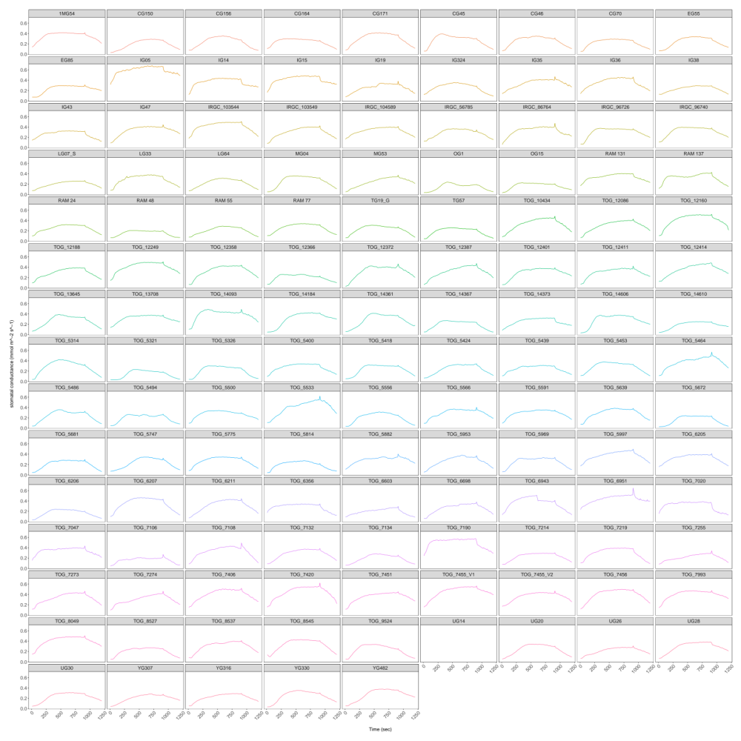
Supp. Figure S1c.
Mean stomatal conductance vs time for each accession.

Slide 5
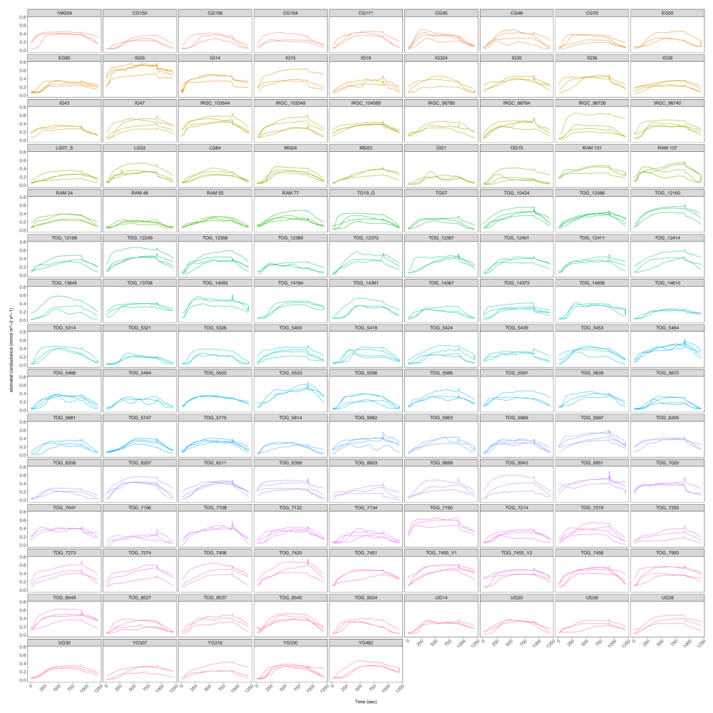
Supp. Figure S1d.
Individual replicate stomatal conductance vs time for each accession.

Slide 6
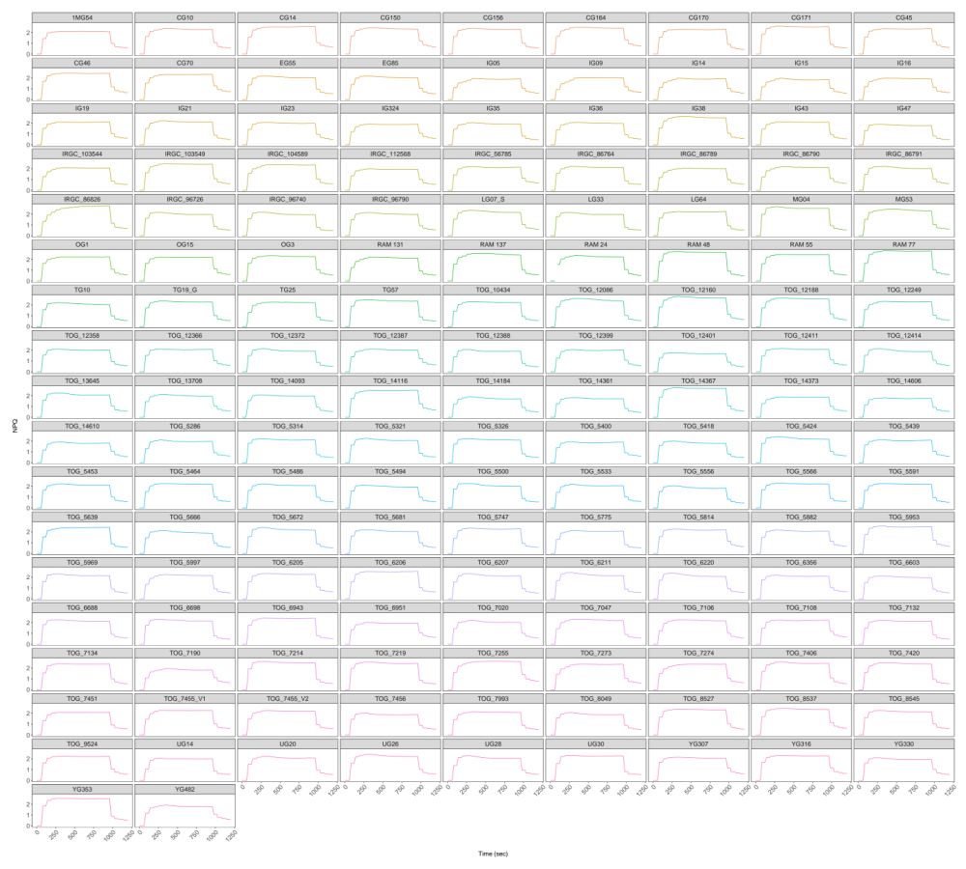
Supp. Figure S1e.
Mean NPQ vs time for each accession.

Slide 7
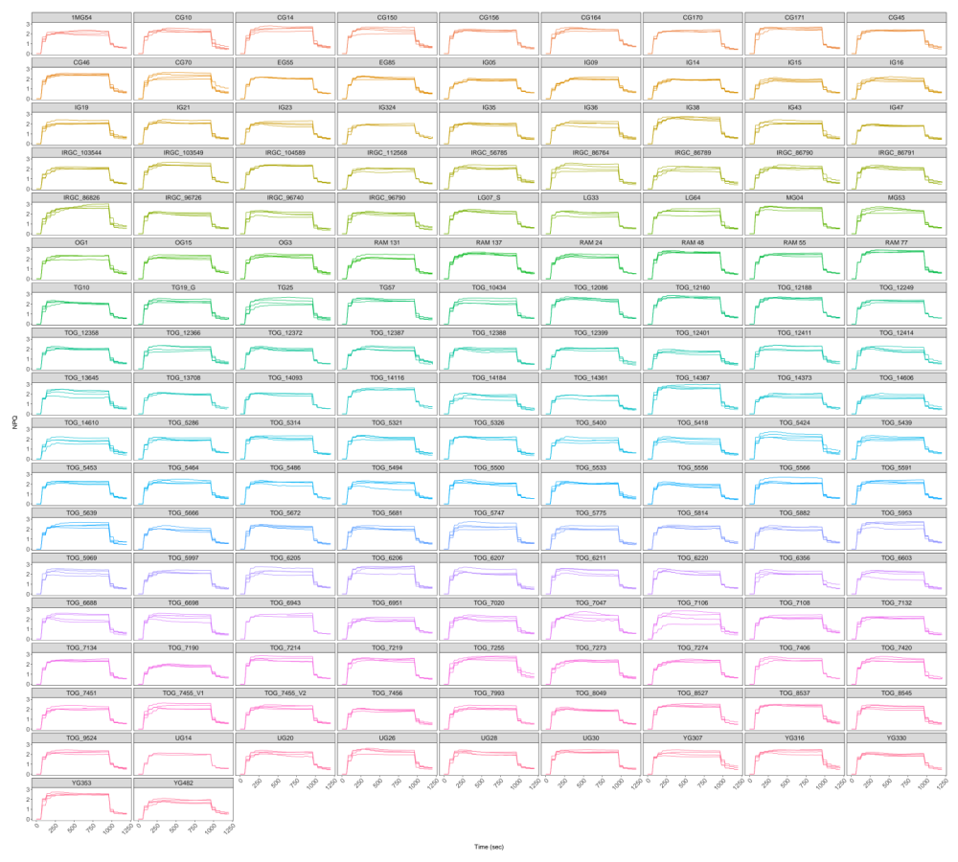
Supp. Figure S1f.
Individual replicate NPQ vs time for each accession.

Slide 8
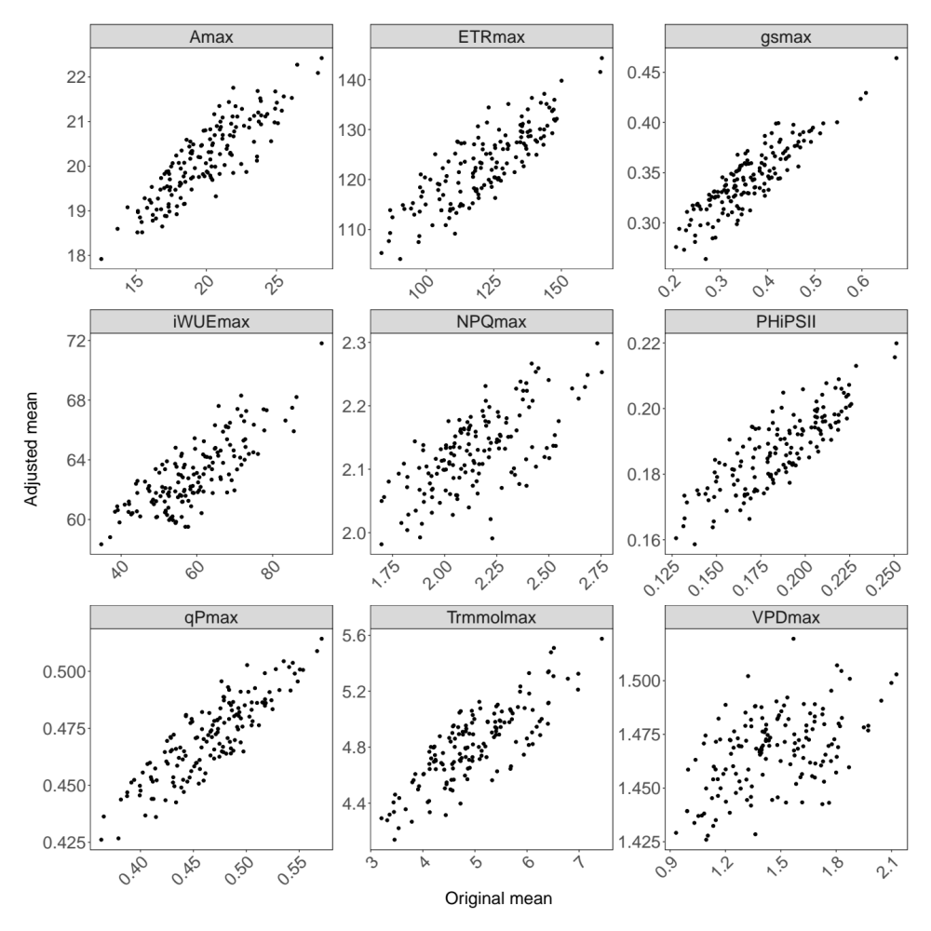
Supp. Figure S2a
Steady state gas exchange and chlorophyll fluorescence traits

Slide 9
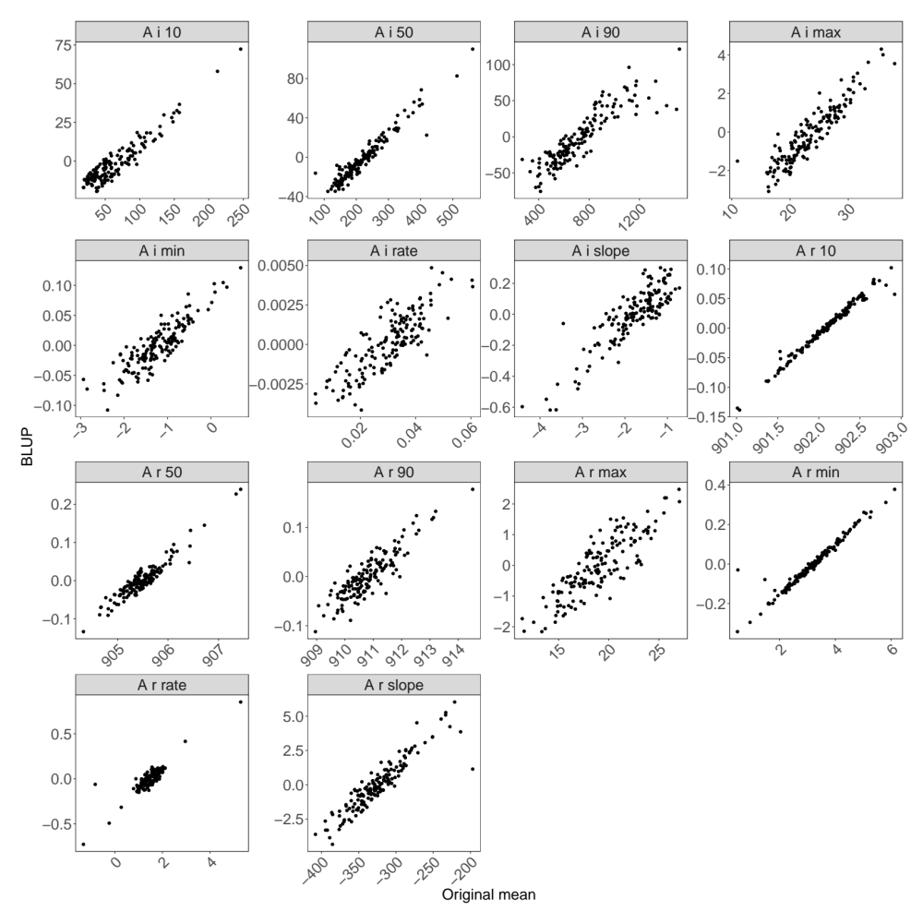
Supp. Figure S2b
Dynamic CO2 assimilation

Slide 10
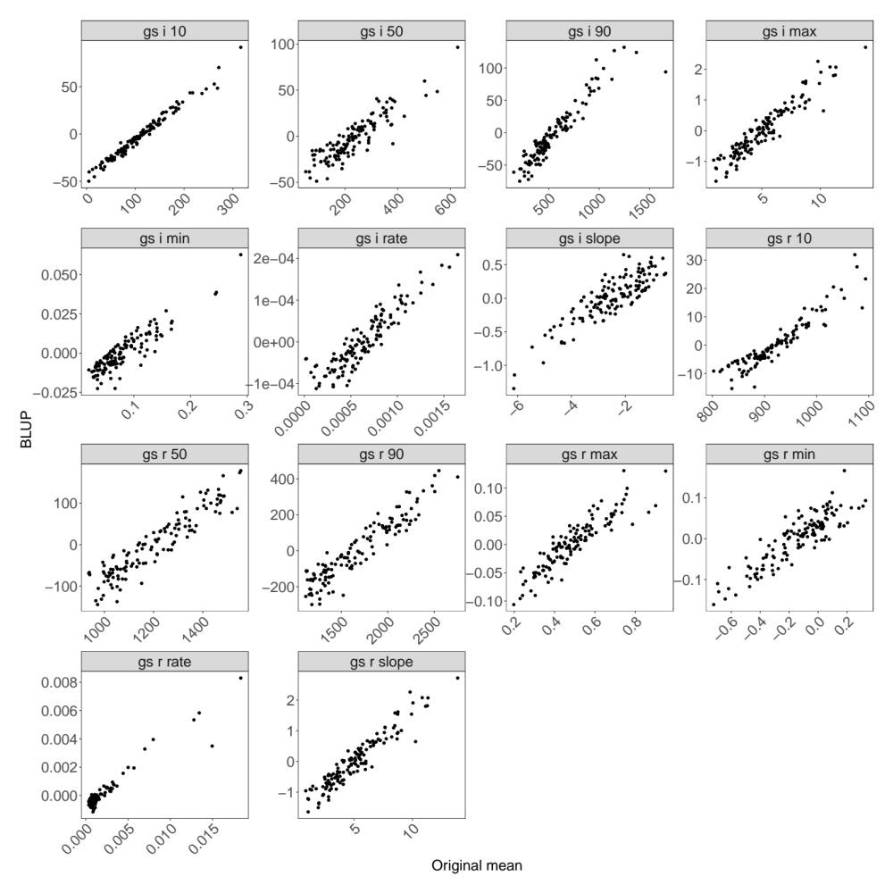
Supp. Figure S2c
Dynamic stomatal conductance traits

Slide 11
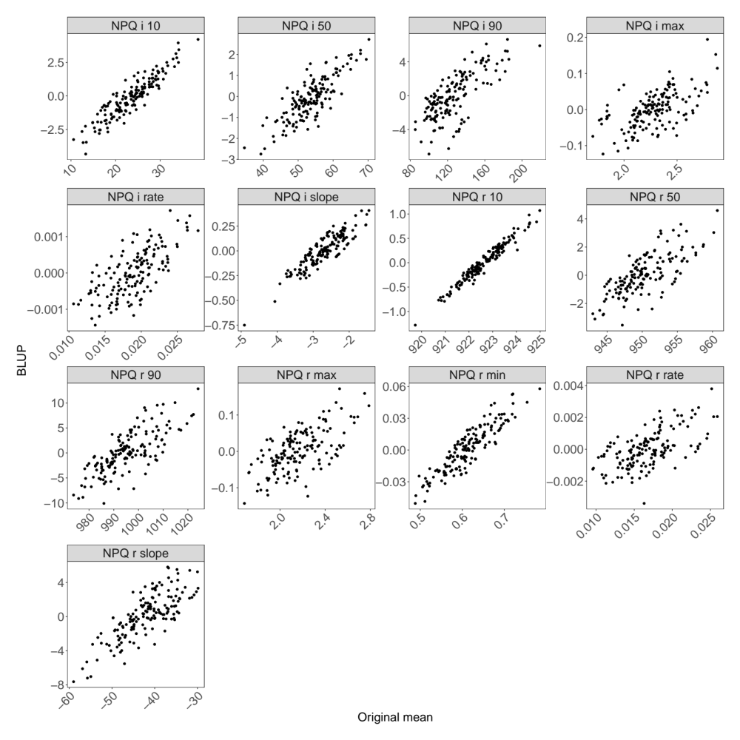
Supp. Figure S2d
Dynamic NPQ traits

Slide 12
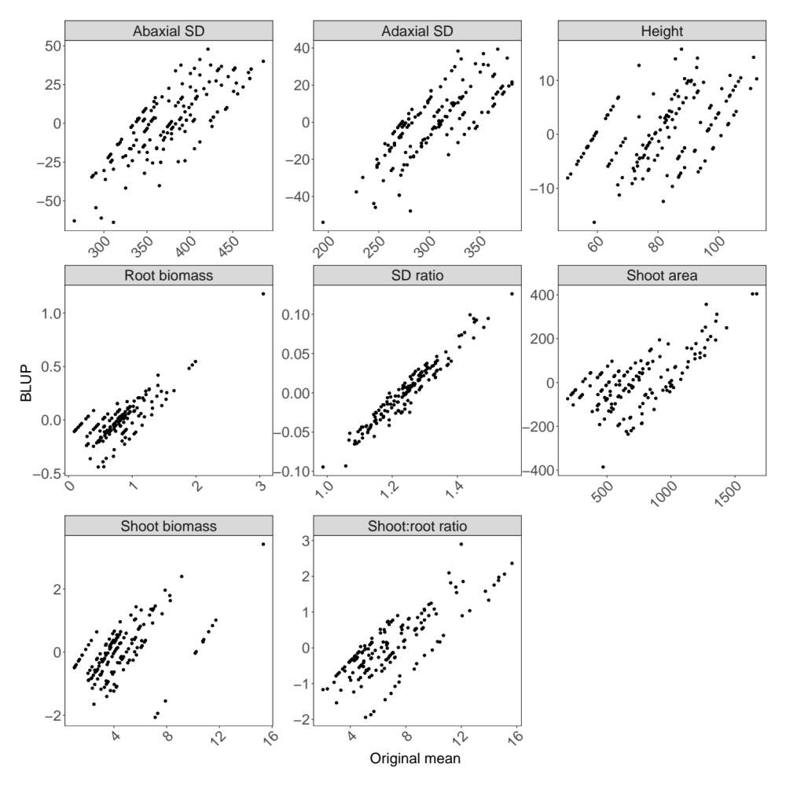
Supp. Figure 2e
Morphology traits

Slide 13
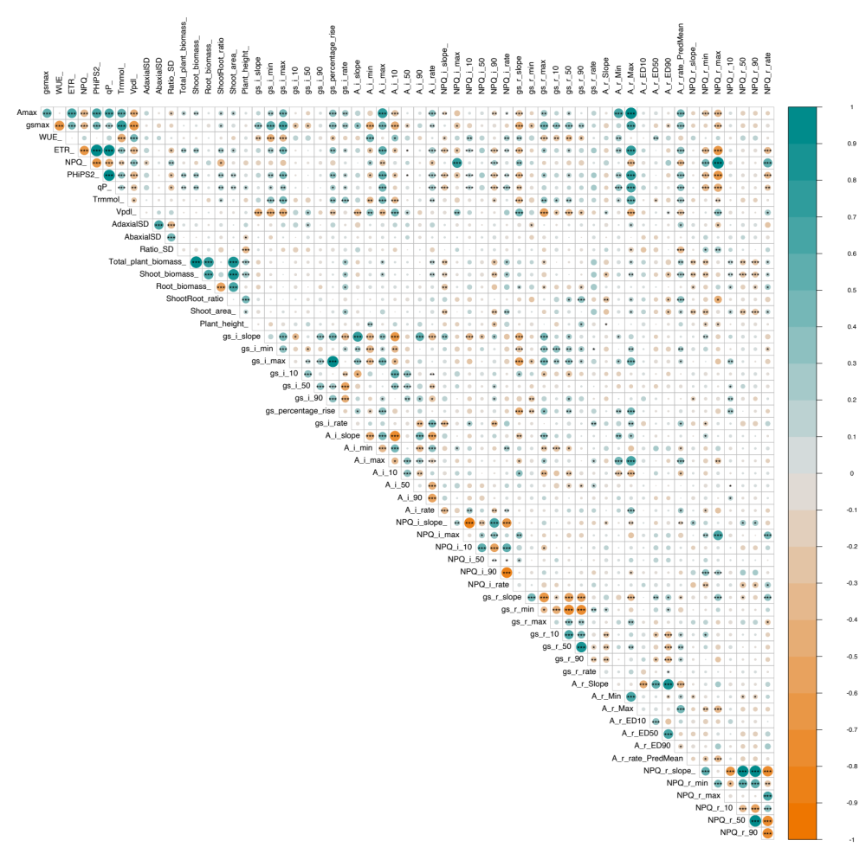
Supp. Figure S3

Slide 14
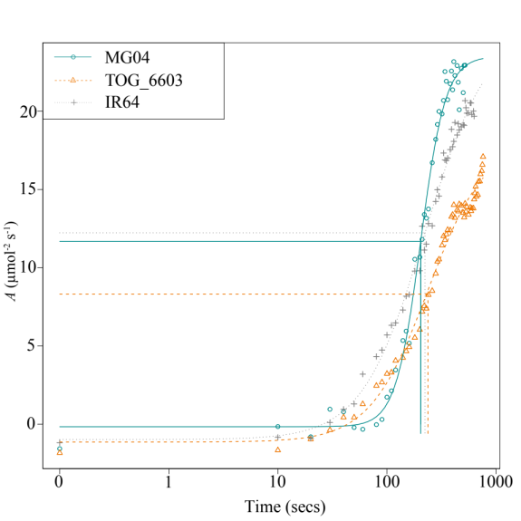
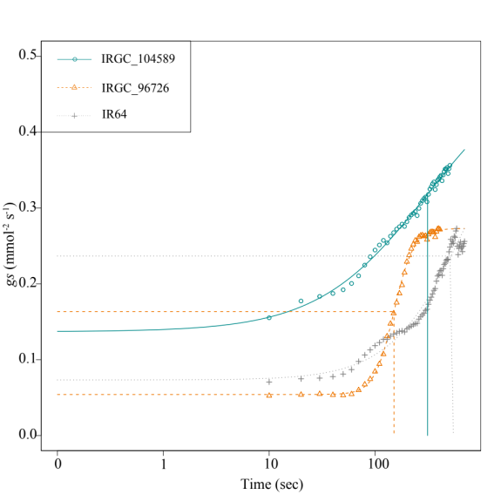
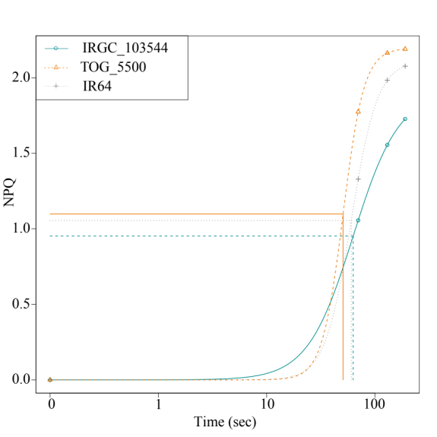
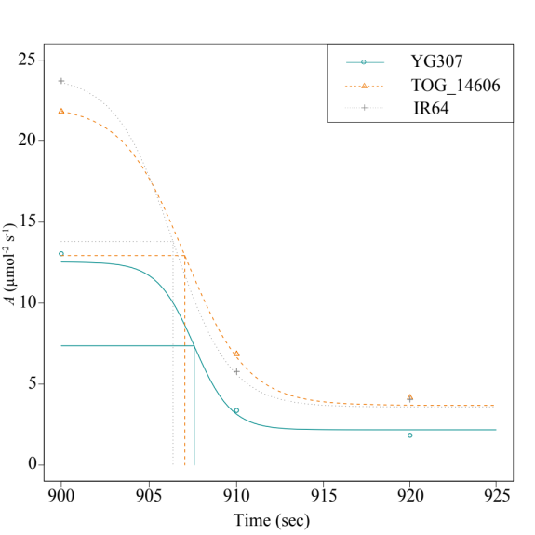
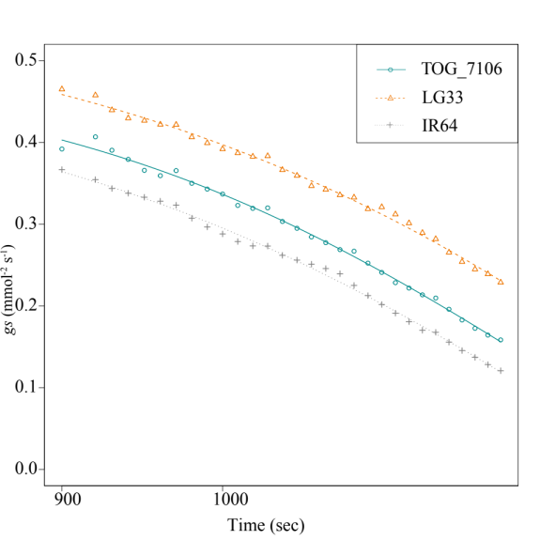
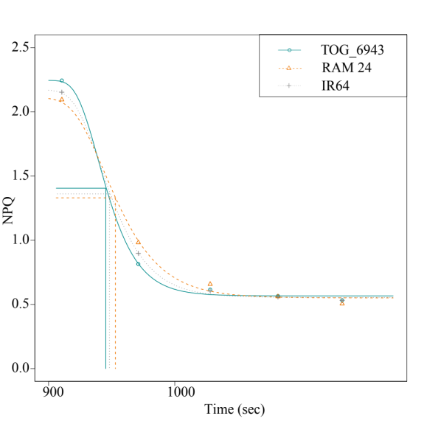
Supp. Figure S4
(a)
(c)
(e)
(b)
(d)
(f)

Slide 15
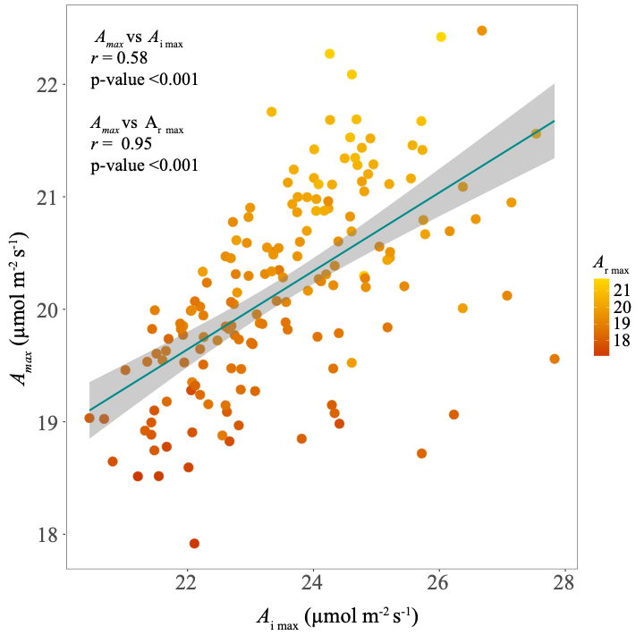
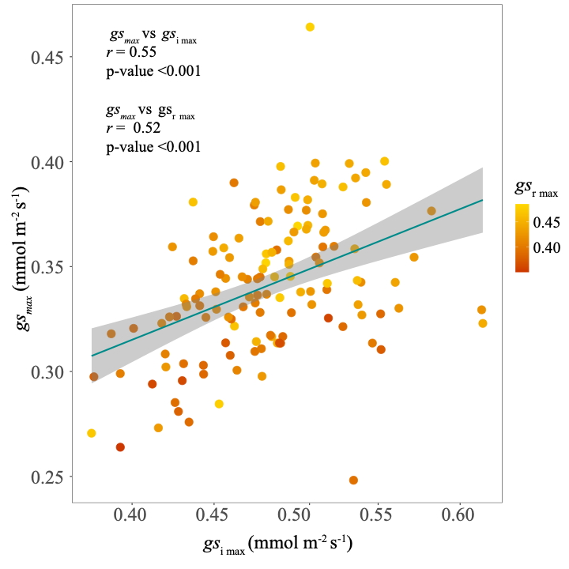
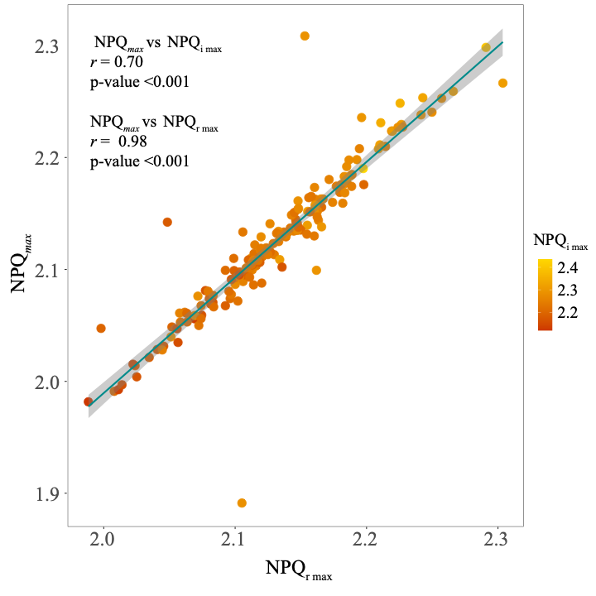
Supp. Figure S5
(a)
(b)
(c)

Slide 16
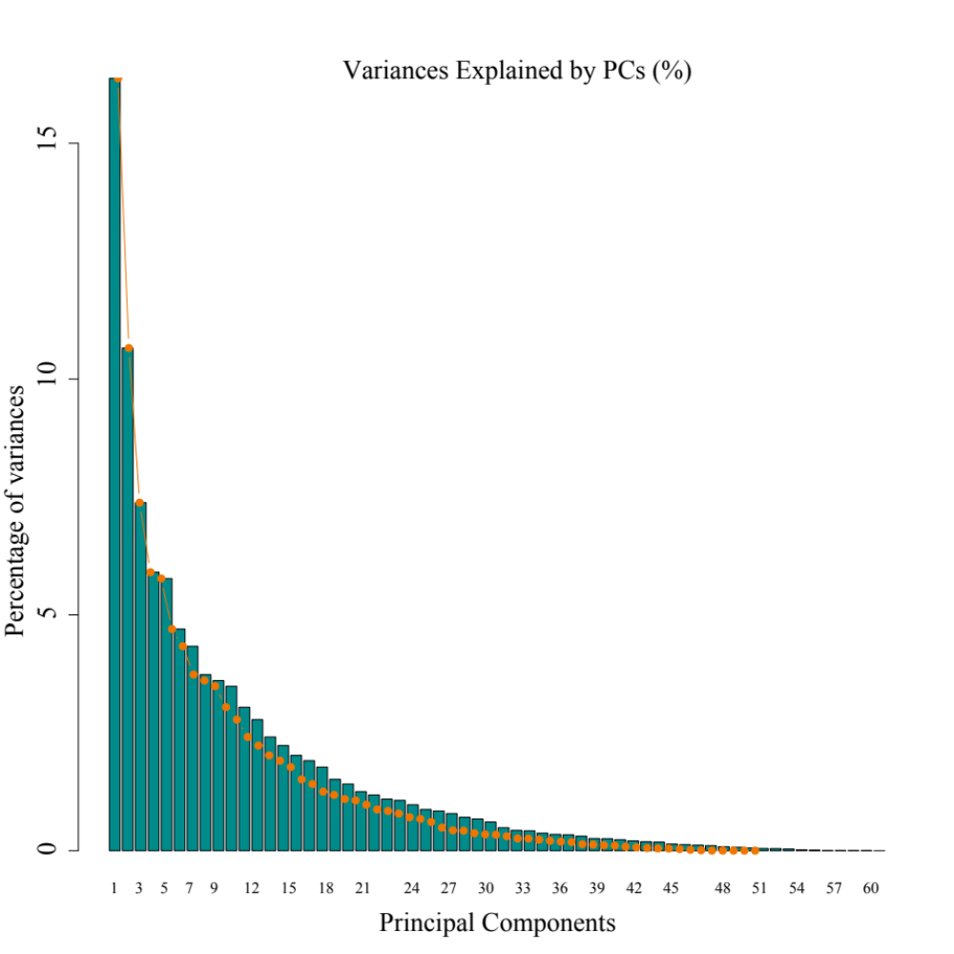
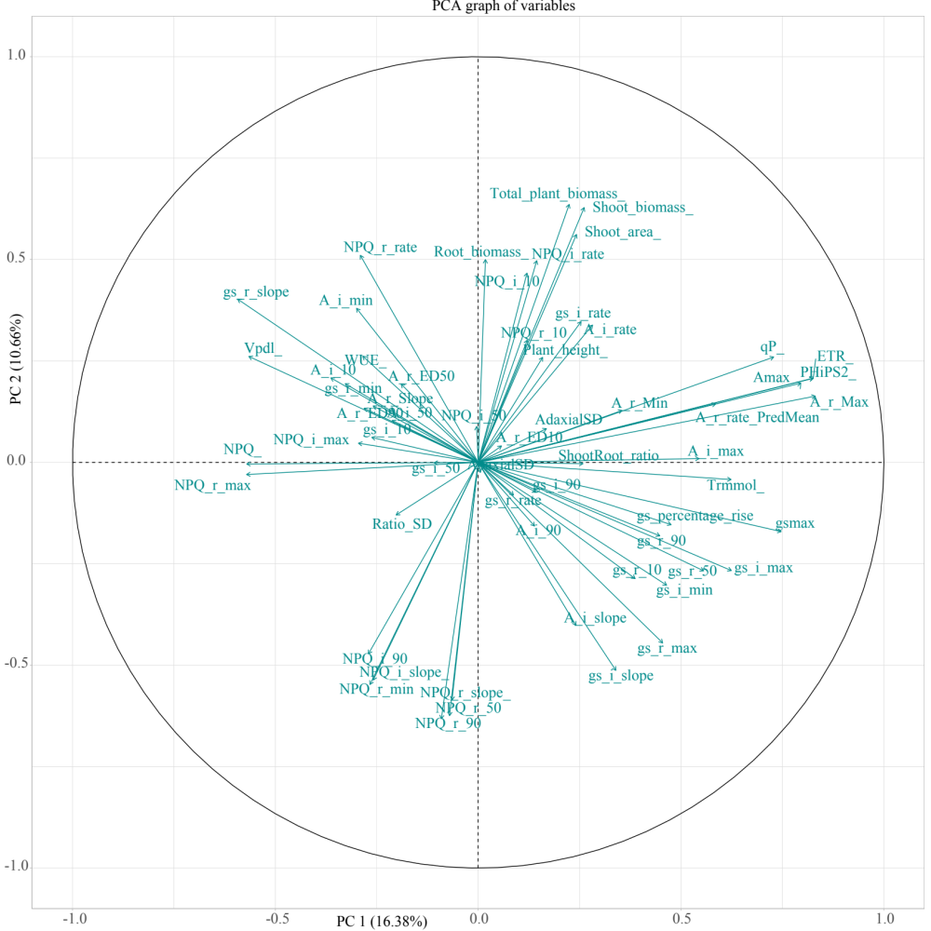
Supp. Figure S6
(a)
(b)

Slide 17
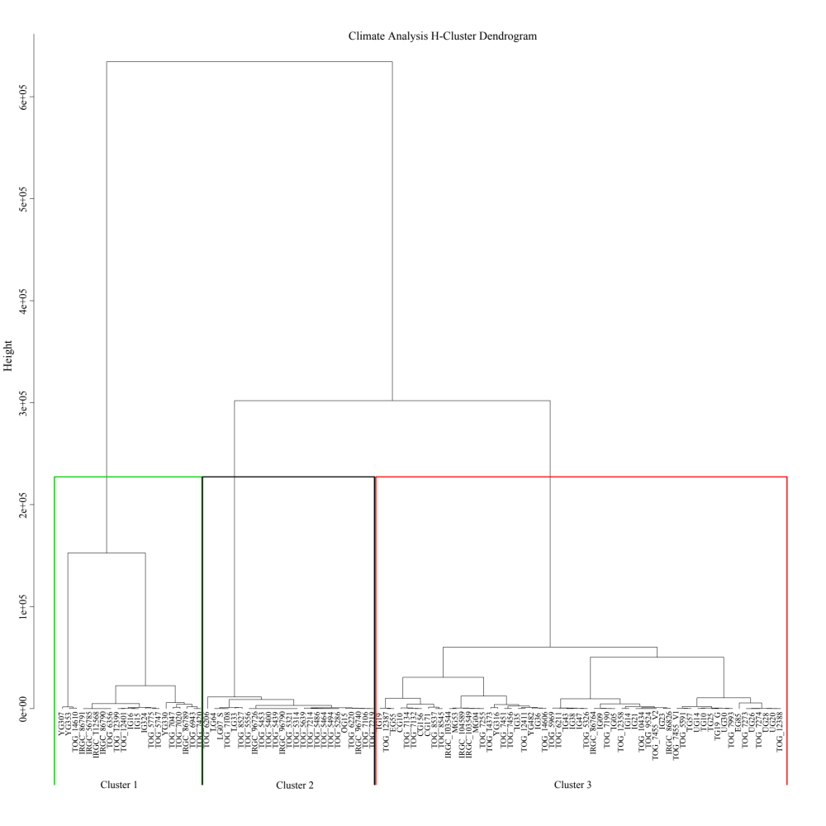
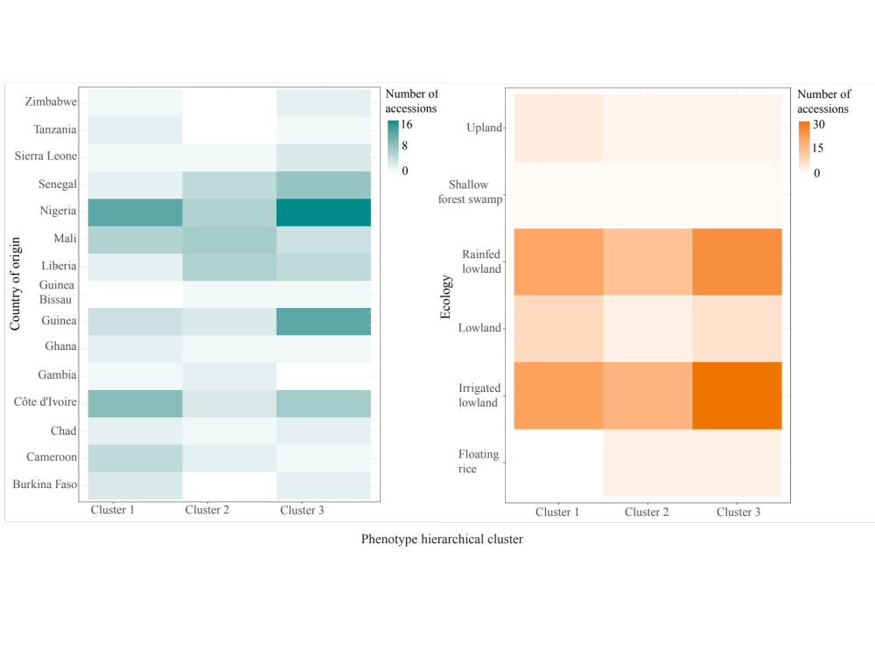
Supp. Figure S7
(a)
(b)
(c)

Slide 18
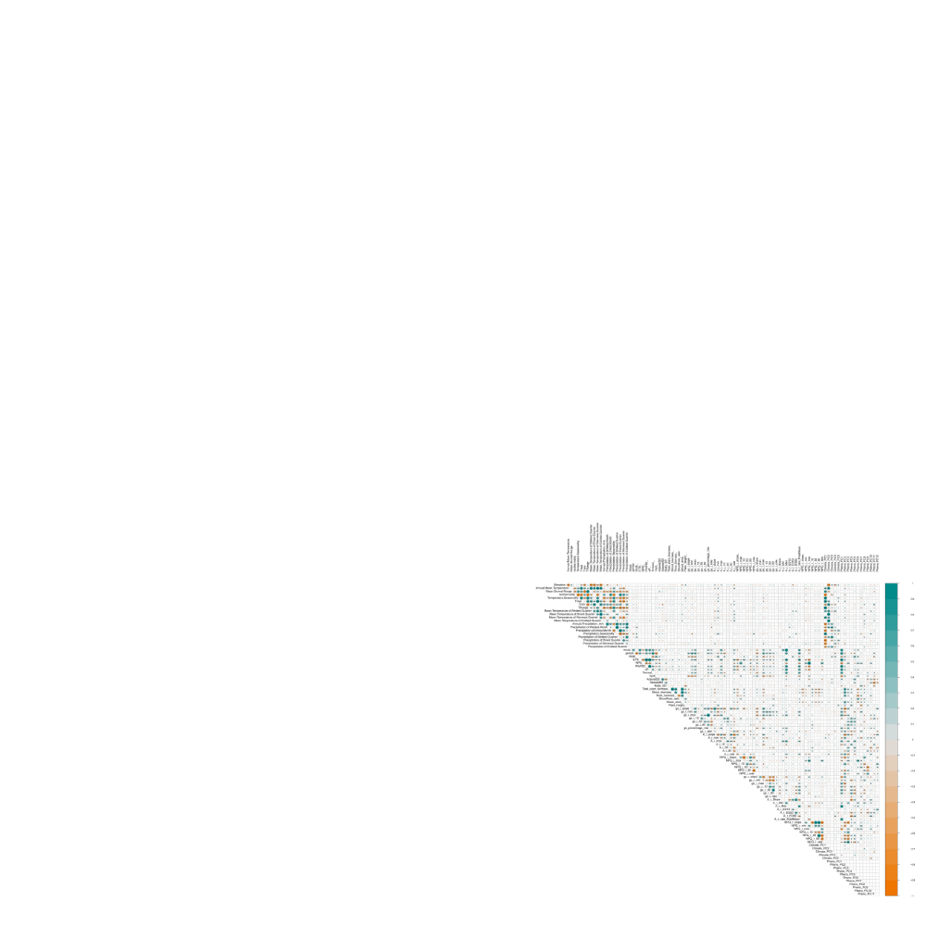
Supp. Figure S8

