Slide 1

The what, how and who in the Bio-IT project
EMBL Lab Day 2021
3rd of September
“Community initiative which aims to build, support, and promote computational biology activity at EMBL”

Slide 2
Why Computational Biology
Integral to experimental design: support experimental design planning and data processing.
Necessary to scale up: to process and store big data, to compare data in different context, even from small-scale experiments.
Data (and science) doesn’t end at publication: ensure scientific FAIRness by properly storing your data and processes and making them findable and available.
Data-driven research: advanced computational techniques applied to biology define a new scientific paradigm.

Slide 3
Why Computational Biology at EMBL
EMBL is committed to Open Science policies.
A dynamic research context such as EMBL needs FAIR data and processes to ensure usability.
In a collaborative environment researchers can easily take advantage of each others’ skills: design experiments to spare time and money and achieve better science.
Even more because of EMBL’s internationality: wide network of collaborations and data sources.
A specific interest of EMBL scientists is populating and maintaining biological databases and tools.

Slide 4




How? Bio-IT
“Community initiative which aims to build, support, and promote computational biology activity at EMBL.”
Infrastructure and resources
GitLab
Coding platforms and tools
Knowledge aggregation and dissemination
EMBL centers / IT services info
WikiHows
Newcomers guide
Training and consulting
Courses and seminars
Course materials
Consulting sessions
Community building and networking
Clubs
Grassroots
Community blog

Slide 5
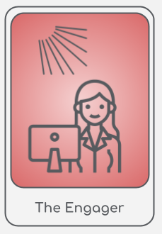
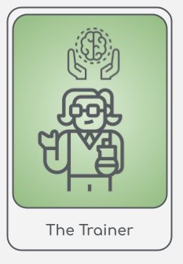
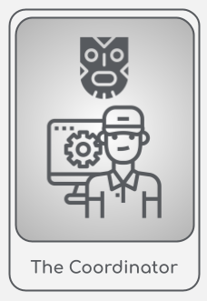
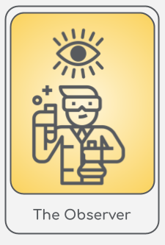
Bio-IT community
We will present the Bio-IT community through personas.
Personas disclaimer: "all persons fictitious"
In this context, personas are fictional characters used to present different way to interact with the community.

Slide 6



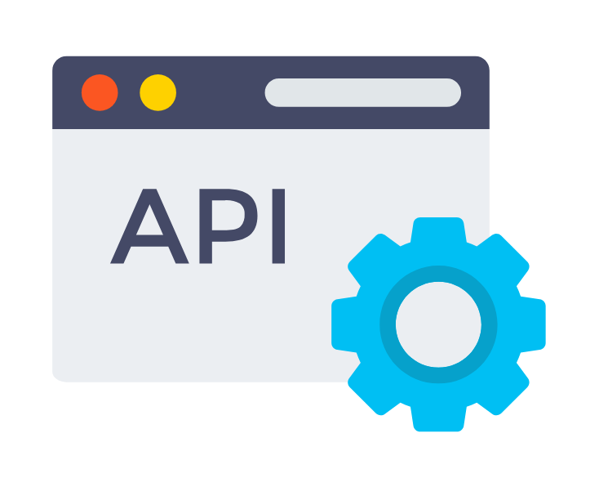
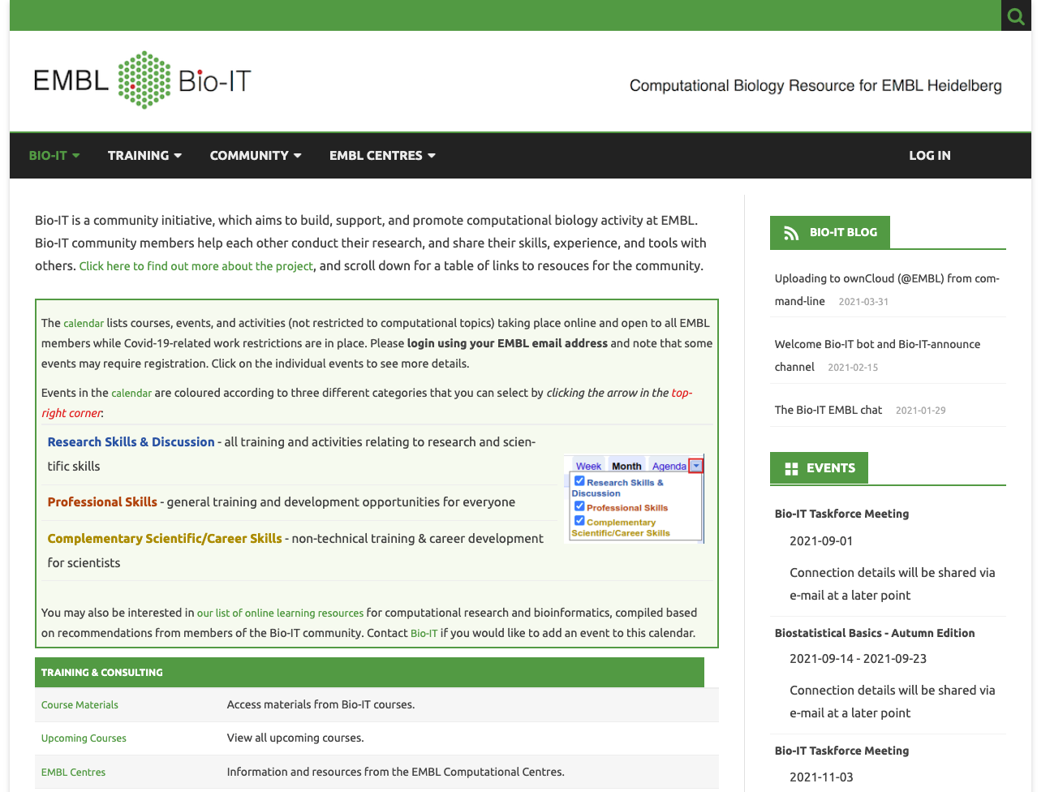
The Observer
Mostly applies wet lab biology techniques in experiments
Sometimes uses computational tools through their graphical interfaces to make some predictions
Got interested in learning how to query them programmatically and tried writing some code
To do so, ended up in Bio-IT website
The Observer

Slide 7

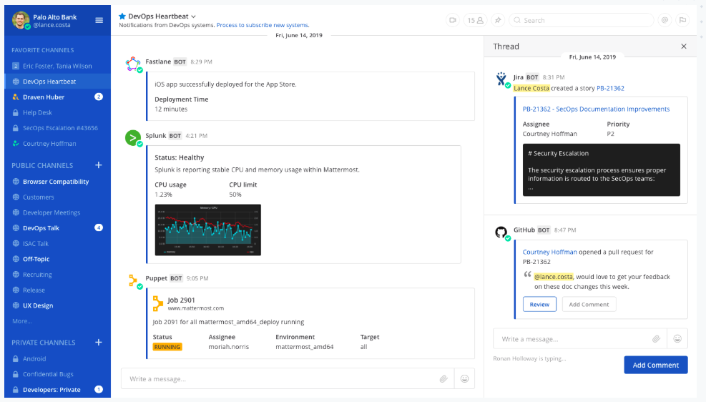
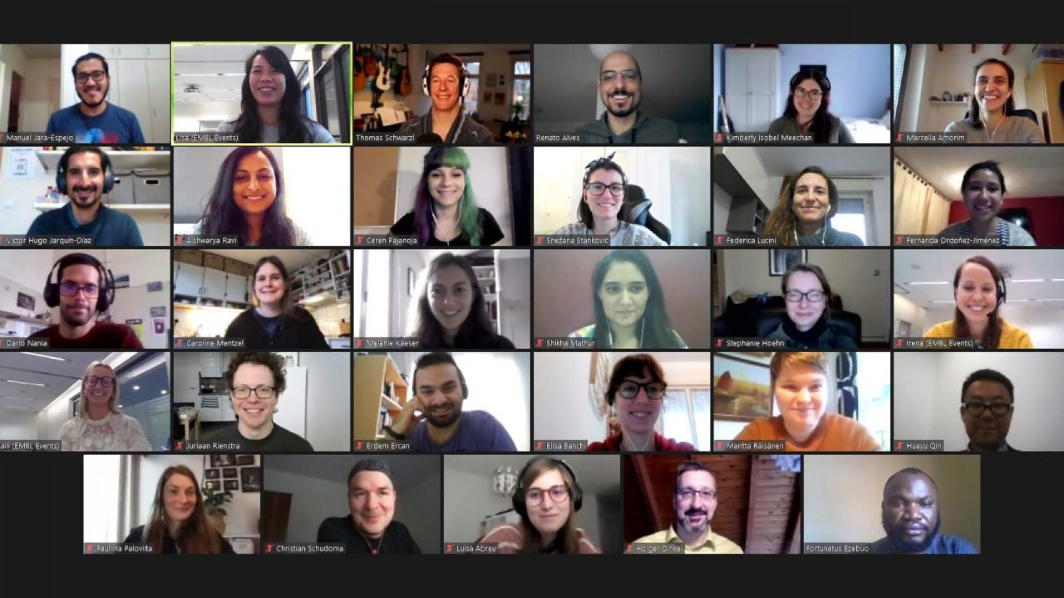
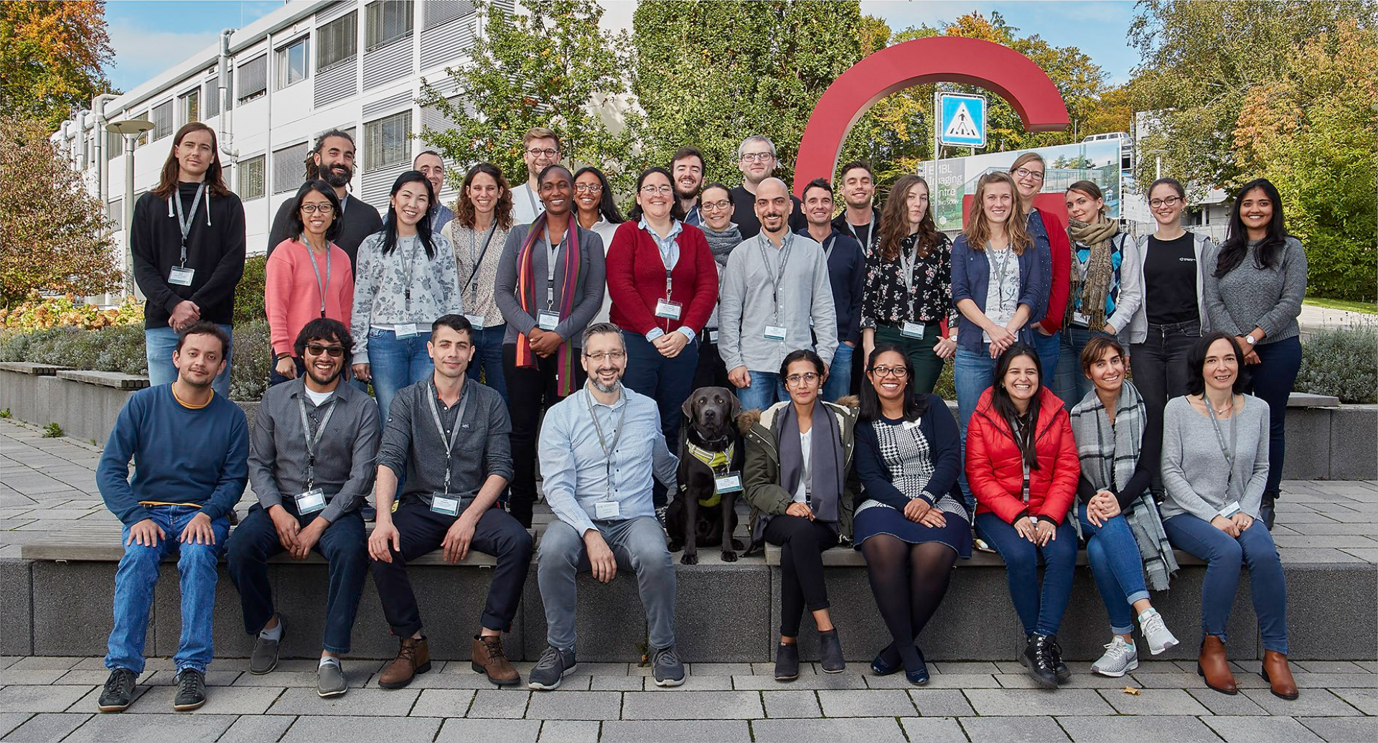
The Observer
Consulted the list of Bio-IT resources to choose the right platform
Uses the chat for consulting
Attends external and internal courses
@ Bio-IT
@ Bio-IT announce
@ Coding Club
@ Python
@ R_and_statistics

Slide 8



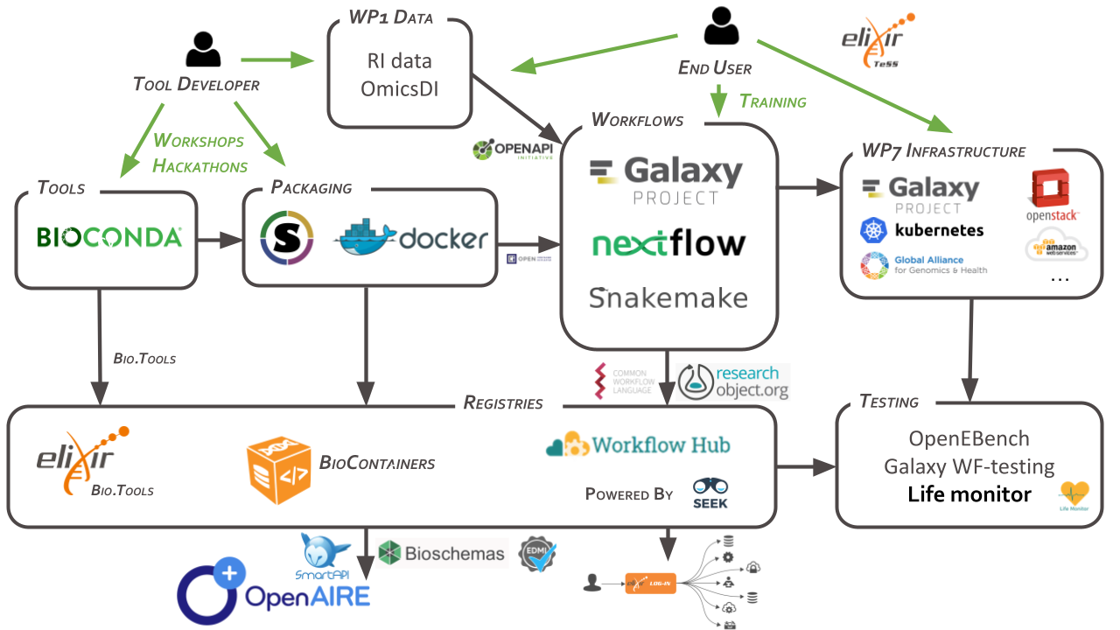


The Engager
Strong computational skills
Developer of computational tools for biological data analysis
Promotes open science practices
EMBL GitLab
EMBL Galaxy
The Engager

Slide 9

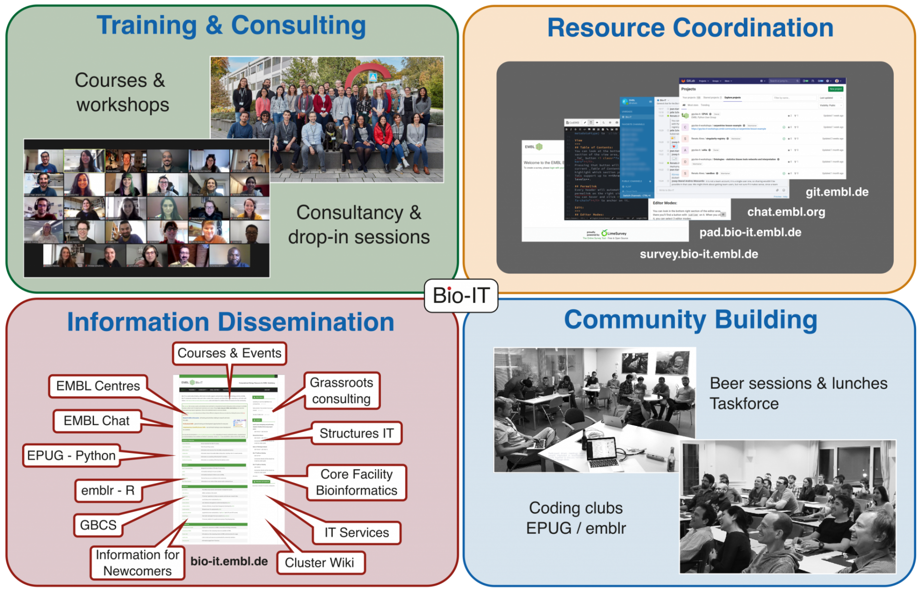
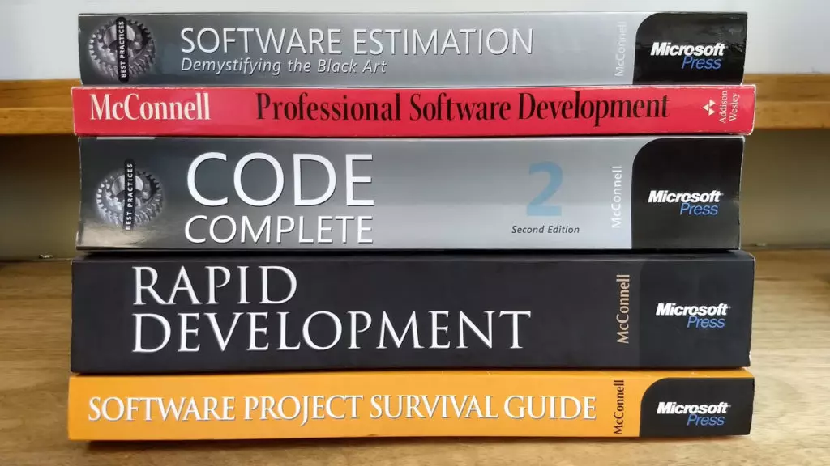
The Engager
Chairs and presents in clubs
Shares coding stories and resources in chat channels
Proposes and leads themed seminars
Joins hackathons
Sometimes joins courses as trainer

Slide 10


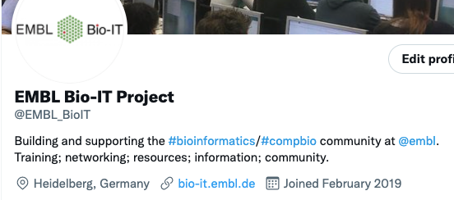
The Trainer
Leads a research group
Has wide experience in computational biology
Uses computational tools from command line for exploratory analysis
Has little time to join Bio-IT activities, but keeps updated
Is listed in the Grassrots consulting table
Follows and interacts with the Twitter profile @EMBL_BioIT
Trainer in external and internal
courses
The Trainer

Slide 11


The Coordinator
Enjoys coding and testing new tools and resources
Maintains Bio-IT resources, admin of GitLab
Maintains Bio-IT website
Chair of meetings and clubs, organiser
Available for consulting via chat or in the Bio-IT drop-in
Organises small groups sessions for discussion
The Coordinator

Slide 12
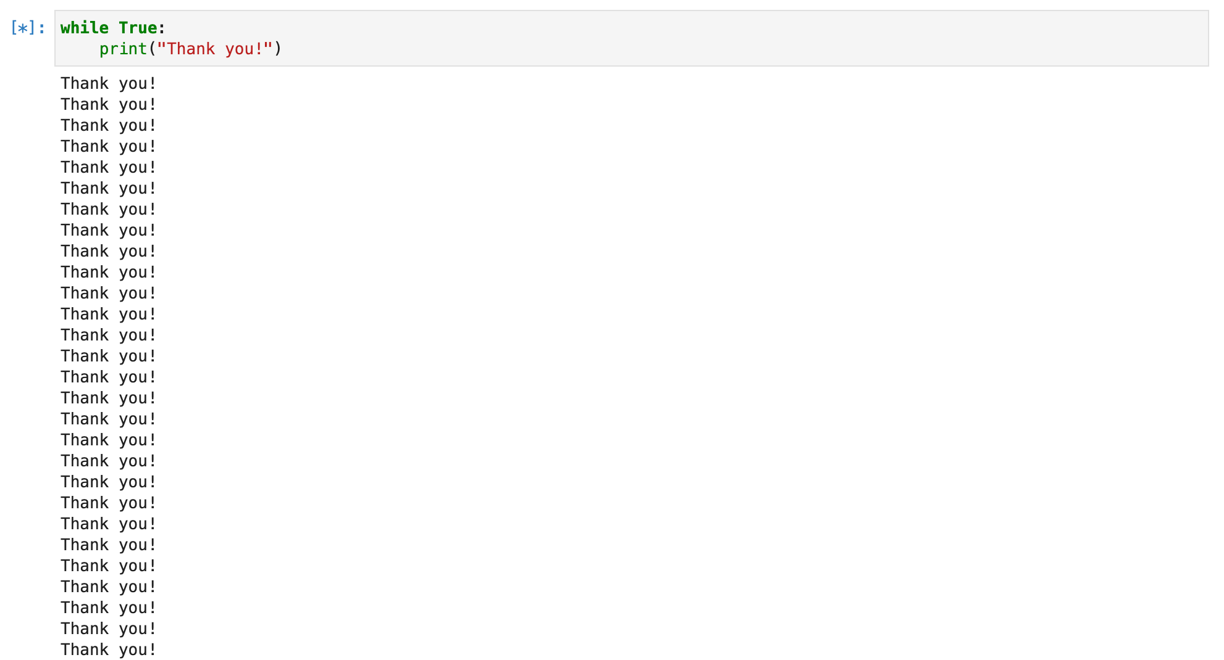




#engage
#stay informed
- Read the blog
- Check upcoming courses / activities *
- Check the news about the resources
@paladin
@ralves
chat.embl.org
bio-it.embl.de
@ Bio-IT
@ Bio-IT announce
@ Coding Club
@ Python
@ R_and_statistics
@EMBL_BioIT
MONDAY
TUESDAY
WEDNESDAY
THURSDAY
FRIDAY
BIO-IT drop-in
10-12 AM
BIO-IT taskforce
2-3 PM
#join
Coding Club
(R or Python)
4-5 PM
* EPUG community discussion (28 September)
* Git Week (15-19 November)
* Bio-IT Hackathon (1-2 December)
bio-it@embl.de

