Slide 1
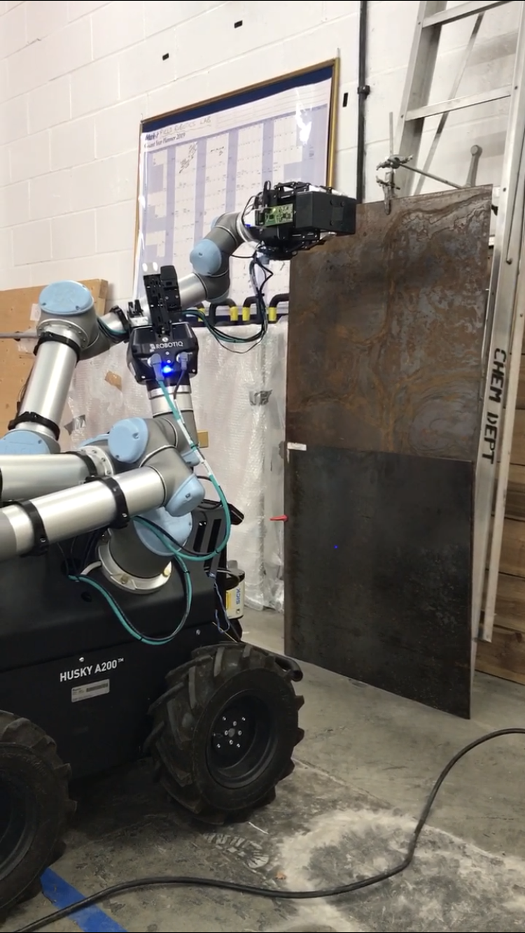
Experimental Setup and Key Parameters – compiled by j.blanche@hw.ac.uk
Antenna – Target Separation = 10cm
Waveguide used = 50 cm Coaxial Cable rated to 26 GHz (Peak interface at Bin 9 FFT)
Chirp Duration = 300 ms
Bandwidth 1500 MHz (24 – 25.5 GHz)
Board input Voltage 12V
1 chirp generated per second
Datasets acquired:
  Clean Steel
  Rusty Steel
  Clean Aluminium
  Clean Copper
  Lab Floor 1 (Concrete)
  Lab Floor 2 (Concrete)
  Lab Floor 3 (Concrete)

Slide 2
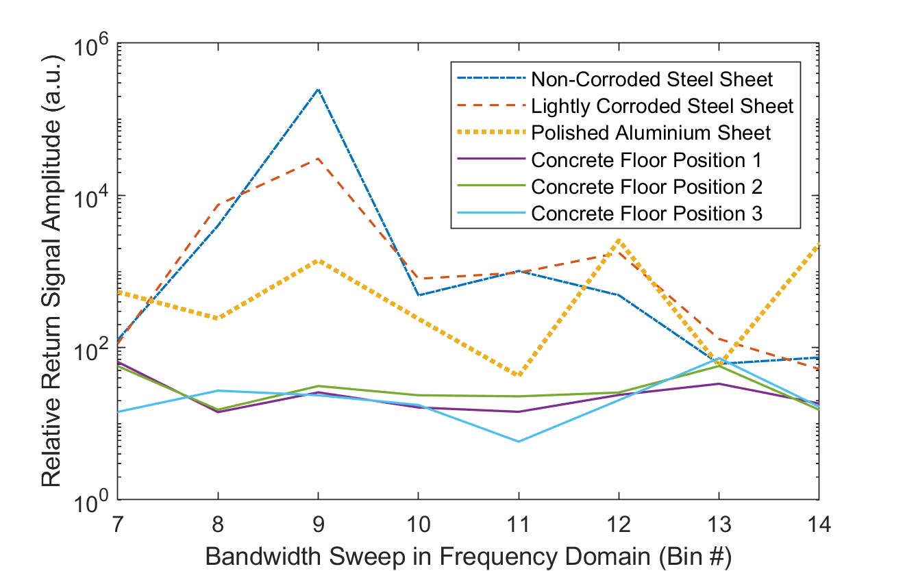
Main Datasets Plotted as FFT

