Slide 1







How can open educational video resources be made more accessible for remixing and translation beyond posting on YouTube?
Anelda van der Walt & Batool Almarzouq
22nd of Sep 2021
https://shorturl.at/ckIPS
@Talarify, @OpenSciSaudi, @openlifesci

Slide 2
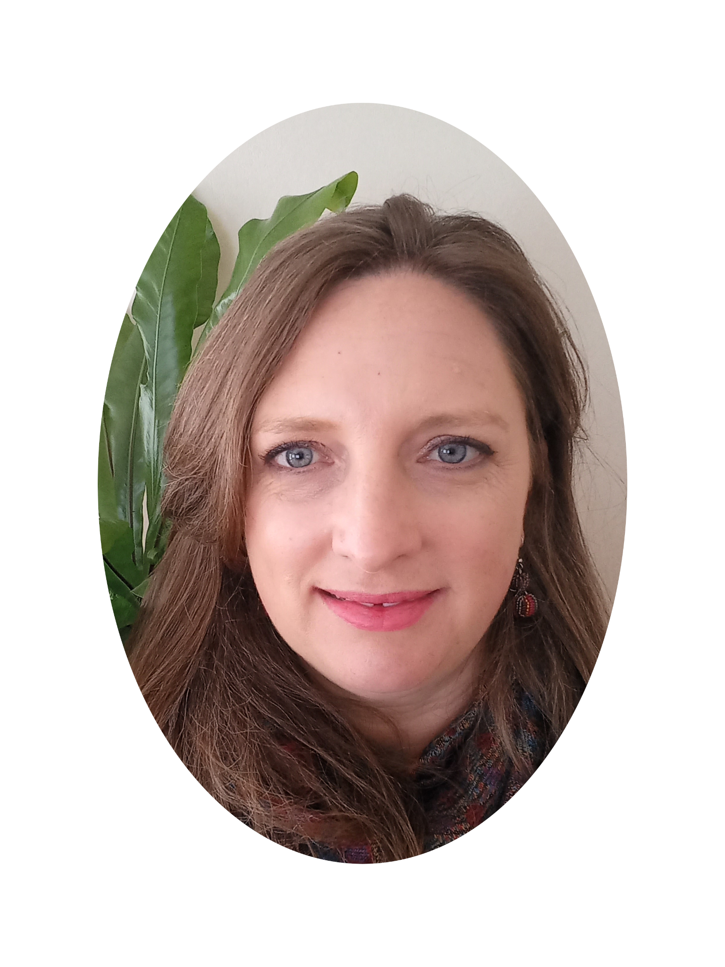
About us ~ Anelda van der Walt
Background in Bioinformatics.
Founded a small South African consulting firm, Talarify, in 2014.
Supports researchers and students in Africa across all disciplines to adopt aspects of open science and reproducible research to enhance the impact of their research.
Twitter: @aneldavdw
Formulated our vision and aims, roadmap - 1st Meetup for Carpentries community in MENA
https://shorturl.at/ckIPS
https://shorturl.at/ckIPS
@Talarify, @OpenSciSaudi, @openlifesci
@Talarify, @OpenSciSaudi, @openlifesci

Slide 3
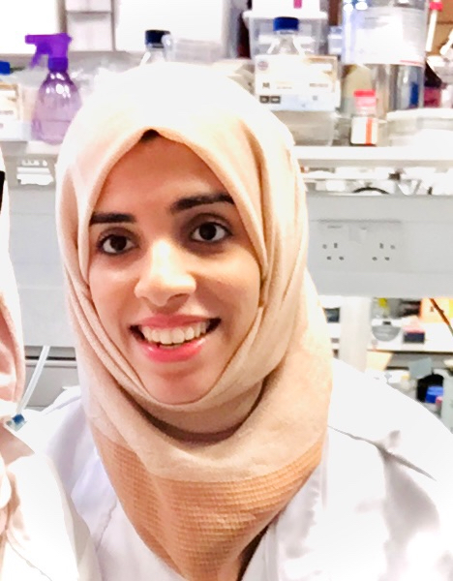
About us ~ Batool Almarzouq
Post-doc in KAIMRC, Saudi Arabia and Honorary Research Fellow at the University of Liverpool, UK
A member of R-Ladies Global committee, a worldwide organization to promote gender diversity in the R community.
Founded the Open Science Community in Saudi Arabia (OSCSA), which aims to create significant value towards Saudi Arabia's Vision 2030.
Twitter: @batool664, Personal Website
Formulated our vision and aims, roadmap - 1st Meetup for Carpentries community in MENA
https://shorturl.at/ckIPS
https://shorturl.at/ckIPS
@Talarify, @OpenSciSaudi, @openlifesci
@Talarify, @OpenSciSaudi, @openlifesci

Slide 4
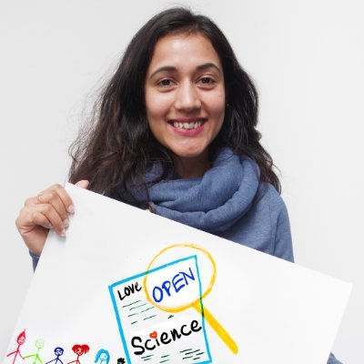
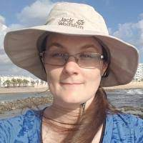
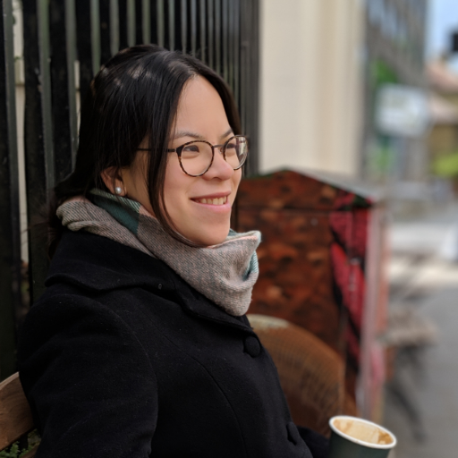
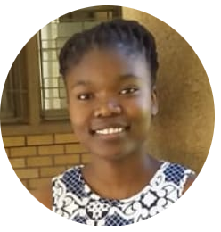
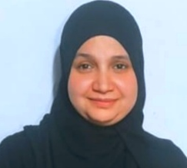
A big Thank You to our Team!
Malvika Sharan
Yo Yehudi
Emmy Tsang
Nelsy Mtsweni
Asmaa Nofal
Formulated our vision and aims, roadmap - 1st Meetup for Carpentries community in MENA
https://shorturl.at/ckIPS
https://shorturl.at/ckIPS
@Talarify, @OpenSciSaudi, @openlifesci
@Talarify, @OpenSciSaudi, @openlifesci

Slide 5

What do we hope to see?
Re-evaluation of best practices for sharing educational videos under CC licenses
Adopting our workflow for other programmes.
Contribute translations to the Open Life Science videos and use it in your own open science communities.
Access to the YouTube playlist here
https://shorturl.at/ckIPS
https://shorturl.at/ckIPS
@Talarify, @OpenSciSaudi, @openlifesci
@Talarify, @OpenSciSaudi, @openlifesci
Notes:
During today’s session we will share our experiences with sharing open educational content via YouTube and the challenges we’ve had in terms of reusing and remixing content. We’d love to hear from you, what approaches you use for sharing open educational video content and making it accessible.
We’ll also share our extended workflow for making video material and transcript files more accessible and hope to get some feedback. The workflow can be repurposed in other projects too.
Finally, we would like to create awareness of the opportunity to contribute translations of video content in this project and you’ll learn how to get more involved in you’re interested.

Slide 6
The 5 Rs of Open Educational Resources
1
RETAIN
Make and own copies
2
REUSE
Use in a wide range of ways
3
REVISE
Adapt, modify and improve
4
REMIX
Combine with other works
5
REDISTRIBUTE
Share with others
David Wiley. (2014). Open Education: A "Simple" Introduction. https://www.slideshare.net/opencontent/open-education-a-simple-introduction
https://shorturl.at/ckIPS
@Talarify, @OpenSciSaudi, @openlifesci
Notes:
Let’s first take a step back and consider what defines an open educational resource.
According to UNESCOs definition OERs are training materials that are available in the public domain or under an open license that permits no-cost access, use, adaptation and redistribution by others with no or limited restrictions.
The 5Rs of OERs define this in greater detail as can be seen here.

Slide 7
YouTube is tremendously popular for learning!
RANK | PERSONAL LEARNING | WORKPLACE LEARNING | EDUCATION
1 | YouTube | Zoom | YouTube
2 | Google Search | Microsoft Teams | Google Docs & Drive
3 | LinkedIn | Google Search | PowerPoint
4 | Twitter | PowerPoint | Zoom
5 | Wikipedia | YouTube | Google Search
YouTube was number 1 on the Top 300 list in 2021
Learning professionals (and others in related areas) nominate Top 10 (digital) tools for learning
Running since 2007
Generated from 2,077 votes from 33 countries and published on 1 September 2021
https://www.toptools4learning.com/
https://shorturl.at/ckIPS
@Talarify, @OpenSciSaudi, @openlifesci
Notes:
In this talk we will specifically focus on the availability of open educational video materials. Many of us refer to YouTube as the definitive source of videos for training purposes.
We were curious to find out just how popular YouTube really is for learning and came across this report by Jane Hart, Director of the Centre for Modern Workplace Learning.
Since 2007, Jane has been compiling an annual Top Tools for Learning List from the results of an open survey.
Participants nominate their top 10 digital tools for learning and a list of top 300 is compiled from the results.
The list is then split into three categories:
Personal learning listing tools used by individuals for self improvement
Workplace learning listing tools used to design, deliver, enable and/or support learning in the workplace
Education listing the top digital tools used by educators and students in colleges and universities
In 2021 YouTube came out tops in the top 300 list as well as the personal learning and education categories and fifth for workplace learning

Slide 8
Many OER guides point to YouTube
as source of OER videos
Notes:
Curiously enough, when we looked around, we also found that most university OER guides and general OER guides point to YouTube as a source for OER videos. Many videos covering the topic of OERs are also available on YouTube under Creative Commons licenses.

Slide 9






Typical workflow for recordings of talks
Jonathasmello, CC BY 3.0, via Wikimedia Commons
https://shorturl.at/ckIPS
@Talarify, @OpenSciSaudi, @openlifesci
Notes:
But when we recently wanted to reuse, revise, and remix videos available from YouTube under CC-BY licenses, we realised that these materials did in fact not comply with either the 5 Rs of OER nor the Creative Commons with attribution license terms.
In summary, CC-BY allows users to share (including copy and redistribute) and adapt (including remix, transform, and build upon) materials.
Simply put, when you are sharing videos and transcripts to YouTube under a Creative Commons license, you are not creating reusable OERs!

Slide 10
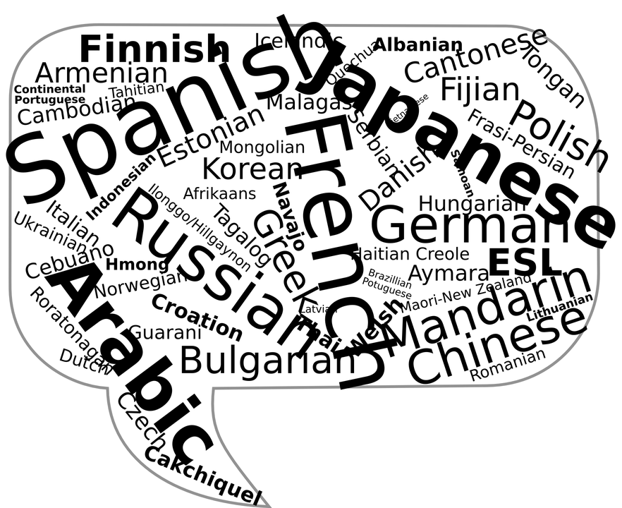
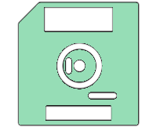


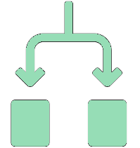

Reality of videos and transcripts posted on YouTube
https://canvas.instructure.com/courses/1123092/pages/the-5-rs-of-open
?
RETAIN
REUSE
REVISE
REMIX
REDISTRIBUTE
https://shorturl.at/ckIPS
@Talarify, @OpenSciSaudi, @openlifesci
Notes:
Why do we say this?
It is not possible to download a copy of the video or transcript (It is against the terms of service from YouTube even though there are workarounds)
The only way in which you can reuse a YT video, is by sharing the link, or embedding it in a website
It is not possible to revise, update, or edit a YT video. Sometimes it is possible to find the owner of a video, but only if the YT channel’s owner were diligent and added contact details in their profile, if they respond to emails, and if the details are current.
Because videos can’t be downloaded, it’s not possible to combine original or edited versions to create new material.
And again, it’s not possible to redistribute the original content or derivations of it.
The transcripts are also not available for download which means it’s not possible to contribute translations and make materials more accessible

Slide 11
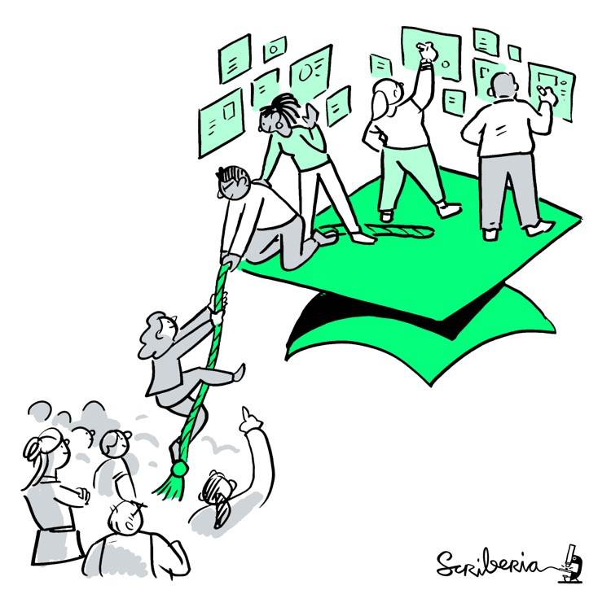
Language barriers
Open Science is a global movement, BUT most of its materials/resources are published in English. Non-English native speakers suffer a genuine disadvantage.
Out of the world's approximately 7.8 billion inhabitants, 1.35 billion speak English. The majority aren't native English speakers.
English is only spoken by 4.83 percent of the world population as first language
The Turing Way project illustration by Scriberia. Used under a CC-BY 4.0 licence. DOI: 10.5281/zenodo.3332807
https://shorturl.at/ckIPS
@Talarify, @OpenSciSaudi, @openlifesci
Notes:
Let’s talk about the need for translated video content in the context of Open Science.
There is growing evidence that open science has an impact on the research enterprise, business and innovation, and society more generally.
Although it is a hot topic in many countries in the Global North, the movement has generally been growing slowly elsewhere in the world.
Many Open Science materials are developed in English and despite the fact that it is available online, often under open licenses, there are still barriers to adopting and adapting these materials in non-English speaking countries.

Slide 12

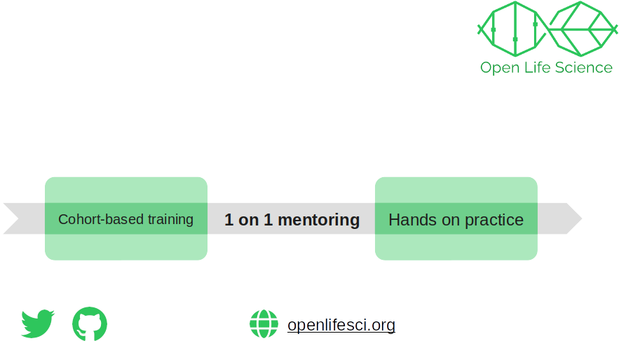
The Open Life Science mentoring and training program
Community-driven program that enables newcomers and long-time practitioners to become Open Science ambassadors
https://openlifesci.org/
Malvika Sharan (2021) https://doi.org/10.5281/zenodo.5017712
https://shorturl.at/ckIPS
@Talarify, @OpenSciSaudi, @openlifesci
Notes:
This brings us to the Open Life Science mentoring and training program also known as OLS.
This programme has been running since January 2020 and offers a 16-week project-based opportunity to learn open science practices and apply them to your project. You can learn more about the programme at their website shown on the slide.

Slide 13
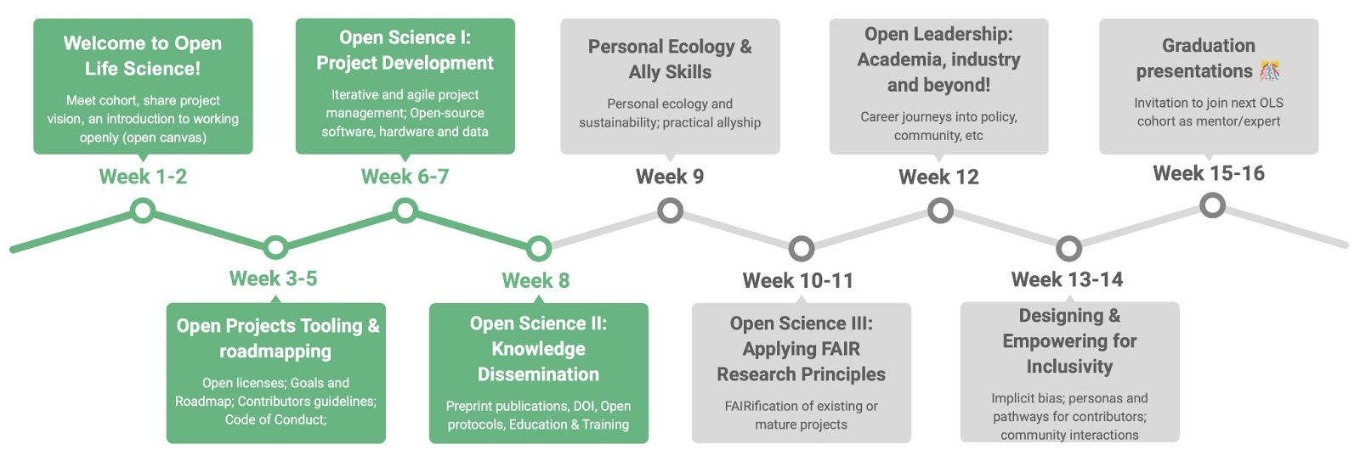
OLS Program Structure
Malvika Sharan (2021) https://doi.org/10.5281/zenodo.5017712
https://shorturl.at/ckIPS
@Talarify, @OpenSciSaudi, @openlifesci
Notes:
Participants are paired up with one or two dedicated mentors for the duration of the programme. Alongside mentorship meetings, regular training sessions covering various topics related to developing and managing open science projects as well as building communities around open science initiatives are run. Here you can see an outline of the topics covered.

Slide 14
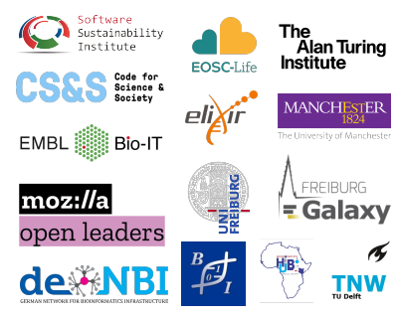
OLS Program Status
Completed
3 cohorts, 91 different projects
257 volunteers as project leads, mentors, experts, supporters
6 continents, 45 countries with diverse social-cultural contexts
17 partnering organisations
Ongoing
4th cohort just kicked off with 26 new projects
CC-BY 4.0, DOI: 10.5281/zenodo.5017713
https://shorturl.at/ckIPS
@Talarify, @OpenSciSaudi, @openlifesci
Notes:
Despite its name, the programme has participants from a wide range of disciplines not only Life Sciences. To date over 250 people have participated in various roles and in September the 4th iteration of the programme kicked off with another 26 new projects.
What’s most notable here is that participants, including mentors and mentees, come from very diverse social-cultural contexts and very many countries.

Slide 15


OLS Process for Sharing Recorded Talks
Virtual cohort meeting with shorter presentations embedded in meeting
Recording
Otter.ai
Transcribing
Manually edit transcript in Otter.ai
https://shorturl.at/ckIPS
@Talarify, @OpenSciSaudi, @openlifesci
Notes:
Throughout the OLS programme, all meetings are recorded. Videos and transcripts are posted onto YouTube after a volunteer have manually corrected the transcripts created by Otter.ai.
That means the OLS presentations by experts from around the world on topics related to Open Science, are available freely online for other Open Science communities to reuse.

Slide 16

Based on a need identified by the newly established Saudi Arabia Open Science community, we developed a workflow to make recorded talks and associated transcripts more open and available for remix and reuse
Notes:
Now I will hand over to my colleague, Batool, who was mostly responsible for creating a workflow to make the OLS videos and transcripts more accessible when we realised that videos shared on YouTube, even under CC licenses, had a number of limitations in terms of reuse and specifically translation.

Slide 17
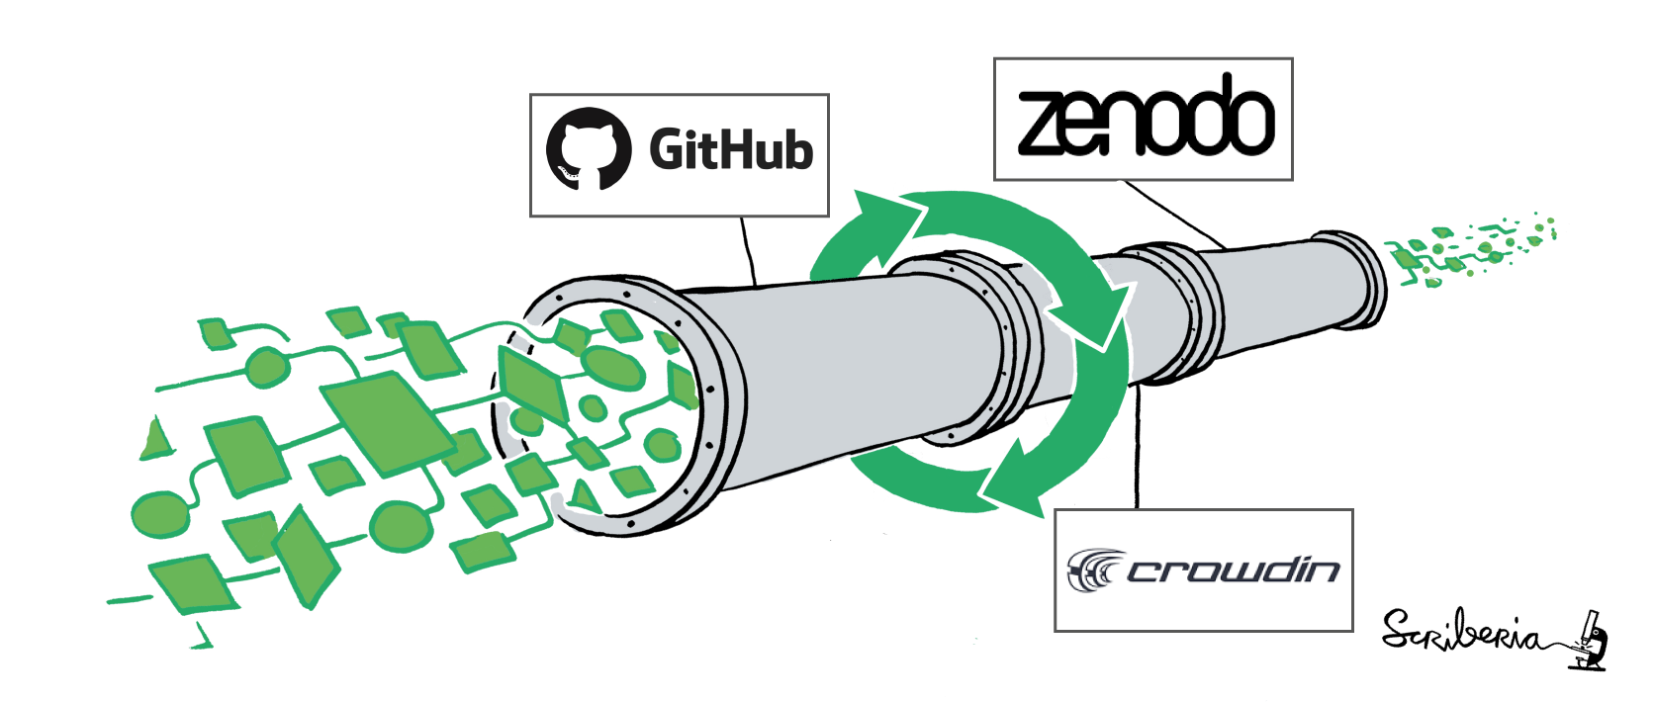
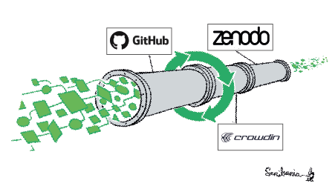
We created a pipeline to make OLS YouTube videos reusable!
This illustration is adopted with changes from The Turing Way project illustration by Scriberia. Used under a CC-BY 4.0 licence. DOI: 10.5281/zenodo.3332807
Notes:
As Anelda mentioned, we created a framework to make YT videos more reusable using three tools (GitHub, Crowdin, Zenodo)

Slide 18
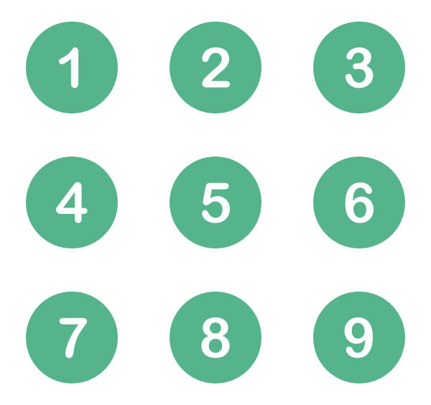

This illustration is adopted with changes from The Turing Way project illustration by Scriberia. Used under a CC-BY 4.0 licence. DOI: 10.5281/zenodo.3332807
A repository for all the project, linked to Crowdin
Version control for translation
Acknowledging contributors
https://shorturl.at/ckIPS
@Talarify, @OpenSciSaudi, @openlifesci
Notes:
Since there’s no straightforward way to download the videos + transcripts, we created a repository in GitHub and added all added all the videos + transcripts. I’m not going to go in details about Git/GItHub, the only thing you need to know, it’s used for version control, or simply time machine where you can go back in time and track the changes in the translation. Another advantage is you can acknowledge contributors (I’ll go back to this point about acknowledging contributors in abit)

Slide 19
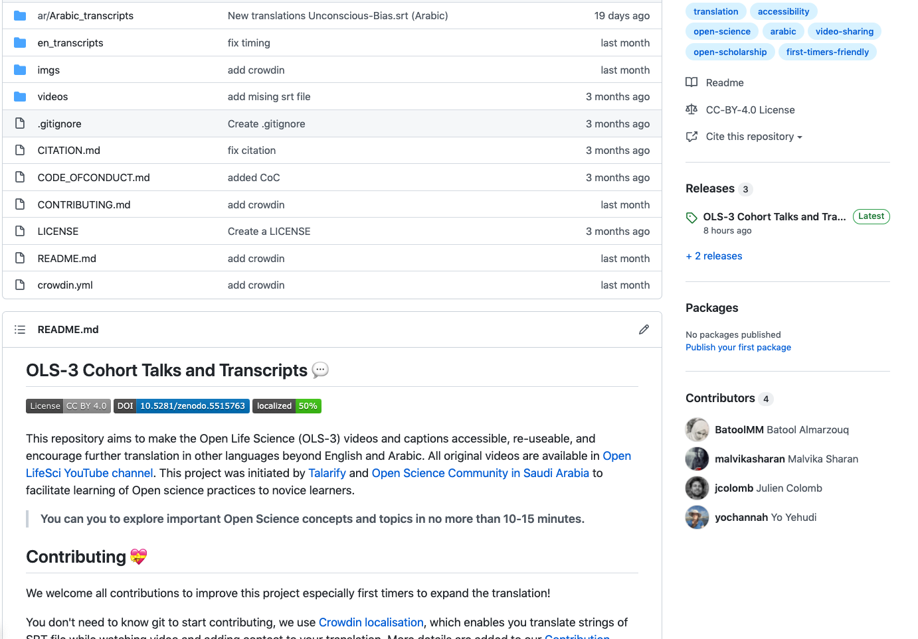
All SRT files and their respective videos are in GitHub
Access our project in GitHub here: https://github.com/open-life-science/ols3-cohort-talks-and-transcripts
https://shorturl.at/ckIPS
@Talarify, @OpenSciSaudi, @openlifesci

Slide 20
All SRT files and their respective videos are in GitHub
Access our project in GitHub here: https://github.com/open-life-science/ols3-cohort-talks-and-transcripts
https://shorturl.at/ckIPS
@Talarify, @OpenSciSaudi, @openlifesci

Slide 21
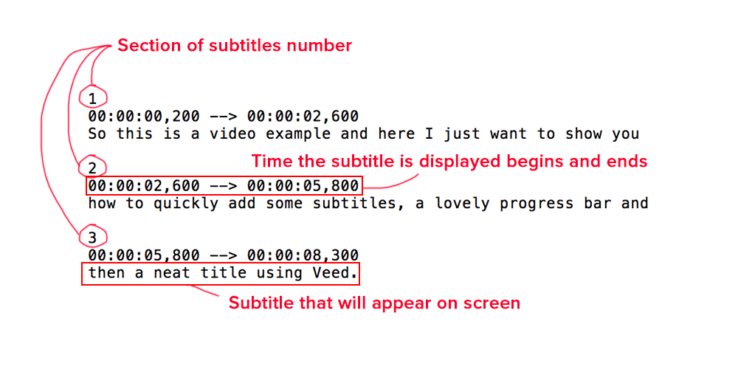
Transcripts format is SRT in GitHub
Access our project in GitHub here: https://github.com/open-life-science/ols3-cohort-talks-and-transcripts
https://shorturl.at/ckIPS
@Talarify, @OpenSciSaudi, @openlifesci
Notes:
The transcripts exist as SRT files. An SRT file is one of the most common file formats used in the process of subtitling and/or captioning. 'SRT' refers to a 'SubRip Subtitle' file, which originated from the DVD-ripping software by the same name. ….. However, editing this file is a bit challenging especially or people who aren’t familiar with GitHub

Slide 22

This illustration is adopted with changes from The Turing Way project illustration by Scriberia. Used under a CC-BY 4.0 licence. DOI: 10.5281/zenodo.3332807
Extract strings from SRT file to be translated.
Generates localized files & CI to GitHub (PR).
Uses glossary and Machine Translation (MT).
https://shorturl.at/ckIPS
@Talarify, @OpenSciSaudi, @openlifesci
Notes:
Therefore, we integrated Crowdin, which is a localisation platform. With Crowdin, you don’t need to know how GitHub works, anything you do in Crowdin will be reflected on GitHub using automation or what we call (CI/PR). What’s very interesting in Crowdin, it uses glossary and machine translation!

Slide 23
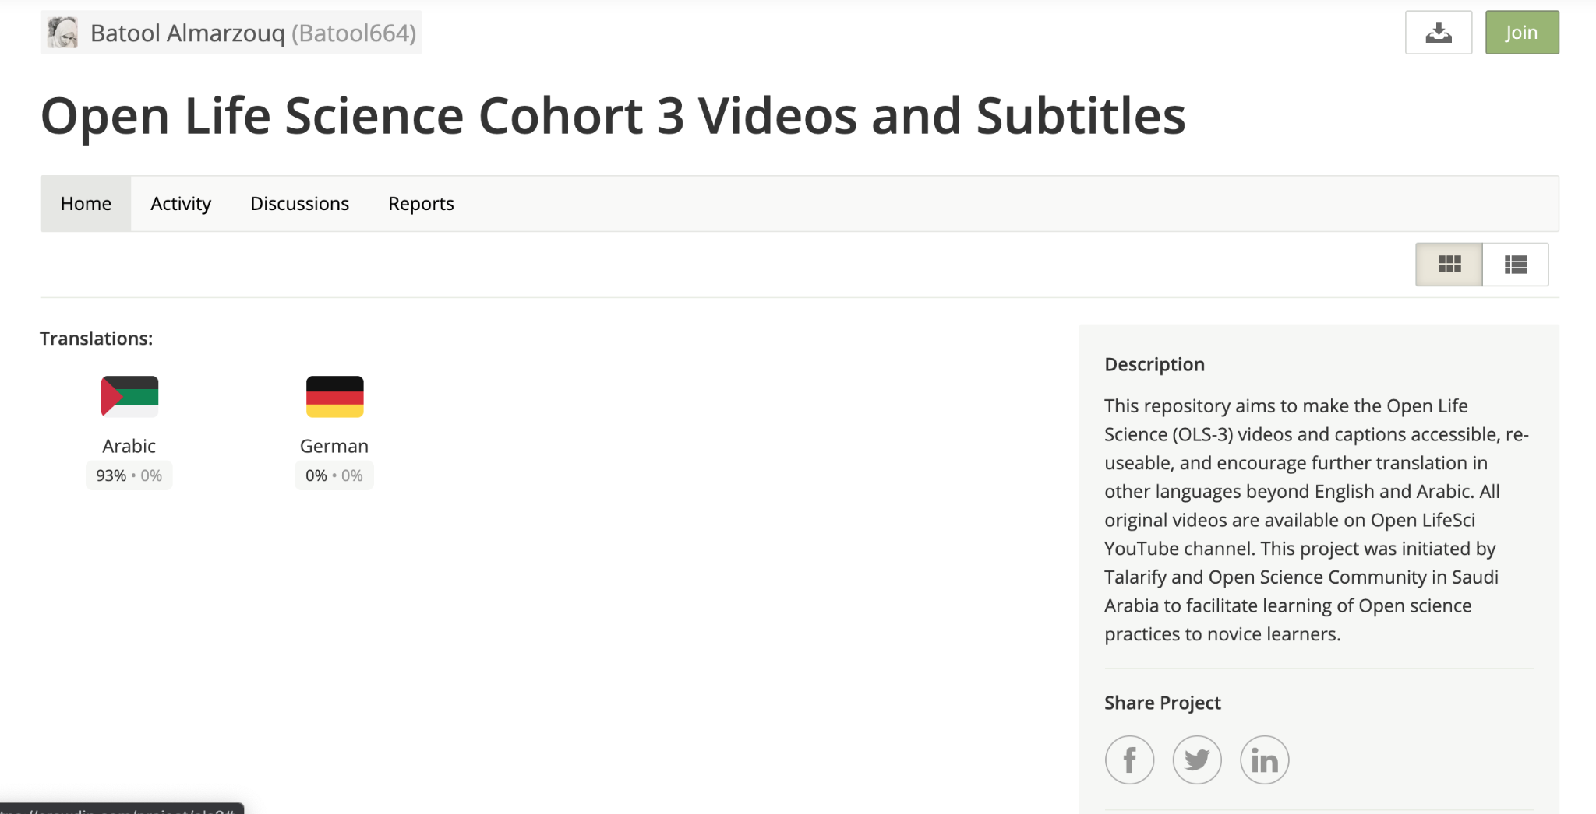
GitHub is linked to Crowdin (Localisation platforms)
You don’t need to know or understand GitHub at all to contribute or use the materials
Access our project in Crowdin here: https://crowdin.com/project/ols3
https://shorturl.at/ckIPS
@Talarify, @OpenSciSaudi, @openlifesci

Slide 24
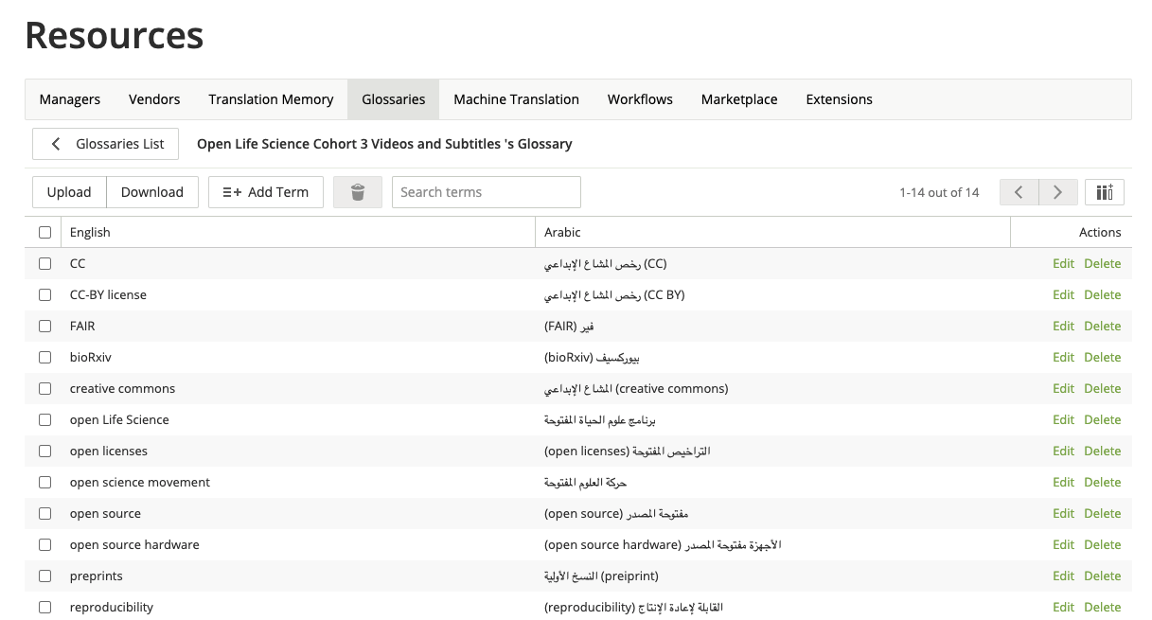
GitHub is linked to Crowdin (Localisation platforms)
We create, store, and manage all the project terminology in one place (Glossary) to keep translations swift and consistent!
Access our project in Crowdin here: https://crowdin.com/project/ols3
https://shorturl.at/ckIPS
@Talarify, @OpenSciSaudi, @openlifesci
Notes:
One of the big struggle we found while we started the translation open science video, a lot of the open science terminology/vocabs doesn’t exist in Arabic. Someone can translate it in one way in the 1st video, and someone else can translate it differently in the 2nd video.

Slide 25
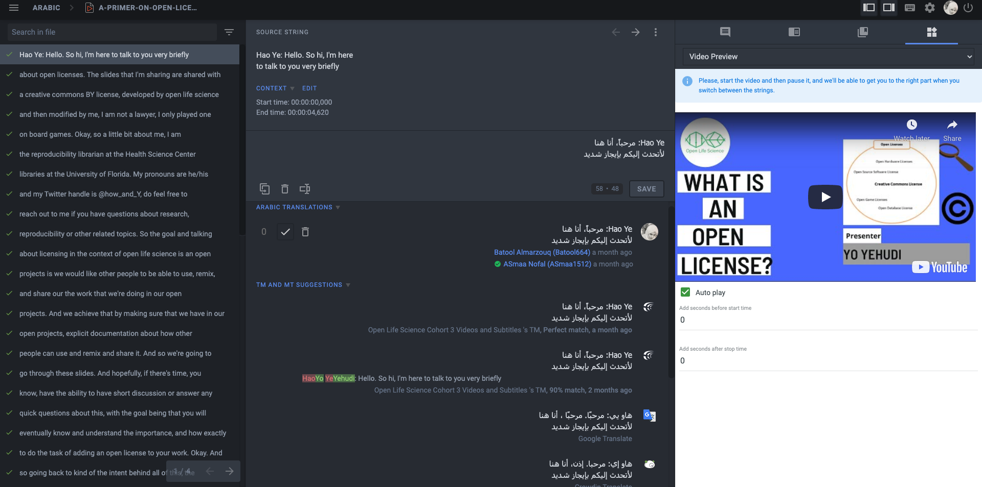
GitHub is linked to Crowdin (Localisation platforms)
We use Translation Memory and Machine Translation (Crowdin, Google, …) to make it easier for new contributors to contribute!
Access our project in Crowdin here: https://crowdin.com/project/ols3
https://shorturl.at/ckIPS
@Talarify, @OpenSciSaudi, @openlifesci
Notes:
Let’s say something wasn’t added to the glossary, Crowdin still remember how it was translate before and it will suggest this translation to you!

Slide 26
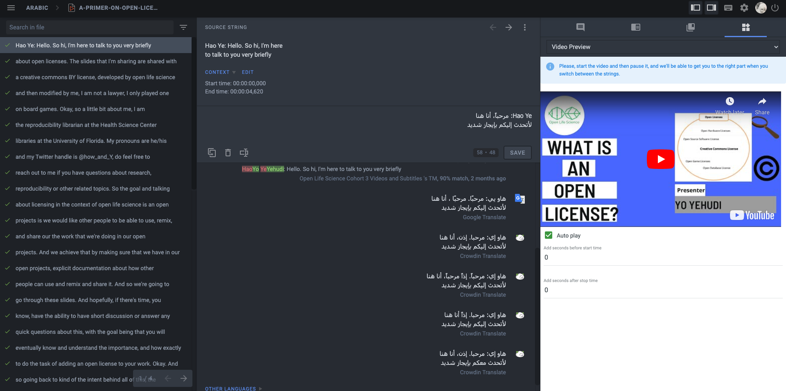
GitHub is linked to Crowdin (Localisation platforms)
We use Translation Memory and Machine Translation (Crowdin, Google, …) to make it easier for new contributors to contribute!
Access our project in Crowdin here: https://crowdin.com/project/ols3
https://shorturl.at/ckIPS
@Talarify, @OpenSciSaudi, @openlifesci
Notes:
If this is a new string, you don’t have to come up with the translation from scratch either. You can start from machine translation and then changing/improving it

Slide 27
This illustration is adopted with changes from The Turing Way project illustration by Scriberia. Used under a CC-BY 4.0 licence. DOI: 10.5281/zenodo.3332807
Generate a persistent identifier (DOI)
Make the materials accessible to download (for individuals who can’t use GitHub)
https://shorturl.at/ckIPS
@Talarify, @OpenSciSaudi, @openlifesci
Notes:
DOI to access and cite the material rather than using the URL which is unstable and get broken frequently

Slide 28
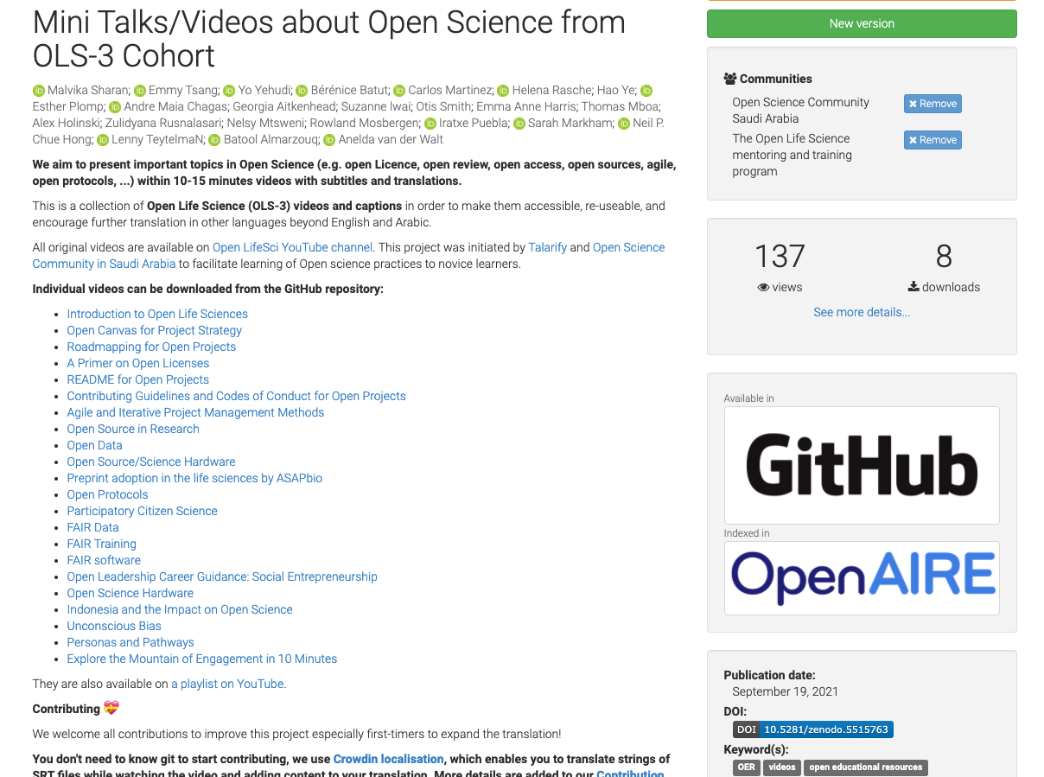
Our Materials in Zenodo
Cite as:
Malvika Sharan, Emmy Tsang, Yo Yehudi, Bérénice Batut, Carlos Martinez, Helena Rasche, Hao Ye, Esther Plomp, Andre Maia Chagas, Georgia Aitkenhead, Suzanne lwai, Otis Smith, Emma Anne Harris, Thomas Mboa, Alex Holinski, Zulidyana Rusnalasari, Nelsy Mtsweni, Rowland Mosbergen, Iratxe Puebla, … Anelda van der Walt. (2021, September 19). Mini Talks/Videos about Open Science from OLS-3 Cohort (v.1.1). Zenodo. https://doi.org/10.5281/zenodo.5515763
Access our project in Zenodo here: https://zenodo.org/record/5515763#.YUcz9GYzZhE
https://shorturl.at/ckIPS
@Talarify, @OpenSciSaudi, @openlifesci
Notes:
This is how our page in Zenodo looks like, This linked to GitHub which is also linked to crowdin

Slide 29
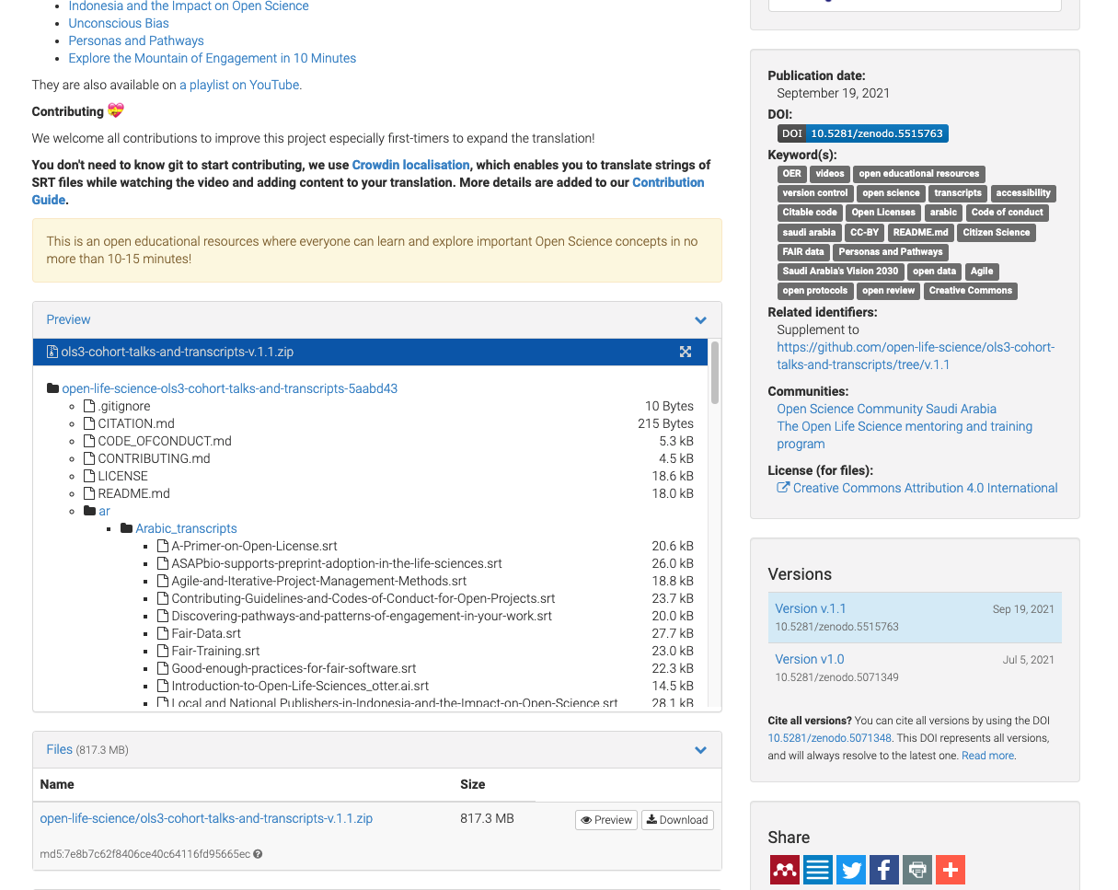
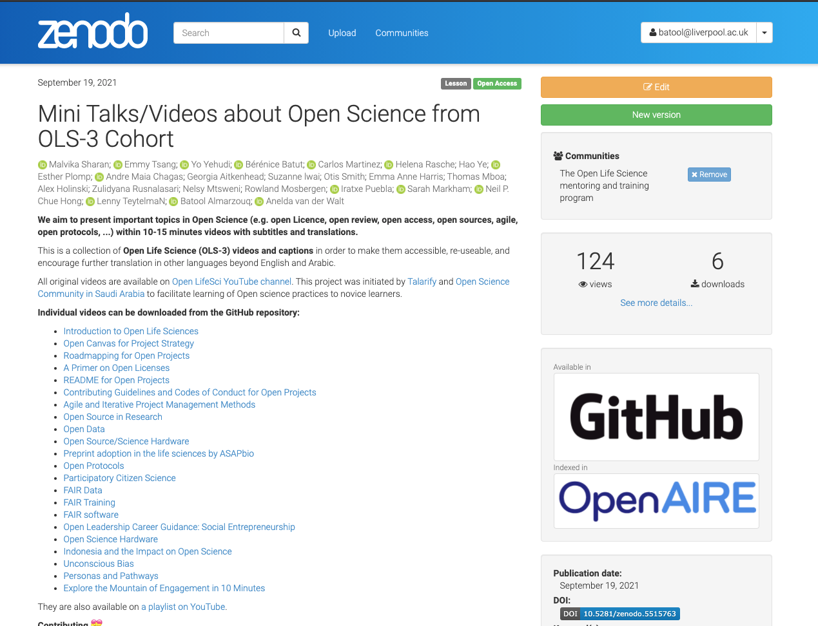
Our Materials in Zenodo
Cite as:
Malvika Sharan, Emmy Tsang, Yo Yehudi, Bérénice Batut, Carlos Martinez, Helena Rasche, Hao Ye, Esther Plomp, Andre Maia Chagas, Georgia Aitkenhead, Suzanne lwai, Otis Smith, Emma Anne Harris, Thomas Mboa, Alex Holinski, Zulidyana Rusnalasari, Nelsy Mtsweni, Rowland Mosbergen, Iratxe Puebla, … Anelda van der Walt. (2021, September 19). Mini Talks/Videos about Open Science from OLS-3 Cohort (v.1.1). Zenodo. https://doi.org/10.5281/zenodo.5515763
Access our project in Zenodo here: https://zenodo.org/record/5515763#.YUcz9GYzZhE
https://shorturl.at/ckIPS
@Talarify, @OpenSciSaudi, @openlifesci

Slide 30
Contributing:
Join the translation Team through this invitation link or visit or Crowdin page and click join!
https://shorturl.at/ckIPS
@Talarify, @OpenSciSaudi, @openlifesci
Notes:
Now we move to the contributions part

Slide 31
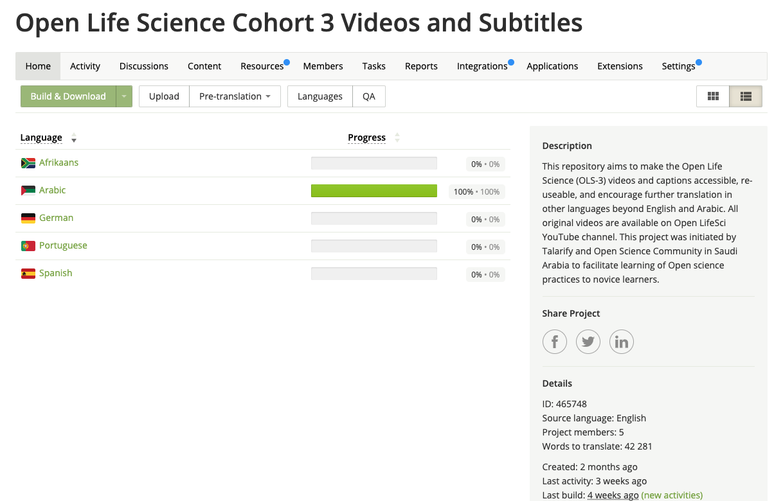
Contributing:
Join the translation Team through this invitation link or visit or Crowdin page and click join!
https://shorturl.at/ckIPS
@Talarify, @OpenSciSaudi, @openlifesci

Slide 32
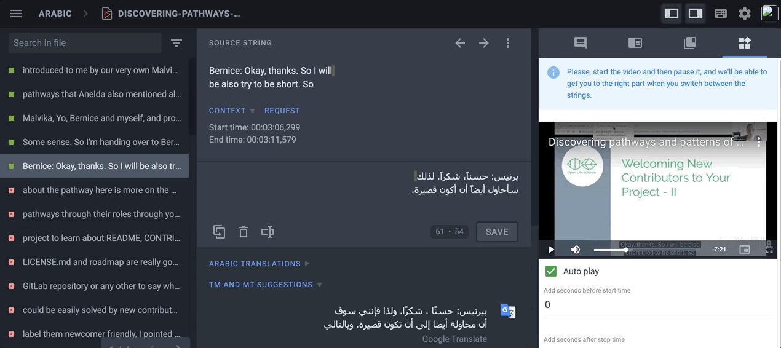
Contributing:
You can translate strings of SRT file while watching video
https://shorturl.at/ckIPS
@Talarify, @OpenSciSaudi, @openlifesci
Notes:
You will be presented with the part of the video relate to the string (so you can understand the context).

Slide 33
Contributing:
You can translate strings of SRT file while watching video
Once you translate a string, a pull request will open in GitHub (automatically) using GitHub actions with the new translated string to be approved by the maintainer.
https://shorturl.at/ckIPS
@Talarify, @OpenSciSaudi, @openlifesci

Slide 34
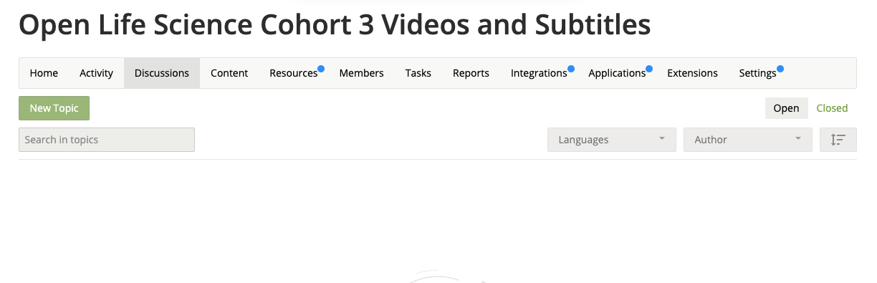
Contributing:
We welcome new contributors to add new languages!
https://shorturl.at/ckIPS
@Talarify, @OpenSciSaudi, @openlifesci

Slide 35
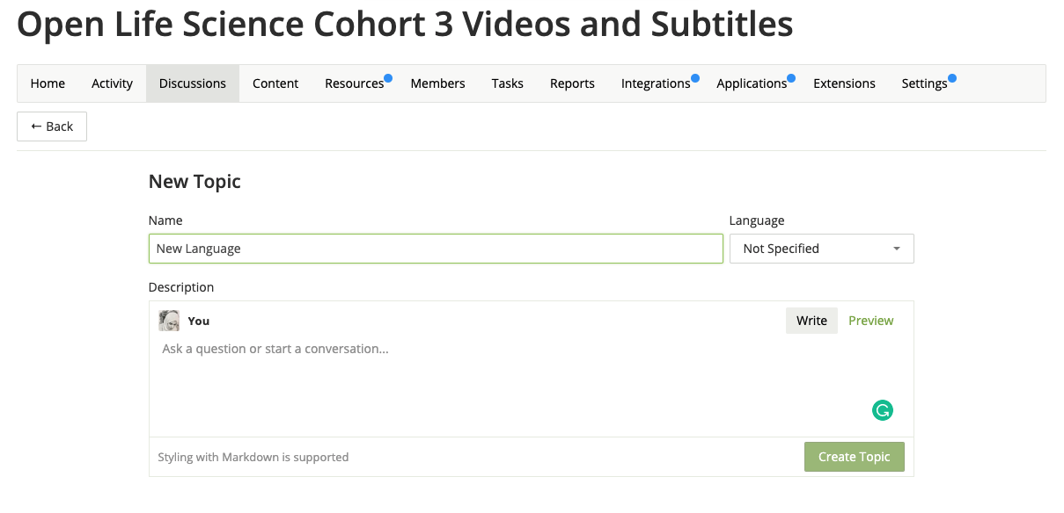
Contributing:
We welcome a new contributors to add new language!
https://shorturl.at/ckIPS
@Talarify, @OpenSciSaudi, @openlifesci

Slide 36
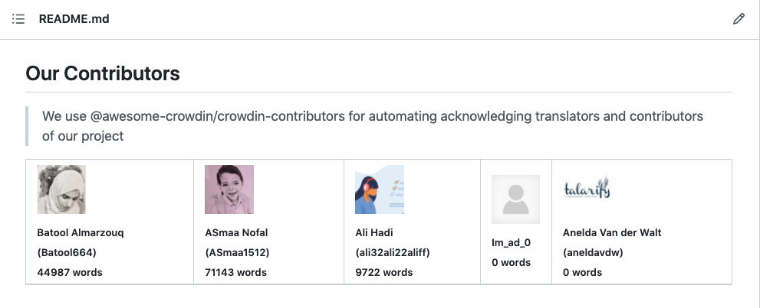
How do we acknowledge contributors?
We acknowledge contributors to our project using
@awesome-crowdin/crowdin-contributors (automation bot) in the README.md
https://shorturl.at/ckIPS
@Talarify, @OpenSciSaudi, @openlifesci
Notes:
We are extremely grateful for any contribution, and we try to acknowledge contributors the best we can ...

Slide 37
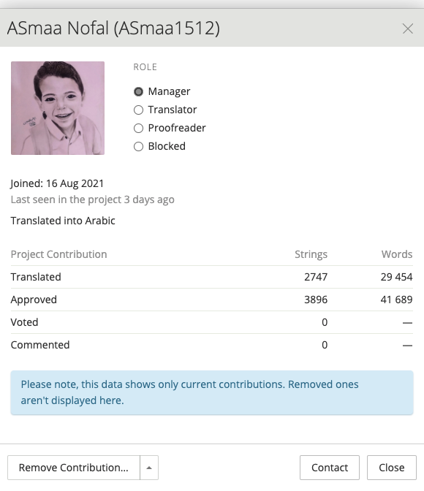
How do we acknowledge contributors?
A profile, which shows how many strings translated/approved/voted or commented in Crowdin.
https://shorturl.at/ckIPS
@Talarify, @OpenSciSaudi, @openlifesci

Slide 38
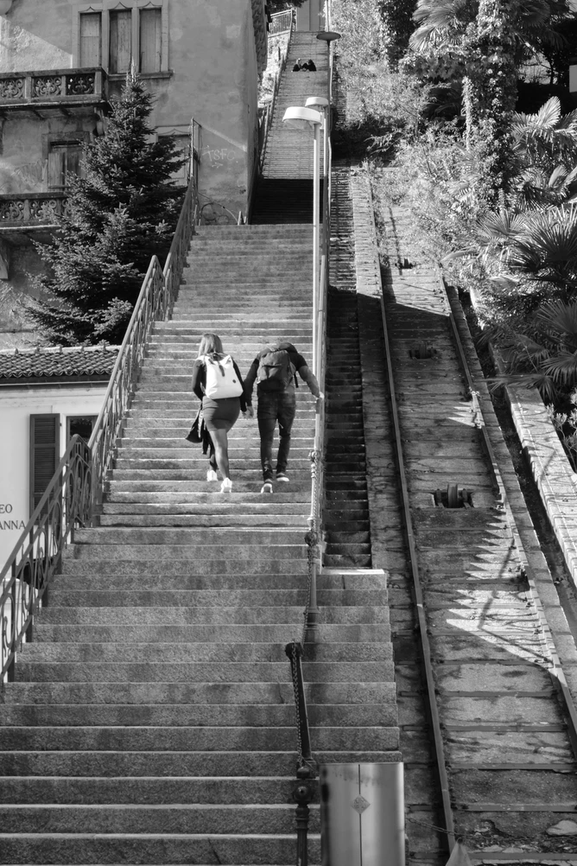
Are you struggling in translating other Open Science materials?
If you are translating a project which include Open Science Terminology, we are very happy to share our glossary and Translation Memory with you!
  Crowdin enable sharing glossary across different projects.
We are also happy to help you implement this pipeline in any open educational resources (OERs) that you are creating!
https://shorturl.at/ckIPS
@Talarify, @OpenSciSaudi, @openlifesci

Slide 39
What do we hope to see?
Re-evaluation of best practices for sharing educational videos under CC licenses
Adopting the workflow for other programmes.
Contribute translations to the OLS videos and use it in your own open science communities.
Access to the YouTube playlist here
https://shorturl.at/ckIPS
https://shorturl.at/ckIPS
@Talarify, @OpenSciSaudi, @openlifesci
@Talarify, @OpenSciSaudi, @openlifesci
Notes:
As Anelda beautifully mentioned, the take out message from this presentation, we want you to re-think “best practices for sharing ...”.

Slide 40
Thank you for your time!
Now we would love to hear from you…
https://shorturl.at/ckIPS
https://shorturl.at/ckIPS
@Talarify, @OpenSciSaudi, @openlifesci
@Talarify, @OpenSciSaudi, @openlifesci

Slide 41
Image Credits
Pixabay , YouStudy, Veed.io, and unsplash unless otherwise indicated

