Slide 1
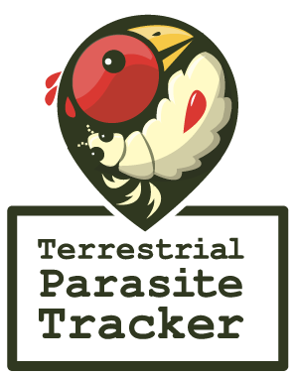

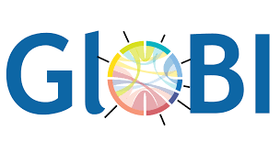
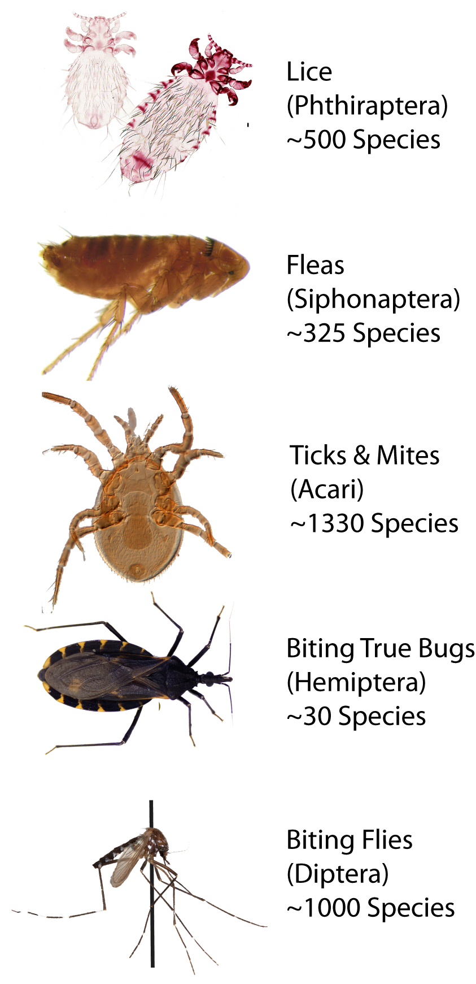
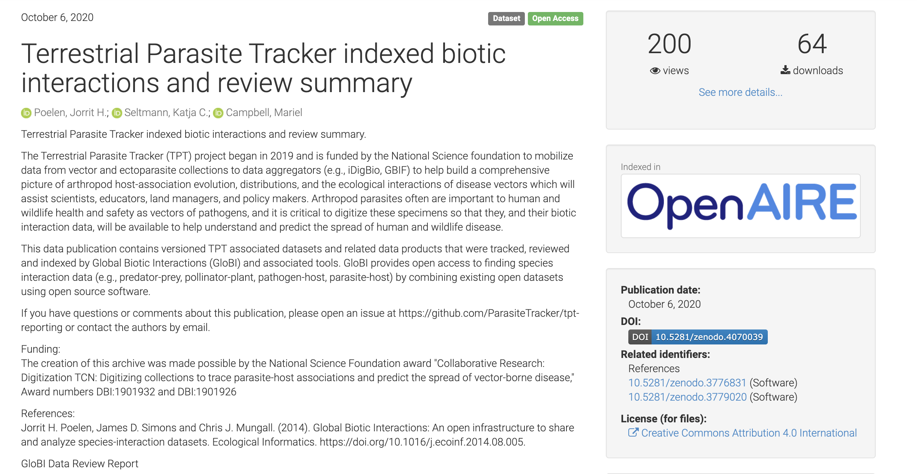
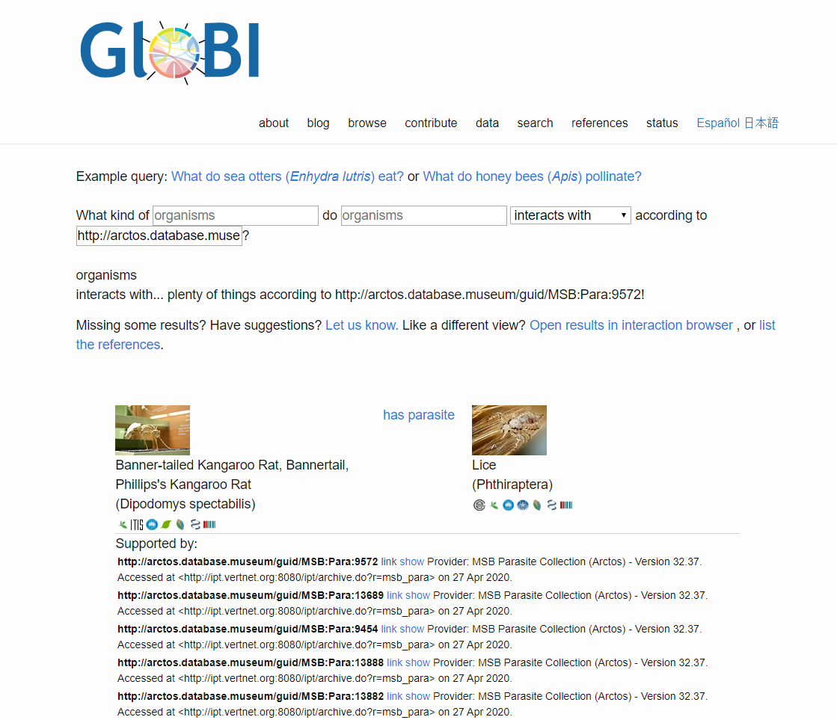
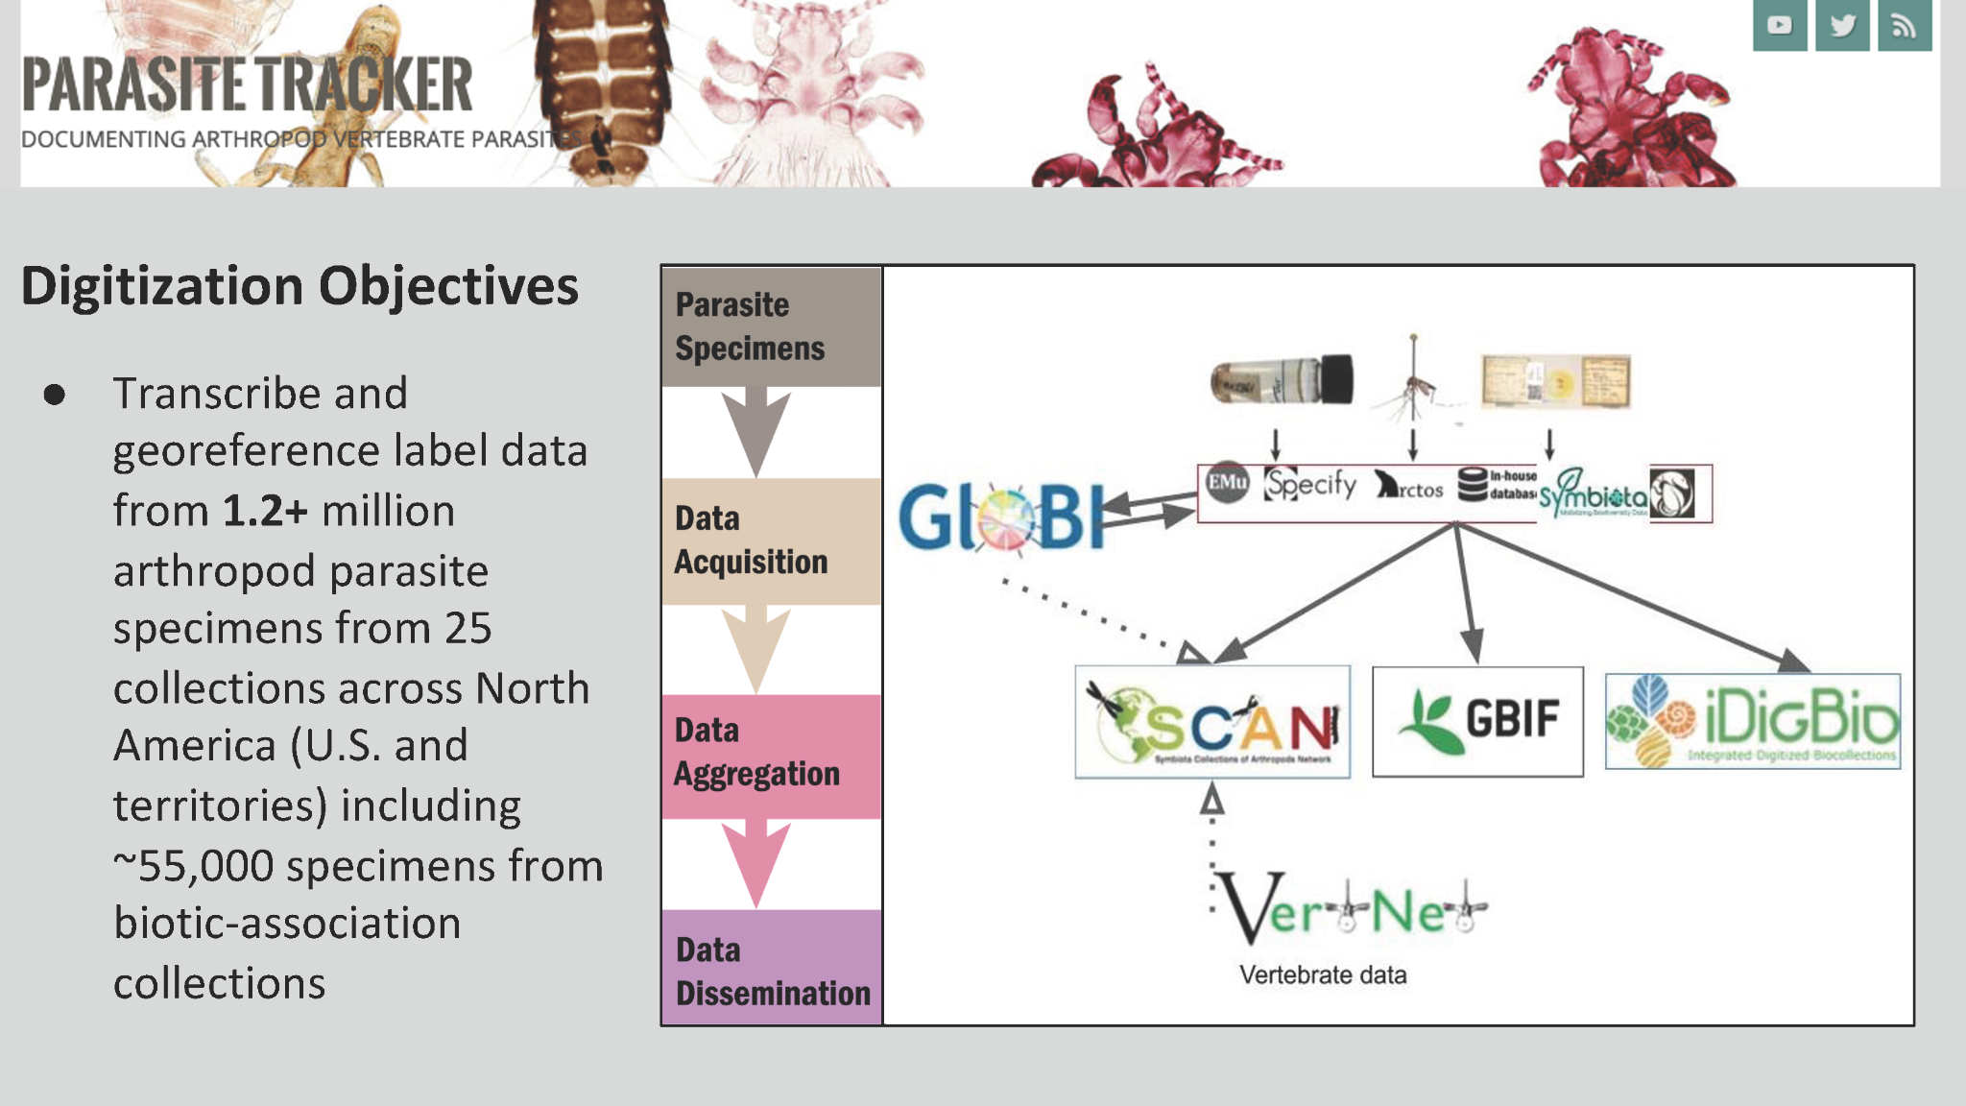
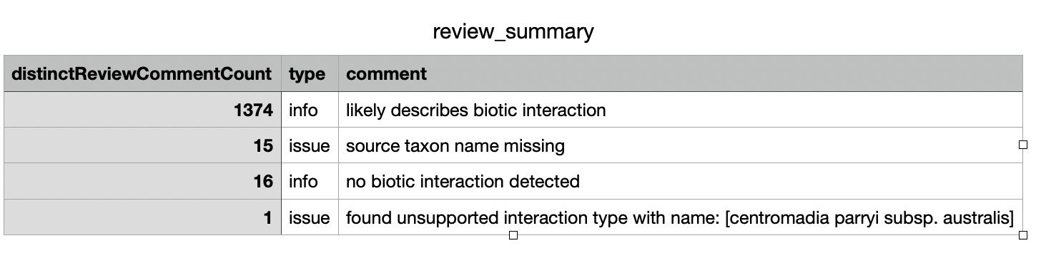
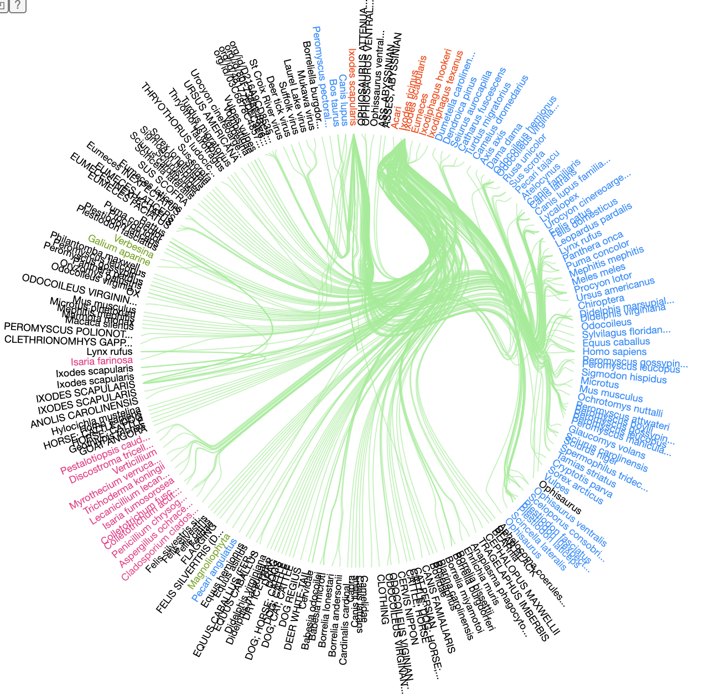
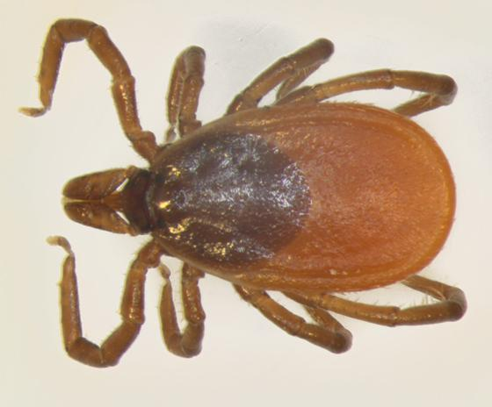
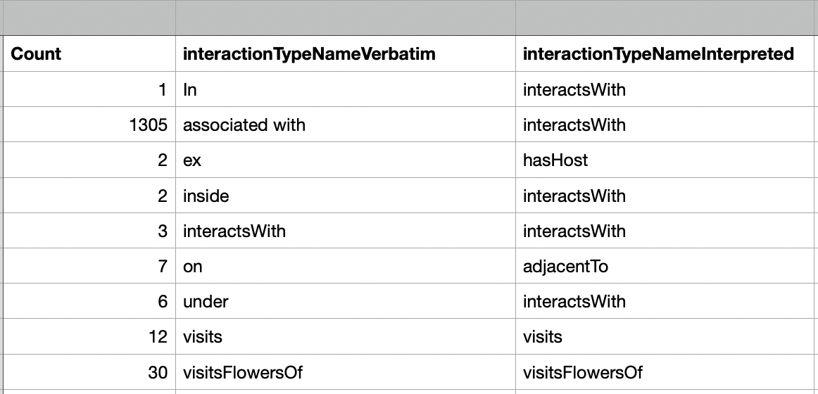


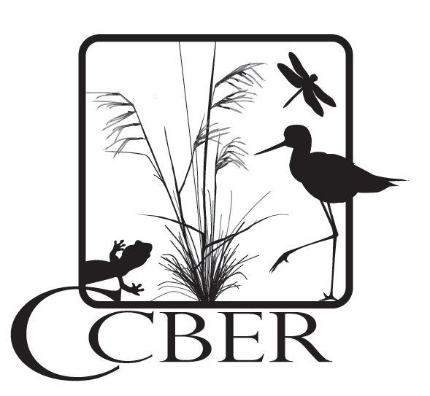

Making Parasite-Host Associations Visible using Global Biotic Interactions
Biodiversity Digitization: Celebrating a decade of progress, September 22-23, 2021
Kathryn Sullivan, Marquette University Biology Department, Milwaukee Public Museum (MPM)
Jorrit H. Poelen, Global Biotic Interactions (GloBI), Ronin Institute, Cheadle Center at UCSB
Katja C. Seltmann, UC Santa Barbara Cheadle Center for Biodiversity and Ecological Restoration (UCSB)
Jennifer M. Zaspel, Milwaukee Public Museum (MPM)
INTRODUCTION
TRACKING PROGRESS
Parasitic arthropods inflict an enormous burden on the health of their hosts either directly or through virulent pathogens that they carry
Although parasites represent a substantial proportion of organismal diversity, their data in natural history collections are not readily accessible
The Terrestrial Parasite Tracker (TPT) Thematic Collections Network digitizes parasite collections across 25 collections in the US & US territories
WHAT IS GLOBI?
Our network provides baseline information for research and management of the ecological interactions among parasites, pathogens, and their hosts in North America (including the U.S. & territories)
Global Biotic Interactions (GloBI) is a data integration tool that indexes existing species interaction datasets, literature, and specimen records from collections:
Search across collections by host/parasite taxa, interaction type, or source
Find explicitly linked parasite/host specimen records across natural history collections
Lookup original specimen records via identifiers and citations
Figure 1: Example of terrestrial arthropod parasites digitized by the Terrestrial Parasite Tracker Network. Images not to scale. Photo credits: S. Hamer, J. Light, H. Lutz, and B. OConnor.
Interaction Relationship
Figure 5: TPT tracks project progress with quarterly published summary report. They include detailed data reviews, list of data providers and original source data. These summary reports document the available interactions data as indexed by GloBI over the course of the project. The latest June 24, 2021 report (shown above) included all 24 TPT collections and 3 non-network collaborators covering 427,775 interaction records.
Citation
DATA REVIEWS
Figure 3: GloBI indexes openly shared data from specimens and literature, maps it to ontologies and name resolution services, and exposes the data as linked text. GloBI sythesizes biotic interaction datasets even though they originate from different locations and formats.
RESULTS
Example of increased availability of Ixodes scapularis (deer tick) records as tracked by GloBI over time
Figure 4: Ixodes scapularis (deer tick)
Figure 2: Diagram depicting overview workflow for the TPT network. TPT data and images will be exported to SCAN and indexed by iDigBio, GBIF, and GloBI.
 | February 2019 | April 2020 | October 2020
Records in GloBI | 515 | 515 | 993
Unique host taxa | 18 | 19 | 25
Unique relationships | parasite of, interacts with | parasite of, interacts with | parasite of, interacts with, has host
INTELLECTUAL MERITS OF TPT
Specimen digitization leads to novel research. TPT provides research-ready baseline data that catalyzes research and education initiatives, and is expected to improve our understanding of parasite-host associations, their biodiversity, and beyond.
TPT contributes to the following research areas covering North America and US territories:
Biological Associations - index parasite-host associations
Disease Ecology - create digital records for organisms that spread disease to better understand their ecological interactions
Changing Species Distributions - provide precise georeferenced specimen data for distribution maps, and identify areas of threatened parasite diversity
Systematics, Taxonomy, and Species Trait Analyses - update arthropod parasite taxonomy to facilitate comprehensive systematic approaches and alpha-taxonomic studies
Figure 6. An example data review produced by GloBI. Data reviews help to provide early feedback to TPT contributors. The reviews are also included in the published quarterly published summary report. The review includes an index of interaction terms or phrases found in the dataset verbatim in addition to suggested OBO Relationship Ontology terms to apply as an interpretation. TPT data providers assist in this process by suggesting, or confirming, the interpretations of label information. This explicit mapping process helps clarify ambiguous interaction language often seen on specimen labels, and helps to better describe parasite/host relationships.
ACKNOWLEDGEMENTS
The TPT project is supported by the National Science Foundation award "Collaborative Research: Digitization TCN: Digitizing collections to trace parasite-host associations and predict the spread of vector-borne disease," Award DBI:1901932 & 1901926
GloBI: https://www.globalbioticinteractions.org/
TPT & GloBI: https://www.globalbioticinteractions.org/parasitetracker/
Table 1: Ixodes scapularis (deer tick, Figure 4) records in GloBI before (2019) and after the TPT project began creating records (2020). The number of documented interactions of deer ticks with other organisms has nearly doubled since the beginning of the project. As more records were indexed by GloBI, the number of unique host taxa also increased and an additional relationship type (i.e., "has host") was captured.
Notes:
Katherine Sullivan - Marquette University Biology Department Graduate Student, MPM
Jennifer Zaspel - Entomology Research Curator and Head of Zoology, MPM; Lead PI on TPT
Jorrit Poelen - Developer of GloBI

