Slide 1
Leoma G. Gilley (SIL International)
Cynthia L. Miller-Naudé (University of the Free State, South Africa)
Intransitive Verb Classes in Shilluk: Morphophonology and Semantics

Slide 2
Introduction
Lexical verbs in Shilluk are categorized as transitive or intransitive
  Distinguished phonologically
  Distinguished by prototypical valency

Slide 3
Introduction
This paper examines intransitive verbs with respect to:
  Morphophonological features (segments and tones) exhibited in the four basic verbal conjugations – divided into classes
  Semantics of situation aspect that tend to correlate to the classes (states, processes, activities, accomplishments, semelfactives)
  Modifications of intransitive verbs to increase or modify the arguments associated with them

Slide 4
Vowel length in Shilluk
Described in detail in Remijsen, Ayoker and Jorgensen (2019)
Three vowel lengths – Short, Long, Extra Long
Short – underlying
  Fixed short – remains short but may change
    in vowel height (i.e., ɪ to ɛ) or final consonant (i.e., r to d)
  Short with Grade – vowel may become longer
Long – underlying
  May become long or extra long
Extra Long – includes additional morphological information

Slide 5
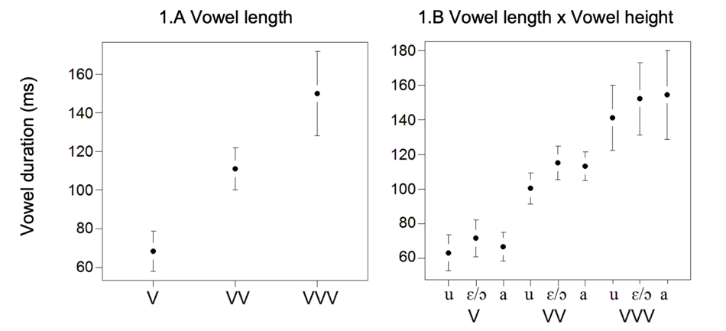
Vowel length in Shilluk
“The mean durations for short, long and overlong vowels are 68, 111, and 150 ms respectively” (Remijsen et al 2019:112) with little overlap in vowel duration between short and long or between long and extra long.

Slide 6
Tone in Shilluk
8 distinctive tone categories found on monosyllabic stems in Transitive verbs
  Low, Mid, High
  High Rise
  Four falling tones - Low Fall, Late Fall, High Fall, High Fall to Mid

Slide 7
Tonal inventory in Shilluk (Remijsen et al 2019)
á−kɔ̀l (Low) past-disturb.2sg | á−kɔ̄l (Mid) past-disturb.appl | á−kɔ́l (High) past-take out.appl.2sg
á−kɔ̑l (Low Fall) past-take out.2sg | á−kɔ̑́l (High Fall) past-disturb.ov | á-kɔ̑́l̅ (High Fall to Mid) past-take out.appl
á−kɔ́l̀ (Late Fall) past-take out.fug | á −kɔ̄̆l (High Rise) past-disturb.appl.2sg

Slide 8
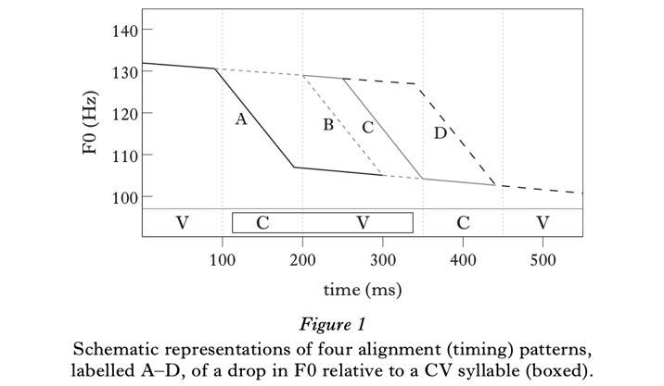
Schematic representation on tone on CVC verb root (Remijsen & Ayoker 2014)
A – Low tone as the Fall happens on the onset consonant
B – Early Fall
C – Late Fall
D – High tone

Slide 9
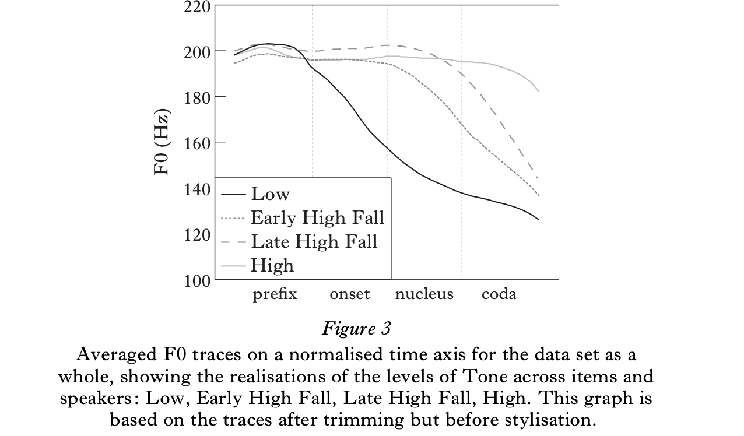
Schematic representation on tone on CVC verb root (Remijsen & Ayoker 2014)

Slide 10
Conventions for marking falling tones
Mid to Low Fall will be marked on long vowels as a̅à and on short vowels as ȃ.
Early High Low Fall will be marked on long vowels as áà and on short vowels as ȃ́.
Late High Fall will be marked on long vowels as aȃ́ (on the second of the vowels) and on short vowels as áˈ.

Slide 11
Transitive verbs
Verb root CVC – fixed Short, Short with Grade, or Long vowel
  Fixed short – vowel stays short in all forms (second root C may change)
  Short with Grade – short in Past, Long in other forms
  Long – always Long, sometimes Extra Long
Tone patterns
  Fixed Short and Short with Grade – either Low or Low Fall
  Long – may have Low or Low Fall or High Fall as their base
Results in 7 transitive verb classes

Slide 12
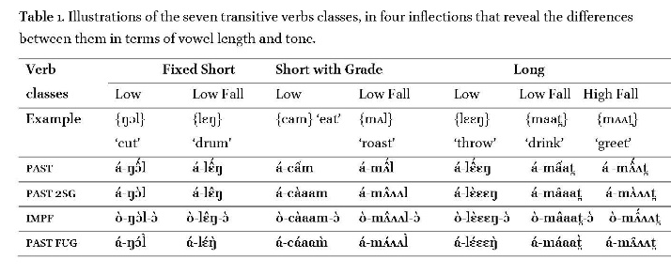
Seven transitive verb classes
(Remijsen, Miller-Naudé and Gilley 2016)

Slide 13
Transitive and antipassive
(1) Transitive (bivalent)
jʌ̂j á-jɛ̑r jɪ̄ twɔ́ŋ
canoe PST-bail:T ERG Twong
‘Twong bailed out the canoe (completely)’
(2) Antipassive (monovalent)
twɔ́ŋ á-jèt kɪ̄ jʌ̂j
Twong PST-bail:AP OBL canoe
‘Twong bailed a canoe’

Slide 14
Transitive and antipassive
Antipassive verb roots differ phonologically from transitive verb roots:
  Vowel – Transitive uses [-ATR]; Antipassive uses [+ATR]
  Final consonant – Antipassive often has an alternation in final consonant if the preceding vowel is Fixed Short
Example:
  Transitive á-jɛ̑r vs. Antipassive á-jèt

Slide 15
Comparison of intransitive verbs to antipassive and transitive
Intransitive verbs are similar to antipassive verbs
  Monovalent and the single argument precedes the verb
Intransitive verbs are similar to transitive verbs
  Can be put into classes based upon vowel length and tone
  Some classes of intransitive verbs can form derived transitives (bivalent)
Intransitive verbs are dissimilar to transitive verbs
  Cannot generally be morphologically modified to indicate
    iterative action
    Direction of verbal action with respect to the speaker
    Benefactive or instrumental constituent

Slide 16
Morphological complexity in intransitive verb inflection
Intransitive verbs and transitive verbs share minimal inflectional features:
  Past (evidential) prefix á-
  Future prefix ʊ́
Six intransitive verb classes based on
  Morphological structure
  Lexical tone of the verb root
  Meanings of the verbs within each class

Slide 17
Semantic features of intransitive verb classes
Kind of action depicted by the verb (Aktionsart)
States, activities, achievements, accomplishments, semelfactives (Smith 1991)
Analysis of Anywa by Reh (1995:183) similarly divided monovalent verbs into semantic categories -- static verbs, action verbs, emission verbs, and process verbs

Slide 18
Intransitive class 1
Past | a-CVC-i | H-L-L
Perfective | CVC-ɔ | L-L
Imperfective | ʊ-CVC-ɔ | H-HF-L
Future | ʊ-CVC-i | H-L-H [H-M-H]
States or activities with no focus on beginning or ending point
Three semantic sub-types of verbs in this class:
states, activities, and motion verbs

Slide 19
Intransitive class 1 – states
Example: bʊ̄ʊl ʊ́pɪ́ɪ̀lɔ̀
Bol IMPF:be.intelligent:I
‘Bol is becoming intelligent.’
states derived from adjectives
”property concepts”
  Indicating permanent quality - adjective pɛ̑l ‘intelligent’ (with Low Falling tone)
  Some adjectives may be modified to indicate temporary quality -- pɛ̀ɛl (with Extra Long vowel)

Slide 20
Intransitive class 1 – states
Other examples:
álwìiijì ‘be sweet’
adjective lwȋj ‘sweet [as permanent quality]’
adjective lwɪ̄ɪj ‘sweet’ [as temporary quality]’
ádòoɲɪ̀ ‘be good’
adjective dɔ̑c ‘good [as permanent quality]’
adjective dɔ̄ɔɔ̀c ‘good [as temporary quality]’
ákèeeɲɪ̀ ‘be bitter’
adjective kɛ̑c ‘bitter’ [as permanent quality]’
adjective kɛ̄ɛɛ̀c ‘bitter [as temporary quality]’

Slide 21
Intransitive class 1 – states
May be modified to indicate causality:
jōó á-lʌ̀ᴧɲɪ̀ adjective lȃc ‘wide’
road PST-wide:I
‘The road became wide.’
jōó á-láàɲ jɪ̄ bʊ̄ʊl.
road PST-wide:I:CAUS ERG Bol
‘Bol widened the road.’

Slide 22
Intransitive class 1 - activities
Activity verbs – examples:
áŋɛ̀ɛd̪ɪ̀ ‘laugh’
aŋàamɪ̀ ‘yawn’
ajwòoŋɪ̀ ‘cry’
ájʌ̀ʌɲì ‘begin to boil’
árjɛ̀rɪ̀ ‘swing by hanging’
ámìinì ‘moan’

Slide 23
Intransitive class 1 - activities
Some activity verbs can be derived transitives:
Neutral twɔ́ɔŋ á-ŋɛ̀ɛd̪ɪ̀
Twong PST-laughed:I
‘Twong laughed.’
Derived transitive twɔ́ɔŋ á-ŋɛɛ̑́d̪ɪ̀ jɪ̄ bʊ̄ʊl
Twong PST-laugh:DT ERG Bol
‘Bol laughed at Twong.’

Slide 24
Intransitive class 1 – motion verbs
Motion verbs that are neutral (non-directional) have the shape of class 1 verbs
ʊ̀ɲótì áɡùuŋɪ̀
Onyoti PST-walk.stooping:I
‘Onyoti walked stooping (no direction specified).’

Slide 25
Intransitive class 1 – motion verbs
Motion verbs can be modified to indicate spatial deixis
  Centripetal or vetive (toward the speaker)
ʊ̀ɲóti ̀ áɡúùŋɪ̀
Onyoti PST-walk.stooping:I:CP
‘Onyoti walked stooping (towards me).’
  Centrifugal or itive (away from the speaker)
ʊ̀ɲótì áɡɔ́ɔ̀ŋɪ̅ pa̅àc.
Onyoti PST-walk.stooping:I:CF village
‘Onyoti walked stooping (away from me) (towards) the village.’

Slide 26
Intransitive class 1 – motion verbs
Can be modified as a derived transitive -- the situation aspect is that of an accomplishment rather than an activity
twɔ́ɔŋ á-kwàaŋɪ̀
Twong PST-swim:I
‘Twong swam (i.e., he swam around, not going anywhere).’
nāàm á-kwaȃ́ŋ jɪ̄ twɔ́ɔŋ
river PST-swim:DT ERG Twong
‘Twong swam the river (i.e., he crossed it completely).’

Slide 27
Intransitive class 2
Structure of the verbs in class 2 are identical to class 1 except for the tone patterns
Past | a-CVC-i | H-HF-M
Perfect | CVC-ɔ | L-L
Imperfective | ʊ-CVC-ɔ | H-HF-M
Future | ʊ-CVC-i | H-H-H

Slide 28
Intransitive class 2
Verbs involve achievements in that the end point of the action is in view:
ɑ̀cʊ̂l á-ɟúùrɪ̅.
Acol PST-reach.maturity:I
‘Acol reached maturity’
álɑ̄m á-kʌ́ᴧ̀rɪ̄
Alam PST-was wealthy:I
‘Alam was/became wealthy’

Slide 29
Intransitive class 2
Cannot be modified to indicate:
  Iterativity
  Derived transitivity or causality
Differ from class 1 verbs in two ways:
  No corresponding adjective for these verbs
  Class 2 states are viewed as temporary rather than permanent qualities – “stage-level” statives

Slide 30
Intransitive class 3
Forms a distinct class from classes 1 and 2
  there is no i-suffix in either the Past or the Future.
  No Past suffix at all; Future suffix is -ɔ
Past | a-CVC (no suffix) | H-L
Perfect | CVC-ɔ | HF-L
Imperfective | ʊ-CVC-ɔ | L-HF-L
Future | ʊ-CVC-ɔ (-i is replaced by -ɔ) | L-LF-M
Future Repeated | ʊ-CVC-ɔ | H-L-L

Slide 31
Intransitive class 3
This class has the smallest number of examples – semantics of the class remain tentative
Involves activities in which the focus is on the beginning of the action and the action continues for some time – ingressive
dɛ̄ŋ á-kím
Deng PST-sit.with.head.in.hand:I
‘Deng sat with head in hand (i.e., he is depressed)’

Slide 32
Intransitive class 4
Class 4 has the same structure as classes 5 and 6, except for the tone patterns.
Past | a-CVC | H-HF
Perfect | CVC-ɔ | L-L
Imperfective | ʊ-CVC-ɔ | H-HF-L
Future | ʊ-CVC | H-HF

Slide 33
Intransitive class 4
Action of verb is viewed as happening immediately – semelfactives
  No direct cause can be given for the actions of the verbs
  There is “no outcome or result other than the event itself” (Smith 1991:55)
kɔ̄t̪ á-tɛ̑́m
rain PST-stop.at.season:I
‘The rain stopped (i.e., it was the end of the rainy season)’

Slide 34
Intransitive class 5
distinctive tone patterns in this class are a High Falling tone in the Past and Imperfective, Low Falling in the Perfective, and High in the Future
Past | a-CVC | H-HF
Perfective | CVC-ɔ | LF-L
Imperfective | ʊ-CVC-ɔ | H-HF-L
Future | ʊ-CVC | H-H

Slide 35
Intransitive class 5
Verbs in this class involve actions which continue for some time and focus on the process leading up to the result – accomplishments
Generally, the actions are things that should happen
dwʌ̄j á-cjʌ̑́r
moon PST-become.visible:I
‘The moon gradually became visible (e.g., through the clouds)’

Slide 36
Intransitive class 5
Contrast:
  Class 5 (accomplishments)
  áwȏ́p ‘male matures’
  Class 2 (achievements)
  á-ɟúùrɪ̅ ‘female mature (i.e. begins menstruation)’

Slide 37
Intransitive class 5
Derived transitives – agent causing the action must be a direct cause, not an indirect cause
bʊ̄ʊl ʊ́-cjéèwɔ̀.
Bol IMPF-wake.up.gradually:I
‘Bol wakes up gradually.’
bʊ̄ʊl ʊ́-cjèwɔ̀ jɪ̄ twɔ́ɔŋ
Bol IMPF-wake.up.gradually:I:DT ERG Twong
‘Twong wakes Bol up gradually.’

Slide 38
Intransitive class 6
Largest class of verbs
Distinctive class – subject of the verb is the patient of the action (unaccusative)
Similar in some respects to transitive verbs in allowing modifications to the verb

Slide 39
Intransitive class 6
a tɔ́ŋ ɡyɛ́n átɔ̑́j
  eggs:of chicken PST-crack:I
  ‘The eggs cracked (all at one time, spontaneously)’
b tɔ́ŋ ɡjɛ́n átɔ̑́jɪ̀
  eggs:of chicken PST-crack:I:R
  ‘The eggs cracked (continuously, one after the other)’
c tɔ́ŋ ɡjɛ̄n átɔ́ɔ̀j jɪ̄ bʊ̄ʊl
eggs:of chicken PST-crack:DT ERG Bol
‘Bol cracked the eggs’

Slide 40
Intransitive class 6
 | Past | Perfective | Imperfective | Future
Intransitive Class 5 | á-Cv̑́C | Cv̑vC-ɔ̀ | ʊ́-Cv̑́C-ɔ̀ | ʊ́-Cv́C
Intransitive Class 5 Derived transitive | á-Cv́v̀C | ʊ́-Cv̀vC-ɔ̀ | ʊ̀-Cv̑C-ɔ̀ | ʊ́-Cv̑́C
Intransitive Class 6 | á-Cv̑́C | Cv̀C-ɔ̀ | ʊ̀-Cv̀C-ɔ̀ | ʊ́-Cv̑́C
Intransitive Class 6 Derived transitive | á-Cv́v̀C | ʊ́-Cv̀C-ɔ̀ | ʊ̀-Cv̀C-ɔ̀ | ʊ́-Cv́v̀C
Intransitive Class 6 Iterative | á-Cv̑́C-ì | Cv̑C-ɔ̀ | not possible to say | ʊ́-Cv́C-í
Transitive basic | á-Cv̑́C | ʊ́-Cv̀C-ɔ̀ + | ʊ̀-Cv̀vvC-ɔ̀ | ʊ́-Cv̑́C

Slide 41
Intransitive class 6
bʊ̄l á-tùjɪ̀ɪ kɪ̄ tɔ̄ŋ ɡjɛ̄nɔ̀
Bol PST-crack:DT:AP:SING INDEF egg.of chicken
‘Bol cracked an egg (once)’
bʊ̄l á-tūjì kɪ̄ tɔ̄ŋ ɡjɛ̄n
Bol PST-crack:DT:AP:R INDEF eggs:of chickens
‘Bol cracked eggs (repeatedly)’
  tɔ̄ŋ ɡjɛ̄nɔ̀ á-túùjɪ̀ d̪ɑ̄n̪ɔ̀ jɪ̄ bʊ̄l
  egg.of chicken PST-crack:DT:BEN person ERG Bol
  Bol cracked the egg for a person.

Slide 42
Conclusions
Intransitive verbs in Shilluk, like transitive verbs, can be differentiated into classes based upon their morphological structure and tone patterns for each of the basic verbal conjugations
Intransitive verb classes seem to relate, at least in part, to the semantics of the verb relating to situation aspect
Intransitive verbs classes also relate to the kinds of modifications that can be made to the verb, such as derived transitivity or causality, iterativity, and benefactive.

