Slide 1
Autoencoders for data compression in ATLAS
George Dialektakis - 26/08/2021
GSoC - HSF (ATLAS)
Supervised by: Alex Gekow, Antonio Boveia (Ohio State University)
Baptiste Ravina (University of Glasgow)
Caterina Doglioni (Lund University)
Presentation given by: Alex Gekow (Junior mentor)
Report, logs and code will soon be found on Zenodo

Slide 2
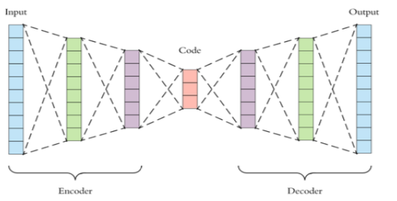
The problem we’re trying to solve and how
This project aims to investigate the use of autoencoders (AEs) to compress event-level data generated by HEP detectors.
Continuing and extending the work of 2020 GSoC and Master’s theses (for references & adjacent work, see report and this poster at the Offshell conference)
Context: ATLAS experiment at the LHC
Every second, ATLAS handles 1.7 billions collision events (~1 MB each) → huge storage needed → restricts the amount of information / event rates that can be recorded
Τhe ATLAS experiment uses trigger systems to filter out irrelevant information by picking and sending only interesting events to the data storage system.
A reduction of the event size can allow for explorations that were not previously possible due to the limited storage.
Compressed/latent space
to be stored instead of input
Slide from G. Dialektakis’s GSoC evaluation task

Slide 3
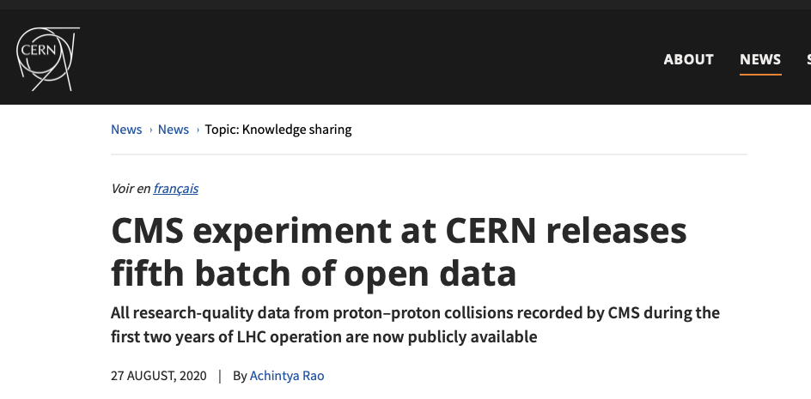
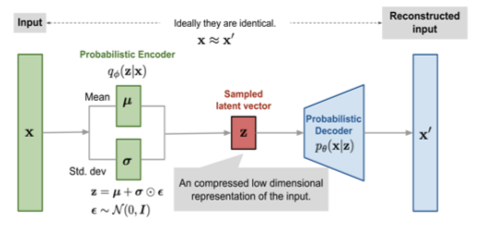
The dataset and the methods
Goal of GSoC project:
  test different autoencoder architectures, namely
  Simple autoencoder
  Variational autoencoder
  Sparse autoencoder
    Same as simple autoencoder, but removes redundancies from the input
Using CMS Open Data from 2013 LHC operations: 10.7483/OPENDATA.CMS.KL8H.HFVH
  HT stream → mostly hadronic jets
  19 / 27 features in total
Preprocessing: outlier removal and normalization
  Result from GSoC 2021: comparison of different normalization methods, min-max performs better than what used so far

Slide 4
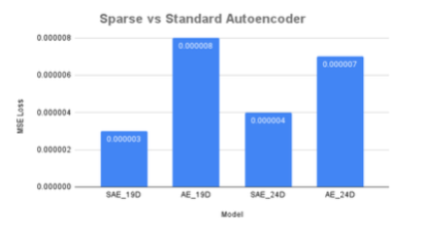
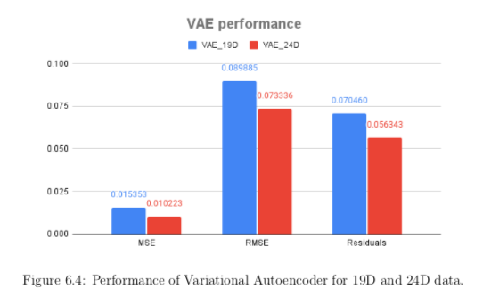
Results & next steps
Performance of Variational and Sparse AE benchmarked against simple AE
  Metric: MSE loss on validation sample (but also: residuals of variables)
  Sparse AE does better than simple AE
  VAE does not do well at all → needs more work and tweaking (see e.g. https://arxiv.org/abs/1811.10276 where it works well for anomaly detection)
All code available & documented for future students
Next/ongoing steps: event-level autoencoders (S. Astrand), investigate implementation of sparse AE on FPGA (B. Ravina A. Gekow and A. Boveia’s new student), compression of raw data...

