Slide 1

Where to go when your bioinformatics outgrows your compute
Welcome!
The webinar will commence at 12pm AEST/ 11:30am ACST/ 10am AWST

Slide 2



Actively supporting Australian life sciences research through bioinformatics and bioscience data infrastructure
biocommons.org.au AustralianBioCommons @AusBiocommons

Slide 3
Acknowledgement of Country
We acknowledge the Traditional Owners and their custodianship of the lands on which we meet today.
We pay our respects to their Ancestors and their descendants, who continue cultural and spiritual connections to Country.
We recognise their valuable contributions to Australian and global society.

Slide 4

Housekeeping
Session is recorded
Autogenerated captions available
Questions via Q&A function

Slide 5





Today’s webinar
Basic needs and choosing the right infrastructure
Compute options in Australia
NCMAS for access to HPC

Slide 6
Understanding the compute requirements of your bioinformatics workflows
Dr Georgina Samaha
Sydney Informatics Hub, University of Sydney

Slide 7
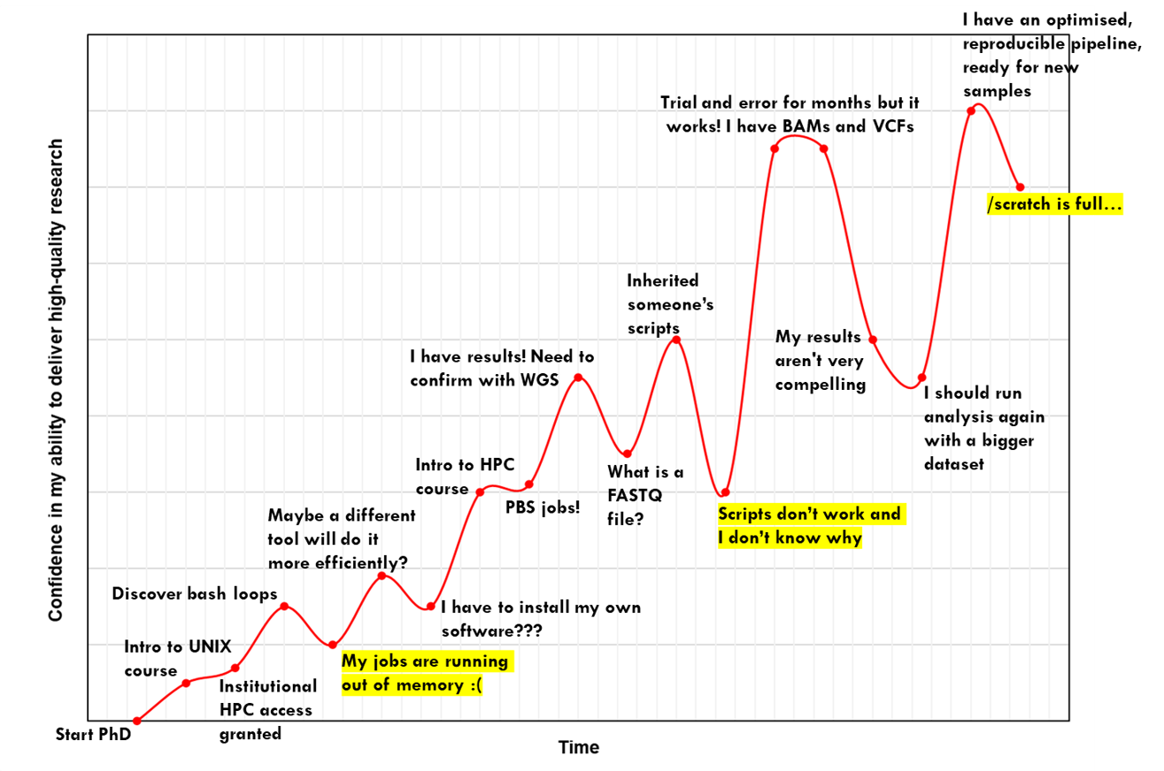
My HPC journey
Why do we struggle?
Datasets can be massive
Biology-fluent computational expertise is scarce
Applications are not designed for HPCs
Biological variation adds complexity to analyses
Pipelines consist of multiple tools
Applications have scale limitations

Slide 8
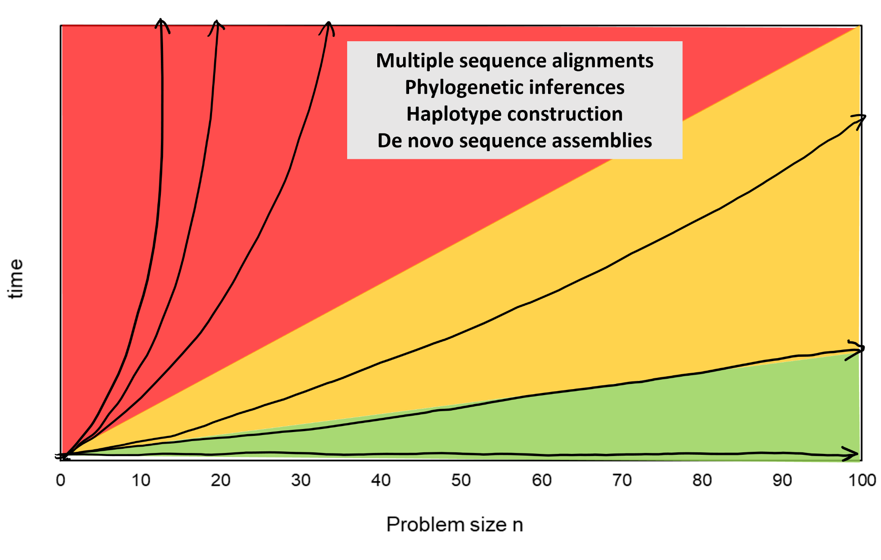
Bioinformatics is hard because biology is messy
Bioinformatics algorithms have a complexity that limits their speed
Biological data has a complexity that limits the algorithm’s speed
Data complexity is highly variable
No one-size-fits-all solution, so we need to be dynamic
log(time)

Slide 9
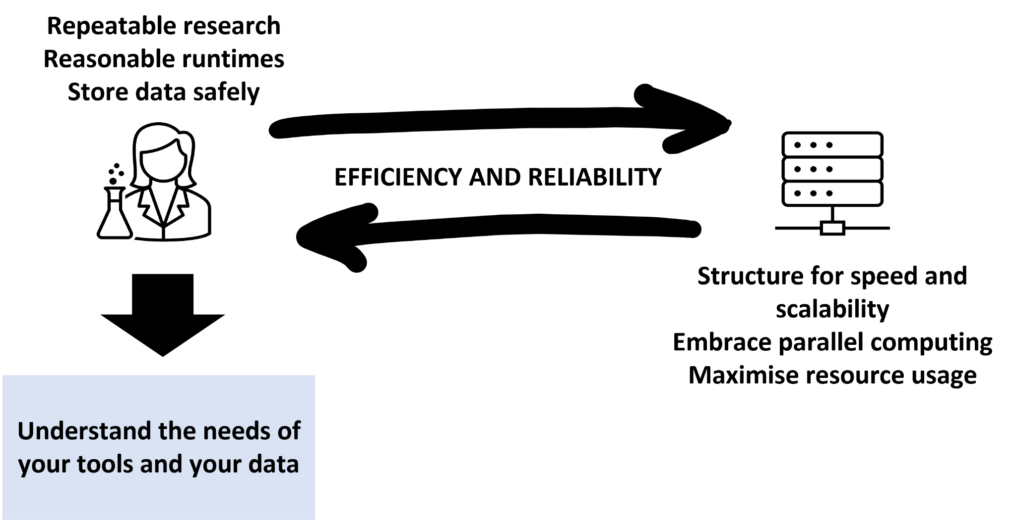
High performance computing is a two-way street

Slide 10
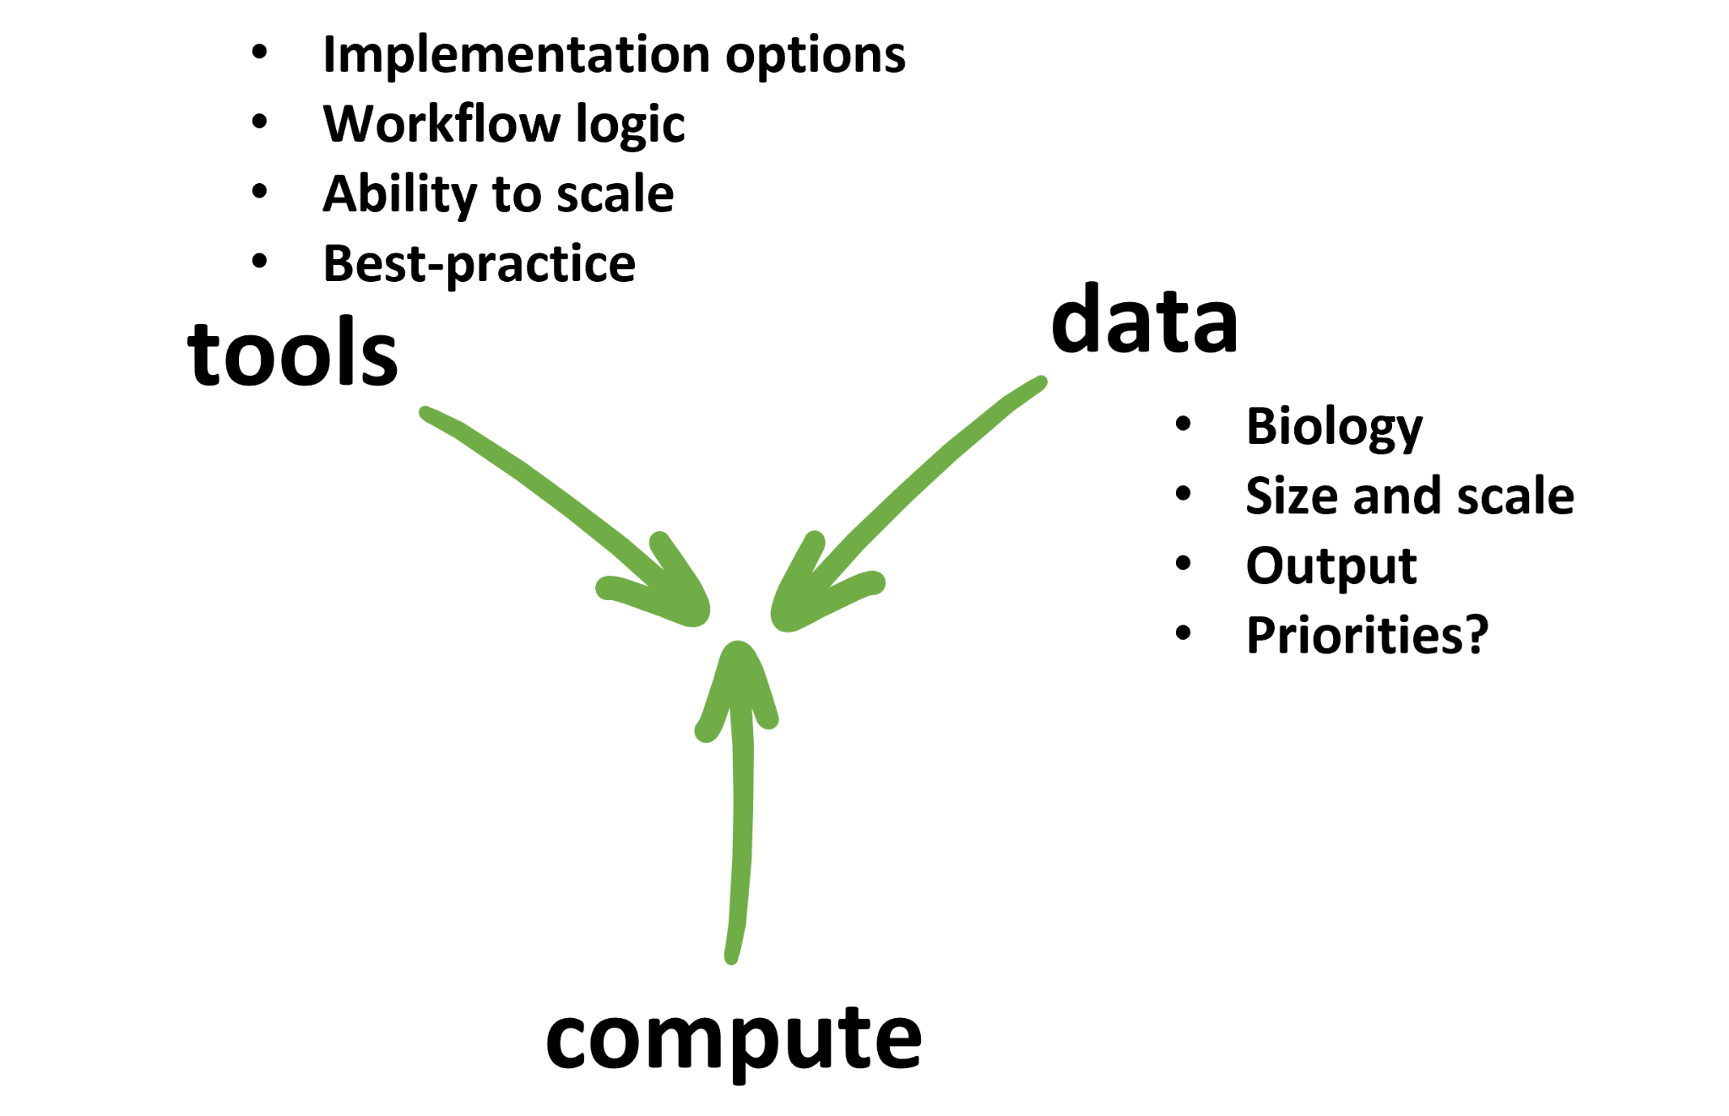







Ask questions in context
What are my needs?
Learn about best practice bioinformatics concepts like reproducibility and scalability
What are the performance bottlenecks?
What efficiencies are expected of me?
Bigger isn’t always better

Slide 11
Australian Research Data Commons
Dr Paul Coddington

Slide 12
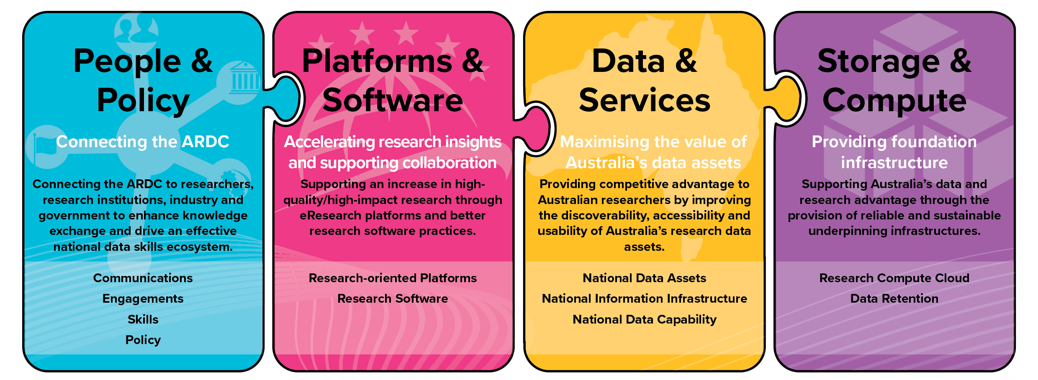
ARDC - Australian Research Data Commons

Slide 13

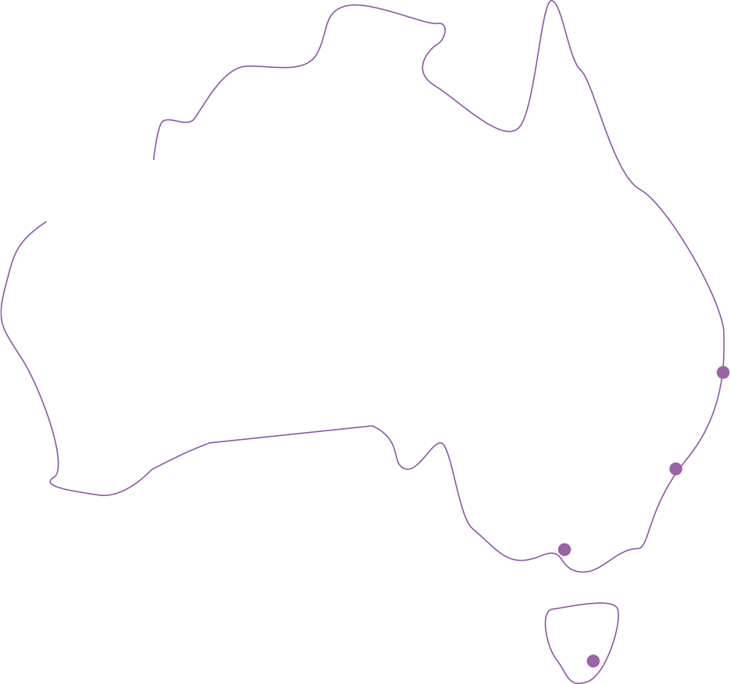










ARDC
Australia’s National Research Cloud
8,000
20,000
Virtual Machines
Physical CPU Cores
Advancing Australian
research since 2012
QCIF
Brisbane
60,000+
1.8PB
Virtual CPU Cores
Object Storage
Intersect
Sydney
5PB
Monash
University
Melbourne
File Storage
The University
of Melbourne
Melbourne
TPAC
Hobart
‹#›

Slide 14
ARDC - Nectar cloud infrastructure
Cloud provides virtual servers on demand
  can be used as scalable compute resources or for hosting online services
Fills the compute gap between desktop PC and HPC
Nectar virtual machines come in many sizes or flavors
  From 1 virtual cpu (vcpu) and 1 GB RAM up to 32 vcpus and 128 GB RAM
  Can request new “Huge RAM” flavors up to 48 vcpus and 360 GB RAM
  Non-standard flavors with higher RAM are also possible
File or object data storage, and a database service
New services in development (available early 2022)
  GPUs
  Jupyter notebooks
  Virtual desktop

Slide 15
ARDC - use of Nectar Cloud for bioinformatics
~20% of compute resources on the Nectar Cloud are used for projects in Biological Sciences or Medical & Health Sciences.
763 project allocations in Biological Sciences
374 project allocations in Medical & Health Sciences
>100 NHMRC grants supported per year
Nectar Cloud has been used for:
Galaxy Australia
Stemformatics Virtual Laboratory
Cancer Therapeutics CRC
Genomics studies on threatened species (e.g. Macquarie Perch)
  “The allocation on Nectar was a huge help to our lab” - Dr Alexandra Pavlova, School of Biological Sciences, Monash University

Slide 16
ARDC - accessing the Nectar Cloud
The Nectar Research Cloud can be used by any researcher with an AAF identity.
User logs in to the Nectar Research Cloud dashboard using AAF.
Project Trial (2 VCPUs for 3 months of usage) automatically allocated.
Users can apply for a Project Allocation (for 3-12 months) by completing and submitting an allocation request form from the dashboard.
Project Allocations are approved for provisioning under the Research Cloud National Allocation Scheme by the Nectar Allocation Committee
Allocation requests usually assessed within 2 weeks.
Users can request an update or extension of a project allocation at any time.
No (direct) cost to the researcher – ARDC covers capex and Nodes cover opex.

Slide 17
ARDC - accessing the Nectar Cloud
The Nectar Research Cloud has two categories of cloud infrastructure:
  National - ARDC funded, accessible through a national allocation scheme
  Local - Node funded, for Node-prioritised (local) allocations
Projects are eligible for a national allocation if they meet specific criteria:
  National competitive research grant (e.g. ARC, NHMRC)
  Supports (or is funded by) an NCRIS capability, including ARDC projects
  Approved by the Nectar Allocation Committee as meeting other merit criteria
Local allocations require some arrangement with a Node

Slide 18
ARDC - Nectar training and user support
Nectar national helpdesk operates 7am to 6pm AEST/AEDT, accessed via:
Email support@ehelp.edu.au
Web interface from the Support Portal or the Helpdesk
Live chat help from the Support Portal
The Support Portal has self-paced online tutorials
Monthly online Getting Started with Nectar training for new users.

Slide 19
ARDC - more information
More information is available here:
https://ardc.edu.au/
https://ardc.edu.au/services/nectar-research-cloud/
Or email support@ehelp.edu.au

Slide 20
Galaxy Australia
Simon Gladman
Melbourne Bioinformatics, University of Melbourne

Slide 21
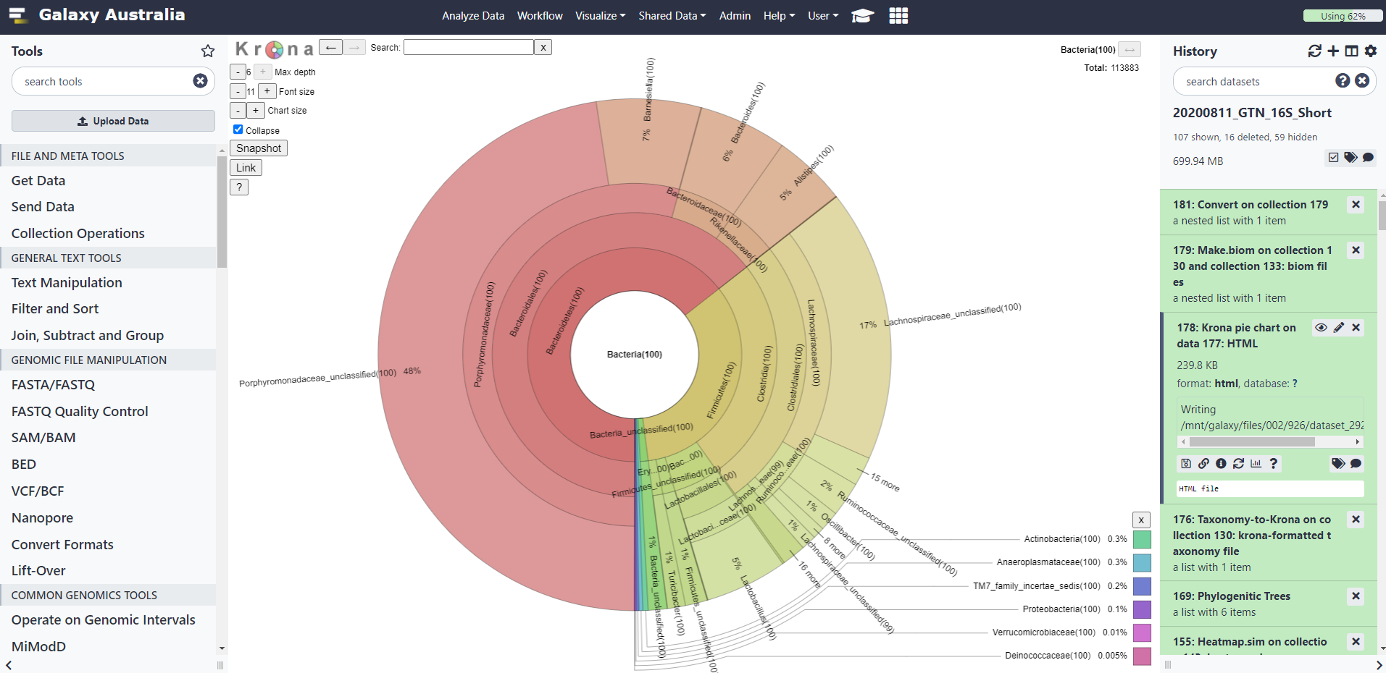
Galaxy Australia
Notes:
This is Galaxy - its a web interface allowing you to perform all sorts of data analyses and visualisations. It’s really easy to use, with a GUI interface meaning you don’t need to know the ins and outs of the linux command line to get the most out of it. The really cool part is that it is connected to a lot of national computing resources including those with high memory and large core counts. Its aim is to lower barrier for entry into large compute systems and make them super accessible.

Slide 22
Galaxy Australia
Galaxy Australia is a hosted web-accessible platform that lets you conduct accessible, reproducible, and transparent computational biological research.
Galaxy Project - Global open source project
Used all over the world
Over 15 years of constant global operation and community-based contributions
Cited in over 10,000 publications using Galaxy to enable research
Backed by 8,000+ analytical tools and growing
Training supported through Galaxy Training Network with over 190 training topics
Has ongoing funding within Australia
Notes:
Talk to points here in brief - point of the slide: it’s big and its here to stay

Slide 23
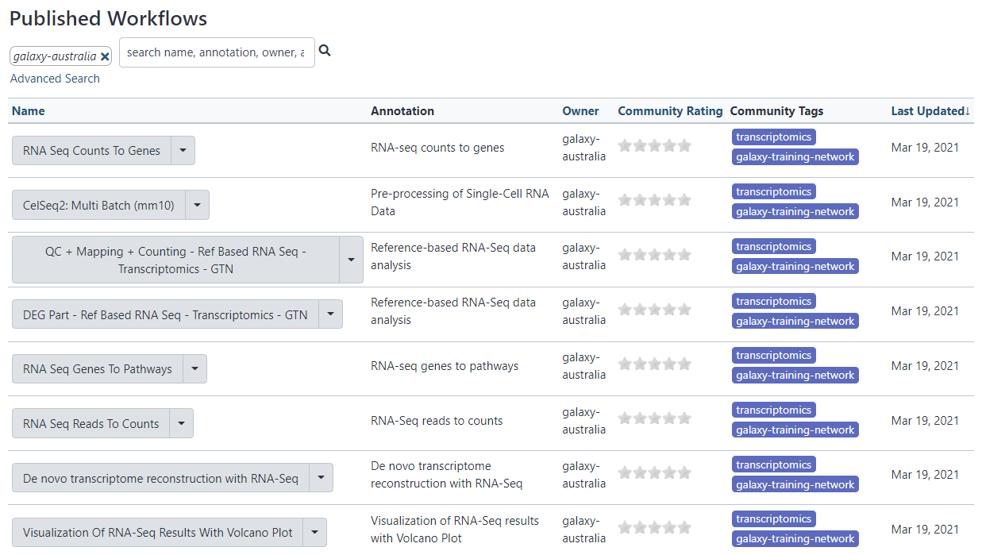
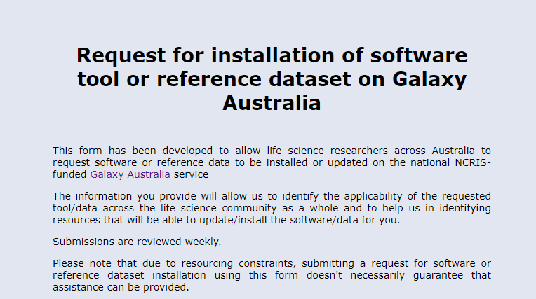
Galaxy Australia - accessing tools and references
Currently has 1,400+ tools installed covering genomics, proteomics and metabolomics, statistics and data visualisations
100s of reference data sets and tool indices
100s of global, peer-reviewed workflows - simple one click use
And if we don’t have it - just ask us
Notes:
Options for analysis and how to get your functionality onto Galaxy. We can action tool requests quickly.

Slide 24
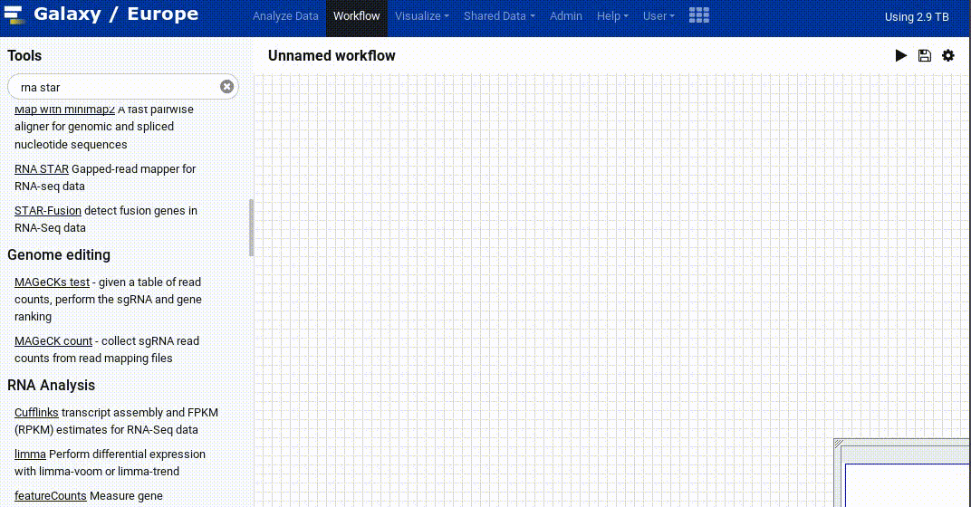
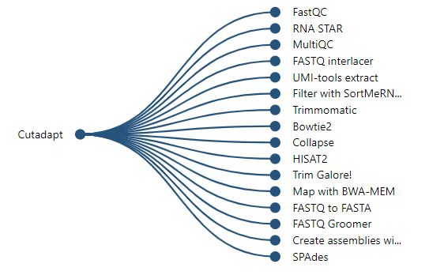
Galaxy Australia - part of a global community of coders, developers, trainers and users
Using Galaxy means you can draw on the experiences of 10,000s of users worldwide.
Galaxy offers - common use tool recommendations:
inside Workflows and each tool execution
Galaxy Training Network - https://training.galaxyproject.org/
Gitter - https://gitter.im/galaxyproject/Lobby
Galaxy Project news - https://galaxyproject.org/blog/
Notes:
What it means to be part of a global community and how that can help you to learn new topics, process new data types and to get in contact with the Galaxy community
As Galaxy remembers what everyone does, it can agglomerate this data to make smart suggestions of commonly used chains of tools to help you with your analysis next steps

Slide 25


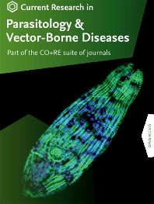
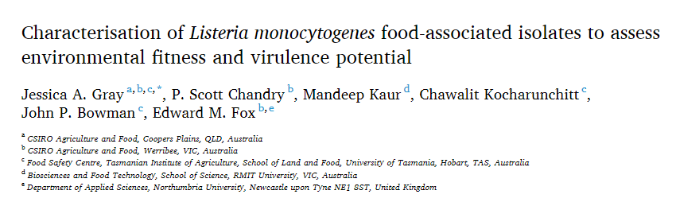

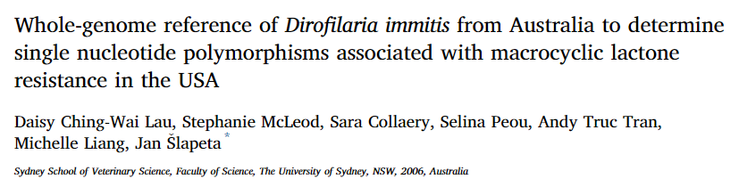
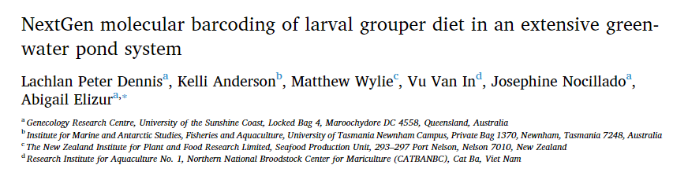
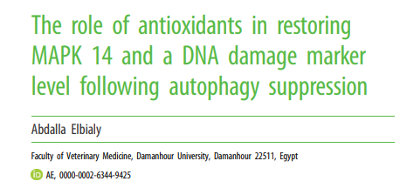
Galaxy Australia - compute leading to publication
Notes:
Some examples of the impact of Galaxy Australia, 3 x 2021 and 1 x 2020, both human and non-model organisims

Slide 26


Galaxy Australia - access
Register using your academic email (where possible), receive the largest analysis quota
https://usegalaxy.org.au/
help@genome.edu.au
https://twitter.com/galaxyaustralia
Notes:
How to access Galaxy Australia - easy to access, easy to register and easy to perform your analysis on some of Australia’s biggest backend compute.

Slide 27
NCI
Dr Roger Edberg
Javed Shaikh

Slide 28
High-performance computing, data, storage
Resource schemes
Merit: NCMAS, ANUMAS
Stakeholder: universities, .gov.au, institutes
NCI Startup: development
Industry: service agreements
https://nci.org.au
help@nci.org.au

Slide 29
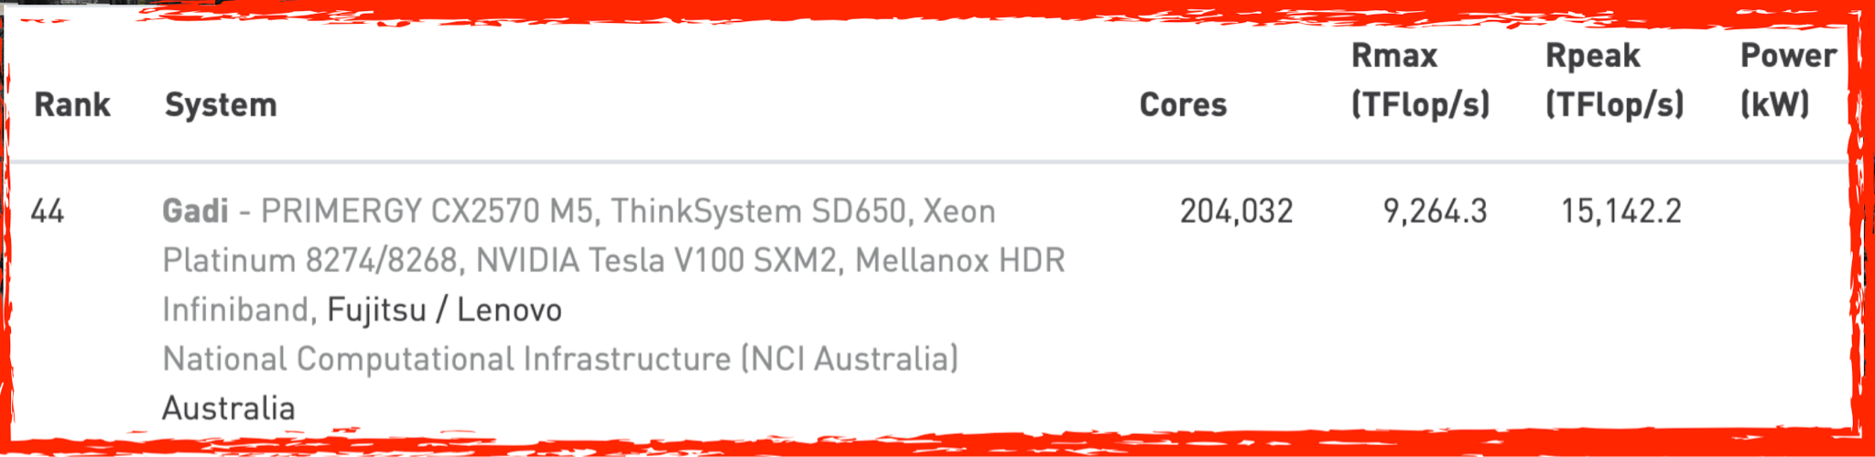
NCI
NCI Systems
Gadi: tier-1 compute system
Lustre file systems: /scratch, /g/data
Massdata tape archive
Data collections
Cloud
Open OnDemand, will supersede Virtual Desktop Interface (VDI)
Gadi - Bioinformatics
Hugemem (1.5 TB), megamem (3 TB), gpuvolta nodes
/g/data and /scratch file systems

Slide 30
NCI
Stakeholders (resource schemes)
Government: Bureau of Meteorology, CSIRO, Geoscience Australia, Antarctic Division, NSW, QLD, VIC
Universities: Adelaide, ANU, Deakin, La Trobe, Melbourne, Macquarie, Monash, RMIT, Sydney, Tasmania, UNSW, UQ, Victoria, WSU, Wollongong
Consortia: BioCommons, Intersect, QCIF
Institutes: Garvan, Victor Chang, Autism CRC, CCIA

Slide 31
NCI
Services
Help Desk: help@nci.org.au
User registration: https://my.nci.org.au
Start up projects: https://my.nci.org.au (Gadi)
Consultation: User services group
Application build and install: User Services, HPC
Workflow optimisation: User Services, HPC
Data collections
Cloud: coming...
Open OnDemand: coming…
Training: new training group, led by Dr Jingbo Wang

Slide 32
NCI
Any relevant activities, training, communities of practices

Slide 33
NCI
Resource schemes
Merit: NCMAS, ANUMAS
Stakeholder: universities, .gov.au, institutes
NCI Startup: development
Industry: service agreements

Slide 34
NCI
Public web site https://nci.org.au
User and project registration https://my.nci.org.au
NCMAS https://ncmas.nci.org.au

Slide 35
Pawsey Supercomputing Centre
Dr Maciej Cytowski

Slide 36

Pawsey Supercomputing Research Centre
Introduction
Australian Tier-1 Research Facility
Headquartered in Perth, Western Australia on Whadjuk country
Launched as Pawsey in 2014 with foundations back to 2000
Critical support for SKA infrastructure on Wajarri Yamatii country, 800km north of Perth
AU$70m capital refresh by Australian Government
Pawsey People
50+ staff employed via CSIRO in UJV
Supercomputing Applications Specialist with research background in various fields including bioinformatics, quantum chemistry, CFD, astrophysics, computational science and more…
Pawsey Researchers
Supporting 200+ projects and 3000+ researchers across all disciplines

Slide 37
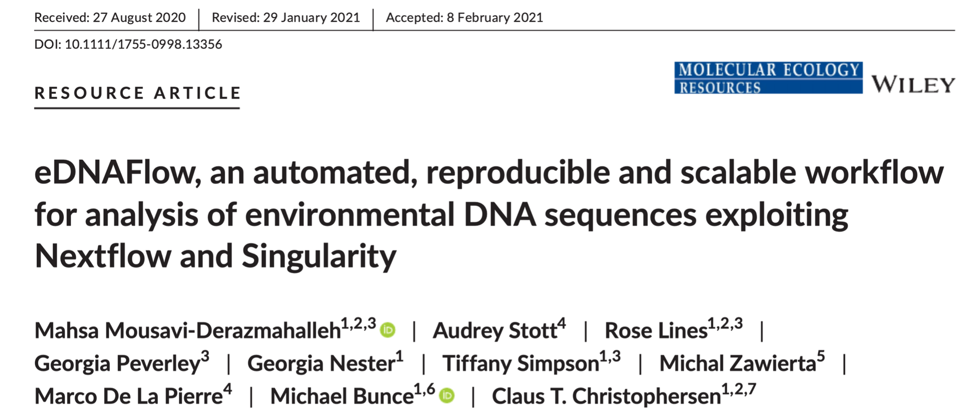
Pawsey Supercomputing Research Centre
Project Examples
Trace and Environmental DNA (TrEnD) Laboratory (Curtin University)
  Environmental DNA (eDNA) metabarcoding reveals biodiversity
  Nextflow workflow led to joint publication of eDNA pipeline
Computational Biology Lab (Telethon Kids Institute)
  Leveraging public datasets to discover biomarkers in childhood cancers
  Rare genetic diseases

Slide 38
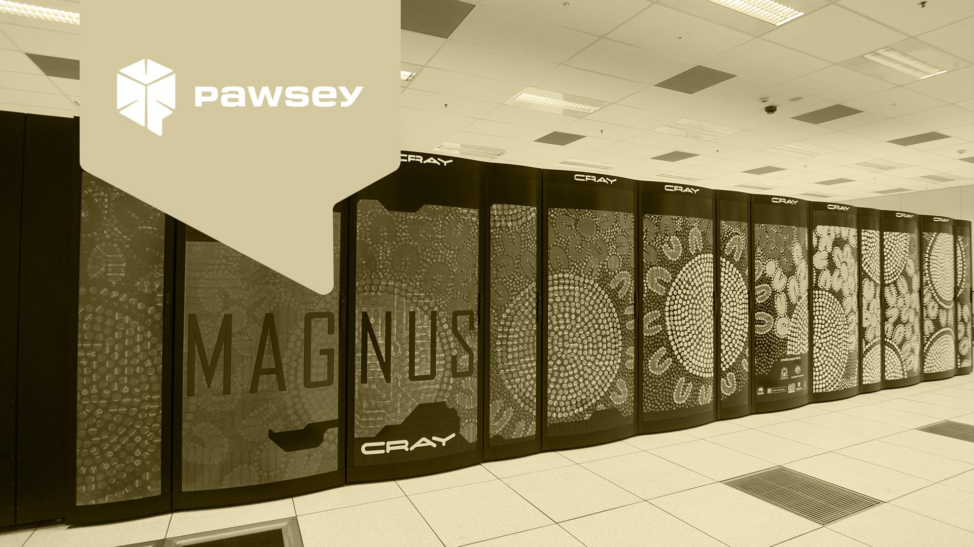
Pawsey Supercomputing Research Centre
Supercomputing Services
Current systems: Magnus, Zeus, Topaz
Future system: Setonix (next slide)
Large Scale computing
Access: Merit Allocation Calls
Nimbus Research Cloud Services
OpenStack based cloud environment
Various flavours of Virtual Machines (VMs), CPU and GPU based
Access: Pawsey Application portal (apply.pawsey.org.au)
Managed Data Services
Storage services for data collections
Data Portal
Access: Pawsey Application portal (apply.pawsey.org.au)
Visualisation Services
Remote visualisation services
High-end Linux-based and Windows based servers
Access: Available for Pawsey researchers
Expert advice, Solution Design and Consulting
Support for Large Scale Computing
Support in Scaling Up Research
Training and Education
Help Desk
Documentation

Slide 39

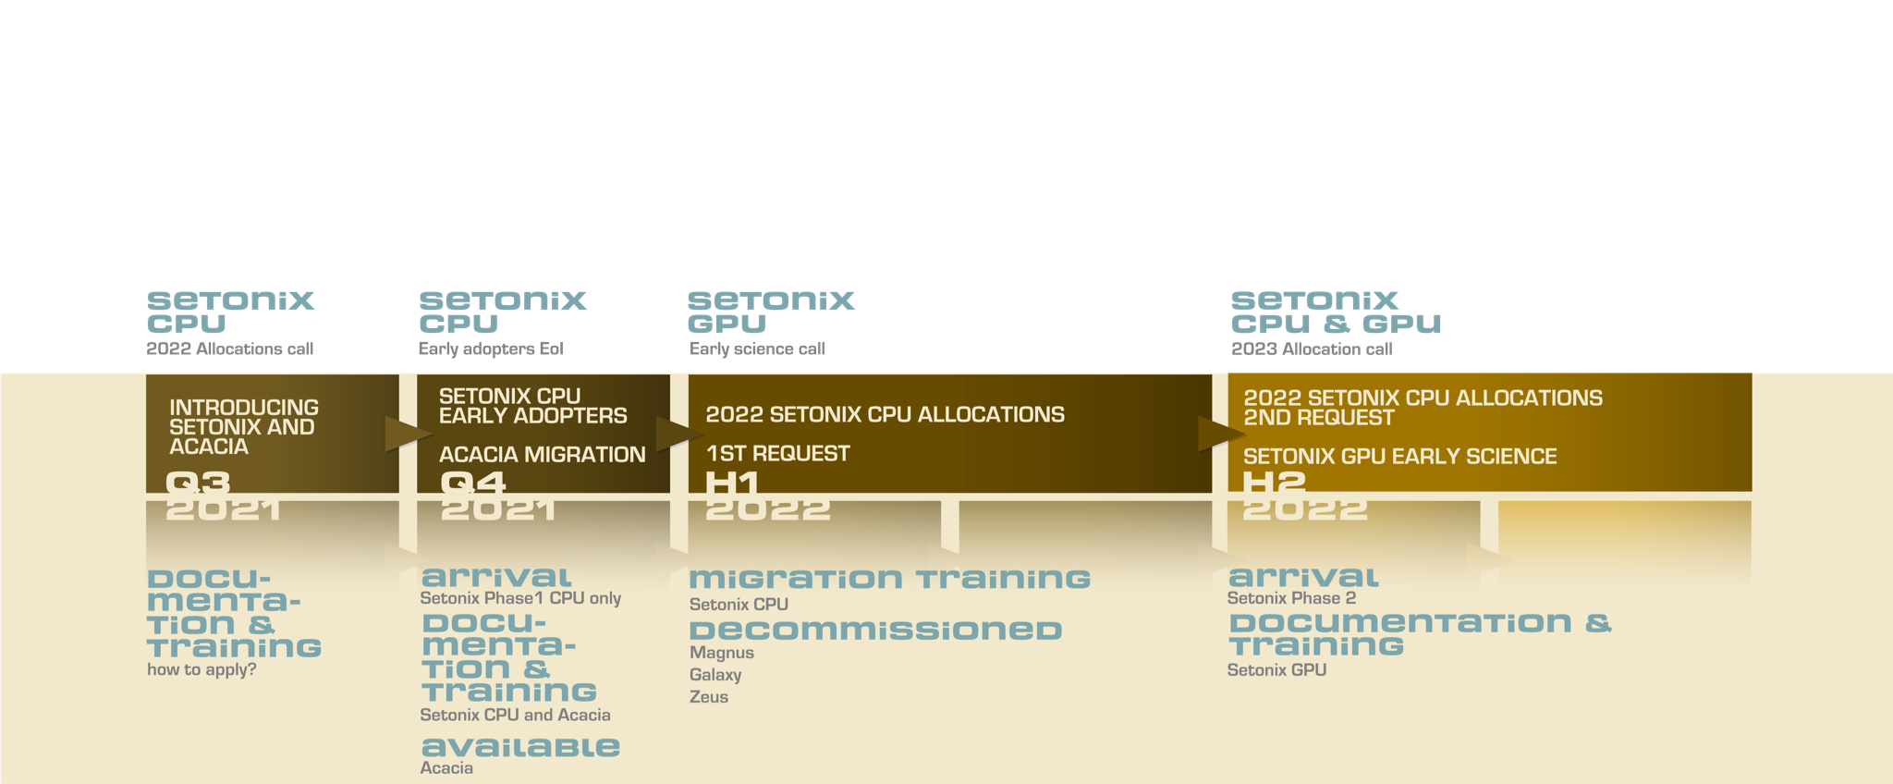
Pawsey Supercomputing Research Centre
Setonix
Australia’s new 50 petaflop system
200,000+ AMD Milan CPU cores
750+ AMD MI-Next GPUs
548+ TB system memory
15 PB ClusterStor Lustre filesystem with 2.7PB SSD
https://support.pawsey.org.au/documentation/display/US/Changes+in+Supercomputing+Services+for+2022

Slide 40

Pawsey Supercomputing Research Centre
Dedicated support for Bioinformatics
Investing a lot in making sure we can support bioinformatics and provide necessary tools including workflow tools and container environments
Leveraging all Pawsey services to support complex workflows (e.g. Fgenesh, Cromwell, RStudio)
Pawsey is part of BioCommons and provides resources to BioCommons researchers
Events
Bioinformatics Symposium - 1 day conference and workshop (2018)
Bioinformatics at Scale and Australia’s Next Generation of Supercomputers, online event (2021)
Trainings
Implementing Scalable Bioinformatic Workflows in Snakemake & Nextflow, hybrid event organised with Australian BioCommons and EMBL-ABR (2019) 150+ participants
Using Containers in Bioinformatics, online webinar & workshop series (2020), hundreds of participants (national and international)
Introduction to Containers (2020), online training (80+ participants)
Hackathons
Nextflow Hackathon (2019), 1 week, 40+ participants
Other activities
Ask Me Anything sessions dedicated to Bioinformatics
Bioinformatics HPC Community of Practice

Slide 41

Pawsey Supercomputing Research Centre
pawsey.org.au​
Pawsey Friends mailing list​
Pawsey Twitter feed (@PawseyCentre)​
Pawsey YouTube Channel (https://www.youtube.com/pawseysupercomputingcentre)​
User Support Portal (support.pawsey.org.au)
Pawsey Training Portal (https://pawseysc.github.io/training.html)
Pawsey YouTube Home, Videos & Playlists

Slide 42
Commercial Services
Dr Rosemarie Sadsad
Sydney Informatics Hub, University of Sydney

Slide 43
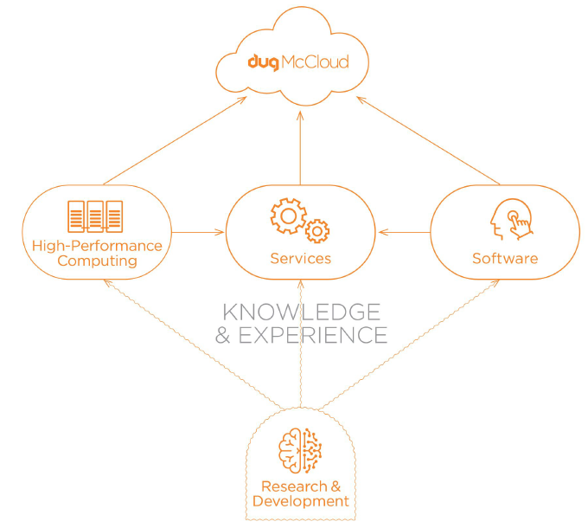
DUG
Australian technology company
High Performance Computing Experts
Big compute, big data and big storage
Full support to make your research a success
  Onboarding
  Installation
  Optimisation
  Testing
Own and operate some of the greenest data
centres in the world
Keep your data and compute in Australia
Users of DUG: Harry Perkins Institute of Medical Research, CSIRO

Slide 44

Bioinformatics at DUG
Bioinformatics pipelines include Trinity, GATK4 FASTQ to GVCF, joint GT, 3D DNA de novo assembly, HiC
Software includes Sambamba, Samtools, Bowtie2, BWA, GATK, Trinity
Package Managers/Repos include Bioconda, Biocontainer, Github
Workflow managers include Cromwell, Nextflow, Snakemake
Comparison: Trinity on Marsupial sample (20GB)
Regional HPC: 76 hrs
Institutional HPC: 55 hrs
DUG VAST Filesystem: 22 hrs

Slide 45

For more info
www.dug.com
Aaron Lewis
Business Development Manager
aaronle@dug.com
DUG’s blog
dug.com/the-daily-dug

Slide 46
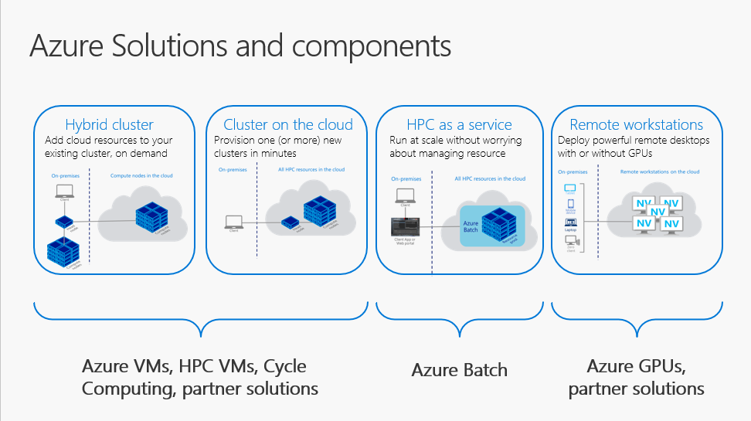

Azure

Slide 47
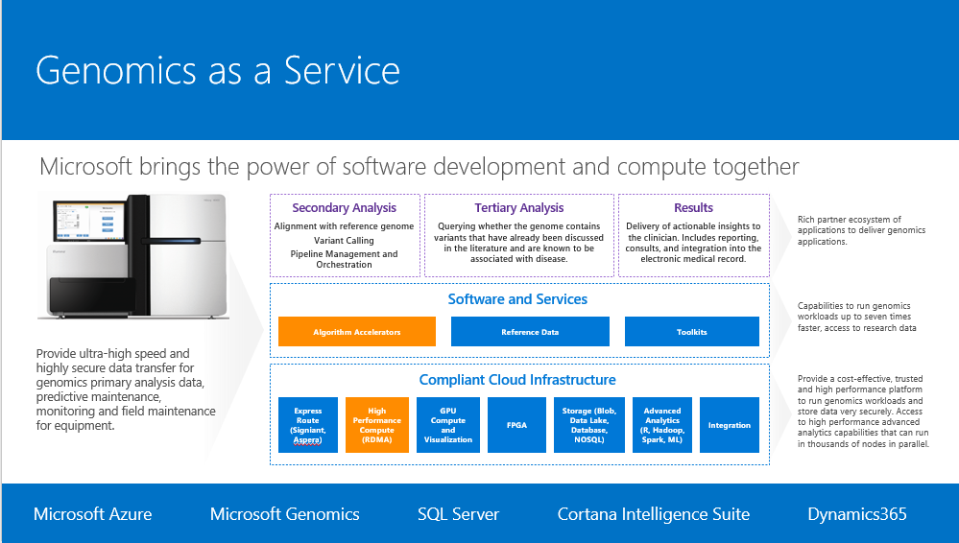
Azure

Slide 48
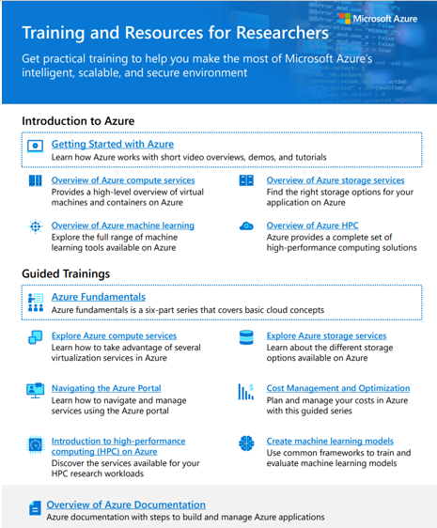
Azure
https://aka.ms/AzureResearch
aus-edu@microsoft.com

Slide 49
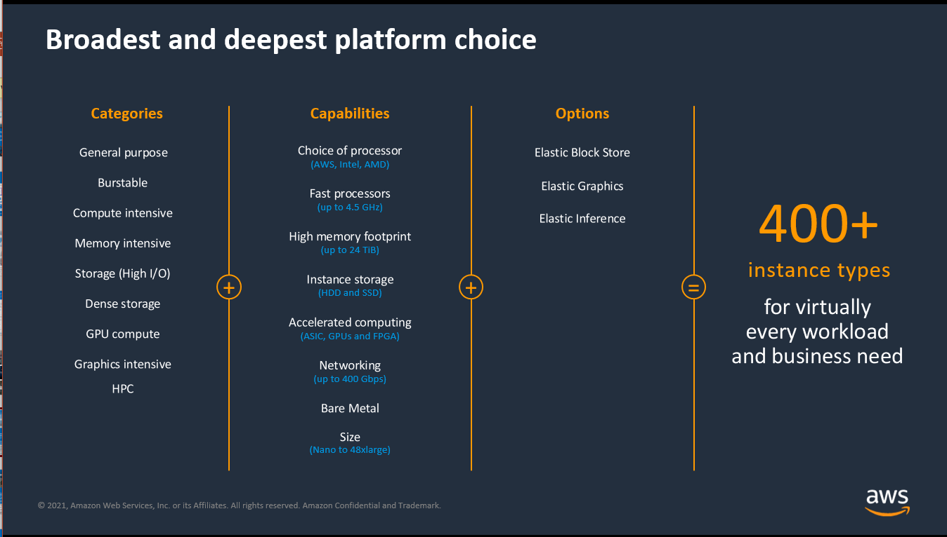
AWS

Slide 50
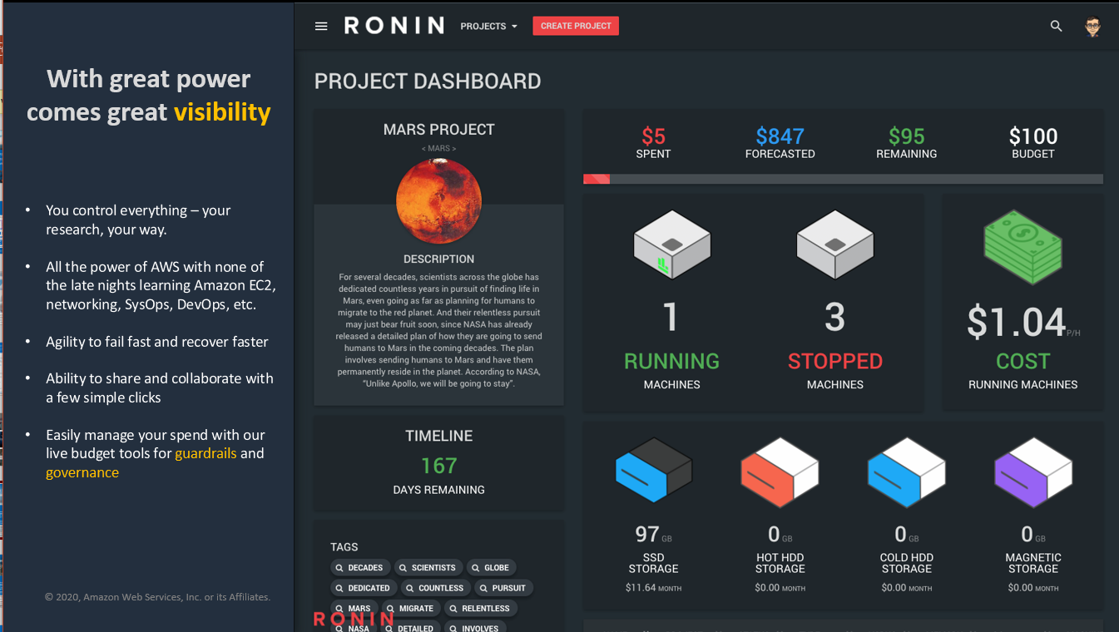
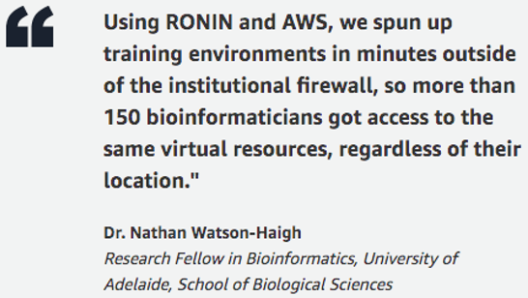
AWS

Slide 51
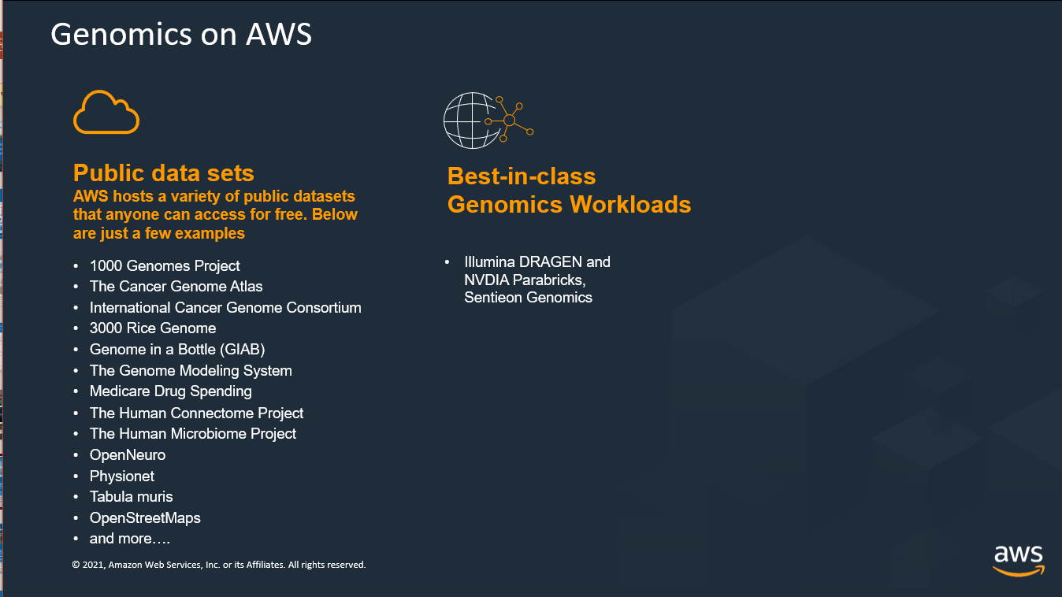
AWS

Slide 52
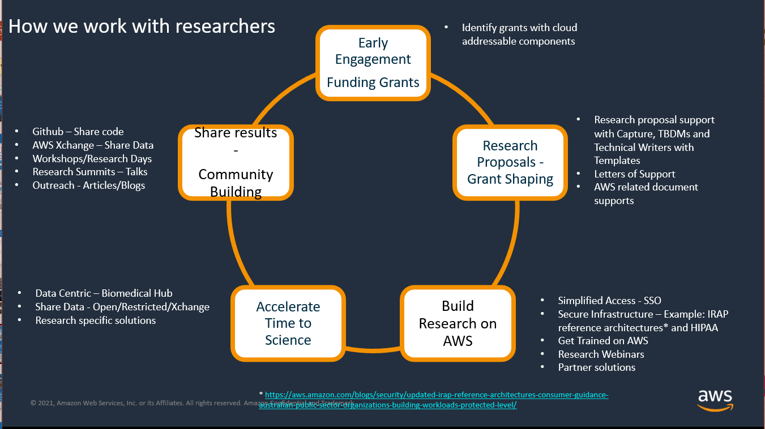
AWS

Slide 53
AWS
More information:
https://aws.amazon.com/government-education/research-and-technical-computing
https://www.amazon.science/academic-engagements
Training: https://aws.amazon.com/government-education/research-and-technical-computing/research-seminar-series/
https://pages.awscloud.com/APAC-public-OE-AWS-Research-Webinar-Series-On-Demand-2020-reg.html?did=ep_card&trk=ep_card

Slide 54
NCMAS
Roger Edberg

Slide 55
NCMAS
National Computational Merit Allocation Scheme
2022 Call for Applications
NCI: Gadi 280 MSU
Pawsey: Setonix 250 MSU (two components)
MASSIVE: M3 2.5 MSU
Allocations are made through a merit-based competitive process.
Roughly ¾ of applicants receive allocations, however many receive less than they request because demand exceeds supply.

Slide 56
NCMAS
2022 Call for Applications
Opens: 18 August
Closes: 5 October
https://ncmas.nci.org.au

Slide 57
Next steps
Get to know the needs of your workloads
Get access- contact your institution’s ICT department
Training resources for you to get some experience
  BioCommons training cooperative
  Galaxy training
Pipelines and tools already deployed at national facilities
  Australian BioCommons ToolFinder
  Australian BioCommons WorkflowHub

Slide 58
Join us tomorrow ...
High performance bioinformatics: submitting your best NCMAS application
20 August 2021 12pm AEST/10am AWST
biocommons.org.au/events/ncmas

Slide 59
Tell us what you thought ...
Feedback survey

Slide 60


Thanks for joining us!
The Australian BioCommons is enabled by NCRIS via Bioplatforms Australia funding

