Slide 1

High performance bioinformatics: submitting your best NCMAS application
Welcome!
The webinar will commence at 12pm AEST/ 11:30am ACST/ 10am AWST

Slide 2



Actively supporting Australian life sciences research through bioinformatics and bioscience data infrastructure
biocommons.org.au AustralianBioCommons @AusBiocommons

Slide 3
Acknowledgement of Country
We acknowledge the Traditional Owners and their custodianship of the lands on which we meet today.
We pay our respects to their Ancestors and their descendants, who continue cultural and spiritual connections to Country.
We recognise their valuable contributions to Australian and global society.

Slide 4


Housekeeping
Session is recorded
Autogenerated captions available
Questions via Chat
Mute when not speaking

Slide 5


Sydney Informatics Hub & Australian BioCommons
Dr. Tracy Chew
Bioinformatics Group Lead
Sydney Informatics Hub, University of Sydney
Dr. Georgina Samaha
Australian BioCommons Senior Bioinformatics Officer
Sydney Informatics Hub, University of Sydney

Slide 6

Poll: Which of these best describes you?
I am here to see if I should apply for NCMAS
I am a first time NCMAS applicant
I have applied for NCMAS in the past but was unsuccessful
I have applied for NCMAS in the past but was only awarded part of my requested allocation

Slide 7

Introduction

Slide 8

‘Bring Your Own Data’ Expansion Project
https://www.biocommons.org.au/byod-expansion

Slide 9
This webinar
Bioinformatics is an emerging computational discipline. In this webinar, we will:
Provide tips to help you understand if NCMAS is right for you
Focus on how to address the technical criteria in your application
Introduce key technical concepts
Describe strategies used to achieve computationally performant bioinformatics workflows
Help you to understand the landscape of how HPC is being used across domains, how bioinformatics fits in with this, and how you can use this to put your best NCMAS application forward
Please refer to https://ncmas.nci.org.au for specific eligibility and assessment criteria criteria.

Slide 10
Agenda
Determine if NCMAS is right for you and your research project
Prepare data to support your application
Preparing your application
Advice from the committee - Roger Edberg
Additional resources
Q & A (10 mins)

Slide 11

Is NCMAS is right for you
and your research project?

Slide 12
About NCMAS
https://ncmas.nci.org.au
The National Computational Merit Allocation Scheme (NCMAS) provides meritorious research projects a pathway to access national compute facilities.
For 2022, that includes: NCI Gadi, Pawsey Setonix, MASSIVE
Assessment phases
Administrative
Technical assessment
Merit assessment

Slide 13
Have your bioinformatics plan ready
Allocations are provisioned quarterly - a clear plan for 2022 will help you with
preparing your application.
Receive Illumina whole genome sequencing data for 200 samples at 60X coverage.
Perform mapping with BROAD best practice pipeline
Somatic variant calling using using BROAD best practice pipeline
Quarter 2
Quarter 4
Jan 2022
Quarter 1
Quarter 3
Mapping complete, perform
downstream analysis
Germline variant calling for short variants using BROAD best practice pipeline
Call structural variants with CNVkit, Manta, GRIDSS

Slide 14
Do the facilities meet your data needs?
Familiarise yourself with facilities available through NCMAS 2022
NCI Gadi, Pawsey Setonix, MASSIVE
Facility information usually provided in “Information for Applicants”
Matching tool requirements to facility hardware and usage policies
NCMAS is for experienced HPC users
What are the compute resource requirements for the tools you wish to use?
  Running them at another HPC facility? If it didn’t work - why didn’t it work?
Check facility hardware and usage policies (e.g. walltime limits) - do these match what your tools need?

Slide 15
Do your workflows match facility requirements?
Generally, facilities available through NCMAS are suitable for data-intensive, large scale bioinformatics
Highly resource efficient, scalable pipelines that have multi-node capability
  Most bioinformatics workflows require some optimisation
E.g. Mapping and variant calling hundreds of human genomes
Pipelines that require specialised hardware such as high memory or disk local to the node (e.g. jobFS on Gadi), commonly required for I/O intensive algorithms such as de novo genome and transcriptome assemblers
GPUs

Slide 16

Are there more suitable options?
There are other compute facilities available.
There are alternate ways of accessing Pawsey, NCI and MASSIVE. These often have different eligibility criteria
E.g. research specific, fewer compute request requirement, etc

Slide 17
What if I don’t have experience?
Get experience and seek help - help is available :)
Run your pipelines on a facility that is available to you
Attend training
  Attend NCMAS 2022 Information Sessions
  NCI Training
  Pawsey training
NCI, Pawsey, MASSIVE helpdesk
Do some reading, become very familiar with common compute terminology and concepts. I recommend: “Ten simple rules for getting started with command-line bioinformatics” Brandies & Hogg, 2021
Get a start up project (more on this later)

Slide 18
Poll: Is NCMAS right for you?
Yes, I am ready to put my application together!
Maybe - I need to check my eligibility
Maybe - I need to check that the facilities meet my data needs
Maybe - I am not sure if my compute request will be large enough
No

Slide 19

Gather data to support your application

Slide 20
Why do I need to collect data?
NCMAS is a highly competitive scheme. In your application, you will need to demonstrate:
Experience running the tools on the facility
Evidence that tools use compute resources efficiently when applied at scale
The optimal compute job configurations to apply (CPUs, RAM, walltime, disk)
The data storage requirements, data movement and lifecycle
An understanding of the algorithms/workflows applied
Why you need supercomputer resources

Slide 21
How to gather data - get a start up project
Start-up projects provide you access and a small allocation to a system. They can be used to:
Assess if the facility is fit for your purpose
Gain experience on a system
Obtain performance and compute resource metrics to include in the “Computational Details” section of your NCMAS application

Slide 22
Process of gathering data
The start-up allocation is very small and my recommendation is to:
Install tools/set up the pipeline(s) you wish to include in your application
Choose a very small representative dataset
Benchmark each job in your pipeline
Perform scalability tests using the most resource efficient configuration
Extrapolate resources required to process the full dataset

Slide 23
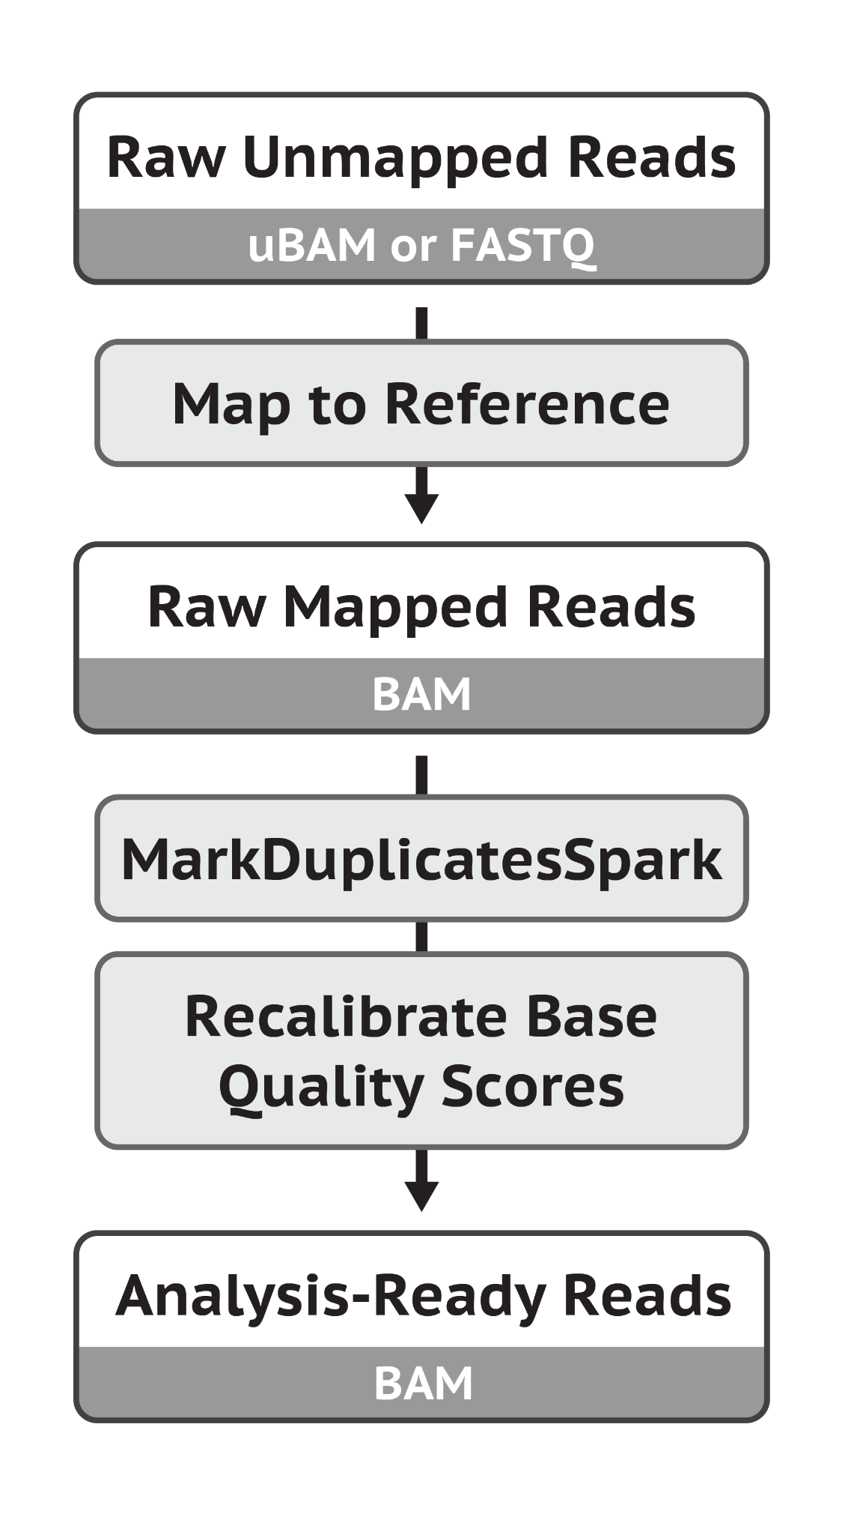
Let’s go through an example...
I would like to apply for NCMAS and use the allocation to align 1,000 whole human genomes, sequenced with an Illumina platform at 100 X coverage.
My pipeline follows BROAD’s best practices. Using the align job as an example, the job consists of one command which is:

Slide 24

Let’s go through an example...
Install tools
Choose a small representative dataset
  Sub-sample 500,000 read pairs from 1 sample for benchmarking
  Whole genome sequence for 6 samples for scalability testing

Slide 25
Let’s go through an example...
Benchmarking
Measuring compute utilisation efficiency given a set of compute resources to perform a task
3. Benchmark each job in your pipeline
BWA and SAMtools have multithreading capability and can utilise multiple cores
We can observe how well the command utilises
2, 4, 6, 12 CPUs

Slide 26
Let’s go through an example...
Job Name | CPUs | Mem | CPUtime | Walltime | CPU Efficiency | MEM Efficiency | Service units
align_2CPUs.o | 2 | 826.96MB | 0:07:41 | 0:04:04 | 0.94 | 0.01 | 0.27
align_4CPUs.o | 4 | 1.32GB | 0:07:04 | 0:01:57 | 0.91 | 0.09 | 0.26
align_6CPUs.o | 6 | 1.68GB | 0:06:28 | 0:01:32 | 0.7 | 0.07 | 0.31
align_12CPUs.o | 12 | 2.2GB | 0:06:32 | 0:00:48 | 0.68 | 0.05 | 0.32
3. Benchmark each job in your pipeline
Using a small representative dataset
In this example, 500,000 pairs of reads from 1 sample

Slide 27
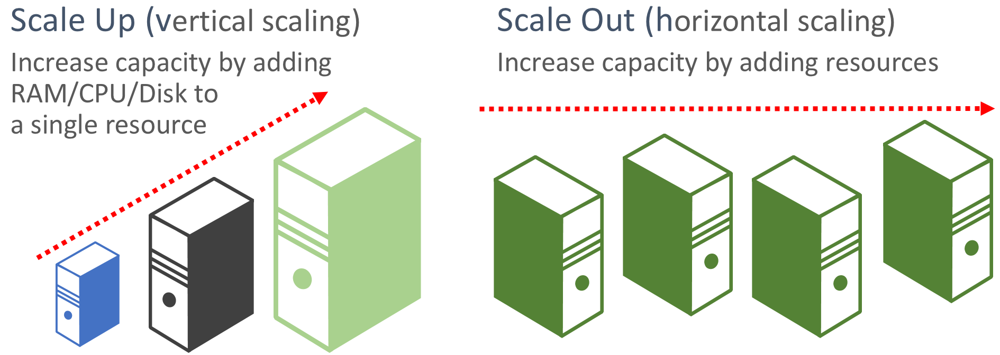
Let’s go through an example...
4. Perform scalability tests using the most resource efficient configuration
Job configuration required to achieve high compute resource efficiency to align 500,000 read pairs was observed in benchmarking
Can we maintain high compute resource efficiency to process 6 samples (~4.8 billion read pairs)?
Scalability
The ability to increase or decrease compute resources as demand changes

Slide 28
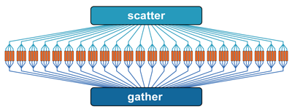
Let’s go through an example...
Many bioinformatics tools do not natively scale well. We can improve their ability to scale with some re-engineering.

Slide 29
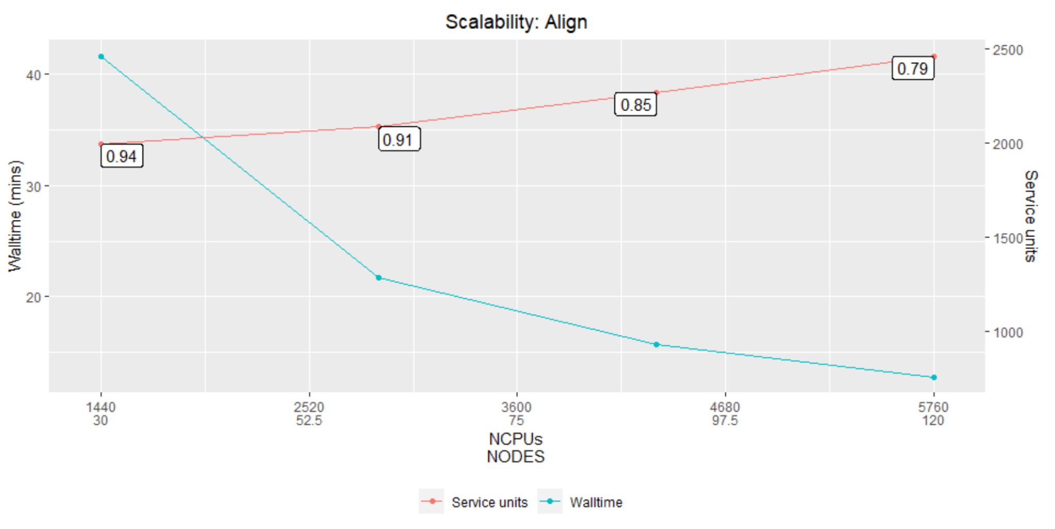
Let’s go through an example...
4. Perform scalability tests using the most resource efficient configuration
Test performance aligning 6 samples (total ~4.8 billion read pairs)
Scatter FASTQ into smaller FASTQs containing 500,000 read pairs
For every 500,000 read pairs, allocate 4 CPUs, process in parallel
The test - add more resources, observe CPU efficiency and walltime

Slide 30
Let’s go through an example...
5. Extrapolate resources required to process the full dataset
Using benchmark and scalability tests on the small representative dataset, extrapolate resources required to analyse the full dataset
Determine optimal job resource configuration to analyse the full dataset

Slide 31
Let’s go through an example...
5. Extrapolate resources required to process the full dataset
To process 6 samples:
Job operation | Total job CPUs | Total job RAM usage | CPUtime (HH:MM:SS) | Walltime (HH:MM:SS) | CPU Efficiency | RAM Efficiency | Service Units | Queue
Align | 2880 | 9490 | 945:21:11 | 0:21:43 | 0.91 | 0.85 | 2085 | normal

Slide 32
Let’s go through an example...
Extrapolated to 1,000 samples
To stay within job queue limits, 2 align jobs could be run concurrently
Job operation | Resource multiplier | Walltime multiplier | Job CPUs | Job RAM | Expected walltime (HH:MM:SS) | Queue | KSUs
Align (batch 1, job 1) | 7 | 11.5 | 20160 | 79800 | 4:09:44 | normal | 174
Align (batch 2, job 2) | 7 | 11.5 | 20160 | 79800 | 4:09:44 | normal | 174
 |  |  |  |  |  | Subtotal | 348
 |  |  |  | +10% biological variation |  |  | 35
 |  |  |  |  | Total request |  | 383

Slide 33
Let’s go through an example...
5. Extrapolate resources required to process the full dataset (storage)
To process 6 samples:
Job | Input (GB) | Output (GB) | Max disk (GB) | iNode input | iNode output | Max iNode
Align | 799.0 | 1100.0 | 1899.0 | 19,421 | 19,422 | 38,843

Slide 34
Let’s go through an example...
5. Extrapolate resources required to process the full dataset (storage)
Extrapolated disk for processing 1,000 samples:
Job | Input (TB) | Output (TB) | Max disk (TB) | iNode input (K) | iNode output (K) | Max iNode (K)
Align | 133.2 | 183.3 | 316.5 | 3236.8 | 3237.0 | 6473.8

Slide 35
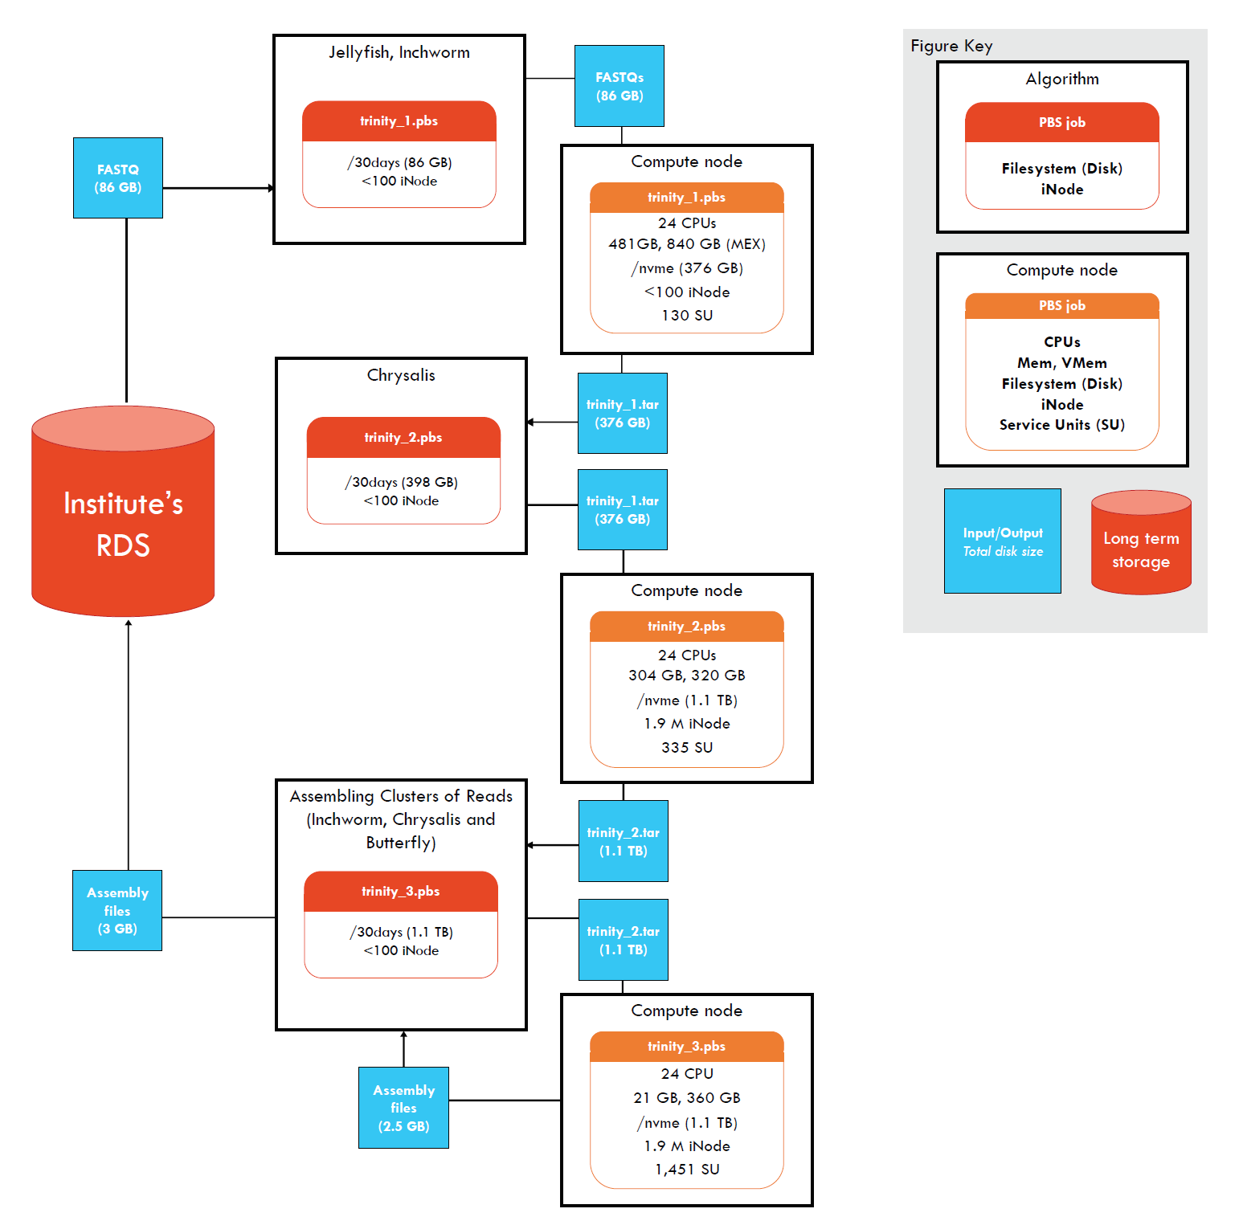
Let’s go through an example...
Extrapolate compute and storage requirements and fit these into a resource lifecycle plan.
Describe in detail inputs and outputs, disk, iNodes, data life cycle, long term data storage plan.

Slide 36
Preparing your application

Slide 37
NCMAS general application format
Applications are submitted through an online portal. There are a number of fields that require you to type-in responses and/or upload PDF responses.
Required responses are generally centred towards:
You and your research
Early career or special consideration
Australian Strategic Research Priority (FoR codes)
Research proposal
Funding
Publications, conference papers, presentations

Slide 38
NCMAS general application format
Applications are submitted through an online portal. They contain a number of fields that require you to type-in responses and/or upload PDF responses.
Required responses are generally centred towards:
Compute requests and supporting details
Compute Request (KSU) at each nominated facility
Prior HPC Experience
Software
Computational Details
A clear justification for use of supercomputer resources
Usage of Previous Allocations

Slide 39
Computational details
In the past, requested Computational Details included:
1. Scalability
2. Compute job resources
3. Storage
4. Algorithms and Workflows
5. Clear justification for use of supercomputer resources
6. Strategies to improve low efficiencies
You should be able to address these with the data you’ve gathered :)

Slide 40
Recommendations from the National Computational Merit Allocation Committee
with thanks to the NCMAS Secretariat

Slide 41
What elements are essential in a bioinformatics application to the NCMAS?
Factors specific to bioinformatics should be clearly stated up front. This helps inform NCMAS committee members who may not be aware of specific challenges in the field.
A clear description of a biological problem that requires substantial compute and storage resources to address
A well-characterised analysis pipeline, described in detail
Clearly defined input and output for each analysis step, and stepwise compute and storage requirements
Involvement of a bioinformatician with experience working with large, complex biological data sets, preferably in HPC environments

Slide 42
How should computational factors be addressed in your NCMAS application?
Highlight how your workflow has made best use of the facility
State clearly which algorithms/codes in use are external software
  Limitations with external software are inherent and out of your control as a user
For workflows with I/O bottlenecks and limited scalability it should be made clear that despite these issues, efforts have been made to maximise workflow efficiency in HPC environments.
Bioinformatics is storage intensive. Your storage requirements should be well described and characterized, with a discussion of temporary and longer-term requirements.
Larger requests receive more rigorous assessments
Account for contingencies in your resource requests: +10% KSU

Slide 43
What factors make a bioinformatics application more competitive in NCMAS?
If software supports multi-threading, then presenting basic scaling data is useful to support decisions about optimal use of algorithms.
Include memory usage information (table or graph) for memory-intensive tasks.
More specific examples could include things like an ability to split long-running jobs into smaller chunks. An example of this might be an ability to split whole genome tasks into individual chromosome tasks, which can run in parallel.
Experience with bioinformatics workflow management tools, such as NextFlow, Snakemake and so on.

Slide 44
Bioinformatics in the NCMAS landscape
Bioinformatics is rapidly maturing and is a relative newcomer to NCMAS. NCMAS has had to learn how to support it. (Getting there…)
Bioinformatics pipelines often have more moving parts and computational bottlenecks than “traditional” computational science.
6 of the 34 members of the current NCMAS committee have bioinformatics expertise.
In 2021 call 15 of 231 applications were in bioinformatics/genomics

Slide 45
Additional resources

Slide 46
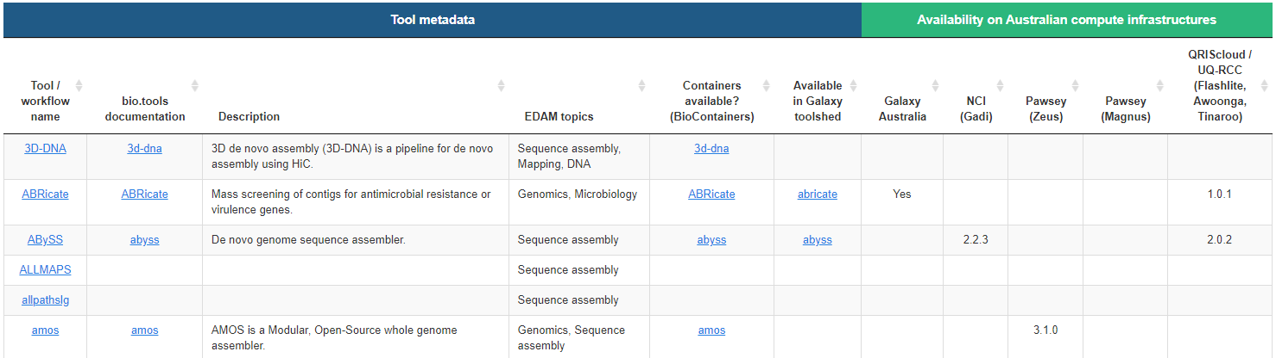
Tools & workflows
ToolFinder

Slide 47
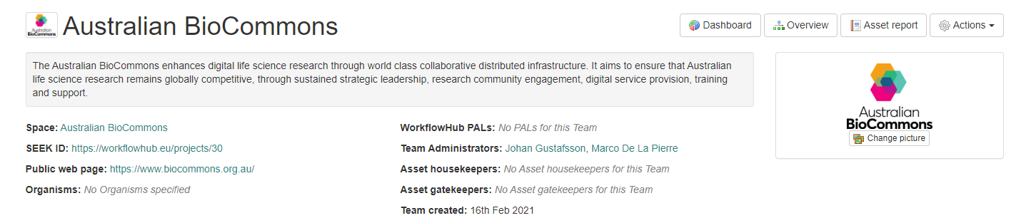
Tools & workflows
WorkflowHub - includes pipelines optimised for national compute facilities

Slide 48
Additional resources
NCI
NCI Training and Educational Events
Merit Allocation Schemes
Pawsey
NCMAS Application Process and Assessment Criteria
Writing a Strong Competitive Merit Application
Pawsey Events
Pawsey Friends Newsletter
MASSIVE
Access through NCMAS
We are also preparing a successful sample NCMAS 2021 application to share widely.

Slide 49
Where to get further help
Please contact your local ICT or compute facility support staff.
NCMAS email: ncmas@nci.org.au
Australian BioCommons: https://www.biocommons.org.au/contact-form
Sydney Informatics Hub, University of Sydney: sih.info@sydney.edu.au

Slide 50
Q&A

Slide 51
Next ...
Where to go when your bioinformatics outgrows your compute
Other bioinformatics training events
biocommons.org.au/events
Recording available soon
https://www.youtube.com/c/AustralianBioCommons

Slide 52
Please tell us what you thought ...
Feedback survey

Slide 53


Thanks for joining us!
The Australian BioCommons is enabled by NCRIS via Bioplatforms Australia funding

