Slide 1

National Identifier Infrastructure - Australia
CAUL-ARDC-AAF webinar
PRESENTED BY
Natasha Simons, Associate Director, Data & Services
https://orcid.org/0000-0003-0635-1998
12 August 2021
Notes:
This is a title slide. Heading and Subtitle are on the right.
Presenters name and date on the left.

Slide 2
We acknowledge and celebrate the
First Australians on whose traditional lands we meet, and we pay our respect to the elders past and present.

Slide 3
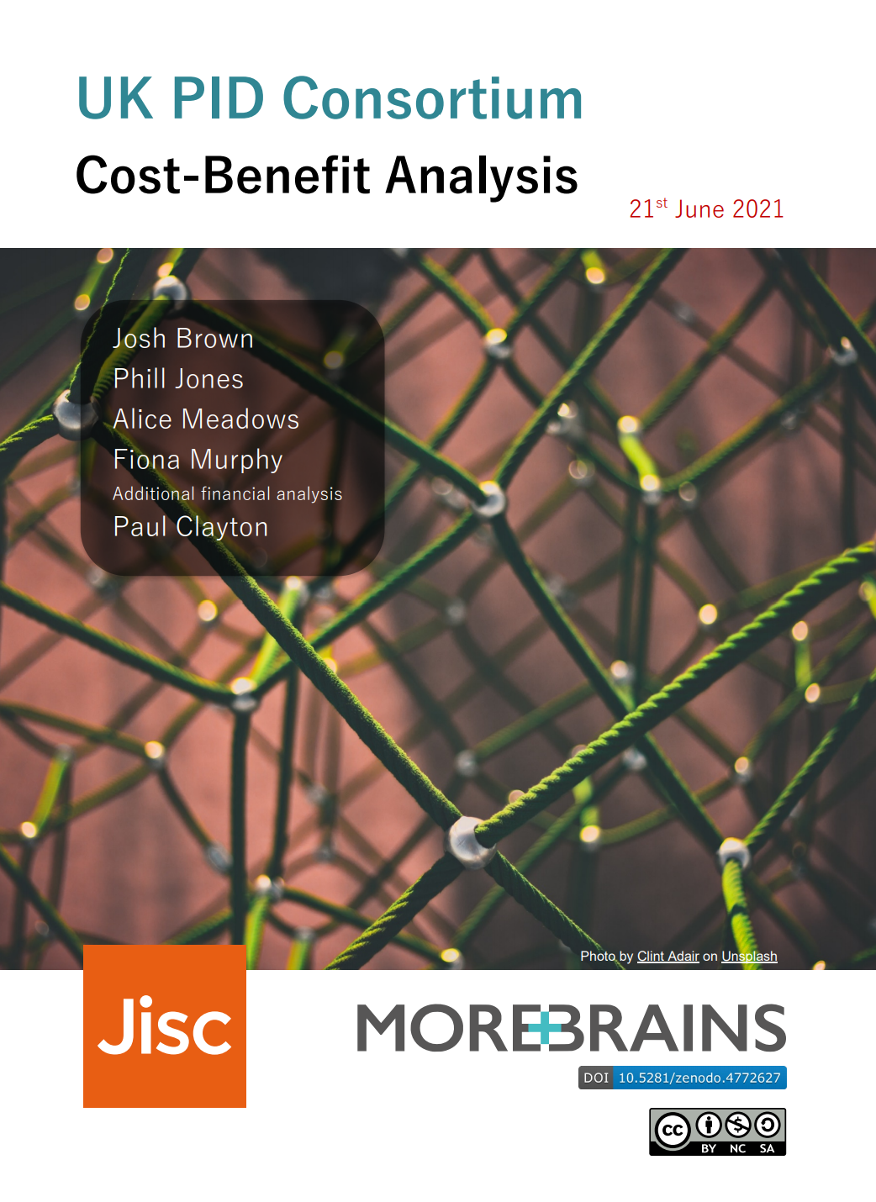
How could cost-benefit analysis translate to Australia?
Q - What’s the AUD equivalent of £5.67M?
A - About $10.68M

Slide 4

Q1 - Does the cost-benefit analysis translate to Aus?
Could the method of analysis in the UK report be applied to the Australian context?
Consider differences such as:
Size of research sector
Scale of investment in research
Research funding levels
Uptake and usage of persistent identifiers (benchmarking)
Research infrastructure development/availability

Slide 5
Q2 - do we have the identifier infrastructure needed?
Do we have the persistent identifier (PID) infrastructure needed to realise the benefits?
Identifier for | Identifier type | Offered by | In collaboration with international PID provider
People | ORCID | AAF’s Australian ORCID Consortium | ORCID
Grants | PURL/DOI | ARDC/CrossRef | Internet Archive / CrossRef
Projects | RAiD | ARDC | Handle system
Samples | IGSN/DOI | ARDC’s IGSN service/ ARDC’s DataCite Consortium | IGSN eV / DataCite
Data, software, instruments, ‘grey literature’ | Handle/DOI | ARDC’s Handle Service/ ARDC’s DataCite Consortium | DataCite
Publications | DOI | Publishers | CrossRef
Organisations | ROR / GRID |  | ROR / Digital Science

Slide 6

Q3 - do we have a national PID strategy?
Do we have a nationally agreed upon approach to investing in persistent identifiers as key infrastructure for research?
We have:
National Research Infrastructure Investment Plan & Roadmap
ARDC FAIR Data Guidelines and Persistent Identifiers Policy
Various governance groups for PID infrastructure e.g. Australian ORCID Consortium Governance Group, ARDC DataCite DOI Consortium

Slide 7
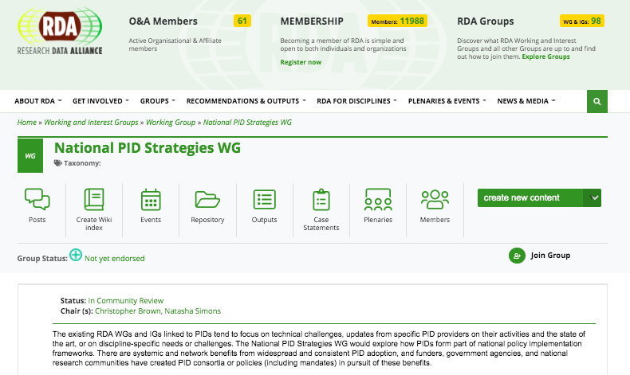
Are we alone?
No, a number of countries are trying to work this out

Slide 8

What could we do next?
Start the conversation about a national PID strategy
Invest in a PID cost-benefit analysis for Australia
...and alongside this:
Invest in and make use of PID infrastructure
Build PIDs into research infrastructure (systems, platforms)
Build PIDs into research workflows
Help researchers to use PIDs
Make use of tools like research graph to track research outcomes and impact
AUSTRALIAN PID INFRASTRUCTURE
?

Slide 9





















Enabled by NCRIS
Notes:
NCRIS capabilities

Slide 10



















Our Members

Slide 11


www.ardc.edu.au
australian-research-data-commons
ARDC_AU
Notes:
End slide

