Slide 1
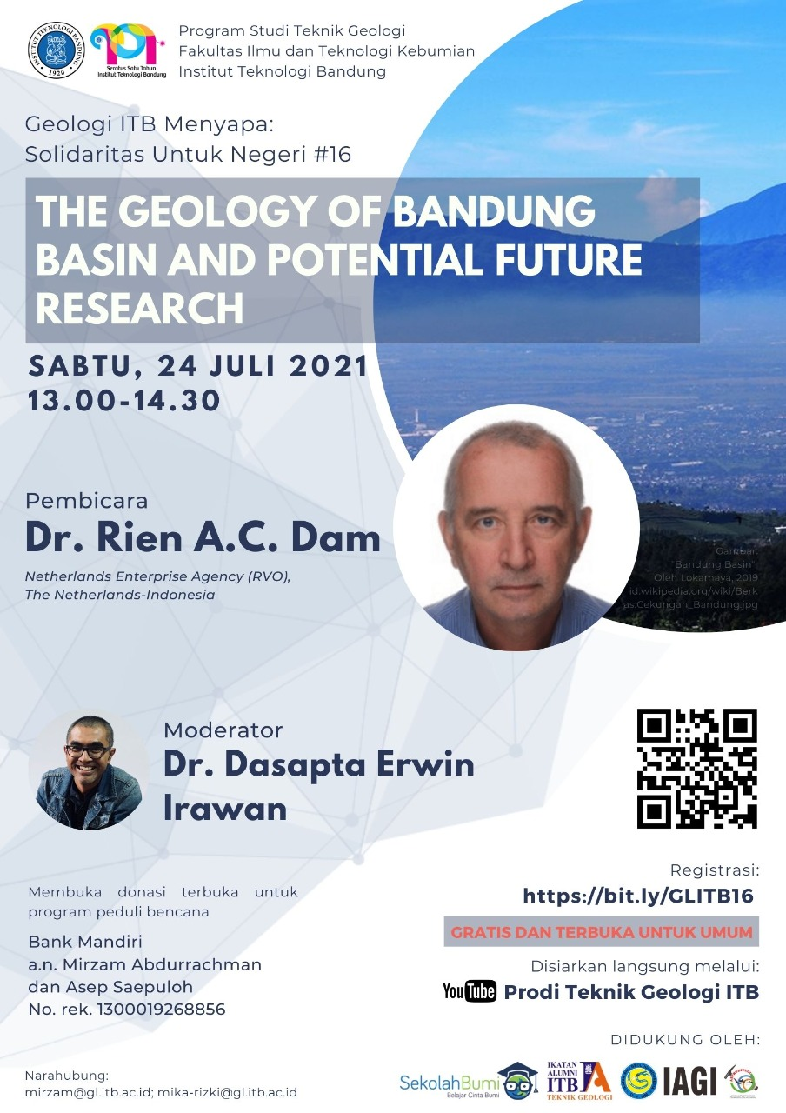


The Geology of Bandung basin and potential future research
Geologi Cekungan Bandung dan potensi riset masa depan
ITB, 24 July, 2021

Slide 2
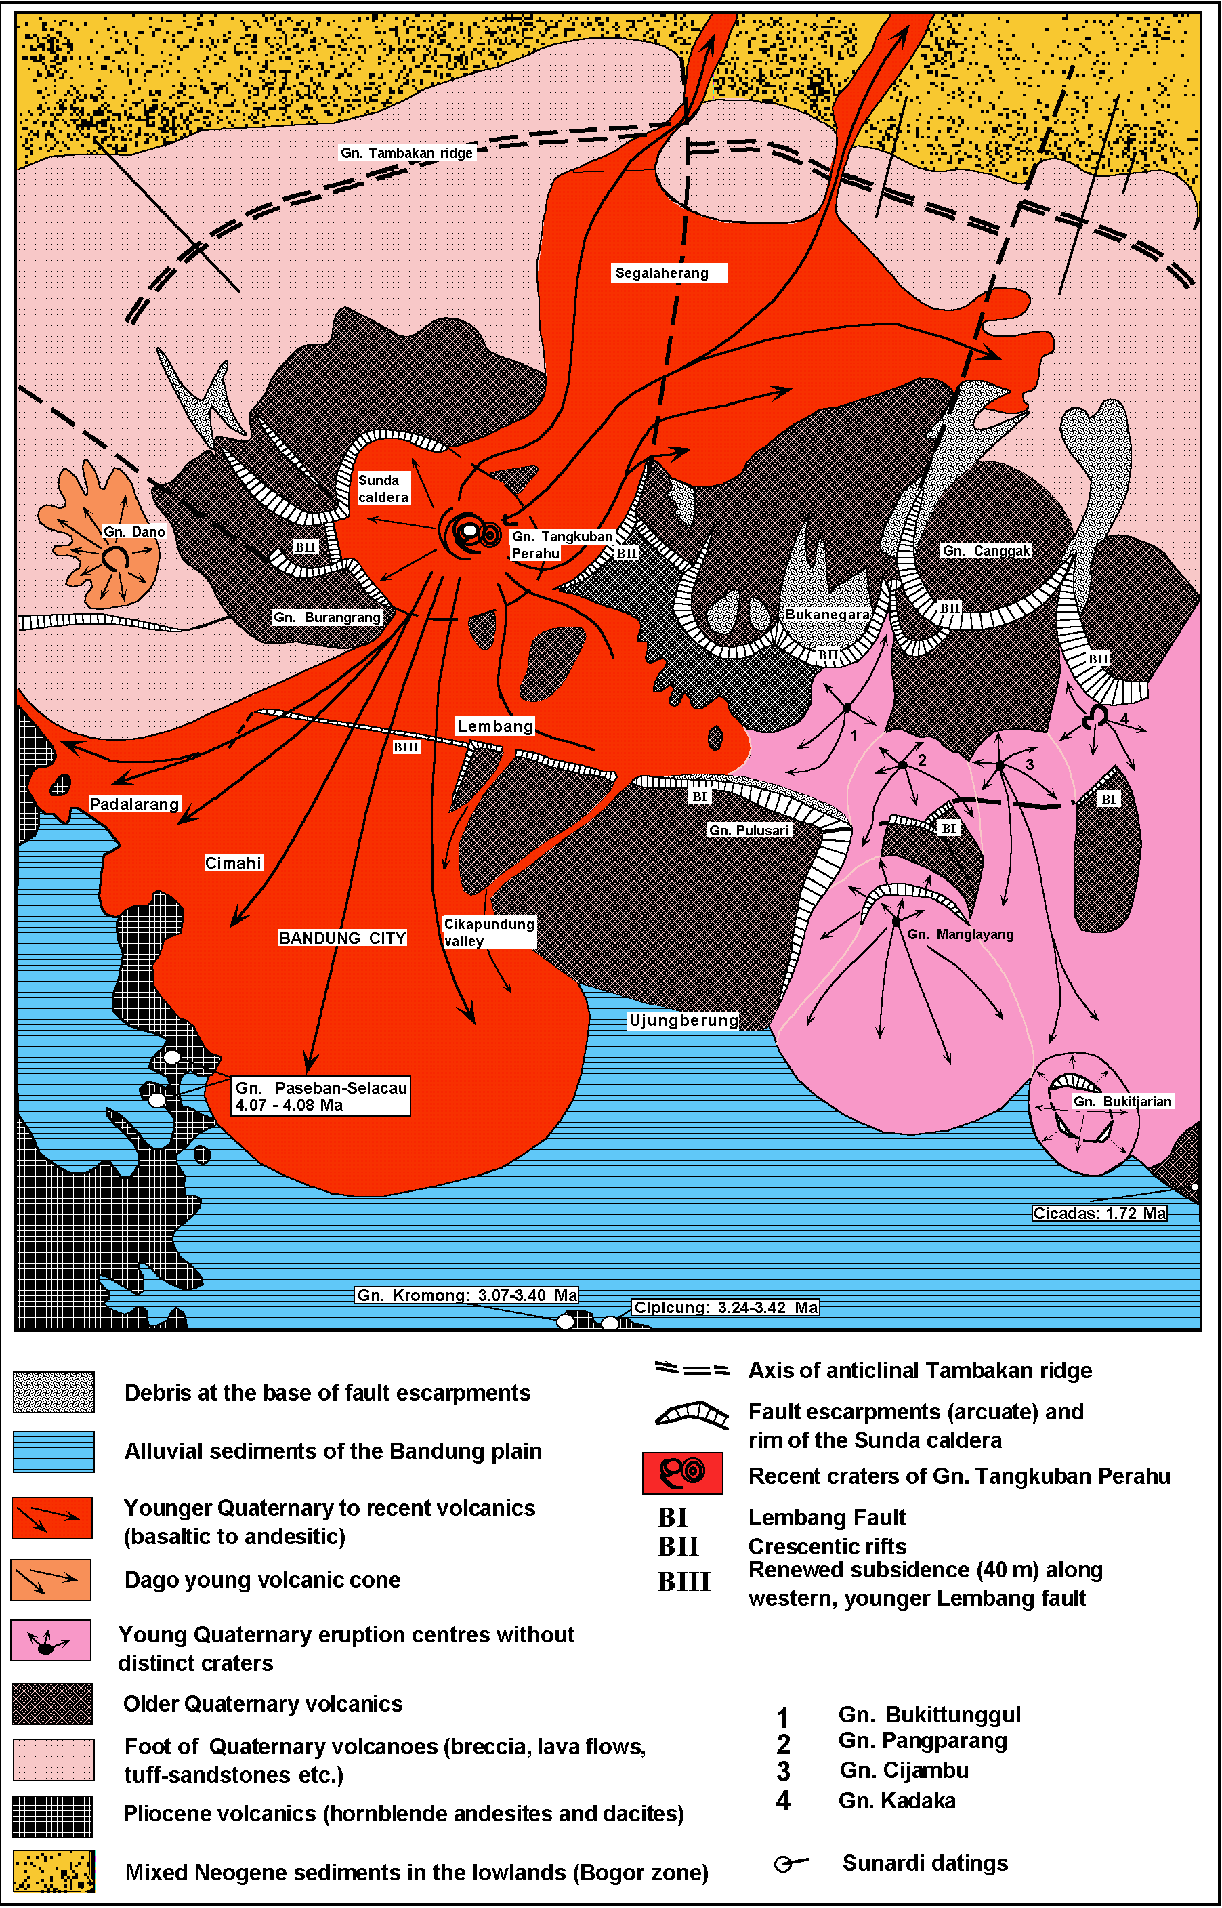
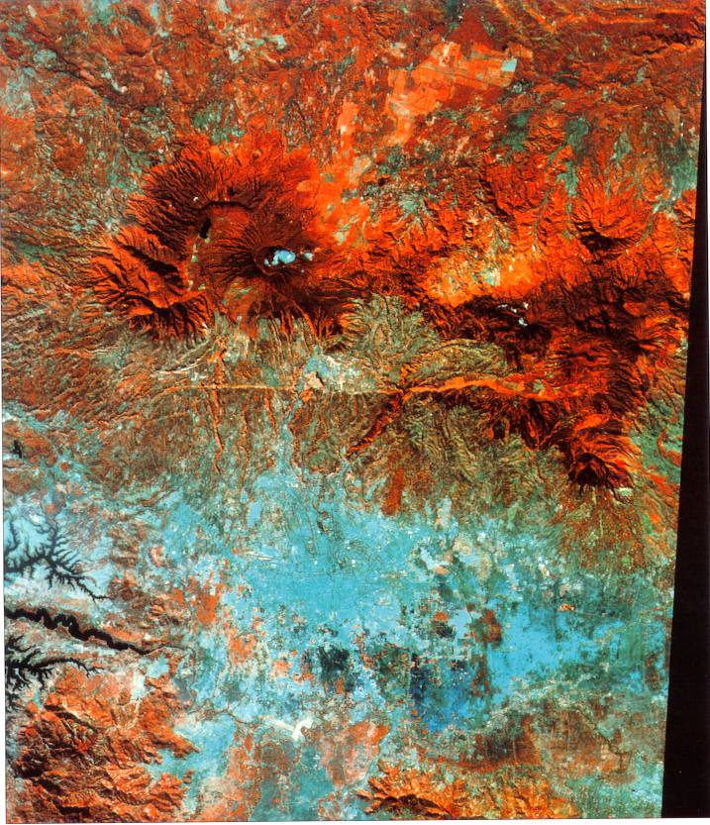
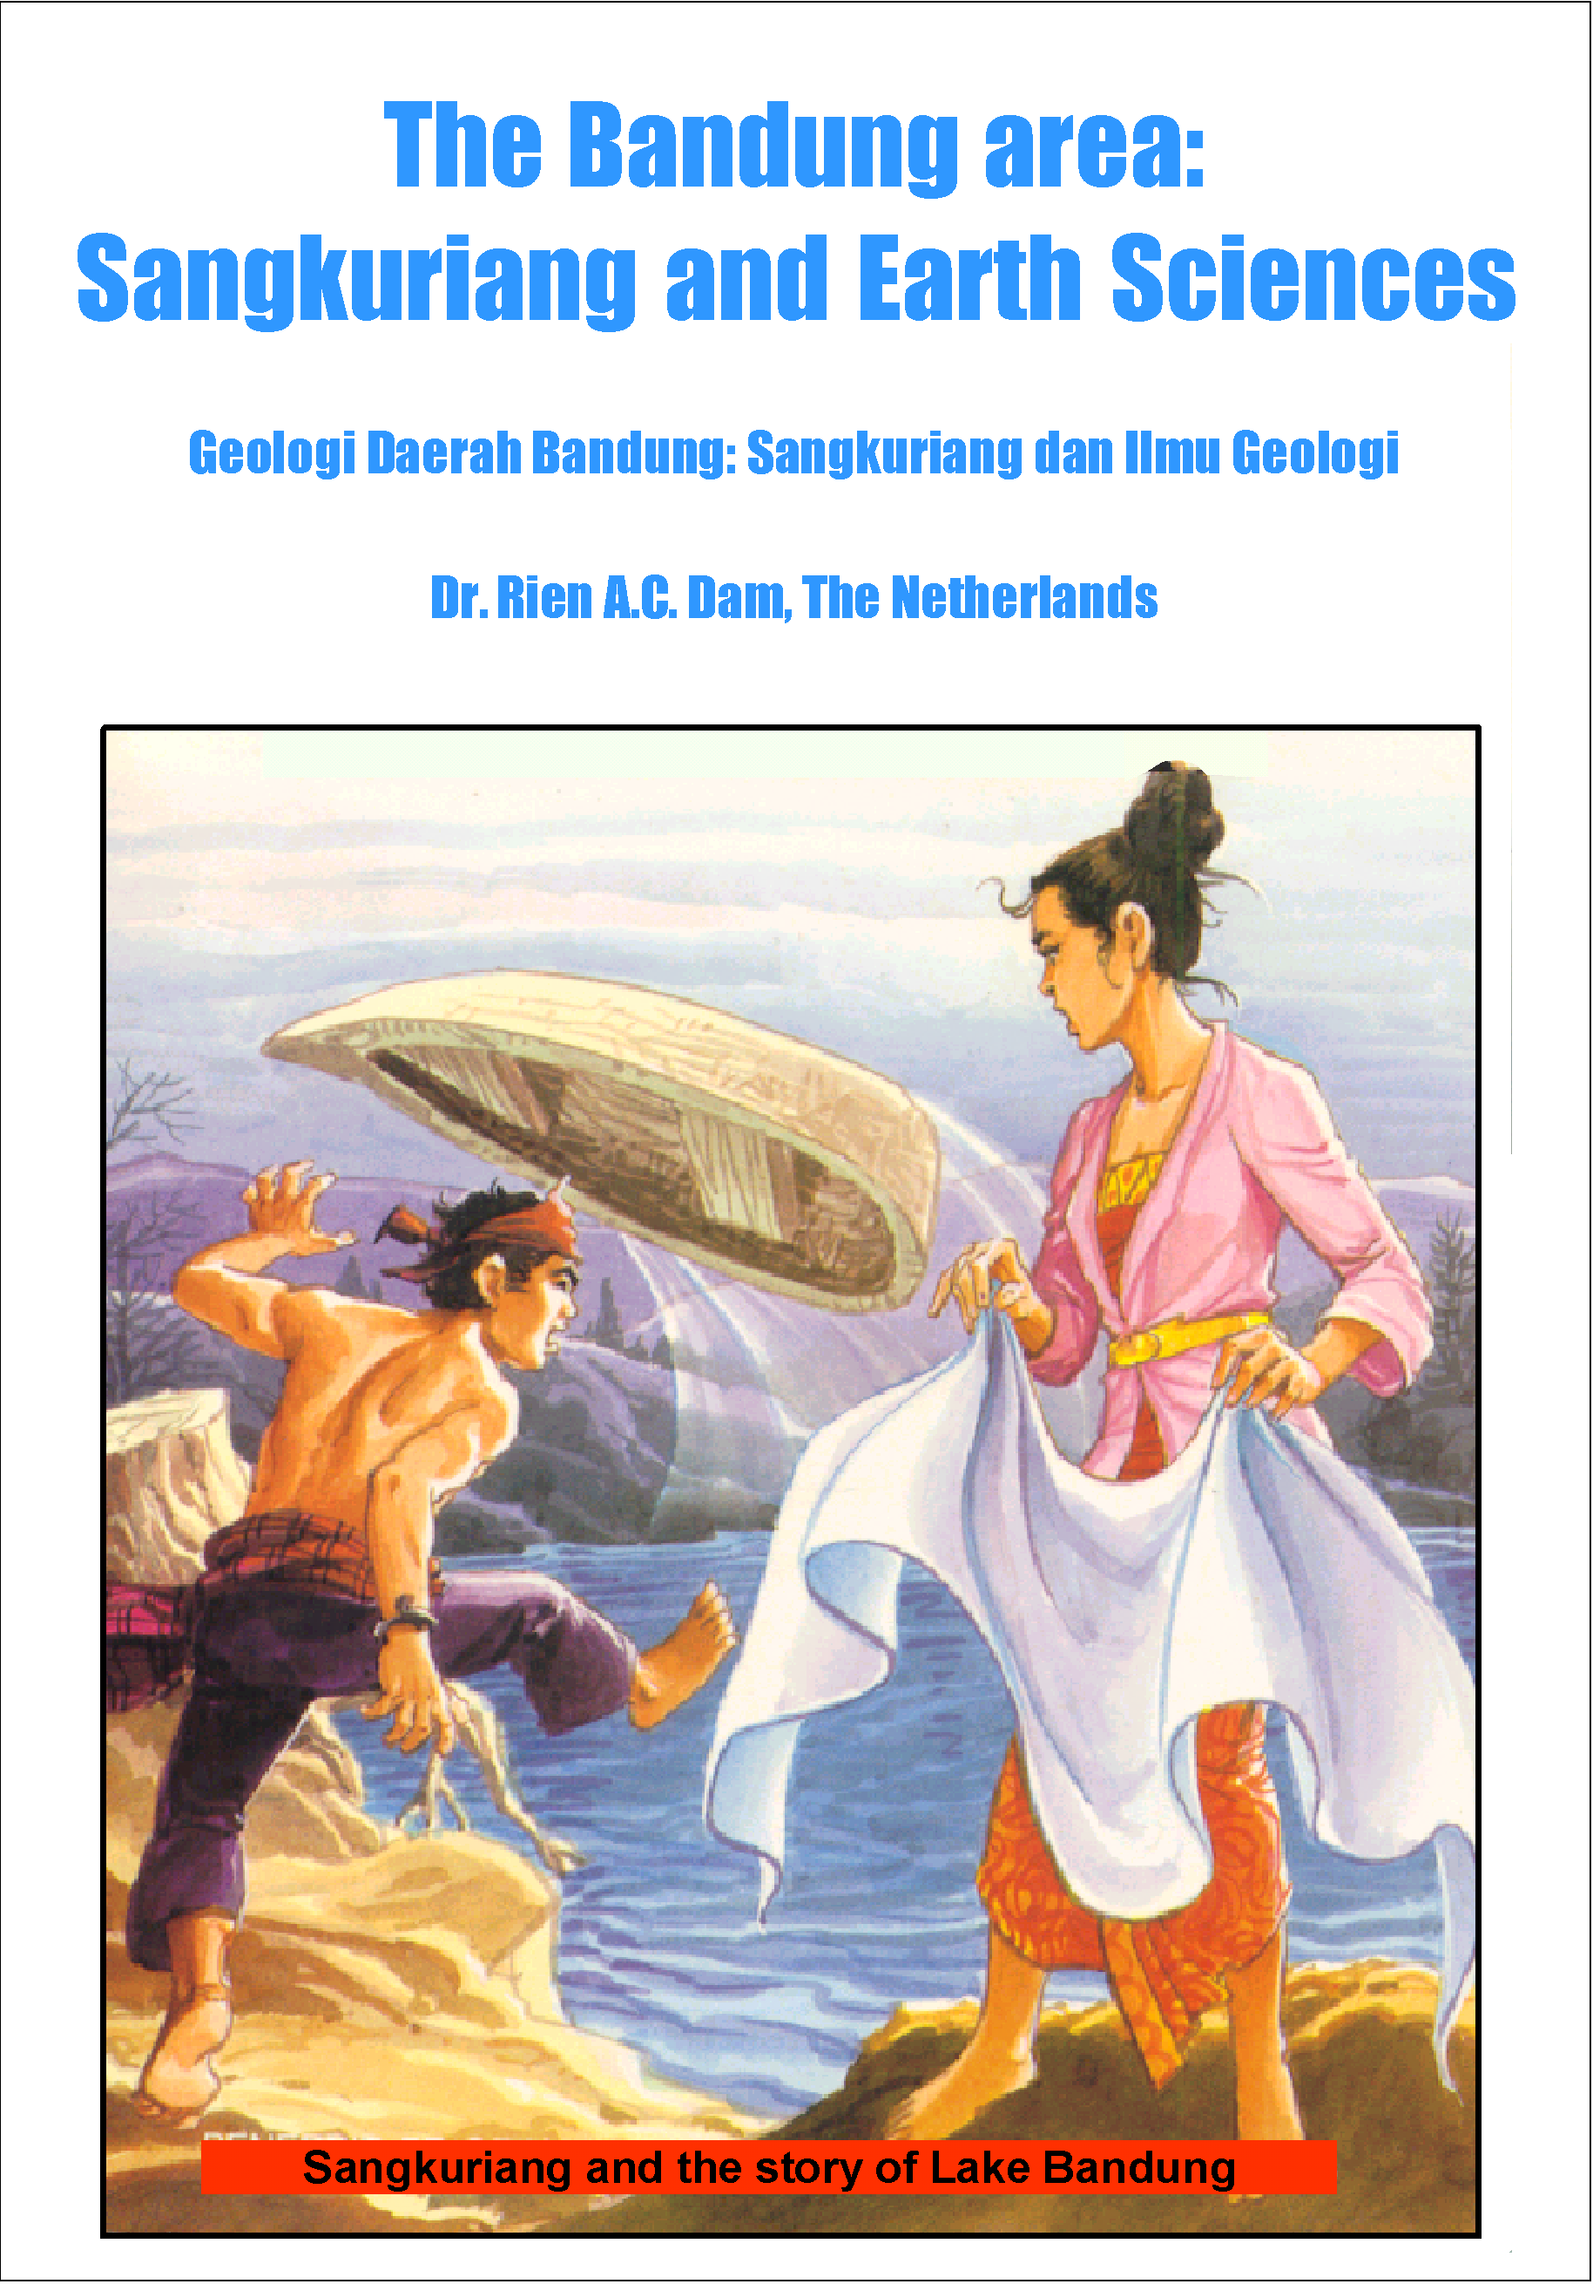
Geological overview Bandung basin –studies 1986, 1989-1993
Integration of geological data, Regional scale – regional use – Quaternary mapping - Geoscientific

Slide 3
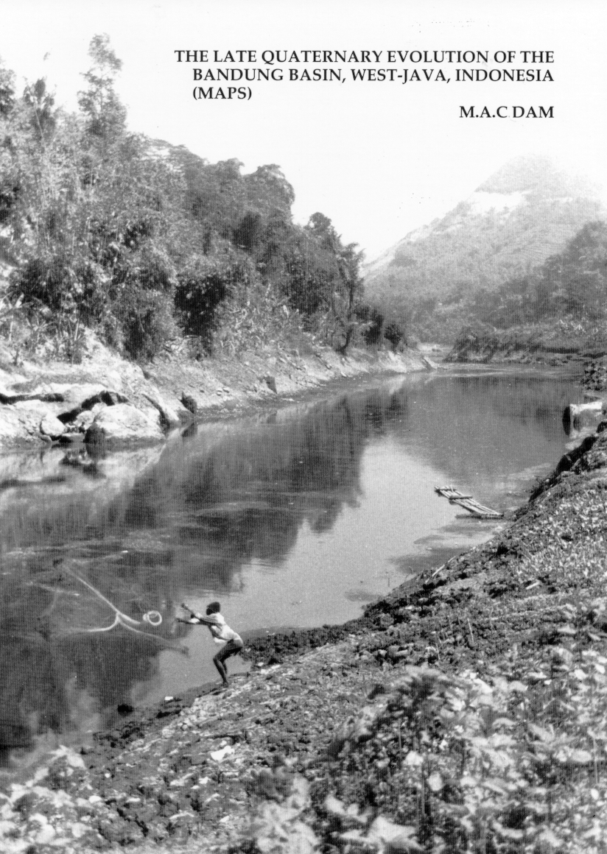
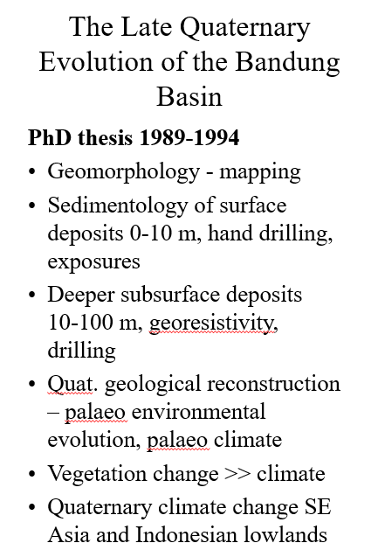
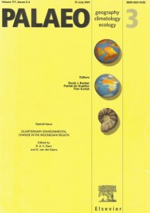
My PhD research: Bandung basin (1989-1994); 1996-2001; Other locations (Rawa Danau, Banten; Lake Tondano-Manado; Halmahera –Teluk Kau; Kepala Burung, Irian Barat; QUTERNARY ENVIRONMENTAL CHANGE IN THE INDONESIAN REGION

Slide 4
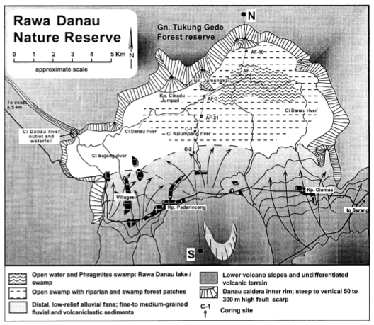
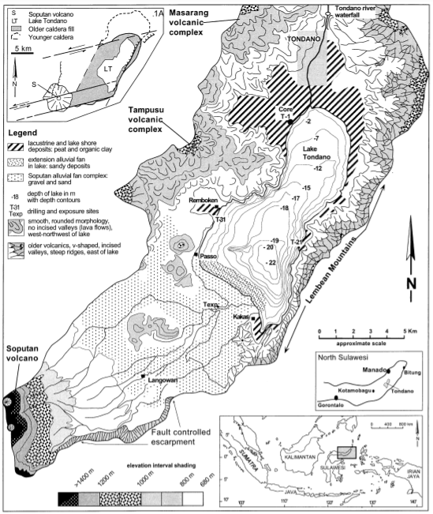
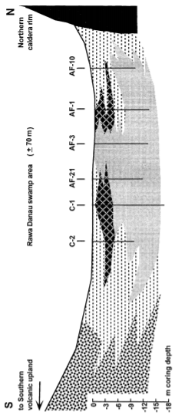

Slide 5
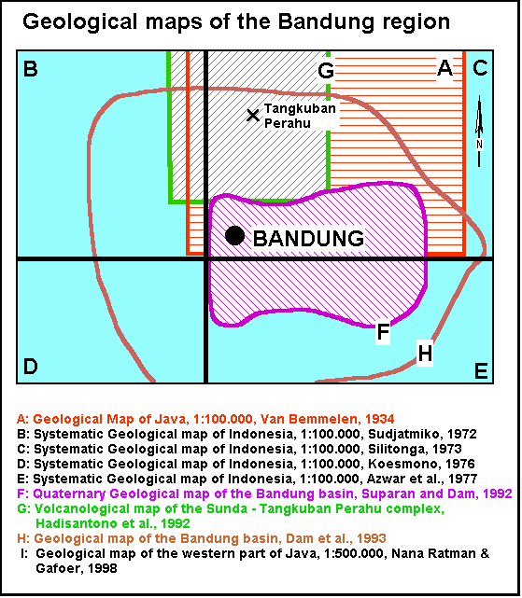
Geo-information
Old days
Tradition of geological map making
Systematic mapping – Formations
Progressive insight – changing
objectives
Very selective user group
Geoscience anno 2021
Different societal needs
Advanced methods of data integration and visualization (GIS, models, use Cloud working)
Demand driven studies – solutions
Various stakeholders needs

Slide 6
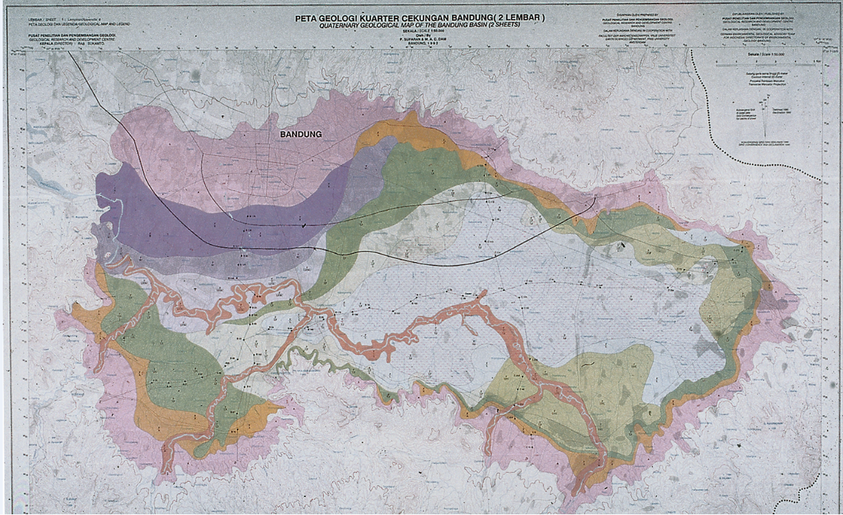
Quaternary Geological Map
Bandung basin 1: 50.000, 1993
Integration of geological data
Regional scale – regional use
Geoscientific

Slide 7
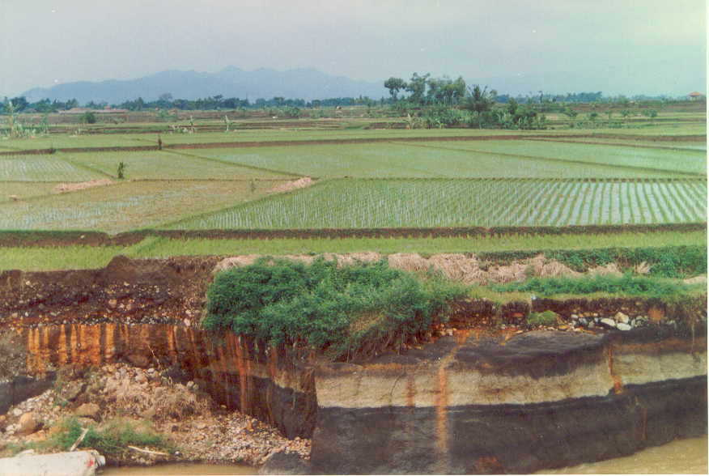
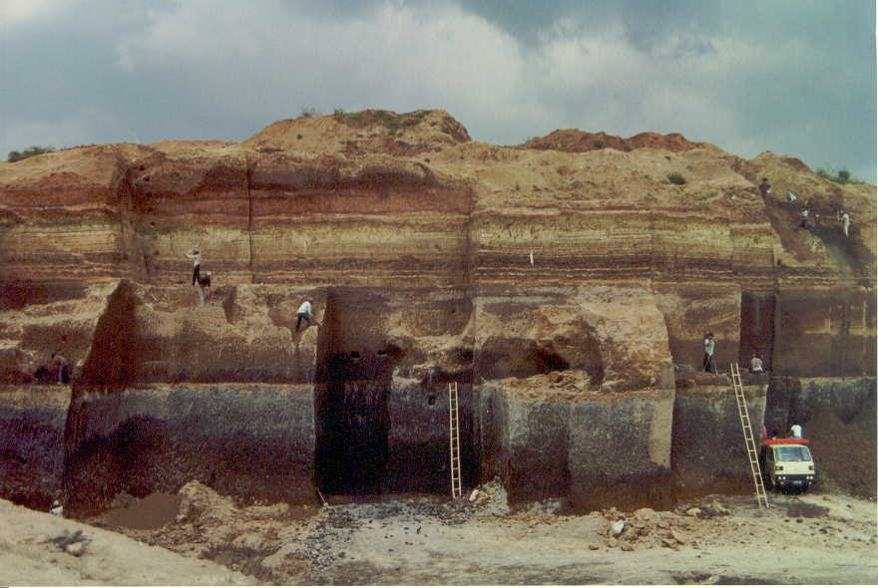
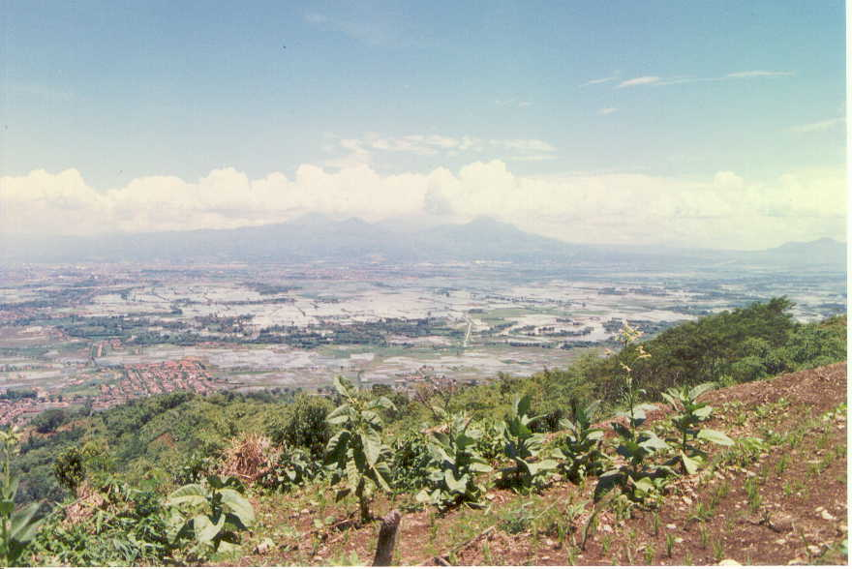
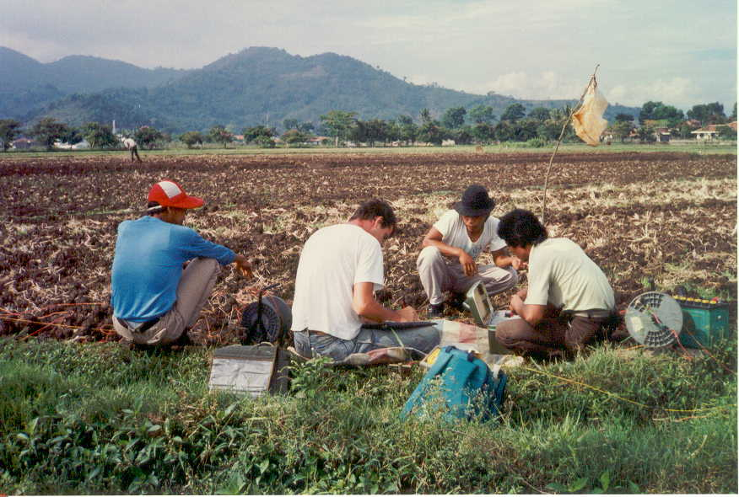

Slide 8
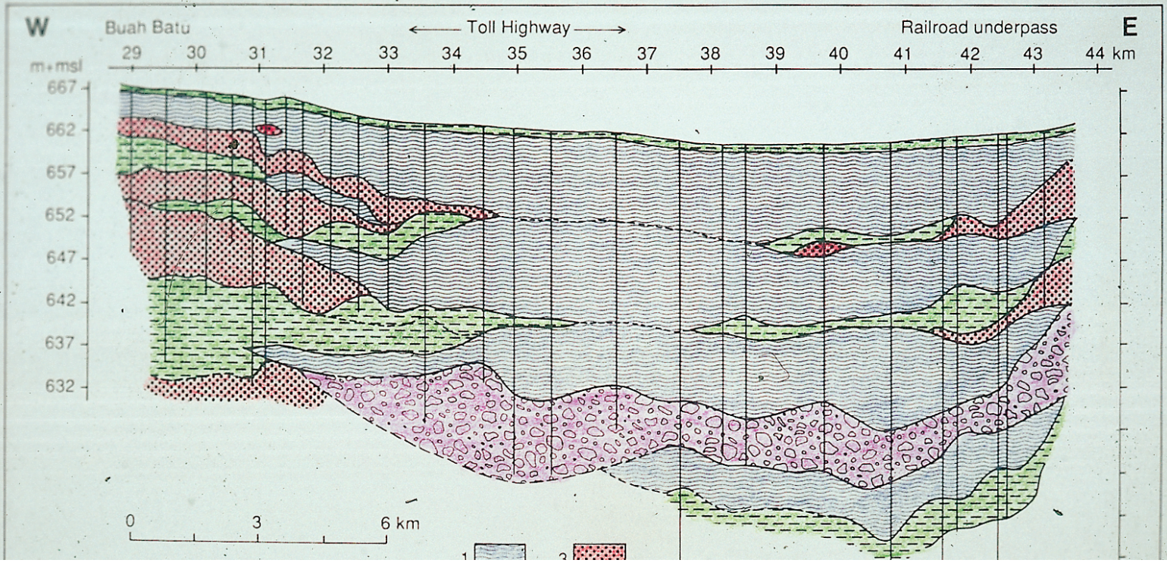
Basin fill – geology, west to east , upper 50-60 m
50 m thick, nearly continuous sequence of lake deposits – very good environmental
record – sediment lithological, palynological, geochemical analysis, dating, integration

Slide 9
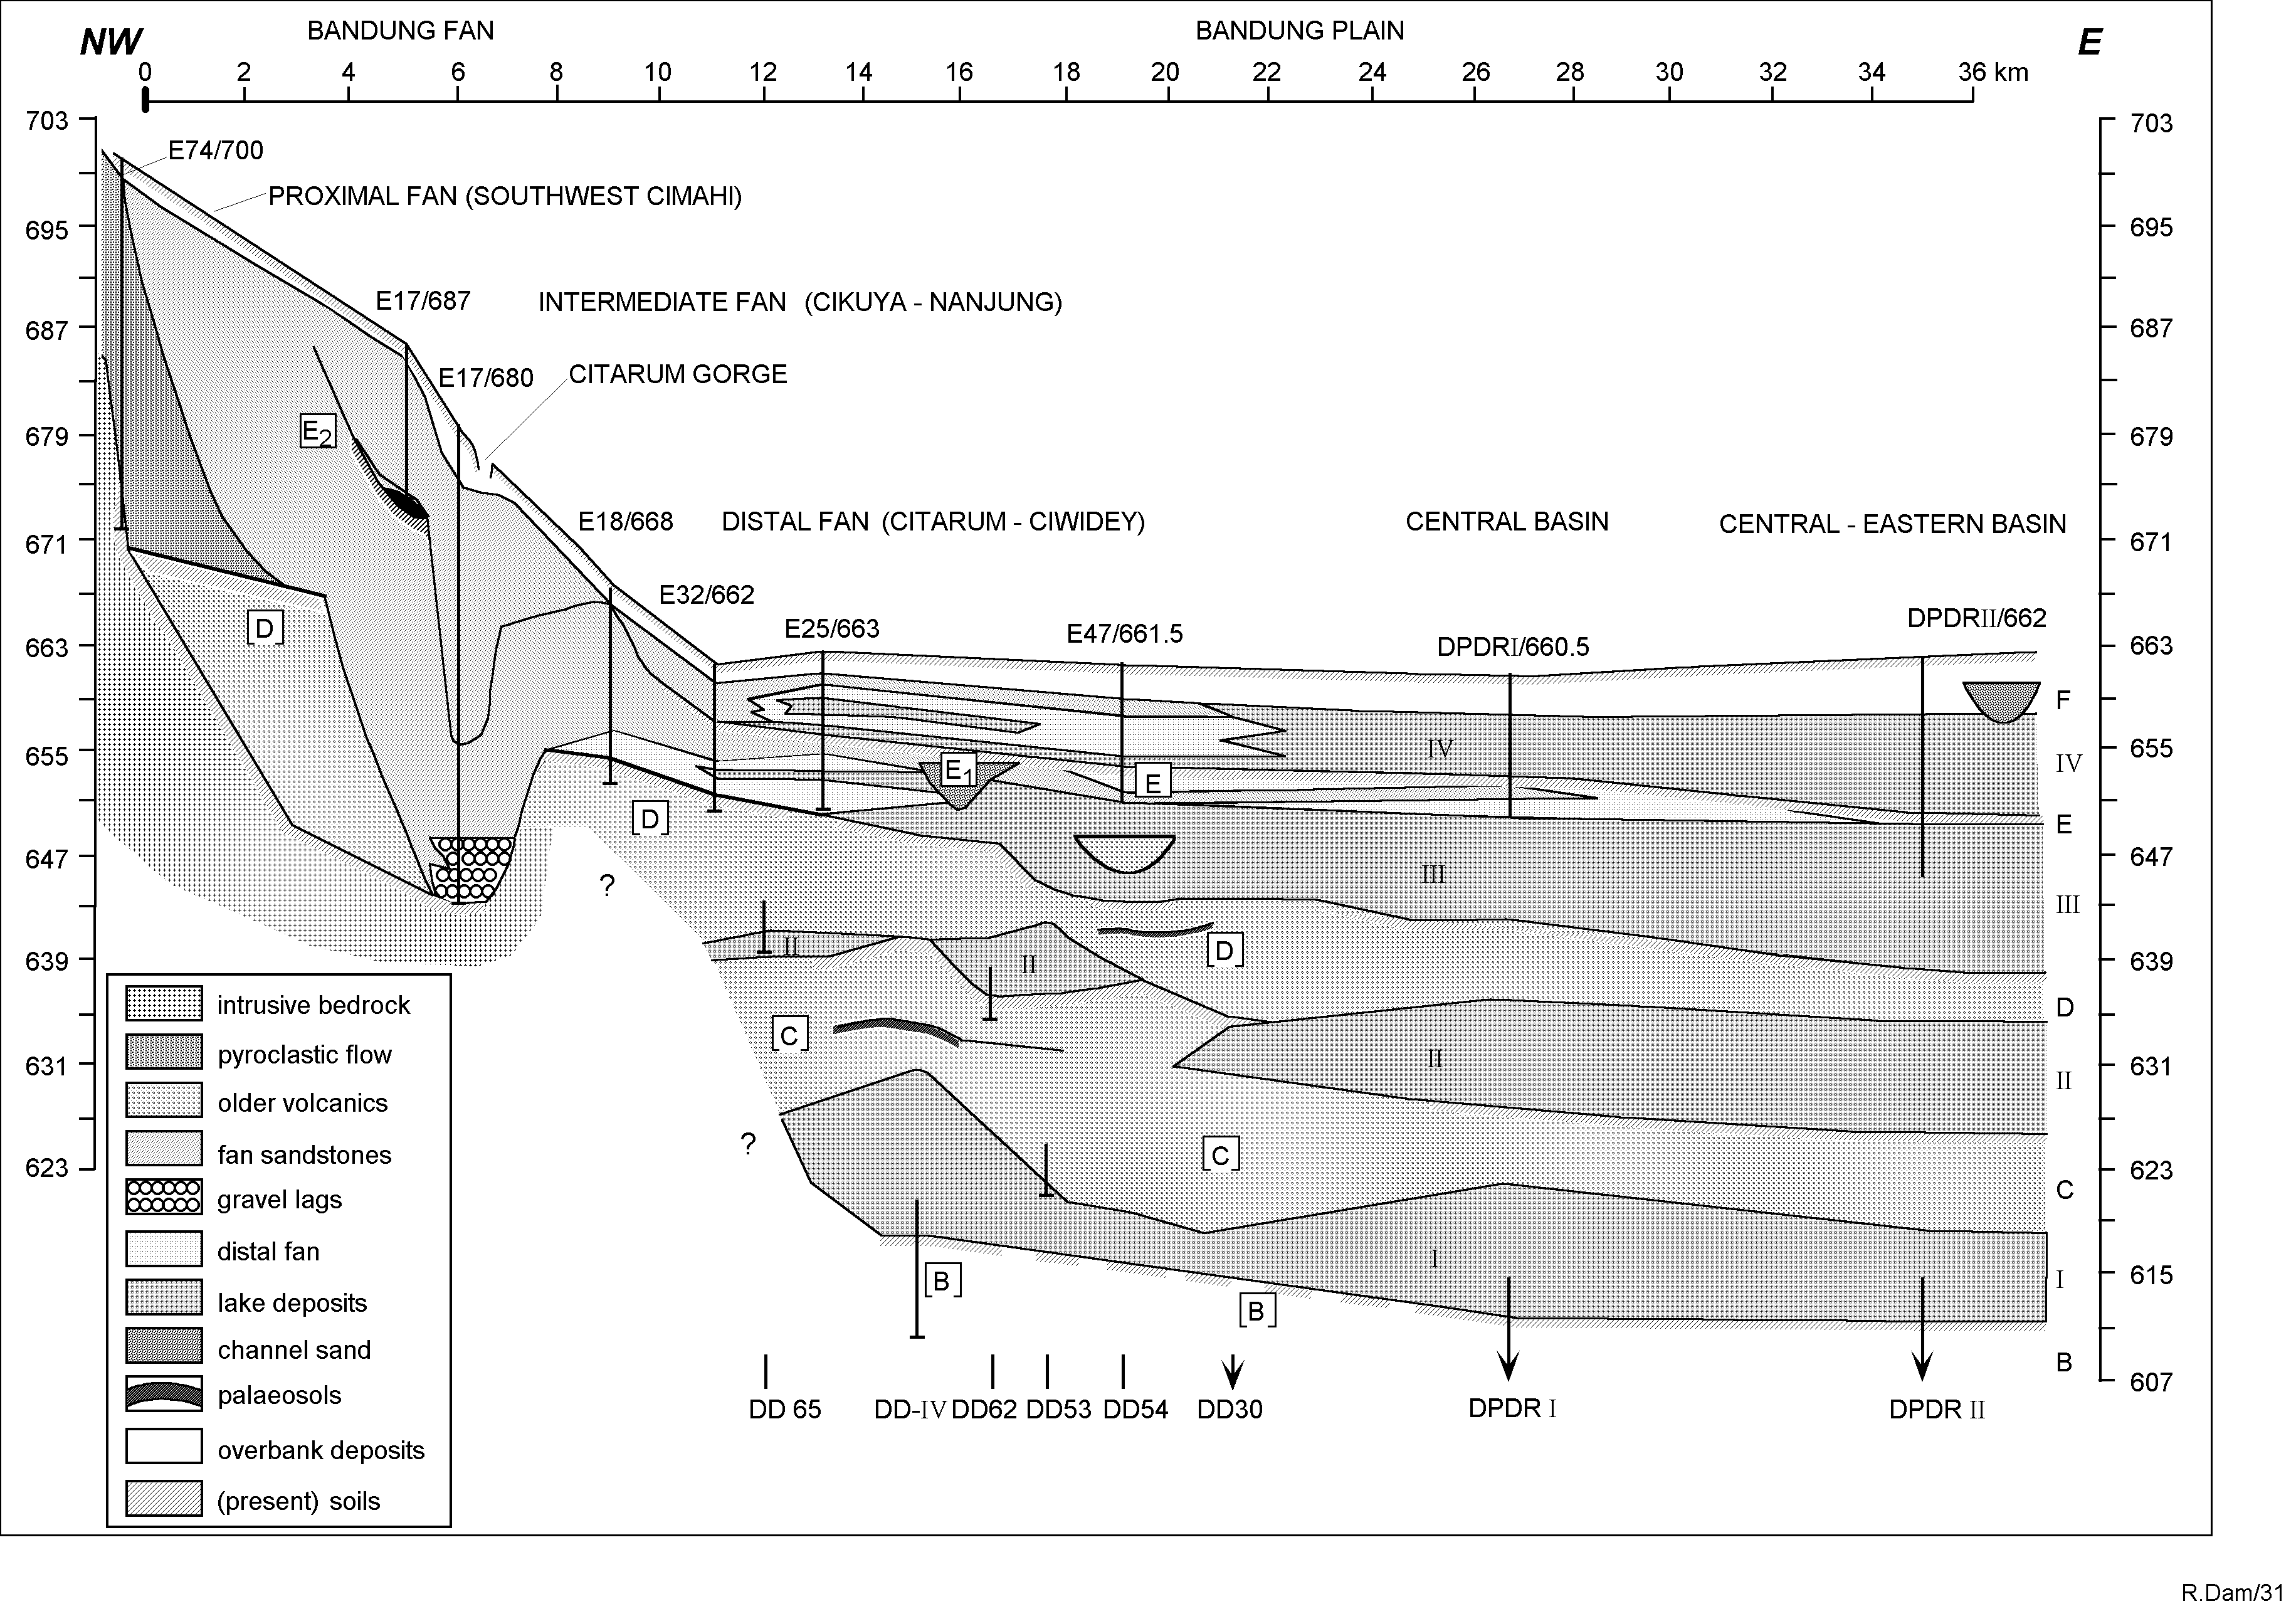
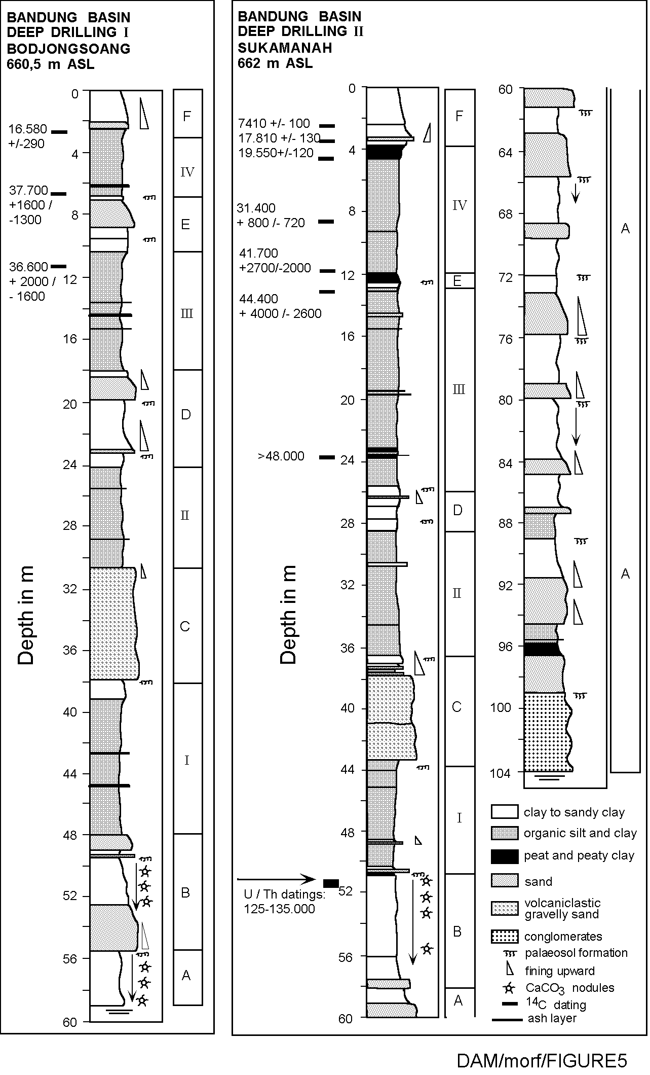
Integation of geological data (exposures, drilling, analysis

Slide 10
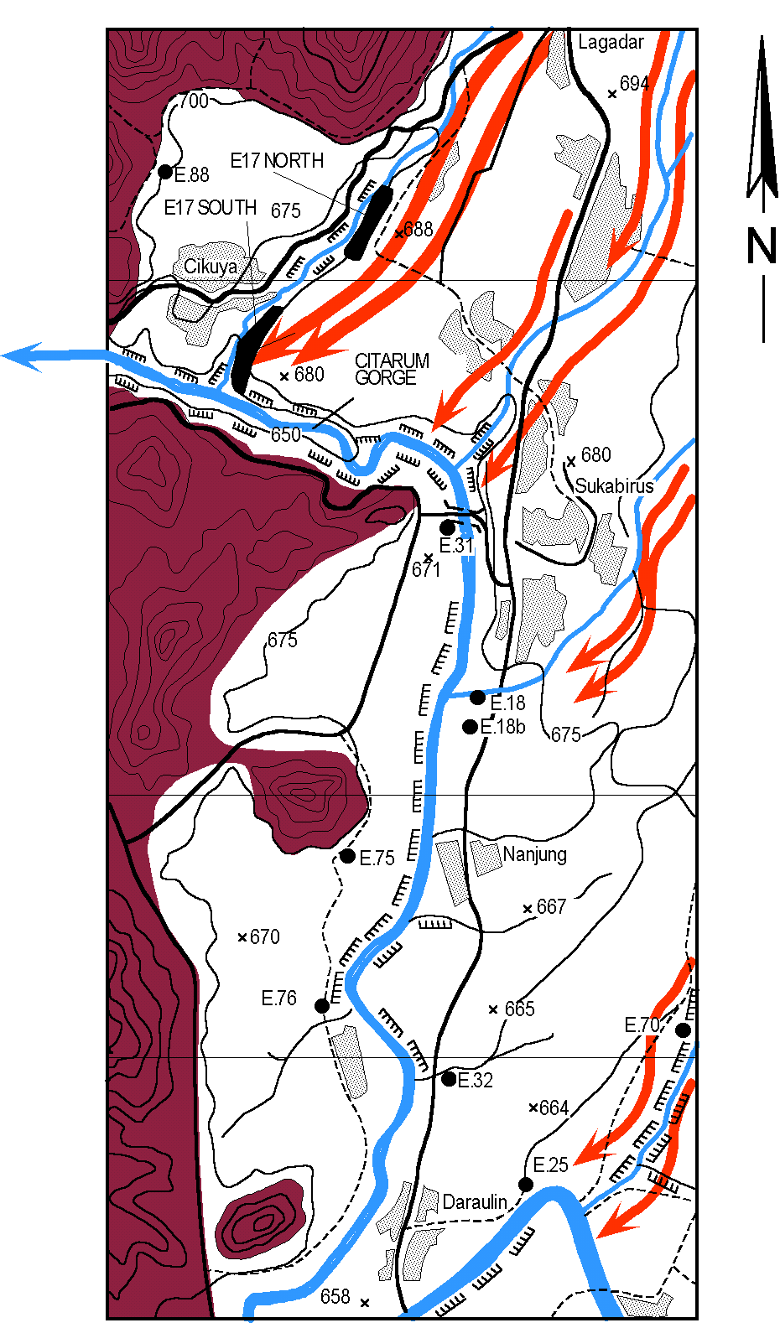
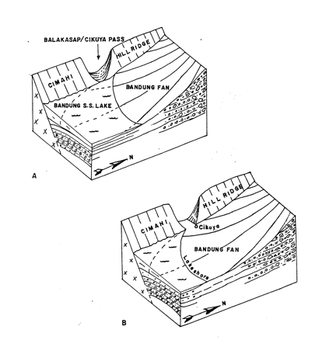
Nanjung-Cikuya – Citarum gorge
Curug Jompong waterfall
Bandung basin drainage – geomorphological
barriers – Citarum river to west - Batujajar
Citarum gorge + Curug Jompong
Waterfall control water levels
Major volcanic event. Sunda /
T. Perahu >> volcanic fan formation
Citarum gorge blocked >>
>>> drainage impeded
>>> lake levels rising
>>> delicate balance;
-water flows (hydrology)
-erosion/sedimentation
-sediment compact/subsidence
-basin structural formation

Slide 11
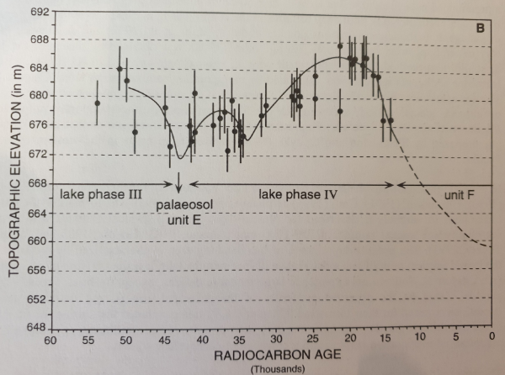
Bandung Basin: complex Quaternary basin, landscape
development, sedimentation – lake level history
Current Bandung Plain around 660 m amsl; below 660 m series of lake deposits 50 m thick
Bandung basin used to be filled by a lake
Evidence for high lake levels (690 m amsl)
Basin is essentially structurally determined,
with fault control north and south
Compaction of the sequence of lake deposits
from 20,000 yr BP till now (20 m ?)
Fault-controlled basin subsidence during
longer period – Quaternary structural activity
ongoing till now
Important geoscience information !!
High lake levels ?
Low lake levels ?

Slide 12
Topographic base Bandung basin & deformation
Subsiding basin
as a depocentre
for Quaternary
deposits
Structural
controls N & S
of the basin
Central basin
sediment
compaction &
subsidence

Slide 13
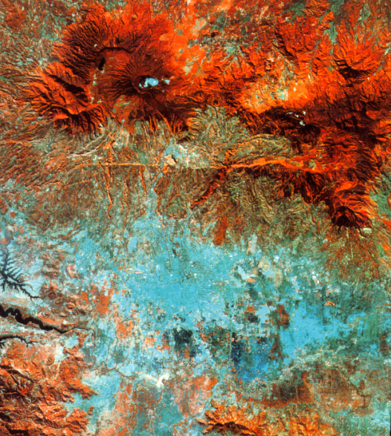
Land Subsidence and
the Use of Geological
Information
Case studies of land subsidence - Bandung, Jakarta, Semarang, Pekalongan
Geoscientist role to investigate and understand this complex geological process
Management and presentation of geo-information
From scientific analysis to informing stakeholders
A message for the geoscience community in Indonesia to provide state-of-the-art and useful geological information to (local-regional level) decision-makers and the general public.
Notes:
Land Subsidence is a widely recognized and fairly well understood geological phenomenon. Geoscientists and other experts are monitoring it, try to explain it and point out the impacts and importance of mitigating it. In Indonesia, we are now familiar with well-know cases in Jakarta, Bandung and NORTH COAST OF Central Java (Pekalongan-Semarang). There are various methods to detect land subsidence, and different ways to present the findings. Sometimes land subsidence is called the “hidden problem” because indeed, it takes place underground and out of sight, there is no clear “owner”, and it is not always clear who or which agency is responsible for resolving it. Nevertheless, there are many stakeholders that have to deal with the impacts and problems caused. Besides reliable and accurate ways to monitor land subsidence (for instance by using InSAR satellite methods), it is important that clear, easy-to-understand methods are used to present data and inform stakeholders about the impacts of land subsidence. This not only applies to land subsidence; also information about other geological features and processes (sometimes serious hazards that are common in Indonesia) has to be available and presented in an accurate and understandable way, both to the geoscience community, as well as to the general public and decisions-makers.

Slide 14
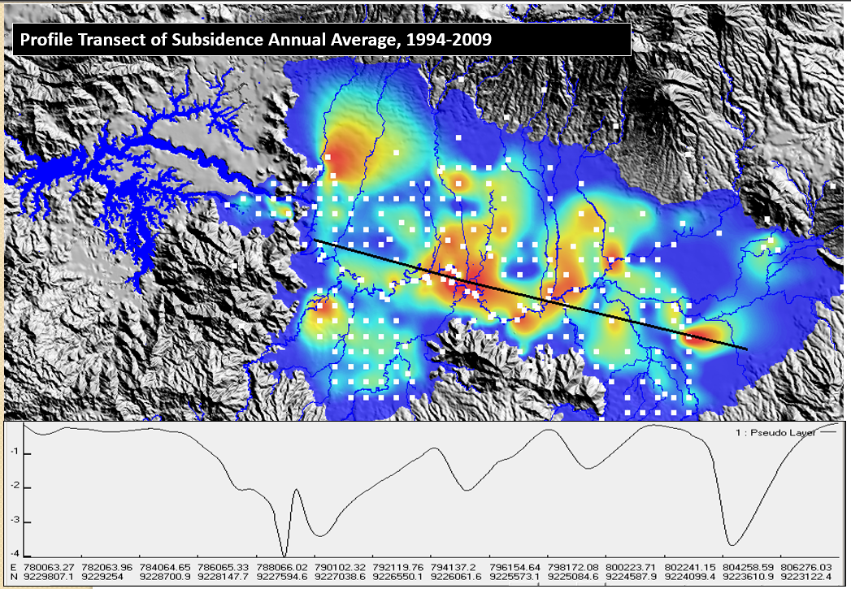
Recent geodetic
studies confirm
the ongoing
subsidence:
Flooding
Damage to
structures
But integration of
data and new
studies needed to
Really understand
the problem and
support regional
development
Abidin – Andreas, 2009

Slide 15
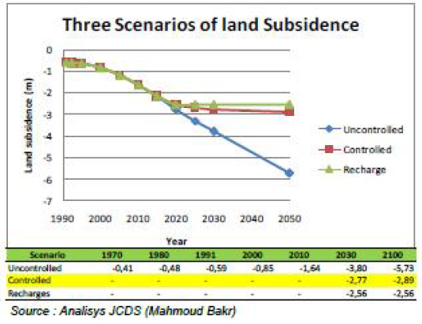
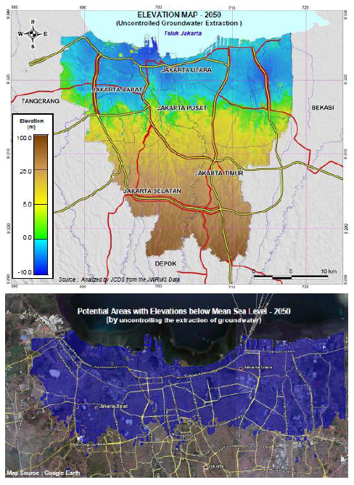
Land Subsidence Jakarta (initial data - early analysis)
LS data linked to groundwater
extraction, but disputed

Slide 16
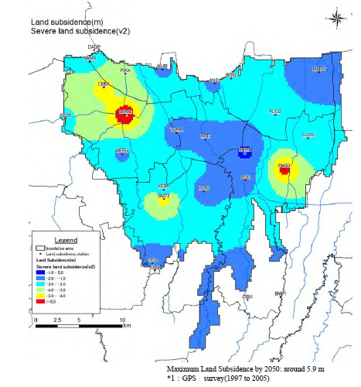
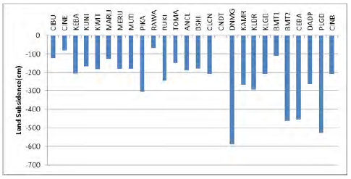
JICA, 2012
Figure shows the estimated land subsidence until 2050.
The amount of land subsidence
varies from 0.7m up to 5.9m.
Land subsidence data are used in flood forecast model
Notes:
Very technical - academic

Slide 17
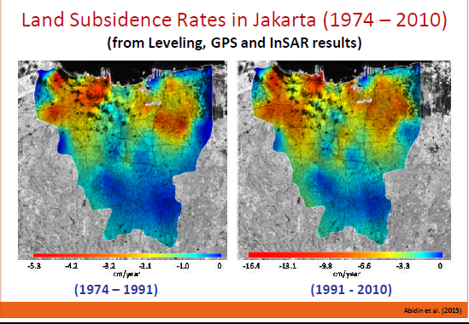
Land Subsidence Jakarta (Abidin, Andreas, others)
Integration of
different data:
levelling, geodetic,
InSAR, modelling
Very important
progress in
communicating the
urgency of the
problem and
underlying data

Slide 18
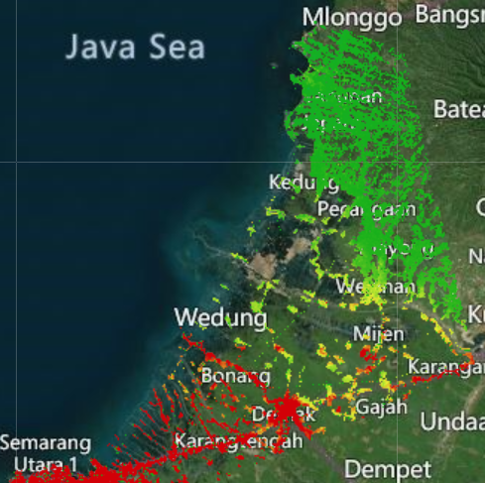
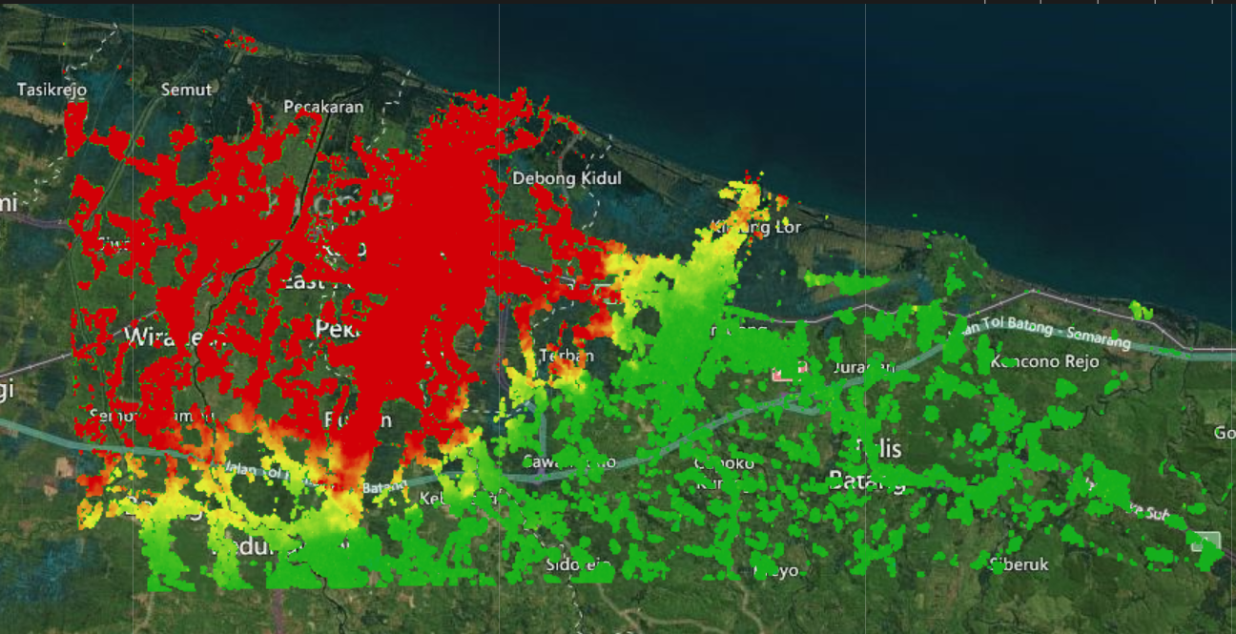
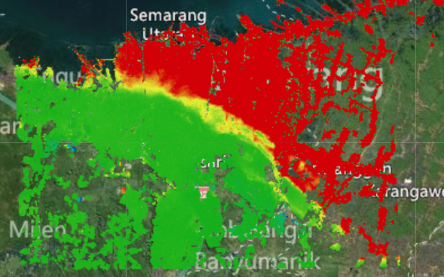
Land Subsidence InSAR study
Central Java - ongoing work
(flood mitigation – coastal zone
management )
Pekalongan area, 2021
Semarang & Demak area

Slide 19
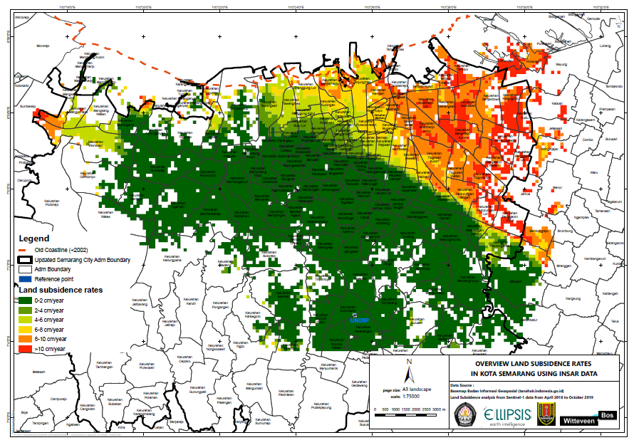
InSAR based
Land Subsidence
analysis results for
Semarang area
(part of Water
Management
Semarang project.
Land Subsidence
has major
implications for
water management
and coastal safety

Slide 20
First impressions of InSAR land subsidence data set for Pekalongan
Time period analysed: November 2015 to March 2021
Areas without houses – infrastructure = no reflectors = no data
Massive subsidence in western and city area, quickly ending in eastern area
LS extends south-southeast to around Toll road, then it stops (consistent with the geology)
Highest rates observed in central Pekalongan, > 16 cm /year, large areas with >10 cm/yr average LS.
Detailed analysis required
Analysis
Change the colour coding
In GIS, interpolation of points to get 100 % coverage (blank spaces also get a colour
Contour lines of LS rate, calculation of surface areas
Cumulative subsidence
Construct several profiles west – east (2x) and north south (2x)
Correlation with 1) geology, 2) GW wells, 3) GW levels in the subsoil
Extrapolation of current DEM to future DEM
Explanation wiggle curves (seasonal GW dynamics ??)

Slide 21
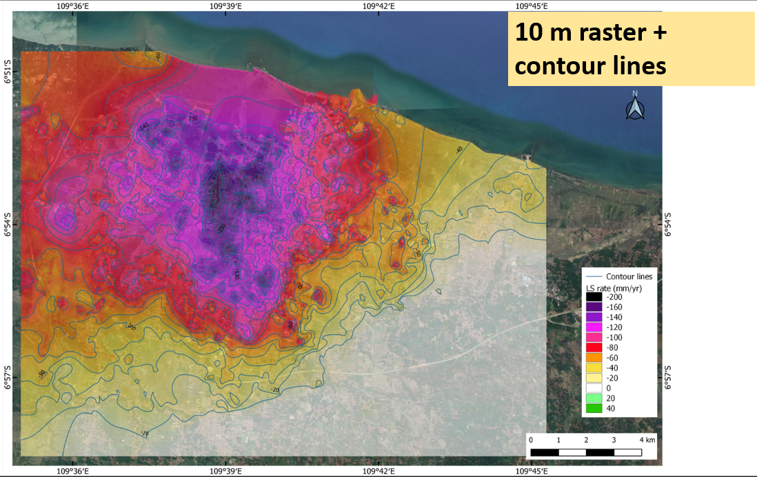
First impressions of InSAR land subsidence data set for Pekalongan
Time period analysed: November 2015 to March 2021
Areas without houses – infrastructure = no reflectors = no data
Massive subsidence in western and city area, quickly ending in eastern area
LS extends south-southeast to around Toll road, then it stops (consistent with the geology)
Highest rates observed in central Pekalongan, > 16 cm /year, large areas with >10 cm/yr average LS.
Detailed analysis required

Slide 22
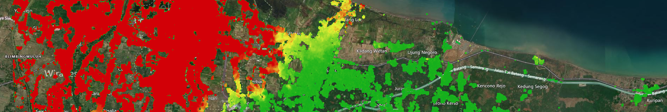
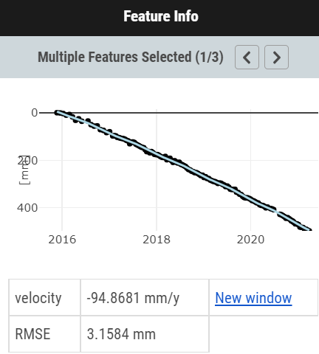
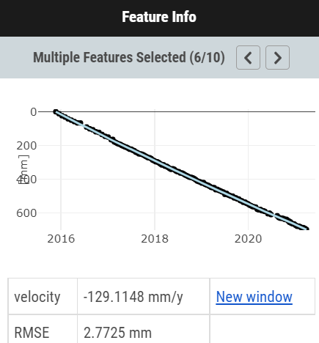
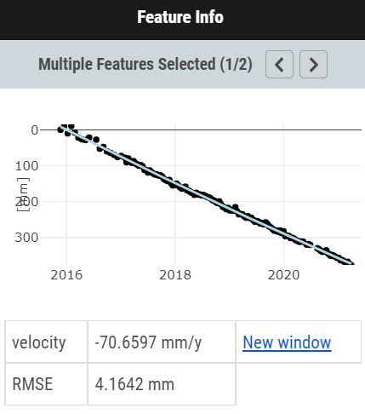
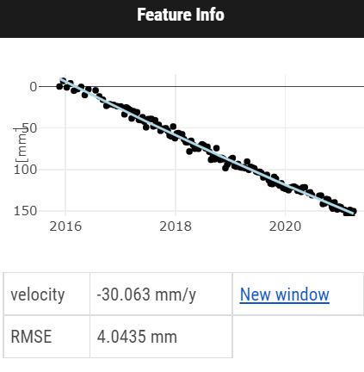
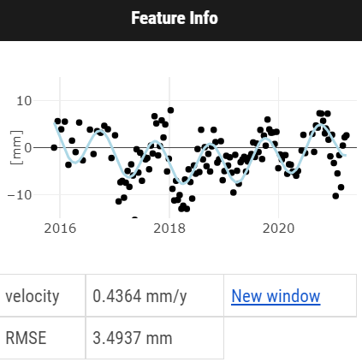
Subsidence trends West – East section
Bondansari:
9.5 cm/yr
Yosorejo 2
12.91 cm/yr
Denasri wetan:
7.1 cm/yr
Kasepuhan:
3.0 cm/yr
Kencono:
0.043 cm/yr

Slide 23
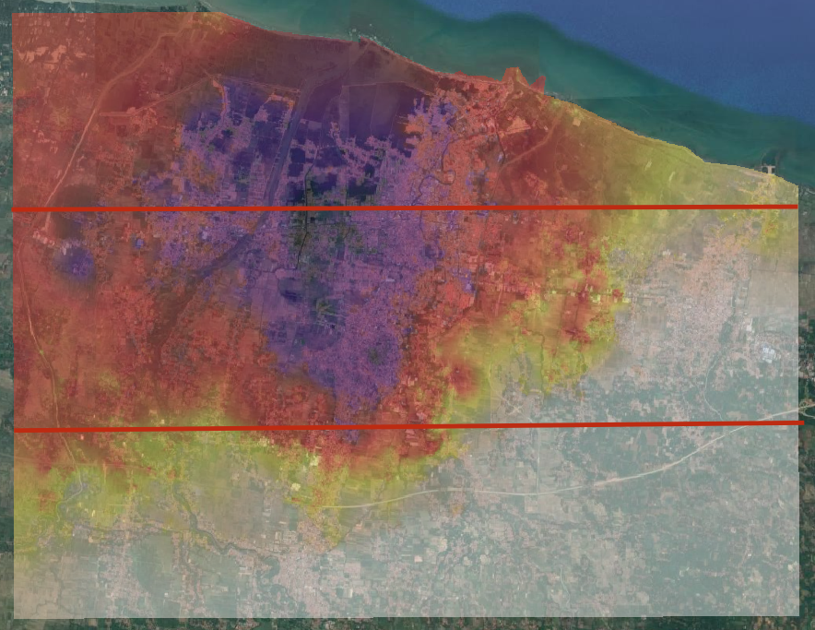
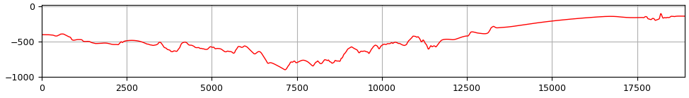
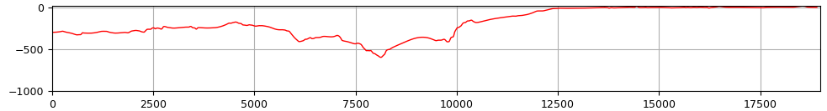
Pekalongan: Cumulative 5 years LS
January 2016 – January 2021
4
Large areas in Central city have LS of >80 cm in 5 years !!
5
West
East
4
(mm)
Distance from west (m)
5
(mm)
Distance from west (m)

Slide 24
Land Subsidence Information Pekalongan & Semarang – ongoing work
Land Subsidence has major implications for urban water management & coastline management
Land level changes in 5, 10, 20 years → urban floods (rain, river, rob)
Deformation / damage to vital infrastructure (roads, sea wall, sluices, bridges, port infrastructure )
Water supply options
Use of groundwater to be reduced /phased out; where to find new water sources ?
Land Subsidence in Central Java coastal zone
Important threat to sustainable coastal development & safety
LS data in ICZM database for regional planning and decision-support

Slide 25
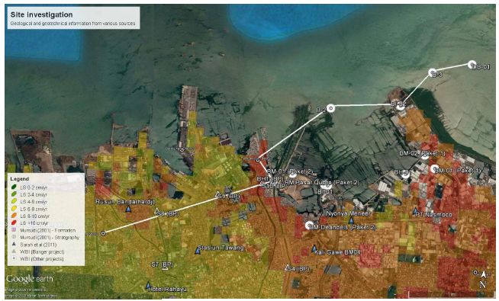
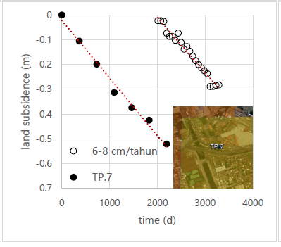
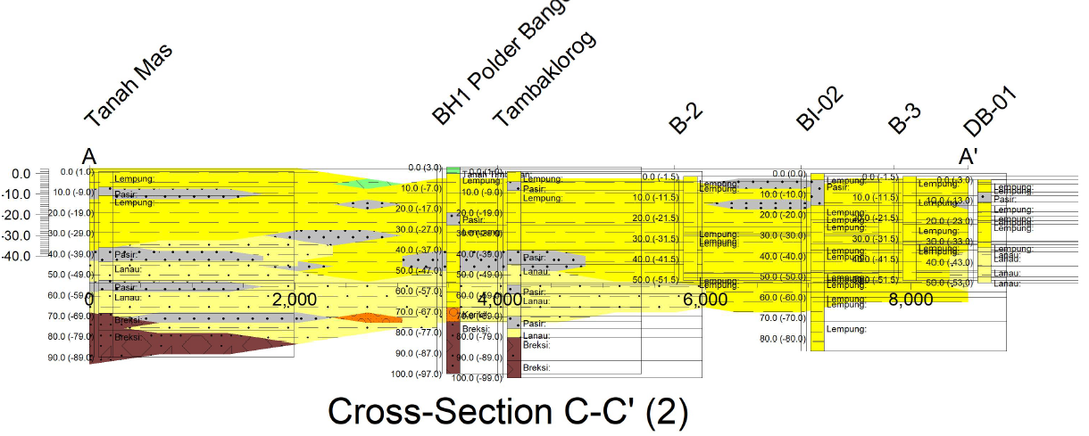
Supporting geological
data to understand and
mitigate land subsidence
- accurate DEM
- detailed borehole data
- groundwater data

Slide 26
Message
Land subsidence is a tricky issue, but by using modern tools
(satellite-land based; data integration, etc. we can increase data
capture and understanding to solve or mitigate
Modern society needs modern geoscience data:
Integrate local-regional geoscience information, using modern
data integration and visualization methods like GIS, modelling
and cloud based data portal
Geoscience information is Geo-business; local stakeholders
need local/regional tailor-made information (Kota-Kabupaten
Plenty of scientific challenges

Slide 27
Geologi Cekungan Bandung dan potensi riset masa depan
InSAR satellite based Land Subsidence analysis of the Bandung basin area
Integration with earlier geodetic surveys (ITB !), geological information basin sediments and
information concerning groundwater extraction
Reliable Land Subsidence model; implications of groundwater use; flood management
& infrastructure risk assessment >>>> important societal issues
Bandung basin sediment record is still one of the few Late Quaternary environmental arsip
Need to be researched, upper 20 m: 35,000 to Present; valuable climate & environmental information, very unique in SE Asia and Indonesia
Structural development of the basin still not very well understood
Geoscience information for regional development is urgently needed

Slide 28
Have a look at my website for further information
Rien Dam geological papers http://waterlandexperts.nl/
PDF of complete PhD Thesis (1994); on request
or sent e-mail for PDF
Rien.dam@outlook.com
Thank you for your attention

