Slide 1

Joint Statement about future ambitions
Transition Ceremony, 23 June 2021

Slide 2

FAIR is both a destination and a journey
Vision
Towards an Internet and Web of FAIR data and services:
‘One Computer and One FAIR Data Set 4 all’
Mission
Contribute by making explicit FAIR-related implementation choices and pioneer realisations
Strategy
Community Driven, ’Get Things Done’, Open Learning by Doing, Pool Resources, Actively Drive Convergence of Competences and Knowledge, Avoid Re-inventing the Wheel
* June 2021, based on transition meetings of the executive board and the existing and emerging offices
… worth every step of
the way!

Slide 3
Global Open FAIR - Changes happen
Transition Ceremony, 23 June 2021

Slide 4
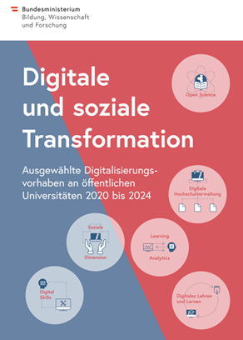
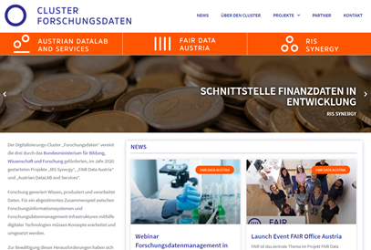
Servus! AUSTRIA
Currently, a very dynamic situation at Austrian RPOs for infrastructure/tool/service/ support development
Funding of 35 innovative, digital projects in academia by ministry of science between 2020-24
Implementation of data stewardship
Aim: We want our researchers to be aware of the great potential of the new technologies and to be able to exploit them!

Slide 5
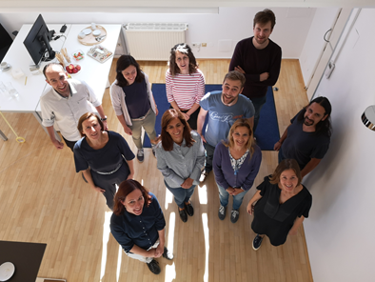
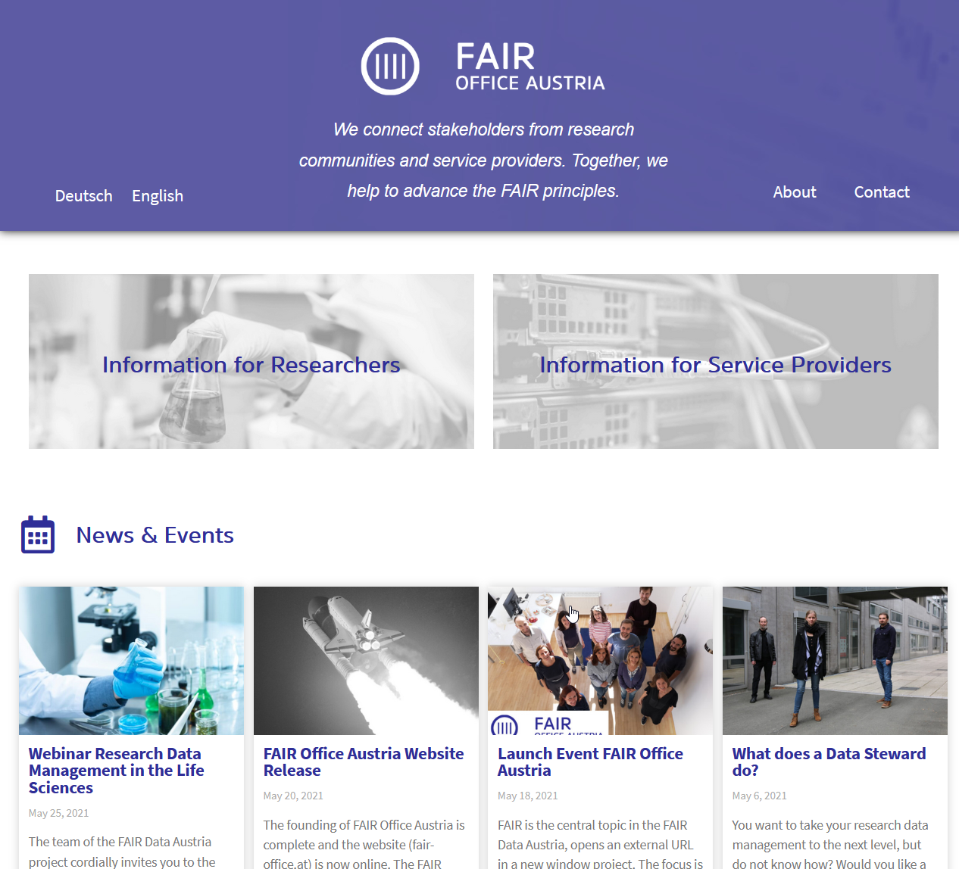



Servus! AUSTRIA
Mission:
“We connect stakeholders from research communities and service providers. Together, we help to advance the FAIR principles.”
https://fair-office.at/
contact@fair-office.at
FAIR Office Austria Consortium in implementation phase: 3 universities
Launch Event on June 9th
Embedded within „FAIR Data Austria“ project until end of 2022
Scalability is envisioned and desired
Notes:
tasks, competences and responsibilities recently
Misson Statement?
Training extra erwähnen?

Slide 6





Servus! AUSTRIA
The founding consortium brings:
Planned activities:
Build FAIR enabling infrastructure
Get the Austrian community involved
Organize meetings, involve ICT experts
Facilitate involvement in INs
Provide trainings on FAIR and Data Stewardship
Contribute to FAIR knowledge building
Collaboration in Data Together/RDA and EOSC Mandated Organization

Slide 7





Bom dia! BRAZIL (1 of 2)
The Brazilian Institute of Information in Science and Technology (Ibict) is responsible for the GO FAIR Brazil Office, which has a joint governance model among some Brazilian institutions
We are used to joint coordination!
Activities are organized according to the 3 pillars (change, build, train) and executed within thematic networks, e.g., Health (Fiocruz), Nursing (Unirio), Humanities (Ibict), Teaching, Science, Technology and Innovation (Capes), Nuclear Sciences (Cnen), Agriculture (Embrapa), Biodiversity (Rio de Janeiro Botanical Garden)
Support INs to define FAIR implementation strategies in cases where they do not exist;
Systematize and disseminate guidelines, ensuring consistency with the FAIR principles;
Maintain constant communication with other GO FAIR national offices and INs

Slide 8

Bom dia! BRAZIL (2 of 2)
GO CHANGE
GO-FAIR Brazil Governance: robust coordination with operating rules
Join Forces with Aligned Initiatives:RDA Brazil, DataONE, Dataverse, TDWG, Godan
Funding Agencies: support from the main funding agencies at the national level (Capes & Cnpq)
Universities & Education: training for BSc, MSc, and PhD students and early career researchers
Implementation Networks: health, nursing, agriculture, and growing...
GO BUILD
Network of research data repositories (OasisBr)
National literature repository network connected to LattesData, Aleia & BrCris
New assessment mechanisms, where interoperability of data repositories has a key role
Use cases experimentation with FAIR Data Points: VODAN-BR, BrCris
GO TRAIN
More than 50 trainings carried out (2019-2021), including workshops and seminars
Launch of book "FAIR PRINCIPLES APPLIED TO RESEARCH DATA MANAGEMENT”
Virtual Library on Research Data Management and FAIR Principles

Slide 9
大家好！CHINA
Computer Network Information Center, Chinese Academy of Sciences, is responsible for the Research Data infrastructure development and maintenance, and running the CODATA-China Office.
CAS research data infrastructure will be improved in the next five years, and FAIR principle and related specification will be adopted
FAIR Data network is a key pillar of GOSC initiative, which funded by CAS and CODATA. A IPO is planning to establish, which might coordinate GO FAIR issues in China and even in East Asia
Organize a series workshops and communication events to promote FAIR principles and specifications to be adopted
Co-develop tools for FAIR implementation and joint establish the testbed and showcases
FAIR Data skills training

Slide 10
God dag! DENMARK (1/6)
DeiC coordinates the Danish e-Infrastructure as an umbrella organisation for the eight Danish universities.
In our Data Management (DM) team we currently have special focus on:
Facilitating and coordinating national work on FAIR strategy and implementation
DM competence building; Data Stewardship (DS); M4M; Research Software
DM e-Infrastructures, covering the whole data life cycle
International cooperation, including GO FAIR, RDA, EOSC, EUDAT CDI, Knowledge Exchange
Soon launching our National FAIR Data Strategy
In pursuit of better DM based on the FAIR principles we believe in international cooperation, on the concrete knowledge, tools and e-Infrastructure level.

Slide 11
God dag! DENMARK (2/6)
DeIC supports the strengthening of FAIR data related cooperation within the framework of GO FAIR and the proposed International Support and Coordination Office (ISCO)
DeIC is be happy to contribute in-kind PM’s as well as cash to ISCO, pending submission of proposal to the DeIC board.
DeIC is interested in ISCO initiatives within:
Further change via development of core GO FAIR concepts (e.g. Three-point FAIRification; M4M; FIP; FDP etc.)
International scaling of Data Stewardship (DS) training, as well as application
Building e-Infrastructure/services, if credible, competitive and financed

Slide 12
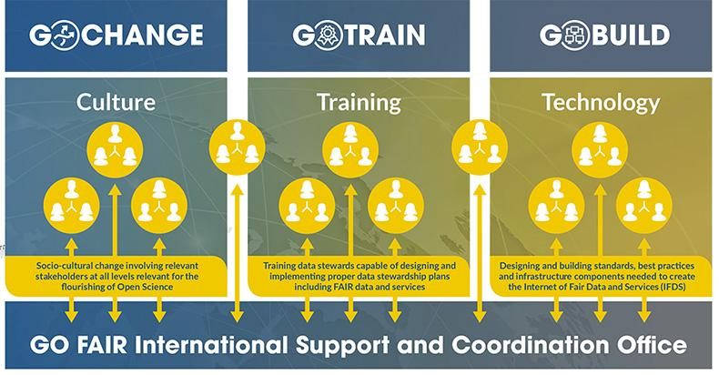


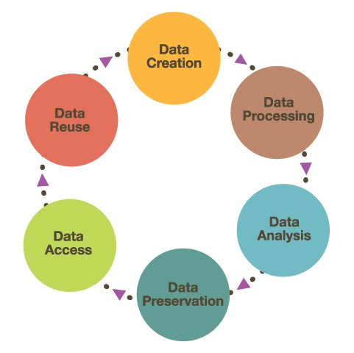
God dag! DENMARK (3/6)
3 FAIR Implantation Areas
3 Key Challenges
Raison d'être Dualism
Data Steward Ambiguity
Disconnect in Funding

Slide 13
God dag! DENMARK (4/6)
Change: Raison d'être Dualism
FAIR
Push
FAIR is gradually absorbed,
often with researcher reluctance,
as a global civilisation aspiration
Think: Provide clear incentives (stick and carrot)
Pull
FAIR is fiercely pursued,
often with researcher enthusiasm, as a research agenda necessity
Think: Provide useful tools and infrastructure
Change with a primary focus on the pull

Slide 14

Train with joint international focus, where universities alone cannot
God dag! DENMARK (5/6)
Train: Data Steward Ambiguity
Z = Level
From upgraded librarian to postdoc integrated DS
know-how
X = Field
From Humanities to Tech/Nat community culture and DS competence
Y = Content
From subject specific to generic data lifecycle DS infrastructure

Slide 15
Build with joint national funding (Not just Horizon Europe))
God dag! DENMARK (6/6)
Build: Disconnect in Funding

Slide 16
Bonjour! FRANCE
French office for GOFAIR 1.0
Laurent Crouzet (director)
Xavier Engels
French office for GOFAIR 2.0
???
Office held within the Ministry for Higher Education, Research and Innovation (MESRI), at the same department (Digital Services and Infrastructures) that is also hosting the French RDA node and the EOSC steering board representation.
Widespread range of actions: support the French participants to GO FAIR and promote the initiative in France; represent national agenda within GO FAIR; support GFISCO whenever needed, organize and fund the Convergence symposium with the German office.
Office mandated by the MESRI, to support the INs, while national coordination (national FAIR hub) covering FAIR initiatives (including RDA, OpenAIRE, etc.) and EOSC would still remain under the support of the Ministry.
Actions taken by the new office are still to be discussed with the mandated institution ; “nesting” activities could be coordinated from the hub, so potentially GO FAIR could take advantage of it.

Slide 17
Guten Tag! GERMANY
Katharina Kriegel
Klaus Tochtermann
Anja Busch
based at ZBW Leibniz Information Centre for Economics
Kiel & Hamburg, Germany
Since 2017 part of the International Support and Coordination Office (GFISCO); Funding until June 2021
Aim: in-kind contribution to a joint coordination of GO FAIR on a national and international level
Possible Future Contribution
Practical support for certain INs
Coordination of the GO FAIR community
Communication and dissemination
Visibility of GO FAIR in RDM landscape (e.g. Data Together)
Competences and Responsibilities
Support event organization
GO FAIR website
Regular newsletter
Social media activities (Twitter)
Press activities

Slide 18
Goede dag! THE NETHERLANDS
The Netherlands is in a transition process to a National Programme Open Science (NPOS, coordinator Karel Luyben as NCOS)
The formal ISCO funding ended in 2020
We continue some of the ISCO functionality on small grants
The proposal for NPOS will soon be submitted to the Government and will include a DataTogether element, including the NL GO FAIR office.
Meanwhile, the GO FAIR Foundation continues and works on taking the GO FAIR (1.0) implementation choices and prepare for specifications and certification tooling.
We are very much in favour of a ‘distributed ISCO function’ and a consolidation of the number of Implementation Networks
We will inform the community as soon as we have a verdict from our prospective funders.

Slide 19
Goede dag! THE NETHERLANDS
Barend Mons
Erik Schultes
Hana Pergl
Leiden, Poortgebouw
most likely multiple locations in new situation
combined with other Data Together partners
Since 2017 part of the International Support and Coordination Office (GFISCO); Funding until mid-2020
Aim: in-kind contribution to a joint coordination of GO FAIR on the international level
Please note: there has never been a ‘Dutch GO FAIR office’
Possible Future Contribution
Practical support for certain INs
Coordination of the GO FAIR community
Helping to keep FAIR ‘on track’
Continue to develop FDP, M4M, FIP and certification framework with the GO FAIR Foundation.
Competences and Responsibilities
High level FAIR definitions
Training/Train the Trainer
International co-operation
Schema development
Strong connection to CODATA

Slide 20

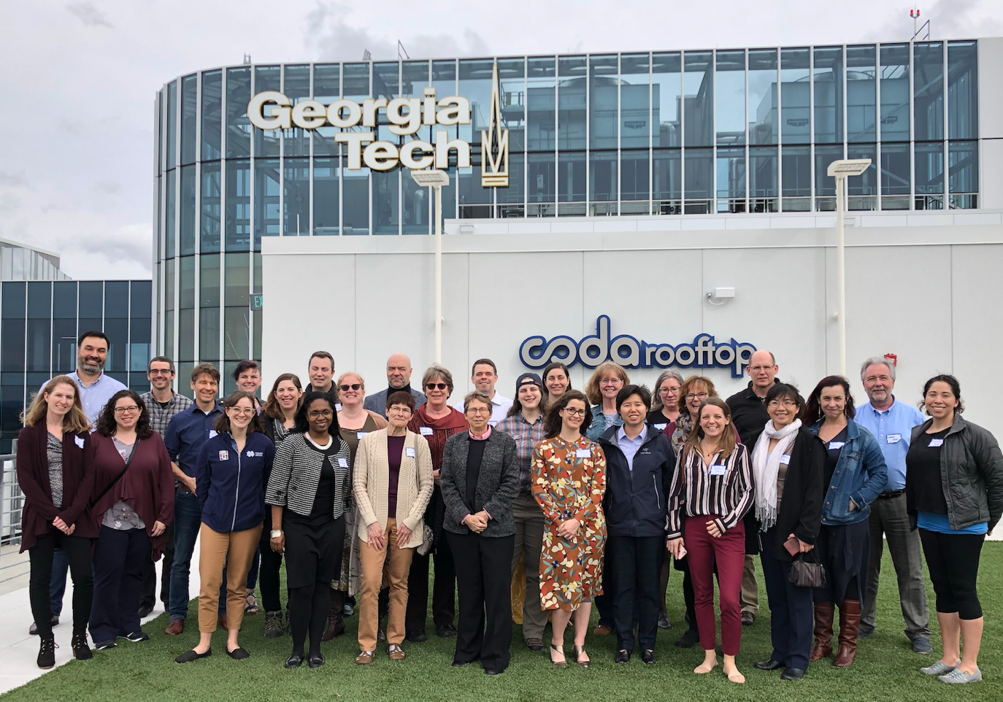
Hello!
http://GoFAIR.US
Competencies:
GO CHANGE: Community building, policy, webinars, DS capacity building
GO BUILD: eInfrastructure and skills for pilots (storage, cloud, devops, project management), FAIR in AI, AI reproducibility, FAIR planning tools for organizations and projects
GO TRAIN: Carpentries reusable curriculum, ‘FAIR on a budget‘ (lack of funder reqs), events
Domain Expertise: Astronomy, Bioinformatics, Computer Science, Data Science, Geosciences,
Information Science, Life Sciences, Materials Science, Metabolomics, Neuroscience
Possible contribution:
National: Building organizational sustainability for the US
International Level: visibility in RDM landscape, contact
point , communications, co-developed
training and pilots

