Slide 1
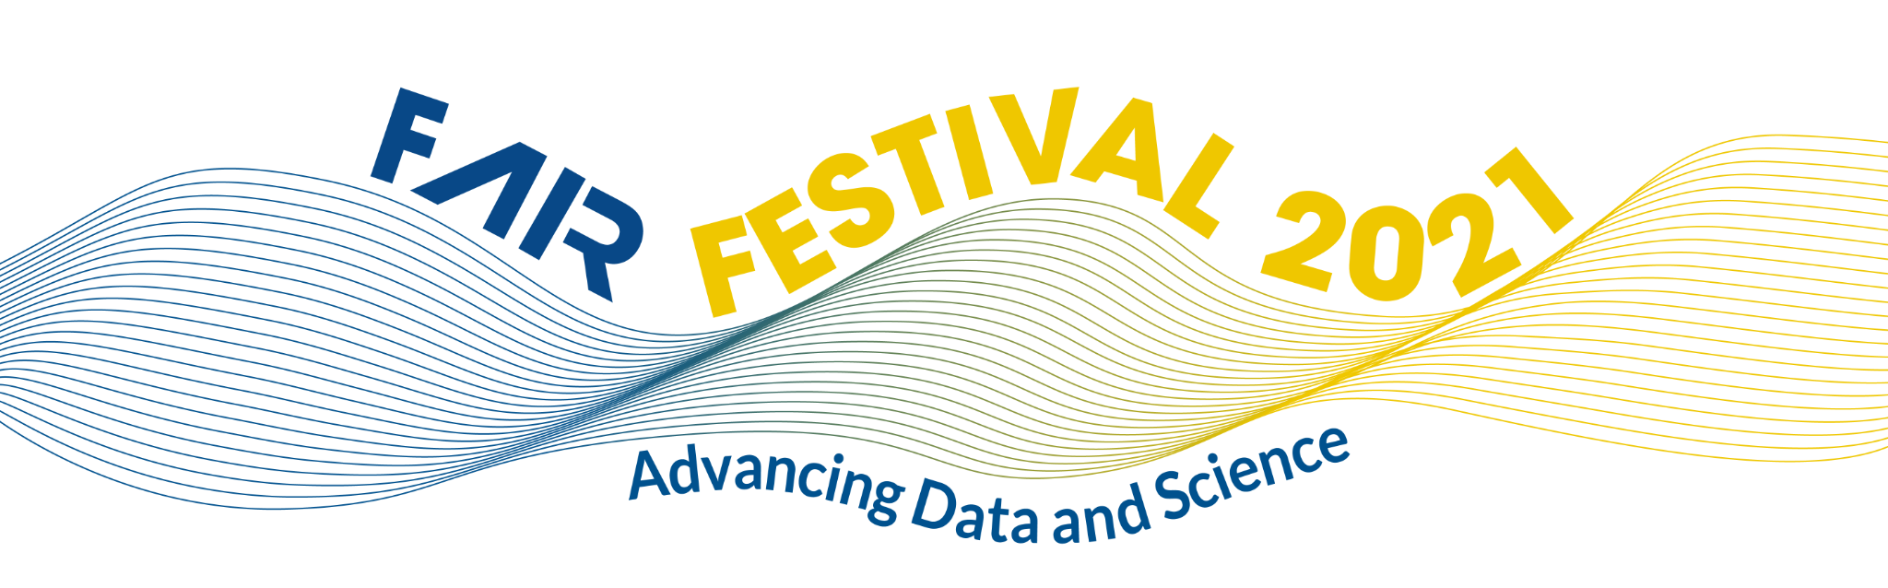
Sharing FAIR Data Stewardship knowledge across borders
Data Stewardship Competence Center Implementation Network
22 June 2021

Slide 2
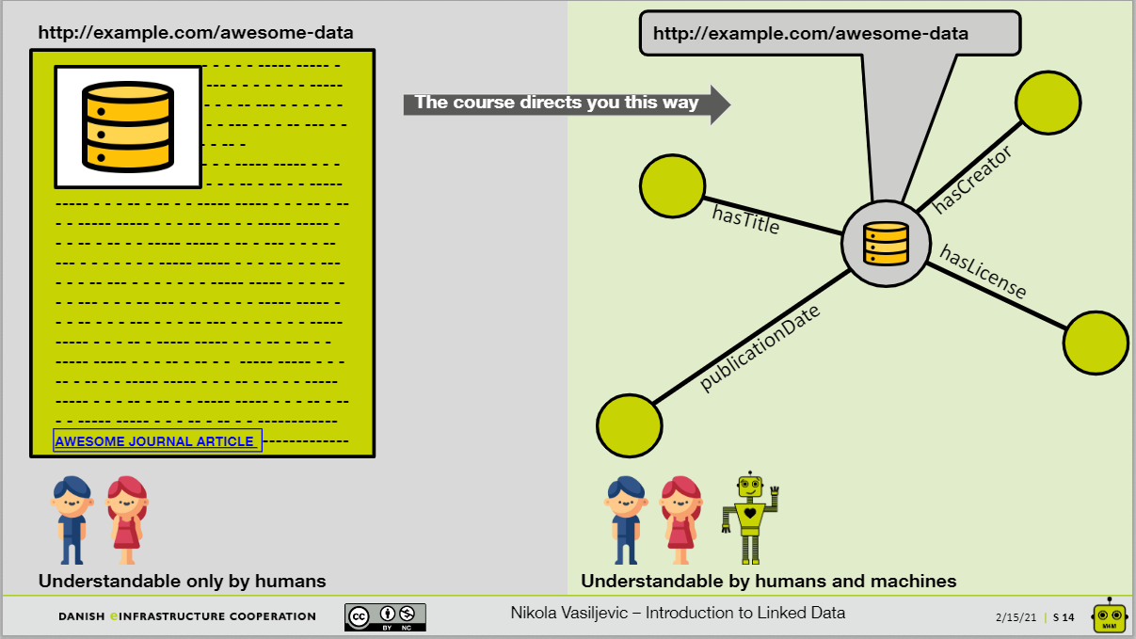
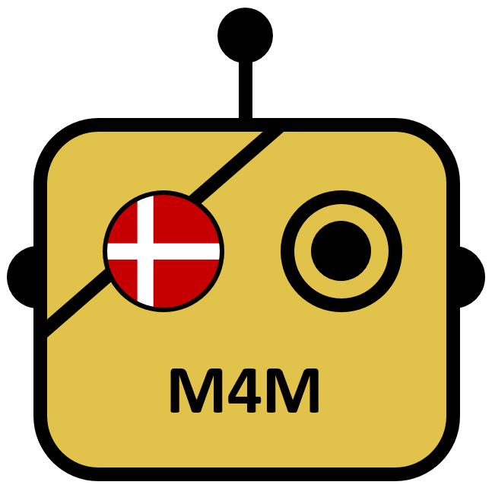

M4M workshops in Denmark
The reason for M4M workshops
Machine actionable metadata is important, because:
  It increases the impact of your research group’s data by making more of your data discoverable and increase the number of citable outputs
  You learn good data handling practices, which strengthens your data handling for yourself individually as well as with your collaborators
  It can help you receive funding.
Slide from: https://zenodo.org/record/4462058

Slide 3
M4M workshops in Denmark
The ‘rapid’ M4M concept
Homework before the workshop
  Mainly consisting of getting the right accounts, finding a suitable dataset, familiarizing yourself with the concept of FAIR
1 hour pre-WS meeting
  To avoid technical issues during the workshop and to assist with structuring the dataset
2 x ½ days online workshop
All information can be found here: https://m4m-dk.readthedocs.io/en/latest/
This collaboration was made possible by with:
Nikola Vasiljevic 0000-0002-9381-9693 (DTU, DK)
Diba Terese Markus 0000-0001-8025-5131 (AAU, DK)
John Graybeal 0000-0001-6875-5360 (Stanford University, USA)
Erik Schultes 0000-0001-8888-635X (GFF)
Hannah Mihai 0000-0002-0454-4289 (DeiC, DK)
Anders Sparre Conrad 0000-0002-5283-2074 (DeiC, DK)
Rene Belsø 0000-0001-6912-0498 (DeiC, DK)

Slide 4
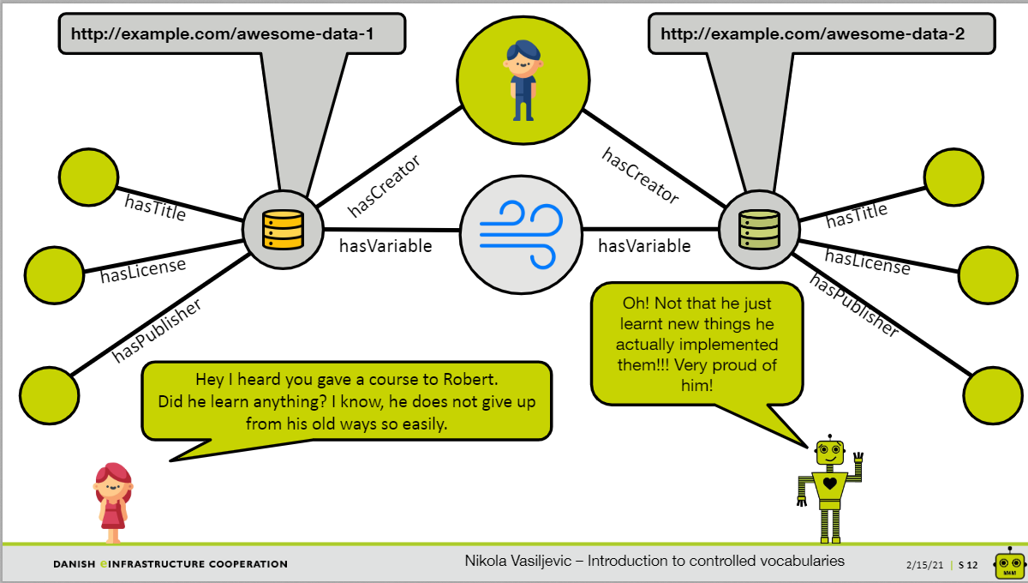
M4M workshops in Denmark
Slide taken from: https://zenodo.org/record/4705676

Slide 5
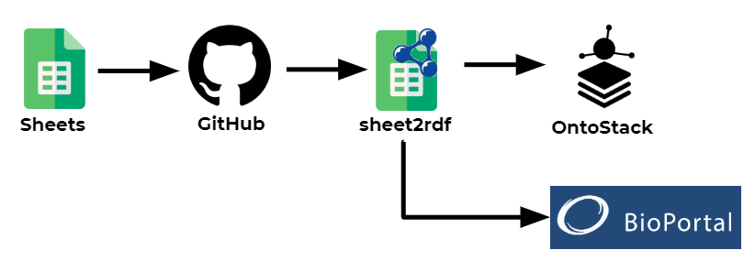
M4M workshops in Denmark
The workflow

Slide 6
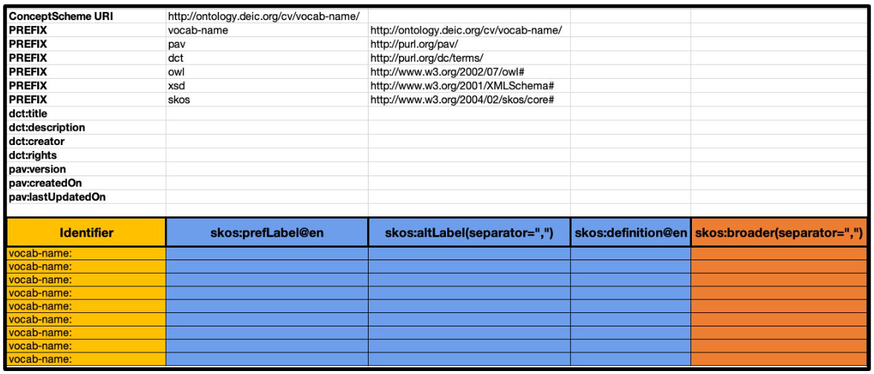
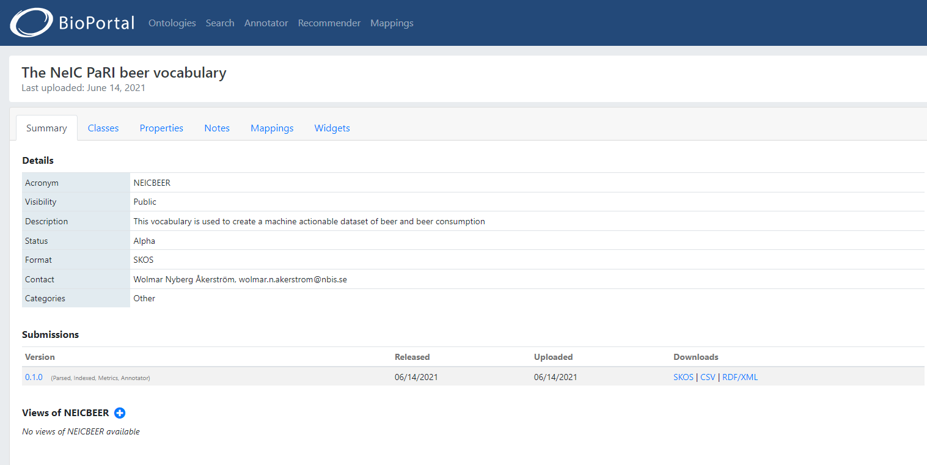
M4M workshops in Denmark
The ontology can be found here:
https://bioportal.bioontology.org/ontologies/NEICBEER
Slide taken from:
https://zenodo.org/record/4705676

