Slide 1




Professionalising the data steward roles in the Netherlands
FAIR data stewardship capacity building
& the role of communities
Mijke Jetten, Community Manager Data Stewardship
DTL & Health-RI, mijke.jetten@dtls.nl
RDMF21, July 12, 2021

Slide 2
Outline
The need for skills and capacity building in data stewardship
  How much capacity is needed?
  Data stewardship roles and competences
The Netherlands
  Dutch roadmap towards professionalising data stewardship
  Data stewardship training
  Data stewardship community building
International initiatives
Link to slide deck: https://doi.org/10.5281/zenodo.5091300

Slide 3
Part 1
The need for skills & capacity building in data stewardship

Slide 4
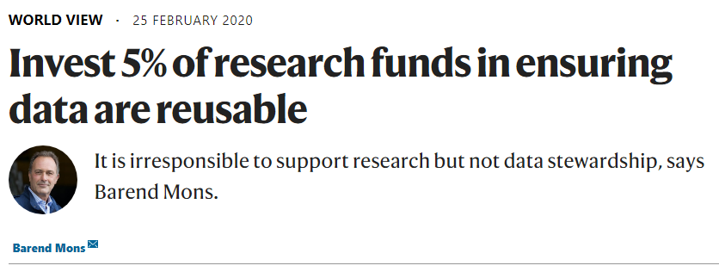
The need for skills and capacity building in data stewardship
Data stewardship and data management skills are essential in research.
Challenges:
There is no consensus on the responsibilities and tasks of data stewards, and formal profiles (including knowledge, skills and abilities (KSAs)) are lacking
No/too little and/or not findable tailored education & training
This hampers the adequate capacity building and complicates efficient data management which are necessary for open science implementation
(Inter)national alignment and coordination are needed to achieve coherent training and education, accompanied with a consistent human resource (HR) policy
In the Netherlands, by bundling expertise and manpower, supported by the research funders, and embedded in (inter)national initiatives, we are making steps to tackle FAIR data handling challenges
Joint capacity building efforts will help build a skilled
workforce that is ready for professional data handling
Our approach: by the community, for the community
https://doi.org/10.1038/d41586-020-00505-7

Slide 5

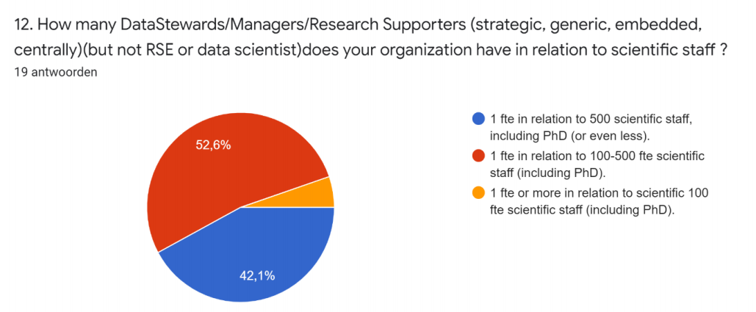

How much capacity is needed?
Role | Task | FTEs needed per 1000 researchers
Data Steward | Assisting researchers with effective management of research data | 26
Trainer on data stewardship | Training researchers on data management skills | 4
That is 3 FTE per 100 researchers. Number taken from OECD report
The EC High Level Expert Group EOSC estimates 5 FTE per 100 researchers
Results of LCRDM Do I PASS for FAIR 2020 survey

Slide 6
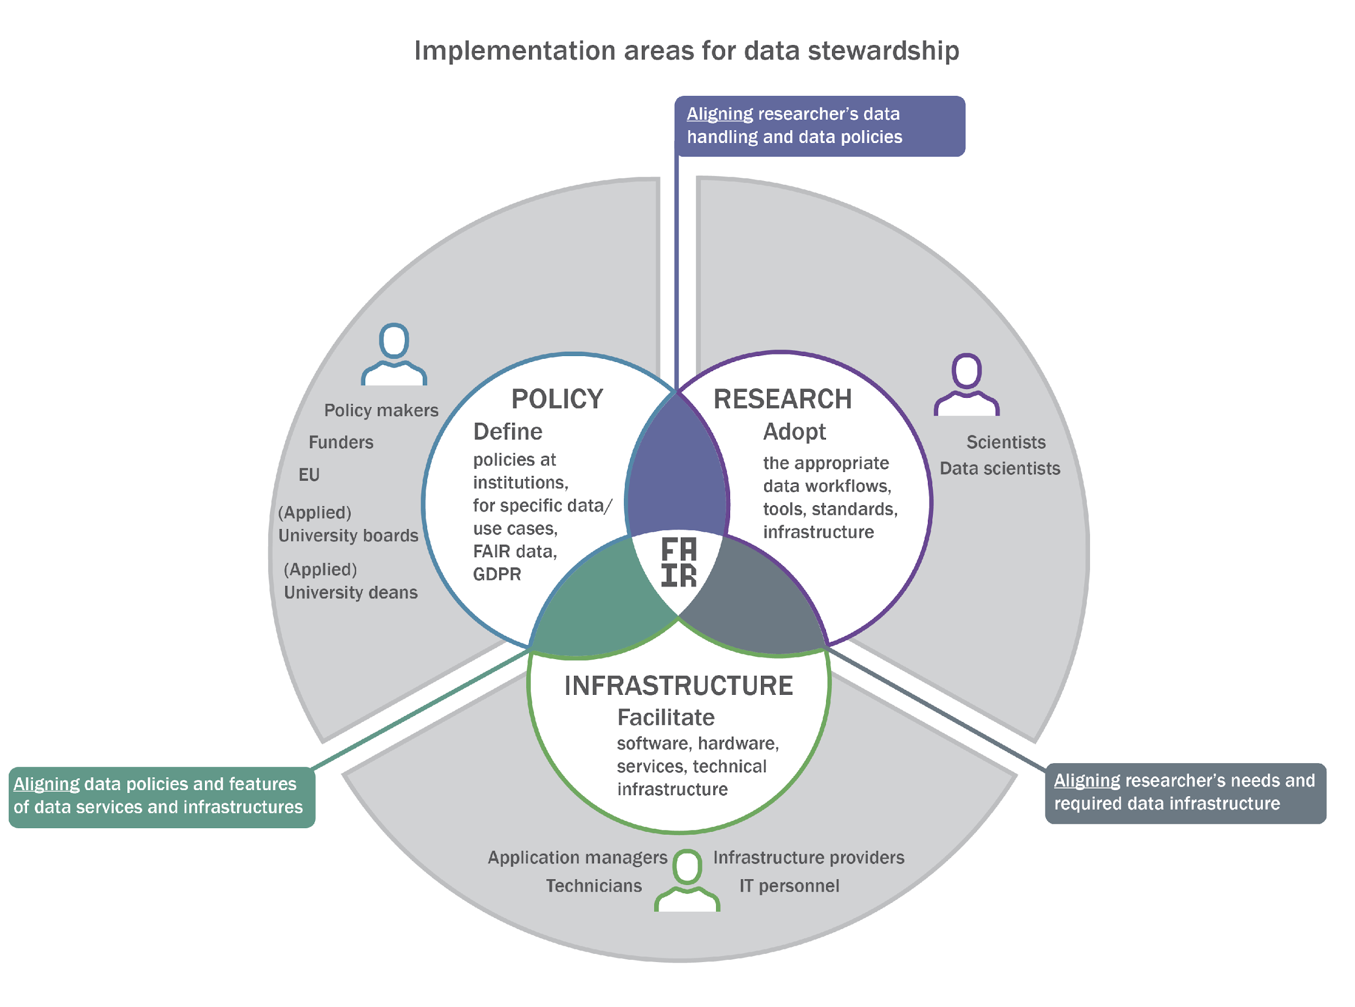
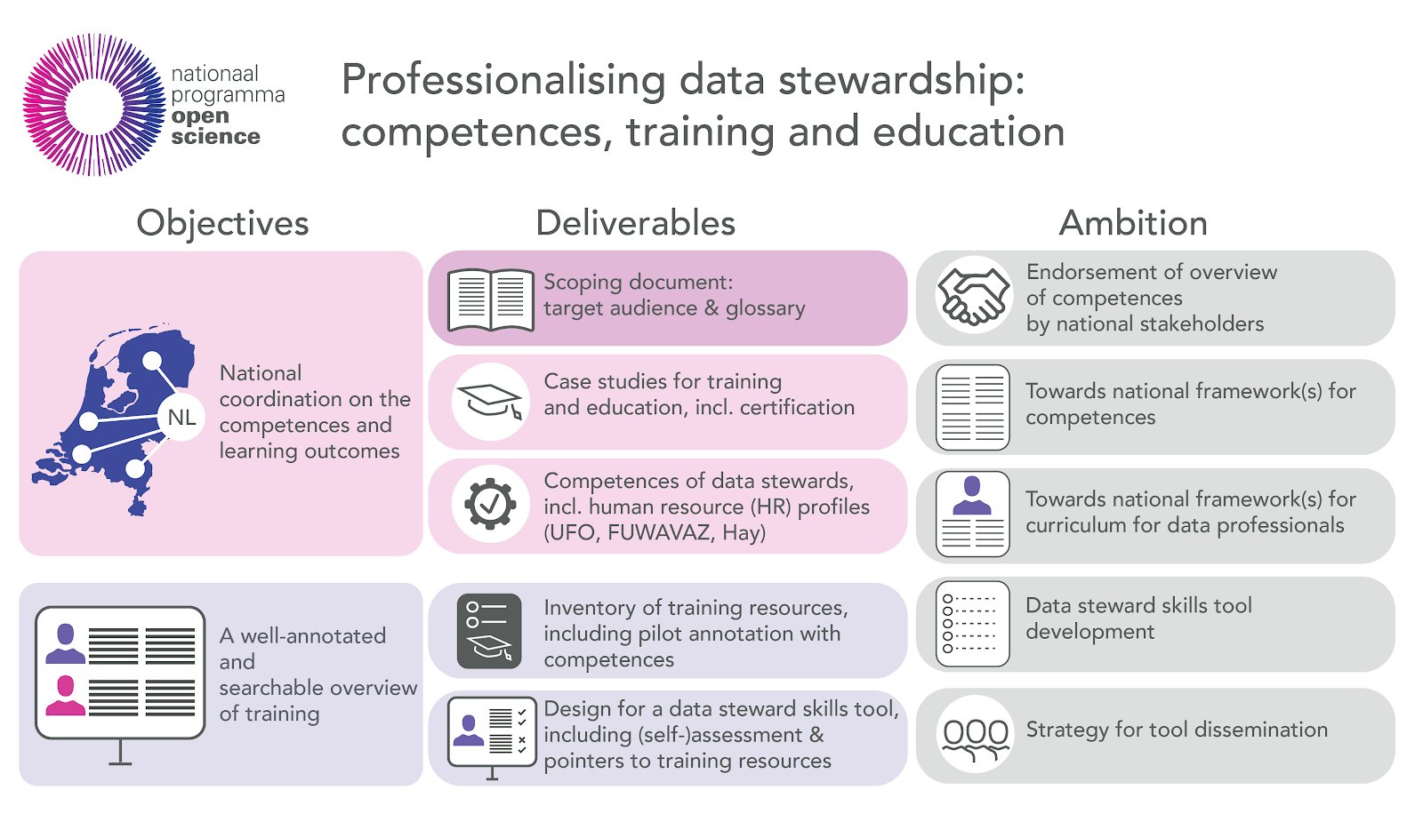
Data stewardship roles and competences
NPOS/ELIXIR/ZonMw competency framework:
responsibilities, activities, KSAs and learning objectives of data steward roles
Data steward policy: institute and policy focused
Data steward research: project and research focused
Data steward infrastructure: data & e-infrastructure focussed
ZonMw report (2019) “Towards FAIR data steward as profession for the
life sciences”, with matrices and a Zenodo archive with output
Implemented in the EBI Competency Hub
Work continued in the Dutch National Programme Open Science
(NPOS) and the NPOS F professionalising data stewardship report
A collaborative effort of over 30 representatives of universities,
UMCs, UASs, service providers, and representatives of the major
Dutch umbrella organisations

Slide 7
Part 2
The Netherlands

Slide 8
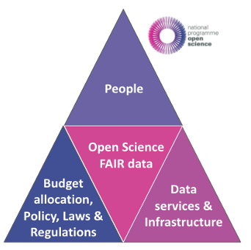
Dutch roadmap towards professionalising data stewardship
Creating FAIR data implies
Making well informed choices about
… the number of data stewards
... where in the organisation
… and with what competences
… including training
Realising data steward capacity implies
Changes in research-performing organisations, including HR management
National funds for science and institutional budgets
Coordinated action of research institutes, policy makers and research-funding organisations for the required changes
Dutch National Programme Open Science (NPOS)
Three key areas: 100% Open Access publishing, optimal reuse (FAIR) of research data, and corresponding evaluation and valuation systems
The data stewardship report (NPOS F) links to the second key area, together with a report on the Dutch data infrastructure and services landscape (NPOS E)
NPOS F: for a quick overview, we advise to read the preambule, executive summary and Chapter 7

Slide 9
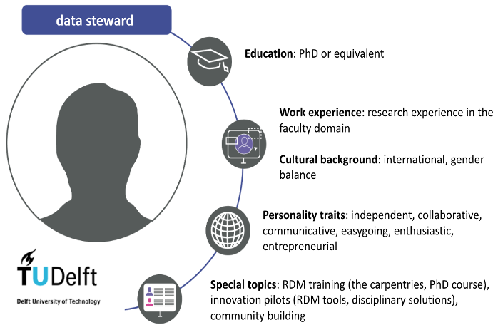
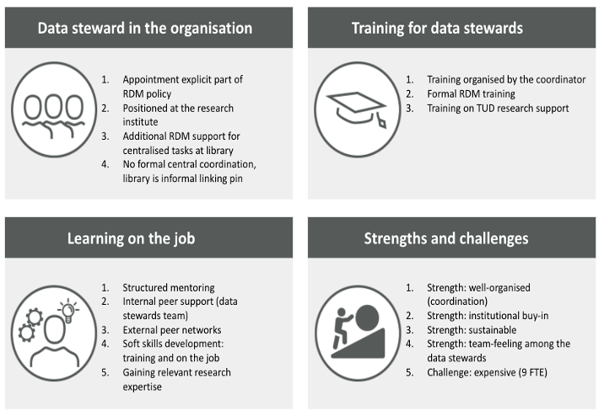
NPOS F: Landscape analysis on training and education
8 case studies (universities, UASs & UMCs) as a first fact check on data stewardship training and education in the Netherlands. Example case study: Delft University of Technology

Slide 10
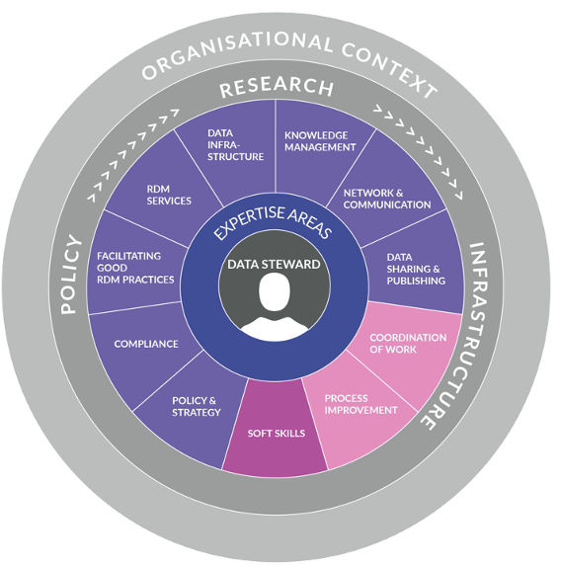
NPOS F: Basic data steward job profile components
Various annexes with detailed information
Domain areas, responsibilities, tasks, and competences of a data steward
Basic components of the data steward job profile - for the UFO (universities) job classification system, as a first step
Three local university data steward job profiles for the FUWAVAZ (UMCs) job classification system
Proposal for a job profile for data stewards in UASs
Context of the Digital Competence Centers: additionally, the basic components of the research software engineer job profile

Slide 11
NPOS F: Training, education and certification
Inventory of training resources and pilot annotation of courses based on competences
Inventory of existing certification mechanism, for different categories: courses, trainees, trainers, and organisations
Certification for data stewardship is still in its early days and needs to be done in alignment with similar activities in Europe and beyond
NPOS F: Data stewards skills tool
Sketch for a data steward skills tool as a single point of reference for data steward competences, training and education
5 data steward personas, to show how stewards could benefit from the tool, and possible pathways for these personas in such a tool
In collaboration with ELIXIR, as a pilot, content was added to the EBI Competency Hub: expertise areas, responsibilities, tasks, KSAs, and learning objectives. The Competency Hub is interested to expand their tool for our use case and discuss adaptations needed

Slide 12


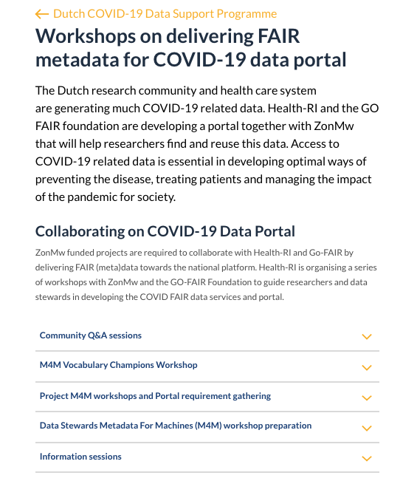
Data stewardship training
Helis Academy course FAIR data stewardship (for life sciences),
materials available for reuse
First edition (‘19)
Second edition (‘19)
Third edition (‘21)
ELIXIR-NL Technical Data Stewardship Course 2019
Data stewardship training for Marie Curie Early Career Researchers
COSMIC (materials) (‘20)
ProEVLifeCycle (materials) (‘20)
Various national data stewardship webinars and metadata workshops
were given for data stewards and project leads of the ZonMw granted
Covid-19 projects, as a collaborative action of GO FAIR, Health-RI and
DTL, as part of the ZonMw FAIR data requirements

Slide 13
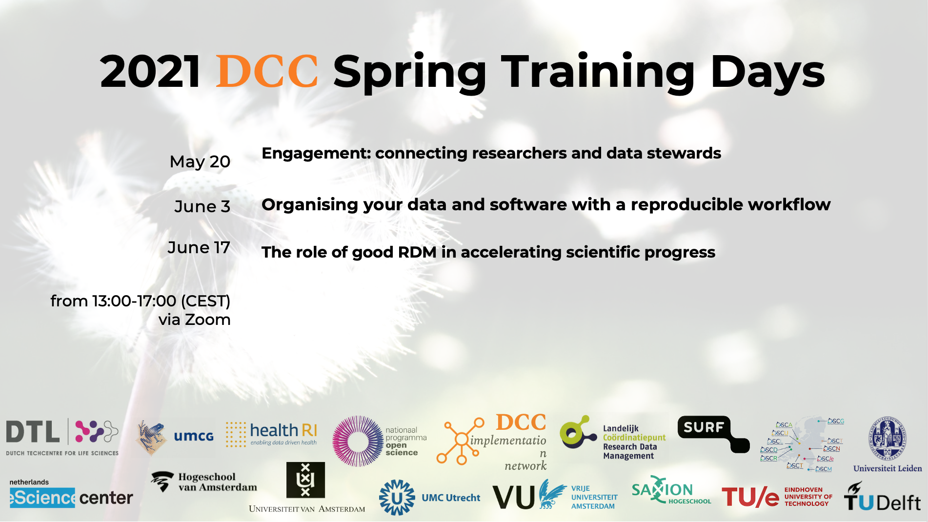
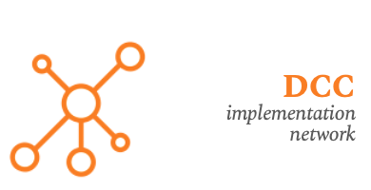


Slide 14
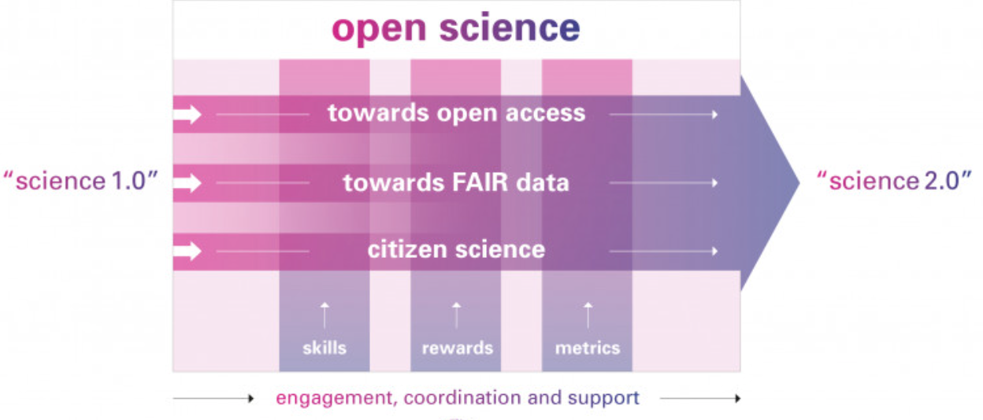
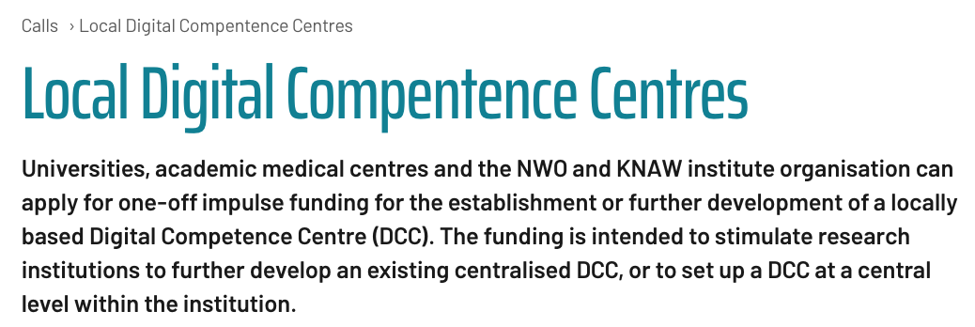







Slide 15
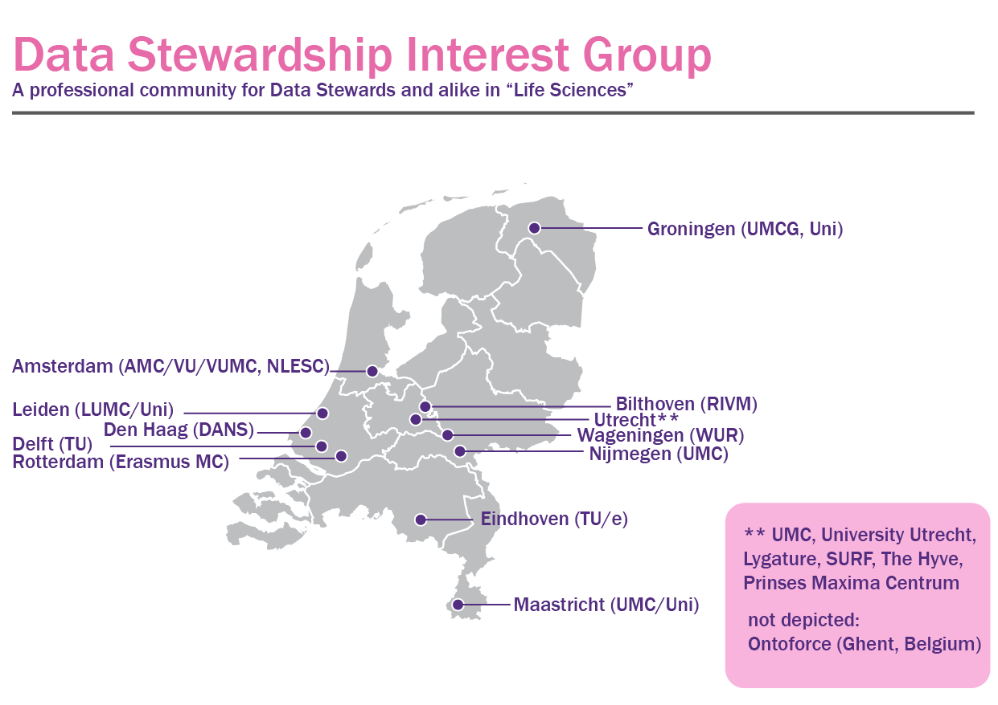

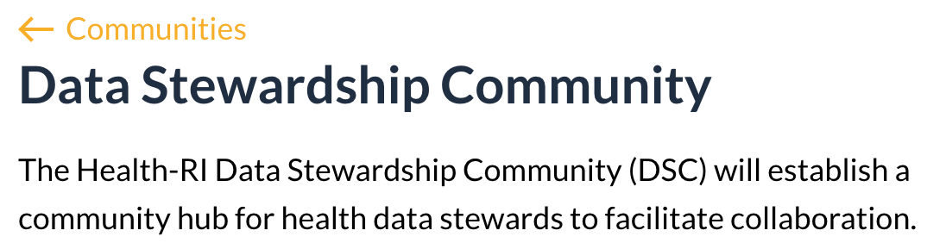
Data stewardship community building
Facilitating communities is an essential element of
professionalising data stewardship and capacity building
Exchange experiences and good practices
Jointly tackle data challenges
For many years, DTL facilitates the Data Stewards Interest
Group (DSIG), with regular meetings (next one in September)
and a vibrant (slack channel) community for data stewards
and like-minded in the Netherlands and beyond (welcome
to join!) to share experiences and foster the (Dutch) national
implementation of data stewardship
In Health-RI, the Data Stewardship Community (DSC)
unites healthcare data stewards in national collaborations,
so each institute does not have to reinvent the wheel locally
575 members

Slide 16
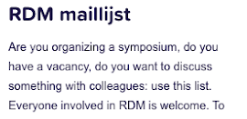
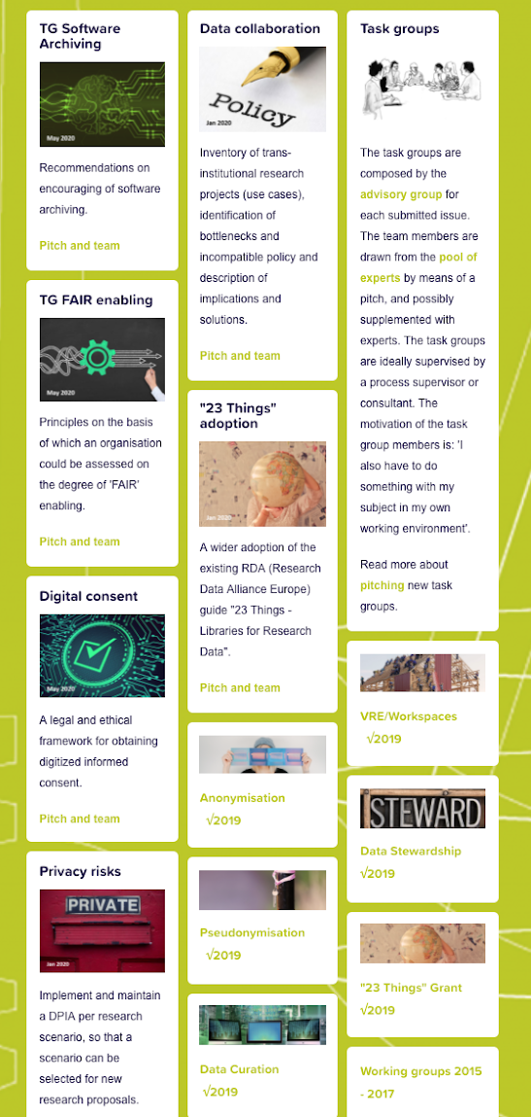
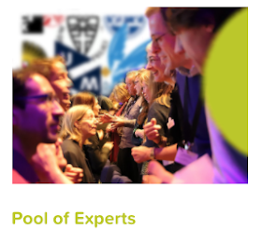
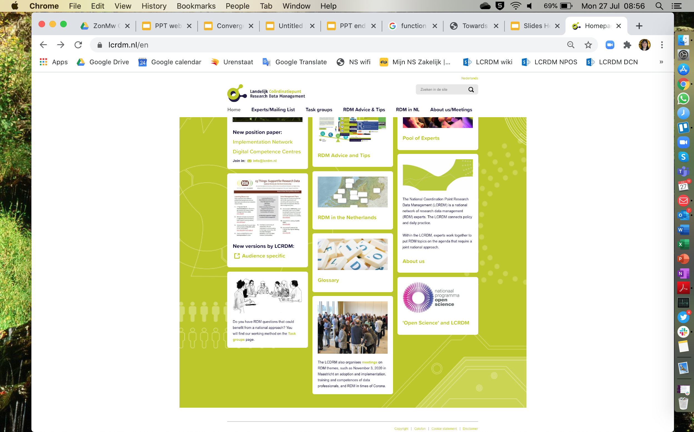
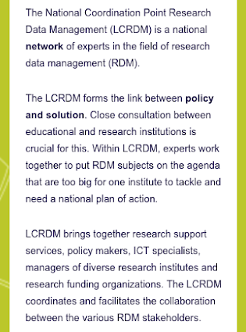
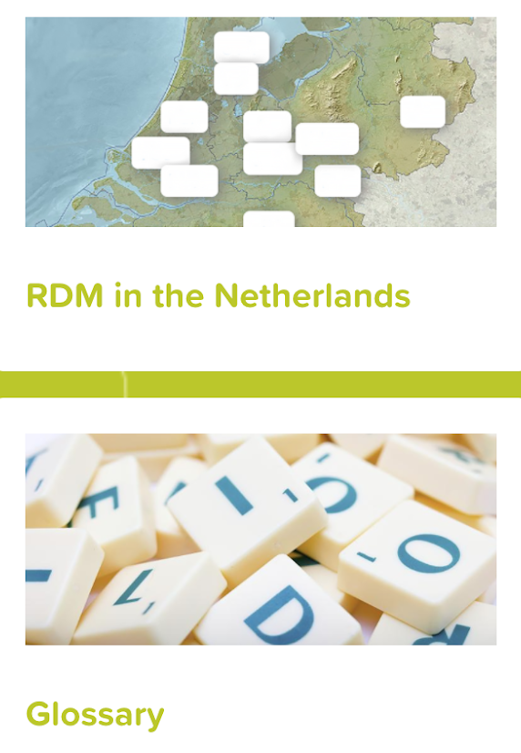
https://www.lcrdm.nl/en

Slide 17
Part 3
International initiatives

Slide 18
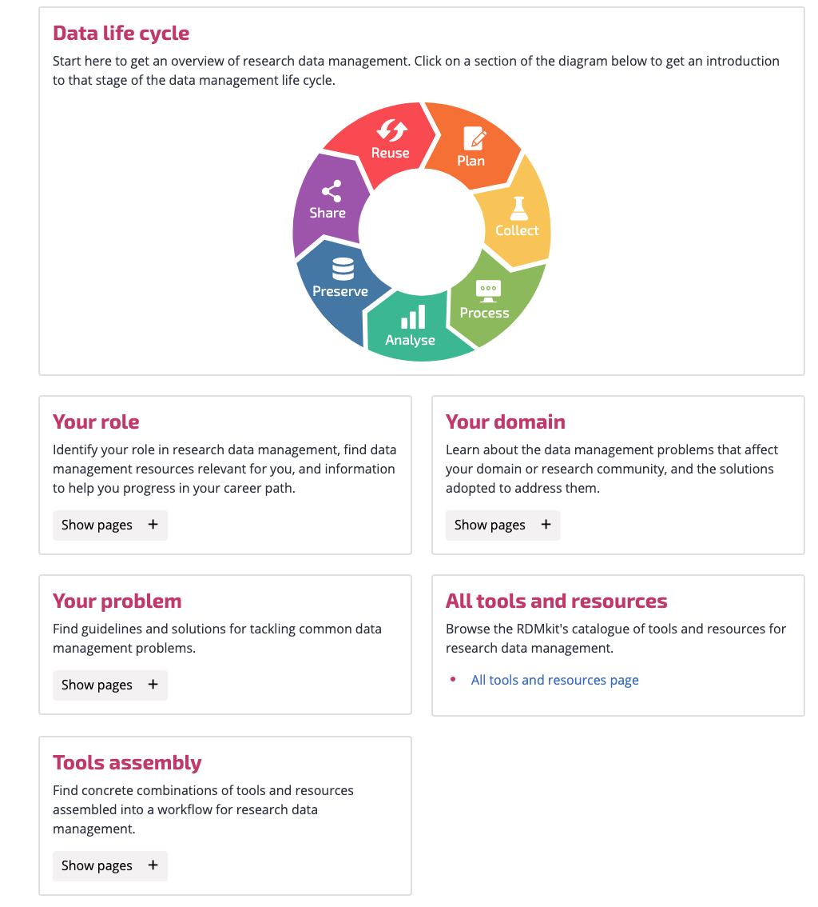
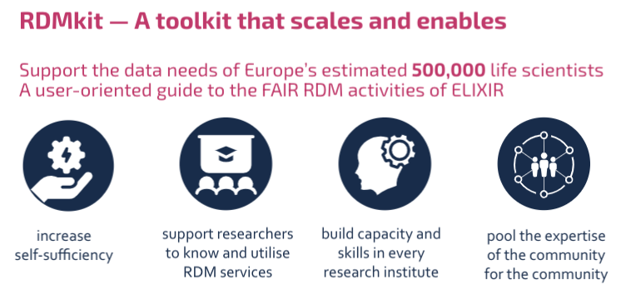
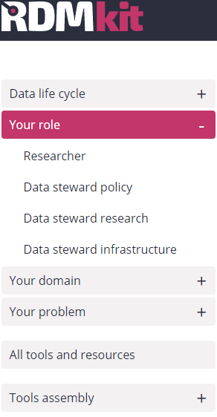
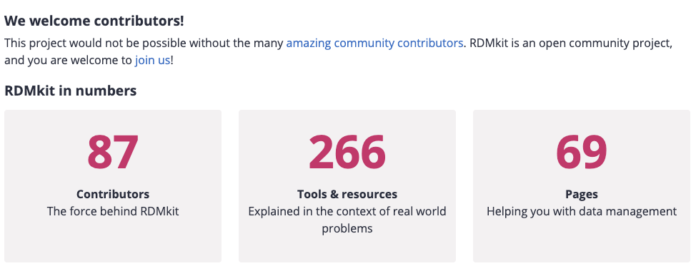

ELIXIR-CONVERGE: Toolkit
https://rdmkit.elixir-europe.org

Slide 19
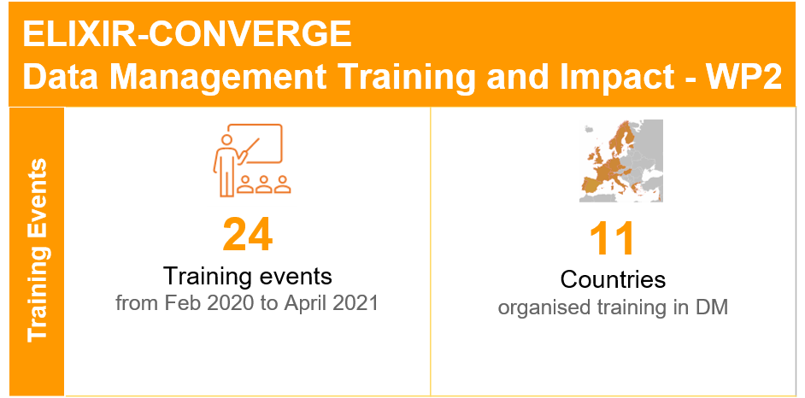
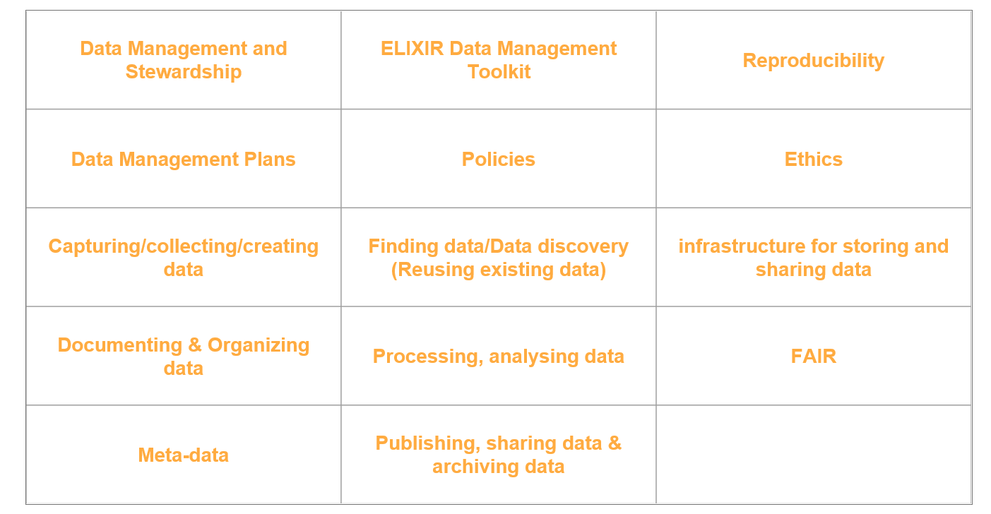

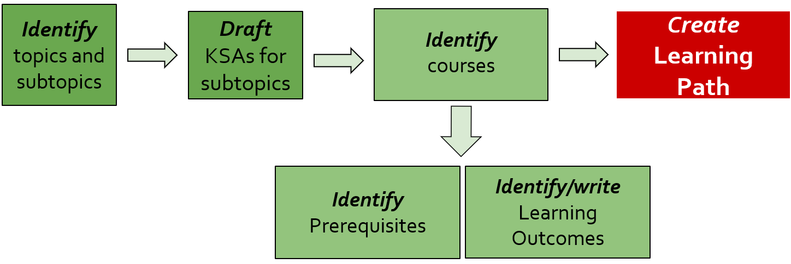
ELIXIR-CONVERGE: Training
Design courses, develop course materials (a.o. through hackathons) and deliver courses
Audiences: data stewards, researchers, tool developers and trainers
In alignment with node priorities and/or national strategies
Actions
First trainings have been delivered
Training gap analysis has been performed
Defining topics, KSAs and learning paths at
biohackathon 2020 (#29) & 2021 (#13)
Upcoming
Training material generation hackathons related to the gap analysis topics
Train-the-data-stewardship-trainer courses

Slide 20
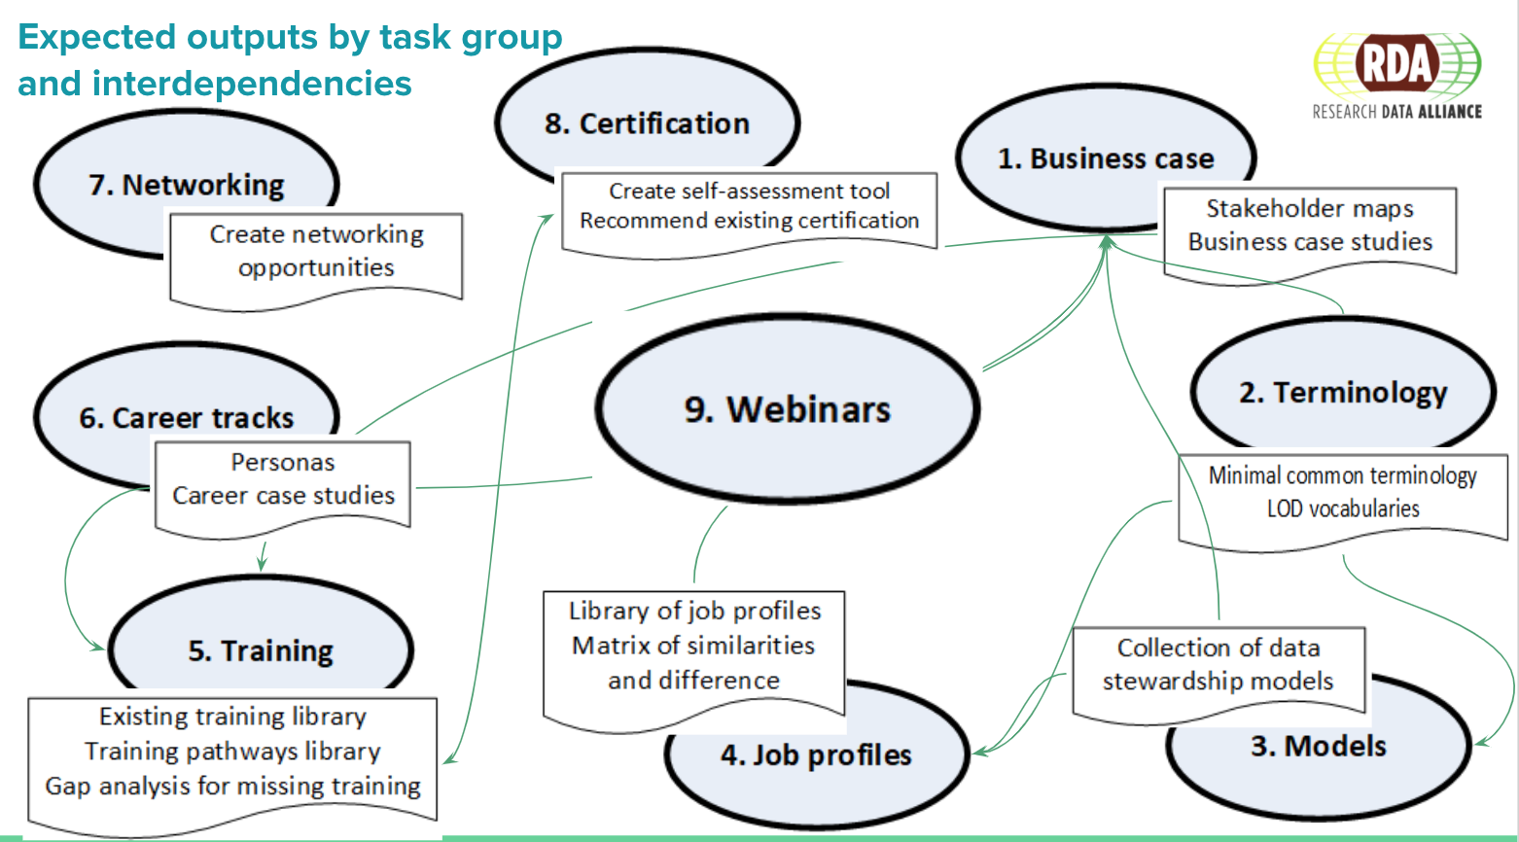
RDA Professionalising Data Stewardship IG: topics
We need you to make professionalising data stewardship a real community effort, by and for the community!
Make sure to check into our slack community for regular communication
See PDS IG session notes with full slide deck and relevant links in the VP17 notes

Slide 21
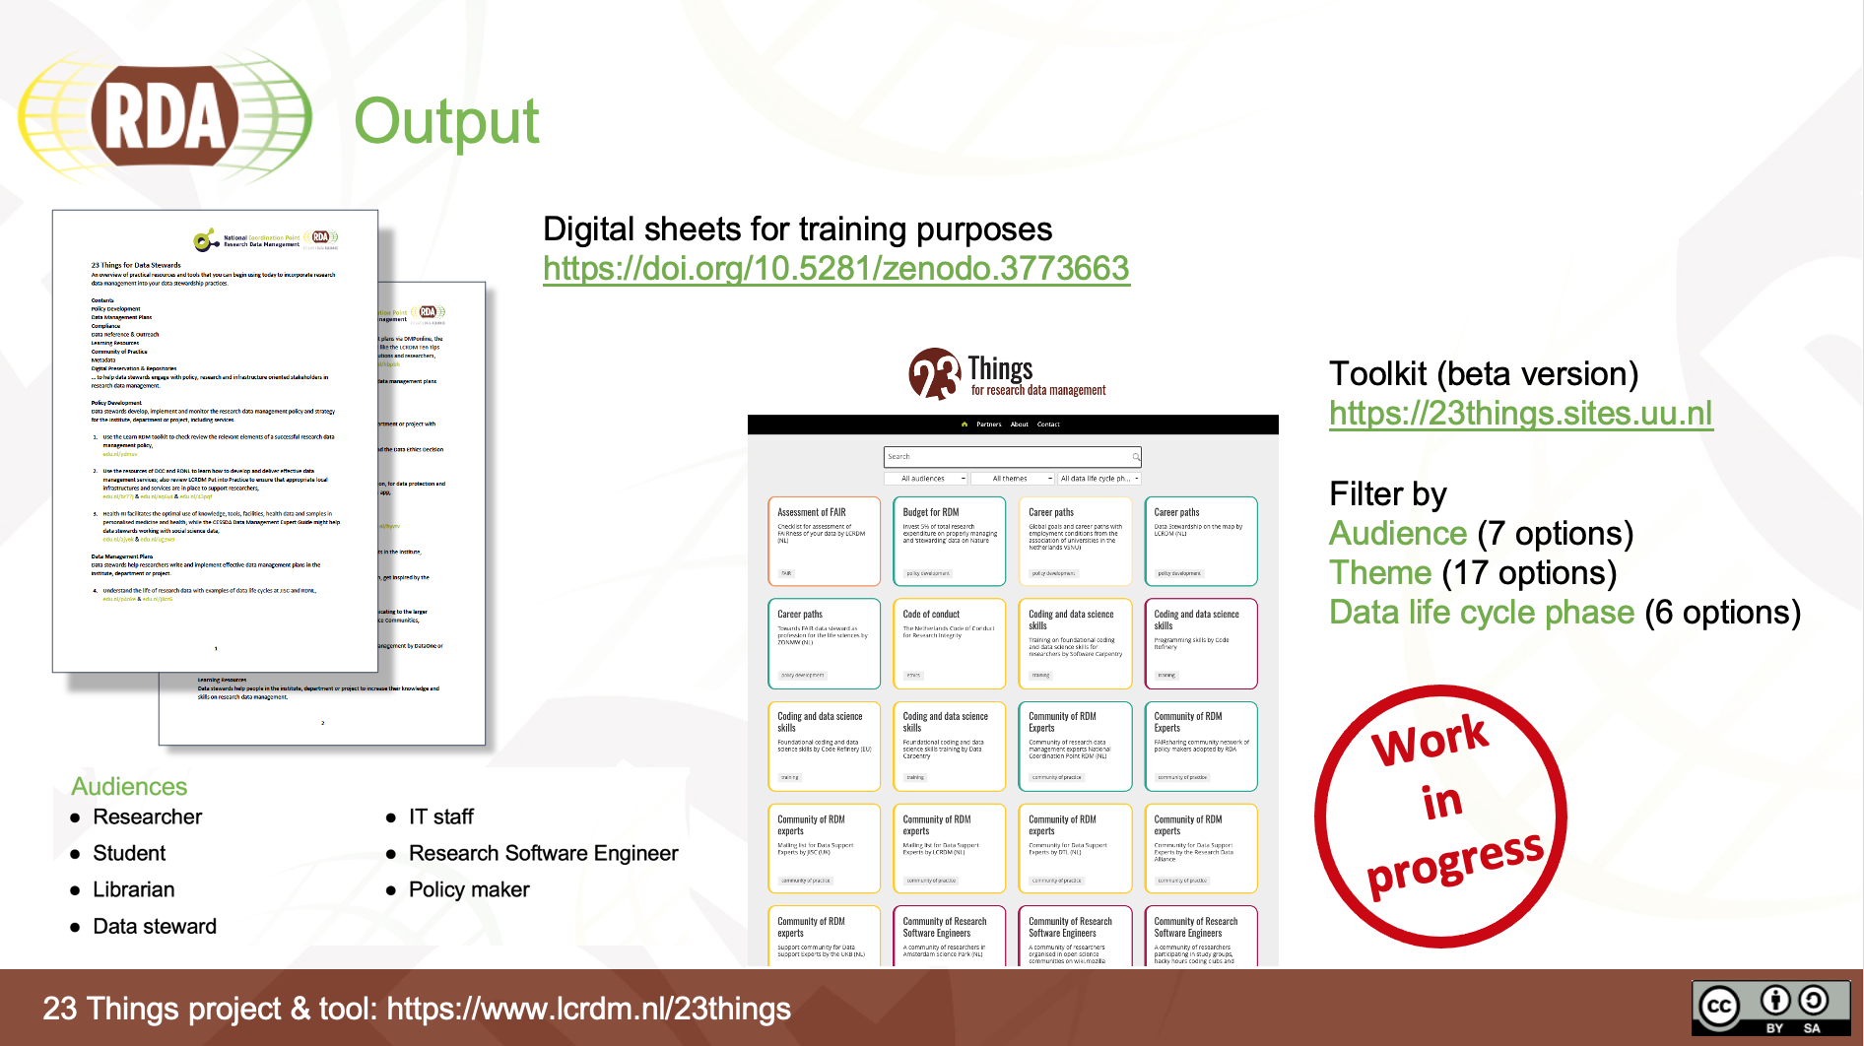

RDA Libraries 4 Research Data IG: 23 things for data stewards

Slide 22

Acknowledgements
The ELIXIR-NL, DTL and Health-RI team, particularly Celia van Gelder
ELIXIR-CONVERGE members
NPOS-F team
DTL Data Stewards Interest Group (DSIG) and the Health-RI Data Stewardship Community (DSC)
RDA Professionalising Data Stewardship Interest Group
Thank you for listening!
Interested to learn more about DTL, Health-RI, ELIXIR-NL and NPOS activities? Contact me via mijke.jetten@dtls.nl

