Slide 1
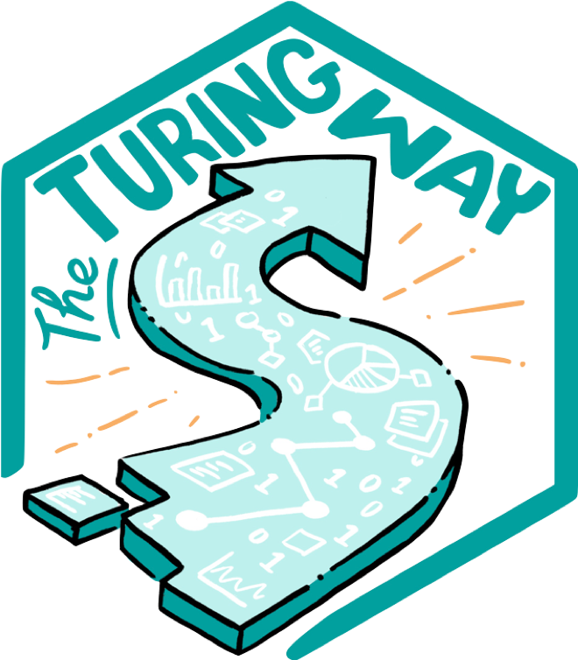
The Turing Way:
Guide to Reproducible, Ethical and Collaborative Research
Malvika Sharan
Pronouns: she/her
@malvikasharan @turingway, CC-BY 4.0, Zenodo: https://zenodo.org/record/5083747, DOI: 10.5281/zenodo.5083747
Notes:
Hi everyone, my name is Malvika Sharan, and I will be talking about The Turing Way project and the community approaches to building a Guide to Reproducible, Ethical and Collaborative Research

Slide 2
The Turing Way
An Open Source guide on Data Science.
We involve and supports a diverse community to make data science reproducible, ethical, collaborative and inclusive for everyone.
@malvikasharan @turingway, CC-BY 4.0, https://github.com/alan-turing-institute/the-turing-way, DOI: 10.5281/zenodo.5083747
Notes:
The Turing Way is an open source project that involves and supports its diverse community in making data science reproducible, ethical, collaborative and inclusive for everyone. We believe that to make our project truly beneficial and comprehensible for as many people as possible we need to collaborate with people with diverse skills, backgrounds, lived experiences and domain knowledge.

Slide 3

The national institute for data science and artificial intelligence
@malvikasharan @turingway, CC-BY 4.0, https://www.turing.ac.uk/, DOI: 10.5281/zenodo.5083747
Notes:
It is a part of the Alan Turing Institute, which is the National Institute for data science and artificial intelligence in the UK.

Slide 4
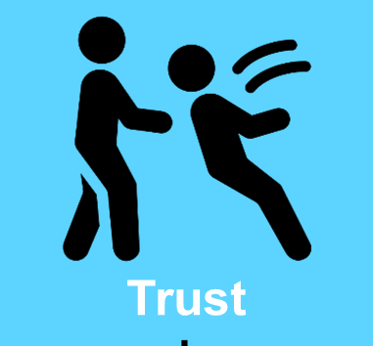

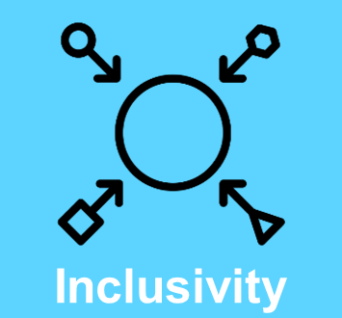
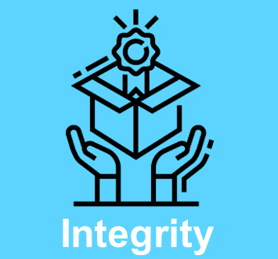
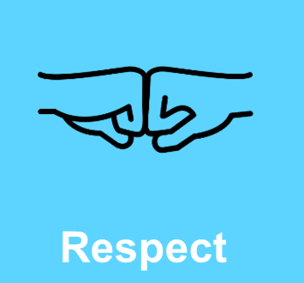
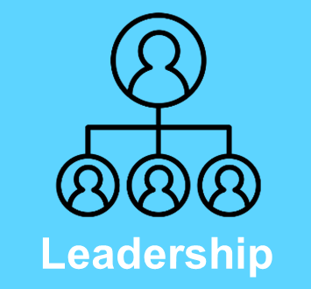
Tools, Practices and Systems
Trustworthy systems
Transparent reporting
Inclusive interoperable design
Ethical integrity
Respectful co-creation
Leadership in open research
@malvikasharan @turingway, CC-BY 4.0, https://www.turing.ac.uk/, DOI: 10.5281/zenodo.5083747
The Alan Turing Institute, Tools, Practices and Systems
Notes:
And it is developed under the research programme called tools, practices and system. The core values of this program to embed values for trustworthy systems, transparent reporting, inclusive interoperable design, ethical integrity, respectful co-creation, and leadership in open research. The Turing Way sits across most of these goals and provides a central resource for good practices to all our researchers within the UK and internationally.

Slide 5
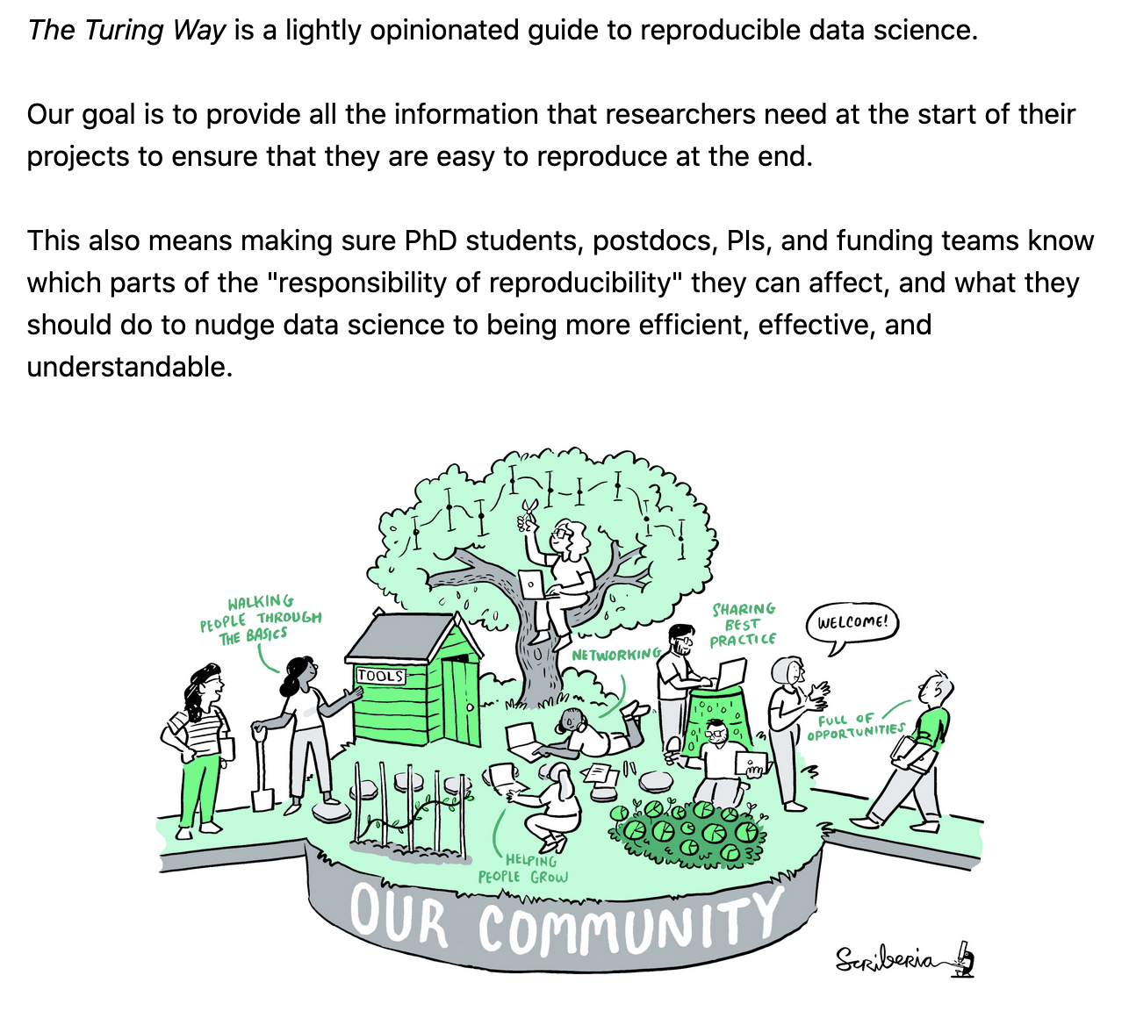
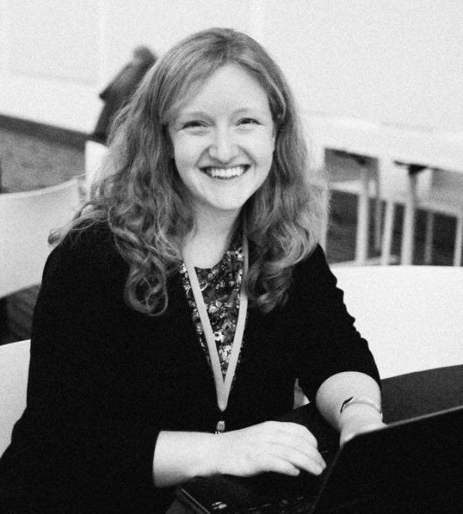
The Turing Way Book on Reproducibility
Kirstie Whitaker
Lead of Tools, Practices & Systems Programme
Notes:
It was started as a book on reproducibility by Kirstie Whitaker, who is the project lead. Shared as a lightly opinionated guide, this book provides reproducible tools and practices to help ensure that the PhD students, postdocs, PI, funding teams, policymakers and all different stakeholders in research know what their responsibility of reproducibility is, where they can make an impact, and how they can make their work more efficient and understandable.

Slide 6
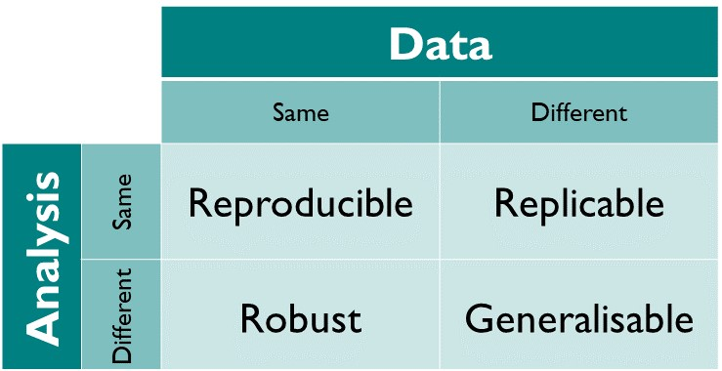
Reproducibility
@malvikasharan @turingway, CC-BY 4.0, https://github.com/alan-turing-institute/the-turing-way, DOI: 10.5281/zenodo.5083747
Notes:
Reproducibility: When the same analysis is applied to the same data, it should give the same result. There are other concepts around reproducibility like replicability, robustness and generalisability, but reproducibility should be maintained as a minimum criteria to ensure quality and integrity of our research.

Slide 7
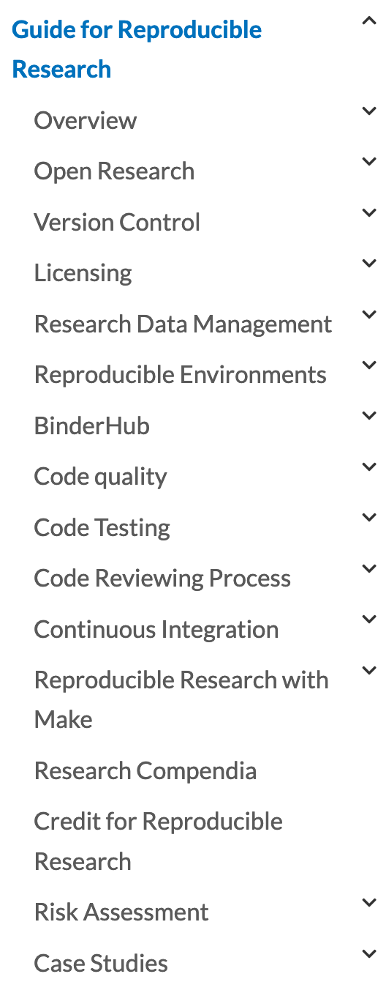
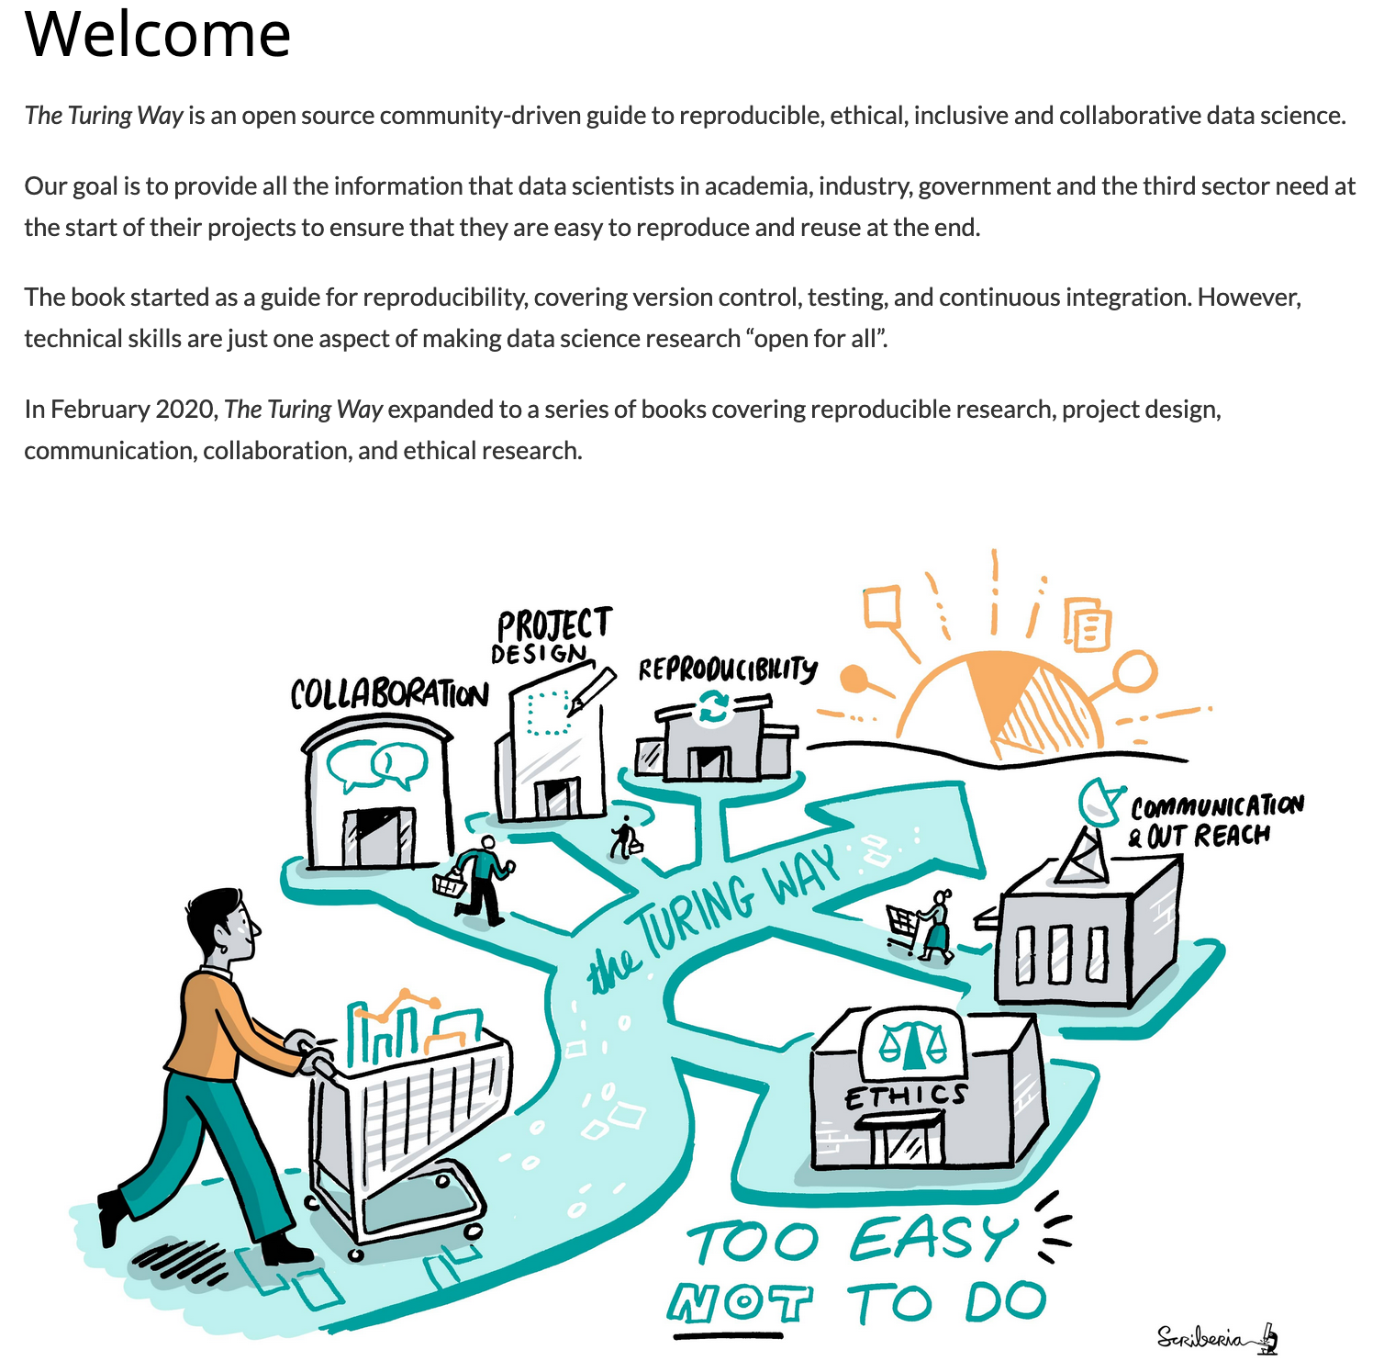
Guide for Reproducible Research
@malvikasharan @turingway, CC-BY 4.0, Book: https://the-turing-way.netlify.app/welcome, DOI: 10.5281/zenodo.5083747
Notes:
The project started to involve contributors who documented best practices, guidance and recommendations in chapters, describing various concepts and tools that can ensure the reproducibility aspects of our work.
These chapter include topics such as open research, version control, licensing, data management, code testing and reviewing, continuous integration and so on.

Slide 8
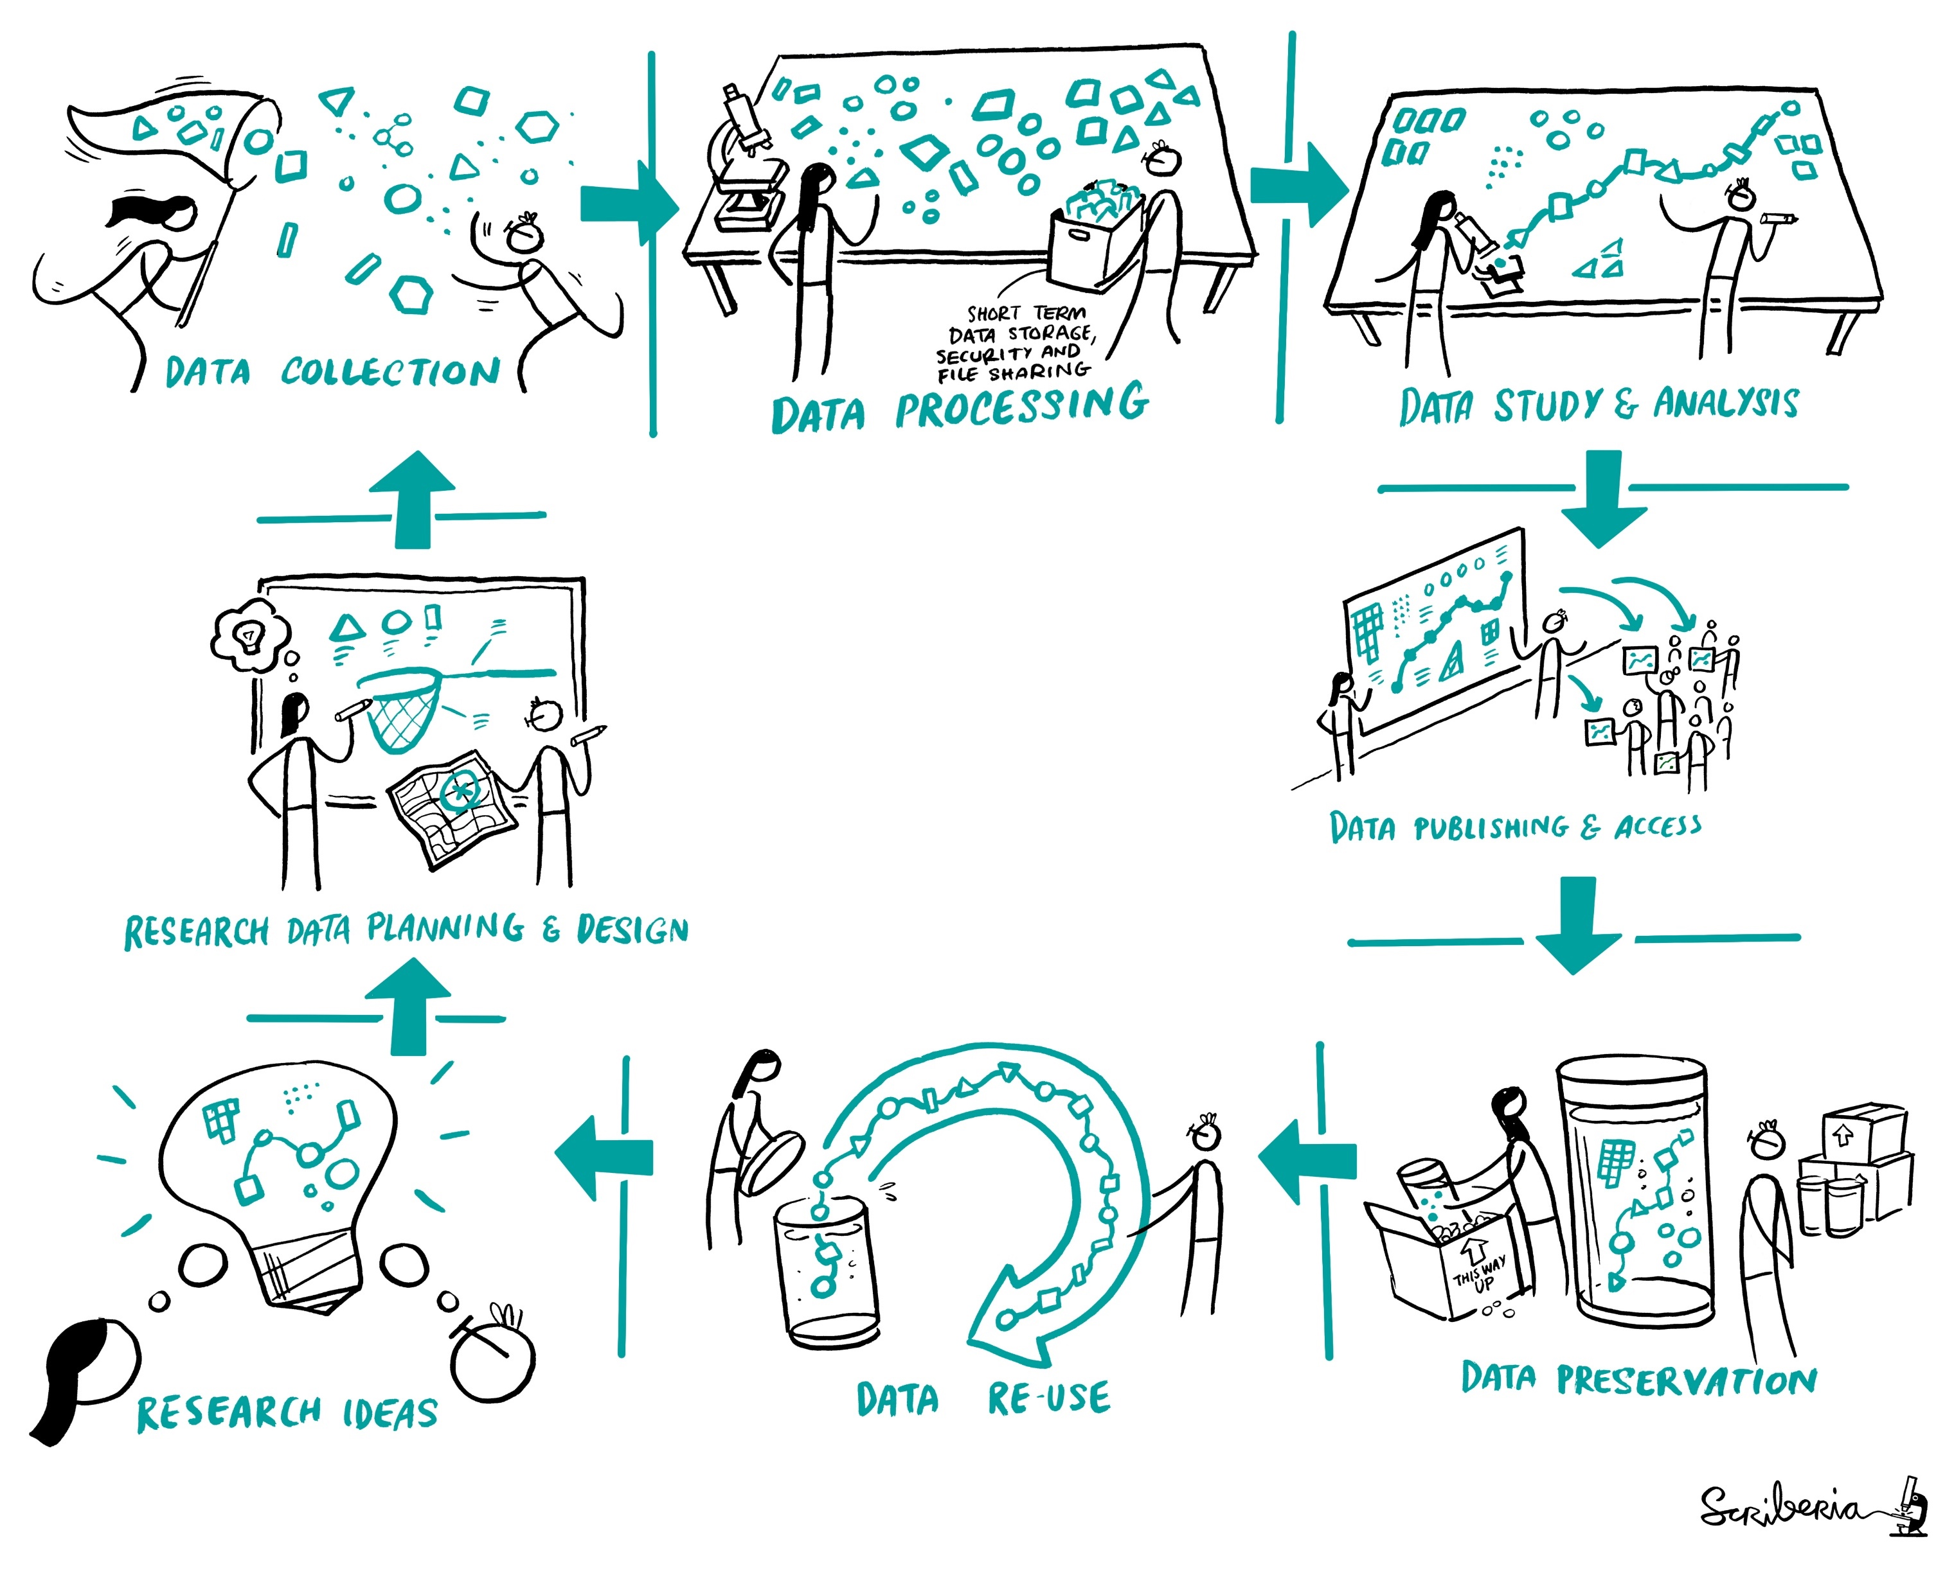
Reproducibility
@malvikasharan @turingway, CC-BY 4.0, CC-BY image by The Turing Way and Scriberia, , DOI: 10.5281/zenodo.5083747
Notes:
It is apparent that reproducibility may be defined quite simply, but it involves making complex decisions at every step of the way.
The integration of our personal values as well as biases starts right when we have a research idea. we start by communicating our ideas with the potential collaborators, plan and design the work. Then we choose and describe the protocol and collect data sets. As the research goes on, we continue processing and wrangling our data, conduct our studies and analysis, publish our data along with other research components so everybody can access it. Then comes the archiving that can ensure that our data is reusable, meaning, that someone else can go through this whole process of reproducing or building upon our work.
That's quite an overwhelming process and it involves making .
Moreover, it does not "just" involve the data practices, but also include the way we communicate our work with others, how do we design our project, how efficiently we collaborate with each other. All these while ensuring the highest ethical standards in our research.

Slide 9
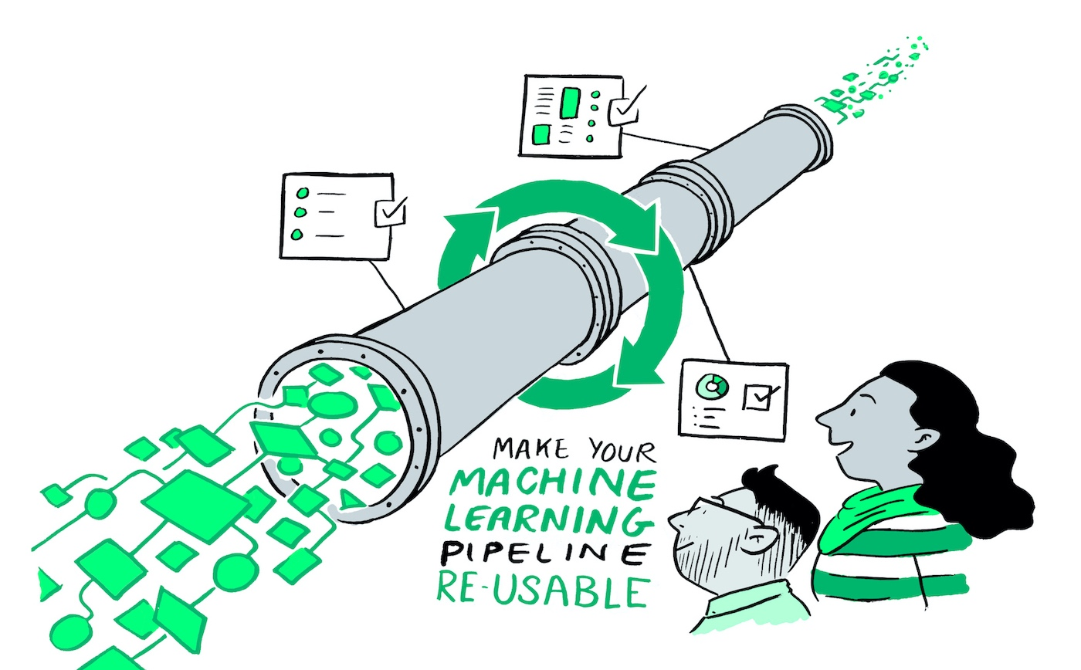
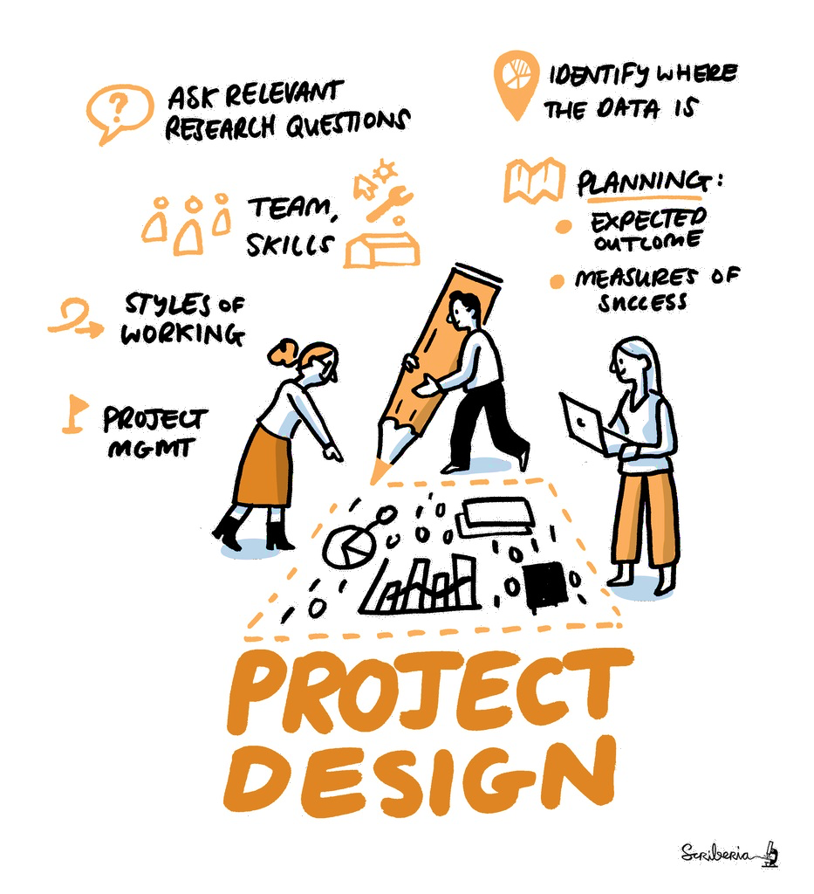
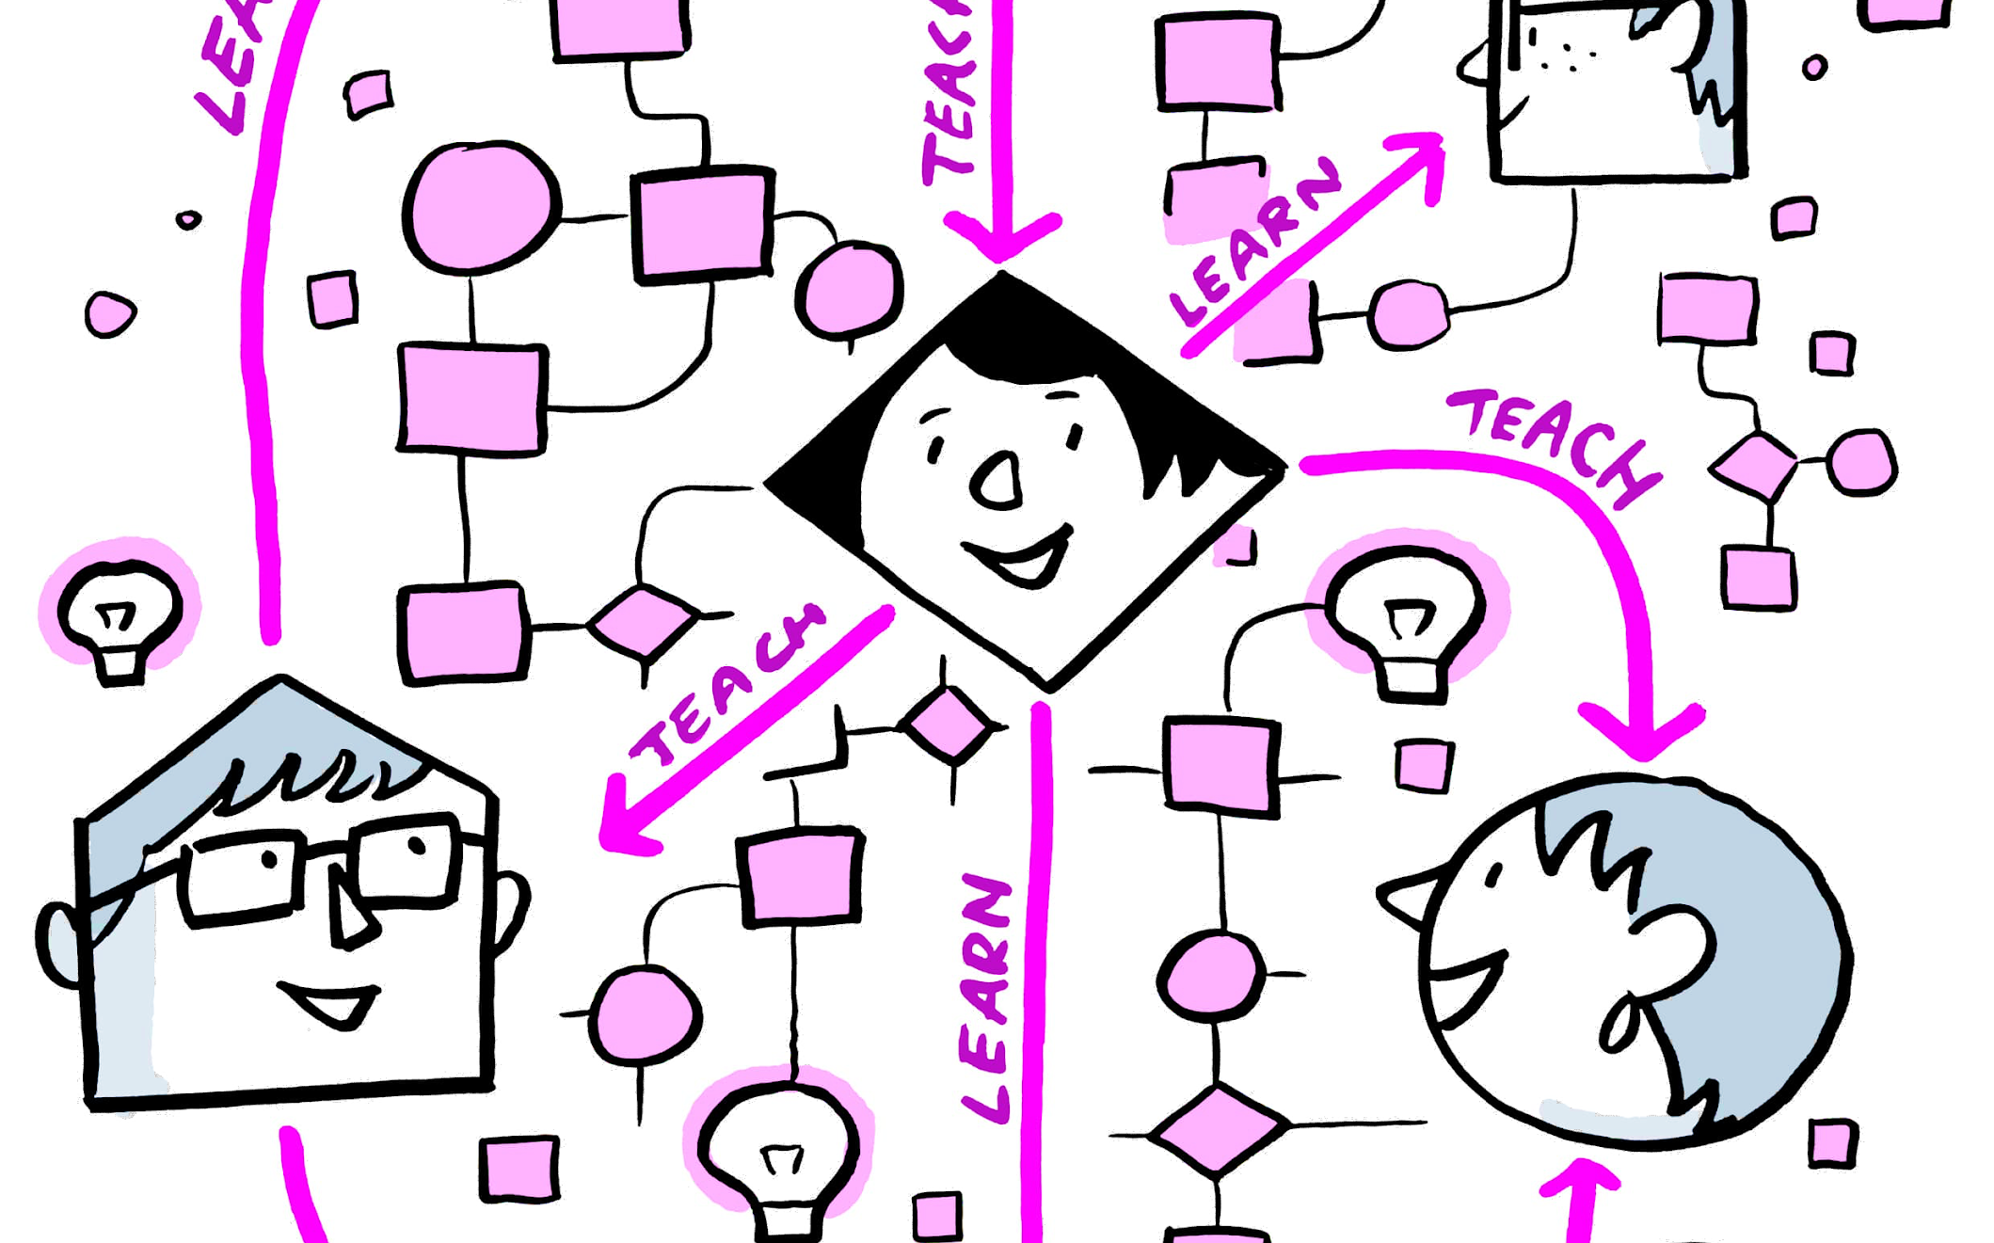
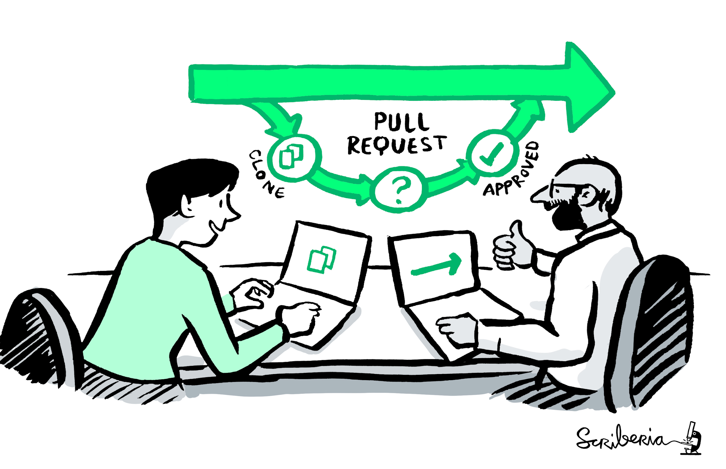
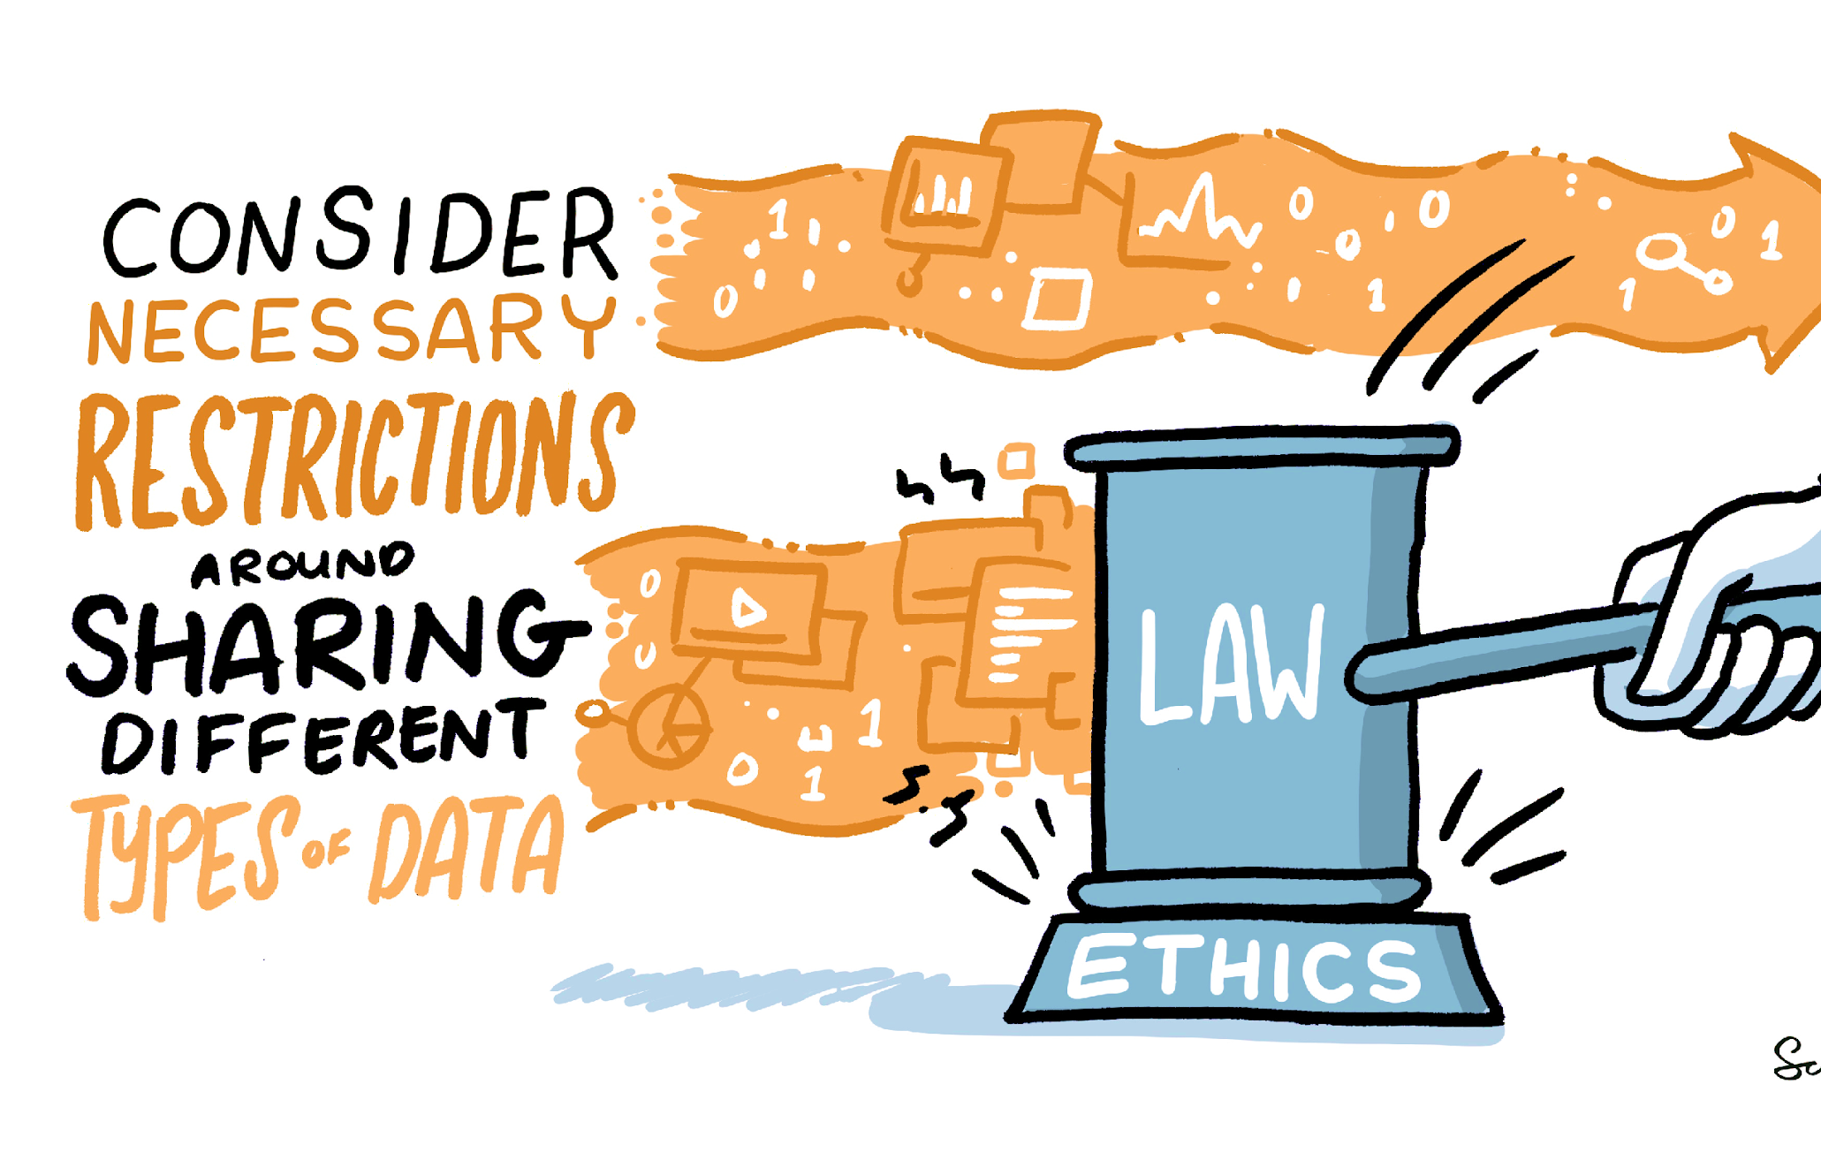
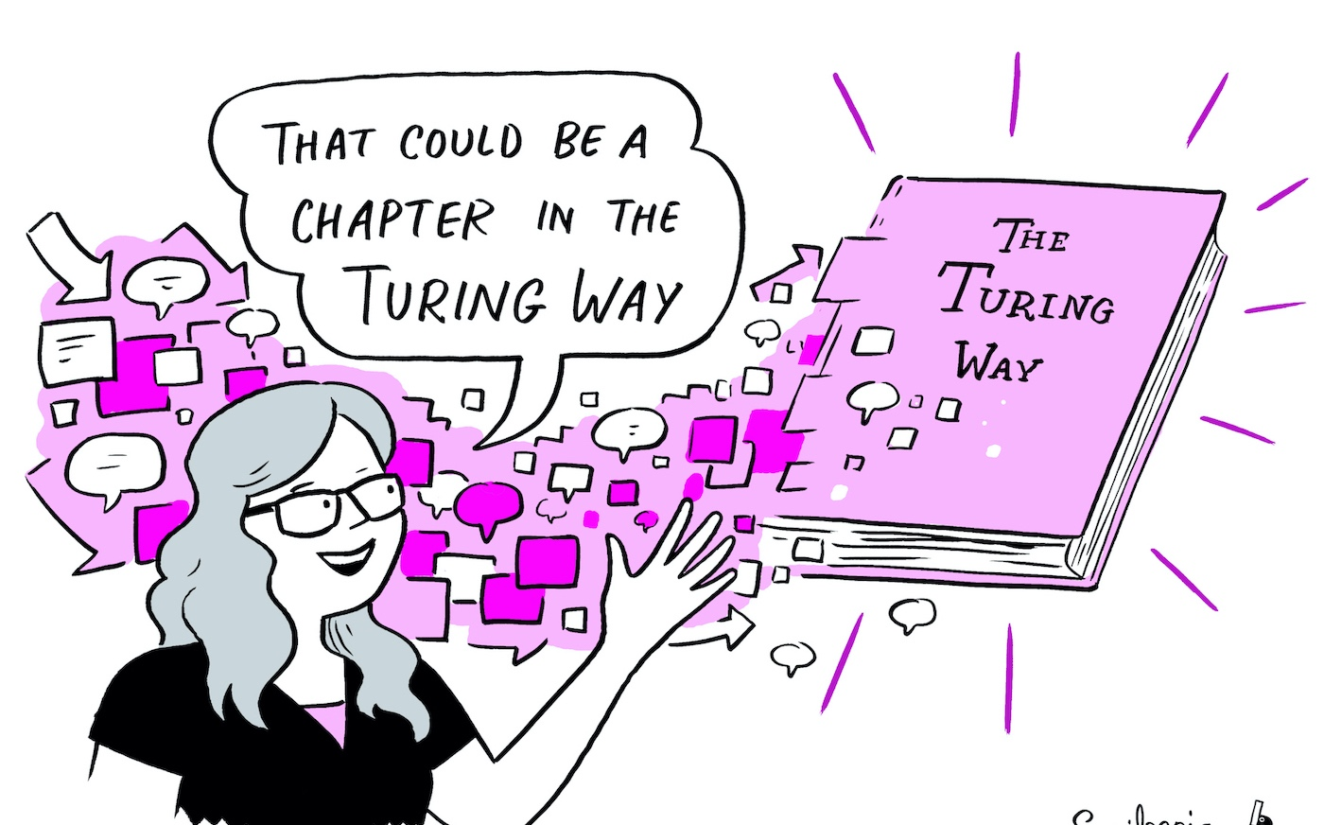
The Turing Way Guides
Reproducibility
Project Design
Communication
Collaboration
Ethical Research
Community Handbook
Notes:
In order to accommodate all these requirements in research and data science, the project expanded to include four more guides: in addition to the guide for reproducible research, we have guides for project design, communication, collaboration and ethical research.
We also record all the community practices that we are developing and practising within the Turing Way in our community handbook.

Slide 10
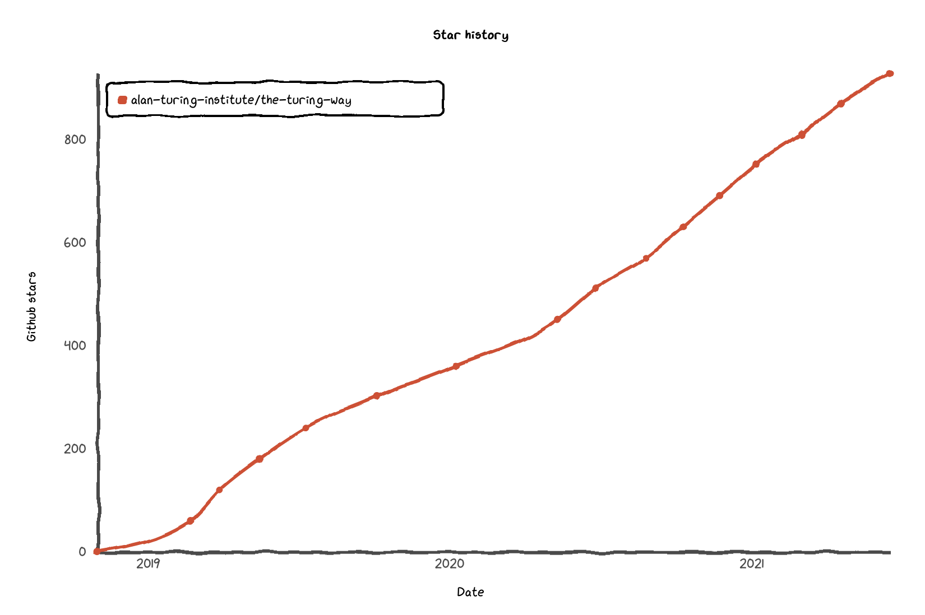







Project and Community Growth
2.5 years, >170 pages
Community resources, events, guidance, templates, training
275 direct GitHub contributors and thousands of users
https://zenodo.org/record/3332807
@malvikasharan @turingway, CC-BY 4.0, https://star-history.t9t.io/#alan-turing-institute/the-turing-way, DOI: 10.5281/zenodo.5083747
Notes:
We have seen our project and community grow in the last two years. We currently host over 160 sub-chapters across five guides.
In order to ensure that our community members are able to participate irrespective of their previous experience of working with the Open Source or data science community, we provide the resources, guidance, templates, training and pathways that they can use to stay involved in the community.
We have over 270 direct contributors on GitHub, where we develop our resources and 1000s of users. For example, our illustrations, which I have intensively used in my talk, have been downloaded over 5000 times.
We have over 550 subscribers of our newsletters, over 2000 Twitter followers and over 200 people who participate on Slack and witness the day to day conversations. For a community that started at a grassroot level, we are very grateful to have these members working with us.

Slide 11
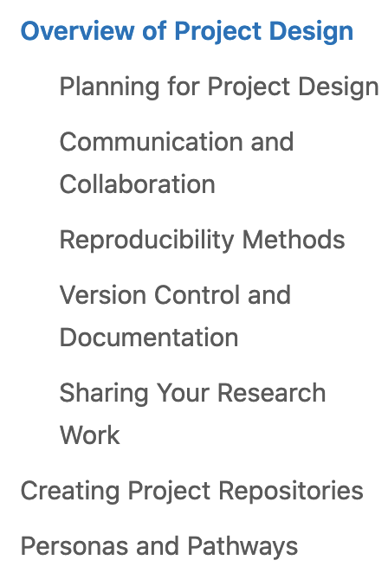
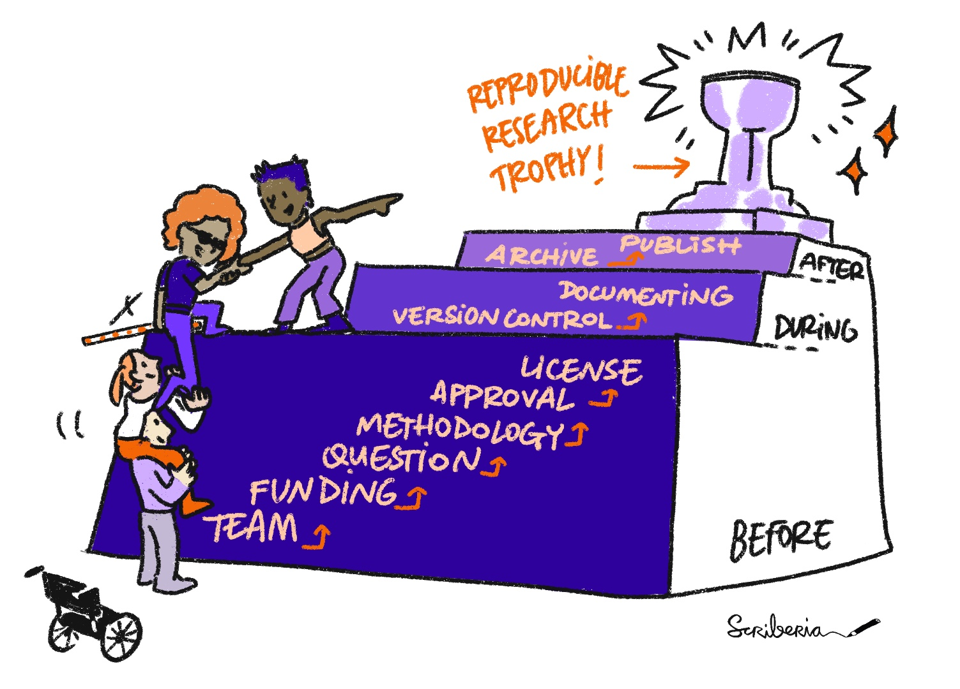

@malvikasharan @turingway, CC-BY 4.0, CC-BY image by The Turing Way and Scriberia, , DOI: 10.5281/zenodo.5083747
Notes:
The Turing Way is not a book that you read from cover to cover – you simply should not. Start with the tool, concept and method that you need now, in your current work.
We are working to improve how people interact with the book and give multiple entry point that people can select based on their area of research and project’s maturation level. If you are new to reproducibility and open science, I suggest you to start with the overview of project design. Mariana Vivas, a graduate student from Venezuela worked with me to curate important chapters on reproducibility, communication and collaboration approaches that we recommend any research projects to apply.

Slide 12
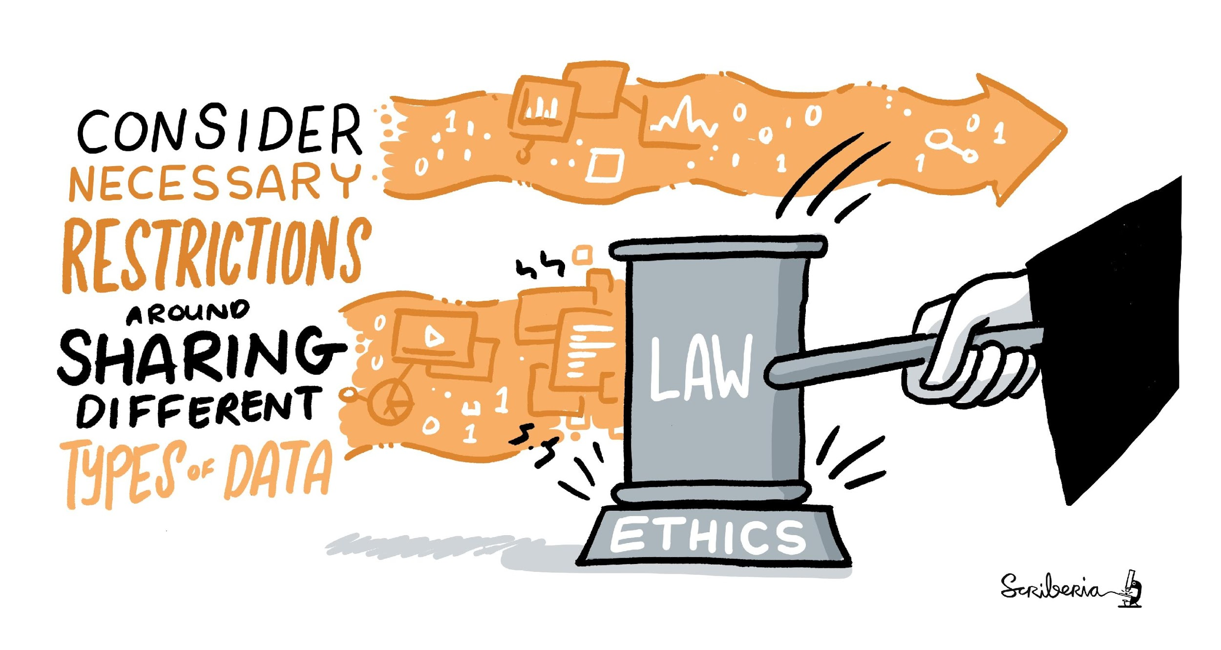
Ethical Research
Researchers in data science have an obligation to consider the ethical standards and their impact of people’s lives.
CC-BY 4.0, https://the-turing-way.netlify.app/ethical-research/ethical-research.html, DOI: 10.5281/zenodo.5083747
Notes:
With that background, I want to highlight the guide for ethical research.
The aim of is guide is to support data scientists - and researchers using data science - to work in an ethical way. We start from the position that as data science researchers, we have an obligation to consider the impact of our research.

Slide 13
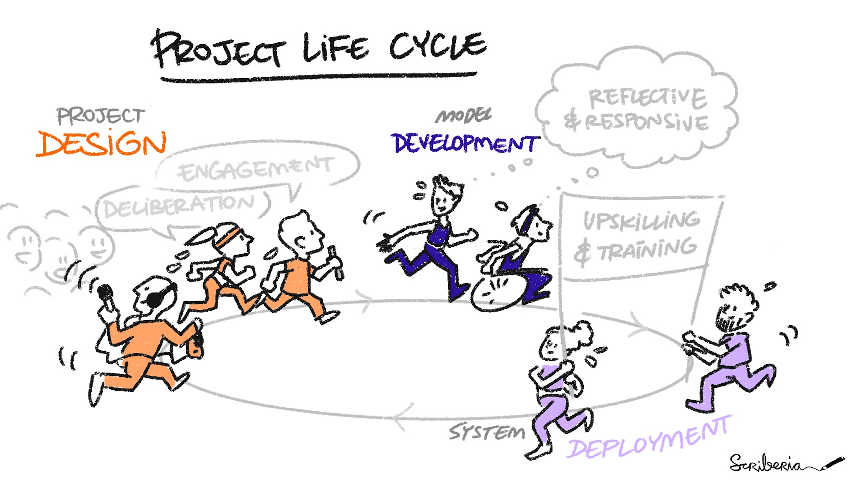
CC-BY 4.0, https://the-turing-way.netlify.app/ethical-research/ethical-research.html, DOI: 10.5281/zenodo.5083747
Christopher Burr | Automating Ethics. (2021, February 19https://chrisdburr.github.io/blog/automating-ethics/automating-ethics/
Notes:
As we already discussed, that we as researchers and data handlers make decisions throughout the lifecycle of our data-based projects – from project design to model development to system level deployment.
As scientists, we have a duty to ensure that our work meets the highest scientific standards. We also have an obligation to ensure that our work maintains the highest level of moral integrity: especially when it impacts people’s lives.
This impact on lives can be through the process we build in conducting the research, data we collect and use, or through the data products we build for others. It can also be through the policies that we follow at our organisations, and the working conditions that we create for others in our teams.

Slide 14
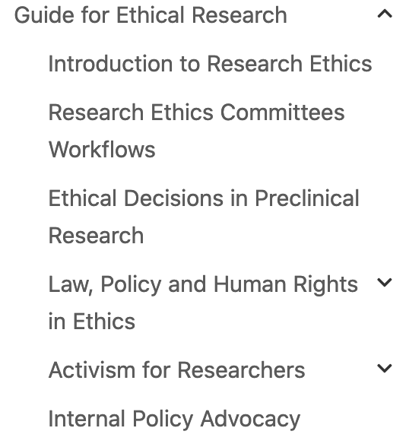
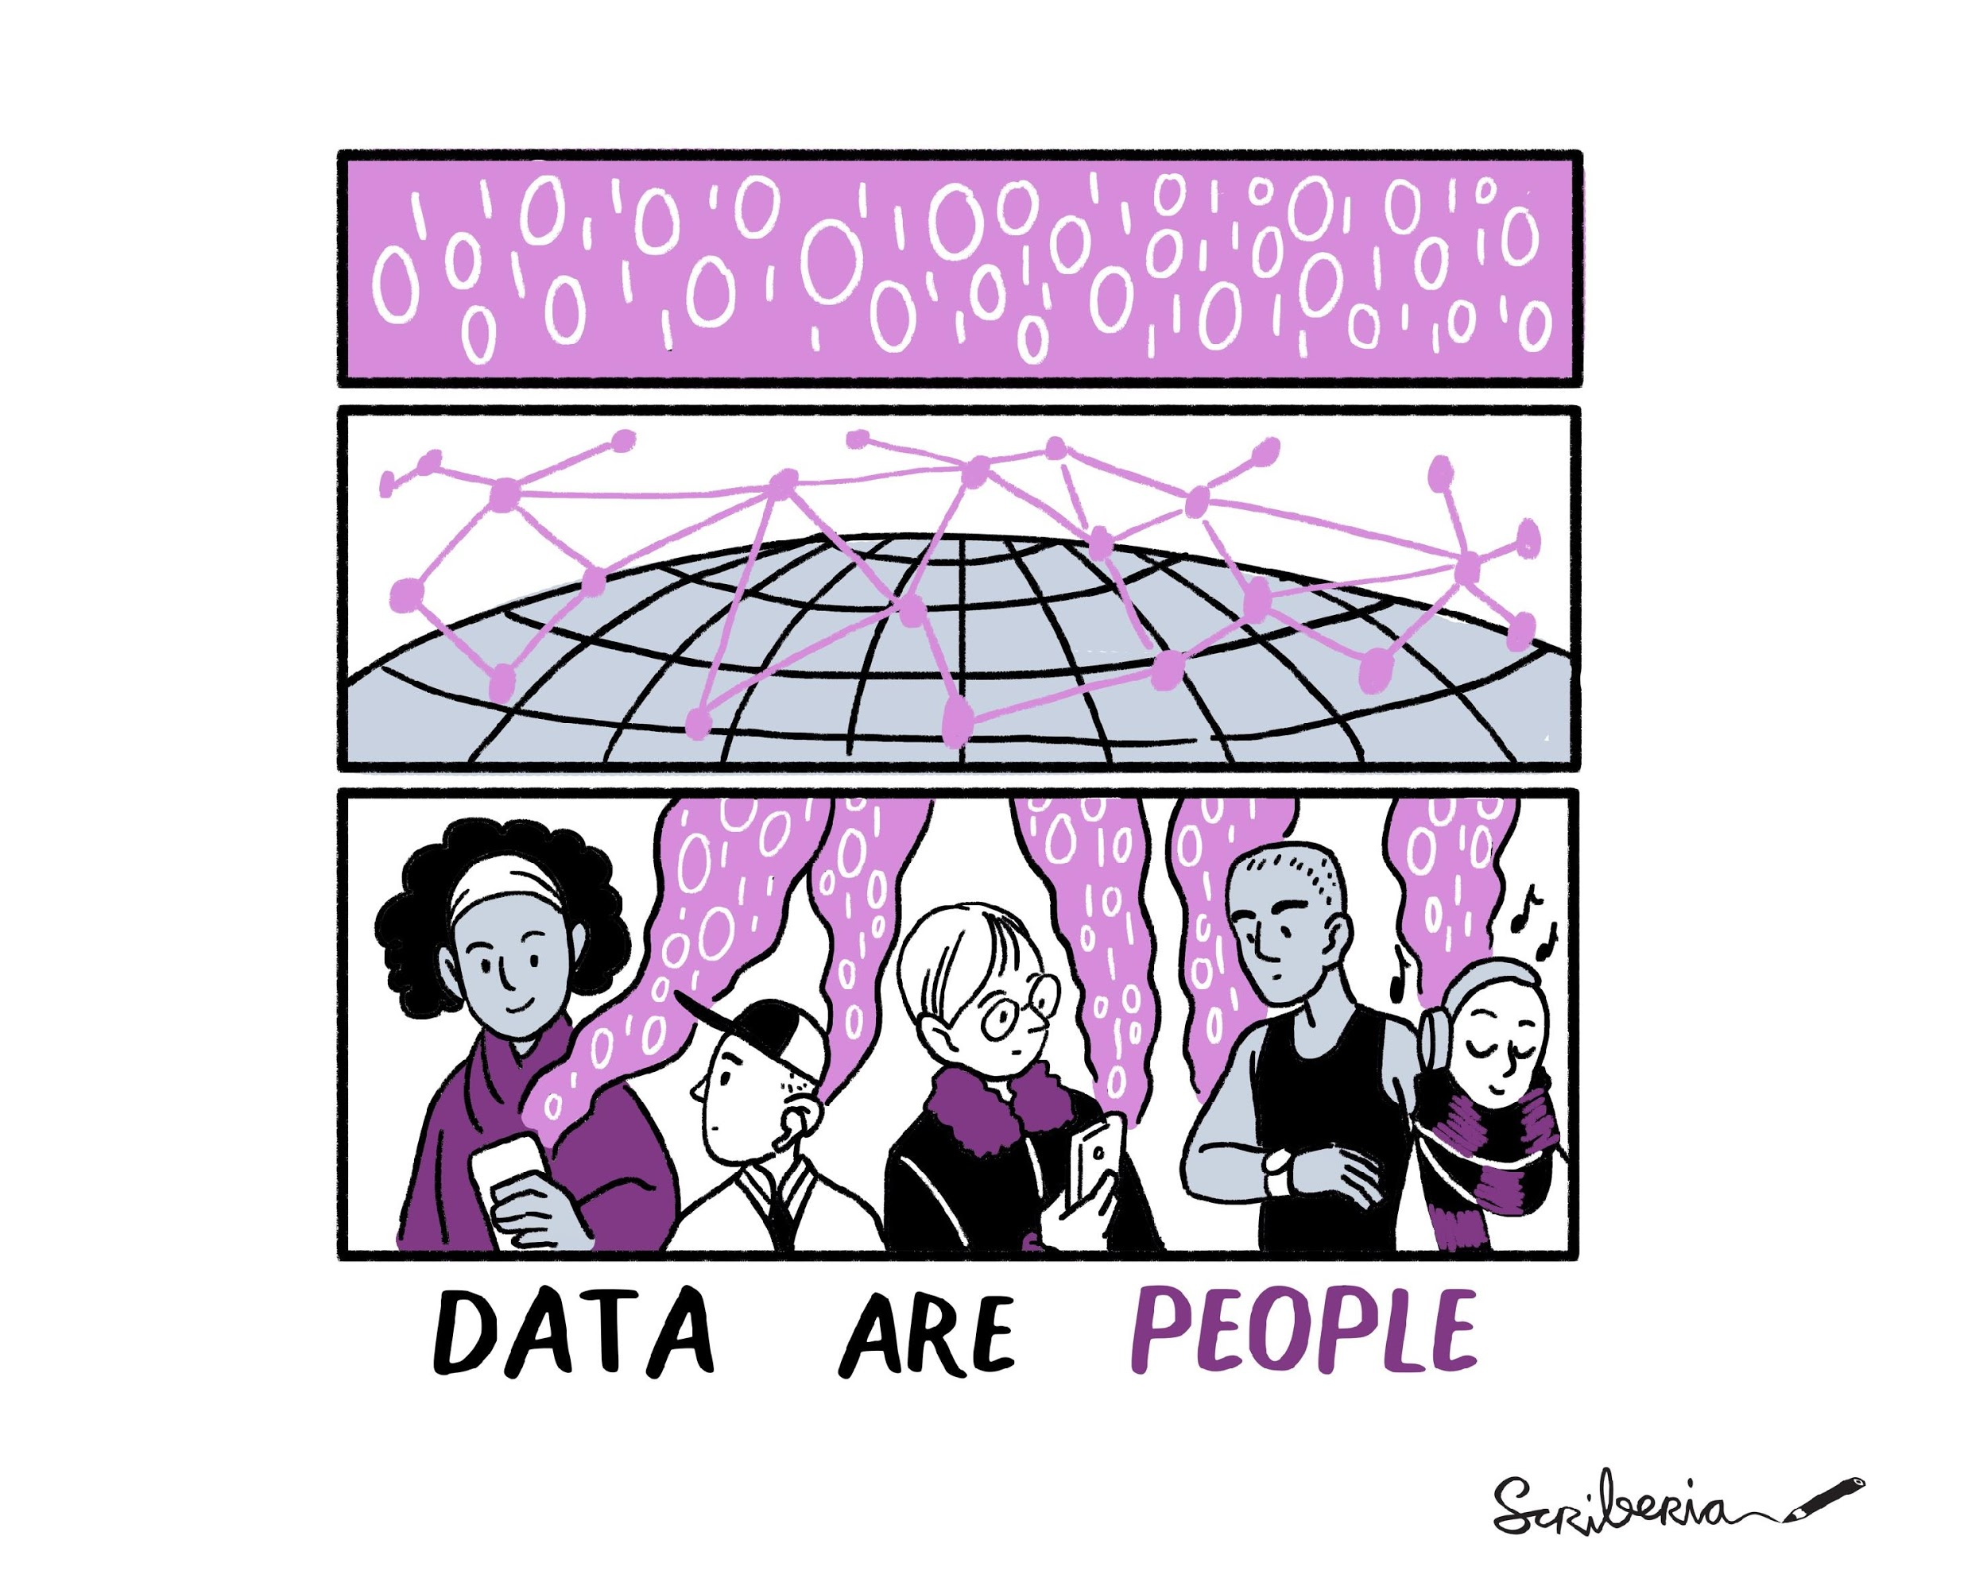
CC-BY 4.0, https://the-turing-way.netlify.app/ethical-research/ethical-research.html, DOI: 10.5281/zenodo.5083747
Core contributors: Laura Carter, Ismael Kherroubi-Garcia, Arielle Bennett, Laura Acion
Notes:
So far, contributors to the Guide to Ethical Research have contributed chapters introducing the concepts, case study on working with institutional ethics boards, ethics in preclinical research, and relationship between ethics, law, policy and human right.
But we don't see ethics as a static or one-off part of the research process. Ethical research includes recognising where your data comes from, and the impact of collecting and using it in your work.
I would like to acknowledge Laura Carter, Ismael Kerroubi Garcia, Arielle Bennett and Laura Acion who are the core contributors of this guide and mentored many new contributors in developing and reviewing resources.

Slide 15
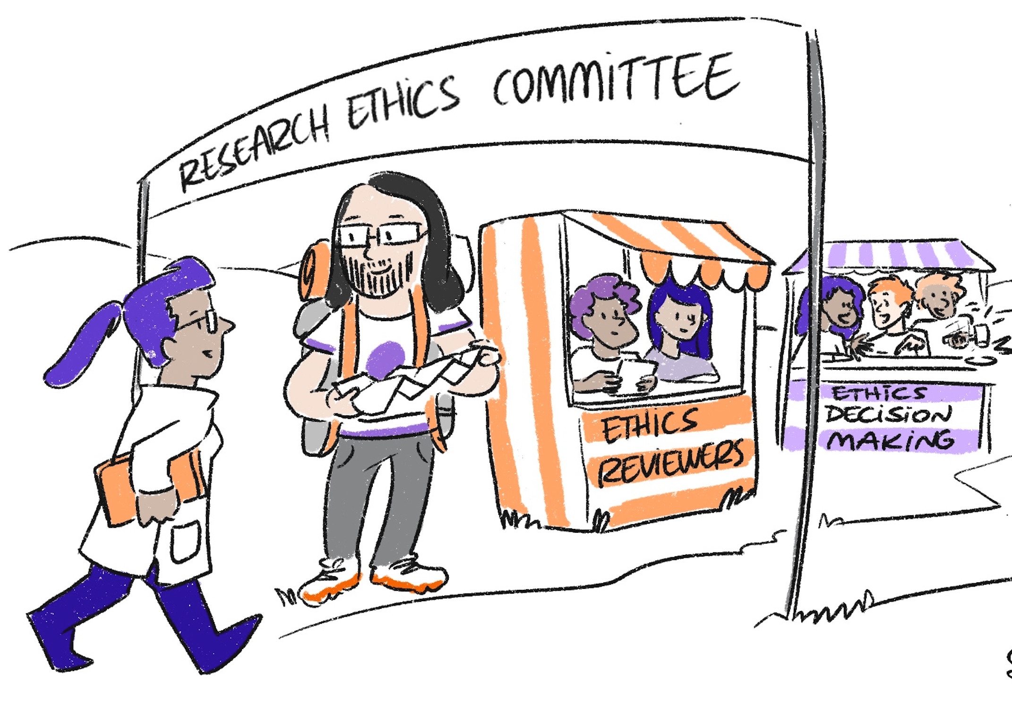

Areas of ethical concerns:
Project description
Data & Methodology
Consent
Privacy & Security
Societal Consequences
CC-BY 4.0, https://the-turing-way.netlify.app/ethical-research/ethics-case-study.html, DOI: 10.5281/zenodo.5083747
Owen, R., & Pansera, M. (2019). Responsible Innovation and Responsible Research and Innovation.
Notes:
In the current version of the guide, you can read a case study written by Ismael describing Research Ethics Committees Processes.There are many ways for research ethics committees to develop their review framework. In this case study, we explore five areas of ethical concerns where a review committee will raise questions that we should aim to address from the start. These areas include: Project description, Data & Methodology, Consent, Privacy & Security and Further Societal Consequences
You can read about why each of this element is important and specific considerations a researcher might make when preparing a response.

Slide 16
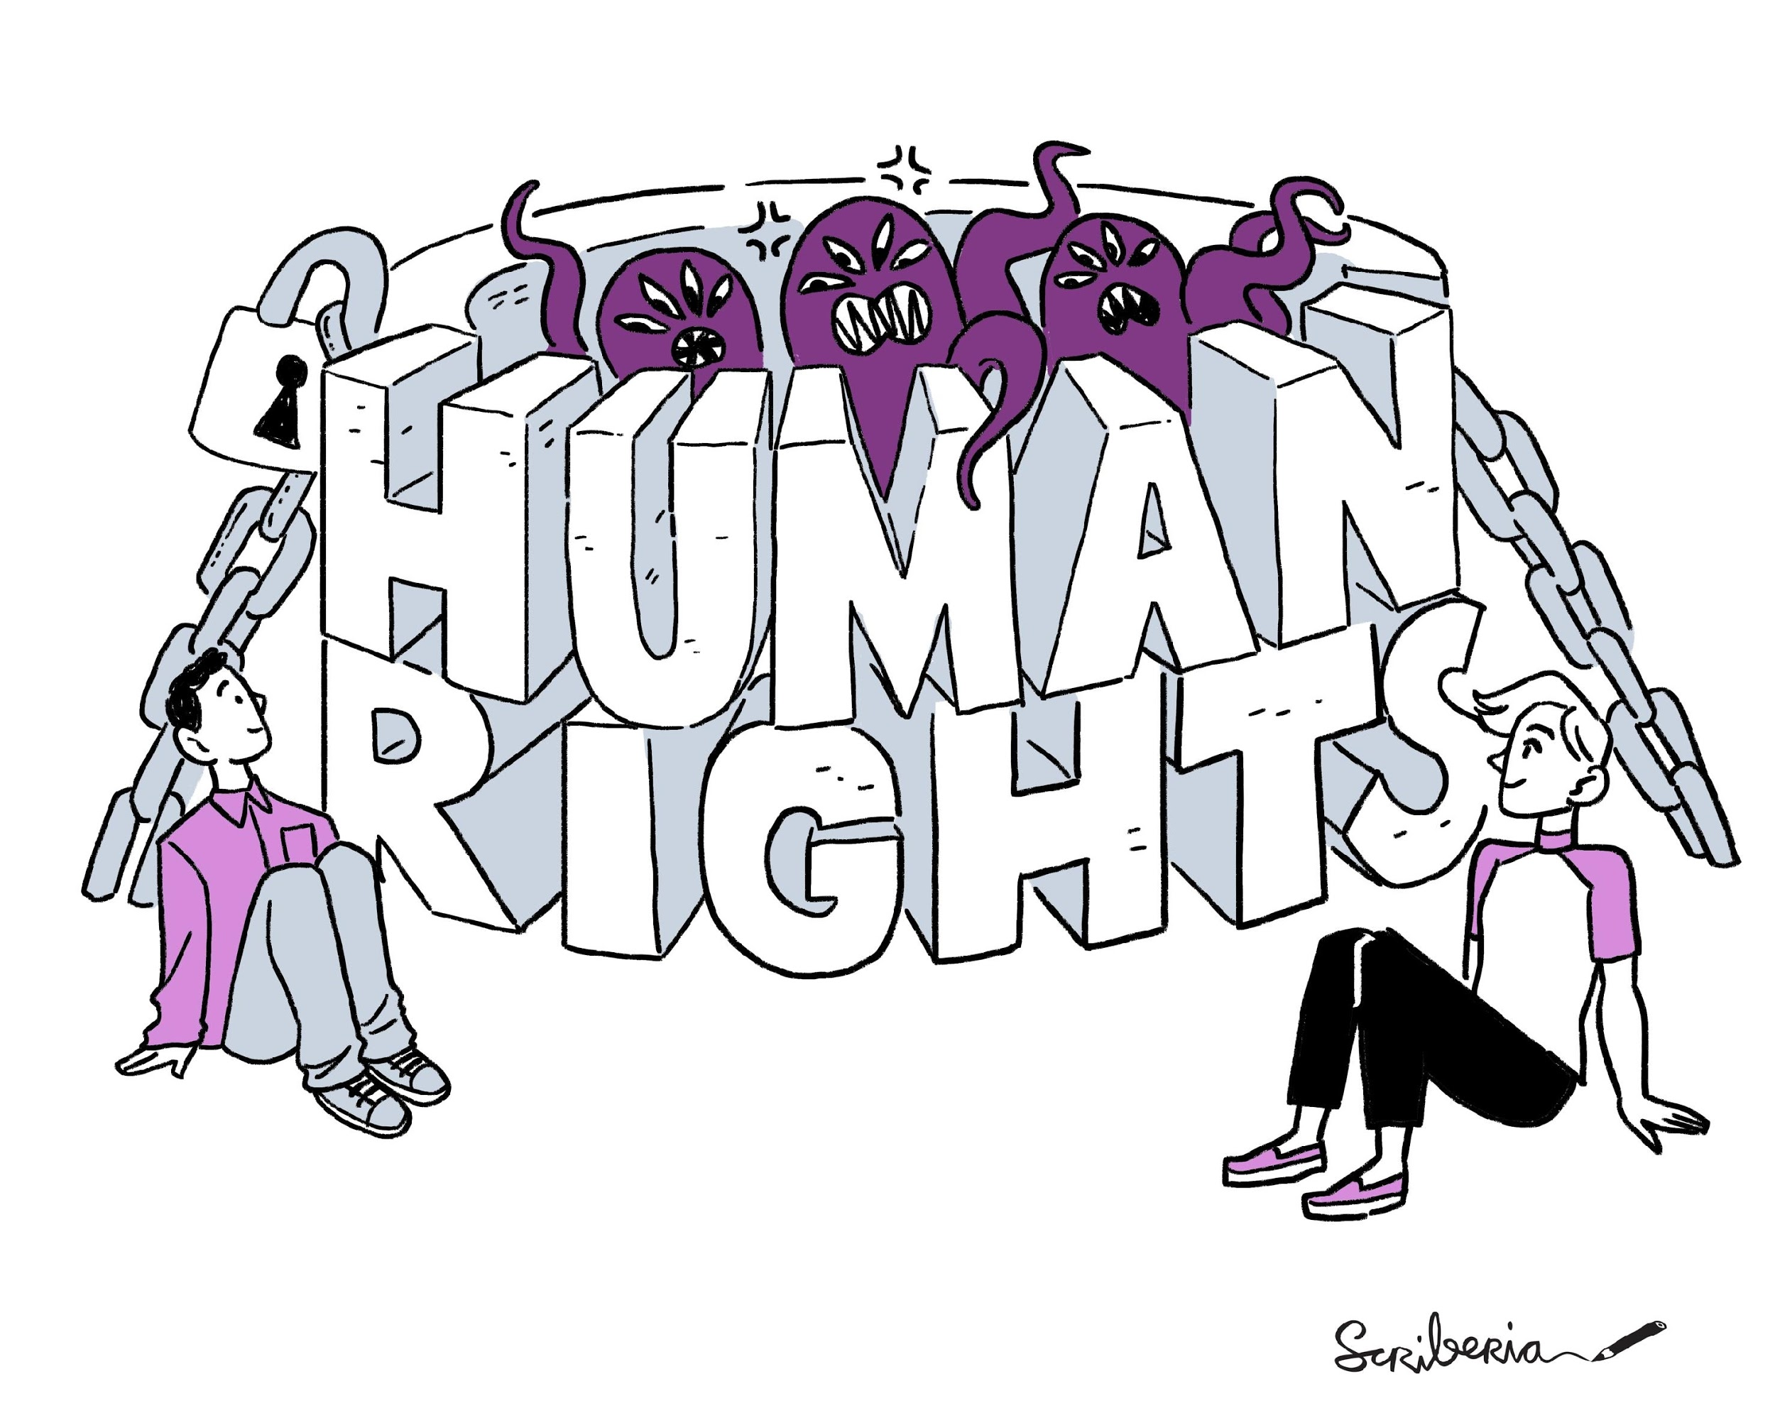
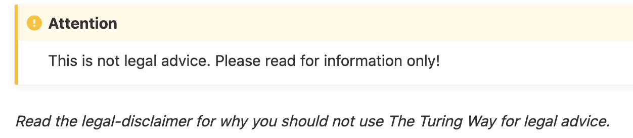

Researchers and data scientists should ensure that they respect, protect, and fulfil human rights.
https://the-turing-way.netlify.app/ethical-research/law-policy.html, The Universal Declaration of Human Rights at 70: Putting Human Rights at the Heart of the Design, Development and Deployment of Artificial Intelligence - HRBDT. (2019)
Notes:
Ethical data science research also includes making sure that ethical work is grounded within existing human rights frameworks. Laura Carter has written a chapter explaining the relation between ethics, law, policy and human rights.
In her words: Human rights are defined in law. This means in many ways they are less malleable than ethics. The laws governing human rights, and the ways that they are implemented, are agreed internationally. A violation of human rights is a violation wherever it happens.
This is not necessarily true of codes of ethics. An action that one group of people sees as ethical, may be seen as unethical by others.
There is a wider shared understanding of what human rights means across different countries, cultures and groups of people. It’s important to recognise that the work required to respect, protect, and fulfil human rights looks different for different people, and that means it’s important to listen to everyone about what being able to enjoy their human rights means to them
Making sure that research complies with human rights is not just about ensuring that it doesn't harm. It can also be about doing work that is actively pro-rights.
Researchers and data scientists should, in general ensure that they respect, protect, and fulfil human rights:
this means not doing work that itself abuses human rights
It also means trying to ensure that their work cannot be used by others to abuse human rights
And it also means doing work that actively helps other people be able to enjoy all their human rights
There are accountability and enforcement mechanisms within the human rights framework.
But because they are a legal framework, they are not as easily accessible, and hard to apply to the daily work of data science and research. Which is the ethical guidance and codes can be a useful way to interpret and implement human rights in their work.
Among other references, Laura highlights The Universal Declaration of Human Rights at 70: Putting Human Rights at the Heart of the Design, Development and Deployment of Artificial Intelligence

Slide 17
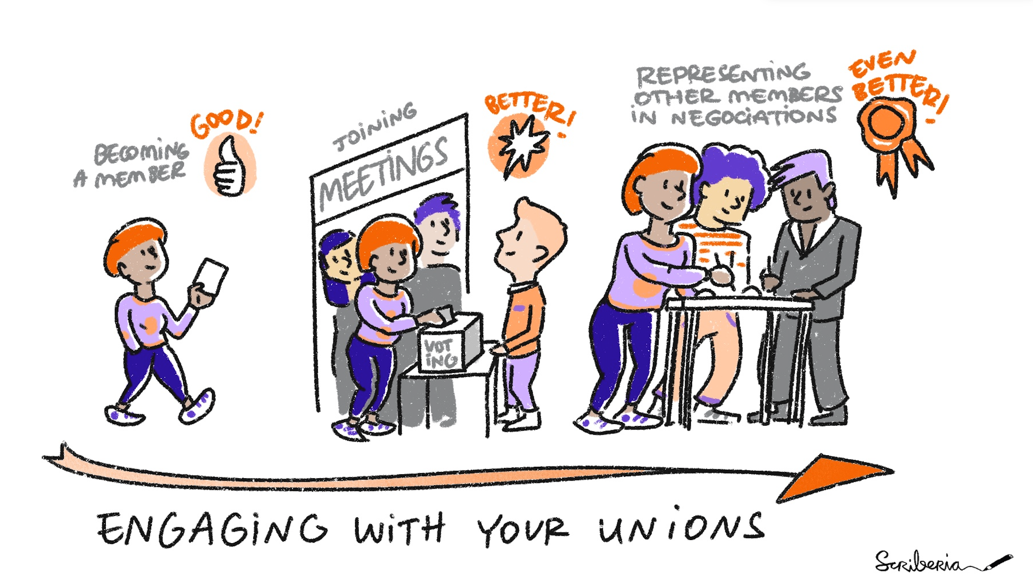
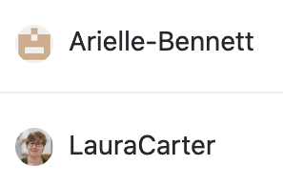
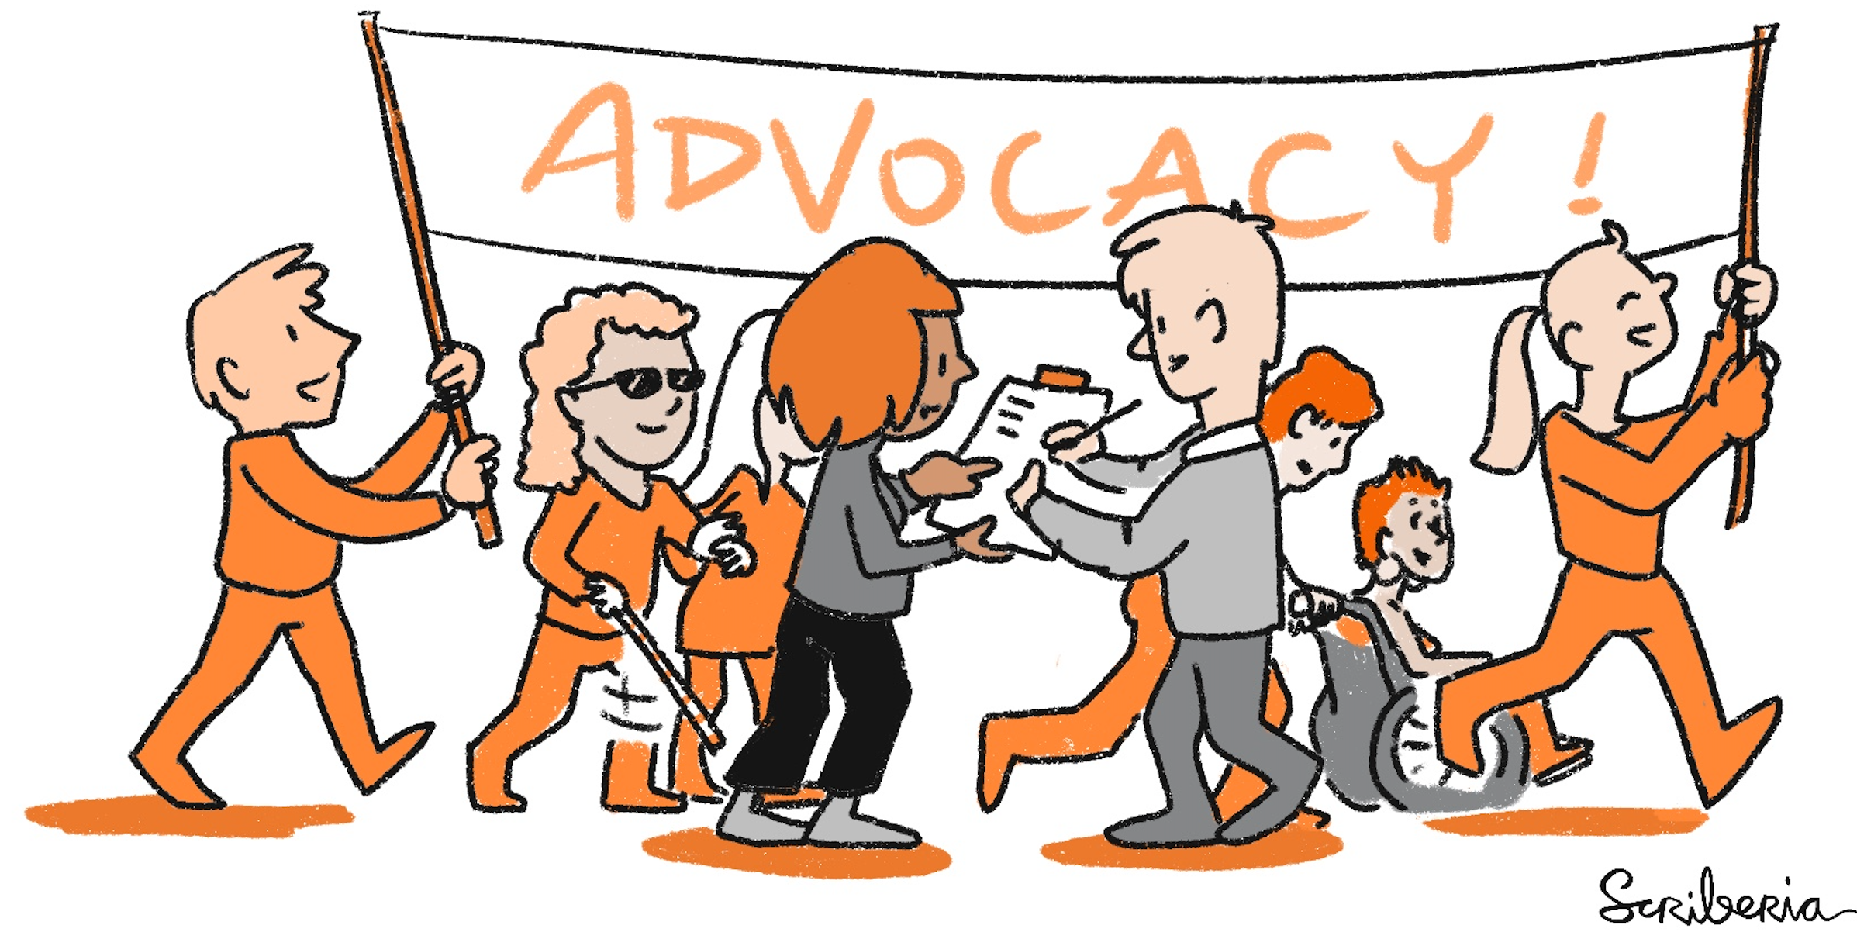
CC-BY 4.0, https://the-turing-way.netlify.app/ethical-research/activism.html, DOI: 10.5281/zenodo.5083747
Notes:
The Guide to Ethical Research also includes information on how to be an activist researcher. One of our most recent chapters is on how to advocate for policy change within your institution: if you don't like how something is done, you can work towards changing it!
We recognise that ethical research includes treating our colleagues and collaborators well and apply inclusive approaches in how we establish collaboration and acknowledge others work. The Guide to Ethical Research includes chapters advocacy and unions authored and mentored by Arielle Bennett and Laura. They discuss resources for workers’ rights for scientific workers and information about how you can join and support a union yourself!

Slide 18

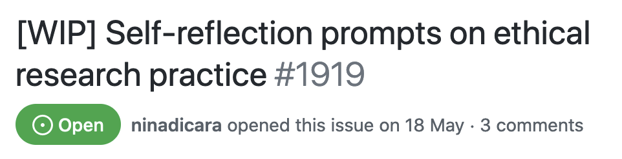
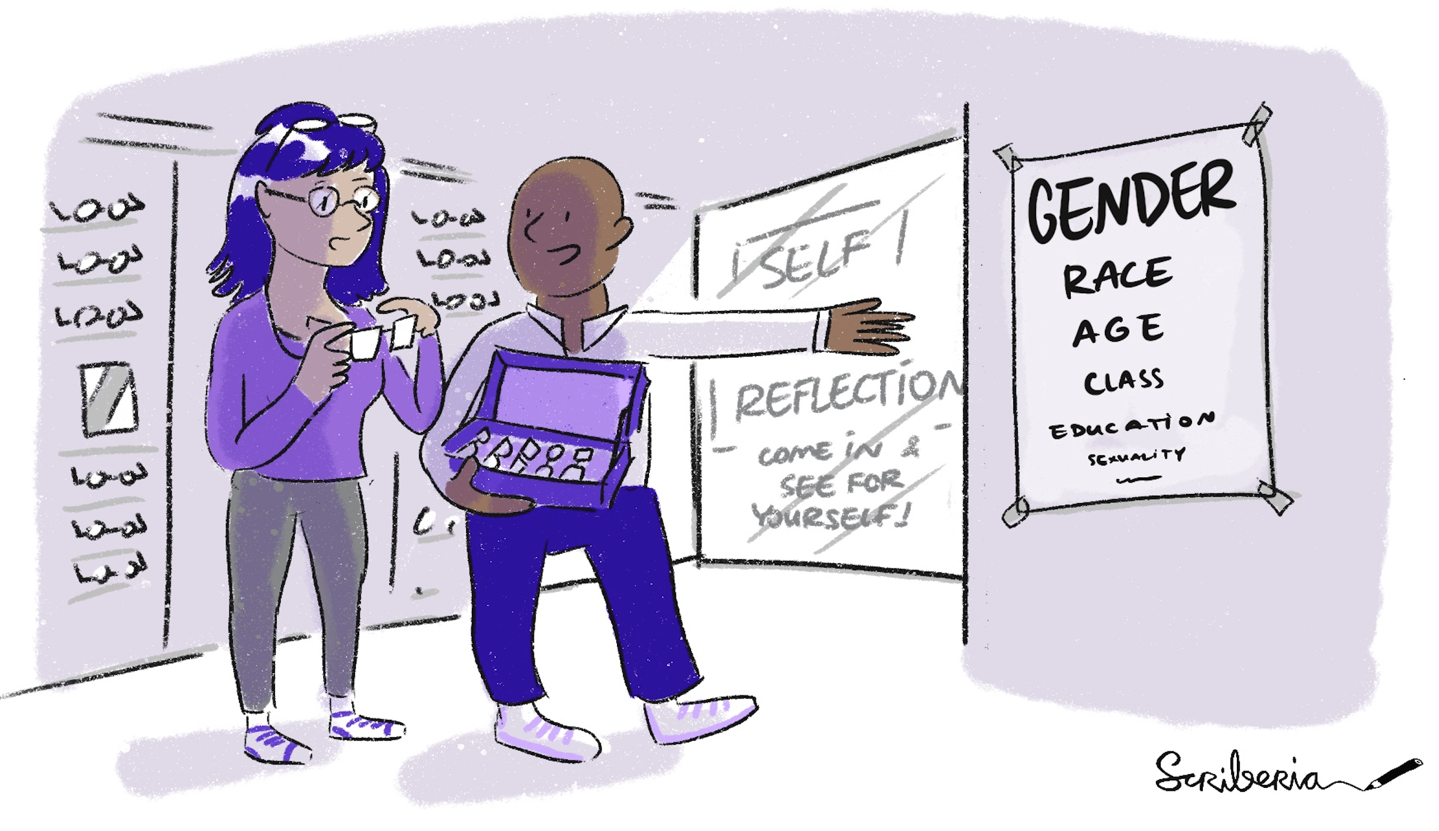
The questions we ask, the analysis we conduct the patterns are heavily influenced by the lenses by which we view the world.
Draft by Nina Di Cara
The Turing Way GitHub issue: https://github.com/alan-turing-institute/the-turing-way/issues/1919 ,
Haraway, D. (1988). Situated Knowledges: The Science Question in Feminism and the Privilege of Partial Perspective.
Ricker, B. (2017, February 04). Reflexivity, Positionality and Rigor in the Context of Big Data Research.
Notes:
Finally, there is a chapter available in the issue linked here which is being developed by Nina Di Cara with her discussions with other researchers and contributors that aims to encourage people to build a habit of self reflection on ethical research practice.
She quotes Donna Haraway’s paper describing how 'view from nowhere’ will be ideal in interpreting data studies, but realistically, our lived experiences including our culture, education, upbringing as well as experiences of oppression or success influence the ways we do research.
The questions we ask, the analysis we conduct the patterns are heavily influenced by the lenses by which we view the world.

Slide 19
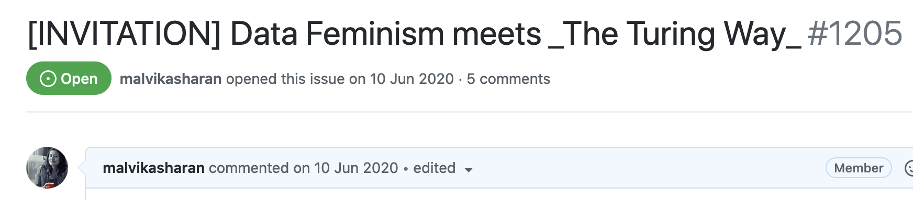
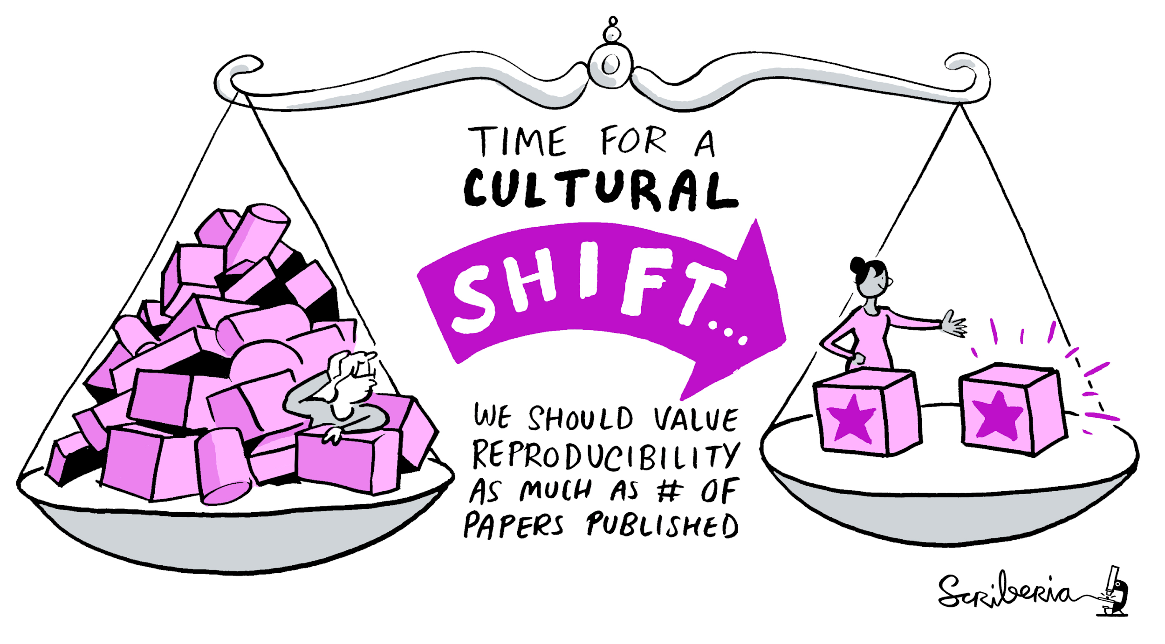
“Data Feminism" has not only shed light on imbalanced power structures underlying data science but also started a timely discussion around research ethics.
CC-BY 4.0, https://github.com/alan-turing-institute/the-turing-way/issues/1205, DOI: 10.5281/zenodo.5083747
Catherine D'Ignazio and Lauren Klein. 2019. Data Feminism. MIT Press.
Notes:
Finally, I would like to highlight data feminism book by Catherine D-Ignazio and Lauren Klein that highly aligns with The Turing Way’s mission and vision.
“Data Feminism" has not only shed light on imbalanced power structures underlying data science but also started a timely discussion around research ethics.
If you have read it or plan to read it, I invite you to help sprinkle the knowledge across the guide for ethical research.

Slide 20
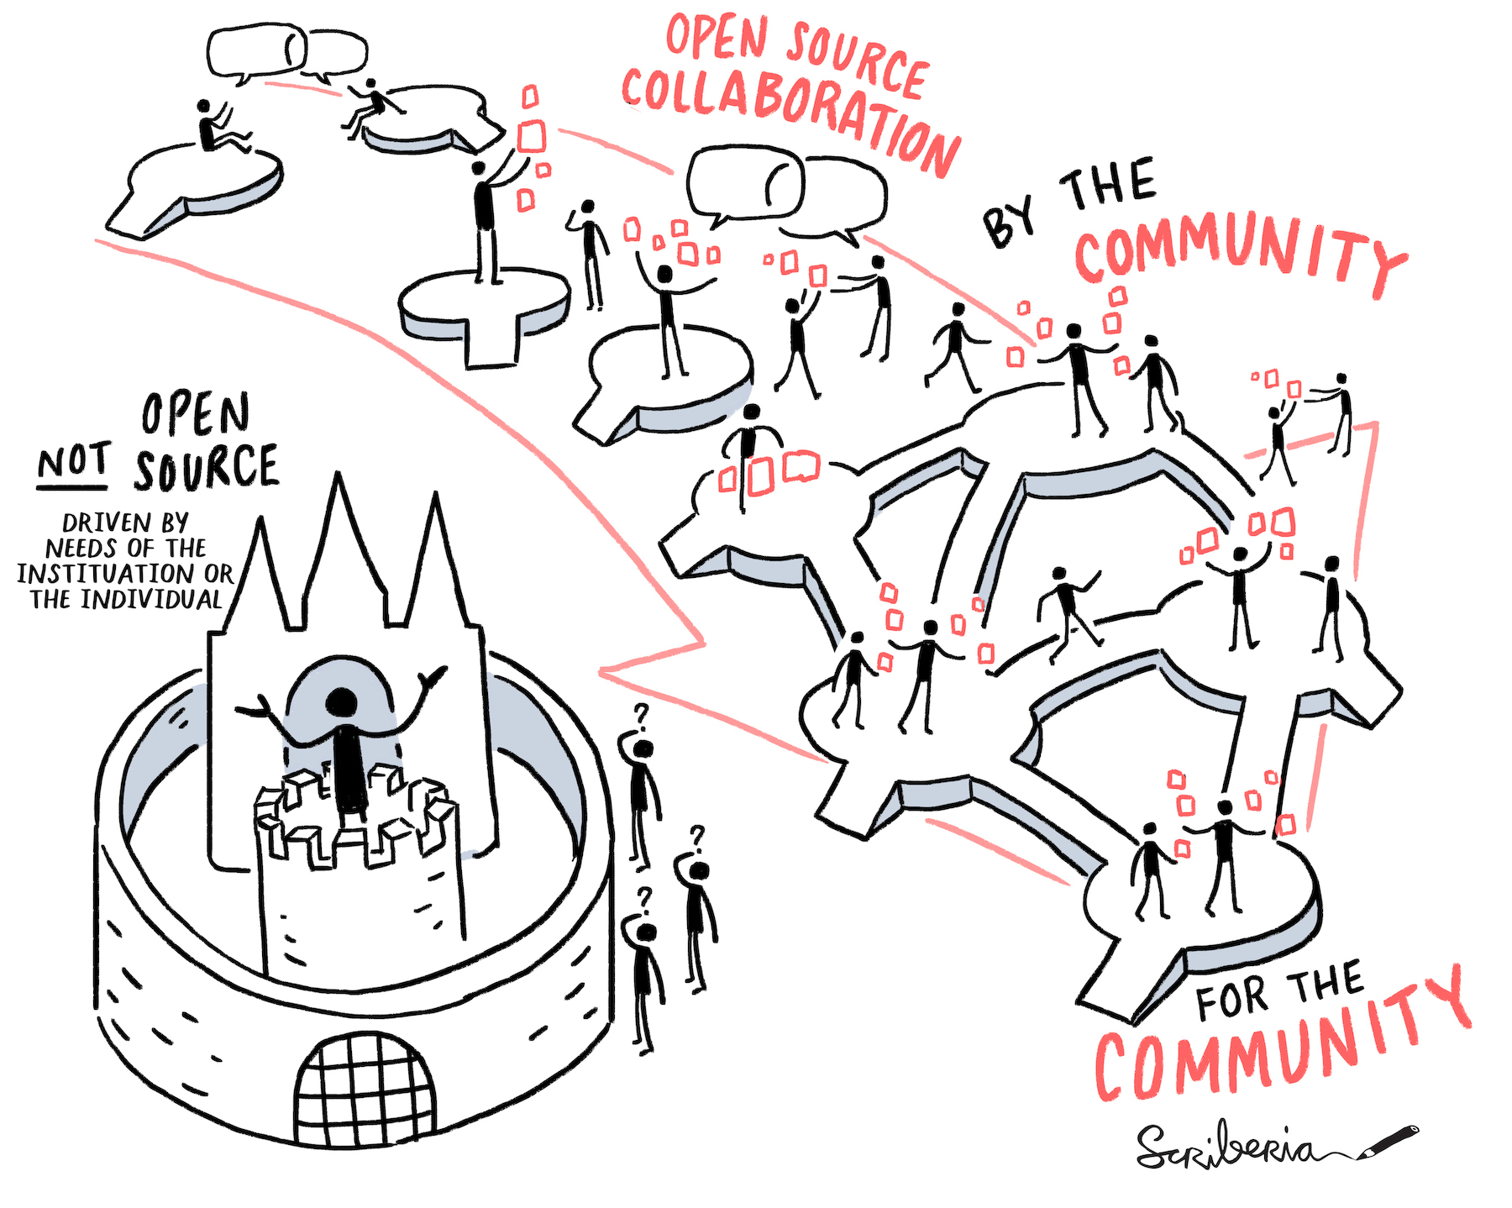
The Turing Way Community Framework
We avoid individual authorship in favour of establishing shared ownership and agency in this project. The project belongs to the community and is always a ‘work in progress’.
CC-BY 4.0, https://the-turing-way.netlify.app/community-handbook/community-handbook.html, DOI: 10.5281/zenodo.5083747
Kelly, Anthony, "With Head, Heart and Hand: Dimensions of Community Building" (Boolarong Press) ISBN 978-0-86439-076-9
Notes:
I want to return to The Turing Way project as a whole to discuss our community framework where our contributors and researchers collaborate.
The key to intentional community building is to have more people involved in the decision-making process. This means that diverse contributors are given opportunities to come into the project with different perspectives, participate in the development process and integrate their combined values in the product by-design. Only such a product will truly be relatable, useful and beneficial to diverse users.

Slide 21

Open leadership is a set of practices and skills people can use and build projects that allows them to collaborate within inclusive communities.
@malvikasharan @turingway, DOI: 10.5281/zenodo.5083747
Open Leadership Program
Notes:
We use Open leadership principles in the core of our processes. Open leadership is a set of practices and skills people can use in projects that allows them to collaborate within an inclusive community.

Slide 22

Design for Collaboration
Understanding
Your work is clear, authentic and widely accessible
@malvikasharan, CC-BY 4.0, DOI: 10.5281/zenodo.5083747
Open Leadership Program
Notes:
We use Open leadership principles in the core of our processes. Open leadership is a set of practices and skills people can use in projects that allows them to collaborate within an inclusive community.
There are three simple rules of open leadership practices:
1) understanding: so that your work is clear, authentic and widely accessible.

Slide 23

Design for Collaboration
Understanding
Sharing
Your work can be adapted, reproduced, and built upon
@malvikasharan, CC-BY 4.0, DOI: 10.5281/zenodo.5083747
Open Leadership Program
Notes:
2) Sharing: so that your work can be adapted, reproduced or built upon by others.

Slide 24

Design for Collaboration
Understanding
Sharing
Participation & Inclusion
Creates a shared ownership that inspires contributions
@malvikasharan, CC-BY 4.0, DOI: 10.5281/zenodo.5083747
Open Leadership Program
Notes:
3) participation and inclusion so that we create a sense for shared ownership, that inspires contributions.

Slide 25
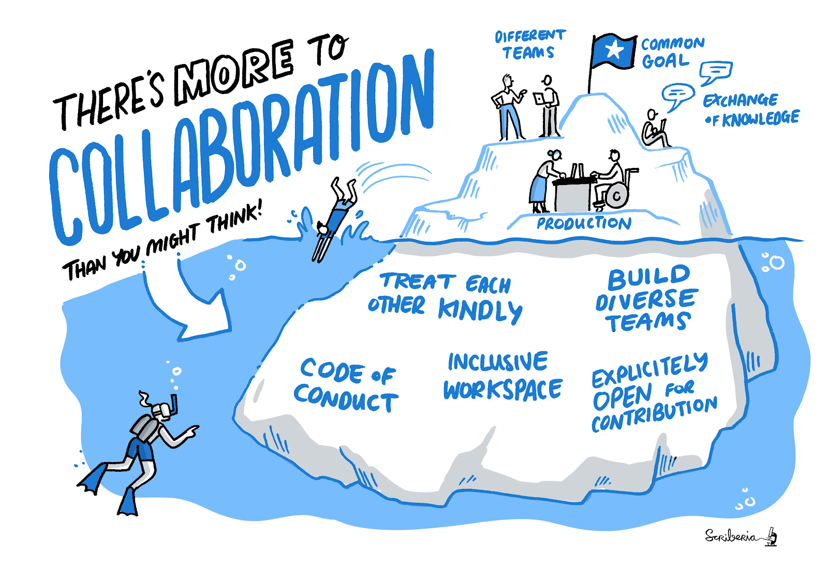

Every contribution counts
The Turing Way fosters a culture of collaboration
@malvikasharan, @turingway, CC-BY image by The Turing Way and Scriberia, DOI: 10.5281/zenodo.5083747
Open Leadership principles
Notes:
In The Turing Way, every little contribution counts. We foster a culture of collaboration by ensuring that the collaboration is not defined just by the common goals, product or the team. But, we also take time to make sure that people are given the inclusive workspace that they need to perform their best. That they treat each other kindly, abide by the code of conduct, know what roles they can take, and contribute to building diverse teams by explicitly opening ideas for contributions. In all our work, we apply open leadership principles.

Slide 26
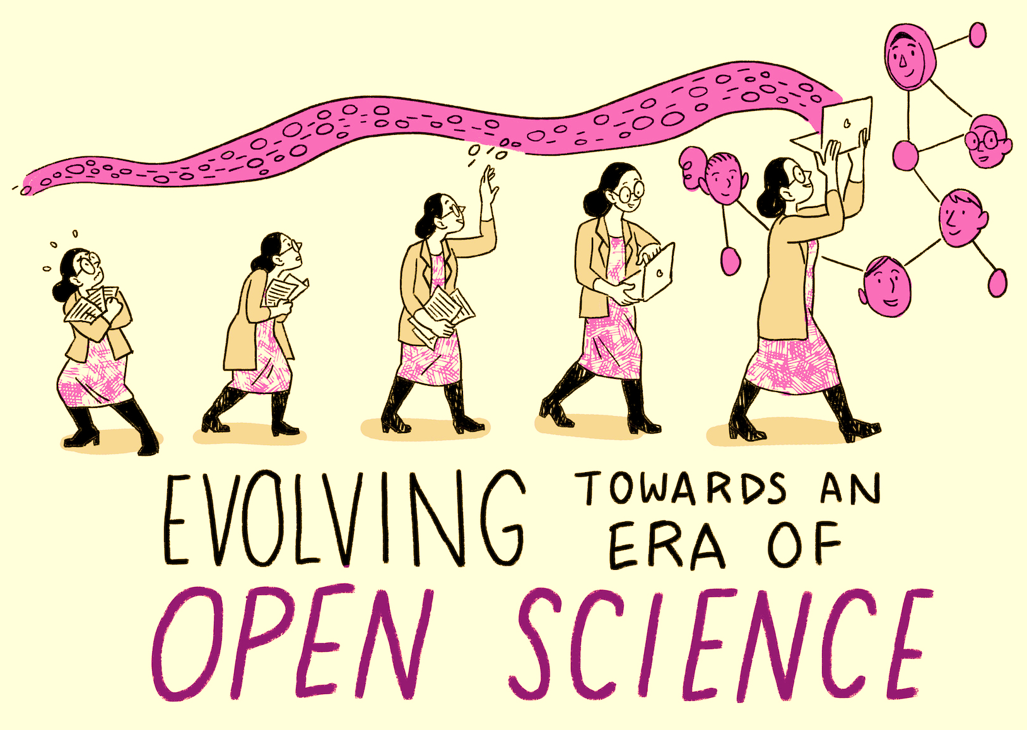
Building an Open and Collaborative Community
Open is by default not:
Inclusive
Accessible
Community-led
Intentional designing
@malvikasharan, @turingway, CC-BY image by The Turing Way and Scriberia, DOI: 10.5281/zenodo.5083747
Notes:
In order to make collaboration successful and effective among open source community members, we need to first understand and accept that open, by default, is not: inclusive, accessible, or community-led. By definition, as we saw, the Open Source community only means that people are collaborating to build something which will be made available online - and honestly, that is not enough. We need to bring people in!
If we want these aspects to become part of the process, we need to intentionally design our project to make people a part of the development process. The human-centred design approach to make sure that we move from open to inclusive practices in the community, which is accessible for everyone and where everyone's contributions count.

Slide 27
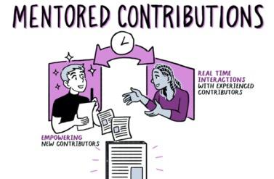
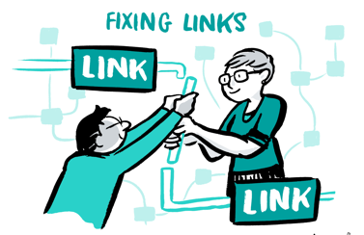
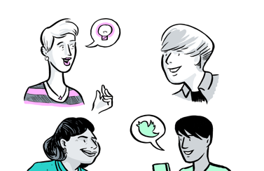

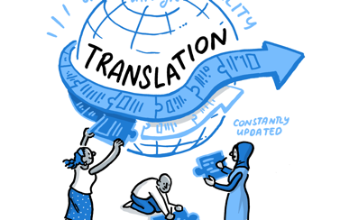
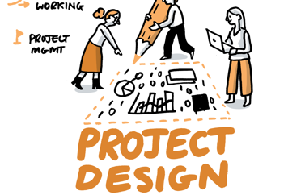
Pathways for Collaboration
Develop & share
Maintain & improve
Share resources
Review and update
Make it global
Share best practices
Notes:
We define pathways for collaboration that always require multiple people to support each other. For example, people are invited to develop and share resources through mentored contributions,
We also create opportunities for people to maintain and improve resources which could be as simple as fixing a broken link or a bug, or creating new resources of their interest. Contributors are also those who share these resources, review and update the existing chapters and translate them in languages that ensure accessibility for a wonder community. Finally, we encourage everyone to share best practices by highlighting their work.

Slide 28
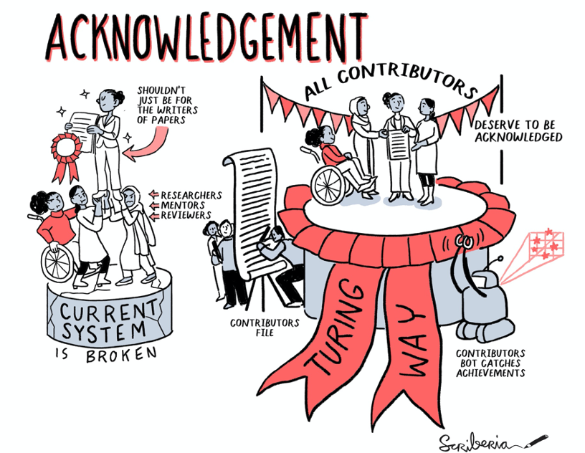
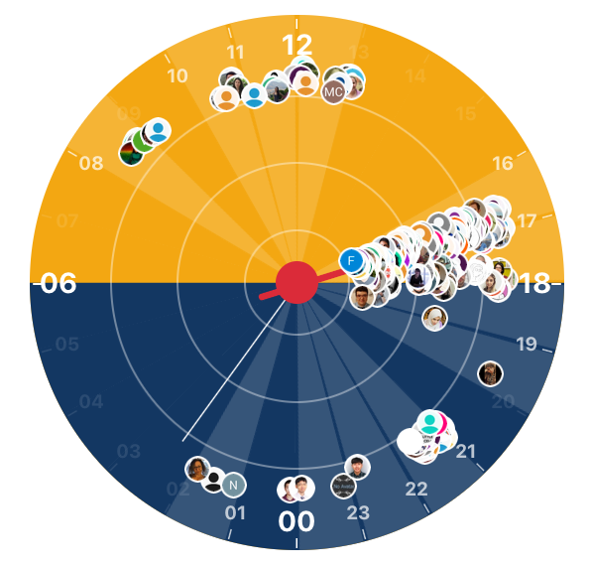
A community-oriented collaborative book
Community members from Slack in different time zones
Time Zone distribution by https://whena.re, @LauraC_rter, @malvikasharan, DOI: 10.5281/zenodo.5083747
Notes:
To represent different perspectives, It’s important to us that the book is a community project: driven by the needs and wishes of the contributors, and built with those needs in mind. We involve diverse voices and acknowledge all contributions fairly. We understand, that if we do not recognise all contributions, we will end up disproportionately ignoring the hidden labour that a lot of people do, and especially those who are new to the tech communities. Often those people are members of marginalised groups who have historically been excluded from Open Source and tech spaces.
As a community-developed resource, The Turing Way Guide to Ethical Research is a work in progress: and it’s open source, We have contributors from all over the world – you can see the time zones they are in here.

Slide 29
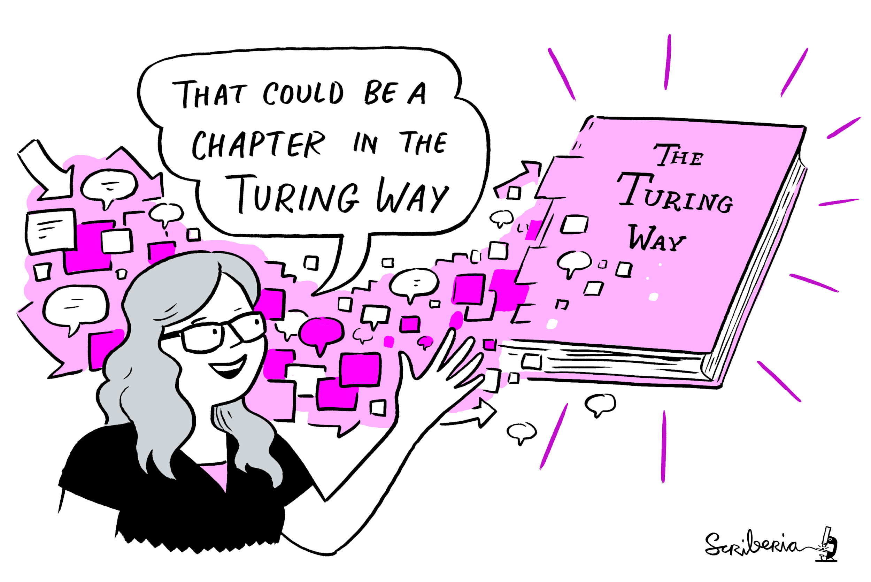
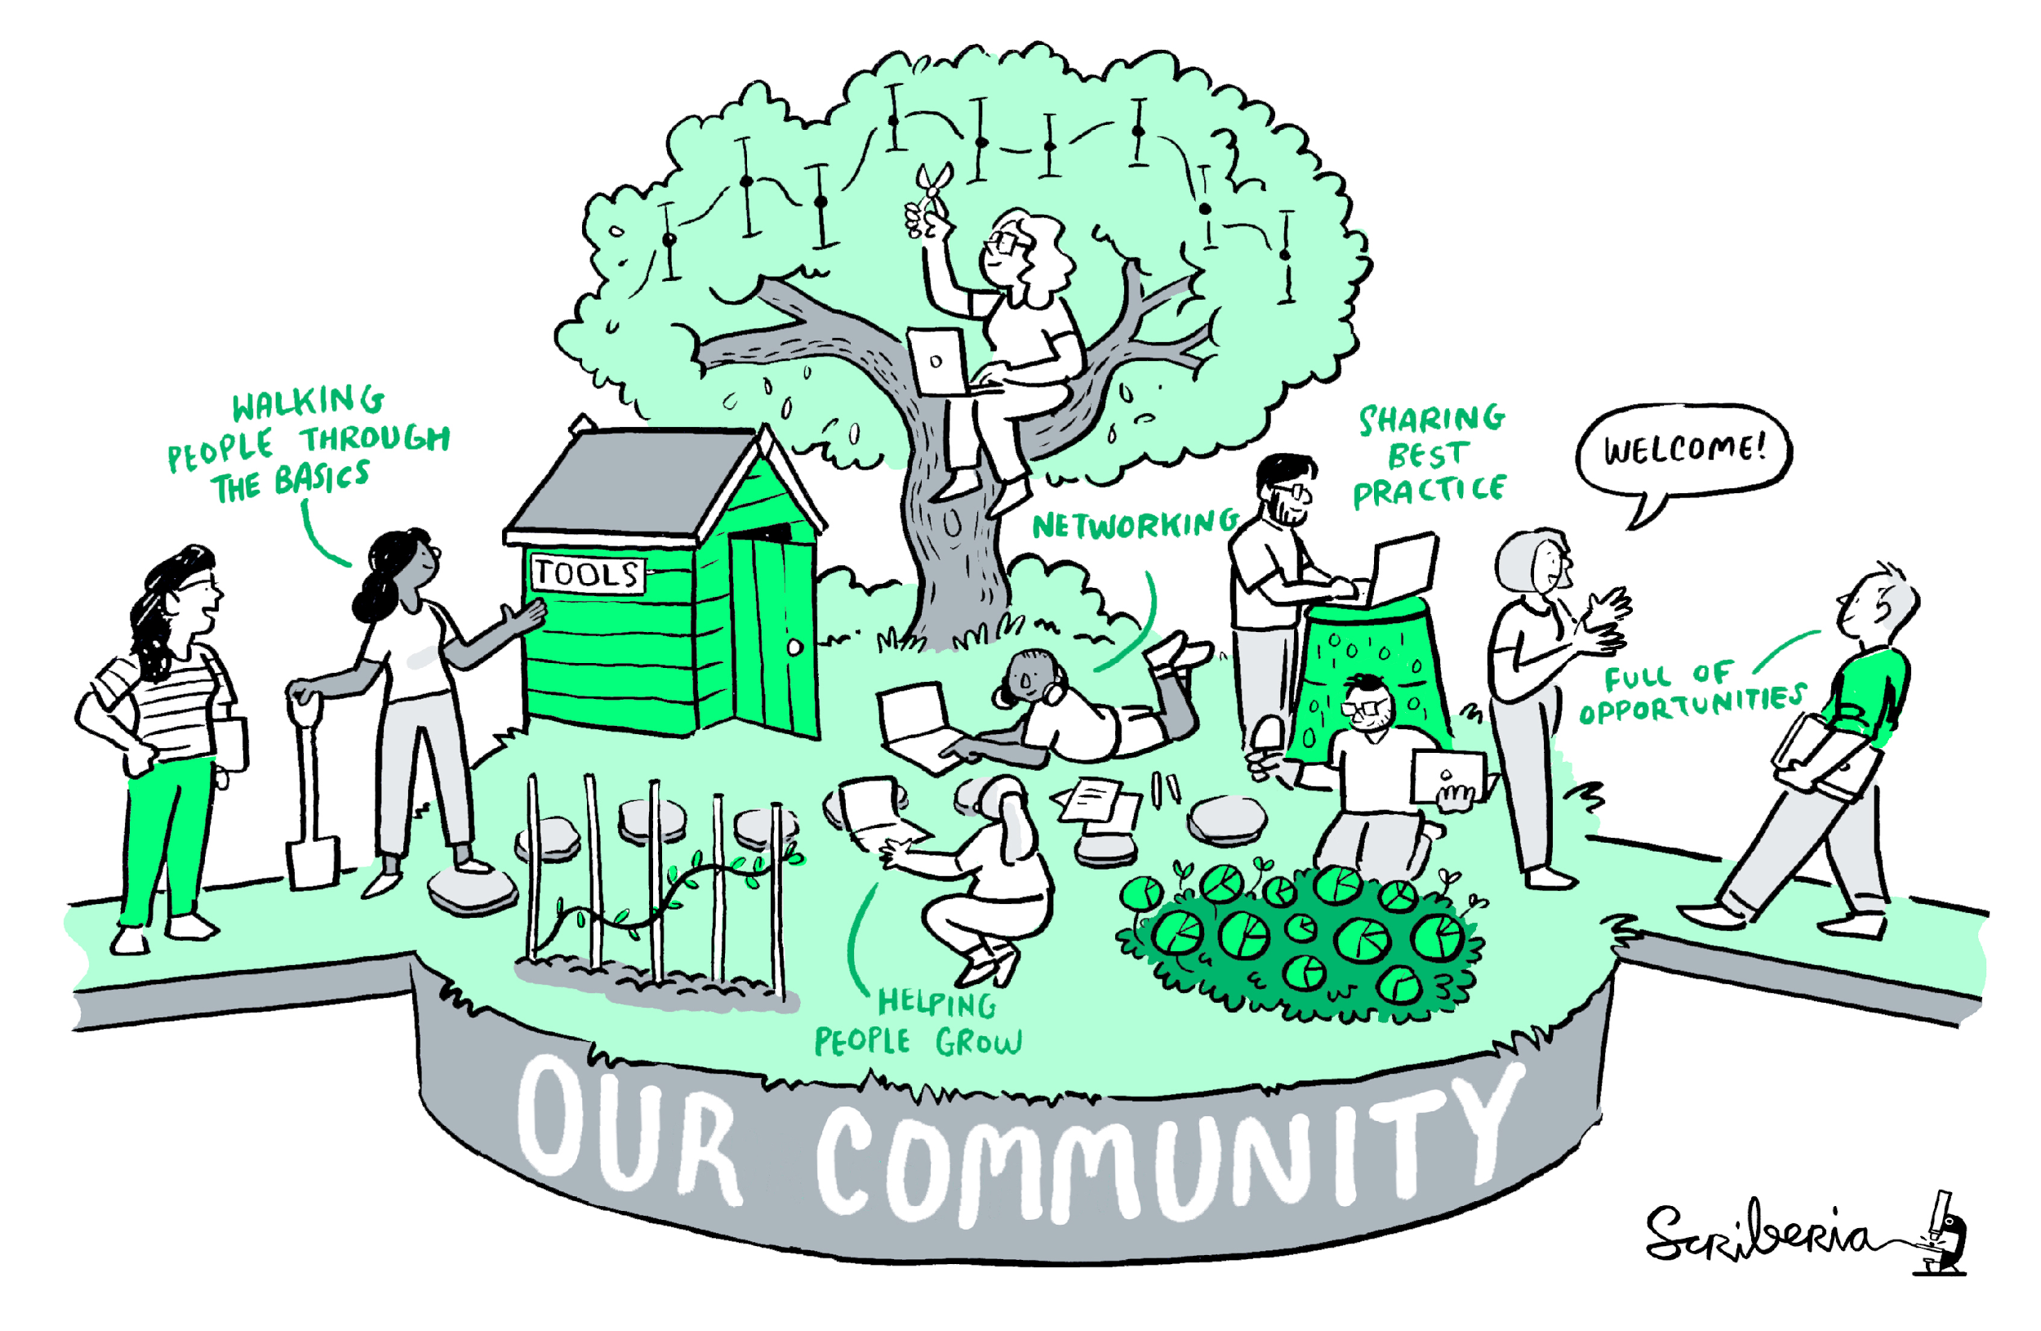
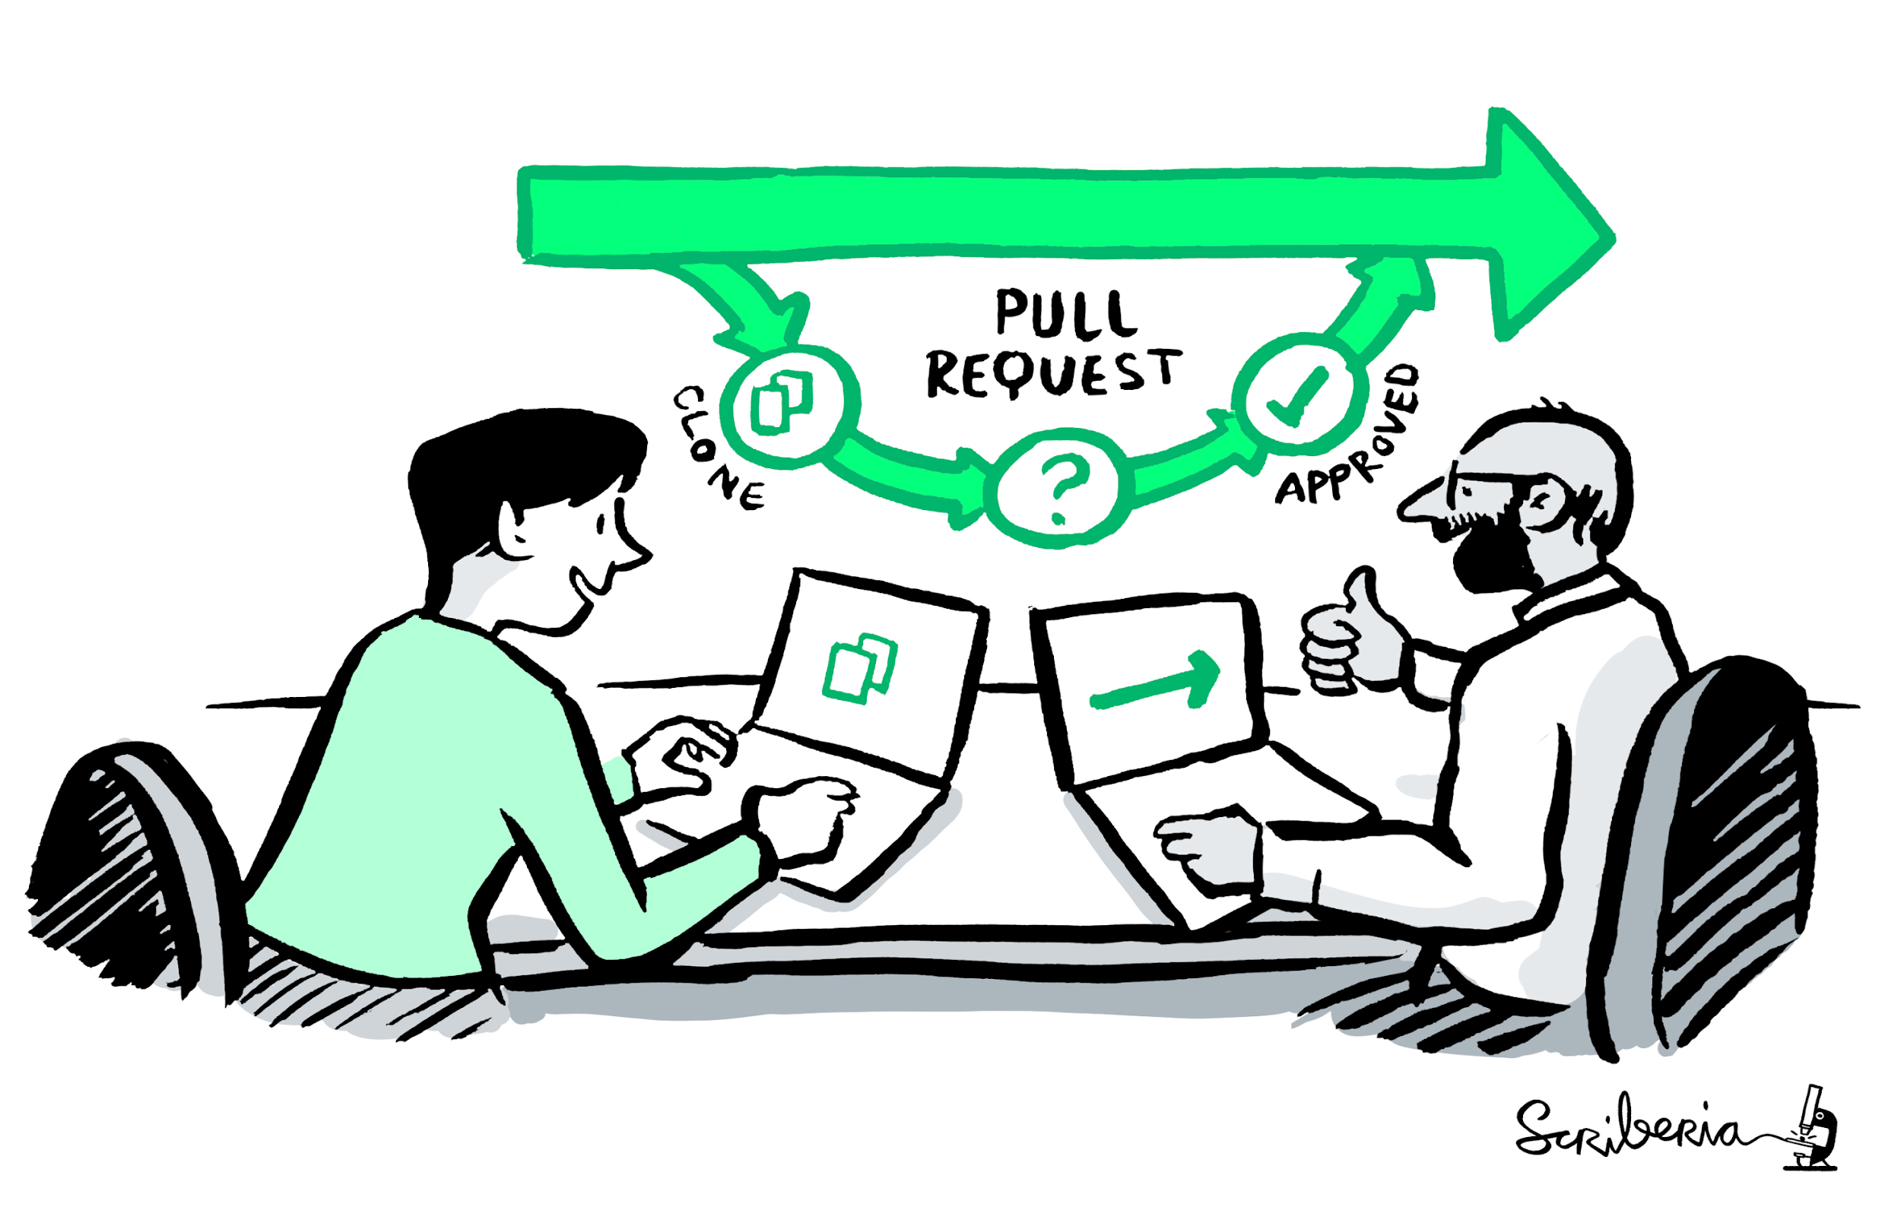
A Book with Five guides
A Community
Book:
the- turing-way.netlify.app/
GitHub:
github.com/alan-turing-
institute/the- turing-way
Twitter:
twitter.com/turingway
Email:
theturingway@gmail.com
CC-BY 4.0, The Turing Way
An Open Source Project
A Culture of Collaboration
Notes:
To put in perspective:
The Turing Way is a Book.
A community where people come together to collaboratively write chapters, build and maintain resources, share their skills and ideas around best practices in data science and research.
We apply open source principles in the development and maintenance of this project.
And finally, it's built on the culture of collaboration, which is the process and the backbone of our project.

Slide 30
Notable Impacts Beyond the project
Resources are being used by learners, educators, community builders, policy makers and researchers globally
Reproducibility of scientific results in the EU 2020 (report)
An Emerging Technology Charter by Mayor of London (policy)
Innovation Scholars: UKRI grant 2020 (funding)
CodeRefinary and Library Carpentries (training materials)
Projects by data scientists including at the Office for National Statistics
Cited by 10+ peer-reviewed articles & 10+ open source projects
@turingway, @malvikasharan, CC-BY 4.0, DOI: 10.5281/zenodo.5083747
Notes:
Our moonshot goal is to make reproducibility too easy not to do. And that can happen when there are system and structure level changes by influencing research at the national and international levels, where inclusive practices and reproducibility are as important as a data and algorithm. We promote our resources for use by learners, educators, policymakers and researchers globally.
Some of the notable impact had in 2020 with the support of our contributors are that the project was highlighted in the EU report for reproducibility for the scientific result, a policy by the Mayor of London On an emerging technology charter used The Turing Way for informing their open and inclusive projects, a funding call from UKRI referenced the project for the example of data science culture, communities for training like code refinery and library carpentries have cross-referenced The Turing Way and the work has been cited by multiple peer-reviewed articles.

Slide 31
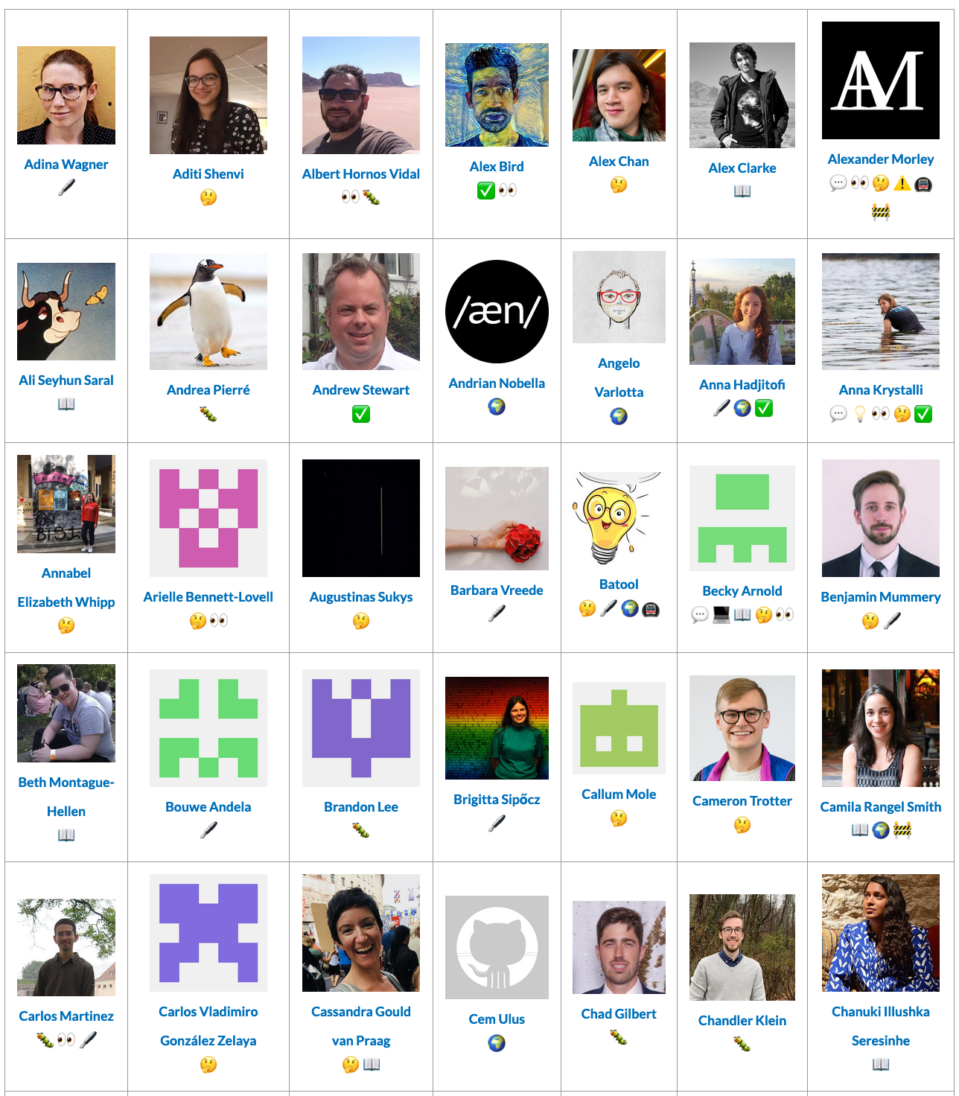
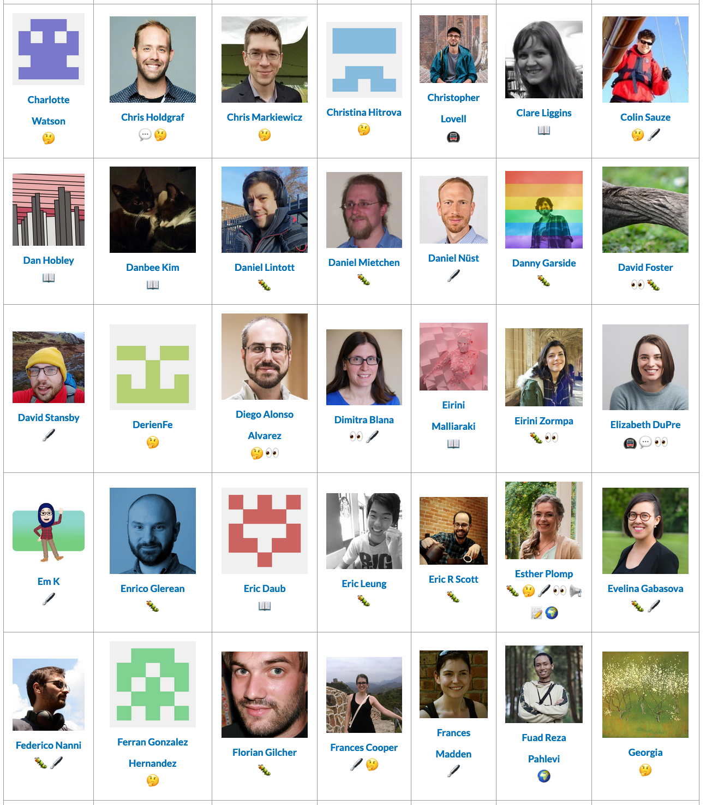











Thanks to our community of contributors & users!
Notes:
None of this work would be possible without our community of collaborators.
We'd like to invite you to become a contributor to the Turing Way, to help us develop chapters of data, human rights and other topics that can help others to understand research ethics. We welcome all kinds of contributions.
Case studies, and lived experiences, are welcome too. You don't need to have coding experience to contribute! You just need an idea and a willingness to learn.

Slide 32
Meeting you where you are!
Join the community
Learn a new skill
Share your skills
Collaborate with others
Mentor others’ contributions
Represent this community
We value your participation!
CC-BY image by The Turing Way & Scriberia, @turingway, @malvikasharan, CC-BY 4.0, DOI: 10.5281/zenodo.5083747
Notes:
In order to create opportunities for bringing people in and highlight their work, we want to meet them where they are. So, if you are new to the community, you can join us. You can learn a new skill or share your skills. You can collaborate with others and receive mentoring or mentor others’ contributions. You can also represent this community.

Slide 33

Join a Community Event
- Collaboration Cafes
    1st & 3rd Wednesdays (14:00 UTC)
- Coworking Calls
    Mondays (10:00 UTC)
- Onboarding Calls
    Fridays (17:00 UTC)
- More ways to connect
    bit.ly/turingway
CC-BY image by The Turing Way & Scriberia, @turingway, @malvikasharan, CC-BY 4.0, DOI: 10.5281/zenodo.5083747
Notes:
We host multiple community events and calls weekly and you are invited to join us. These rYou can find details in the shared notes - these slides are available on Zenodo. You can also reach out to Laura or me directly:
If you go to bit.ly/turingway you can find a link to these slides, as well as the emails addresses to contact Laura or me directly

Slide 34

Job Opportunities
- Community Manager, AI for Science and Government
- Senior Community Manager, Early Detection of Neurodegenerative diseases
- Community Manager, Turing Roche Partnership
- More opportunities will be announced
    bit.ly/turingway

Slide 35

Notes:
The Open Life Science program is a 16 week mentoring and training programme to help researchers and stakeholders worldwide working in research fields in becoming Open Science ambassadors. It’s led by: berenice batut, Emmy Tsang, yo yehudi, malvika sharan.
So what happens during the programme? We have cohort calls where you’ll learn from various topic experts and your peers in the programme. At the same time, project leads will be paired with a mentor who will support and guide them as they apply that knowledge they’ve learnt in their project work. Mentors also receive professional training for mentorship.
(In the end, you will learn to lead your project openly, share your work effectively and bring a culture change in your communities.). Through 3 cohorts, we have offered training to 146 participants from 6 continents, across 45 countries.
We have just opened the call for the next cohort – deadline for application is July 15. Visit our website openlifesci.org, for more information.

Slide 36

Acknowledgements:
Kirstie Whitaker, Whitaker Team Members
The Turing Way community, friends & collaborators
Book: the-turing-way.netlify.com
Twitter: twitter.com/turingway
Newsletter: tinyletter.com/TuringWay
Chat: gitter.im/alan-turing-institute/the-turing-way
GitHub: github.com/alan-turing-institute/the-turing-way
Original artwork by Scriberia: https://doi.org/10.5281/zenodo.3332807
Notes:
Thanks to Kirstie Whitaker for starting this project. All our resources are available online and I am happy to share more details. You can subscribe to our newsletter to receive updates on our next book dash events and ways to get involved in the project.

