Slide 1

Development of a Flemish AP for Research Datasets in FRIS
Evy Neyens 2021-04-19

Slide 2
ECOOM
  Expert Centre Research & Development Monitoring of the Flemish Region
  Development of a consistent system of R&D and innovation indicators for the Flemish government with the aim of mapping innovation and R&D efforts in Flanders.
  Consortium with participation of each Flemish university
  ECOOM-Hasselt: Information modelling & classification

Slide 3
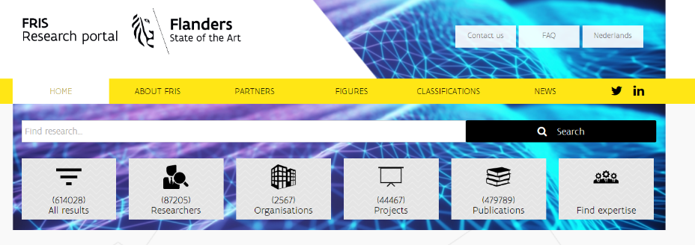
Flanders Research Information Space: FRIS-Portal (researchportal.be)
  Research discovery platform
  BOF- & IOF reporting obligation: Information suppliers must provide research information about research financed with Flemish public funds to FRIS
  ECOOM-partners support FRIS-Portal
    ECOOM-Hasselt: Modeling & semantic harmonizing of the information delivery among Flemish information suppliers

Slide 4


Source: https://www.eosc.eu/eosc-sria-v10-15-february-2021
Source: https://eoscsecretariat.eu/eosc-governance/eosc-executive-board-outputs

Slide 5
EOSC Interoperability Framework
Technical interoperability
  Infrastructure and applications
Semantic interoperability
  Unambiguous, shared meaning in ontologies & thesauri
  Minimal set of common metadata formats
Organisational interoperability
  Documentation, integration and alignment of processes
Legal interoperability
  EOSC, FAIR principles, regulatory and/or policy measures
Source: https://op.europa.eu/en/publication-detail/-/publication/d787ea54-6a87-11eb-aeb5-01aa75ed71a1/language-en/format-PDF/source-190308283

Slide 6
Flemish Open Science Board (FOSB)
Foundation of the Flemish Open Science Board (FOSB) in 2019
  WG Architecture
  WG Metadata & Standardisation
  WG Research Data Management & Open Science
Roadmap to implement Flemish Open Science Policy
5 KPIs: ORCID, Open Access, DMP, Open & FAIR data
Source: https://www.ewi-vlaanderen.be/sites/default/files/bestanden/5fc5f514b328e9000c0007f7.pdf

Slide 7

FOSB WG Metadata & Standardisation
Aim
  Generic model
    FRIS (researchportal.be) → EOSC
    Semantically harmonized amongst Flemish information providers
    Aligned with international metadata standards
Link: researchportal.be

Slide 8
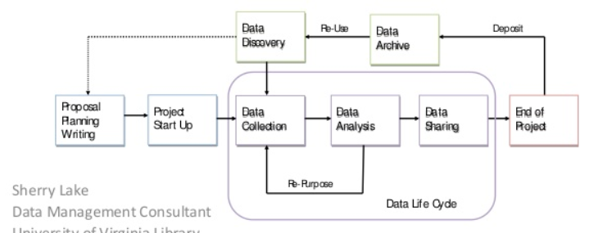
CRIS as leverage for Open Data within institutions
Publication
Organization
Patent
Researcher
Project
Data
Infrastructure
Source: Sherry Lake, Data Management Consultant, University Virginia Library, February 2nd, 2015

Slide 9
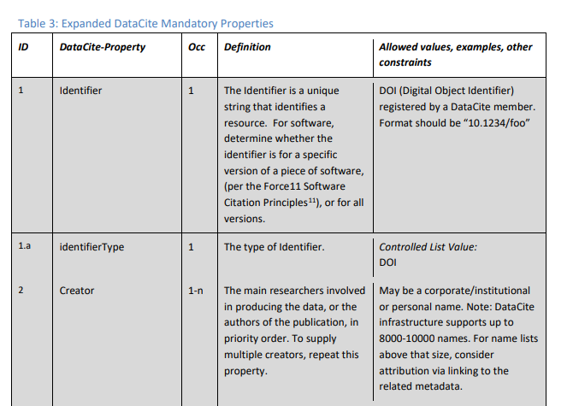
  DataCite Metadata Schema v4.3
Develop application profile based on DataCite
Group discussions on which (sub)properties to retain, adapt, or add
Fit the Flemish context
Open Science Metrics
Source: https://schema.datacite.org/meta/kernel-4.3/, August 16th, 2019

Slide 10
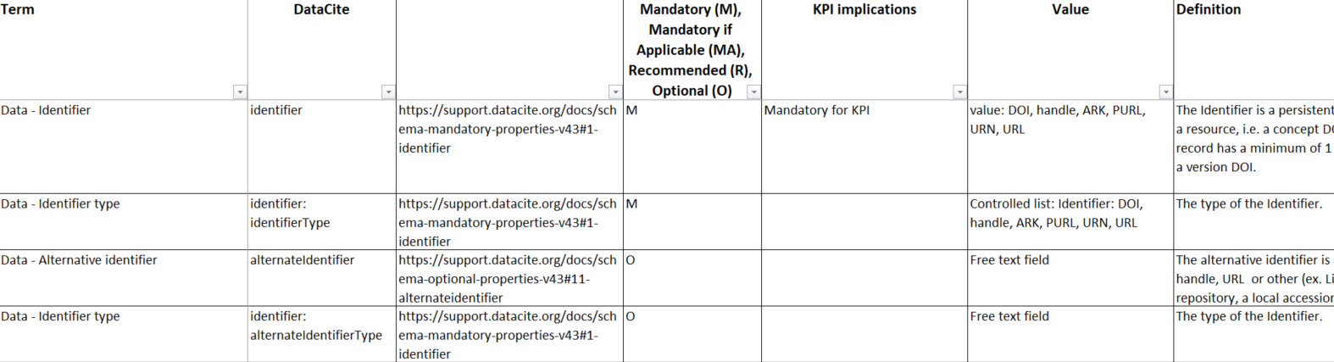
FOSB Metadatamodel_V1.7ter
Characteristics:
  21 properties → 15 originating from DataCite
  Requirements: M, MA, R, O
  Values
  Definition and example
Source: https://github.com/SadiaVancauwenbergh/FOSB-WG-Metadata-and-Standardisation

Slide 11
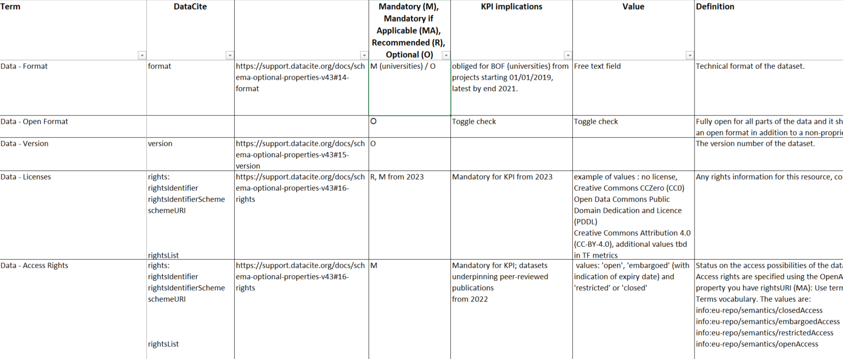
FOSB Metadatamodel_V1.7ter
Deduplication:
  Description: Abstract, description
  Subject: Research discipline, keywords
  Rights: Licenses, Access rights
New: Open Format, legitimate opt-out, FAIR data label
Source: https://github.com/SadiaVancauwenbergh/FOSB-WG-Metadata-and-Standardisation

Slide 12

Questions
Acknowledgements:
FOSB WG Metadata & Standardisation members
ECOOM:
ECOOM Project leader: Sadia Vancauwenbergh
Mail: ECOOM@uhasselt.be
Team:
Evy Neyens
Funded by Flemish Government, Dept. Economy, Science and Innovation (EWI)
FRIS Project leader: Ils De Bal
Mail: ils.debal@vlaanderen.be

