Slide 1












Introduction to pedagogy and training design
Adapted from the EOSC Synergy Train the Online Trainer course
Helen Clare, Jisc & Linas Cepinskas, DANS
EOSC-SYNERGY receives funding from the European Union’s Horizon 2020 research and innovation programme under grant agreement No. 857647
Notes:
Welcome to this session on pedagogy and learning design.
My name is Helen Clare from Jisc in the UK and I’ll be running this session with Linas Cepinskas from DANS in the Netherlands. We both work on the EOSC Synergy project where we are creating a train the trainer programme for online learning. This session is adapted from those materials.

Slide 2
Programme
10:30-10:50 Introduction to pedagogy
10:50-11:00 Short break
11:00-11:45 Design your training in easy steps
  Initial training analysis (15 min)
  Learner’s journey (20 min)
  Rounding up (10 min)
Notes:
In terms of a plan for our session, we’ll start with a short talk on pedagogy and design and after the break we’ll have a practical session on design.
This session is a taster - there is a lot of information around pedagogy and design, but we are focussing on a few key points. I have over 20 years experience as a trainer and these are some of the key ideas and approaches I’ve found most useful.
It would be good to know what experience you have so please answer the Menti question about your experience.

Slide 3
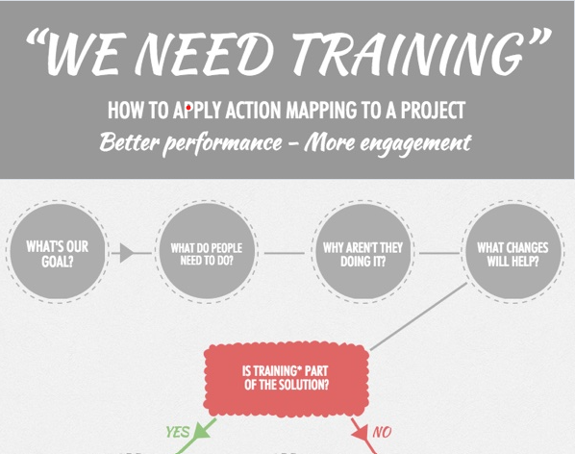
Before we start
Our aim is to help you create the best training you can
Meeting your aims and the needs of your learners
We are starting from the assumption that training is the right solution!
What makes a good / bad training experience?
Cathy Moore’s action mapping workflow
https://blog.cathy-moore.com/action-mapping-workflow-at-a-glance/
Notes:
We probably have a mix of experience on the course, so hopefully we can all learn from each other.
In this session we want to help you create the best training you can, which meets your aims and the needs of your learners.
We are starting from the assumption that training is the right solution to the problem you are trying to address. It’s useful to ask yourself this question - as within organisations in particular, other approaches may be better, for example improving documentation or streamlining procedures. The action mapping approach on the slide can help you think this through.
So how do we make sure training meets your aims and the needs of your learners? We’d like you to think about training you’ve been on - what makes it good or bad? Add your comments in the chat.

Slide 4
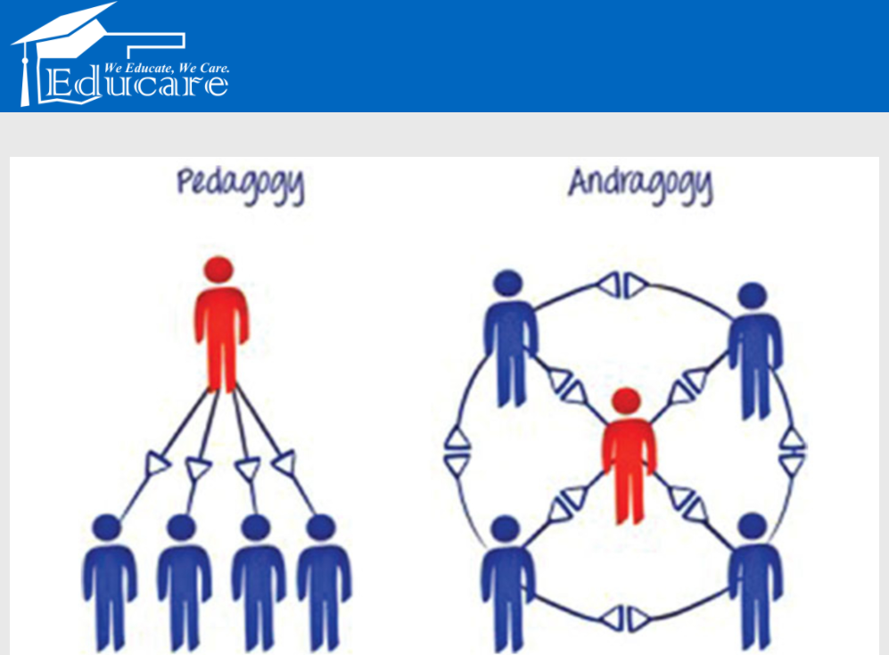
Pedagogy
“the art, science, or profession
of teaching”
www.merriam-webster.com
“the study of the methods and activities of teaching”
dictionary.cambridge.org
www.educarepk.com/pedagogy-vs-andragogy.html
Notes:
We have some ideas about what good training is, so how do we design this? The starting point is an understanding of pedagogy, or the study of teaching.
It’s worth noting that we are talking about training today, not teaching - for some people there is a huge difference. Teaching is often seen to focus on knowledge, theory and thinking, whereas training is focussed on practical skills. Whether you agree with this or not, understanding pedagogy and how to teach is important.
There is also a debate about the word pedagogy - it’s Greek origin means ‘leading children’ and there has been a reaction to this to say that approaches aren’t always appropriate for adults, so you may hear of andragogy (Greek ‘leading man’). Generally the difference is that adults must be able to see the relevance of their learning and relate it to their experiences, they are more self-directed and self-motivated. https://en.wikipedia.org/wiki/Andragogy
Within pedagogy there are many methods and theories! We will focus on one commonly used theory – Bloom’s Taxonomy

Slide 5
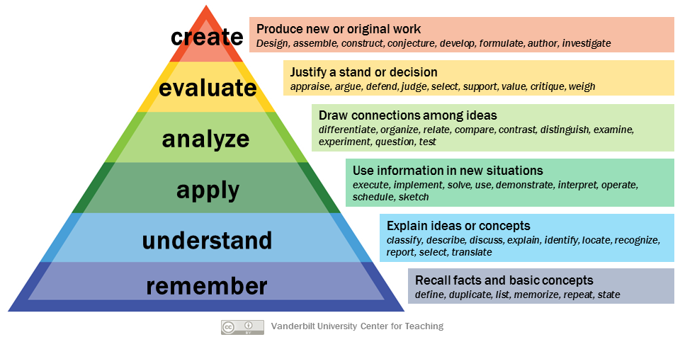
Bloom’s taxonomy
Notes:
Bloom’s taxonomy has three domains: cognitive (knowledge), affective (emotion) and psychomotor (physical), which all work together. This slide shows the cognitive domain.
The idea is that one level builds on the next, leading to higher order thinking, from repetition of facts at the bottom, understanding next… up to evaluation and creation at the top.
This doesn’t mean, however, that the lower levels are less valuable – much learning depends on have a sound knowledgebase to build upon eg remembering what the different Creative Commons licences mean! For example:
What a data management plan is (Remember / understand)
Why it’s important (Understand / apply)
Being able to analyse their own data and decide what information should be included (Analyze / evaluate)
Creating their own DMP (analyze / evaluate / create)
This taxonomy helps you when you come to learning/training design – activities can then be associated with the verbs. Usually you are trying to encourage learners to move up the taxonomy to become more independent in their understanding, application and use of knowledge.

Slide 6
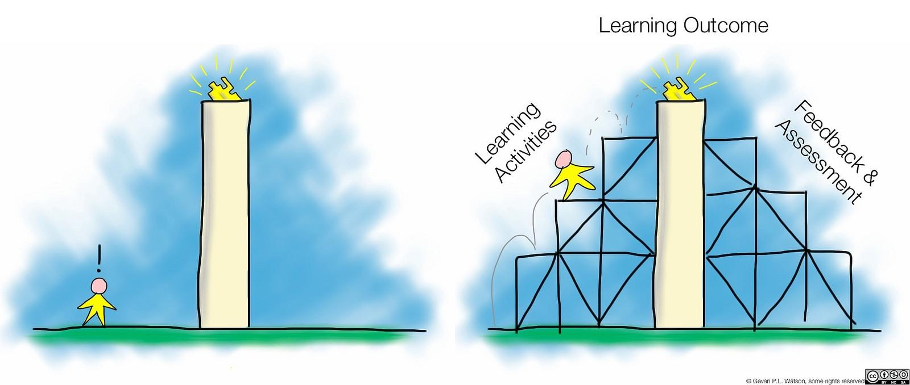
Scaffolding
Notes:
So how do you support your learners through these levels?
You have a goal for the learners – you want them to get somewhere
Your scaffold is your framework for getting them there
At the start they might need more support
By the end they have learned how to do things themselves
Your role as a trainer changes throughout this process

Slide 7

Why are you doing training?
Teach others a topic/skill
Encourage best use / practice
Change attitudes
Promote open science
Gather feedback on services
Build a user community...
Notes:
Teaching others to use a service or learn about a particular topic is the most obvious reason for training. But you’ll find there are many other benefits to training.
The key point here is that you need to be aware of these reasons at the start in order to ensure you build in appropriate approaches.
Other reasons include:
Teach others about a topic/service – you want to raise awareness of a topic/service and enable people to learn about it
Encourage best use / practice – you want learners to be able to use something well, beyond what they might be able to teach themselves.
Change attitudes – training is often seen to be about learning technical or practical skills, but there is a motivational element. You may need to change attitudes by giving a clear idea of the benefits of your service / topic.
Promote open science – in the context of EOSC you might want to encourage open science practices
Gather feedback on services – if you deliver an online service of any kind, training can be a useful way to get feedback. You can find out what issues people struggle with and how they use your service. This can lead to improvements.
Build a user community – you may wish to use a training course to encourage learners to become part of a user community for your service. This will allow future peer support and enable you to better understand the needs of your learners.
Evidence of use / you have performance indicators – most services need to provide evidence of success and training is one way to show that you have made an effort to raise awareness and encourage use of your service.

Slide 8








Reasons to think about design
Make your course more effective
Choose suitable methods and tools
Make best use of resources
Make materials easy to use and re-use
Meet legal requirements
Save yourself time
To measure the success of your training
Notes:
Creating training material can be time-consuming - there are many things to remember and it is good to make sure you consider these right at the start, rather than at the end when it becomes more work. A bit like researchers and data management, it’s a lot easier if you follow good practice right from the start!

Slide 9
How to think about good design
Many models available
ADDIE gives an overarching framework
Other models can be used to guide each stage
Analyse
Design
Evaluate
Implement
Develop
Notes:
We’ve talked a little about pedagogy so now we’ll move on to design.
Again, there are many models available - we will use a very common training framework called ADDIE.
It’s important to note that this outlines the steps you go through and various approaches can be used in each of these steps.
We will focus mainly on the analysis and design stages.

Slide 10
In reality
It’s tempting to jump straight into development
Don’t skip analysis and design
Start here
Start here
Analyse
Design
Evaluate
Implement
Develop
Not here!
Notes:
It’s tempting to start by developing your materials, but make sure you do some analysis and design.

Slide 11
In reality
It’s iterative
It’s not always linear
Evaluation at the core
Analyse
Design
Evaluate
Implement
Develop
Notes:
However, it is iterative and not always linear - is at the core at every stage and you may make changes as you go through the steps.

Slide 12
Evaluation
Results
Different levels of evaluation
Linked to assessment
Needs to be considered in design, not at the end
Behaviour
Learning
Reaction
Kirkpatrick, D. L. (1994). Evaluating training programs: the four levels.
San Francisco: Berrett-Koehler.
Notes:
Evaluation is one of the most important parts of design - it’s good to be able to demonstrate what learners have achieved, both for the learner and you as a trainer (evidence of success!).
There are different levels of evaluation from ‘reaction’ eg how do learners feel after the course through to learning, behaviour and results.
The key point is that you should try to design in opportunities for assessment and evaluation, learning and reaction can be measured within a training session. Behaviour/results is longer term so harder to measure but it’s possible with follow up activities.

Slide 13
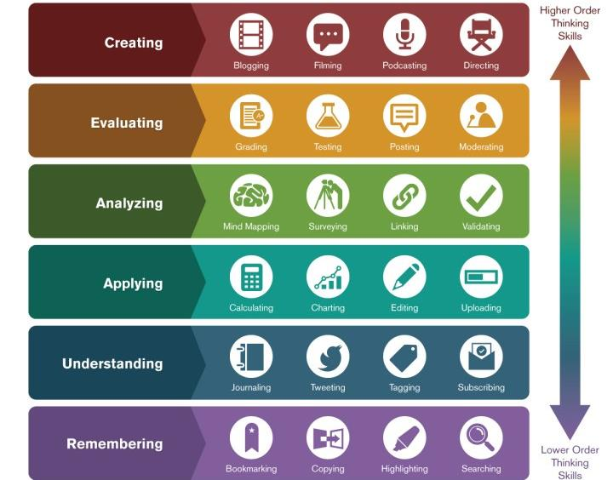
Two points to remember
1. Activities should match the intended outcomes
2. And be engaging and appropriate for learners
Image: Ron Carranza, https://teachonline.asu.edu/2016/05/integrating-technology-blooms-taxonomy/
Notes:
To summarise key points
This illustration shows different (online) activities mapped to the levels of Bloom’s taxonomy, showing that activities need to match intended outcomes.

Slide 14



Technology won’t fix poor training design
Notes:
A note on online learning – simply moving online won’t fix poor training design.
A data management reference - garbage in, garbage out.
If your activities and outcomes are mismatched in your face-to-face design and you replicate that online, then nothing will change.
Most f2f activities are possible online with the right tools and/or creativity

Slide 15
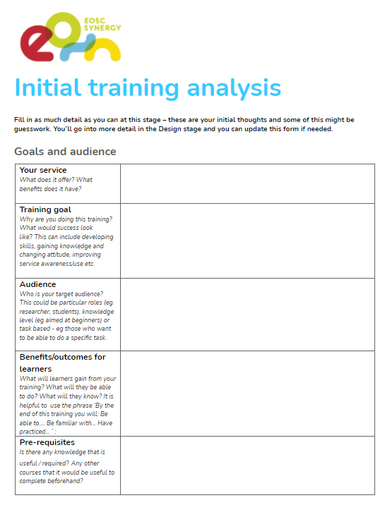
Your initial training analysis
The goals of your training
Topics to cover
Your audience / learners
Learning outcomes
Delivery method
Practical issues
Notes:
For the first stage, we have developed an analysis form which you will be using in the practical. It covers things like goals, content and audience as well as practical issues.
Practical issues include:
Resources available
Your technology
Your time
Timing of training
How will you attract attendees?
How will others use / re-use your materials? (licensing)

Slide 16
Goals, objectives and outcomes
Goals
The big picture
Improve data management at Ghent University
Objectives
What trainers will do to pursue the goal
Run a series of workshops
Raise awareness of available support services
Outcomes
List the features of a data management plan
Explain why data management is important
Be able to create a DMP
Know where to get support
What learners can do afterwards (evidence of reaching goal)
Adapted from: http://www.drew.edu/sla/outcomes/
Notes:
We’ll be getting you to think about goals, objectives and outcomes - it’s useful to know the difference, although again there is a lot of discussion about meaning!
In our session we describe goals and objectives as the bigger picture and what the trainers will do to achieve the goal. Outcomes will be what the learner can do afterwards. Broader to more specific.
Eg.
Goal - to improve data management at Ghent University
Objectives - run a series of training courses
Outcomes - researchers will be able to create a data management plan and know what support is available to them
http://www.drew.edu/sla/outcomes/
"Often, one of the most confusing parts of doing assessment is understanding the difference between goals, objectives, and outcomes. Although there is no official dictionary of assessment, it is helpful for all stakeholders in the assessment process to share a common understanding jargon used in talking about assessment.

Slide 17

Your audience
Role, background and context
Prior knowledge, skills and experiences
Motivation
Barriers / fears
Notes:
Think about your audience and their experience as much as you can - if you don’t know specifically, you can create a ‘persona’ which describes your intended audience. They might be researchers or other staff in your case.
Thinking about their knowledge, experience, motivation, fears etc can help you address these in your training design.

Slide 18
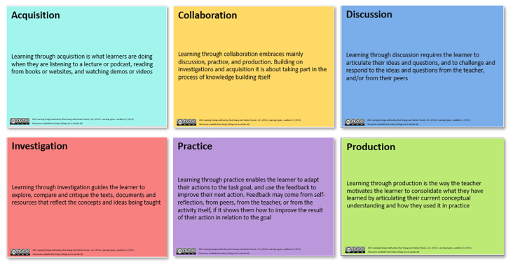
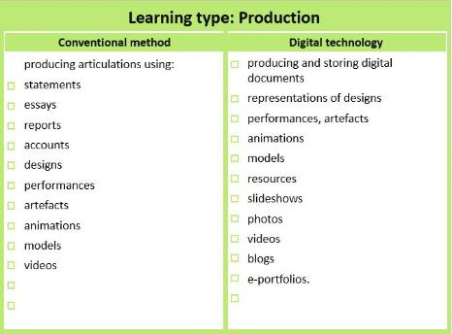
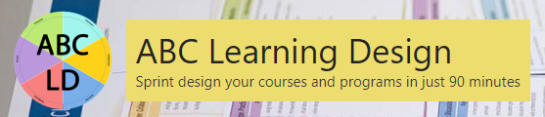
The ABC learning design method
Well established
Quick and simple (1.5 hours)
Can be done online
Map learner journey
Identify learning type activities
Select specific activities
              https://abc-ld.org/
Notes:
Now we come to design, the method we are using is the ABC learning design method developed. It’s quite an interactive methods and has been adapted to online delivery.
It’s a quick and simple method but we have created an even shorter version which Linas will explain shortly, but please do explore the full version after today.
Essentially it involves mapping the learner’s journey through your training and identifying appropriate activities.

Slide 19
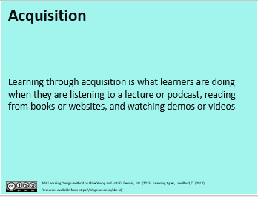
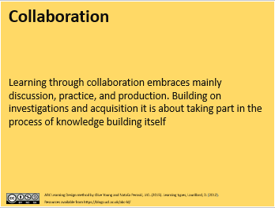
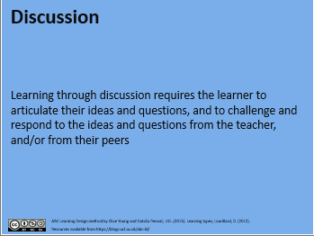
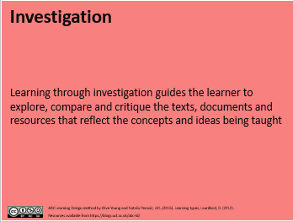
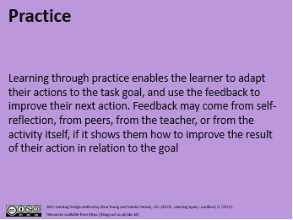
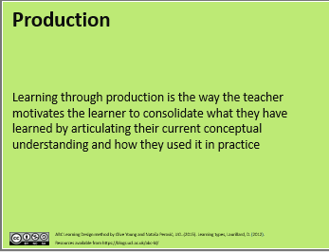
ABC Learning types cards
Notes:
In the full activity you use learning type cards and select what type (or types) of learning you want for each topic.
If you look at the cards you will notice a links to Bloom’s taxonomy (eg acquiring knowledge, practice / producing their own content) and elements of andragogy - learning through discussion and collaboration.

Slide 20
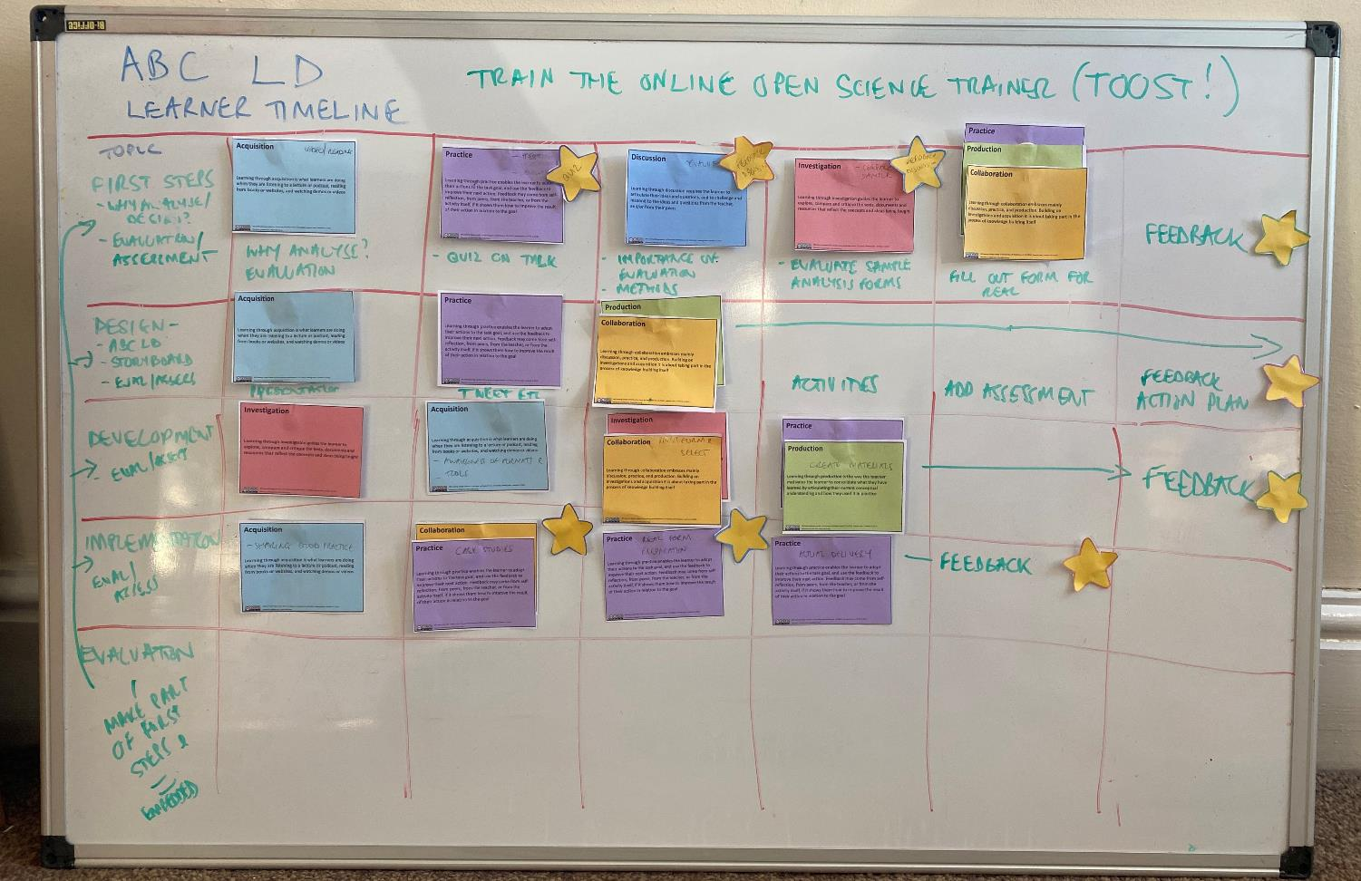
Notes:
If you wanted to do the full version, it’s available at the web site link earlier. It’s useful to do it this way as you can easily see patterns - I ended up starting most of my topics with acquisition, so I could perhaps look at how I could do things differently, eg start with investigation or discussion.
Evaluation is mapped on to the pathway with yellow stars – this could be evaluation of learning ie assessment (formative / summative) or evaluation of the course itself. But it needs to be considered at the design stage, not tagged on afterwards.

Slide 21
Design your training in easy steps
Why? To understand the basics of developing a training course (face-to-face/online) and practise designing it.
What? 2 worksheets with practical questions from the initial training analysis and the ABC learning design model.
How? Small groups of 5-6 participants.
Duration: 45 minutes
Breakout group links in the chat box.
Notes:
Linas will now explain what you’ll be doing after the break.
Please ask questions in the chat and I’ll answer them over the break.

Slide 22
Let’s start: an initial training analysis
Worksheet A - Initial training analysis (15 min):
Work through the worksheet by writing max. 2-3 sentences for each question.
Focus on title/topics, goals, audience, content and benefits/outcomes for your learners.
Running out of time? Continue with the next stage, and update this form later, if needed.

Slide 23
Let’s continue with a design
Worksheet B - A learner’s journey (20 min)
Think of the content and learning activities you would like to include in your training (topics/sessions, learning activities, duration).
Write down your choices in short sentences/key words.
If needed, go back to Worksheet A for the content section of your future course.

Slide 24

For further information:
helen.clare@jisc.ac.uk
linas.cepinskas@dans.knaw.nl
learn.eosc-synergy.eu
www.eosc-synergy.eu

