Slide 1


Paper No.: 01_1006
Efficient electron transport layer for high performance Polymer Light-Emitting Devices
Mora Veera Madhava Rao, Cheol-Hee Moon
Department of Display Engineering, Hoseo University, Asan, 336-795, Republic of Korea
Tel.:82-41-540-5923, E-mail: madhavmora@yahoo.com

Slide 2
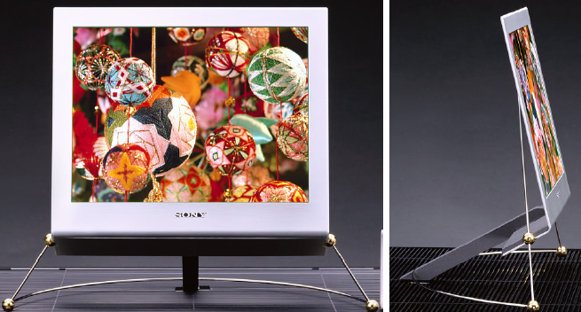
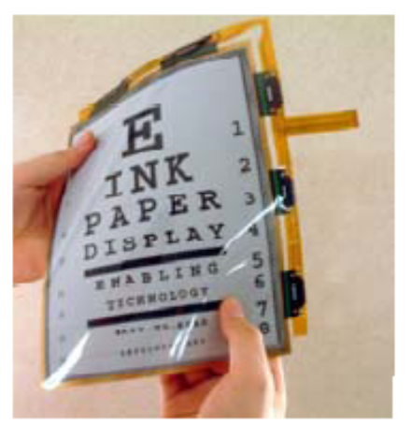
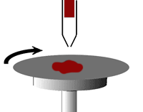
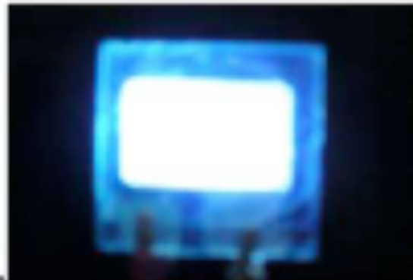
Introduction
No backlight
High brightness
High contrast ratio
Low power consumption than LCD
Does not need diffusers , polarisers etc that goes with LCD display
The PLED based on solution-processing technologies have advantages
Low cost
Large-area fabrications
Light weight
Easy Process
Flexible

Slide 3
Principle of PLED
Electron come from cathode
Hole come from anode
2. Combination in emission layer
3. Generate light and pass through the bottom of device
Cathode
EML
HTL
Anode
HTL
Light emitting
EML
Glass
Cathode
Light emitting
Anode

Slide 4
Experimental
Clean ITO
Deposition
electrode
Measurement
Spin coated
PEDOT:PSS
4000 rpm , 60s
Scrape for
anode
Baked
(150℃ 30min)
Baked
(65℃ 30min)
Baked
(150℃ 5 min)
Spin coated
EML
EML
PEDOT:PSS

Slide 5
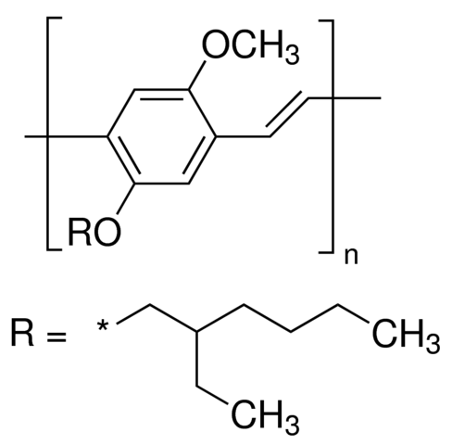
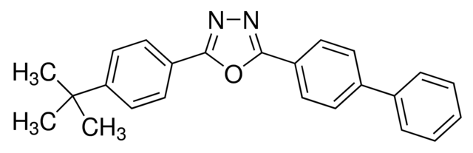
Device structure and organic materials
Ca/Al
PBD:Cs2CO3
MEH-PPV
MEHPPV
PEDOT:PSS
ITO
Glass
PBD

Slide 6
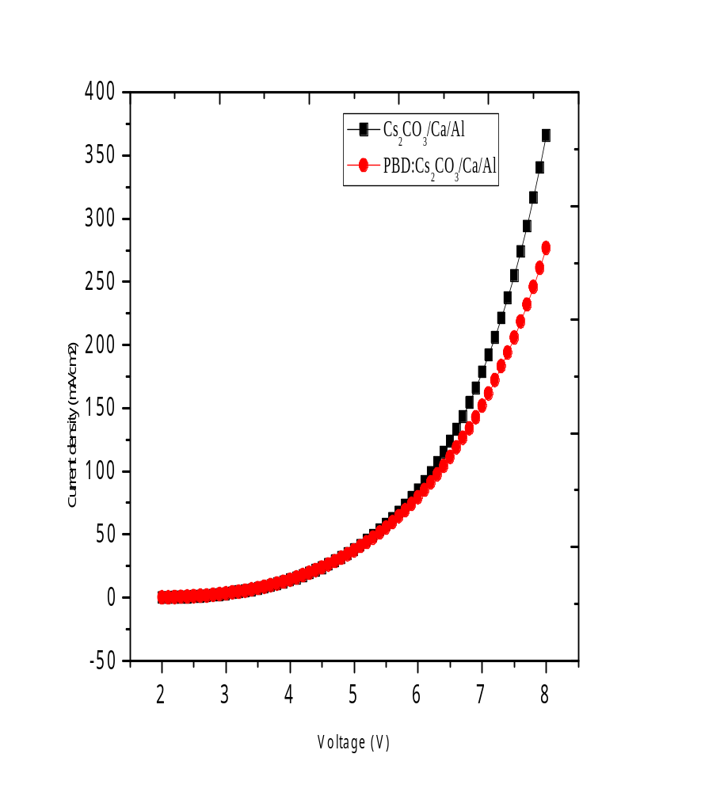
Results & Discussion
Current density-voltage curves of PLEDs
The energy level of the HOMO of PEDOT:PSS is around -5.2 eV and the HOMO level of MEHPPV is around -5.1 eV, there is almost no hole-injection barrier from PEDOT:PSS to MEHPPV. The current density-voltage characteristics show very few difference between Cs2CO3/Ca/Al or PBD:Cs2CO3/Ca/Al cathodes

Slide 7
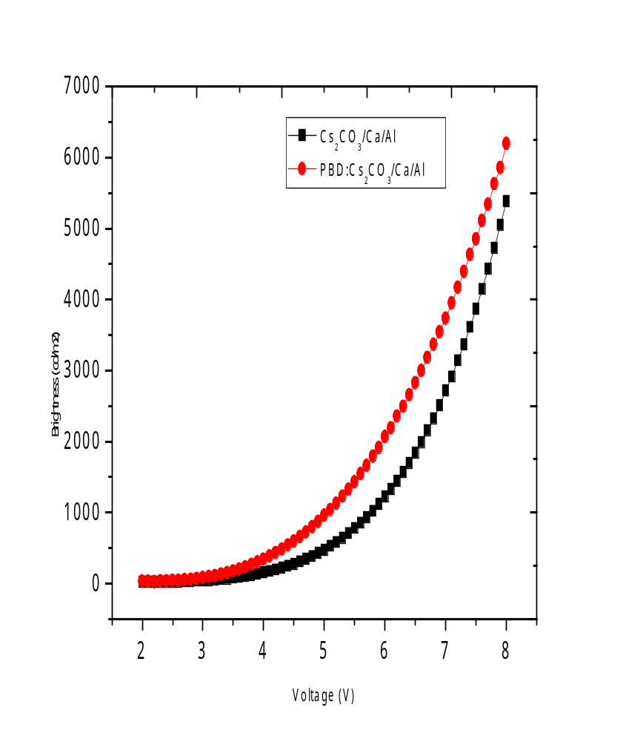
Brightness-voltage curves of PLEDs
The Brightness versus voltage characteristics differs greatly with changing cathodes as a result of the different hole blocking and electron-injection abilities as well as different digress of quenching among these two kinds of cathode configurations. Because the energy level of the LUMO of MEHPPV is around -3.0 eV and the work function of Al and Ca are -4.3 eV and -2.9 eV respectively

Slide 8
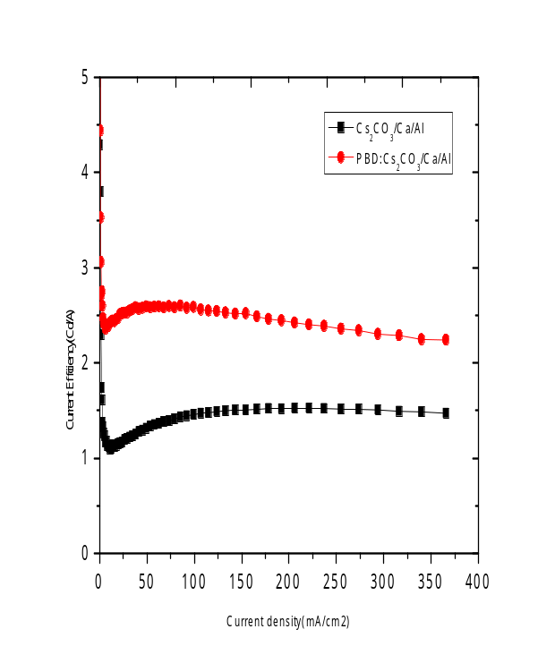
Current efficiency-current density curves of blue PLEDs
Current efficiency versus current density curves shows that the devices with PBD:Cs2CO3/Ca/Al cathodes have higher current efficiency( 2.6 cd/A at 100 A/cm2) than that of the device with Cs2CO3/Ca/Al cathode( 1.45 cd/A biased at 100 A/cm2).
The current efficiency remains high in the high brightness regime when the devices are biased at high current.
No variation in the electroluminescence spectra was observed (not shown in here). Therefore, the increases in the current efficiencies for the above devices are due to the improvement in the device performance, but not the color change of the emission.

Slide 9
Conclusion
In conclusion, we demonstrated a efficient PLED that consisted of interfacial layer between an emissive layer and cathode. This improvement can be attributed to the excellent balancing of holes and electrons through increasing electron transporting and blocking holes with reduced surface roughness. The result is a maximum brightness of over 6200 cd/m² and maximum luminance efficiency of 2.5 cd/A. Most importantly, our results indicate that high-performance PLEDs can be fabricated by processing all the layers from solution. We regard the formation of specific interaction and reaction at the interfacial layer during the cathode deposition which results in the enhanced injection of electrons.
Acknowledgments
This research was supported by the MOTIE (Ministry of Trade, Industry & Energy (PJT#10067826) and Development of core-technology and components in organic electronics for ICT convergence support program for the development of the future display device

Slide 10
References
MVM Rao, YK Su, TS Huang, ML Tu, SS Wu, CY Huang, Journal of The Electrochemical Society 157 (8), H832-H836 (2010)
MVM Rao, YK Su, TS Huang, ECS Solid State Letters 2 (1), R5-R7 (2013)
MVM Rao, TS Huang, YK Su, ML Tu, CY Huang, SS Wu, Nano-Micro Letters 2 (1), 49-52
Mi-Young Ha, MVM Rao ,Dae-Gyu Moon, ECS Journal of Solid State Science and Technology 5 (10), R155 (2016)

