Slide 1

A decade developing energy engineering solutions with and for society
INSPIRING RESEARCHERS ON THE USE OF OPEN SCIENCE IN THEIR PROJECTS

Slide 2
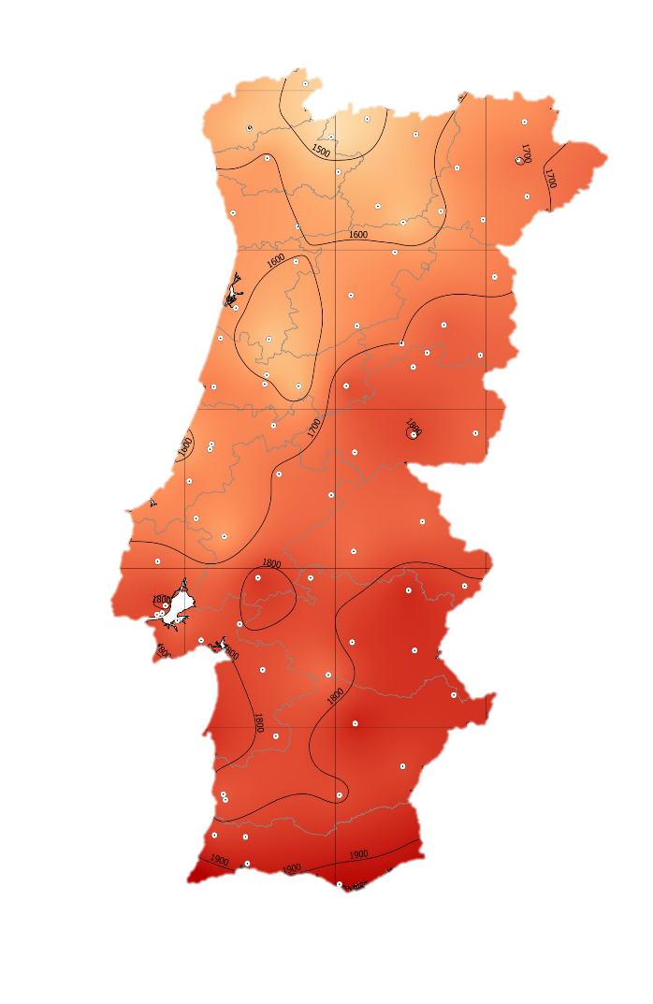
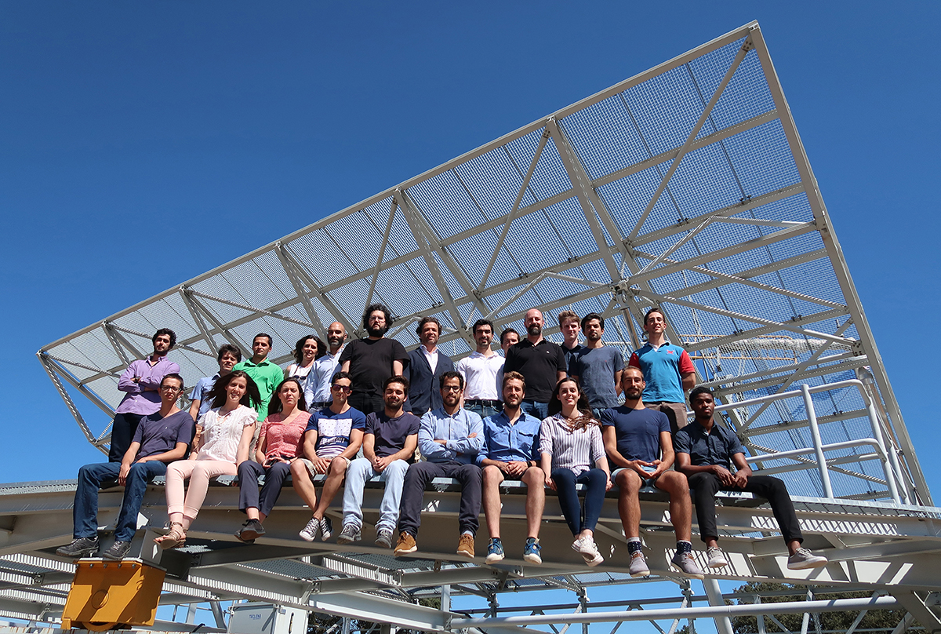

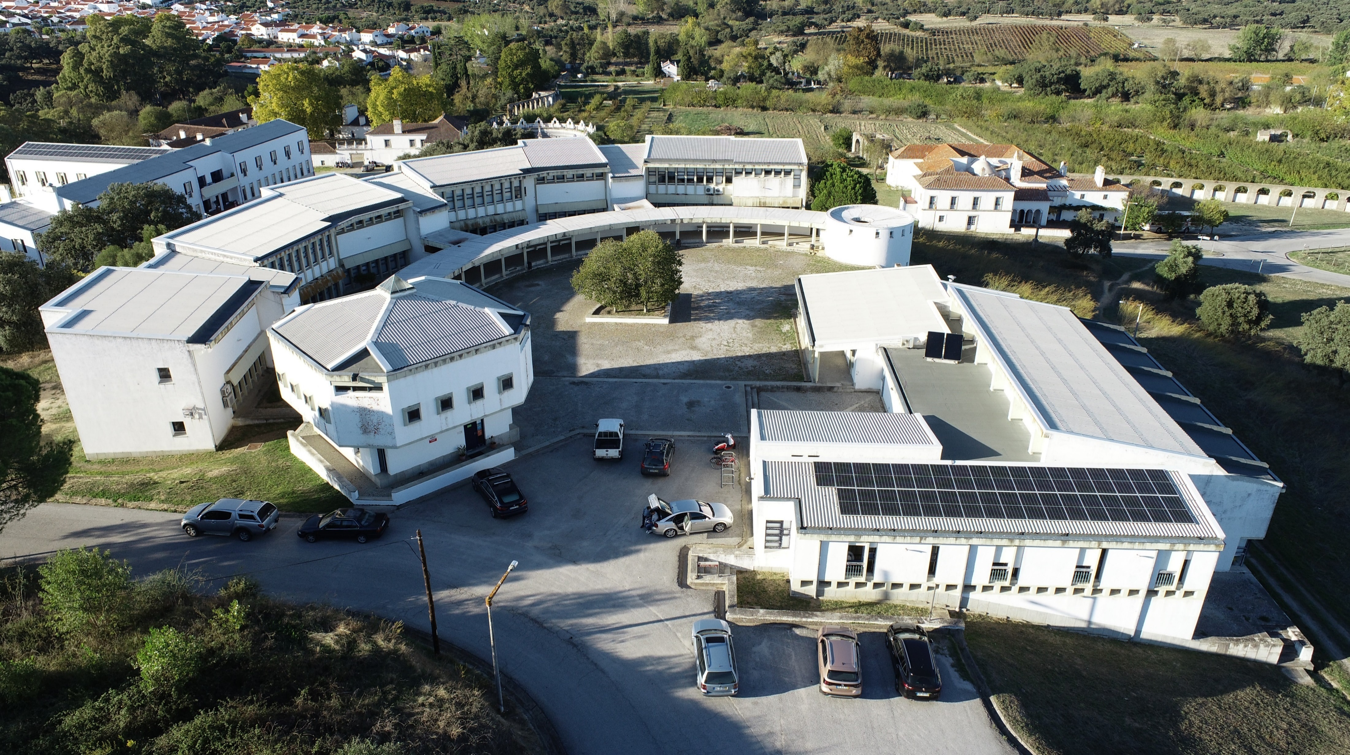
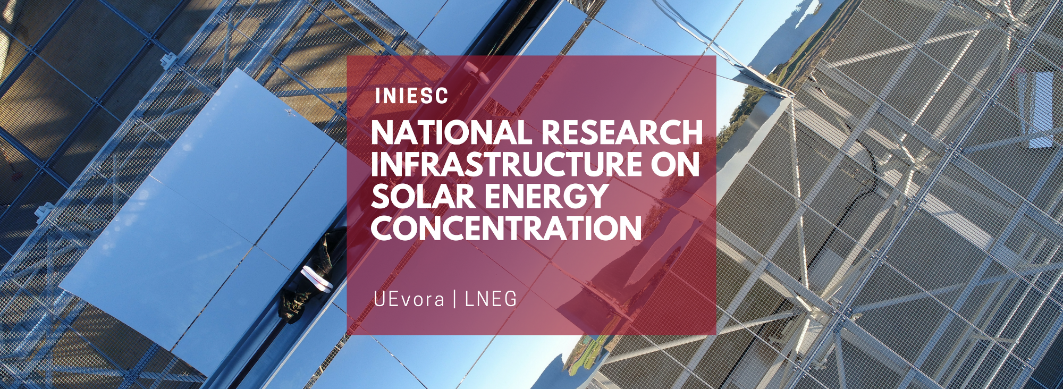

Slide 3
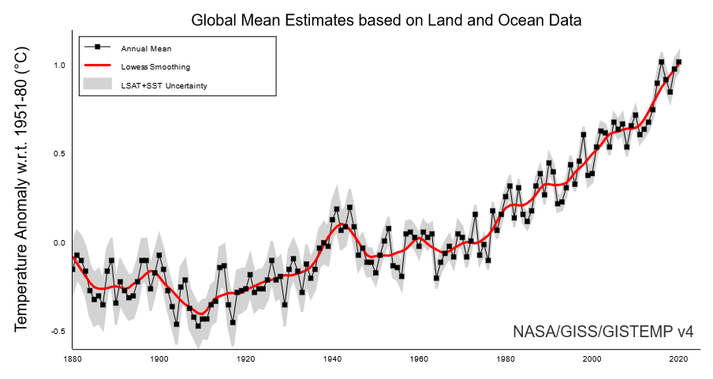
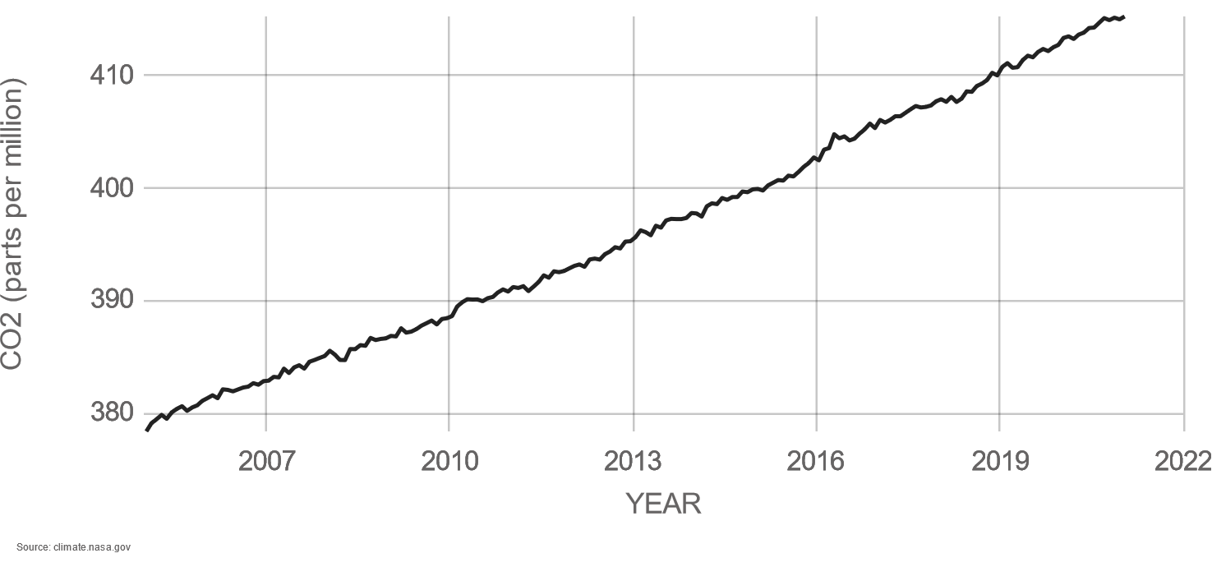
The challenge
+1.02°C
2020
415 ppm
Jan2021
Carbon Dioxide
Source: NASA/GISS
55 Gt de CO₂eq/year
0
55 000 000 000 t

Slide 4
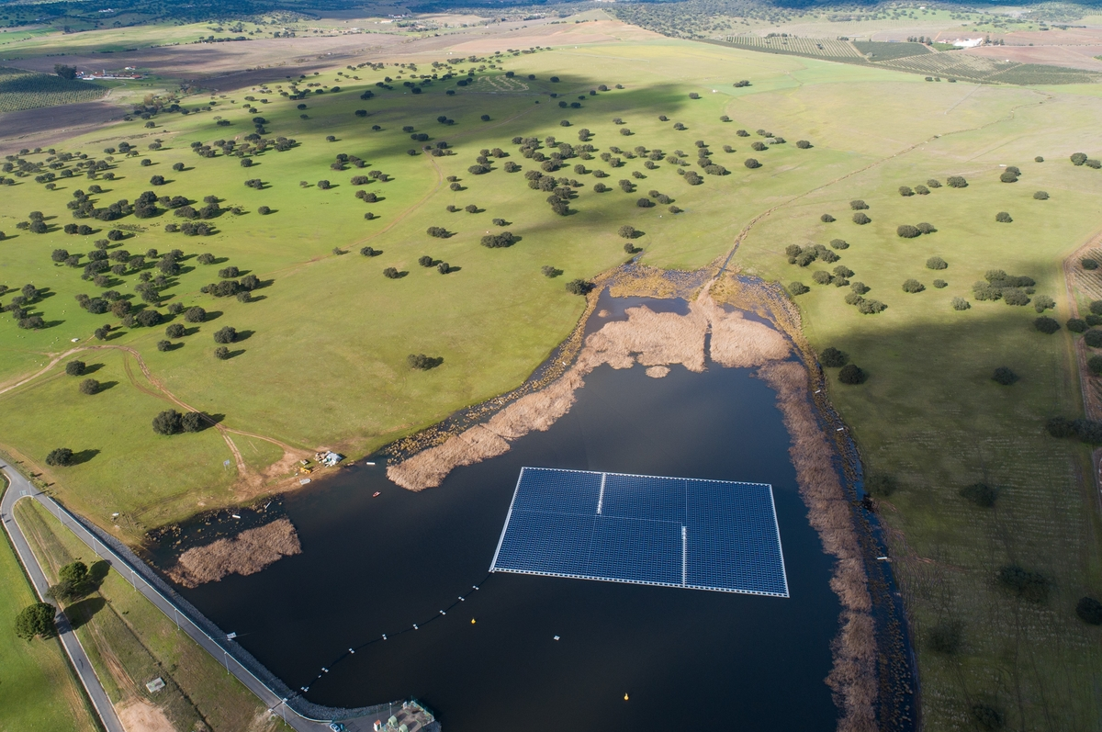
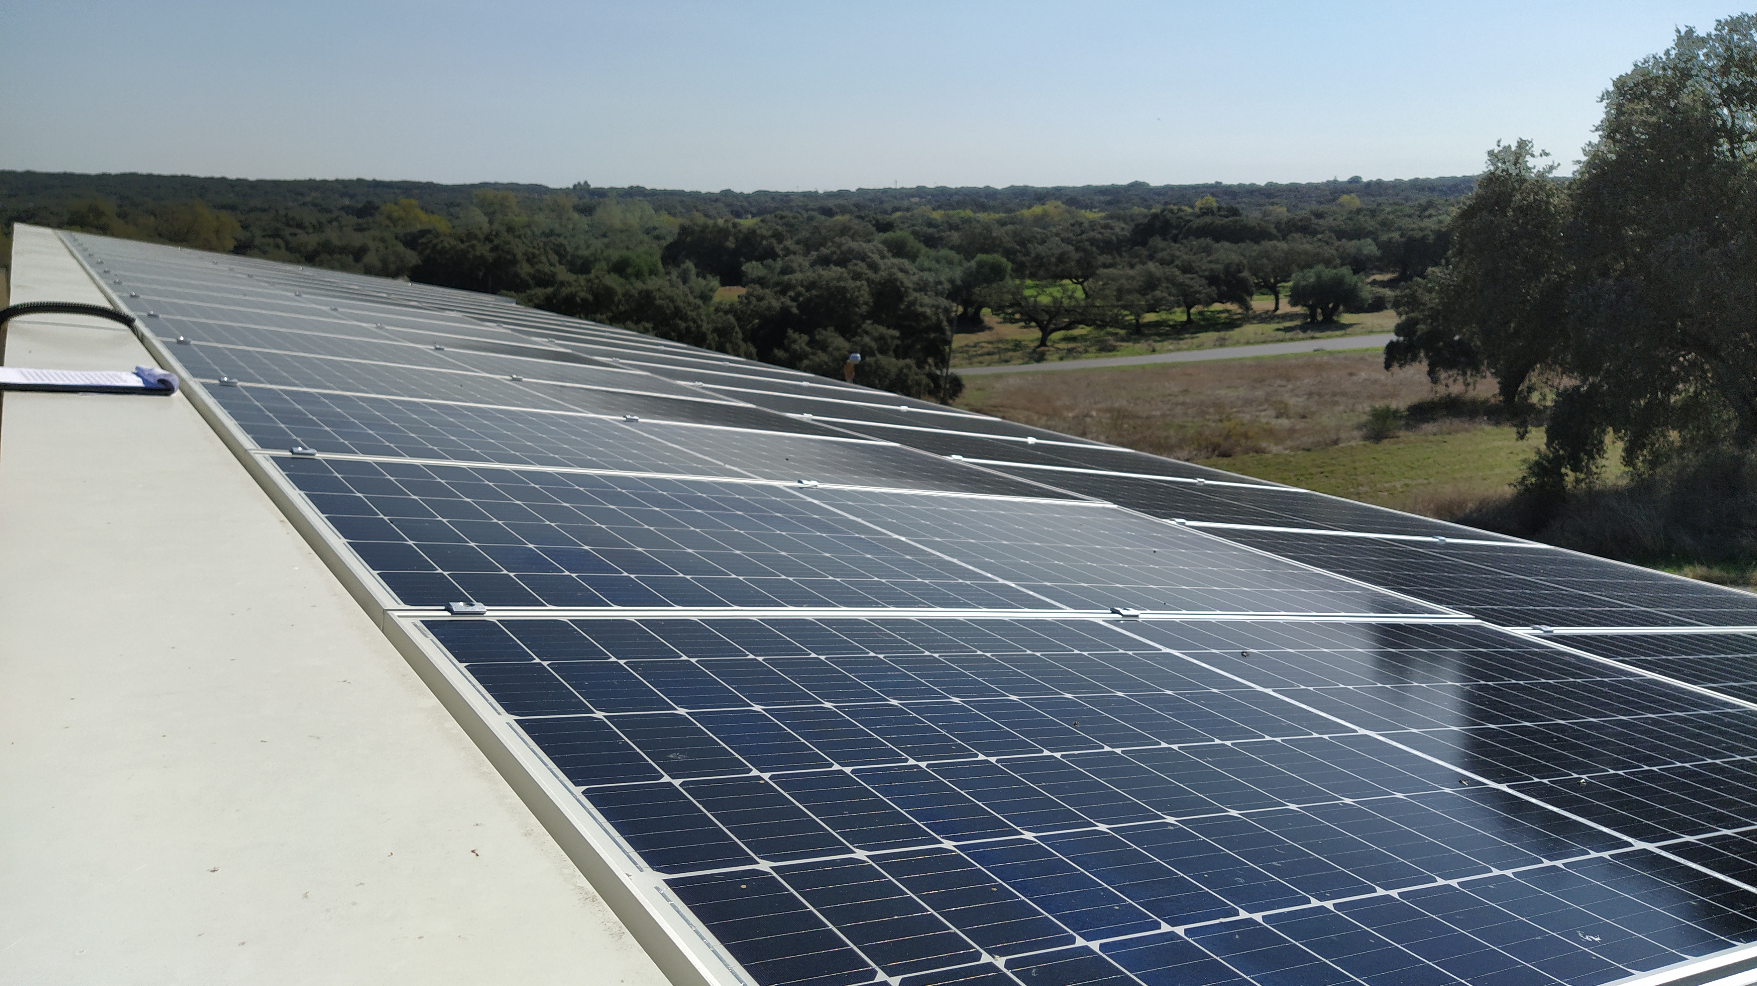
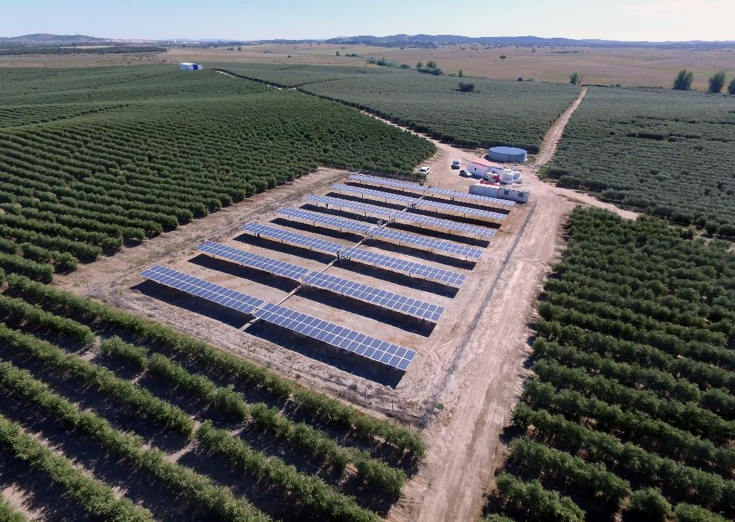
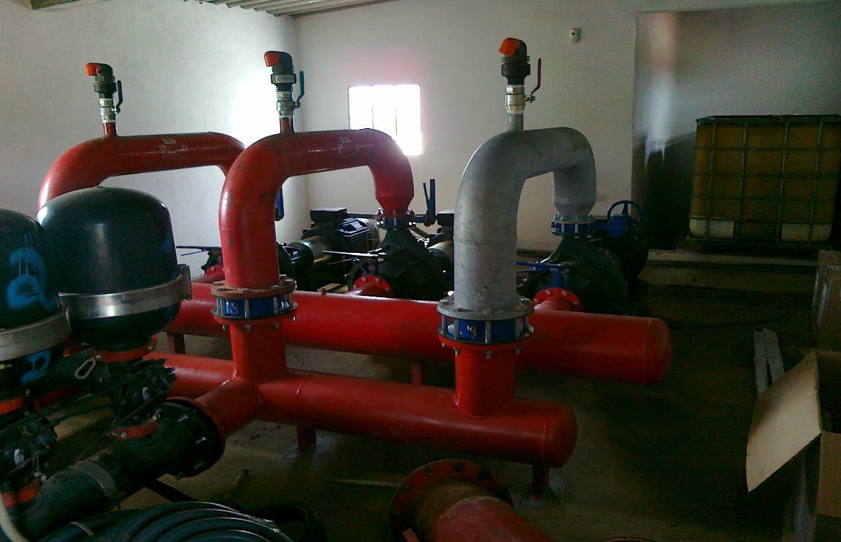
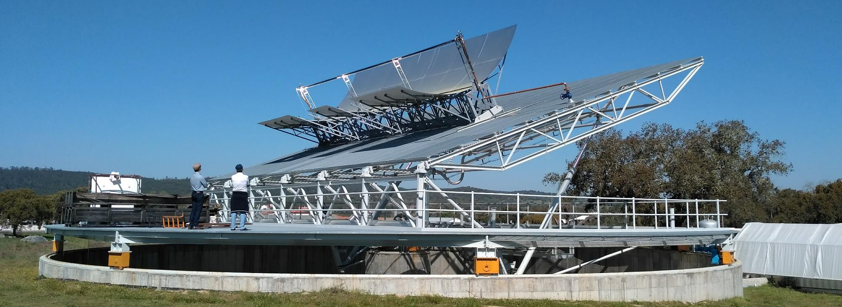
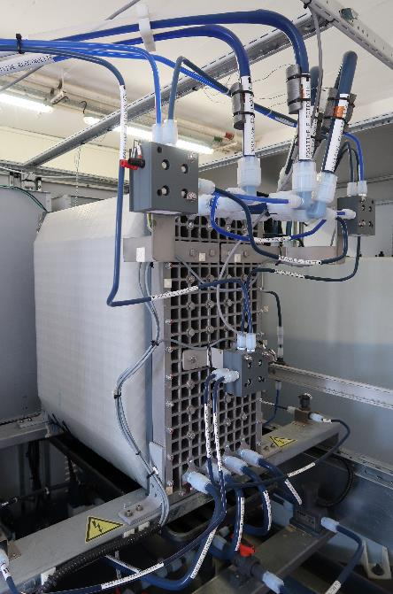
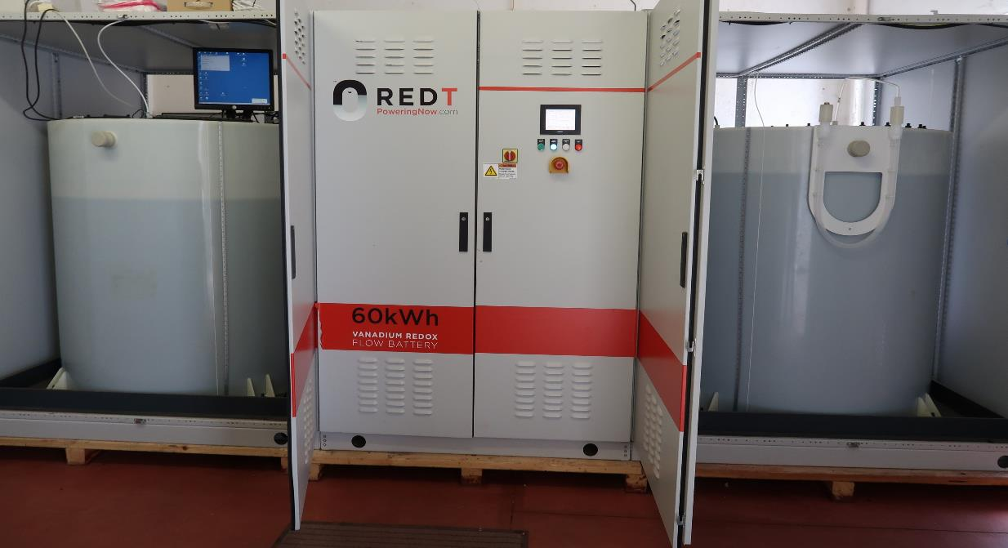
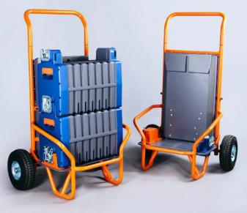
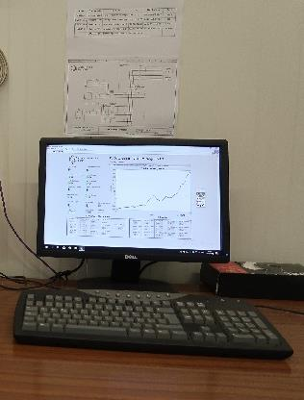
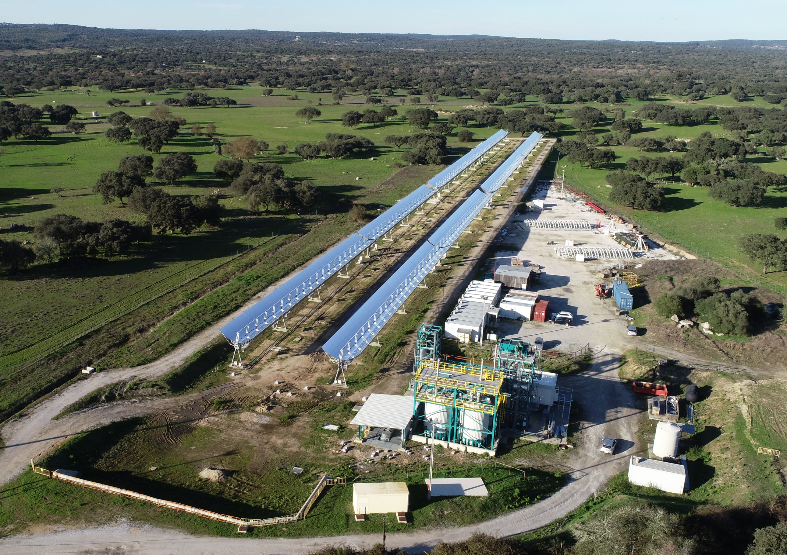
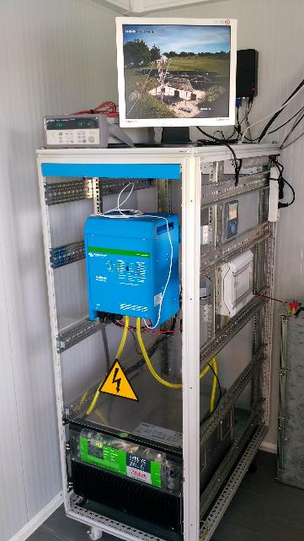
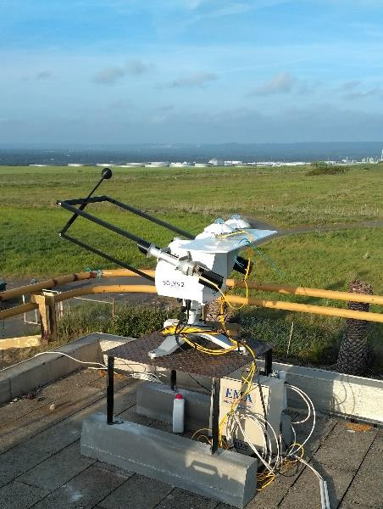
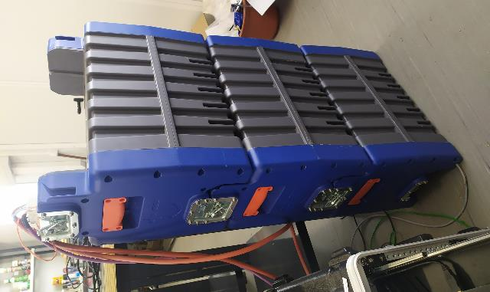
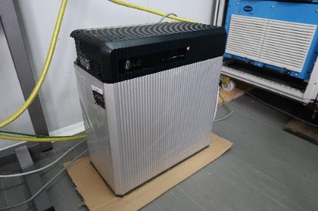

Slide 5
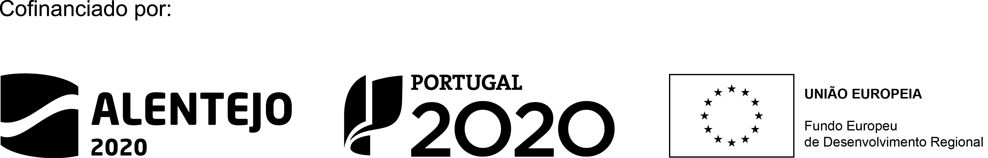
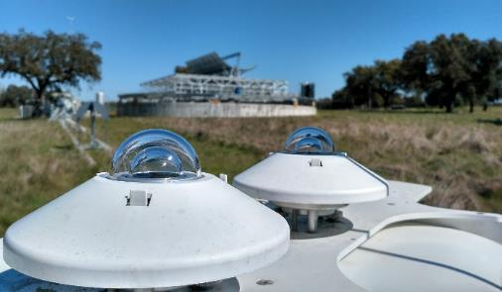
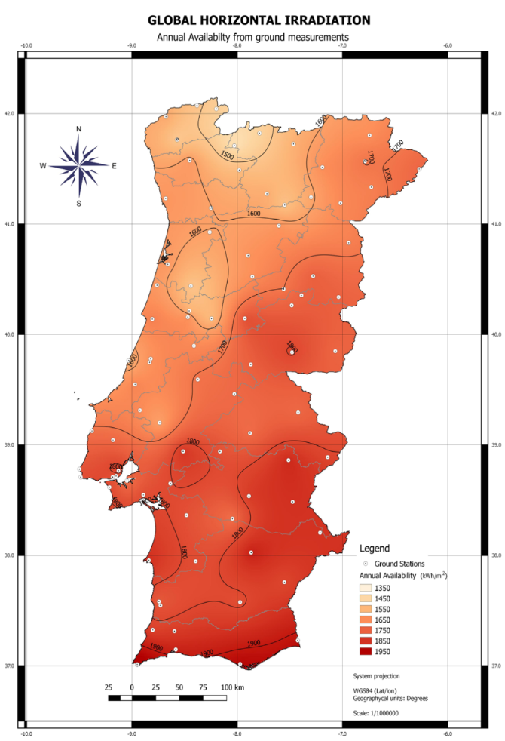
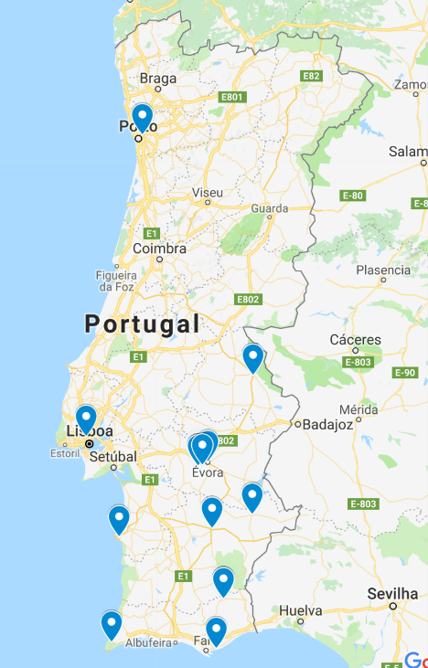
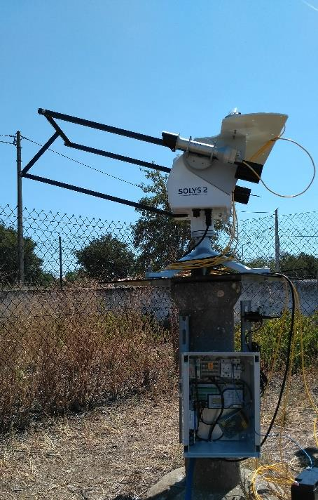
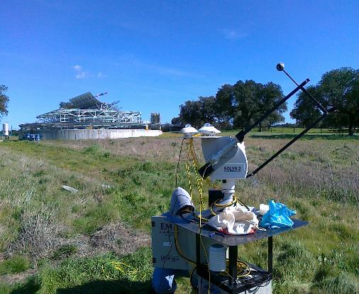
DNI-A Project (Grant n. ALT20-03-0145-FEDER-000011)
14 stations network with two axis sun tracking systems, pyranometers, pyrheliometer, temperature and humidity sensors, distributed mainly in the south of Portugal.

Slide 6
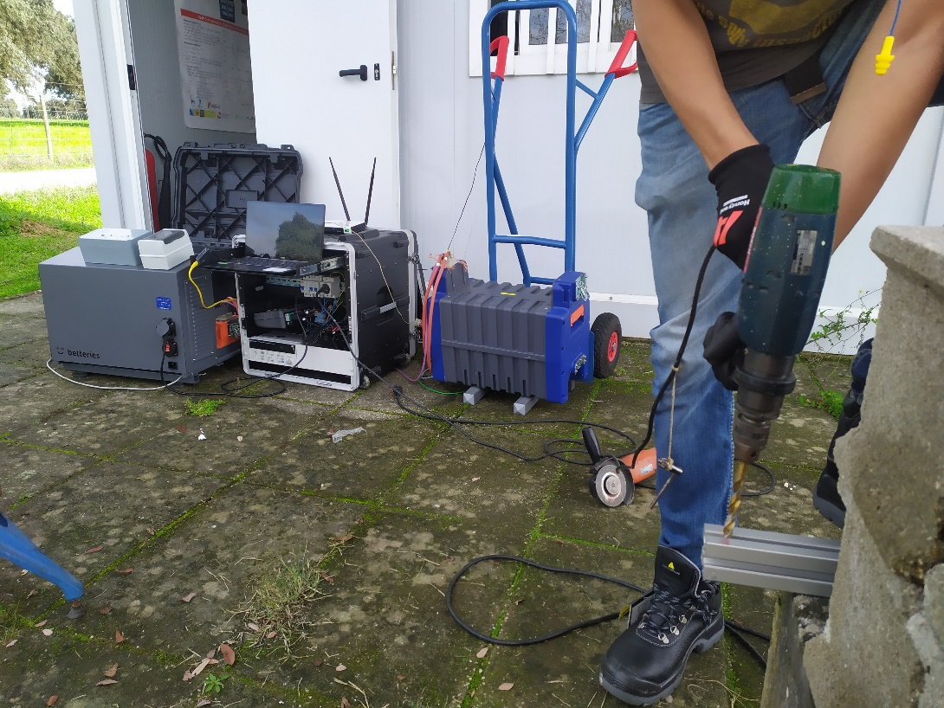

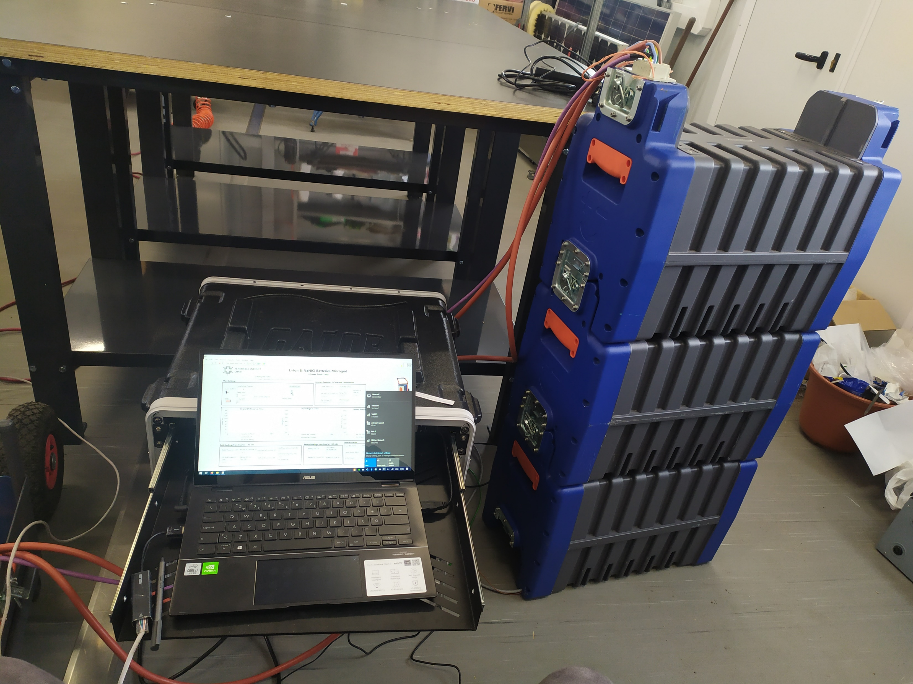
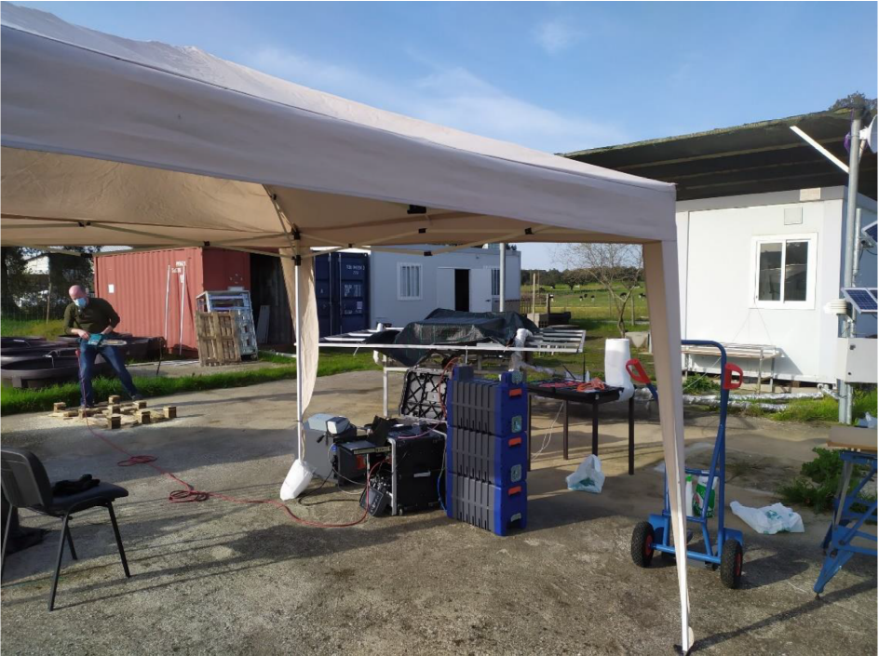

To be deployed in 10 residential end-users.
This project has received funds from the European Union’s Horizon2020 research and innovation programme under Grant Agreement 864400

Slide 7
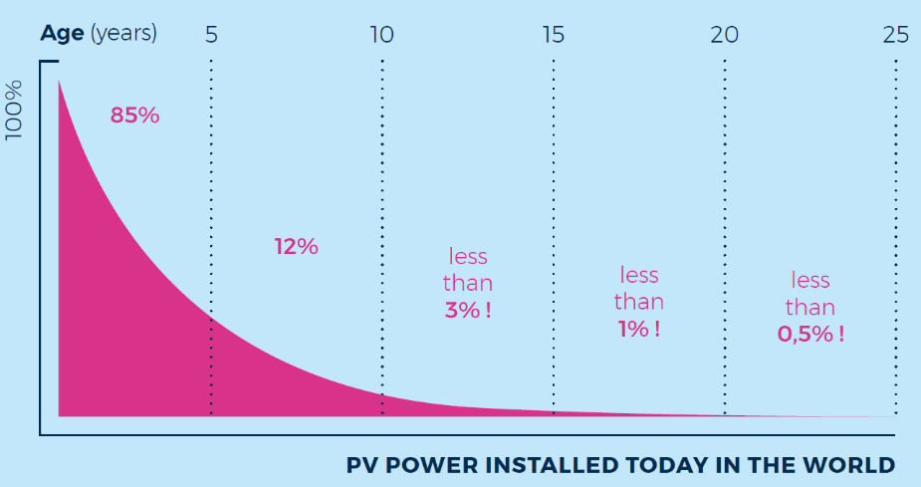
GRECO open call for “Old PV modules”
  Linear degradation model from the beginning of operation:
  Conservative scenario: -0.8%/year.
  Tight scenario: -0.25%/year.
  Reasonable scenario: -0.45%/year.
Power
Engaged 110 PV installations in Europe.
Final data selection:
more than 110MW,
10 different PV manufacturers
- 0.25 %/year
- 0.45 %/year
- 0.8 %/year
25 years

Slide 8



Thank you!
Luis Fialho
lafialho@uevora.pt
This project has received funds from the European Union’s Horizon2020 research and innovation programme under Grant Agreement 787289

