Slide 1
Digital Skills for FAIR and open science -
Report of the EOSC Skills & Training Working Group
Celia van Gelder (ELIXIR-NL), Fotis Psomopoulos (ELIXIR-GR), Ana Portugal Melo (ELIXIR-PT)
ELIXIR All Hands Meeting 2021
2 June 2021
DOI: 10.5281/zenodo.4911506

Slide 2
Digital skills for FAIR and open science
Digital skills for FAIR and open science are a cornerstone of the EOSC’s operations and future.
  Digital skills: “A range of abilities to use digital devices, communication applications, and networks to access and manage information” (OECD report, July 2020)
  In the context of FAIR and Open Science, these skills include an understanding of data, software and tools.
An EOSC network of skilled professionals is essential to bring a culture change for sharing research outcomes, and to empower individuals and institutions to develop and maintain EOSC competences, capabilities and skills.
The EOSC Skills and Training Working Group provided a framework for building competence and capabilities for EOSC

Slide 3
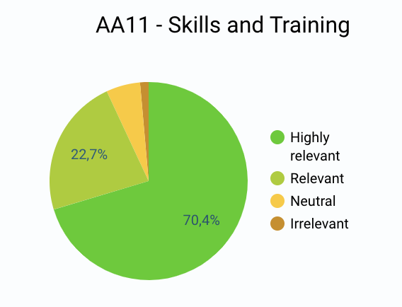
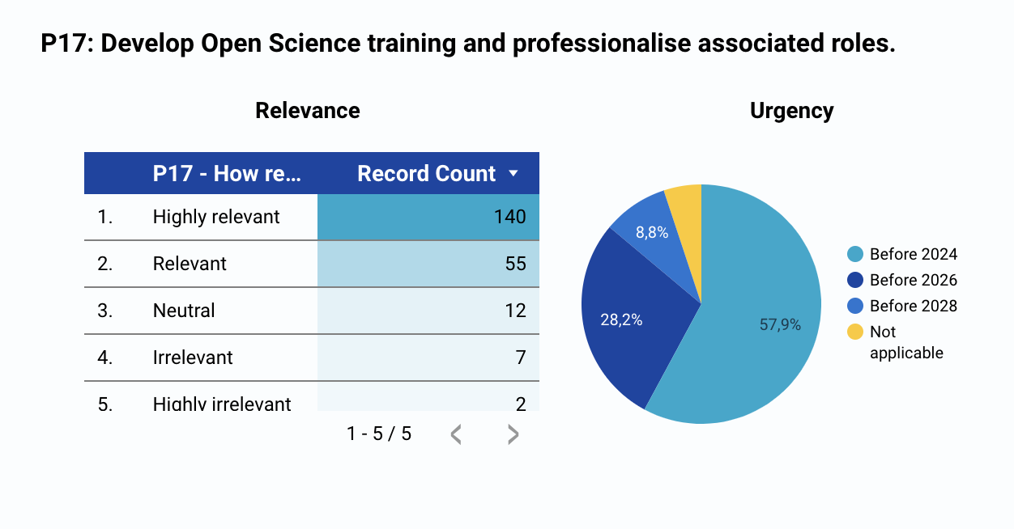
Skills and training a key factor for success of EOSC
September 2020 SRIA consultation feedback
Slide : Vinciane Gaillard

Slide 4
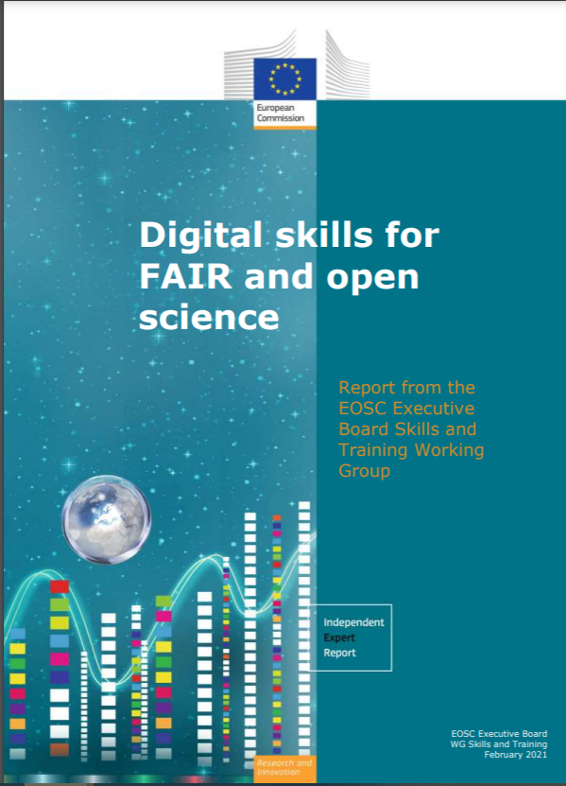
The EOSC Training & Skills Working Group
  In 2020, the Working Group Skills & Training acted as Advisory Group to EOSC Executive Board
  42 members from MS/AC, EC and EC related projects with different type of expertise
  Co-chairs Natalia Manola (OpenAIRE) & Vinciane Gaillard (EUA)
  Rapporteur: Iryna Kuchma (EIFL)
  Report “Digital skills for FAIR and open science” published February 2021
  ELIXIR participation:
    Fotis Psomopoulos (ELIXIR-GR), Ana Portugal Melo (ELIXIR-PT),
    Celia van Gelder (ELIXIR-NL) as national representatives
    Vera Matser (EBI) on behalf of EOSC-Life
    ELIXIR Training Platform was interviewed as Competence Center

Slide 5
The Digital skills for FAIR and open science report – 4 Priority Areas
  Developing the next generation of FAIR and open science professionals
    The framework of all the EOSC actors (roles) and their interactions
  Collaborating to enhance digital skills for FAIR and open science in Europe
    The concept of competence centres
  Building a trusted and long-lasting and knowledge hub of learning and training resources and related tools
    Specifications for the EOSC federated training catalogue
  Influencing national open science policy for skills by supporting strategic leaders.
    Recommendations for Member States and Associated Countries on how to support EOSC in national skills policies and strategies.
Report (February 2021)

Slide 6
Main recommendations of the EOSC Training & Skills WG
Utilise the Framework of Actors in the EOSC Ecosystem in the development and mainstreaming of FAIR and open science skills and training
Coordinate and align relevant skills curricula and training frameworks
Encourage and support the competence centres approach for FAIR and open science training
Facilitate increased integration of FAIR and open science courses with university qualifications.
Build a learning and training catalogue to maximise interoperability.
Include learning and training resources in the EOSC Interoperability Framework (EIF)
Develop an EOSC Skills and Training Leadership Programme
In addition the report gives specific recommendations for the different stakeholders
  Policy makers & funders, Universities & research organisations, Competence centres , EOSC Association, EOSC projects

Slide 7
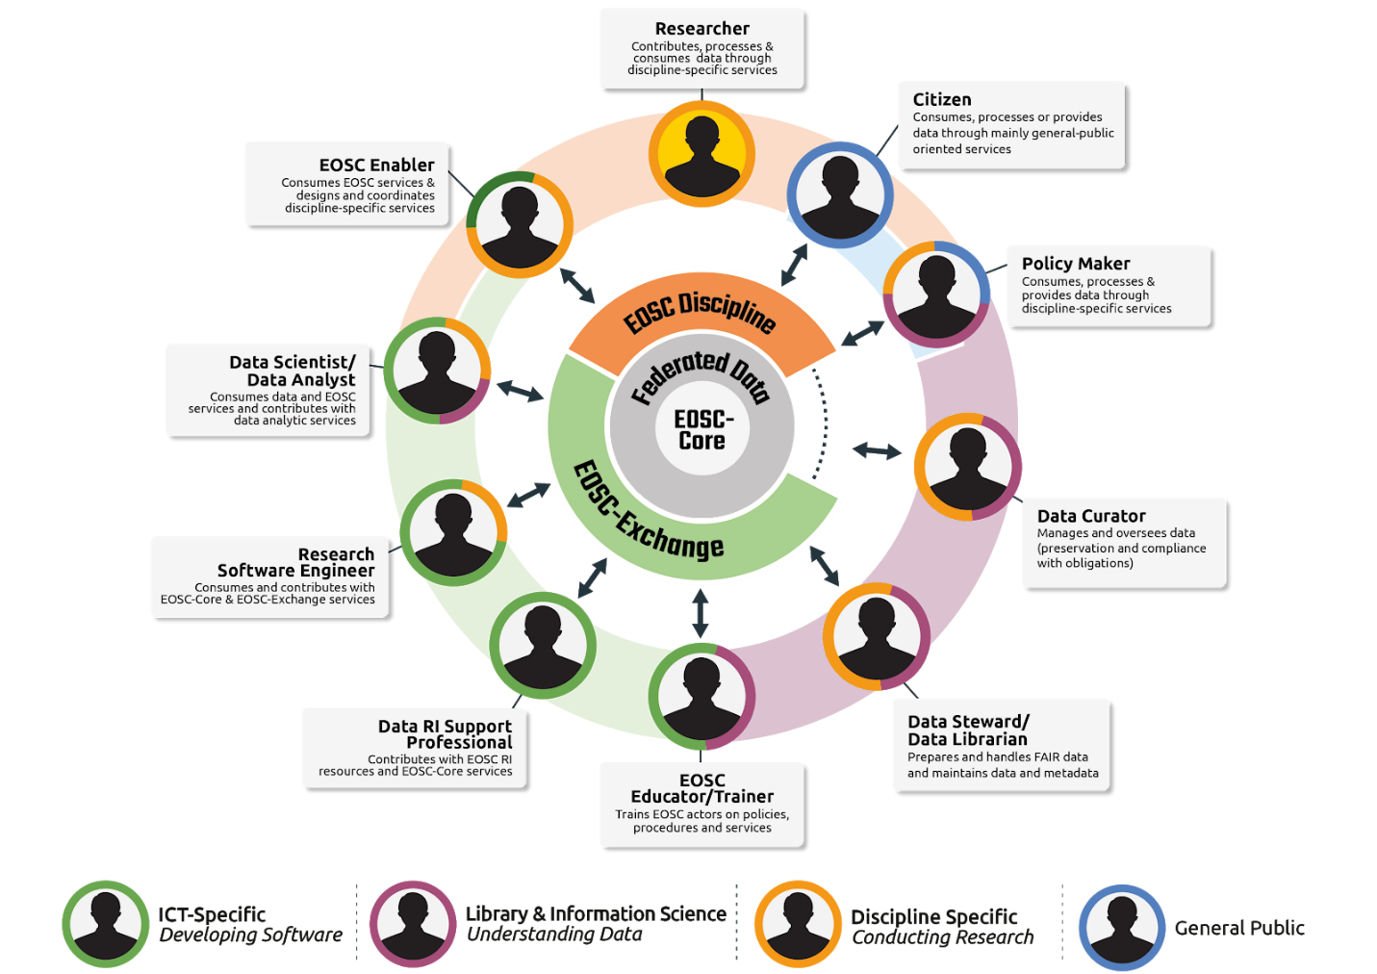
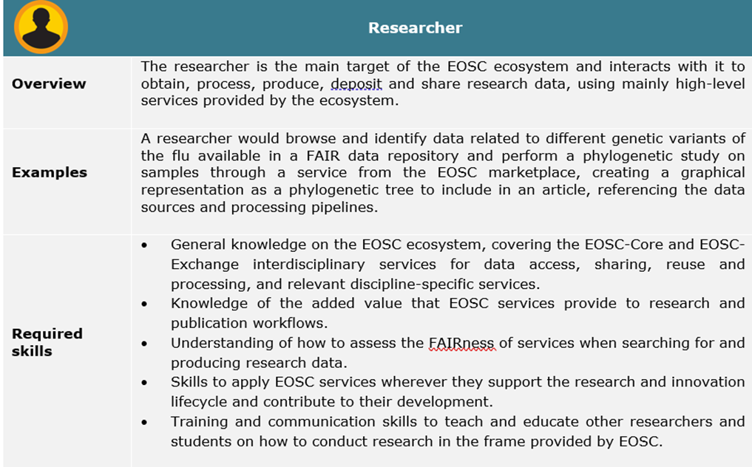
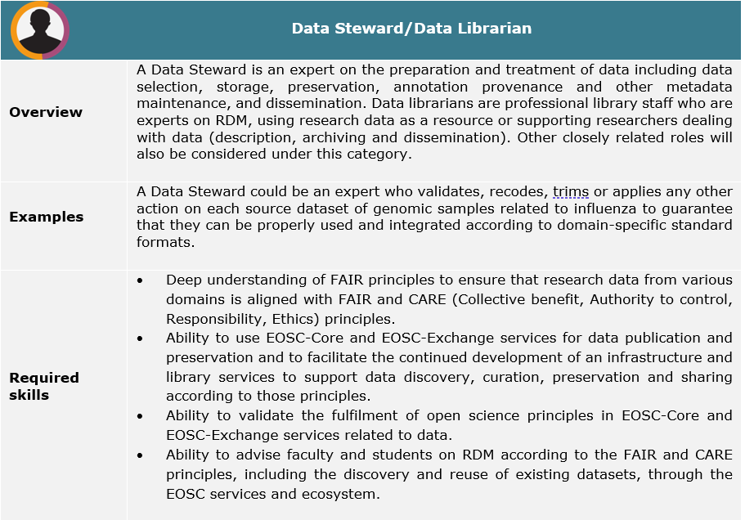
Framework of Actors in the EOSC Ecosystem
Description of 10 roles within the EOSC ecosystem, one situational example for each role and a list of required skills
Also in the Strategic Research and Innovation Agenda (SRIA) of the European Open Science Cloud (EOSC) and the EOSC Glossary,
Dec 2020

Slide 8
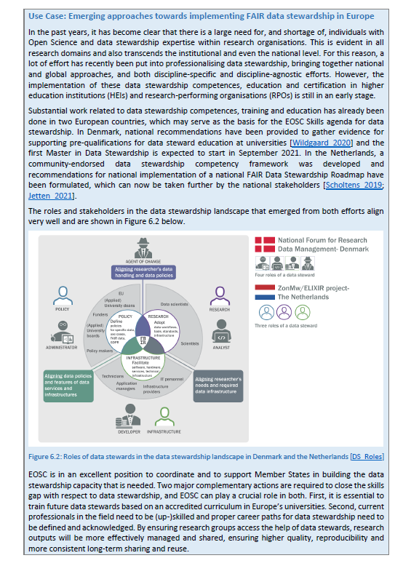
FAIR data stewardship Use Case for SRIA
NPOS/ELIXIR Work on data stewardship
competencies and skills is featuring as use case in Skills Chapter of the
Strategic Research and Innovation Agenda
(SRIA) of the EOSC:
“Emerging approaches towards implementing
FAIR data stewardship in Europe”

Slide 9
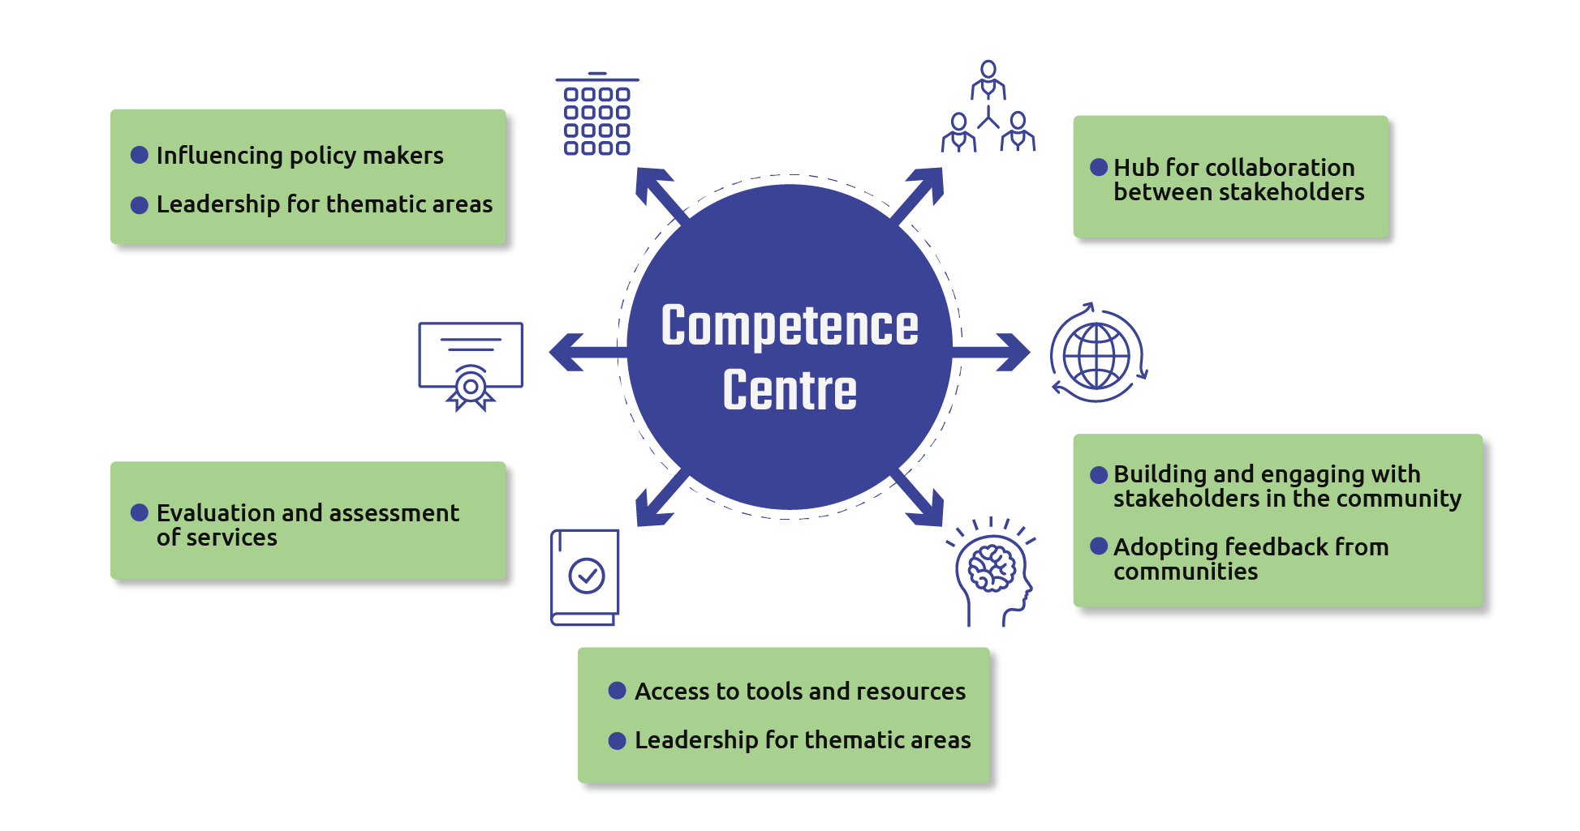
Competence centres
“Shared hubs of expertise in implementing FAIR data stewardship principles, offering leadership, coordination and cataloguing services to connect relevant people, guidance, learning resources and curricula in different thematic areas.”
FAIRsFAIR summary of competence centres features (based on the characterisation of 36 competence centres) (Herterich et al., 2019)
Slide : Vinciane Gaillard

Slide 10
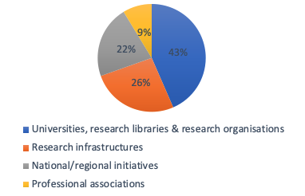
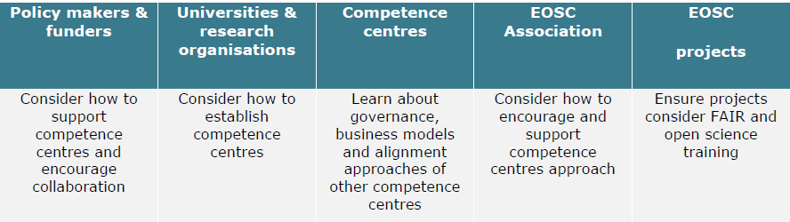
Competence centres, 23 interviews
Scope: Organizational models for the training and
skills elements of competence centers
Landscape analysis
  existing organizational models, what works & what doesn’t
  for 3 levels: Research Infrastructures, national & institutional
Interviews, 3 main categories
  Skills & Competencies
  Governance, business model and sustainability approaches
  Alignment & Collaborations
Recommendations
ELIXIR and GOBLET were also interviewed
Detailed analysis of the 23 interviews can
be found in Chapter 4 of the WG Report

Slide 11
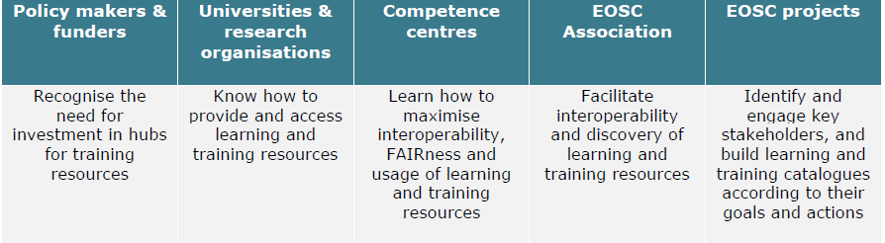
Recommendations for EOSC Learning and Training Catalogue implementation
Build a training catalogue
Include training and learning resources in the EOSC Interoperability Framework (EIF).
Embrace user centricity from the outset
Align metadata of learning and training resources and ensure they become FAIR objects
Ensure technical interoperation of catalogues and underlying processes
Embed quality assurance mechanisms in selecting and exposing learning and training resources
Ensure sustainability and future development

Slide 12
National Digital Skills Strategies
A key challenge to maximising the potential of EOSC to support FAIR and open science is ensuring the availability of highly and appropriately digitally skilled personnel, enabled by appropriate policy and programmes.
The WG Skills & Training sought to frame the digital skills required in EOSC in the wider European agenda for skills and provide recommendations for MS and AC on how to include EOSC in national skills policies and strategies.
Chapter 6 in the WG report Digital Skills for FAIR and open science
  Links to detailed reports LDK:
    EOSC within National Strategies for Digital Skills: Recommendations Report
    EOSC within National Strategies for Digital Skills: Gap Analysis Study
    EOSC within National Strategies for Digital Skills: Landscape Report
    EOSC within National Strategies for Digital Skills: Consultation and Focus Group Report

Slide 13
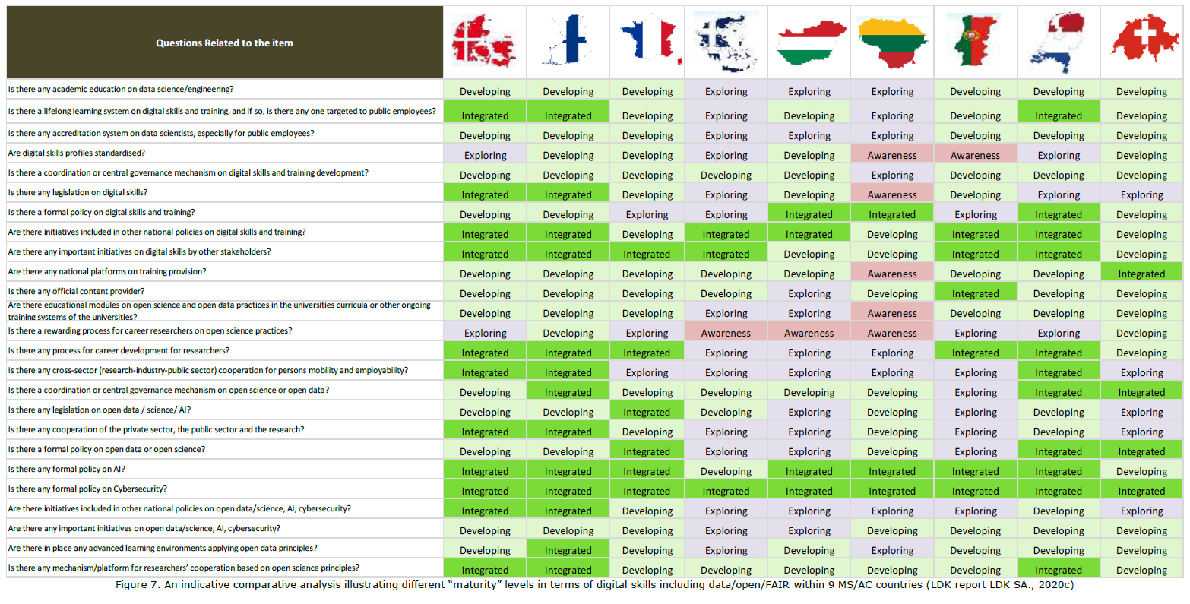

Slide 14
Recommendations for National Digital Skills Strategies
Develop an EOSC Skills and Training Leadership Programme to:
  Increase coordination of European and national policies, programmes and networks supporting the skills elements of FAIR and open science by assisting stakeholders to align initiatives.
  Develop and promote an EOSC skills and training ambassadors programme that is composed of highly specialised experts, mentors and champions who can provide senior leaders with relevant insights to influence national policy.
  Advocate for the inclusion of skills and training of FAIR and open science into major European and national funding instruments.

Slide 15
Going forward
EOSC Association – Advisory Groups/Task Force Topics - Charters currently being written
  Implementation of EOSC
    Rules of Participation compliance monitoring
    PID policy and implementation
    Researcher engagement and adoption
  Technical challenges on EOSC
    Technical interoperability of data and services
    Infrastructure for quality research software
    AAI Architecture
  Metadata and data quality
    Semantic interoperability
    FAIR metrics and data quality
  Research careers and curricula
    Data stewardship curricula and career paths
    Research careers, recognition and credit
    Upskilling countries to engage in EOSC
  Sustaining EOSC
    Defining funding models for EOSC
    Long-term data preservation
EOSC-Future WP9 Training & Skills

Slide 16
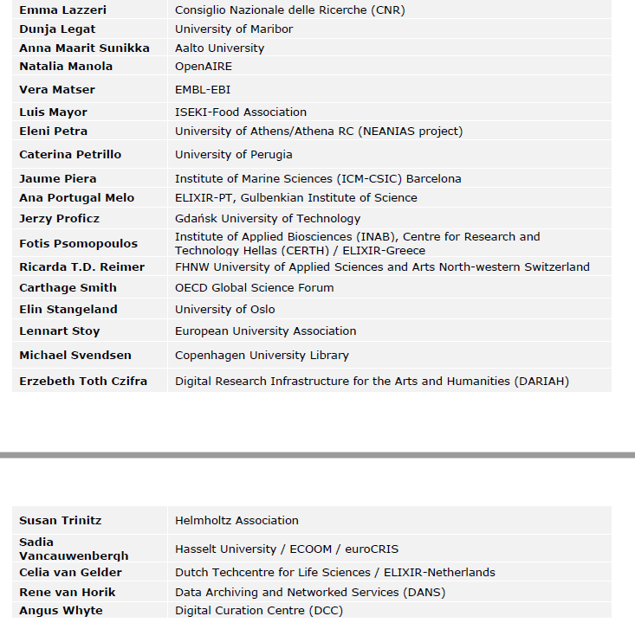
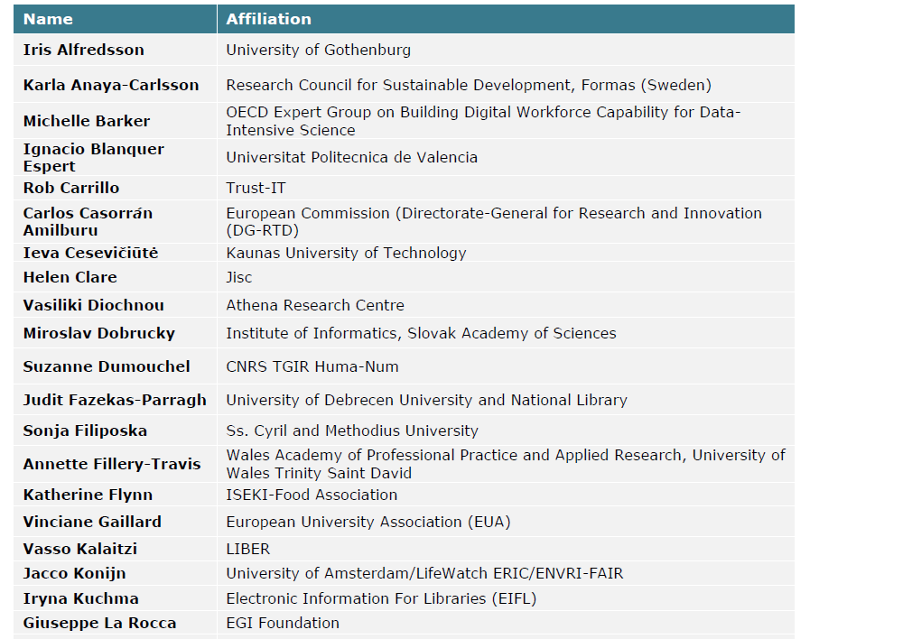
Acknowledgements
All members of the EOSC WG Skills & Training
Special thanks to Iryna Kuchma and
Vinciane Gaillard for sharing their slides!

Slide 17
Thank you!
Thank you!

