Slide 1



Partial results of the project ‘Increasing the efficiency and competitiveness of organic crop breeding’
(Creşterea eficienţei si competitivităţii ameliorării în agricultura organică)
‘ECOBREED’ (acronim)
WP - WHEAT
Responsible: Cristina Mihaela MARINCIU

Slide 2
The coordinating Institution:
KMETIJSKI INSTITUT SLOVENIJE - AGRICULTURAL INSTITUTE OF SLOVENIA (KIS)
The coordinator: Vladimir Meglic
Financed by: European Union

Slide 3
The partners of the project
2. UNIVERSITAET FUER BODENKULTUR WIEN (BOKU), WIEN 1180, Austria,
3. VYZKUMNY USTAV ROSTLINNE VYROBY VVI (CRI), PRAHA, Czech Republic
4. INSTITUT ZA RATARSTVO I POVRTARSTVO (IFVCNS), NOVI SAD 21000, Serbia
5. INSTITUTUL NATIONAL DE CERCETARE-DEZVOLTARE AGRICOLA FUNDULEA (INCDA Fundulea), Romania
6. MAGYAR TUDOMANYOS AKADEMIA AGRARTUDOMANYI KUTATOKOZPONT (MTA ATK),MARTONVASAR, Hungary
7. UNIVERSITY OF NEWCASTLE UPON TYNE (UNEW), NEWCASTLE United Kingdom
8. L.C. SMALES & SON LIMITED (L C Smales), NORTHUMBERLAND United Kingdom
9. SELGEN AS (SELGEN), PRAHA, Czech Republic
10. VOLAKAKIS NIKOLAOS (GEOKOMI), Greece
11. UNIVERSITA DEGLI STUDI DELLA TUSCIA (UNITUS), Italy
12. NATURLAND - VERBAND FUR OKOLOGISCHEN LANDBAU EV (NATURLAND),MUNCHEN, Germany,

Slide 4
The partners of the project
13. UNIVERSIDAD DE VIGO (UVIGO, Spain
14. INSTYTUT HODOWLI I AKLIMATYZACJI ROSLIN - PANSTWOWY INSTYTUT BADAWCZY (IHAR), Poland
15. PANNON EGYETEM (UP), Hungary
16. PRO-BIO OBCHODNI SPOLECNOST SRO (PRO-BIO SRO), Czech Republic
17. BIOMILA SPOL SRO (BIOMILA), Slovakia
18. NARODNE POL'NOHOSPODARSKE A POTRAVINARSKE CENTRUM (NPPC), Slovakia
19. RGA, RAZISKOVALNA GENETIKA IN AGROKEMIJA, DOO (RGA, ltd.), Slovenia
20. SAATZUCHT GLEISDORF GMBH (SZG), Austria
21. POSLOVNI SISTEM GLOBAL SEED DOO CURUG (GLOBAL SEED Serbia
22. SECOBRA SAATZUCHT GMBH (SECOBRA), Germany
23. VEREINIGUNG DER PFLANZENZUCHTER UND SAATGUTKAUFLEUTE OSTERREICHS (Saatgut Austria), Austria
24. Chinese Academy of Agricultural Sciences (CAAS), China (People's Republic of)
25. WASHINGTON STATE UNIVERSITY (WSU), United States

Slide 5
Work teams involved in WP related to WHEAT, whitin INCDA Fundulea:
Breeding wheat laboratory
Center for ecological agriculture and technology transfer systems
Fenotyping and genotyping laboratory

Slide 6
Lower input of pesticides and fertilizers in organic production systems results in lower grain yields. The average wheat yield loss in organic farming is about one-third in countries of low productivity (e.g. Austria, Italy Poland, Spain) and up to 60% in countries of high productivity (e.g. France, Germany) compared to conventional agriculture.
This trend is due to organic farms
a) often being located in less favorable environments and
b) that do not have access to wheat varieties specifically adapted to organic conditions as they were selected for and bred under high input conventional conditions.

Slide 7
The objectives of WPs project related to WHEAT are:
WP1: Creation of core collections and seed multiplication
Identify potential genetic diversity for wheat suited to organic production systems.
Multiply seed material and creation of wheat core collections.
Facilitating further use of the genetic material studied in ECOBREED by making available genotypic and phenotypic data gathered in the project through a user-friendly information portal.

Slide 8
The objectives of WPs project related to WHEAT are:
WP2: Wheat
Perform a detailed phenotypic analysis of the wheat core collections screening for traits suited to organic production systems.
Produce superior elite breeding line(s) with resistance to pests and diseases particularly prevalent in organic production systems e.g. seed borne diseases and to sustain grain quality.
Screen wheat germplasm with improved mycorrhizal associations.
Production of new wheat cultivars and breeding materials suitable for organic production.
WP8: Demonstration, dissemination, exploitation and communication
WP9: Project management and co-ordination

Slide 9
We made many notes and measurements, such as: ground cover, emergency, winterhardiness, growth habit, flag leaf emergency, flag leaf pubescence, flag leaf inclination, flag leaf length, flag leaf width, awnedness, glume color, glume pubescence, plant height, ear habit, ear density, spike density/m2,yield, TKW, TW, grain/seed size and shape, quality parameters, diseases tolerance.
We made, at INCDA Fundulea, a separate field for the screening of bunt resistance.

Slide 10
Wheat core collection tested in South of Europe (Romania, Slovenia, Hungary, Serbia)
Crt. No.2021 | Name | Prov |  | Crt. No.2021 | Name | Prov
ECO 1 | A15 | INCDA FUNDULEA |  | ECO 21 | Mv KEPE | MTA-ATK Martonvasar
ECO 2 | GLOSA | INCDA FUNDULEA |  | ECO 22 | Mv KOLO | MTA-ATK Martonvasar
ECO 3 | IZVOR | INCDA FUNDULEA |  | ECO 23 | Mv KOLOMPOS | MTA-ATK Martonvasar
ECO 4 | LITERA | INCDA FUNDULEA |  | ECO 24 | Mv LUCILLA | MTA-ATK Martonvasar
ECO 5 | FDL MIRANDA | INCDA FUNDULEA |  | ECO 25 | Mv MAGDALÉNA | MTA-ATK Martonvasar
ECO 6 | PITAR | INCDA FUNDULEA |  | ECO 26 | Mv MENROT | MTA-ATK Martonvasar
ECO 7 | SEMNAL | INCDA FUNDULEA |  | ECO 27 | Mv PÁNTLIKA | MTA-ATK Martonvasar
ECO 8 | URSITA | INCDA FUNDULEA |  | ECO 28 | Mv SUBA | MTA-ATK Martonvasar
ECO 9 | UNITAR | INCDA FUNDULEA |  | ECO 29 | Mv TOBORZÓ | MTA-ATK Martonvasar
ECO 10 | FDLGPC1 | INCDA FUNDULEA |  | ECO 30 | Mv UNCIA | MTA-ATK Martonvasar
ECO 11 | ALEX | INCDA FUNDULEA |  | ECO 31 | Mv KÁPLÁR (=MV05-15) | MTA-ATK Martonvasar
ECO 12 | Simnic 60 | INCDA FUNDULEA |  | ECO 32 | Mv-ELITE-CCP | MTA-ATK Martonvasar
ECO 13 | ADELINA | INCDA FUNDULEA |  | ECO 33 | MV-MENTE | MTA-ATK Martonvasar
ECO 14 | VOINIC | INCDA FUNDULEA |  | ECO 34 | BERTOLD | SVK
ECO 15 | FDL ABUNDENT | INCDA FUNDULEA |  | ECO 35 | BONA VITA | SVK
ECO 16 | FDL AMURG | INCDA FUNDULEA |  | ECO 36 | GENOVEVA | SVK
ECO 17 | BÁNKÚTI-1201 | MTA-ATK Martonvasar |  | ECO 37 | ILONA | SVK
ECO 18 | Mv BOJTÁR | MTA-ATK Martonvasar |  | ECO 38 | IS AGILIS | SVK
ECO 19 | Mv KARÉJ | MTA-ATK Martonvasar |  | ECO 39 | IS ESCORIA | SVK
ECO 20 | Mv KARIZMA | MTA-ATK Martonvasar |  | ECO 40 | IS GORDIUS | SVK

Slide 11
Wheat core collection tested in South of Europe (Romania, Slovenia, Hungary, Serbia)
Crt. No.2021 | Name | Prov |  | Crt. No.2021 | Name | Prov
ECO 41 | IS MANDALA | SVK |  | ECO 61 | NEXERA 923 | SL
ECO 42 | IS LAUDIS | SVK |  | ECO 62 | CAPO | Austria
ECO 43 | IS SOLARIS | SVK |  | ECO 63 | EDELMANN | Austria
ECO 44 | JUNO | SVK |  | ECO 64 | ALESSIO | Austria
ECO 45 | PS DOBROMILA | SVK |  | ECO 65 | ARNOLD | Austria
ECO 46 | PS JELDKA | SVK |  | ECO 66 | EHOGOLD | Austria
ECO 47 | PS KVALITAS | SVK |  | ECO 67 | AURELIUS | Austria
ECO 48 | PS PUQA | SVK |  | ECO 68 | ANAPURNA | SERBIA
ECO 49 | RADOSINSKA KAROLA | SVK |  | ECO 69 | BC LIRA | SERBIA
ECO 50 | SLOVENSKA 200 | SVK |  | ECO 70 | FARINELLI | SERBIA
ECO 51 | STANISLAVA | SVK |  | ECO 71 | NIKOL | SERBIA
ECO 52 | VIOLA | SVK |  | ECO 72 | NS 40S | SERBIA
ECO 53 | CCB INGENIO | SL |  | ECO 73 | NS EFROSINIA | SERBIA
ECO 54 | GOROLJKA | SL |  | ECO 74 | NS FRAJLA | SERBIA
ECO 55 | ILLICO | SL |  | ECO 75 | NS ILINA | SERBIA
ECO 56 | IZALCO CS | SL |  | ECO 76 | NS MILA | SERBIA
ECO 57 | RESKA | SL |  | ECO 77 | NS OBALA | SERBIA
ECO 58 | SAVINJA | SL |  | ECO 78 | SOFRU | SERBIA
ECO 59 | TATA MATA | SL |  | ECO 79 | SOLEHIO | SERBIA
ECO 60 | VULKAN | SL |  | ECO 80 | ZVEZDANA | SERBIA

Slide 12
The correlations between productions obtained in 4 conditions
Fundulea
0.55
0,48
Martonvasar
0.49
Novisad
-0.03
0.12
0.05
Slovenia
We analyzed averages of the 3 conditions that had consonant results

Slide 13
The first genotypes classified as average yield
Average of 3 conditions (F, MV, NS)
(2282-4655 kg/ha)
 | GENOTYPE | Average | Min | Max
1 | Mv-KAPLAR | 4655 | 1982 | 6383
2 | UNITAR | 4613 | 2220 | 6250
3 | SIMNIC-60 | 4570 | 2017 | 6083
4 | FDL-ABUNDENT | 4520 | 2131 | 6550
5 | LITERA | 4509 | 2117 | 6083
6 | PITAR | 4481 | 1543 | 6783
7 | FDL-MIRANDA | 4437 | 1945 | 6183
8 | SEMNAL | 4400 | 1902 | 6467
9 | Mv-MENROT | 4376 | 2064 | 6667
10 | Mv-LUCILLA | 4336 | 1976 | 5950
11 | URSITA | 4314 | 1897 | 6183
12 | ALEX | 4200 | 1650 | 5783
13 | CCB-INGENIO | 4189 | 1972 | 5783
14 | Mv-UNCIA | 4178 | 1958 | 5917
15 | Mv-KAREJ | 4168 | 1884 | 6217
16 | GLOSA | 4152 | 1550 | 6217
17 | Mv-PANTLIKA | 4122 | 1791 | 5867
18 | VIOLA | 4101 | 1687 | 5700
19 | Mv-MAGDALENA | 4066 | 1917 | 6267
20 | Mv-BOJTAR | 4039 | 1747 | 5783
DL5%= 333 kg/ha

Slide 14
The first genotypes classified as average grain protein content % in 2 locations (F and MV)
(8.7 – 13.3%)
Clasif | Name | GrainProt %
1 | FDL AMURG | 13.3
2 | SLOVENSKA 200 | 13.1
3 | ALESSIO | 12.7
4 | PS KVALITAS | 12.6
5 | Mv TOBORZÓ | 12.6
6 | Mv-ELITE-CCP | 12.5
7 | IZVOR | 12.4
8 | IS MANDALA | 12.3
9 | PS DOBROMILA | 12.2
10 | Mv SUBA | 12.2
11 | BÁNKÚTI-1201 | 12.2
12 | GOROLJKA | 12.2
13 | RADOSINSKA KAROLA | 12.2
14 | VOINIC | 12.1
15 | FDLGPC1 | 12
16 | PITAR | 11.9
17 | LITERA | 11.9
18 | IS ESCORIA | 11.9
19 | ARNOLD | 11.9
20 | CAPO | 11.8

Slide 15
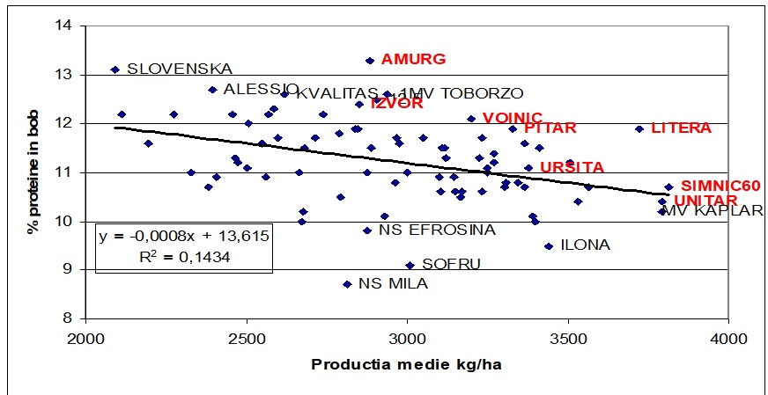
The regression of yield-%grain protein
(average F + MV)

Slide 16
The deviations from the yield-%protein regression
Average Fundulea+ MV. (from-2.66 to +1.99)
Classification | Variety | Deviations from regression
1 | FDL AMURG | 1,99
2 | MV TOBORZO | 1,34
3 | LITERA | 1,26
4 | MV ELITE | 1,21
5 | SLOVENSKA | 1,16
6 | PS KVALITAS | 1,08
7 | IZVOR | 1,07
8 | VOINIC | 1,04
9 | ALESSIO | 1
10 | PITAR | 0,95
11 | MV SUBA | 0,78
12 | IS MANDALA | 0,75
13 | MV KOLOMPOS | 0,68
14 | BERTOLD | 0,67
15 | PS DOBROMILA | 0,64
16 | ALEX | 0,61
17 | IS ESCORIA | 0,56
18 | ARNOLD | 0,56
19 | GOROLIKA | 0,55
20 | IS AGILIS | 0,53

Slide 17
The first wheat varieties classified, as Test Weight, average on 3 locations (F, MV, NS)
(73.6 – 82.2 kg/hl)
Classif | Name | kg/hl
1 | ARNOLD | 82.2
2 | AURELIUS | 81.9
3 | TATA-MATA | 81.6
4 | VOINIC | 81.3
5 | EHOGOLD | 81.2
6 | GLOSA | 81.1
7 | IZVOR | 80.9
8 | IS-ESCORIA | 80.7
9 | IZALCO-CS | 80.7
10 | PITAR | 80.7
11 | FDL-AMURG | 80.5
12 | URSITA | 80.5
13 | Mv-KAREJ | 80.4
14 | Mv-ELITE-CCP | 80.2
15 | BERTOLD | 80.2
16 | Mv-KARIZMA | 80.2
17 | Mv-TOBORZO | 80.1
18 | GOROLJKA | 80.0
19 | CAPO | 80.0
20 | Mv-MAGDALENA | 80.0

Slide 18
The first wheat varieties classified as Thousand Kernel Weight, average on 3 locations (F, MV, NS)
(32.4 - 52.2 g)
Clasif | Name | g
1 | Mv-TOBORZO | 52.2
2 | FDL-AMURG | 50.4
3 | CCB-INGENIO | 48.5
4 | Mv-PANTLIKA | 47.2
5 | BC-LIRA | 46.5
6 | Mv-MENROT | 45.6
7 | Mv-KOLOMPOS | 45.2
8 | Mv-KAREJ | 44.9
9 | MV-SUBA | 44.6
10 | Mv-MAGDALENA | 44.3
11 | GLOSA | 44.3
12 | NIKOL | 44.3
13 | SOLEHIO | 43.9
14 | PITAR | 43.7
15 | VIOLA | 43.6
16 | IS-SOLARIS | 43.6
17 | GENOVEVA | 43.5
18 | UNITAR | 43.5
19 | FDL-MIRANDA | 43.2
20 | SIMNIC-60 | 43.2

Slide 19
The first wheat varieties classified as bunt resistance, tested at NARDI Fundulea
Clasif | NAME | % spikes with bunt/row
1 | LITERA | 1%
2 | SEMNAL | 1%
3 | URSITA | 2%
4 | BC LIRA | 4%
5 | ANAPURNA | 6%
6 | RADOSINSKA KAROLA | 6%
7 | VOINIC | 6%
8 | IS ESCORIA | 6%
9 | MV KEPE | 7%
10 | NS EFROSINIA | 8%
11 | ILLICO | 8%
12 | ADELINA | 8%
13 | NS MILA | 8%
14 | GENOVEVA | 8%
15 | ALESSIO | 9%
16 | MV UNCIA | 9%
17 | MV MENTE | 9%
18 | IZVOR | 9%
19 | RESKA | 9%
20 | IS LAUDIS | 10%

Slide 20
Molecular analyses
No | Variety | Lr34 (cssfr5) | Lr46 | Tsm592 | Rht-B1 | Rht-D1 | PPD-D1 |  | No | Variety | Lr34 (cssfr5) | Lr46 | Tsm592 | Rht-B1 | Rht-D1 | PPD-D1
1 | A15 | - | - | - | a | a | D1b |  | 21 | Mv KEPE | - | + | - | b | a | D1b
2 | GLOSA | + | - | - | b | a | D1a |  | 22 | Mv KOLO | - | - | - | b | a | D1a
3 | IZVOR | + | - | - | b | a | D1a |  | 23 | Mv KOLOMPOS | - | + | - | b | a | D1a
4 | LITERA | + | - | - | b | a | D1a |  | 24 | Mv LUCILLA | - | - | - | b | a | D1b
5 | FDL MIRANDA | - | - | - | b | a | D1a |  | 25 | Mv MAGDALÉNA | - | - | +1B | b | a | D1b
6 | PITAR | + | - | - | b | a | D1a |  | 26 | Mv MENROT | - | - | - | b | a | D1b
7 | SEMNAL | + | + | - | b | a | D1a |  | 27 | Mv PÁNTLIKA | - | - | - | b | a | D1b
8 | URSITA | - | - | +1A | b | a | D1a |  | 28 | Mv SUBA | - | - | - | b | a | D1b
9 | UNITAR | + | + | +1A | b | a | D1a |  | 29 | Mv TOBORZÓ | - | - | +1A | b | a | D1a
10 | FDLGPC1 | H | - | - | b | a | D1a |  | 30 | Mv UNCIA | + | + | - | b | a | D1a
11 | ALEX | + | - | - | b | a | D1a |  | 31 | Mv KÁPLÁR | - | - | - | b | a | D1a
12 | Simnic 60 | - | - | +1A | b | a | D1a |  | 32 | Mv-ELITE-CCP | - | - | +1B | b | a | D1b
13 | ADELINA | + | - | - | b | a | D1a |  | 33 | MV-MENTE | - | - | - | b | a | D1b
14 | VOINIC | - | - | - | b | a | D1a |  | 34 | BERTOLD | - | - | - | a | a | D1a
15 | FDL ABUNDENT | - | - | +1A | b | a | D1a |  | 35 | BONA VITA | - | - | - | a | a | D1a
16 | FDL AMURG | -? | + | - | b | a | D1a |  | 36 | GENOVEVA | - | - | +1B | a | a | D1b
17 | BÁNKÚTI-1201 | - | - | - | a | a | D1b |  | 37 | ILONA | - | - | - | b | a | D1a
18 | Mv BOJTÁR | - | - | - | b | a | D1b |  | 38 | IS AGILIS | - | - | - | a | a | D1a
19 | Mv KARÉJ | - | - | - | b | a | D1a |  | 39 | IS ESCORIA | +? (H?) | - | - | a | a | D1a
20 | Mv KARIZMA | - | + | - | a | b | D1a |  | 40 | IS GORDIUS | - | - | - | a | a | D1a

Slide 21
Molecular analyses
No | Variety | Lr34 (cssfr5) | Lr46 | Tsm592 | Rht-B1 | Rht-D1 | PPD-D1 |  | No | Variety | Lr34 (cssfr5) | Lr46 | Tsm592 | Rht-B1 | Rht-D1 | PPD-D1
41 | IS MANDALA | - | + | - | a | a | D1b |  | 61 | NEXERA 923 | - | - | - | a | a | D1a
42 | IS LAUDIS | - | - | - | a | a | D1b |  | 62 | CAPO | - | - | - | a | a | D1b
43 | IS SOLARIS | - | - | - | a | a | D1b |  | 63 | EDELMANN | - | - | - | a | a | D1b
44 | JUNO | + | - | - | a | a | D1a |  | 64 | ALESSIO | - | + | - | a | a | D1b
45 | PS DOBROMILA | - | - | - | a | a | D1b |  | 65 | ARNOLD | - | - | - | a | a | D1b
46 | PS JELDKA | - | - | - | a | a | D1b |  | 66 | EHOGOLD | - | - | - | a | a | D1b
47 | PS KVALITAS | - | - | - | a | a | D1b |  | 67 | AURELIUS | - | - | - | a | a | D1b
48 | PS PUQA | - | - | - | a | a | D1a |  | 68 | ANAPURNA | - | + | - | a | b | D1a
49 | RADOSINSKA KAROLA | - | no | - | a | a | D1b |  | 69 | BC LIRA | - | + | - | b | a | D1b
50 | SLOVENSKA 200 | - | - | - | a | a | H |  | 70 | FARINELLI | - | - | - | b | a | D1a
51 | STANISLAVA | + | - | - | a | a | D1a |  | 71 | NIKOL | + | - | - | a | a | D1a
52 | VIOLA | - | - | - | H | a | D1a |  | 72 | NS 40S | - | - | - | a | a | H?
53 | CCB INGENIO | - | + | - | a | a | D1a |  | 73 | NS EFROSINIA | - | - | - | a | a | D1a
54 | GOROLJKA | - | - | - | a | a | D1a |  | 74 | NS FRAJLA | - | - | - | a | a | D1a
55 | ILLICO | - | - | - | a | a | D1a |  | 75 | NS ILINA | - | - | - | a | a | D1a
56 | IZALCO CS | - | - | - | a | a | D1a |  | 76 | NS MILA | + | - | - | a | a | D1a
57 | RESKA | - | - | +1A | H | a | D1a |  | 77 | NS OBALA | - | - | - | a | a | D1a
58 | SAVINJA | + | - | +1B | a | a | D1a |  | 78 | SOFRU | - | - | - | a | a | D1a
59 | TATA MATA | - | + | - | b | a | D1b |  | 79 | SOLEHIO | - | + | - | b | a | D1a
60 | VULKAN | - | + | - | a | a | D1a |  | 80 | ZVEZDANA | + | - | - | H | a | D1a

Slide 22
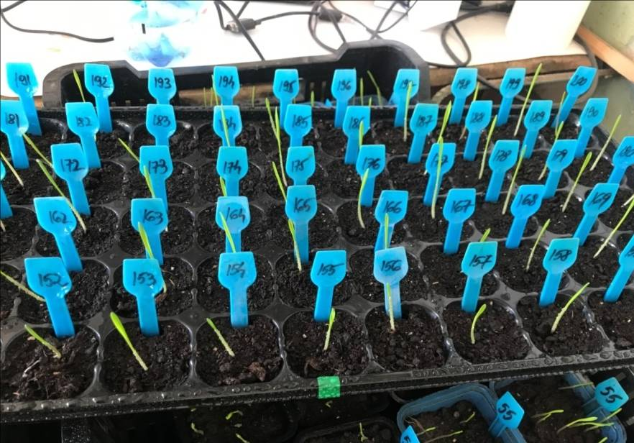
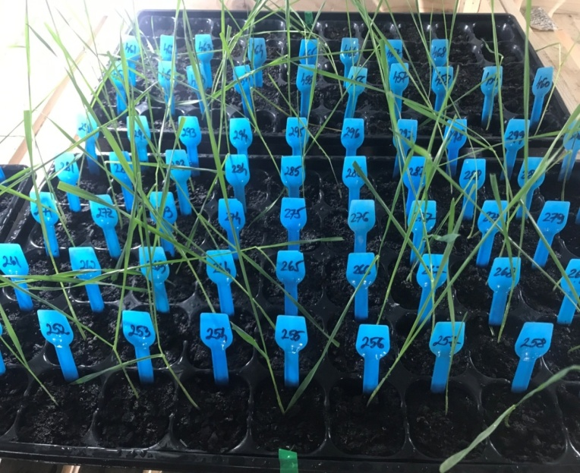
Molecular analyses
The molecular laboratory will test, in this winter, 500 wheat plants (from F3 generation), obtained from Austria, for GPC-B1 gene, responsible for high grain protein content.
The plants were sown in small pots and vernalized at 5ºC, at growth chambre, at the end of November. The plants were already planted in the glass house. The samples of leaves were harvested in the end of January and, in the next period, they will be analyzed in molecular laboratory.

Slide 23
We identified the wheat varieties with desired traits for organic agriculture system, based on all these measurements.
We chosen some genotypes for crossing block that we sowed them, in the autumn of 2020, for making crosses, to obtain some new breeding lines with good results in organic agriculture system.

Slide 24
Wheat varieties classified for some important traits in organic agriculture system
(bold = selected for crossing block)
SOIUL | Yield | %PROT | Prot.deviatons | Bunt res | SUM of ranks
LITERA | 5 | 17 | 3 | 1 | 26
FDL AMURG | 25 | 1 | 1 | 39 | 39
VOINIC | 22 | 14 | 8 | 7 | 51
PITAR | 6 | 16 | 10 | 32 | 64
IZVOR | 34 | 7 | 7 | 18 | 66
URSITA | 11 | 44 | 35 | 3 | 93
MV KEPE | 24 | 39 | 33 | 9 | 105
MV TOBORZO | 30 | 5 | 2 | 78 | 115
SEMNAL | 8 | 59 | 49 | 2 | 118
GLOSA | 16 | 38 | 36 | 44 | 134
FDL ABUNDENT | 4 | 41 | 26 | 65 | 142
UNITAR | 2 | 70 | 46 | 31 | 149
SIMNIC 60 | 3 | 57 | 38 | 52 | 150
MV KOLOMPOS | 26 | 29 | 29 | 72 | 156
ILLICO | 21 | 66 | 60 | 11 | 158
A15 | 77 | 21 | 37 | 23 | 158
MV KARIZMA | 43 | 30 | 34 | 55 | 162
MV KAREJ | 15 | 52 | 47 | 54 | 168
MV KAPLAR | 1 | 72 | 55 | 48 | 176
BANKUTI 1201 | 78 | 11 | 23 | 71 | 183
MV MENROT | 9 | 65 | 57 | 56 | 187
MV LUCILLA | 10 | 69 | 56 | 63 | 198

Slide 25
Thank you for your attention!

