Slide 1
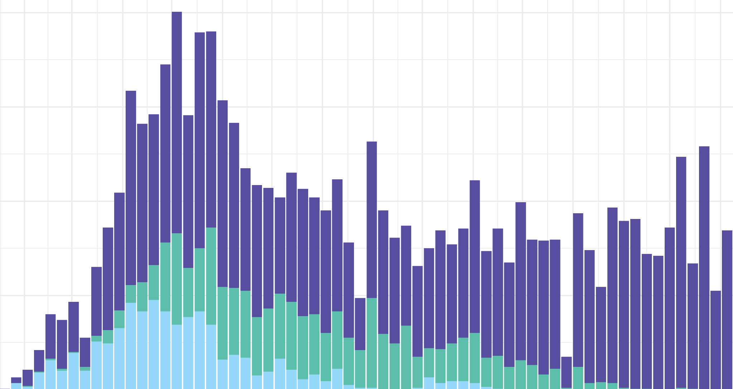


Links from preprints to published papers
in preprint metadata
Bianca Kramer, Utrecht University Library
ISSI 2021 - 18th Conference on Scientometrics and Informetrics
presentation: https://doi.org/10.5281/zenodo.4765963
conference paper: https:/doi.org/10.5281/zenodo.5090061
data/code: https://github.com/bmkramer/covid19_preprints_published

Slide 2














































Preprints - integral part of the way research is communicated

Slide 3
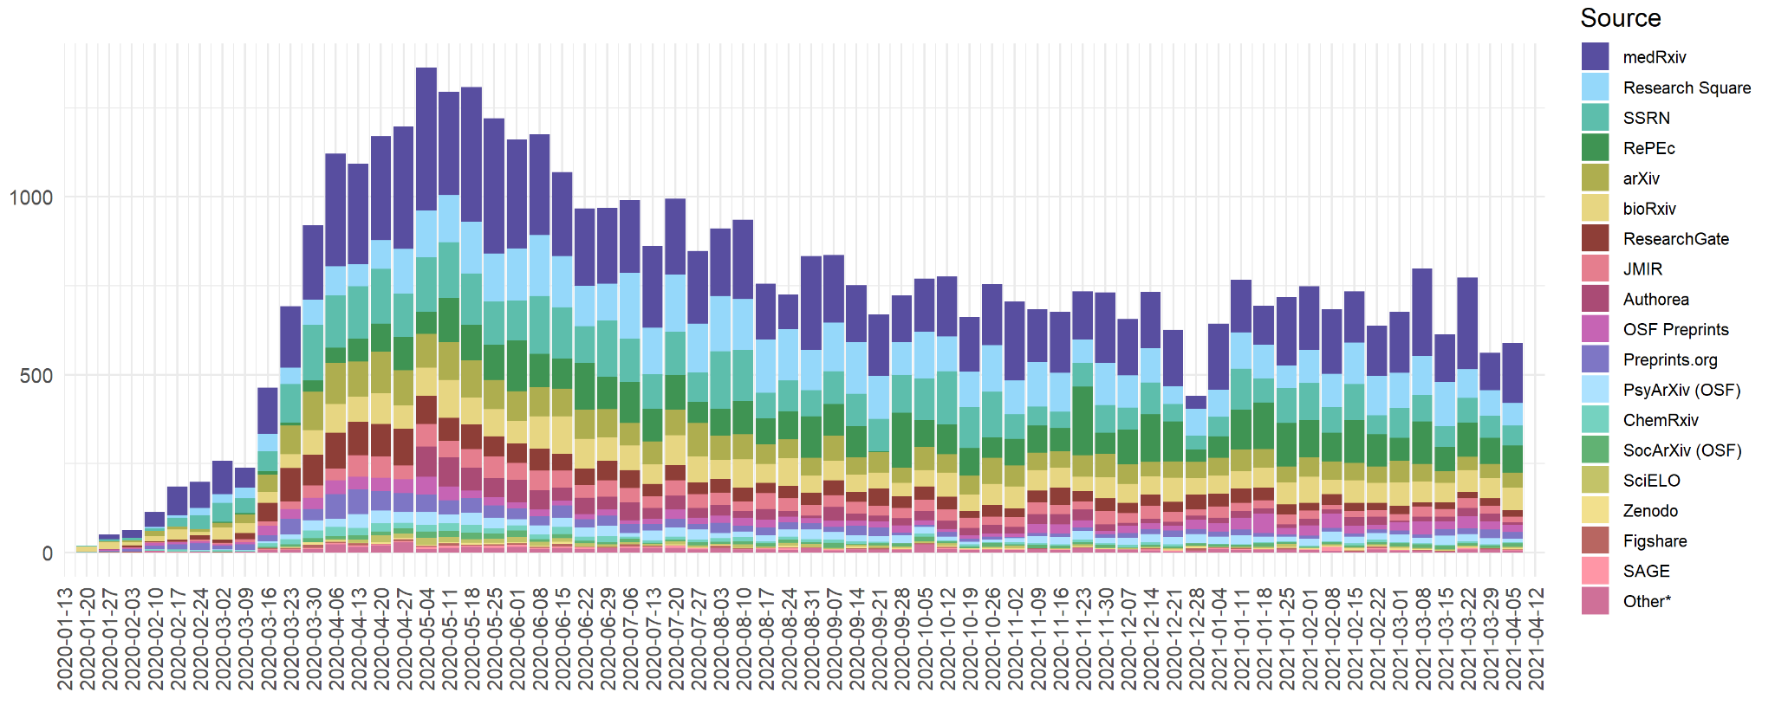
Corpus: COVID19-related preprints per week
(up to 2021-04-11)
https://github.com/nicholasmfraser/covid19_preprints

Slide 4









Preprint servers
disciplinary / regional / linked to publisher
owned by (commercial) publisher / community-governed

Slide 5


Links from preprints to published papers
Transparent record of versions of publications
publication history
track changes over time
discovery
evaluation
analysis of developments in scholarly communication
Preprint
Published paper

Slide 6

1
Publisher
2
3
Preprint server

Slide 7
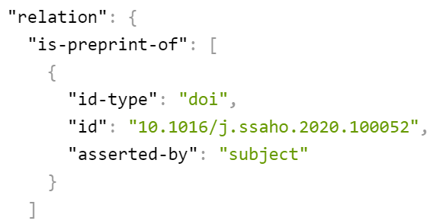

Slide 8
Links from preprints to published papers
Open metadata
no restrictions on use and reuse
available for other system to integrate and build upon
provenance and persistence
Making publications not only accessible and reusable, but also findable and interoperable (FAIR)
Preprint
Published paper

Slide 9
Corpus: COVID19-related preprints per week
(up to 2021-04-11)
https://github.com/nicholasmfraser/covid19_preprints

Slide 10










Preprint servers using
(11713)
(5862)
(6223)
(1356)
(3675)
(312)
preprint servers (3272)
(1865)
these preprint servers
do not yet include links
to published papers
in their metadata
(1314)
(523)

Slide 11
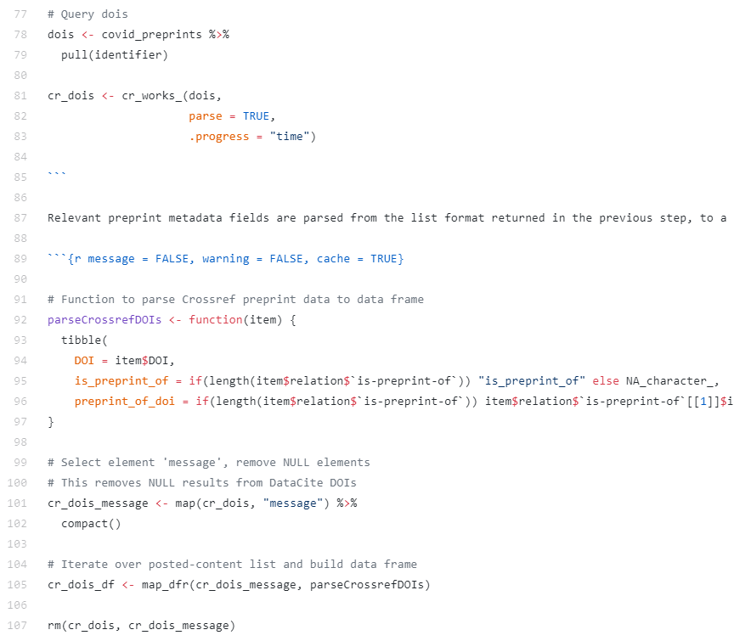
Preprint servers using
(11713)
(6223)
(3675)
preprint servers (3272)
(1865)
(1314)
(523)
Query Crossref API for links to published papers

Slide 12
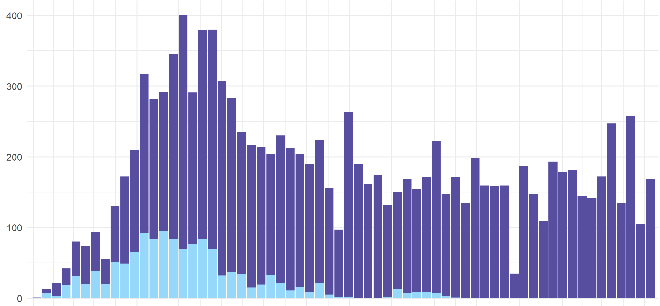
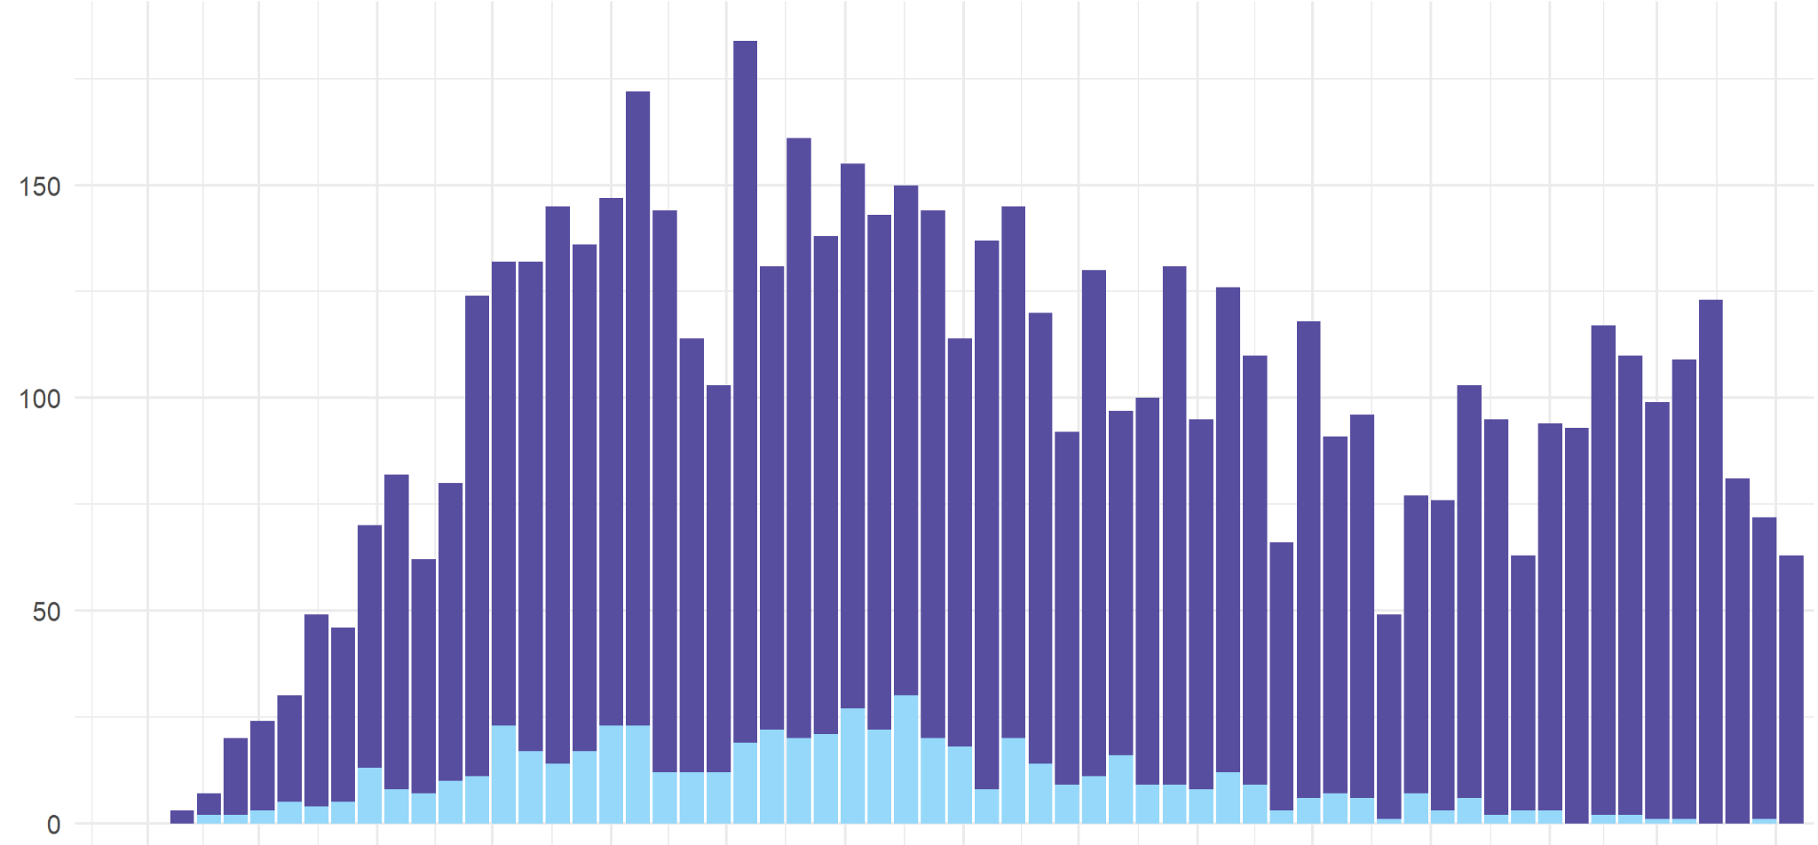
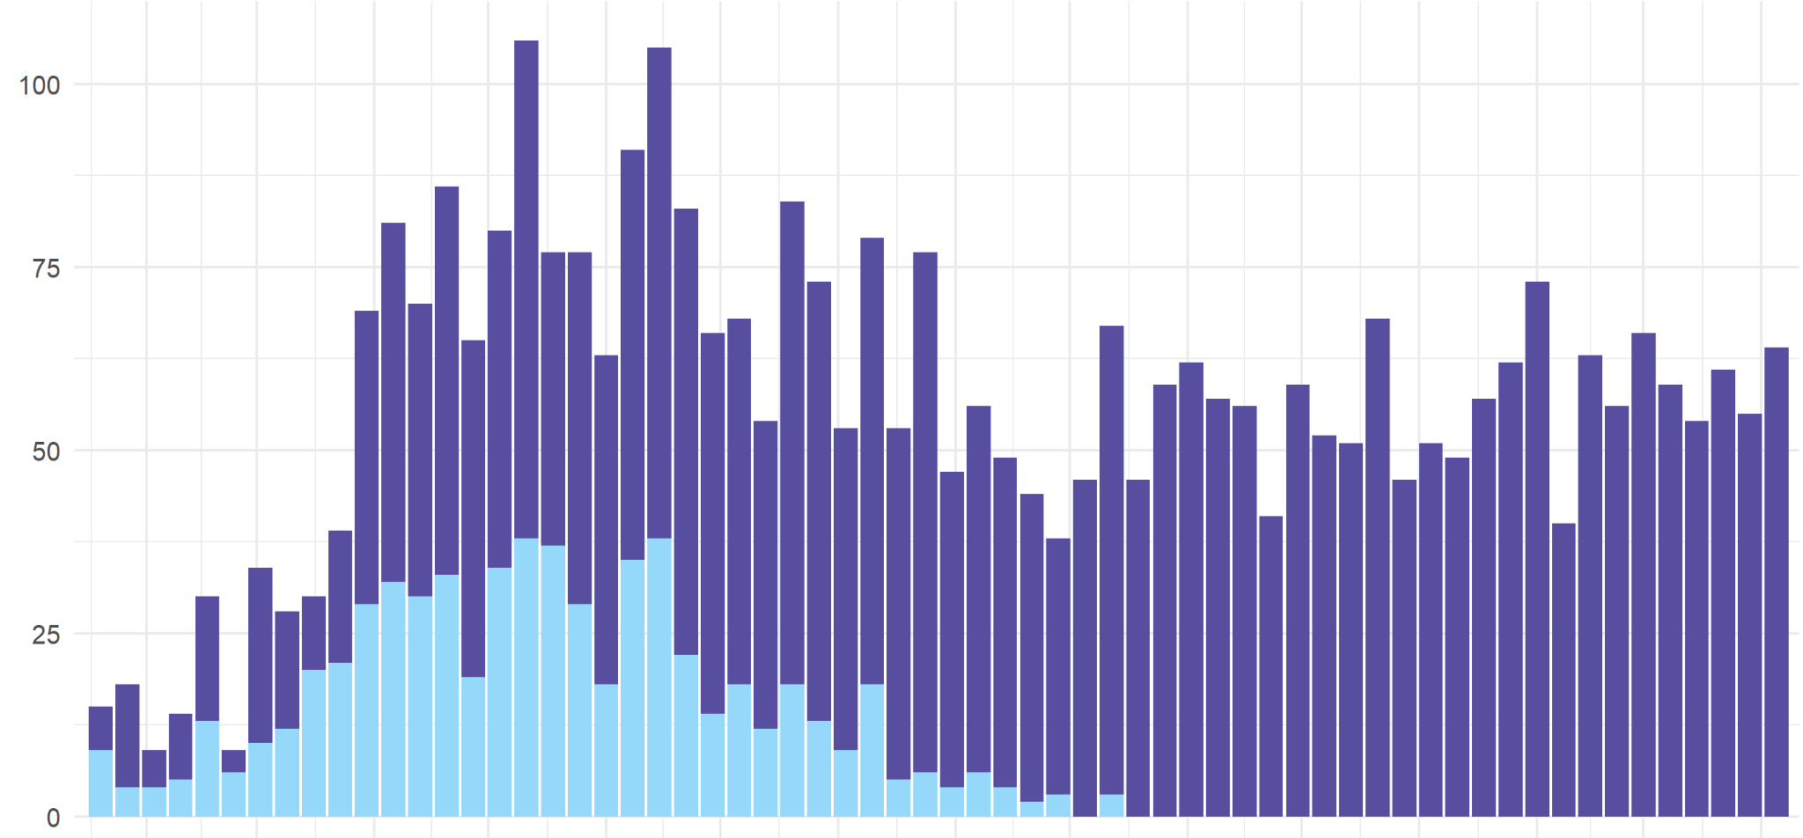
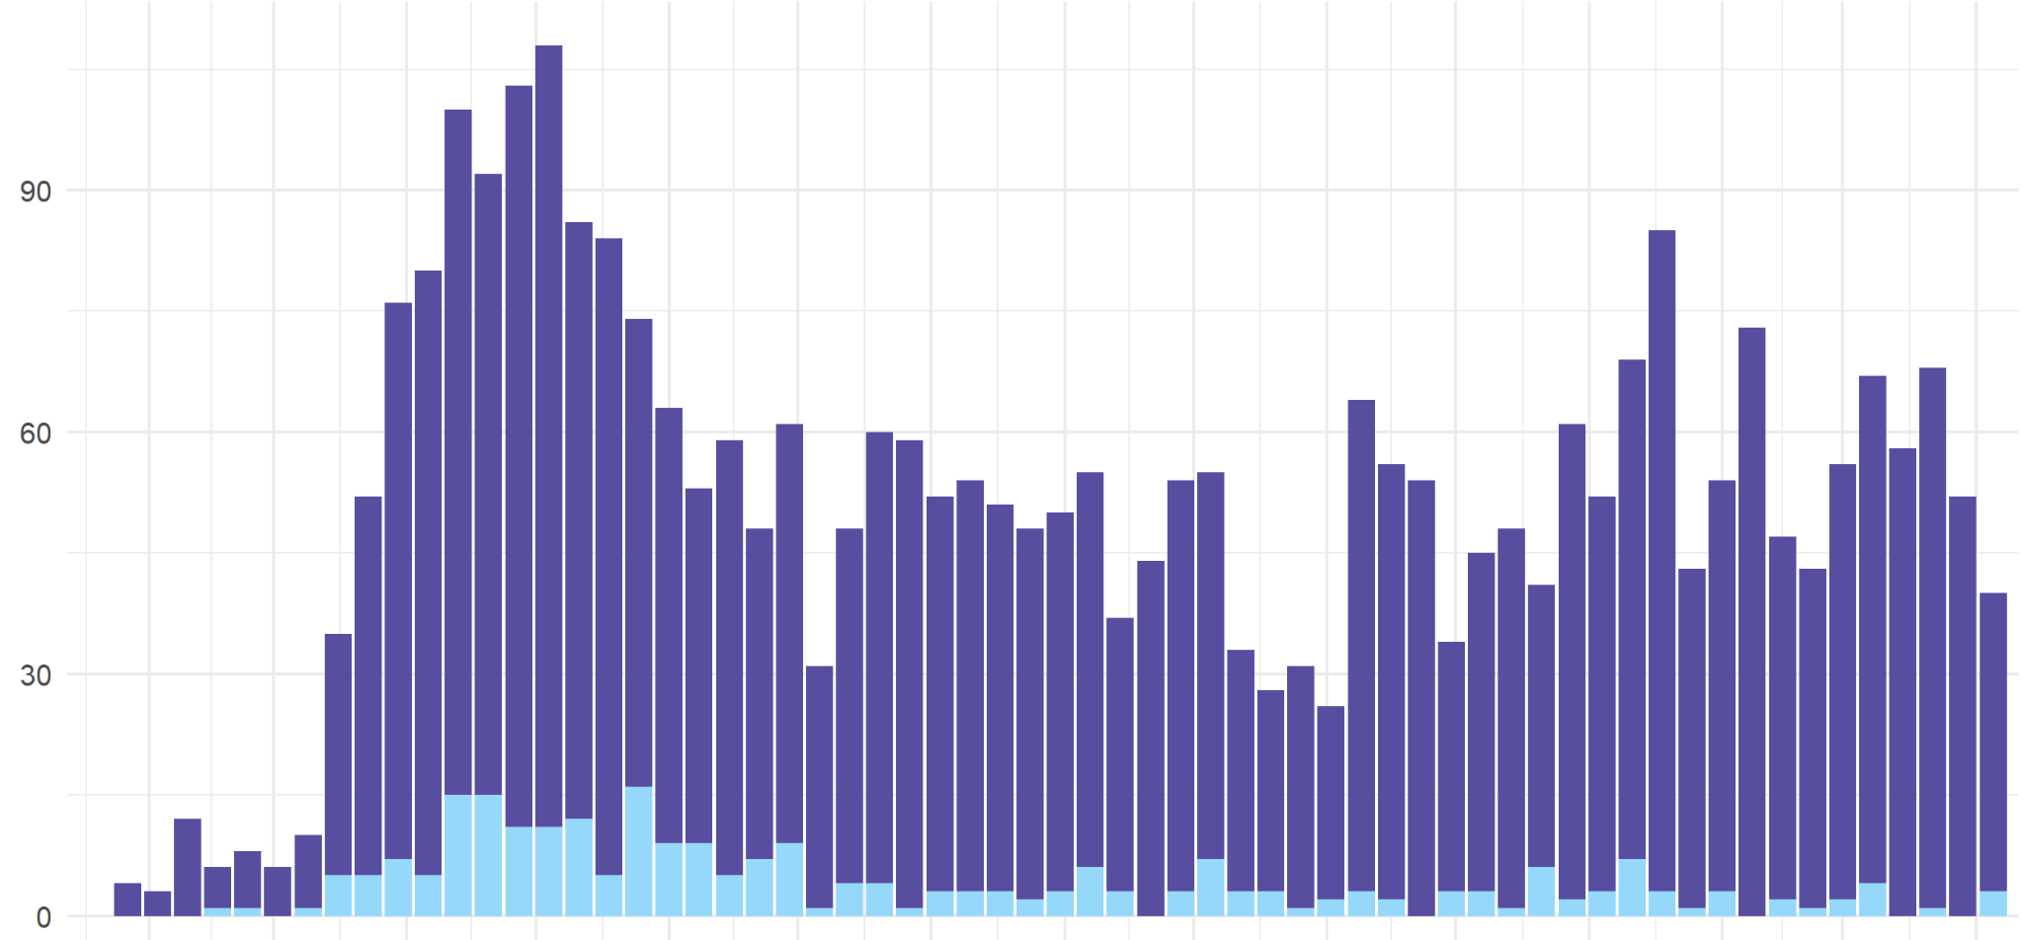
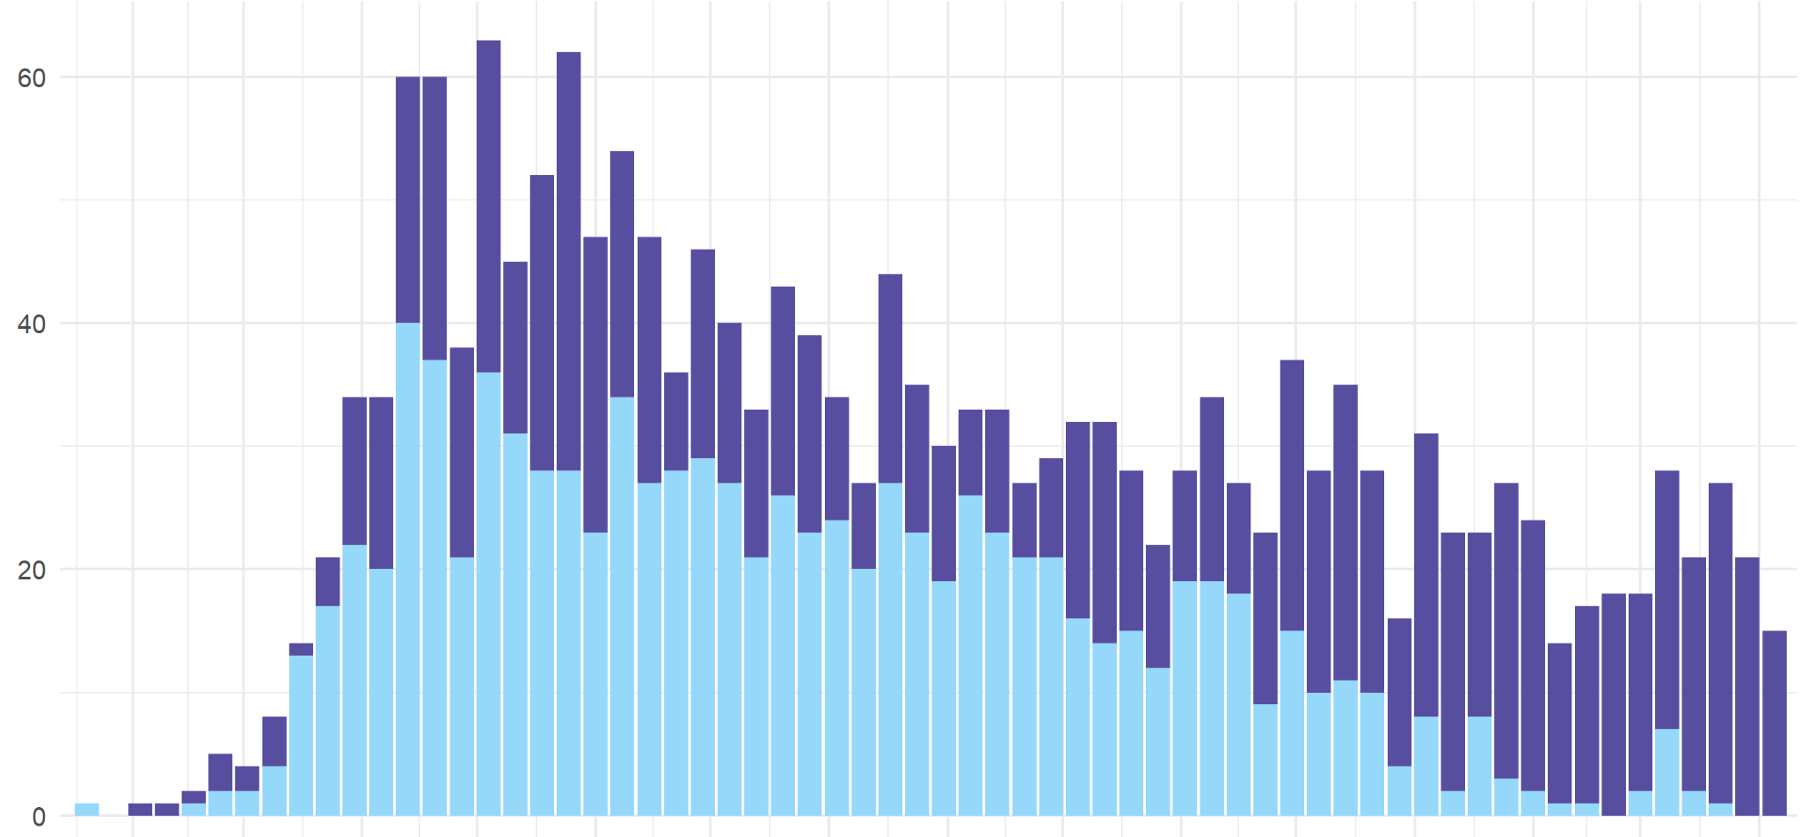
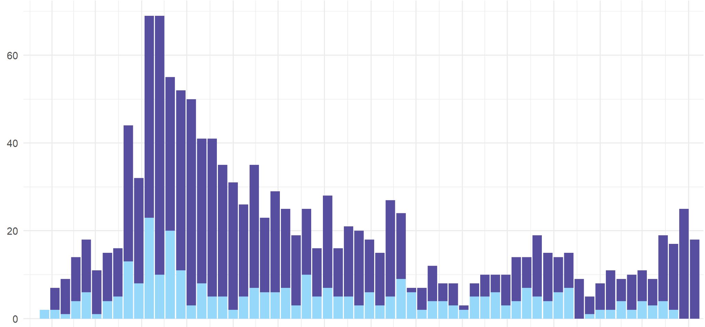
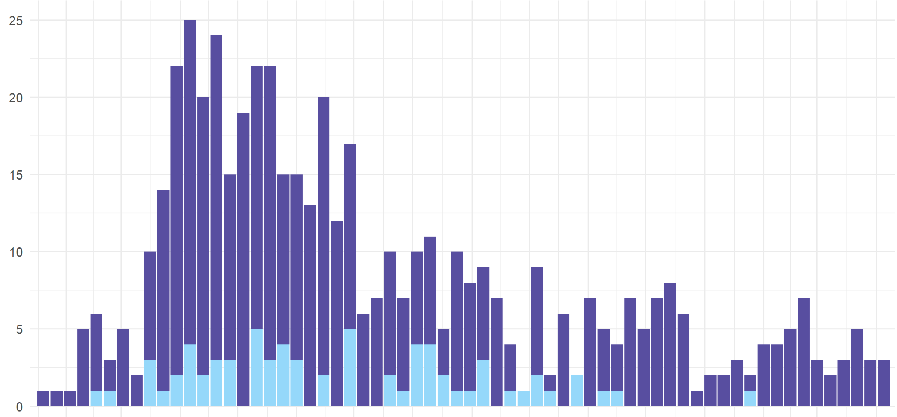
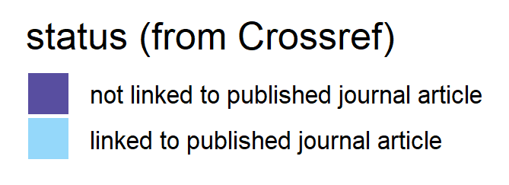
Links to published papers in Crossref metadata
medRxiv (11713)
ResearchSquare (6223)
bioRxiv (3675)
OSF (3272)
JMIR (1865)
Preprints.org (1314)
ChemRxiv (523)

Slide 13
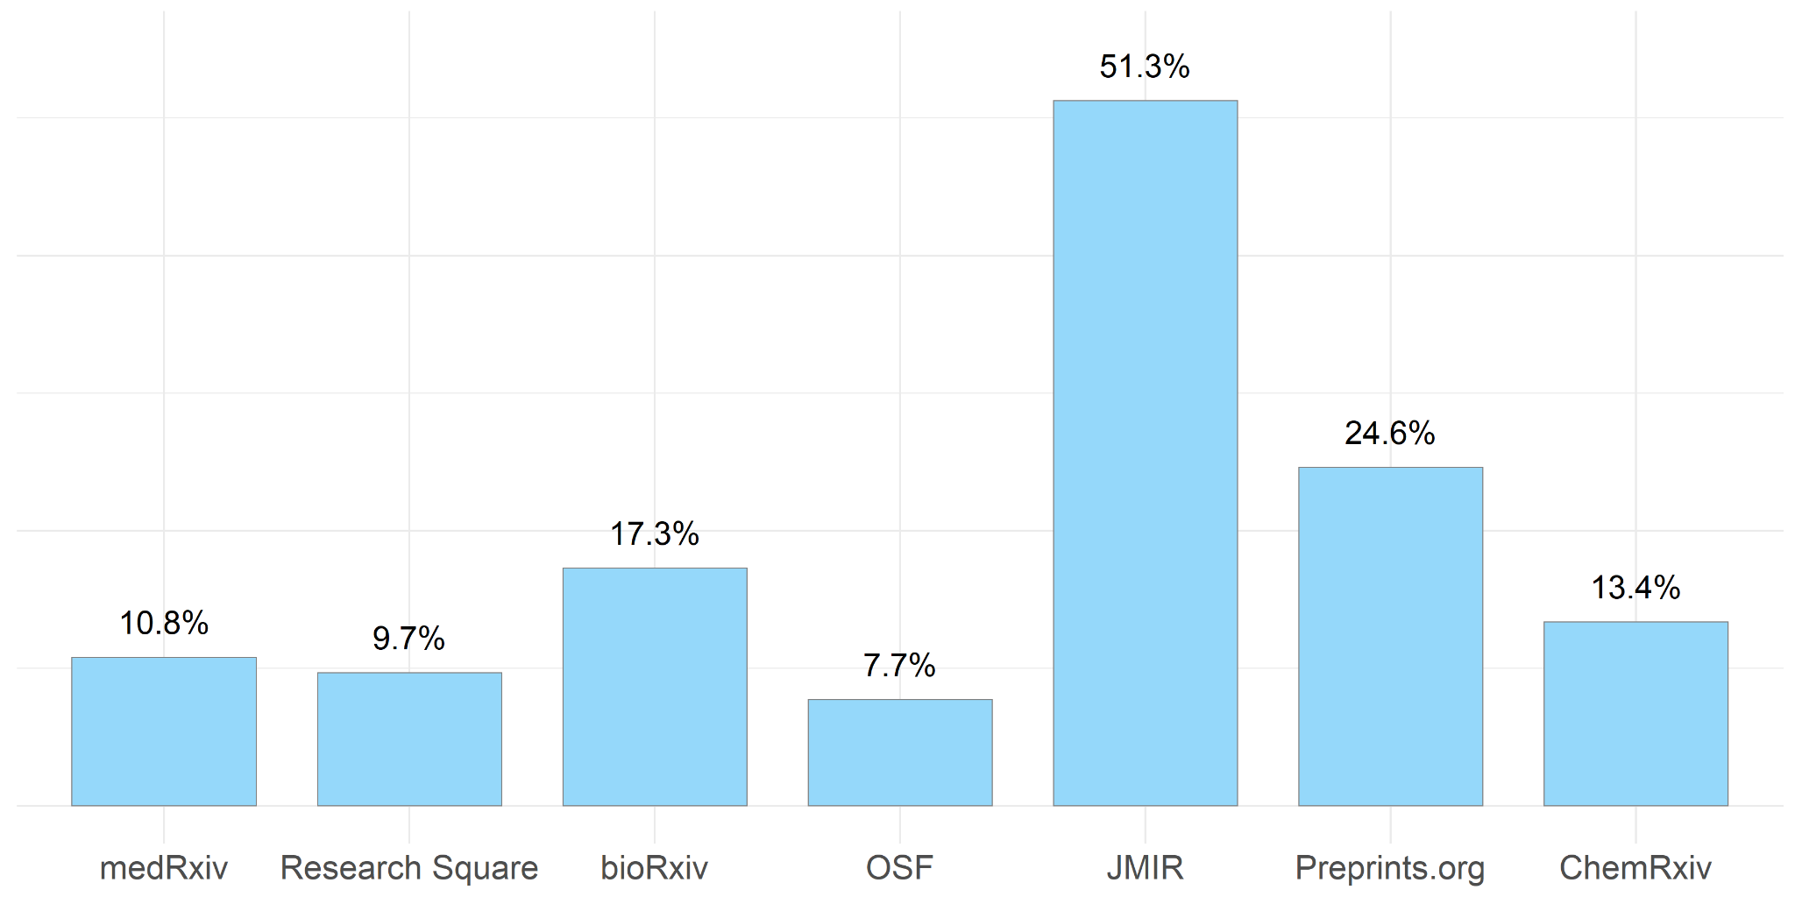
Links to published papers in Crossref metadata
(11713)
(6223)
(3675)
(3272)
(1865)
(1314)
(523)

Slide 14
Links to published papers:
differences between preprint servers
Technical workflows
(e.g. linking might be easier/quicker when preprint server and journals are from the same publisher)
Publication cultures
(e.g. selectivity of journals submitted to, speed of peer review, decisions on when to post a preprint).

Slide 15
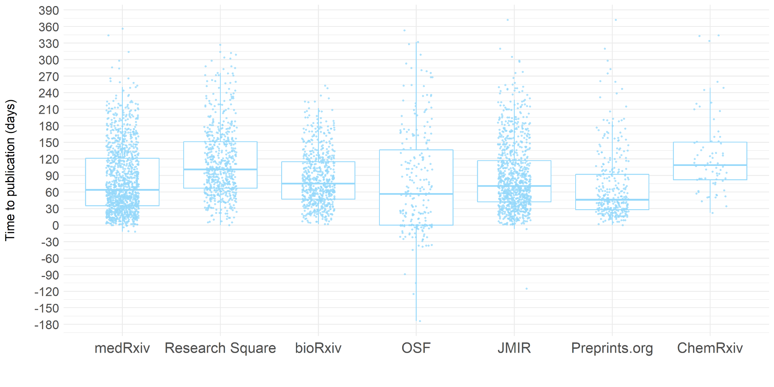
Time to publication (days)

Slide 16
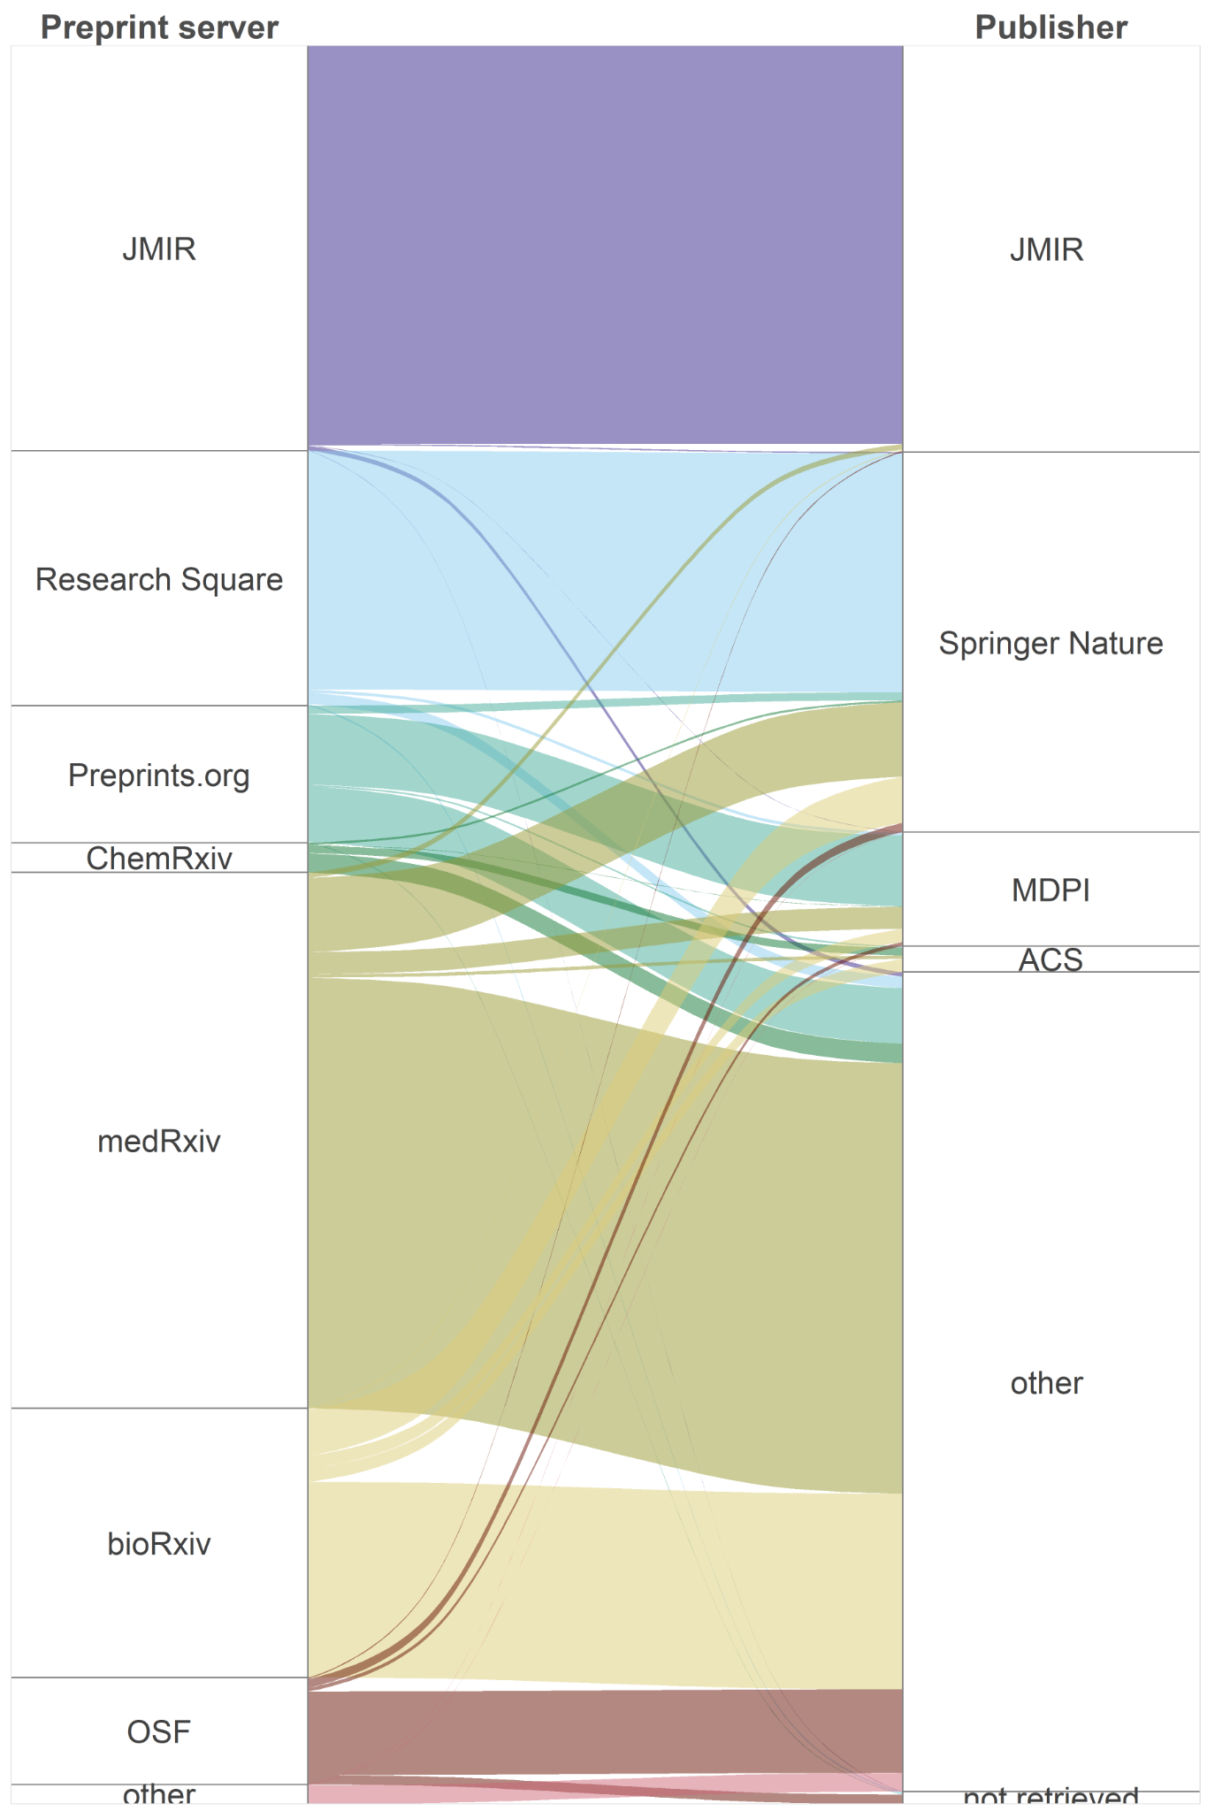
Destination of preprints
linked to published papers
(from Crossref metadata)
JMIR
JMIR
Research
Square
Springer
Nature
Preprints.org
ChemRxiv
MDPI
ACS
medRxiv
other
bioRxiv
OSF
other
NA

Slide 17
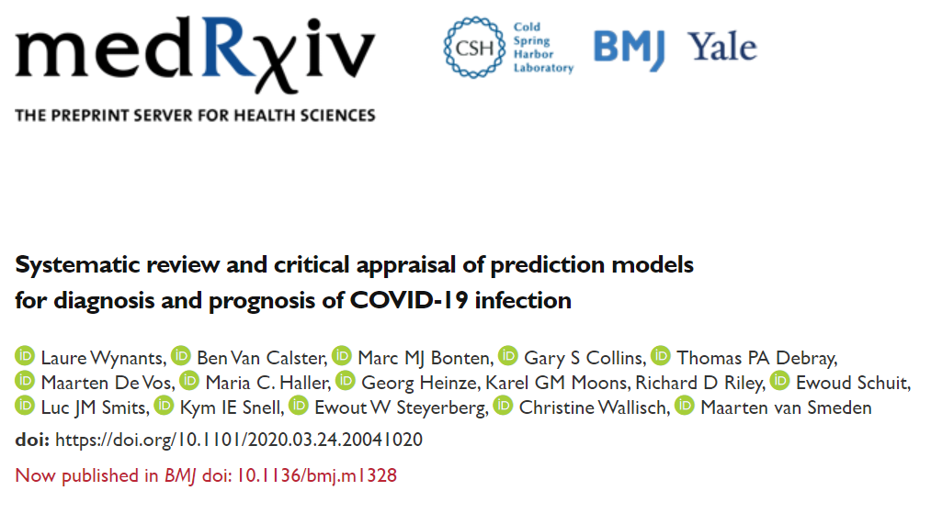
Preprint
Published paper

Slide 18
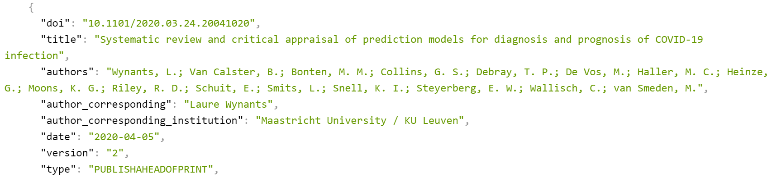
Preprint
Published paper

Slide 19
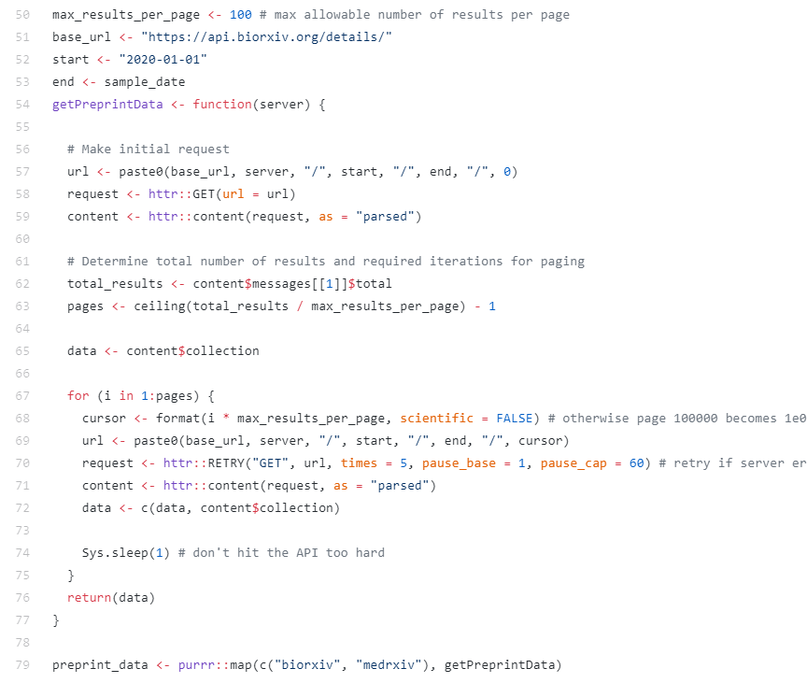
Query bioRxiv / medRxiv API for links to published papers
Query bioRxiv / medRxiv API
for links to published papers

Slide 20
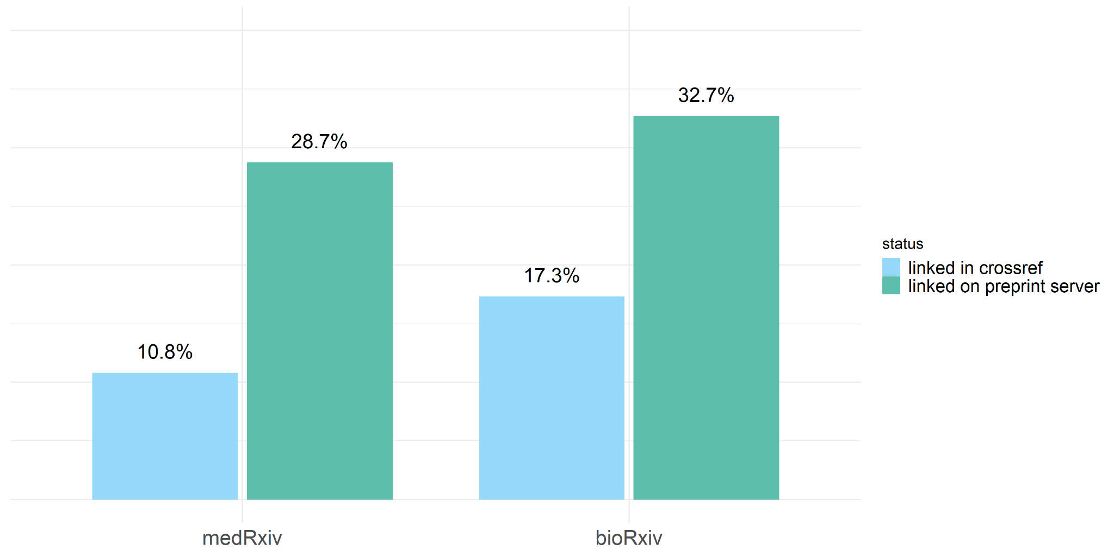
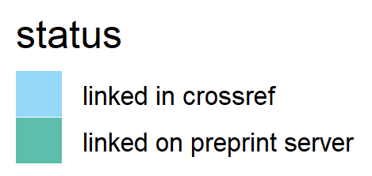
Links to published papers in Crossref metadata
or on preprint server

Slide 21
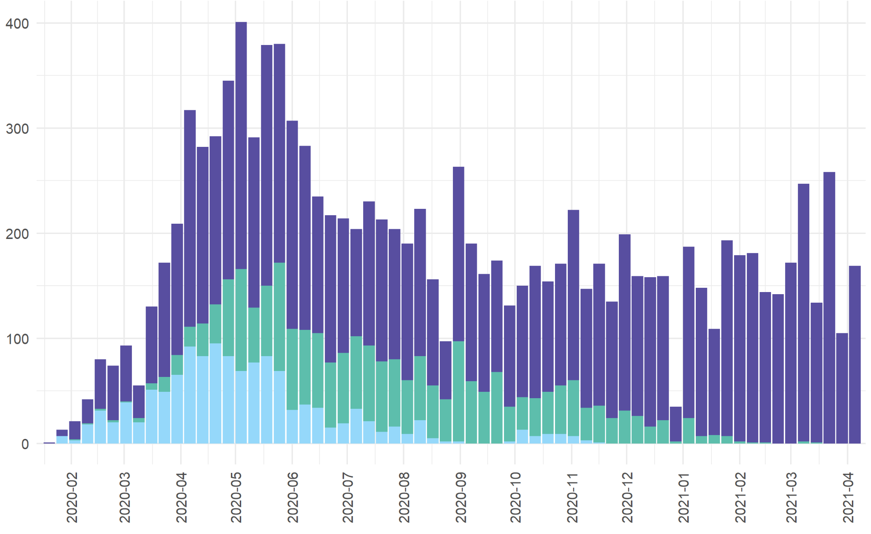
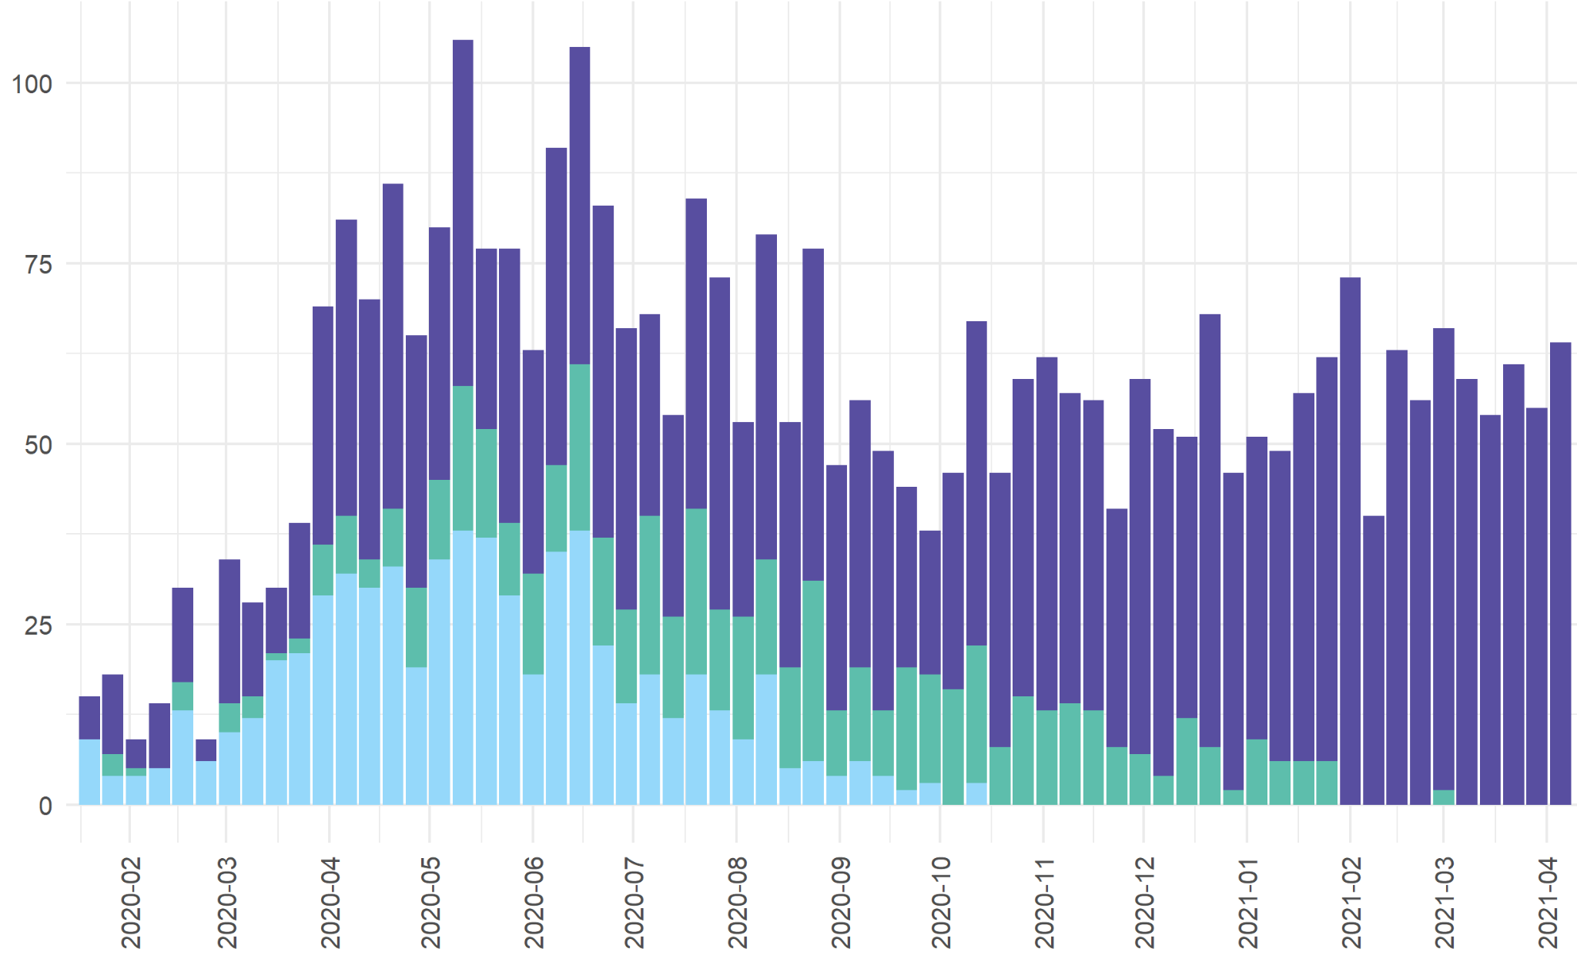
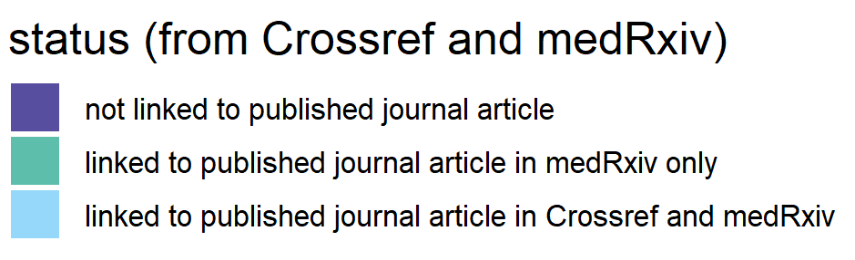
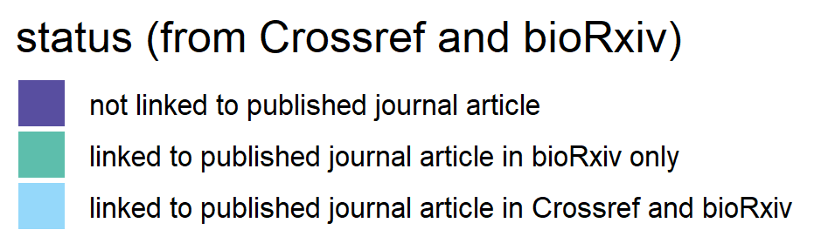
Links to published papers in Crossref metadata
medRxiv (n= 11713)
bioRxiv (n= 3675)

Slide 22
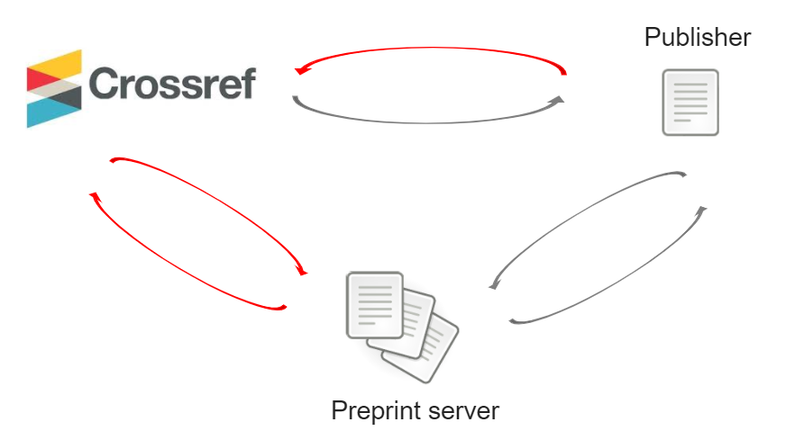

Slide 23



Other platforms make use of information from Crossref
and/or perform their own detection of links between preprints and published papers .

Slide 24
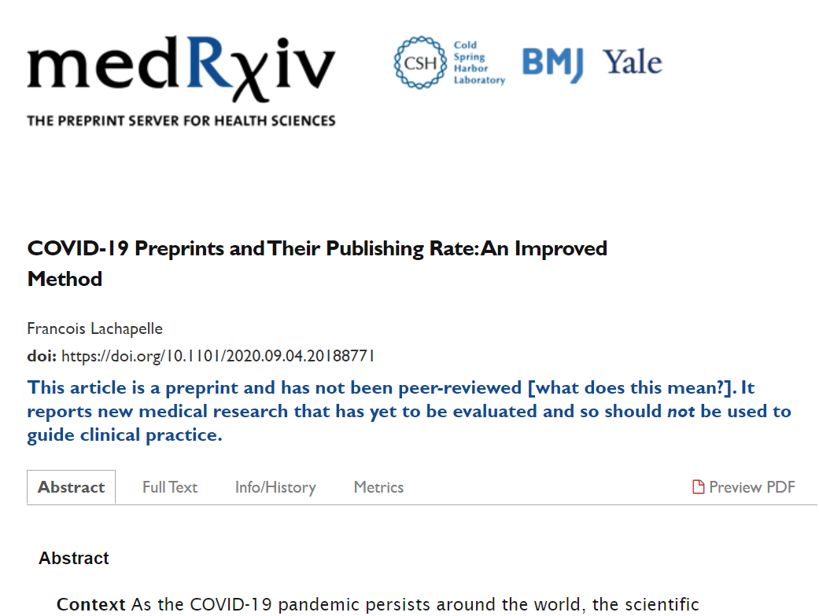
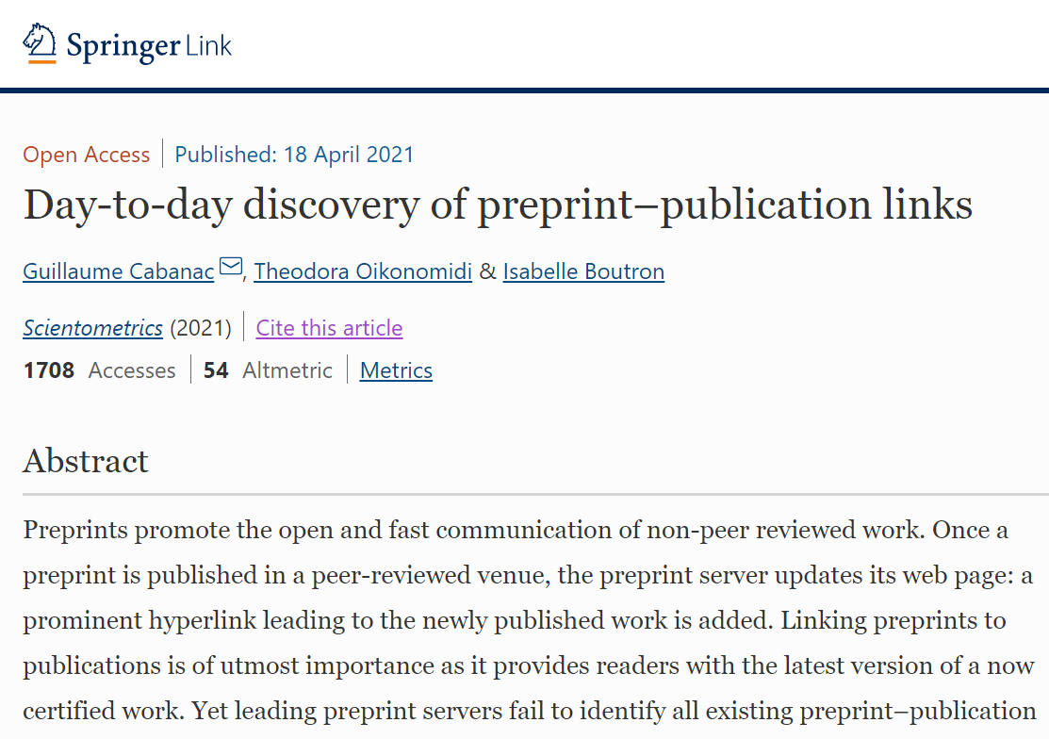
Similarity-based detection of preprint - publication links
http://doi.org/10.1101.2020.09.04.20188771
http://doi.org/10.1007/s11192-021-03900-7

Slide 25
Open metadata
no restrictions on use and reuse
available for other system to integrate and build upon
provenance and persistence
Centralized or distributed ?

Slide 26

based on W3C Linked Data Notifications (LDN)
https://www.coar-repositories.org/notify-repository-and-services-interoperability-project/

Slide 27
Links from preprints to published papers
in preprint metadata
Bianca Kramer, Utrecht University Library
ISSI 2021 - 18th Conference on Scientometrics and Informetrics
contact: b.m.r.kramer@uu.nl / @MsPhelps
presentation: https://doi.org/10.5281/zenodo.4765963
conference paper: https:/doi.org/10.5281/zenodo.5090061
data/code: https://github.com/bmkramer/covid19_preprints_published

