Slide 1
An introduction to Linked Data
CODATA-RDA School of Research Data Science, 16 August 2019
Dr Daniel Bangert
Göttingen State and University Library
bangert@sub.uni-goettingen.de / @enigmaticocean

Slide 2
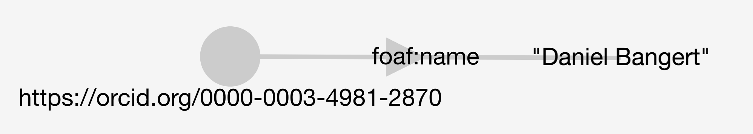





Introduction

Slide 3
Aims for today
Define Linked Data terms and concepts
Hands-on with ontologies and RDF
Explore and query Linked Data
Discuss Linked Data in the context of data stewardship and FAIR data
Introductory and exploratory!
Link to exercises: http://bit.ly/LDexercises

Slide 4
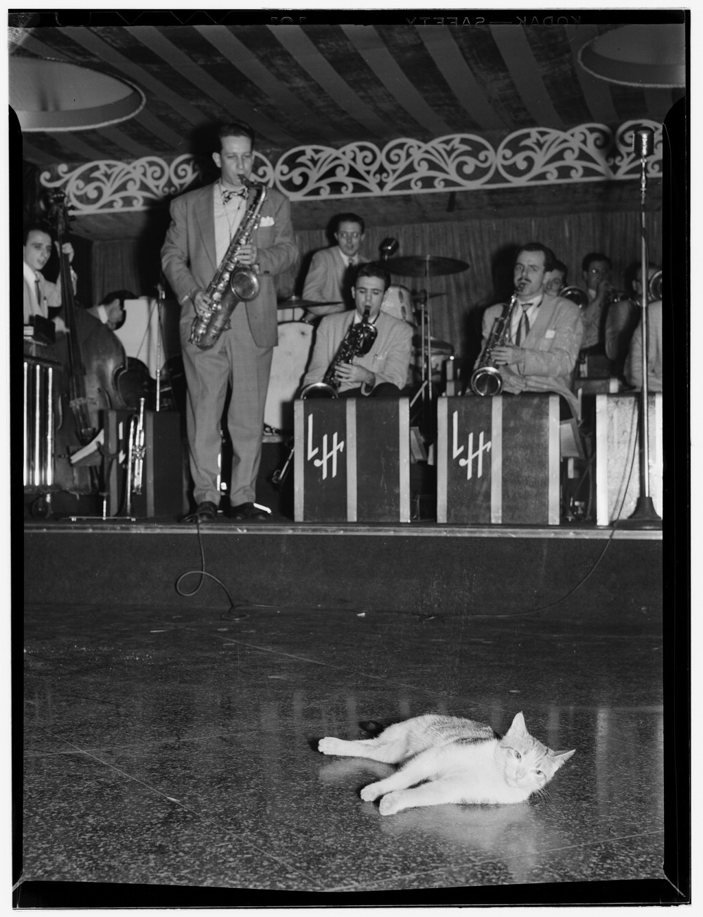
Outline
9:00 Theory and basics
10:00 Ontologies
10:30 Break
11:00 Ontologies (continued)
11:30 Producing RDF
12:00 SPARQL
12:30 Summary and discussion

Slide 5
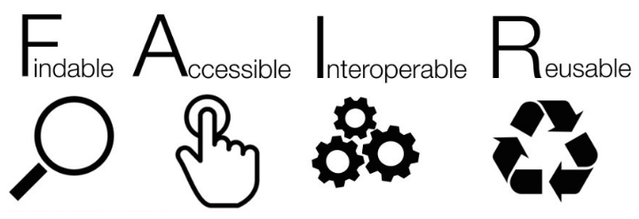
FAIR
Findable
F1. (meta)data are assigned a globally unique and eternally persistent identifier.
F2. data are described with rich metadata.
F3. (meta)data are registered or indexed in a searchable resource.
F4. metadata specify the data identifier.
Accessible
A1. (meta)data are retrievable by their identifier using a standardized communications protocol.
  A1.1 the protocol is open, free, and universally implementable.
  A1.2 the protocol allows for an authentication and authorization procedure, where necessary.
A2. metadata are accessible, even when the data are no longer available.
Interoperable
I1. (meta)data use a formal, accessible, shared, and broadly applicable language for knowledge representation.
I2. (meta)data use vocabularies that follow FAIR principles.
I3. (meta)data include qualified references to other (meta)data.
Reusable
R1. meta(data) have a plurality of accurate and relevant attributes.
  R1.1. (meta)data are released with a clear and accessible data usage license.
  R1.2. (meta)data are associated with their provenance.
  R1.3. (meta)data meet domain-relevant community standards.

Slide 6
Theory and basics

Slide 7

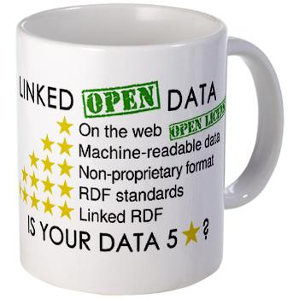
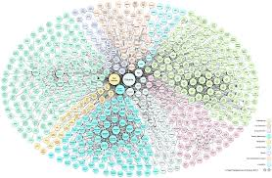
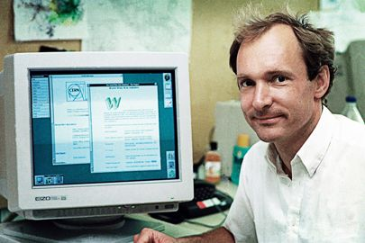
Jargon busting
Subject
predicate
Object

Slide 8
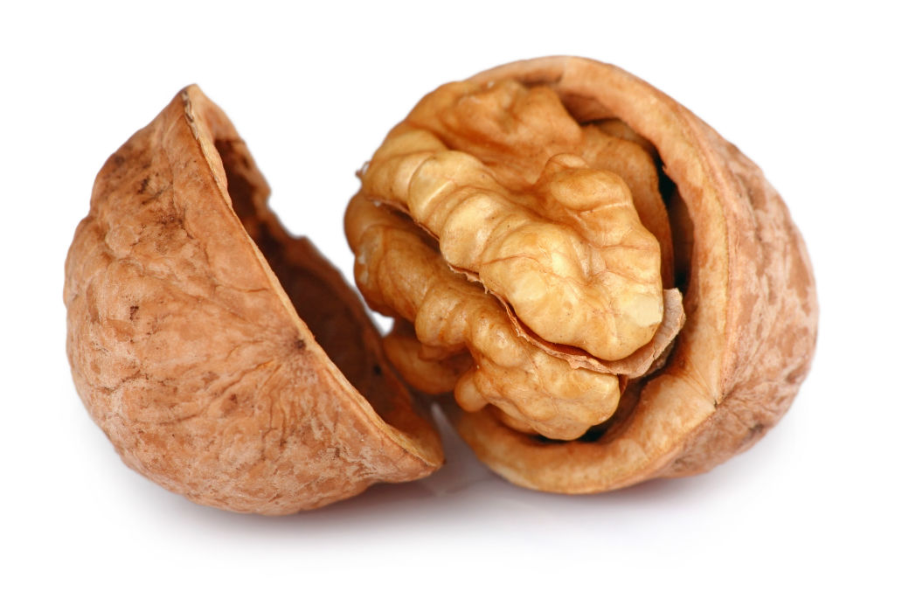
Basics
It’s all about publishing data online
We use unique identifiers (HTTP URIs)
  You know these as pointing to pages
  But rather than point to websites or individual pages, we point to data entities and the relationships between these entities
We do this so that machines can navigate the data
Slide: Terhi Nurmikko-Fuller
Notes:
It’s all about publishing data online
We use unique identifiers (HTTP URIs)
You know these as pointing to pages
But rather than point to websites or their individuals pages, we point to data entities (people, places, etc.), and the relationships between these entities.
Which means that sometimes, there is no digital resource (e.g. website, image) that the URI points to.
We do this so that machines can navigate the data.

Slide 9
Some comparisons
RDF | Relational Database | XML
Flexible - can store any connections between nodes | Data structured into pre-defined tables | Structure depends on XML language
Data connected into a graph | Relations form sets or tables | Most naturally maps to a hierarchical or tree structure
URIs to name things Enables data to be combined | Naming of columns is local | XML namespaces make similar use of URIs
Use of web technology | No natural link to web, but frequently used to store data behind websites | Closely linked to web languages
SPARQL query language | SQL query language | Xpath/Xquery/XSLT to extract information
Comparatively new; Software and tools are still developing | Existed for 30 years plus; Many mature scalable tools available | Mature technology with many tools
Some RDF stores use a relational database to store the triples | There are tools to expose data from a RDBMS as RDF | RDF can be expressed in XML; annotate XML documents with RDF metadata
Slide: Terhi Nurmikko-Fuller

Slide 10
Theory Pt 1
Semantic Web, Linked Data (LD), Linked Open Data (LOD)

Slide 11
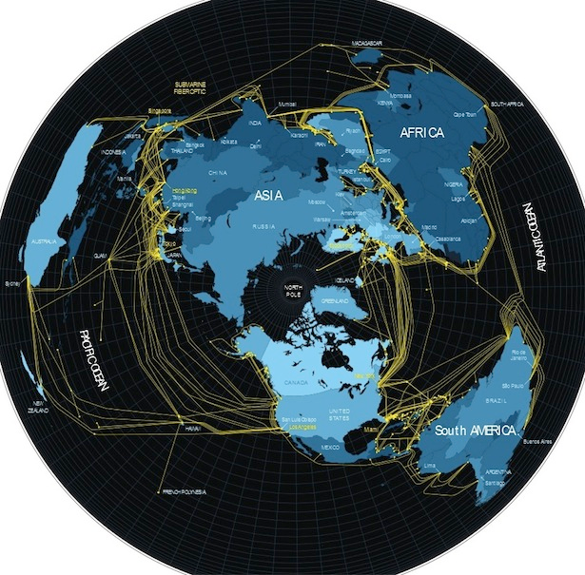
Internet
Source: https://www.theatlantic.com/technology/archive/2012/07/what-the-internet-actually-looks-like/259815/
Notes:
Internet, a physical thing: Collection of fiber-optic cables around the globe (starting with 4 US universities in the late 1960’s)

Slide 12
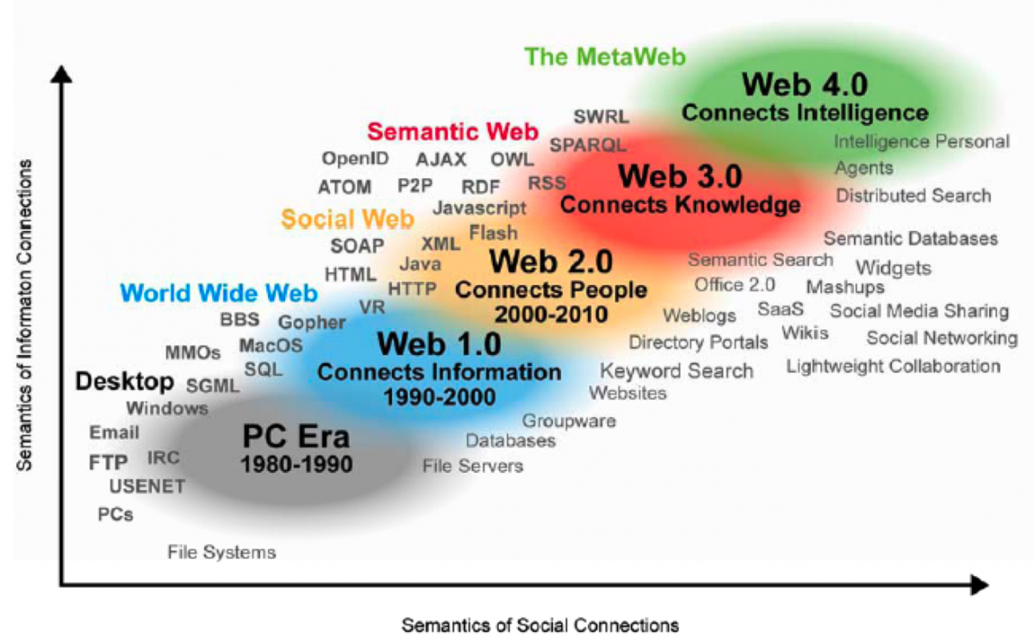
Web
Source: Nova Spivack's illustration of the evolution of the WWW. Radar Networks & Nova Spivack, 2007.
Notes:
World Wide Web: Network of Documents/Addresses/Data/Things using the physical infrastructure of the Internet

Slide 13
Semantic Web
“The Semantic Web […] is an extension of the current one, in which information is given well-defined meaning, better enabling computers and people to work in cooperation.”
Berners-Lee, Tim; Hendler, James; Lassila, Ora: “The Semantic Web: A New Form of Web Content that is Meaningful to Computers Will Unleash a Revolution of New Possibilities” in: Scientific American 284/5 (May 2001), 34–43
Slide: David Weigl & Stefan Münnich

Slide 14
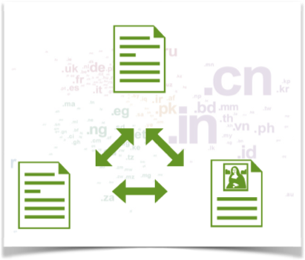
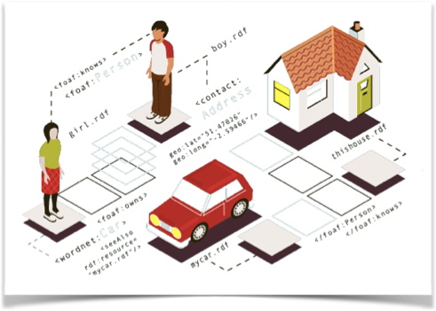
Web of Documents → Web of Data
HTTP URIs point not just to webpages, images, audio, or multimedia resources, but to data entities, and the relationships between them.
Slide: Terhi Nurmikko-Fuller
Notes:
The Web is the largest and most successfully distributed hypermedia system ever constructed...
…But, it is a Web of Documents.

Slide 15
Semantic Web
Linked Data
an (abstract) object
effort to create a web of data
a recommended method
how data should be made accessible, linked and shared
Slide: David Weigl & Stefan Münnich

Slide 16
Linked Data vs Linked Open Data vs Open Data
Data can be Open, without being Linked
Data can be Linked, without being Open
Linked Open Data is the goal

Slide 17
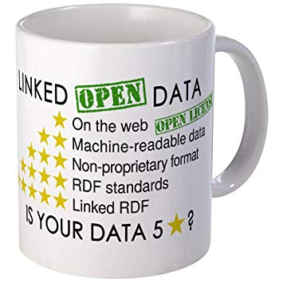
Linked Open Data standards
★
Available on the Web (whatever format) but with an open licence, to be Open Data
★★
Available as machine-readable structured data (e.g. Excel, not an image scan of a table)
★★★
Non-proprietary format (e.g. CSV instead of Excel)
★★★★
Use open standards from W3C (RDF and SPARQL) to identify things, so that people can point at your stuff
★★★★★
Link your data to other people’s data to provide context
Source: https://www.w3.org/DesignIssues/LinkedData.html
Notes:
★ Available on the web (whatever format) but with an open licence, to be Open Data
★★ Available as machine-readable structured data (e.g. excel instead of image scan of a table)
★★★ as (2) plus non-proprietary format (e.g. CSV instead of excel)
★★★★ All the above plus, Use open standards from W3C (RDF and SPARQL) to identify things, so that people can point at your stuff (Use URIs as names for things; Use HTTP URIs so that people can look up those names)
★★★★★ All the above, plus: Link your data to other people’s data to provide context

Slide 18
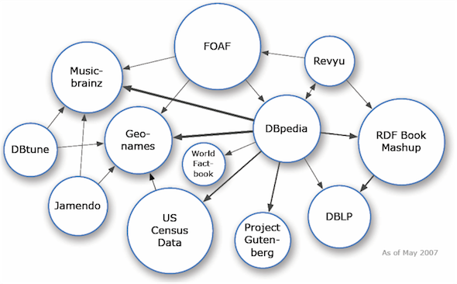
2007
Source: https://lod-cloud.net/

Slide 19
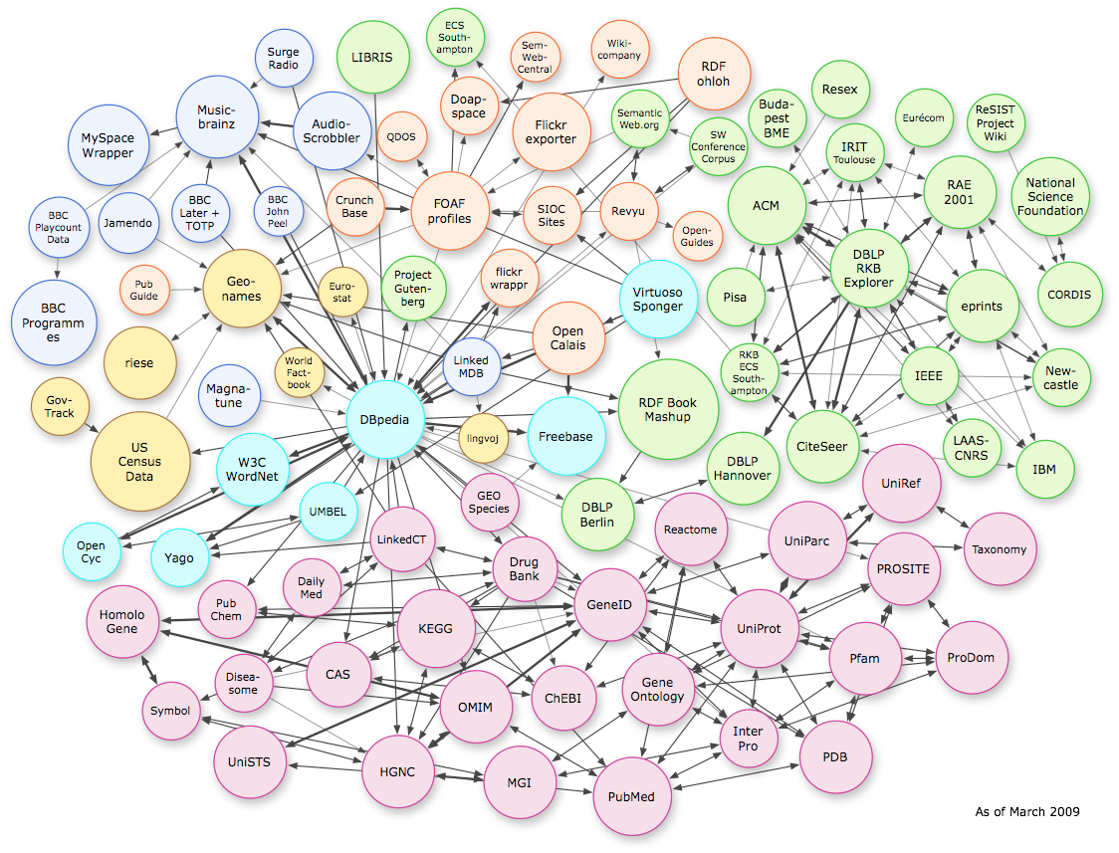
2009
Source: https://lod-cloud.net/

Slide 20
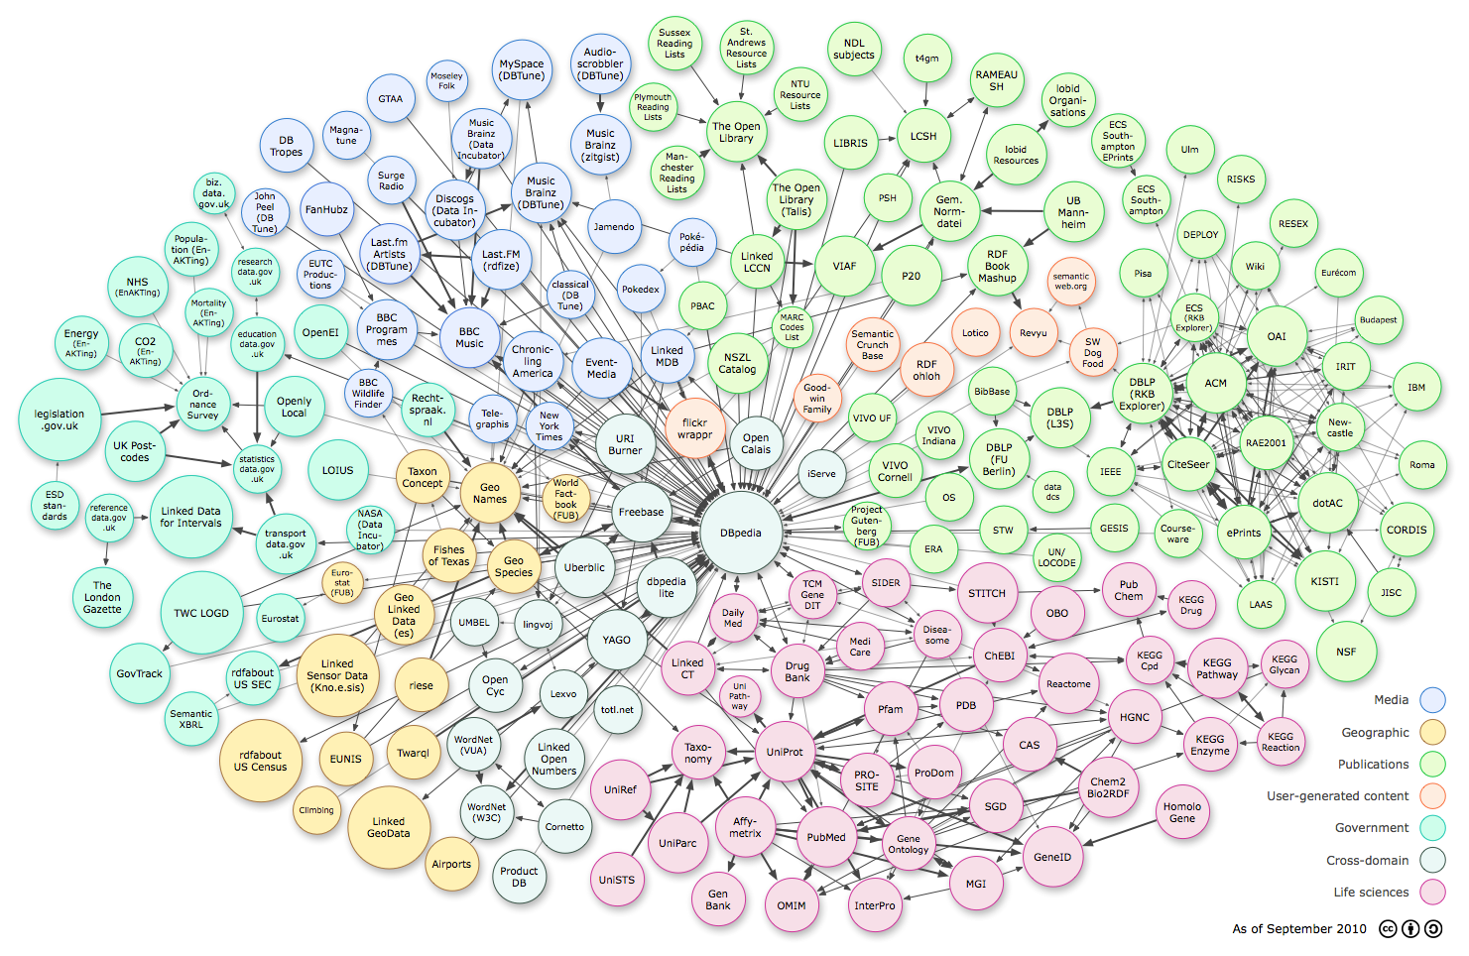
2010
Source: https://lod-cloud.net/

Slide 21
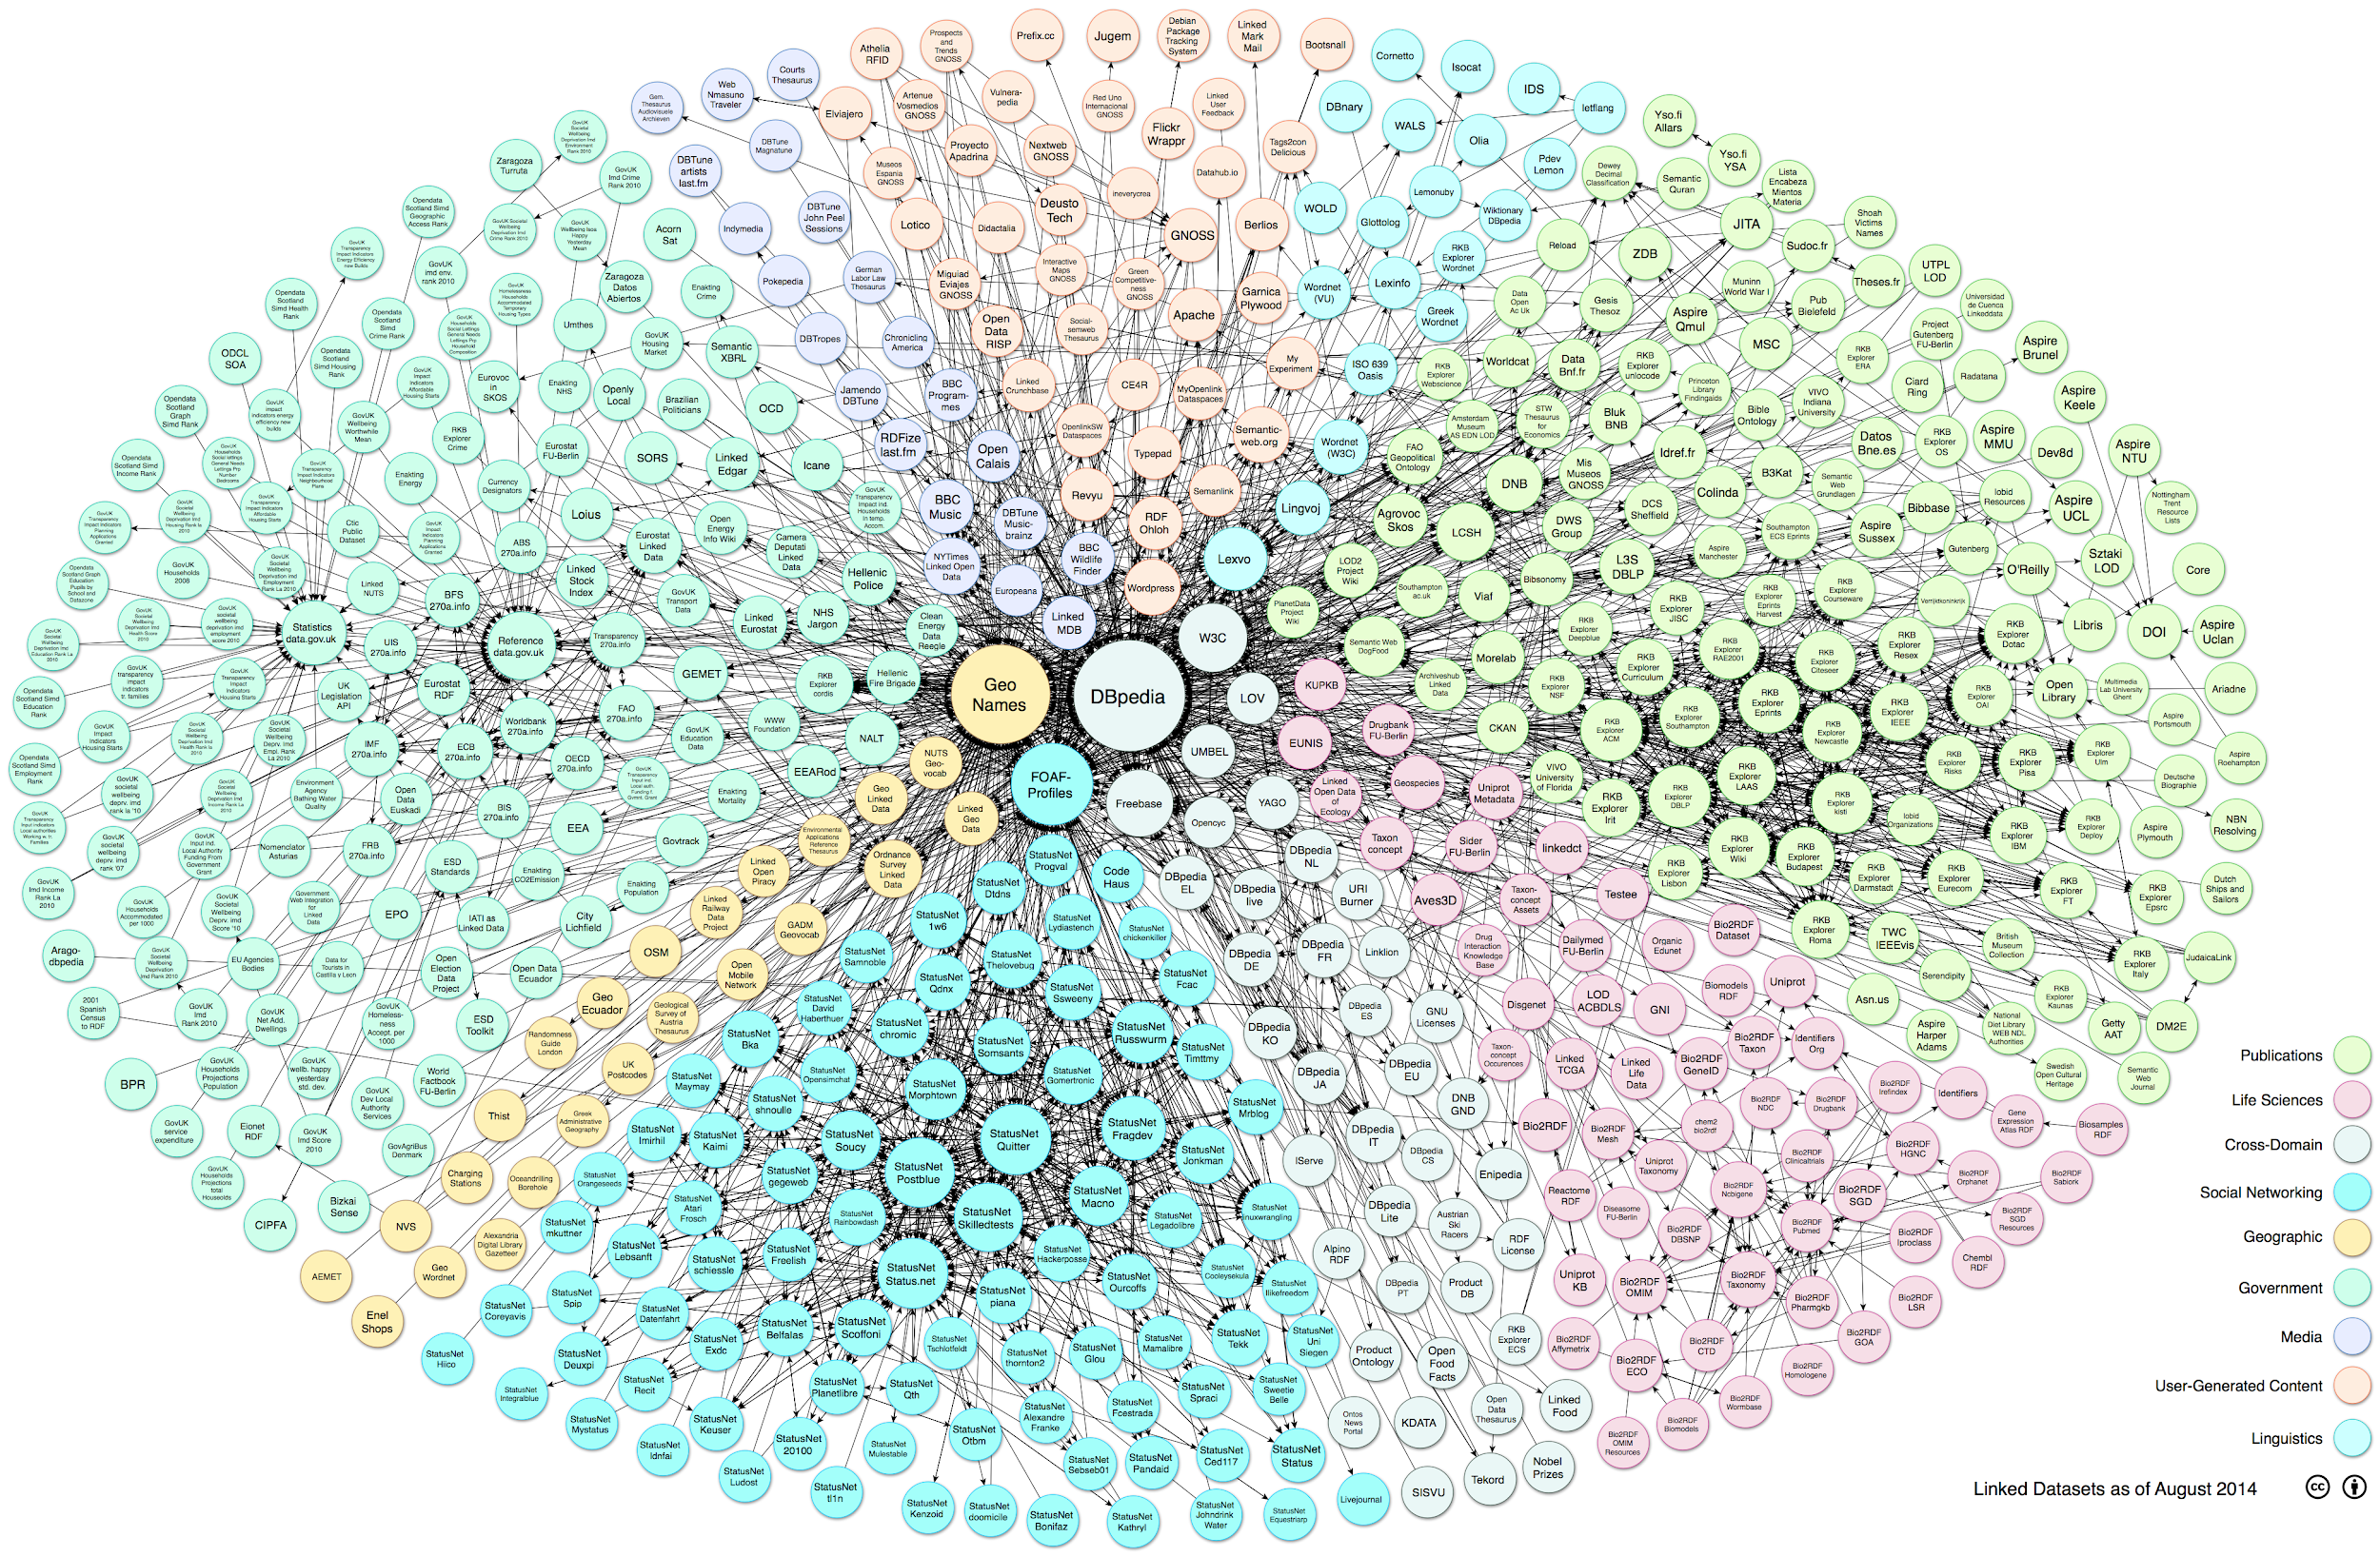
2014
Source: https://lod-cloud.net/

Slide 22
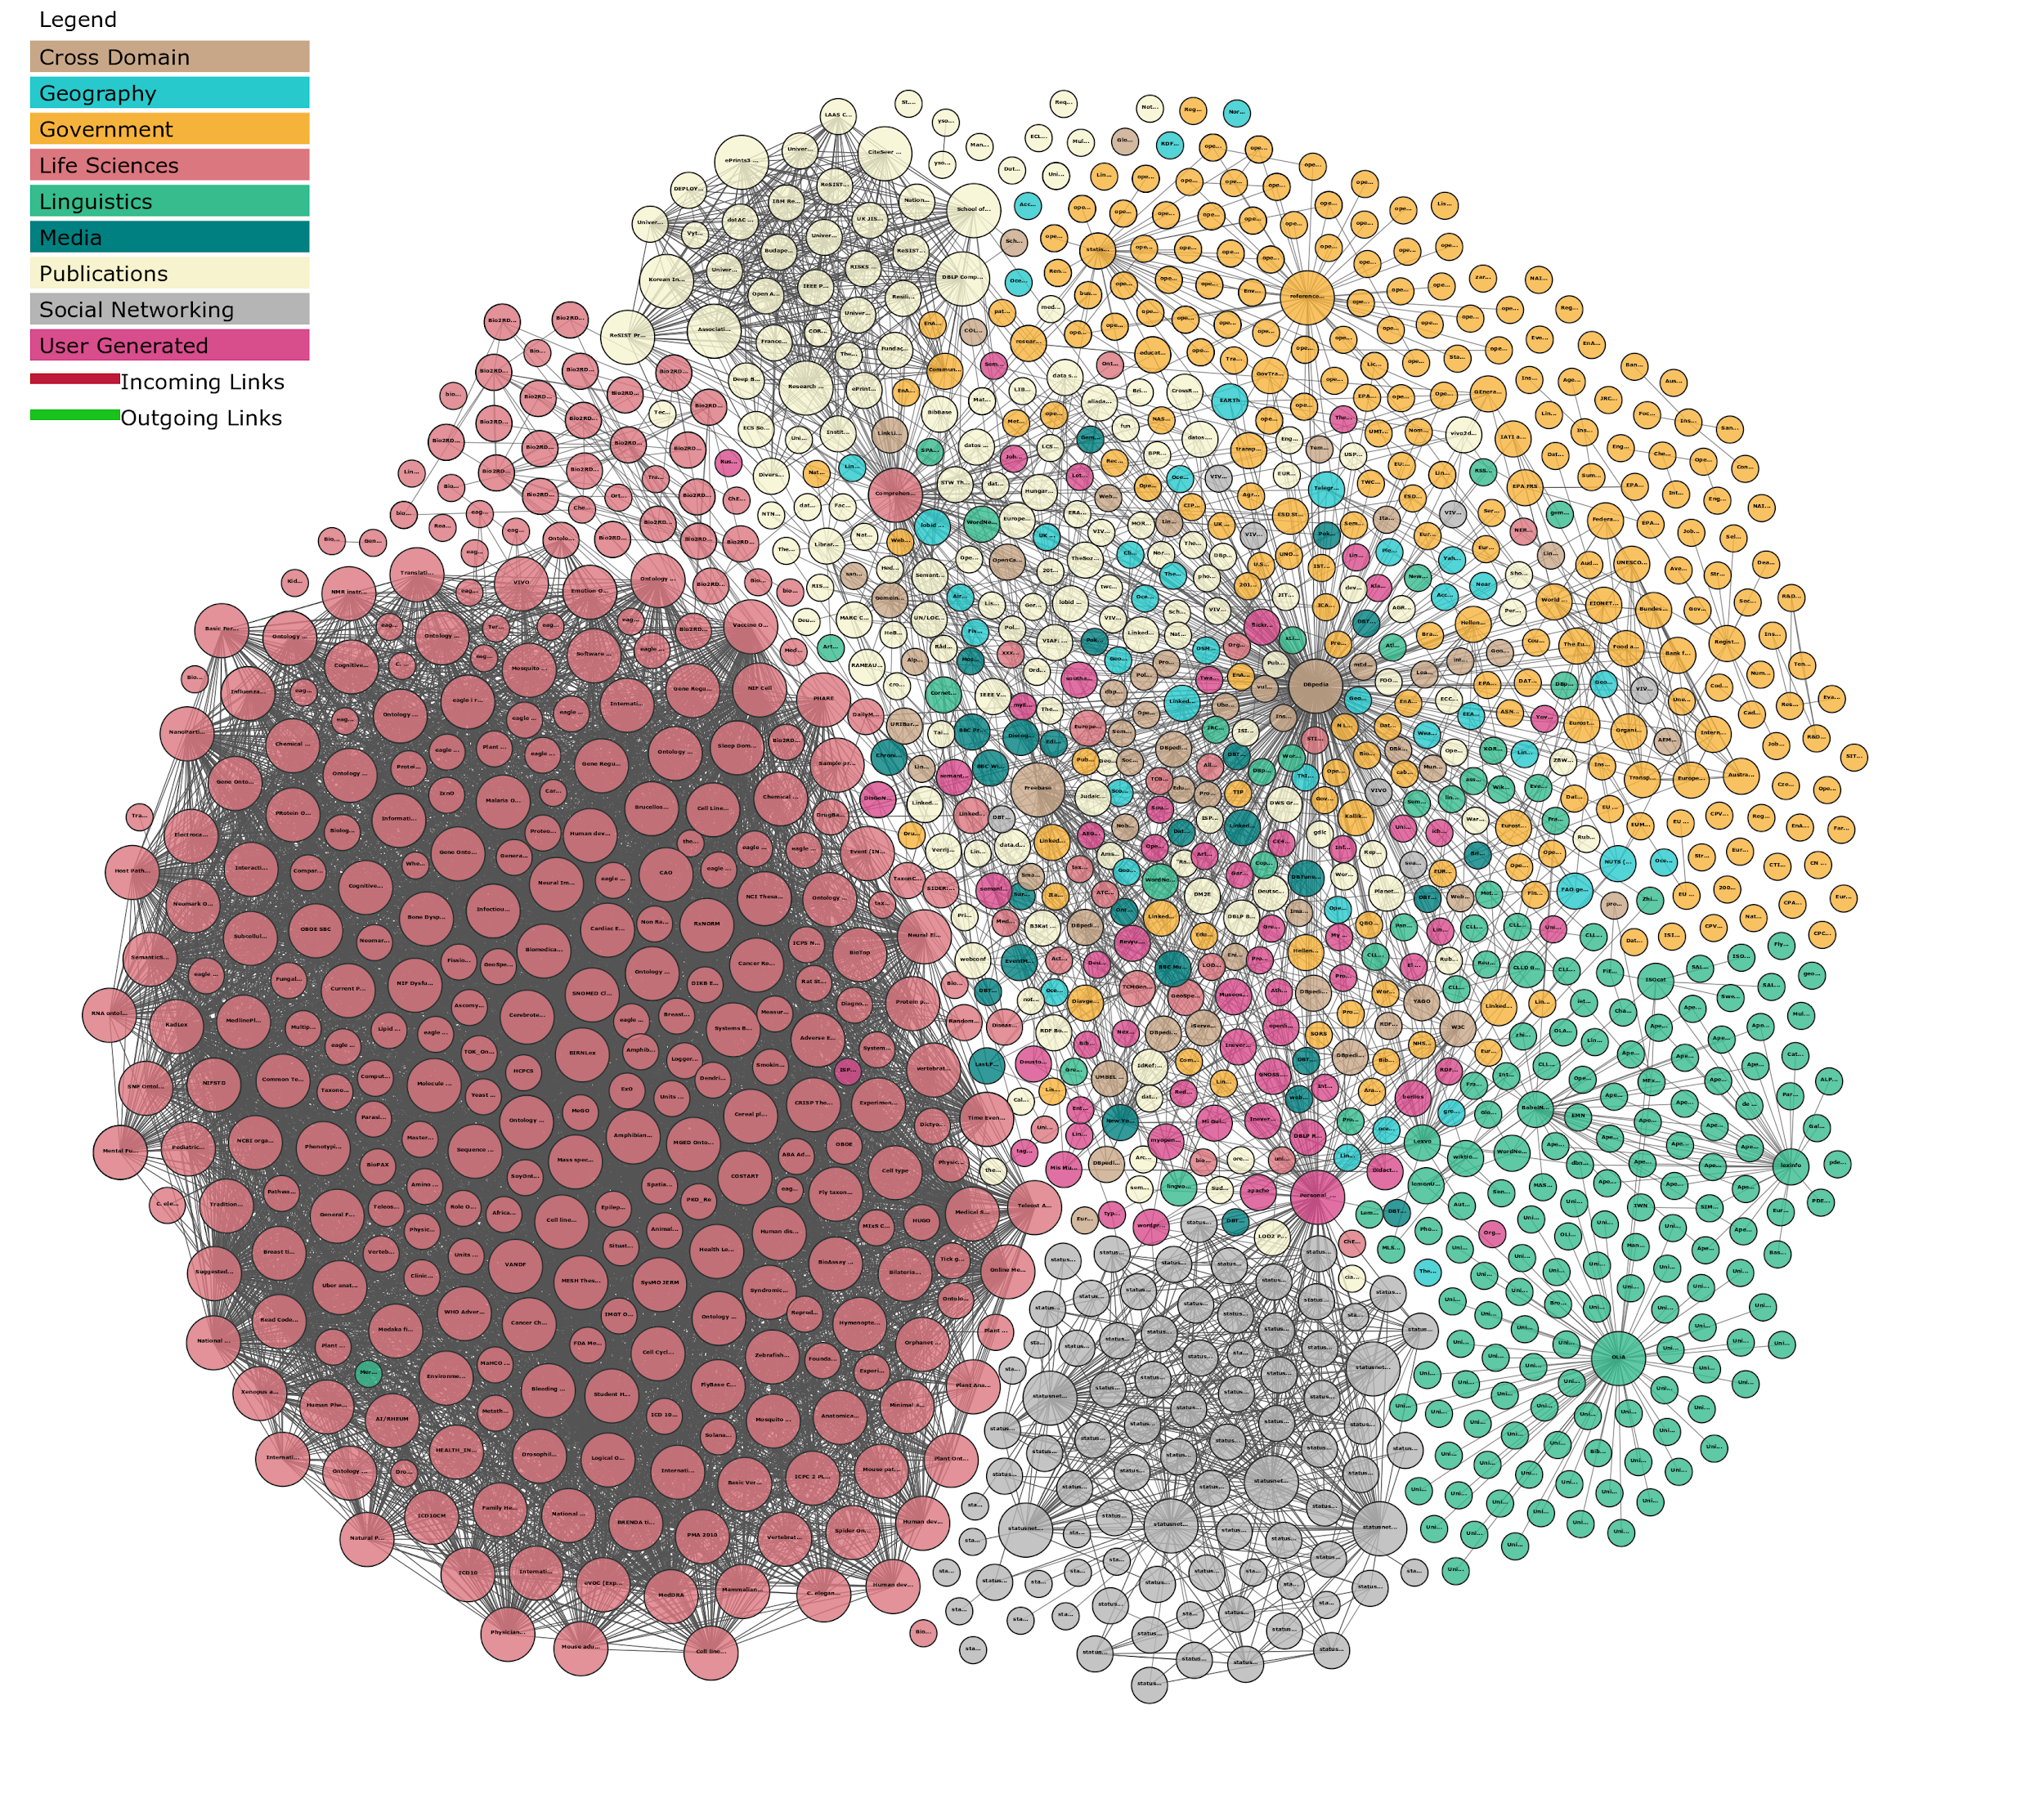
2017
Source: https://lod-cloud.net/

Slide 23
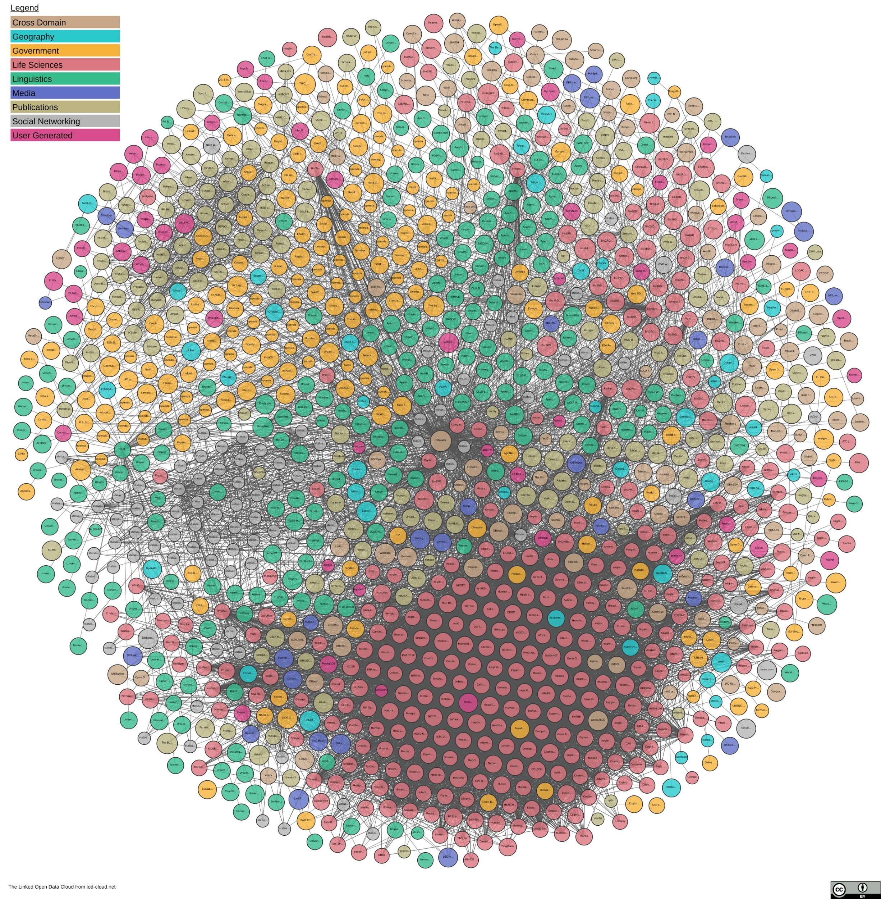
2019
Source: https://lod-cloud.net/

Slide 24
Theory Pt 2
LD, LOD, RDF, URIs, TURTLE, RDFS, OWL, SPARQL

Slide 25
RDF
Resource Description Framework
A means of encoding
    machine-readable
    self-describing meaning
RDF is a simple model

Slide 26
RDF triple
Subject
predicate
Object

Slide 27
URIs everywhere!
Very significantly, each element of the triple can be a URI – a Uniform Resource Identifier
  e.g. http://viaf.org/viaf/96994048/
  They can also be literals (strings or integers) or unnamed (blank nodes)
Shakespeare
Person
is a
http://viaf.org/viaf/96994048/
http://www.w3.org/1999/02/22-rdf-syntax-ns#type
http://xmlns.com/foaf/0.1/Person

Slide 28
RDF triple
URI1
URI2
URI3

Slide 29
Why URIs are awesome
This means we are always unambiguous.
The graph can be split up and distributed while retaining consistency (if desired).
We can also use HTTP URIs as a mechanism for retrieving parts of a graph.
It's a Web of Data!

Slide 30
RDFS and OWL
RDFS: RDF Schema
  The basics required to structure
    an ontology and
    exchange vocabularies
  Classes and properties, super- and sub-classes, range and domain.
OWL: Web Ontology Language
  More sophisticated structures
  Constraints for existence & cardinality, transitive, inverse properties …

Slide 31
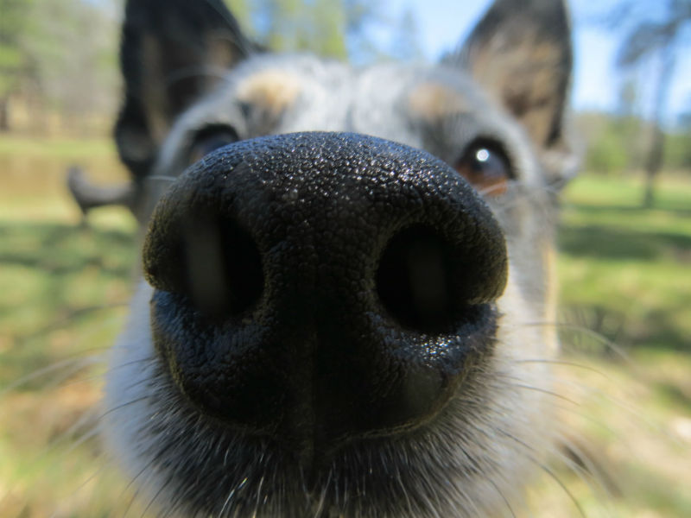
Exercise 1
Follow your nose

Slide 32
Exercise 1: Follow your nose
Go to https://www.wikidata.org/wiki/Q6542448
Who is the current position holder?
When were they born?
In which city were they born?
What is the population of that city?
Explore the graph visually https://w.wiki/782

Slide 33
What is Wikidata?
Collaboratively edited knowledge base operated by the Wikimedia Foundation
Anyone can contribute
Large number of active users, editors, contributors
Can be searched and queried in multiple ways
Data and metadata are published under CC0

Slide 34
Wikidata and FAIR
“By acting as an identifier hub, Wikidata helps other resources across and beyond the research landscape – e.g. including the cultural heritage sector – increase their FAIRness.”
Turning FAIR into reality (2018)
Wikigenomes http://wikigenomes.org/
Further info:
Andra Waagmeester https://www.slideshare.net/OpenAIRE_eu/making-data-fair-on-wikidata-andra-waagmeester

Slide 35
Other uses of Wikidata
Shahnameh of Ibrahim Sultan https://w.wiki/6Rm
Membership of Scholarly societies pre-1800 https://tinyurl.com/yxu78stj
Self-portraits of women https://w.wiki/6Ru
Further info:
Martin Poulter https://t.co/g2Y7hbXtHT?amp=1

Slide 36
Instance-level triples
William
Shakespeare
Person
is_a
“Romeo & Juliet”
Play
is_a
Verona
“Romeo & Juliet”
set_for
Verona
Italy
located_in
Slide: Terhi Nurmikko-Fuller

Slide 37
Simplified version
1564
born in
William
Shakespeare
Person
is a
is author of
Play
A thing
is a
Verona
is set in
is a
is in
has name
“Romeo and Juliet”
City
Italy
is a
Country
Slide: Terhi Nurmikko-Fuller

Slide 38
“William Shakespeare”
xsd:1564
“William Shakespeare”
example:born_in
rdfs:label
<HTTP URI1>
example:
Playwright
example:Person
a
a
example:is_author_of
example:
Play
“Verona”
a
<HTTP URI2>
rdfs:label
example:set_in
<HTTP URI3>
“Italy”
rdfs:label
“Romeo and Juliet”
a
example:is_in
rdfs:label
example:City
example: Country
<HTTP URI4>
a

Slide 39
Serialisation
RDF is an abstract model with several serialisations (aka syntax)
Serialisations include:
  Turtle (.ttl)
  RDF/XML
  JSON-LD
  and others…
You can use an online tool (easyRDF) to swap between different serializations
  http://www.easyrdf.org/converter
Swapping between the serialisations does not result in any loss of information.
Notes:
Turtle
‘Turtle’ is a play on words. ‘Tur’ is short for ‘terse’, and ‘tle’ - is short for ‘triple language’. Turtle is a pleasantly simple way of writing triples.
Turtle uses aliases or a shortcuts known as prefixes, which saves us having to write out full URIs every time.

Slide 40

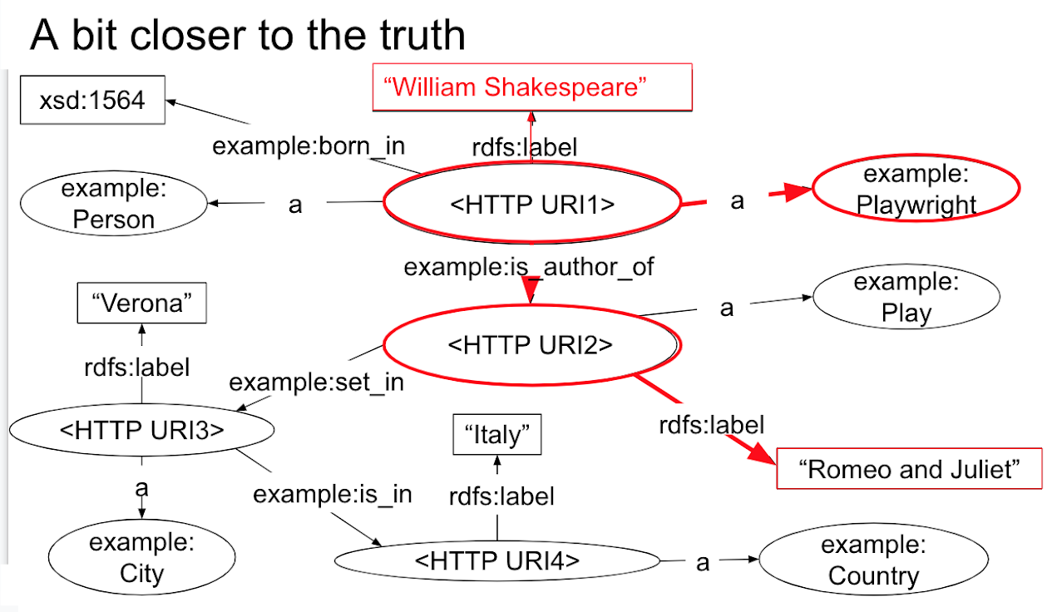
Reading .ttl
@prefix example: <http://example.org/> .
@prefix rdfs: <http://www.w3.org/2000/01/rdf-schema#> .
<http://URI1> a example:Person ;
a example:Playwright ;
example:born_in “1564” ;
rdfs:label “William Shakespeare” ;
example:is_author_of <http://URI2> .
<http://URI2> a example:Play ;
example:set_in <http://URI3> ;
rdfs:label “Romeo & Juliet” .
<http://URI3> a example:City ;
example:is_in <http://URI4> ;
rdfs:label “Verona” .
<http://URI4> a example:Country ;
rdfs:label “Italy” .
Slide: Terhi Nurmikko-Fuller
Notes:
Turtle
‘Turtle’ is a play on words. ‘Tur’ is short for ‘terse’, and ‘tle’ - is short for ‘triple language’. Turtle is a pleasantly simple way of writing triples.
Turtle uses aliases or a shortcuts known as prefixes, which saves us having to write out full URIs every time.

Slide 41
.ttl .rdf-xml
<?xml version="1.0" encoding="utf-8" ?>
<rdf:RDF xmlns:rdf="http://www.w3.org/1999/02/22-rdf-syntax-ns#"
xmlns:ns0="http://example.org/"
xmlns:rdfs="http://www.w3.org/2000/01/rdf-schema#">
<rdf:Description rdf:about="http://URI1">
<rdf:type rdf:resource="http://example.org/Person"/>
<rdf:type rdf:resource="http://example.org/Playwright"/>
<ns0:born_in>1564</ns0:born_in>
<rdfs:label>William Shakespeare</rdfs:label>
<ns0:is_author_of>
<ns0:Play rdf:about="http://URI2">
<ns0:set_in>
<ns0:City rdf:about="http://URI3">
<ns0:in_in>
<ns0:Country rdf:about="http://URI4">
<rdfs:label>Italy</rdfs:label>
</ns0:Country>
</ns0:in_in>
<rdfs:label>Verona</rdfs:label>
</ns0:City>
</ns0:set_in>
<rdfs:label>Romeo &amp; Juliet</rdfs:label>
</ns0:Play>
</ns0:is_author_of>
</rdf:Description>
</rdf:RDF>
@prefix example: <http://example.org/> .
@prefix rdfs: <http://www.w3.org/2000/01/rdf-schema#> .
<http://URI1> a example:Person ;
a example:Playwright ;
example:born_in “1564” ;
rdfs:label “William Shakespeare” ;
example:is_author_of <http://URI2> .
<http://URI2> a example:Play ;
example:set_in <http://URI3> ;
rdfs:label “Romeo & Juliet” .
<http://URI3> a example:City ;
example:is_in <http://URI4> ;
rdfs:label “Verona” .
<http://URI4> a example:Country ;
rdfs:label “Italy” .
Slide: Terhi Nurmikko-Fuller

Slide 42
Ontologies

Slide 43
What’s an ontology?
“An ontology is a formal, explicit specification of a shared conceptualisation”
Studer, Rudi; Benjamins, Richard; Fensel, Dieter: Knowledge Engineering: Principles and Methods in: Data & Knowledge Engineering 25/1–2 (1998), pp. 161–197.
Gruber, Thomas: A Translation Approach to Portable Ontology Specifications in: Knowledge Acquisition 5/2 (1993), pp. 199–220, p. 199
Slide: David Weigl & Stefan Münnich

Slide 44
What’s an ontology?
An ontology is a description of concepts and their relationships.
It’s a file read by a piece of software.
Ontologies enable us to exchange meaning through RDF.
It's about adding meaning to your data so that it can be reused by others.
Slide: Terhi Nurmikko-Fuller

Slide 45
What’s an ontology?
Ontologies don't remove complexity, but they do enable us to scale it.
More than one “correct” ontology can be applicable to a resource – it depends what you're doing with it.
Where available, use an applicable existing ontology (or extend it).
Write the ontologies you need – you can extend them later. Better it be limited and right...
It is probably unwise to expect an ontology for all Things...
Slide: Terhi Nurmikko-Fuller

Slide 46
What do our ontologies express?
Our data, knowledge, information, biases, reality, understanding...

Slide 47
Different levels
Top-level (upper) ontology
Domain ontology
Task ontology
Application ontology

Slide 48
Different levels of complexity
Light-weight
Heavy-weight

Slide 49
How do we know what they mean?
...specifications and documentation!

Slide 50
Ontologies you see everywhere
RDF Schema http://www.w3.org/TR/rdf-schema/
XSD https://en.wikipedia.org/wiki/XML_Schema_(W3C)
Dublin Core http://dublincore.org/
Simple Knowledge Organization System http://www.w3.org/2004/02/skos/
Friend of a Friend (FOAF) http://xmlns.com/foaf/spec/

Slide 51
Other examples
BIBFRAME http://www.loc.gov/bibframe/docs/
CIDOC-CRM http://www.cidoc-crm.org/
Music Ontology http://musicontology.com/
Event Ontology http://motools.sourceforge.net/event/event.html
Timeline Ontology http://motools.sourceforge.net/timeline/timeline.html
Provenance Ontology http://www.w3.org/TR/prov-o/

Slide 52
How do we express our ontologies?
How do we express their structures?

Slide 53
RDFS and OWL (recap)
RDFS: RDF Schema
  The basics required to structure
    an ontology and
    exchange vocabularies
  Classes and properties, super- and sub-classes, range and domain.
OWL: Web Ontology Language
  More sophisticated structures
  Constraints for existence & cardinality, transitive, inverse properties …

Slide 54
Structuring RDF
RDF Schema
  Define Classes of resources
  Define Properties
  SubClasses
    the isA relationship
Animal
rdfs:subclassOf
Mammal
rdfs:subclassOf
Lion
rdfs: → http://www.w3.org/2000/01/rdf-schema#
Notes:
What you say about a class is necessarily true of all sub-classes

Slide 55
RDF Schema (detail)
rdf:Class rdf:Property | resources that are RDF classes class of RDF properties
rdfs:subClassOf | isA relationship between Classes
rdfs:subPropertyOf rdf:type | isA relationship between Properties property to state that a resource is an instance of a Class
rdfs:label | a human-readable version of a resource's name
rdfs:seeAlso | a resource that might provide more information about the Subject
Source: https://www.w3.org/TR/rdf-schema/

Slide 56
Domain and Range
A Property can define a Domain and Range
  Domain is the Class of the Subject.
  Range is the Class of the Object.
Properties run from the Domain to the Range.
Domain
Range
Subject
Object
predicate

Slide 57
Exercise 2
Ontologies

Slide 58
Exercise 2: Ontologies
Choose an ontology (general or related to your domain)
Ontology browsers:
OBO Foundry http://www.obofoundry.org/
BioPortal http://bioportal.bioontology.org/
Ontology Lookup Service https://www.ebi.ac.uk/ols/ontologies
Ontobee http://www.ontobee.org/
Linked Open Vocabularies https://lov.linkeddata.es/dataset/lov/vocabs
Fill in the blank table at http://bit.ly/LDexercises

Slide 59
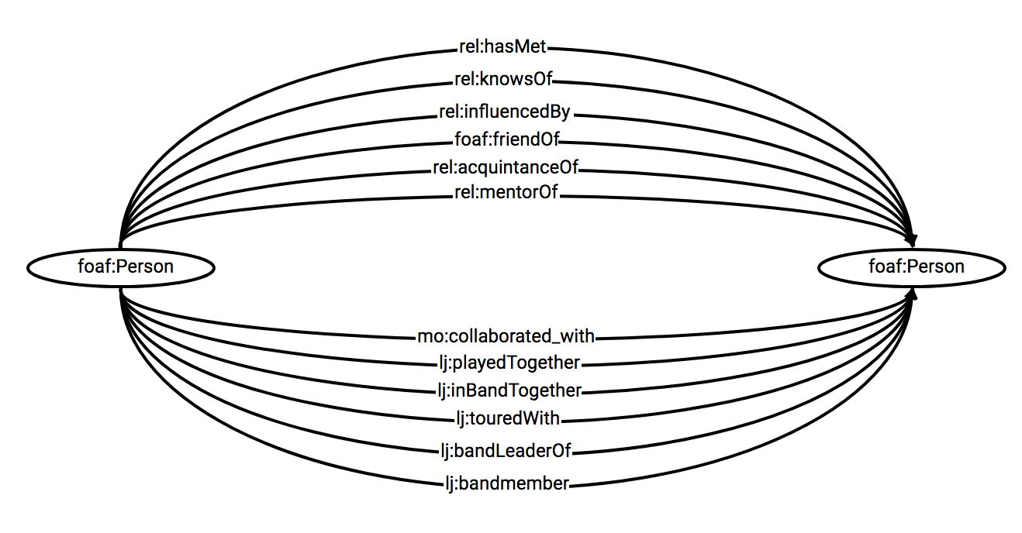
Ontologies in practice
http://jazzcats.cdhr.anu.edu.au/documentation/

Slide 60
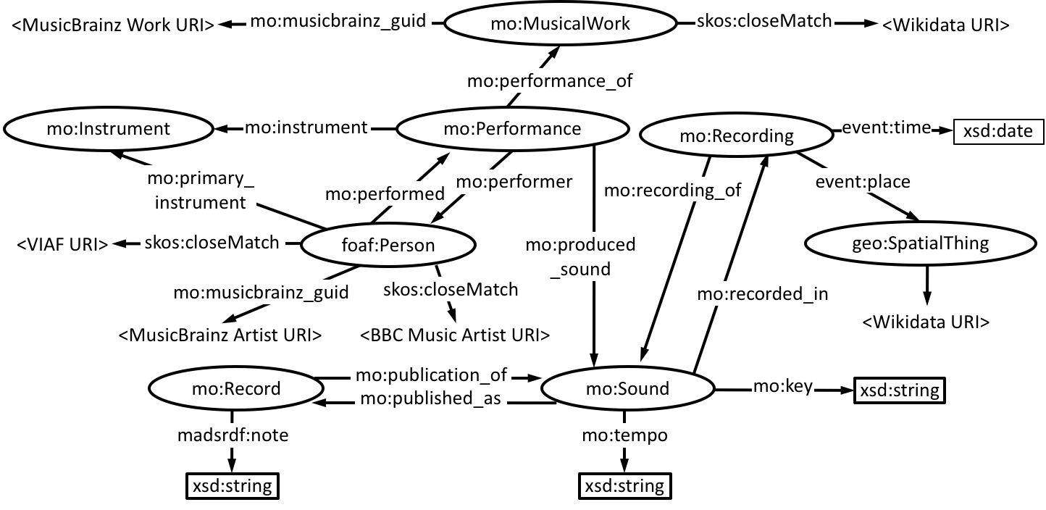
Ontologies in practice
http://jazzcats.cdhr.anu.edu.au/documentation/

Slide 61
Producing RDF

Slide 62
Exercise 3
Building triples

Slide 63
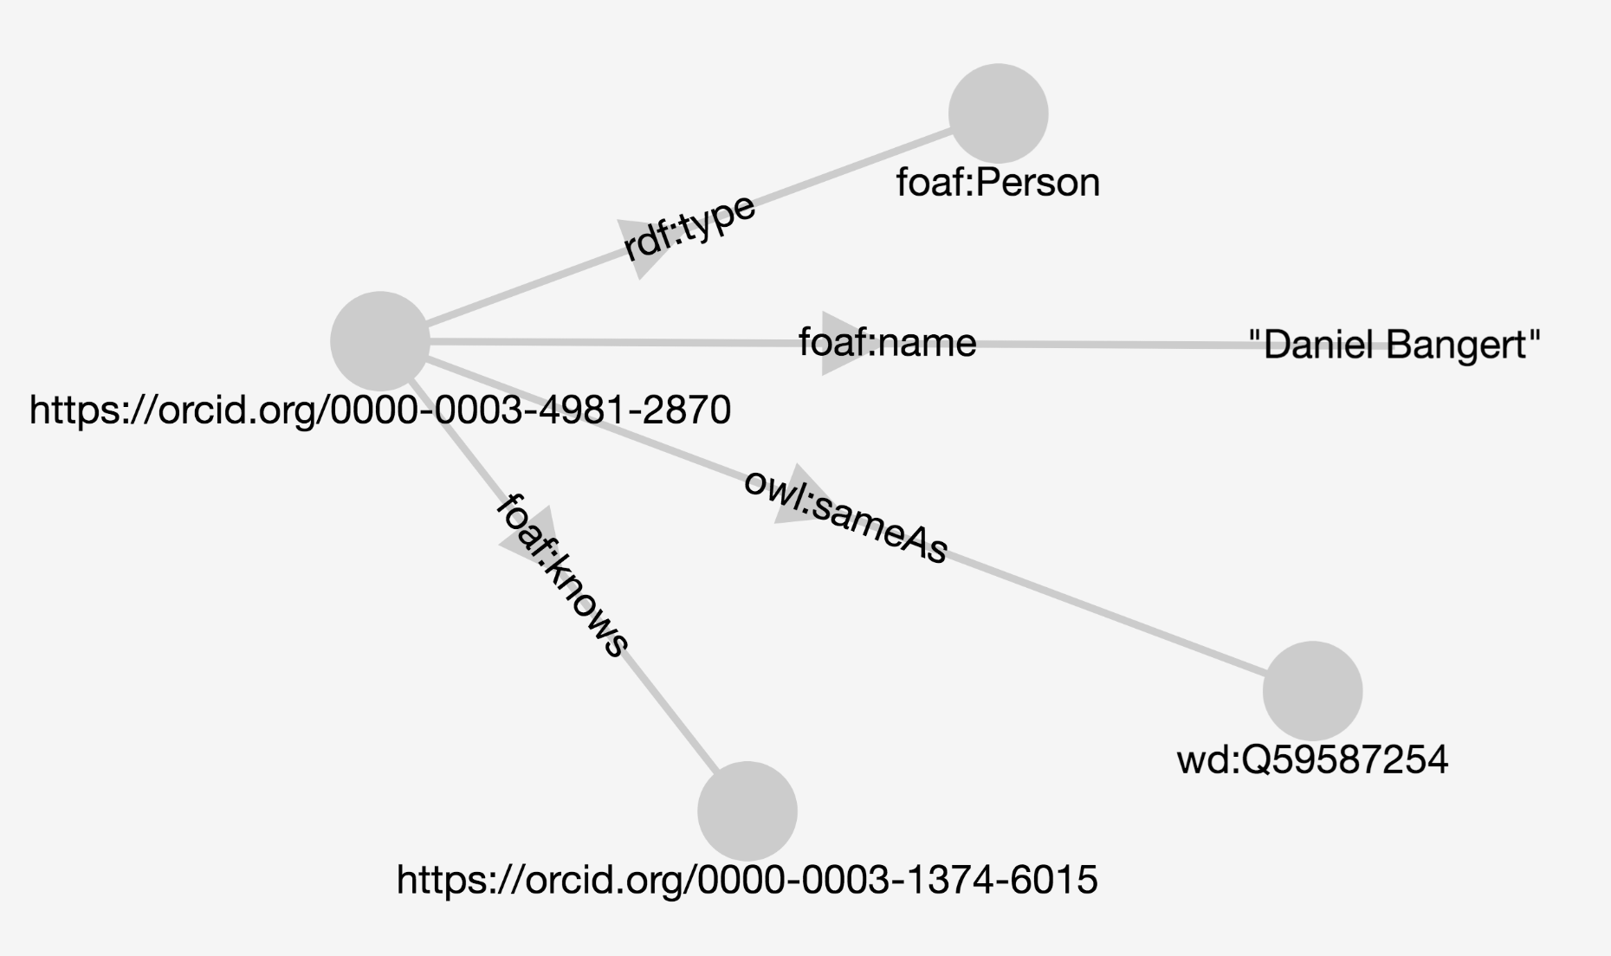
Goal: create some triples

Slide 64
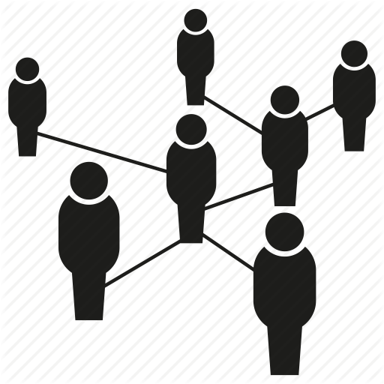
Exercise 3: Building triples
Describe your group in RDF!
Go to https://tb.semlab.io/ (select ‘start building’)
Create three triples per ‘person node’ (at least)
  Hint: use FOAF, Relationships, RDF Schema
Use external URIs and LOD resources where possible
When complete, paste the share URL and N-Triples into http://bit.ly/LDexercises

Slide 65
Triplestores
You can store a collection of RDF statements, or triples, in a triplestore
This can also be thought of as a cache where triples are brought together to do useful things to them as a whole
We can also run queries over the RDF in a triplestore using SPARQL

Slide 66
Triplestores
Examples:
  Jena
  4store
  OpenLink Virtuoso
  Sesame (aka RDF4J)
  AllegroGraph
  Blazegraph
  Amazon Neptune

Slide 67
Demo

Slide 68
Options for producing RDF
You could write a e.g. Python script
You could use CONCATENATE in Excel
You could use Protege and put in instance data
You could type it all out manually :/
You could use OpenRefine and the RDF extension
You could use software like Web-Karma (tabular data)
You could use software like D2R server (relational data)

Slide 69
Useful tools
Protege (ontology editor)
https://protege.stanford.edu/
  https://protegewiki.stanford.edu/wiki/Protege4GettingStarted
  http://owl.cs.manchester.ac.uk/publications/talks-and-tutorials/protg-owl-tutorial/
Web-Karma (data integration tool)
https://usc-isi-i2.github.io/karma/
  https://github.com/usc-isi-i2/Web-Karma/wiki/Installation%3A-One-Click-Install

Slide 70

SPARQL

Slide 71
SPARQL
SPARQL Protocol and RDF Query Language
  Recursive acronym
  Standardisation started in 2004, published 2008
  Note Protocol as well as Query language (unlike SQL)
  SPARQL has several queries, we'll focus on SELECT
    Also CONSTRUCT, ASK, and DESCRIBE
      And UNION, FILTER, LIMIT, OFFSET...
Notes:
A recursive acronym is an acronym where the first letter is the acronym itself

Slide 72
Getting started
You can use simple SPARQL queries to gain familiarity with the graph, e.g.
List of all unique classes
SELECT DISTINCT ?type { ?s a ?type }
List of all unique properties
SELECT DISTINCT ?p { ?s ?p ?o }

Slide 73
Examples with uploaded data
SELECT *
WHERE {
?s ?p ?o.
}
---
PREFIX rdf: <http://www.w3.org/1999/02/22-rdf-syntax-ns#>
PREFIX rdfs: <http://www.w3.org/2000/01/rdf-schema#>
PREFIX foaf: <http://xmlns.com/foaf/0.1/>
SELECT DISTINCT ?s
WHERE {
?s a foaf:Person .
}
LIMIT 10

Slide 74
Not SPARQLing?
Syntax errors (missing prefix, misplaced full stop, etc) you can catch by validating your query.
Logic problems are harder to solve as the SPARQL is valid, but it just doesn’t match the underlying graph.
Slide: Terhi Nurmikko-Fuller

Slide 75
Example
prefix mo: <http://purl.org/ontology/mo/>
prefix xsd: <http://www.w3.org/2001/XMLSchema#>
prefix skos: <http://www.w3.org/2004/02/skos/core#>
prefix foaf: <http://xmlns.com/foaf/0.1/>
prefix rdfs: <http://www.w3.org/2000/01/rdf-schema#>
prefix event: <http://purl.org/NET/c4dm/event.owl#>
SELECT DISTINCT ?artist ?connection_to_Eldridge ?performance
WHERE {
?artist a foaf:Person ;
mo:performed ?performance ;
skos:closeMatch ?another_ID .
?performance a mo:Performance ;
mo:performance_of ?work .
?work a mo:MusicalWork ;
rdfs:label "Body and Soul" .
<http://dbpedia.org/resource/Roy_Eldridge>
?connection_to_Eldridge ?another_ID . }
TRANSLATION
Find recordings of Body and Soul by artists with a connection to Roy Eldridge and show me the artist, the type of connection to Eldridge and the performance.
http://cdhr-linkeddata.anu.edu.au/jazzcats-sparql/sparql

Slide 76
Exercise 4
SPARQL

Slide 77
Exercise 4a: Wikidata SPARQL
Go to https://query.wikidata.org/
Explore and amend a Wikidata example query
Paste the short URL for the query into http://bit.ly/LDexercises

Slide 78
Exercise 4b: Explore another endpoint
https://www.ebi.ac.uk/rdf/services/sparql
https://sparql.rhea-db.org/sparql
https://sparql.uniprot.org/
https://sparql.orthodb.org/
http://nomisma.org/sparql
https://bnb.data.bl.uk/flint-sparql
https://jpsearch.go.jp/rdf/sparql/easy/
Yet Another SPARQL GUI https://yasgui.org/ (select an endpoint)

Slide 79

Useful resources
Learning SPARQL book ---->
http://sparql-playground.sib.swiss/
https://prefix.cc/

Slide 80
Validation tools
http://sparql.org/query-validator.html
http://sws.ifi.uio.no/sparqler/validator.html
http://linked.bodc.ac.uk/validate/query

Slide 81
Summary and discussion

Slide 82
Summary
Subject
predicate
Object

Slide 83
Revisiting FAIR
Findable
F1. (meta)data are assigned a globally unique and eternally persistent identifier.
F2. data are described with rich metadata.
F3. (meta)data are registered or indexed in a searchable resource.
F4. metadata specify the data identifier.
Accessible
A1. (meta)data are retrievable by their identifier using a standardized communications protocol.
  A1.1 the protocol is open, free, and universally implementable.
  A1.2 the protocol allows for an authentication and authorization procedure, where necessary.
A2. metadata are accessible, even when the data are no longer available.
Interoperable
I1. (meta)data use a formal, accessible, shared, and broadly applicable language for knowledge representation.
I2. (meta)data use vocabularies that follow FAIR principles.
I3. (meta)data include qualified references to other (meta)data.
Reusable
R1. meta(data) have a plurality of accurate and relevant attributes.
  R1.1. (meta)data are released with a clear and accessible data usage license.
  R1.2. (meta)data are associated with their provenance.
  R1.3. (meta)data meet domain-relevant community standards.
Notes:
How does Linked Data (as a method) align (or not) with the principles?

Slide 84
Acknowledgements
Terhi Nurmikko-Fuller, Australian National University
David Weigl, University of Music and Performing Arts Vienna
Stefan Münnich, Universität Basel
Contact:
bangert@sub.uni-goettingen.de
@enigmaticocean

