Slide 2
Horizon Europe and Open Science
The following slides are a courtesy of
Victoria Tsoukala, PhD, Policy Officer, Unit ‘Open Science’, DG RTD, and Angelica Marino, DG Research & Innovation (DG R&I-G2)
April 21, 2021, Webinar: A successful proposal for Horizon Europe: Scientific-technical excellence is key, but don’t forget the other aspects

Slide 3
The European Commission and Open Science
2021
FP7
OA Pilot
Deposit and open access
H2020
OA Mandatory
Deposit and open access
& ORD/DMP Pilot
H2020
OA Mandatory
Deposit and open access
& ORD/DMP by default
(exceptions)
2017
Horizon Europe
OA Mandatory
Deposit and open access
DMP in line with FAIR Mandatory
OD by default (exceptions)
& Open Science embedded
2014
2008

Slide 4



HORIZON EUROPE LEGISLATION defines three types of impact, tracked with Key Impact Pathways
1. Creating high-quality new knowledge
Scientific
Impact
2. Strengthening human capital in R&I
3. Fostering diffusion of knowledge and Open Science
4. Addressing EU policy priorities & global challenges through R&I
Societal
Impact
5. Delivering benefits & impact via R&I missions
6. Strengthening the uptake of R&I in society
Economic/
Technological
Impact
7. Generating innovation-based growth
8. Creating more and better jobs
9. Leveraging investments in R&I
Article 50 & Annex V ‘Time-bound indicators to report on an annual basis on progress of the Programme towards the achievement of the objectives referred to in Article 3 and set in Annex V along impact pathways’
Courtesy of Angelica Marino, April 21, 2021, Webinar: A successful proposal for Horizon Europe: Scientific-technical excellence is key, but don’t forget the other aspects

Slide 5
Open Science in Horizon Europe
“Open science” means an approach to the scientific process based on open cooperative work, tools and diffusing knowledge
(Horizon Europe Regulation and Model Grant Agreement)
The concepts of Open Science, Open Innovation, Open to the World should ensure excellence and impact of the Union´s investment in research and innovation, while safeguarding the Union´s interests
(Recital 7 Horizon Europe Regulation)
The work programme may provide for additional incentives or obligations for the purpose of adhering to open science practices
(Horizon Europe Regulation, article 39)
Courtesy of Victoria Tsoukala, April 21, 2021, Webinar: A successful proposal for Horizon Europe: Scientific-technical excellence is key, but don’t forget the other aspects

Slide 6
Important documents and resources
Model grant agreement (MGA), article 17 –lists the obligations you have, i.e. the requirements of the policy
Work Programme General Annexes, evaluation criteria described; open science- a couple of additional obligations outlined there (access for validation and public emergency).
Proposal template- shows where and how to address open science- definition of open science practices
Annotated Grant Agreement (AGA), article 17- offers explanations and guidance for open science requirements
Horizon Europe Programme Guide – presents what is required at proposal stage and how open science is evaluated; open science practices analysed and resources provided-useful for proposers and evaluators
Courtesy of Victoria Tsoukala, April 21, 2021, Webinar: A successful proposal for Horizon Europe: Scientific-technical excellence is key, but don’t forget the other aspects

Slide 7
Open Science practices*
early and open sharing of research (for example through preregistration, registered reports, pre-prints, or crowd-sourcing)
research output management including research data management
measures to ensure reproducibility of research outputs
providing open access to research outputs (e.g. publications, data, software, models, algorithms, and workflows) through deposition in trusted repositories
participation in open peer-review
involving all relevant knowledge actors including citizens, civil society and end users in the co-creation of R&I agendas and contents (such as citizen science)
*Listed in the proposal template
** Mandatory and non-mandatory practices. Mandatory in MGA and WP
Courtesy of Victoria Tsoukala, April 21, 2021, Webinar: A successful proposal for Horizon Europe: Scientific-technical excellence is key, but don’t forget the other aspects

Slide 8
Evaluation of proposals and Open Science
“Excellence” criterion
(methodology)
Up to 1 page to describe OS practices + up to 1 page to describe research data/output management
Evaluation of the quality of open science practices
“Quality of implementation” criterion
(capacity of participants and consortium as a whole + list of achievements)
  Explain expertise on OS (if no OS practices are involved then no expertise required)
  List publications, software, data, etc, relevant to the project with qualitative assessment and, where available, persistent identifiers
  Publications expected to be open access; datasets expected to be FAIR and ‘as open as possible, as closed as necessary‘. Significance of publications to be evaluated on the basis of proposers’ qualitative assessment and not per Journal Impact Factor
**evaluation concerns mandatory and non-mandatorypractices, the latter where appropriate
**exception: ERC does not evaluate open science
Courtesy of Victoria Tsoukala, April 21, 2021, Webinar: A successful proposal for Horizon Europe: Scientific-technical excellence is key, but don’t forget the other aspects

Slide 9
Model Grant Agreement requirements
Open access to scientific publications
Research Data Management
Additional open science practices
Courtesy of Victoria Tsoukala, April 21, 2021, Webinar: A successful proposal for Horizon Europe: Scientific-technical excellence is key, but don’t forget the other aspects

Slide 10
1. Open access to scientific publications I/II
Beneficiaries must ensure OA to peer-reviewed scientific publications relating to their results. In particular, they must ensure:
  at the latest upon publication, deposition of the AAM or VoR in a trusted repository + immediate open access via the repository under CC BY or equivalent (CC BY-NC/CC BY-ND are allowed for long-text formats)
  information via the repository about any research output/tools/instruments needed to validate the conclusions of the scientific publication
Metadata must be open under CC 0 or equivalent, in line with the FAIR principles and provide information about the licensing terms and persistent identifiers, amongst others.
Trusted repository: new term for HE; explained in the AGA; seek assistance from your library to assess whether a repository is trusted
Courtesy of Victoria Tsoukala, April 21, 2021, Webinar: A successful proposal for Horizon Europe: Scientific-technical excellence is key, but don’t forget the other aspects

Slide 11
1. Open access to scientific publications II/II
Beneficiaries (or authors) must retain sufficient intellectual property rights to comply with the OA requirements
Publication in venue of choosing but publication fees are reimbursable only if publishing venue is full open access (publication fees in hybrids not reimbursed)
Courtesy of Victoria Tsoukala, April 21, 2021, Webinar: A successful proposal for Horizon Europe: Scientific-technical excellence is key, but don’t forget the other aspects

Slide 12
2. Research data management
Beneficiaries must manage the digital research data generated in the action responsibly, in line with the FAIR principles and:
  establish + regularly update a data management plan (‘DMP’) for generated (and/or collected) data; by mo 6 of project; with submission or latest by grant agreement in cases of public emergency (e.g. COVID projects)
  as soon as possible and within the deadlines set out in the DMP, deposit the data in a trusted repository (federated in the EOSC if required in the call conditions) + ensure OA under CC BY, CC 0 or equivalent, following the principle ‘as open as possible as closed as necessary’
  provide information via the repository about any research output/tools/instruments needed to re-use or validate the data
Metadata must be open under CC 0 or equivalent (to the extent legitimate interests or constraints are safeguarded), in line with the FAIR principles and provide information about the licensing terms and persistent identifiers, amongst others.
Courtesy of Victoria Tsoukala, April 21, 2021, Webinar: A successful proposal for Horizon Europe: Scientific-technical excellence is key, but don’t forget the other aspects

Slide 13
3. Additional Open Science practices I/II
Some calls may have additional obligations on OS practices- they must be complied with
Beneficiaries must provide (digital or physical) access to data or other results needed for validation of the conclusions of scientific publications, provided legitimate interests safeguarded and unless (open) access already provided at publication (mainstreamed through general annexes of WP; does not currently apply to ERC)
Additional obligations in cases of public emergency
Courtesy of Victoria Tsoukala, April 21, 2021, Webinar: A successful proposal for Horizon Europe: Scientific-technical excellence is key, but don’t forget the other aspects

Slide 14
3. Additional Open Science practices-
Public emergency II/II
If imposed by the call conditions in case of a public emergency, beneficiaries must (if requested by the granting authority) immediately deposit any research output in a repository + provide open access to it under CC BY, CC 0 or equivalent.
As an exception, if the access would be against the beneficiaries’ legitimate interests, beneficiaries must grant non-exclusive licenses — under fair and reasonable conditions — to legal entities that need the research output to address the public emergency + commit to rapidly and broadly exploit the resulting products and services at fair and reasonable conditions.
This provision applies up to four years after the end of the action.
Courtesy of Victoria Tsoukala, April 21, 2021, Webinar: A successful proposal for Horizon Europe: Scientific-technical excellence is key, but don’t forget the other aspects

Slide 15
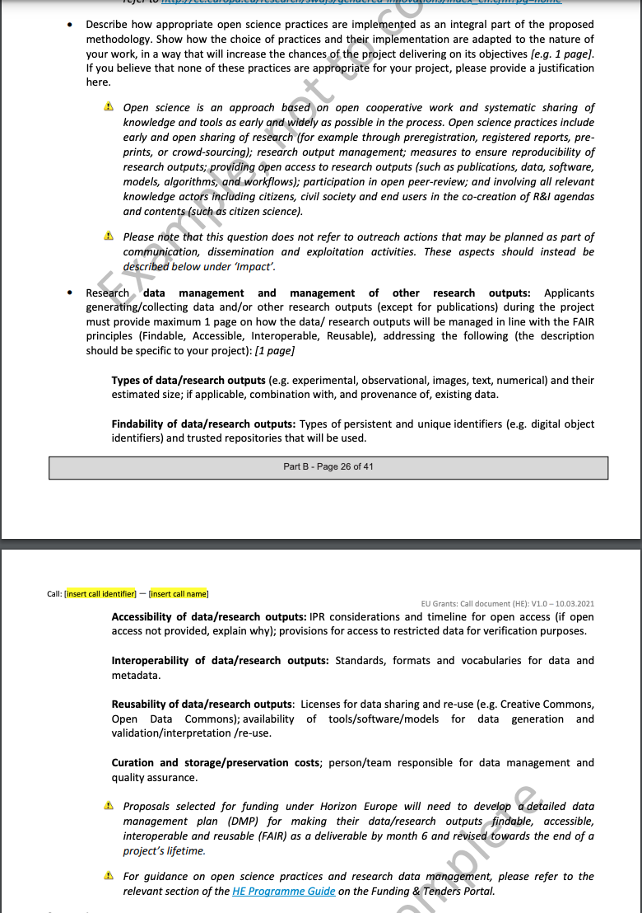
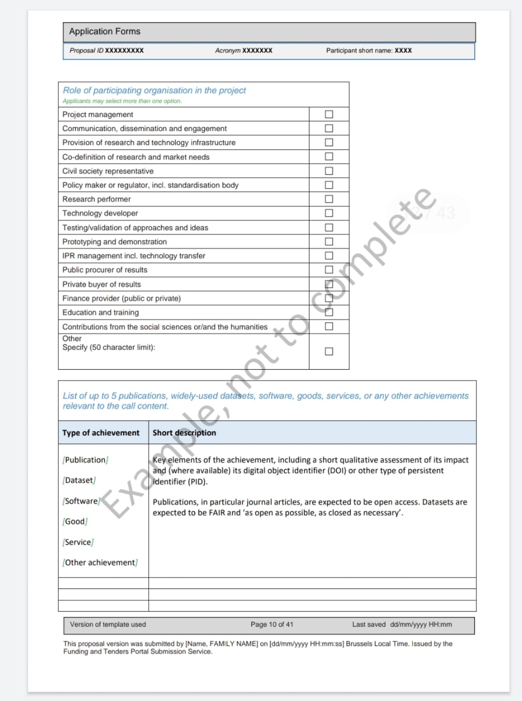
From the Horizon Europe Template
CV of beneficiaries are avaluated for publications (expected to be Open Access) but also widely-used datasets (expected to be FAIR and as open as possible, as closed as necessary), software, goods, services or any other achievements relevant to the call content.
No IF will be used
In proposal part B – methodology:
  Describe how appropriate open science practices are implemented as an integral part of the methodology
  Describe the strategy for FAIR Reseach Data Management

Slide 16
Open Science will be the new normal

Slide 17
The Vision
Why | Who | What

Slide 18
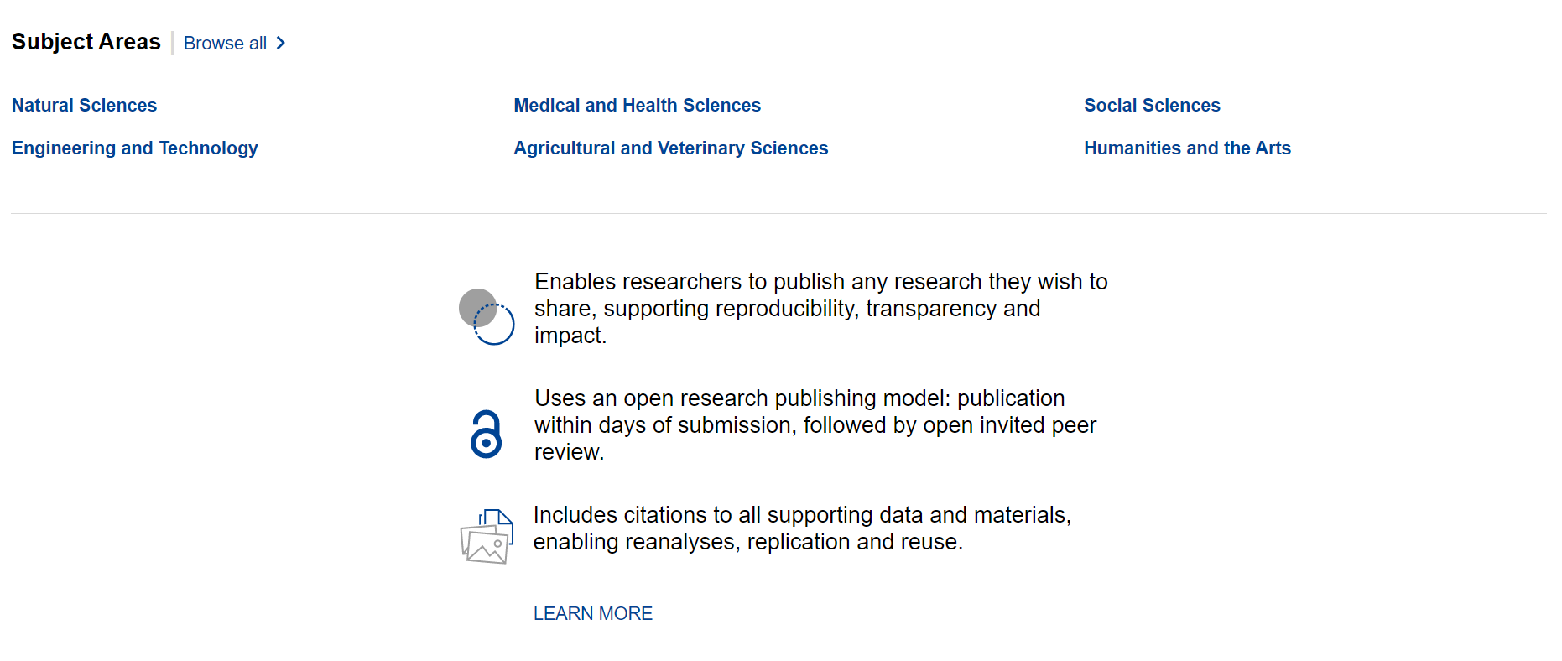
Open Research Europe (ORE)
Public Procurement – 5.8 Million EUR contract signed in March 2020 with F1000 Research for 4 years
GYA, LIBER and Eurodoc as collaborators/subcontractors for communication and sustainability
OpenAIRE are a partner to help with syndication and communication of ORE
https://open-research-europe.ec.europa.eu/

Slide 19
A publishing platform, NOT a Journal
ORE is not a Journal
It is a publishing platform
The aim is to give researcher a venue where to publish the results of their research funded by the EC, irrespective of the perceived level of interest or novelty
Confirmatory or negative results, as well as null studies are suitable
The scope of the Peer Review is not to reject or accept a result but to improve its publication thanks to a collaboration effort among experts
The Reviewers role is to assess whether the research is technically sound and of academic merit.

Slide 20
Why a publishing platform?
High-quality, reliable and efficient publishing venue for Horizon research
High scientific standards, and swift and transparent processes
Expert Scientific Advisory Board
No cost to authors/beneficiaries i.e. non-APC platform
Optional, venue where grantees can publish post-grant the results of their work, while respecting their open access obligations

Slide 21
The European Commission’s ambitions
To lead by example in operationalising open science principles e.g. open peer review, open data, early sharing of research, article level metrics and indicators.
Doing this while contributing to transparency and cost-effectiveness – APCs paid for by the Commission are set in procurement (780 euros).
Exploring sustainable open access publishing business models – cost effective publishing, potential to broaden the platform to other European funders and be interoperable with existing infrastructure.

Slide 22
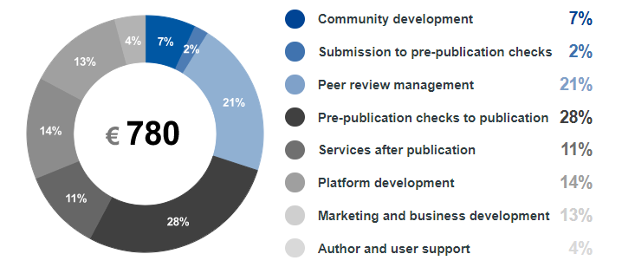
Price Transparency
Transparent about the costs and importantly the breakdown for the price that the Commission pays per article.
https://open-research-europe.ec.europa.eu/for-authors/article-processing-charges

Slide 23
The platform as a publishing service
Original peer-reviewed articles first posted as preprints
Stemming from Horizon 2020-funded research (and later, Horizon Europe)
Immediate open access
With content licensed for re-use
Open peer review
Open reviewer identities, published reviews, post-publication comments
Connected to the scholarly ecosystem
PIDs, connection to repositories, open data and software, interoperable technologies, preservation of content, TDM, etc.

Slide 24
The platform as a publishing service
New generation metrics
Each article will have a dedicated metrics page
Explicit, accessible and transparent on business processes and publication policies
All published on the site for everyone to see
Aligned with the EC policy and principles
Takes burden from researchers as it is fully compliant
Following example of other funders
Such as the Wellcome Trust (Wellcome Open Research) and others

Slide 25
ORE: How it works
The publishing model

Slide 26
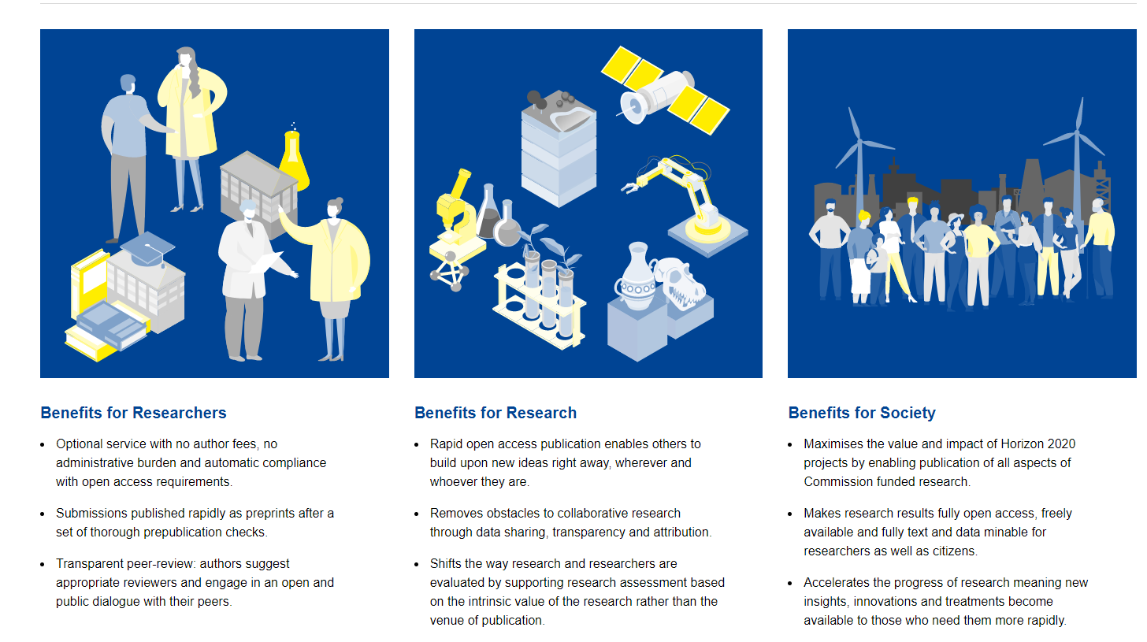

Slide 27
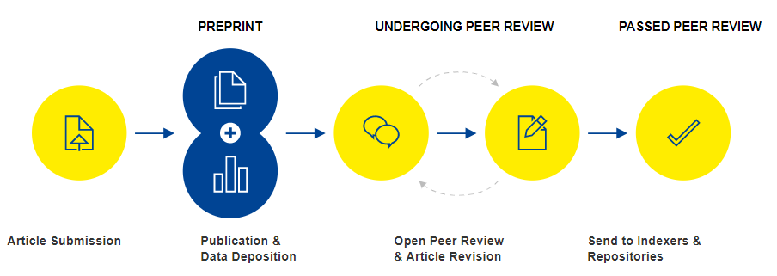
Open Research Publishing Model

Slide 28
Prepublication checks
Upon Submission
Assess author eligibility
Check article scope
Check for plagiarism
Pre-publication Checks
Comprehensive checks on reporting, editorial & ethical guidelines
Check for data availability
Support authors in making data and software FAIR
Production
Converted to text and data-mining formats (PDF, HTML, XML)
Proofs and editing if necessary
Quality checks on citations, references, image resolutions & multimedia
Ensure persistent identifiers are assigned and resolve correctly

Slide 29
Open Research Publishing Model

Slide 30



Data and Software Availability
Open Research Europe requires that, where possible, the source data underlying the results are made available at publication.
However, the sharing of research data must:
Protect the confidentiality, security and privacy of individuals
Respect the terms of consent by individuals who are involved in research
Be consistent with Horizon 2020 legal, ethical and regulatory frameworks
Guard against unreasonable costs
https://open-research-europe.ec.europa.eu/for-authors/data-guidelines

Slide 31
Open Research Publishing Model

Slide 32
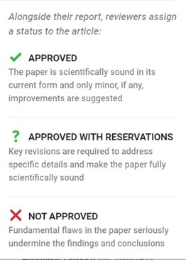


Open Peer Review
Open Identities
Reviewers must provide name and affiliation
Must identify conflicting interests
Open Reports
Reviewer reports will be published alongside the article
These are citable and have viewing metrics
Open Review Status
Reviewers assign a status

Slide 33
Open Research Publishing Model

Slide 34
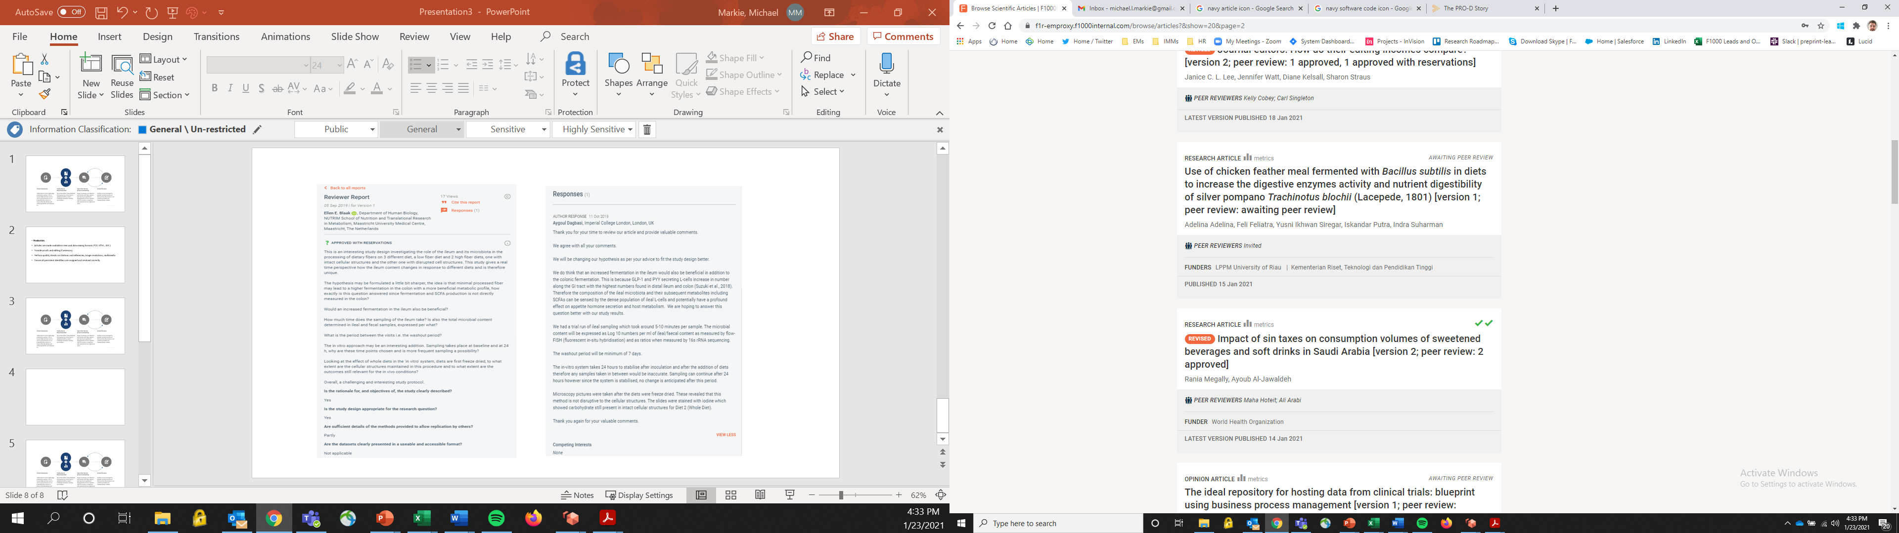

Passing Peer Review
Authors can respond to reviewers and revise their articles based on the comments
Revisions are made through new versions of the article that are linked together (versions are limitless)
Authors need to achieve a certain ‘threshold’ of reviewer status to be pass peer review and be indexed:
2 ‘Approved’ Status
2 ‘Approved with reservations’ and 1 ‘Approved’ Status

Slide 35
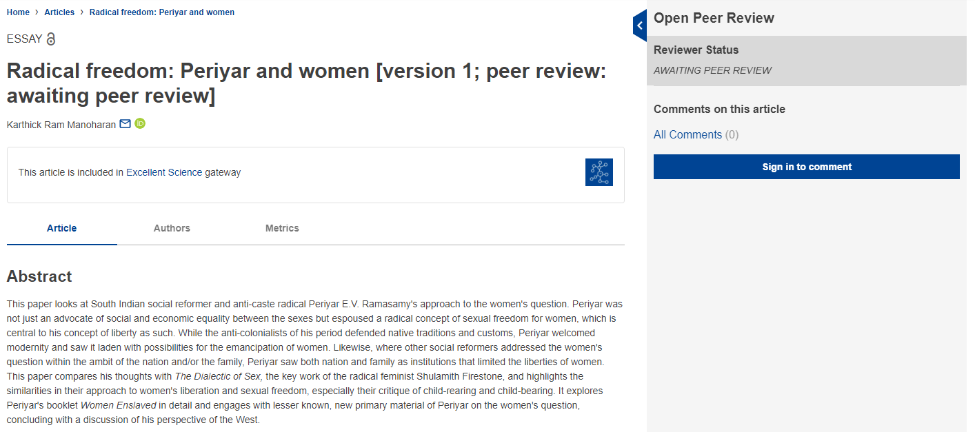
Preprint example
https://doi.org/10.12688/openreseurope.13131.1

Slide 36
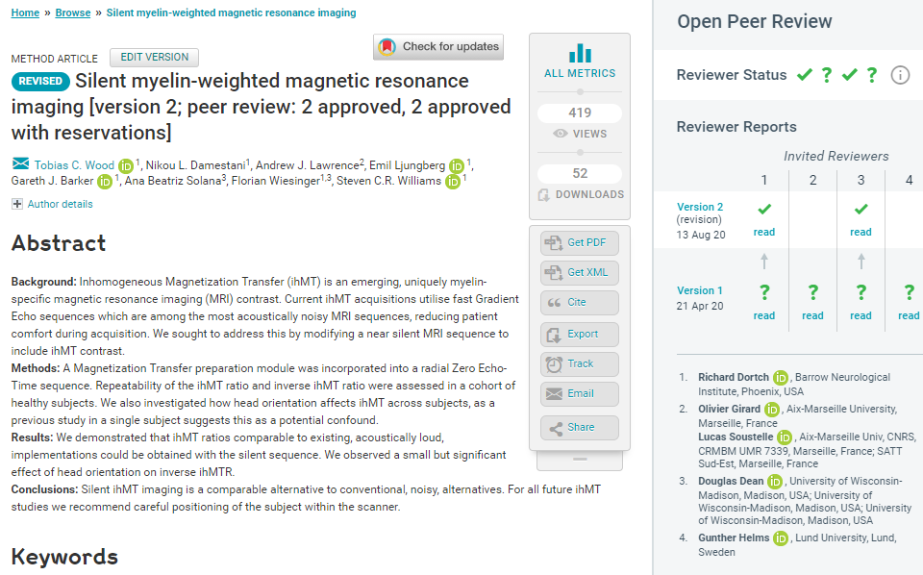
Open peer review example 1
Visibility & credit for reviewers:
Co-reviewing
ORCID ids
DOIs for reports
https://wellcomeopenresearch.org/articles/5-74

Slide 37
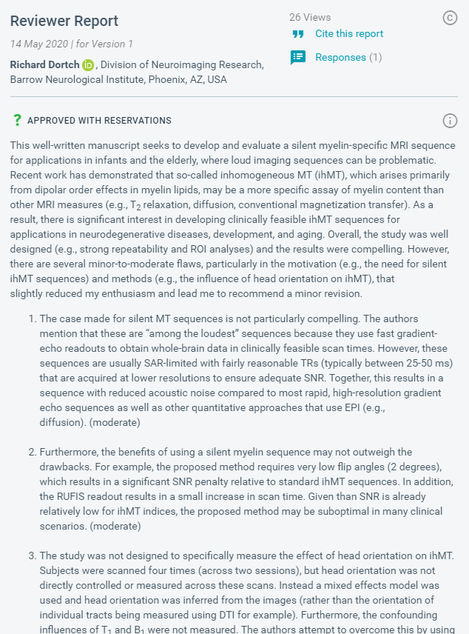

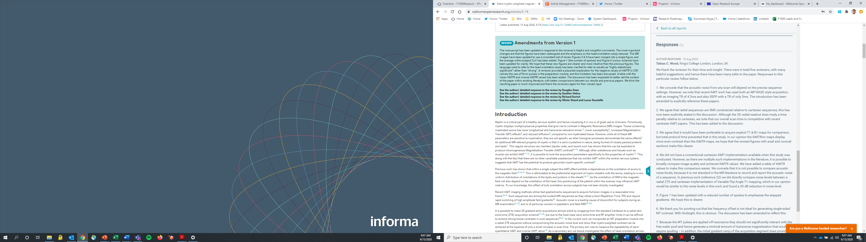
Open peer review example 2

Slide 38
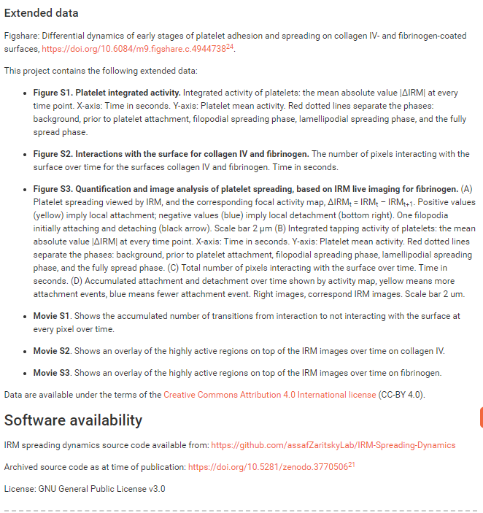
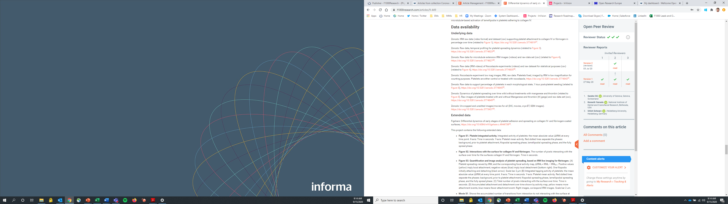
Open data example
https://f1000research.com/articles/9-449

Slide 39
Supporting research across all disciplines
Editorial guidelines and policies specifically for:
  - Science, Technology & Medicine (STM)
  - Social Sciences
  - Humanities
Data guidelines and policies in line with EC policies
We will be supporting many different article types to support disciplinary areas
Content will be searchable by subject areas and by H2020 programme areas.
STM | SS | Humanities
Research Article | Research Article | Research Article
Brief Reports | Essay | Essay
Data Notes | Review | Review
Method Articles | Case Studies
Software Tool Articles | Brief Reports
Study Protocols | Data Notes
Registered Reports | Method Articles
Reviews | Software Tool Articles
Systematic Reviews | Study Protocols
Clinical Practice Articles | Registered Reports
Case Reports | Systematic Reviews
Case Studies

Slide 40
Interoperability and syndication on ORE
From launch:
Zenodo – pushing full text articles and metadata to them via the Zenodo API (once articles have passed peer review).
EPMC – via Crossref we will send life sciences ORE preprints and update them to the full articles once they pass peer review
Over the 4 years:
OpenAIRE – we will be working with OpenAIRE to push ORE content and syndicate with institutional repositories
Institutional Repositories – as part of the sustainability task we will work with LIBER and OpenAIRE to identify and support APIs to directly send content.
Indexing databases – we will apply to all subject specific databases as soon as possible (DOAJ, Scopus, etc.)

Slide 41
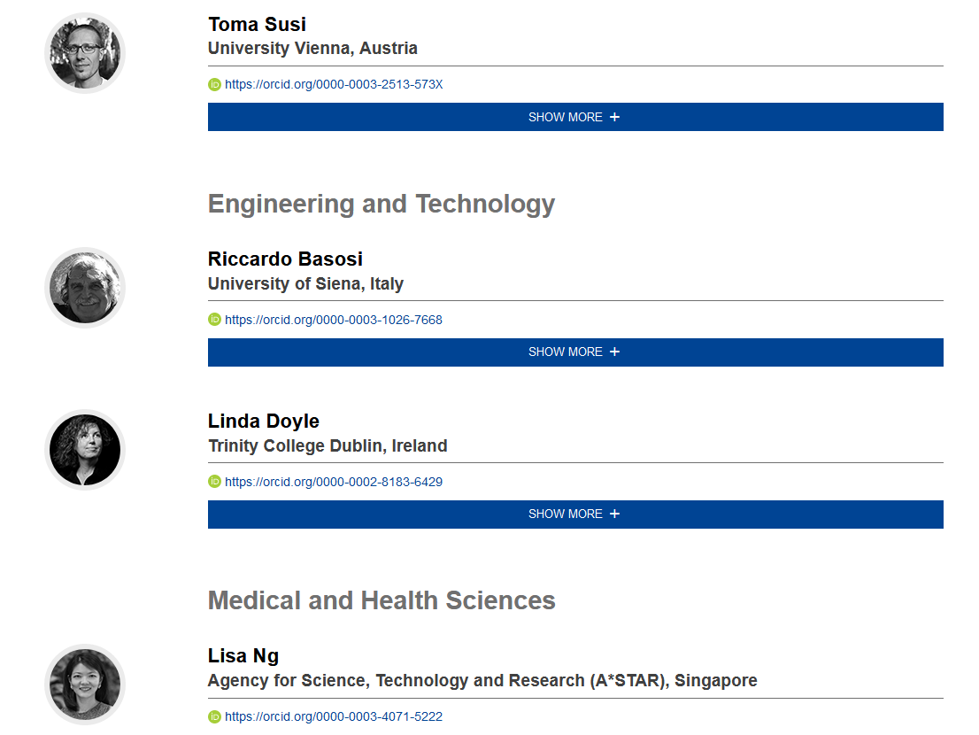
Scientific Advisory Board
Diverse Board, membership covers:
  n=25
  covers STM, Social Sciences and Humanities
  Europe (& beyond)
  researchers across career stages
  diversity
Their role:
  Constructive input and guidance on publishing policies
  Strategic direction and sustainability
  Advising on challenging issues that may arise
https://open-research-europe.ec.europa.eu/advisors

Slide 42
ORE timeline
Submissions Open
December 2020
Social Media Accounts launched
January 2021
Full media launch and publication of articles
24 March 2021

Slide 43
For questions:
info@open-research-europe.ec.europa.eu
Stay informed:
www.open-research-europe.ec.europa.eu
Follow us:
@OpenResearch_EU

