Slide 1

Use of Vocabularies in Repositories
PARSEC: Vocabularies need to be trusted and usable, RDA 17th Plenary, April 2021
Siddeswara Guru
Program lead, TERN Data Services and Analytics Platform
s.guru@uq.edu.au

Slide 2
Repositories
Single discipline
  same metadata specifications and related terms
  Data from one and related discipline
Multiple discipline (aggregator)
  Multiple source metadata specifications
    Harmonised to common specifications
    Need to follow common terms and concepts
    Multiple discipline

Slide 3
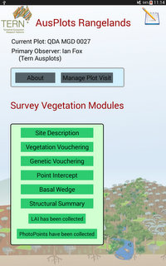
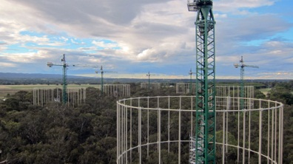
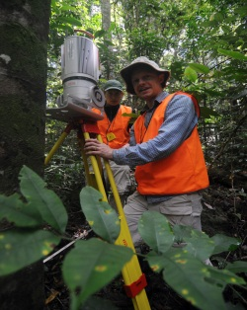
TERN Purpose¹
National collaborative research infrastructure for collecting, collating, storing and sharing Australia’s terrestrial ecosystem data sets and knowledge.
¹ TERN is supported by the Australian Government through the National Collaborative Research Infrastructure Strategy from 2009.

Slide 4
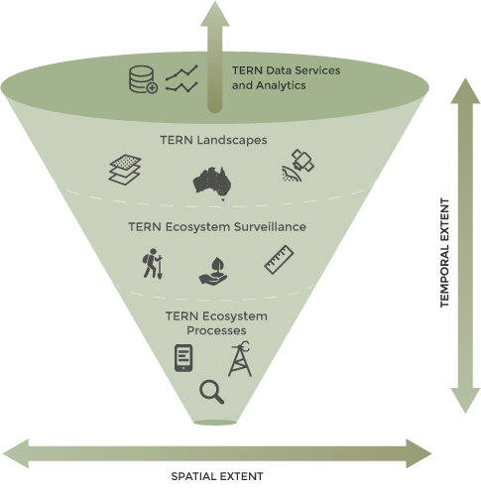
TERN in Operation
Satellite remote sensing
products
Land cover dynamics and phenology
Vegetation composition and structure
Fire dynamics and impacts
Continental Soil & Landscape data
Plot-based surveillance monitoring
Soil sample, leaf tissue samples, LAI, Basal area
Carbon, energy, water fluxes
Phenocams
Acoustic sensors
Flora population

Slide 5
Ecosystem science data
Messy
  Combination of human and sensor observation of different spatial and temporal extent
Diverse
  Same as above and different type, format;
  Point, Grid, time-series, one-off, wide geographical extent

Slide 6
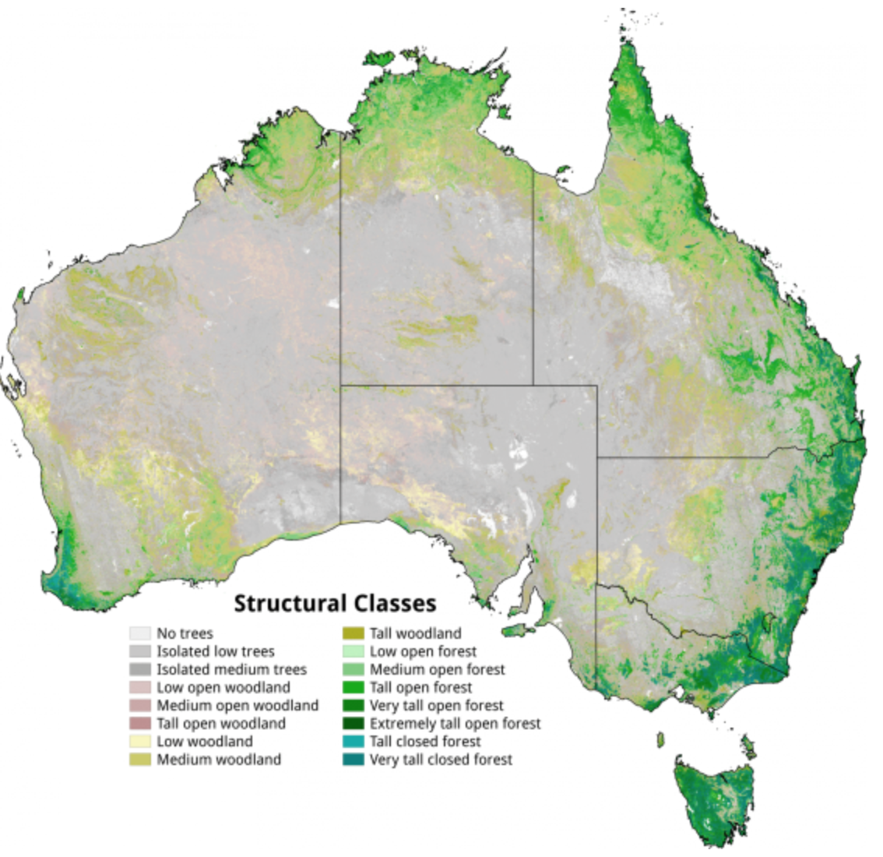
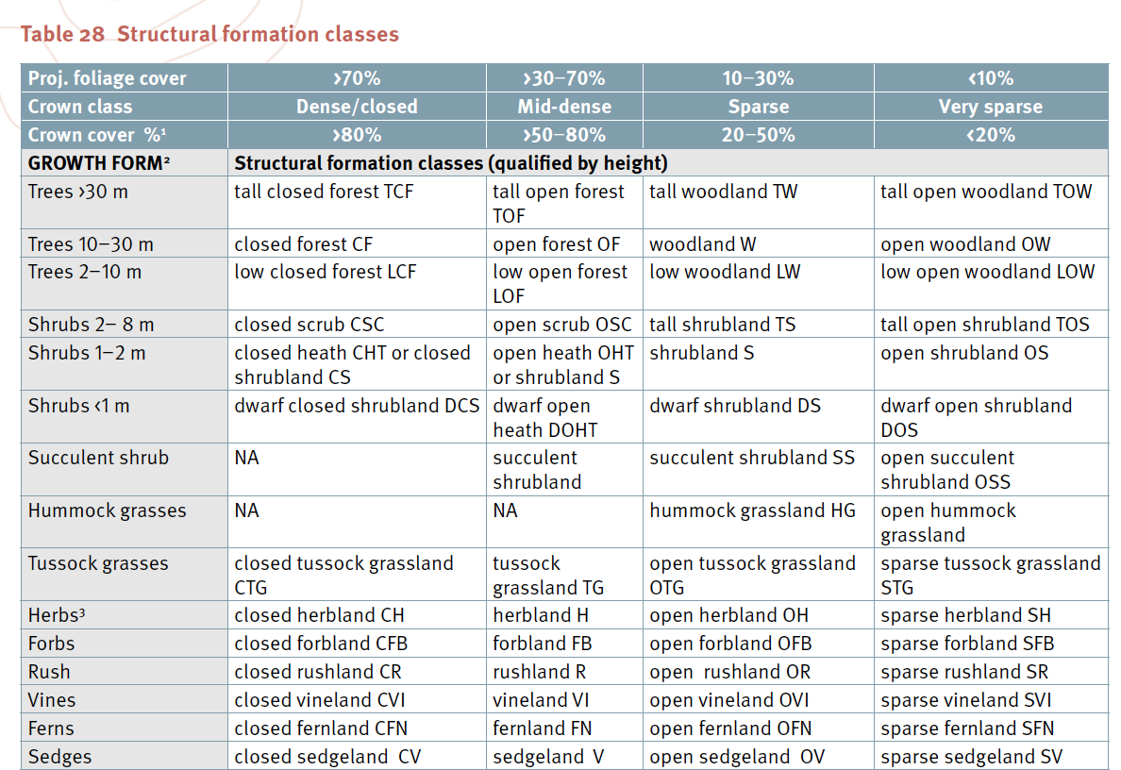
Structural Growth form

Slide 7
control vocabularies provide an opportunity to harmonise at different scale.

Slide 8
Harmonisation
Vocabularies are key
  Platform -- based on SOSA (align with GCMD)
  Instruments – based on SOSA (align with GCMD)
  Spatial regions – Australia’s Bioregions (IBRA), Ecoregions, States and Territories
  Spatial resolution -- RDF (align with GCMD terms)
  Temporal Resolution – RDF (align with GCMD terms)
  Content type – RDF (align with GCMD terms)
  Project – based on schema.org
  UoM – QUDT ontology
  Observed properties – parameter terms (align with EnvThes)
  Methods/procedures – Building Vocabularies for methods
  Organisations – based on schema.org
  People – based on schema.org

Slide 9
Data from TERN Flux towers
Ultimate FOI
Instrument
Observed properties
Spatial resolution
temporal resolution
content type
IBRA
Kipp and Zonen –
Radiation
Point Resolution
30 minutes
NetCDF
Procedure
procedure used
Platform
eddy covariance flux
Ecoregions
Climatic regions
Pyranometer
CNR1

Slide 10
Data from Field Ecology
Platform
Instrument
Observed properties
Spatial resolution
temporal resolution
content type
Ecology sites
Clinometer
Vegetation Height
100 meters - < 250 meters
One-off
CSV
Procedure
Vegetation Canopy Height Assessment Method
Ultimate FOI
IBRA
Ecoregions
Climatic regions

Slide 11
Conclusion
Vocabularies are key for consistent representation of data and contextual information
Improve search, access and reuse
Ability to index data at several agreed terms
Support interoperability between repositories
Enable FAIR data.

Slide 12

We at TERN acknowledge the traditional owners and their custodianship of the lands on
which TERN operates. We pay our respects to their ancestors and their descendants,
who continue cultural and spiritual connections to country.
TERN is enabled by NCRIS.
Our work is a result of collaborative partnerships with many universities and institutions.
To find out more please go to tern.org.au.
Acknowledge to TERN Data Services Team
TERN Linked Data: https://linkeddata.tern.org.au/

