Slide 1


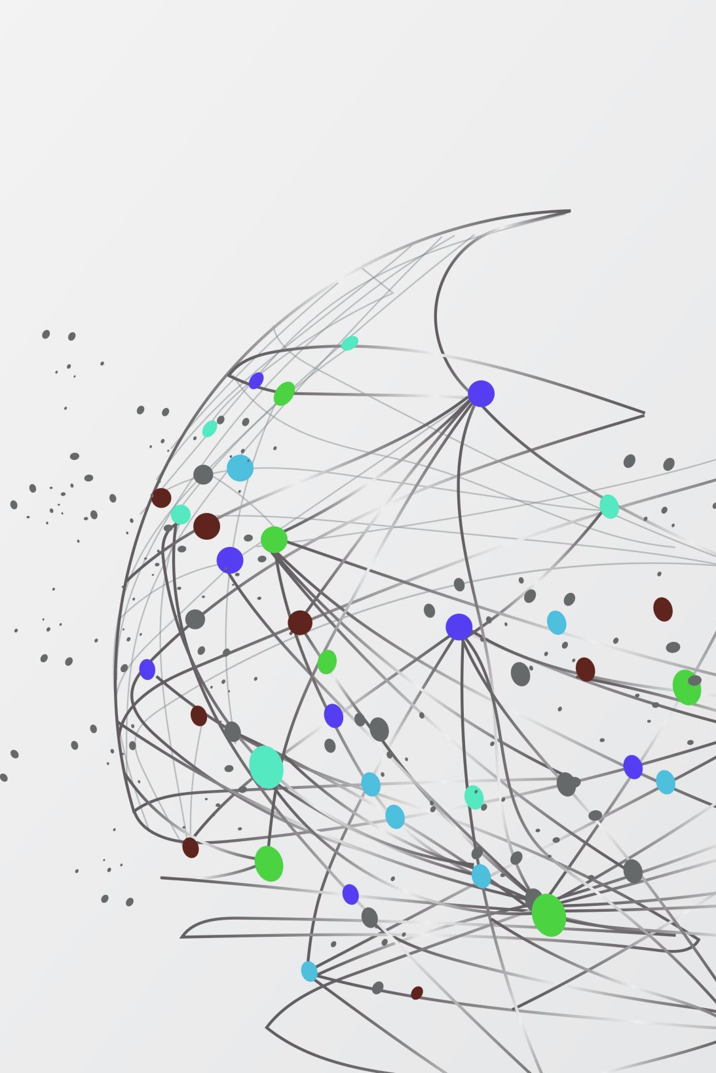


FAIR Persistent Connections
Adam Vials Moore¹ , Josh Brown² , Christopher Brown¹ , Alice Meadows², Fiona Murphy² , Phill Jones²
Jisc¹ & MoreBrains Cooperative²

Slide 2
Who?
What?
Why?
Where?
When?
Who
Jisc & MoreBrains
What
Investigate Persistent Identifiers and Open Access
Why
Where
When
Tickell Report
UK focus, aware of global context
2020 (🦠!) moving into Phase 2 now...
Core PIDs
Bring to bear efficiencies and enable effective science

Slide 3
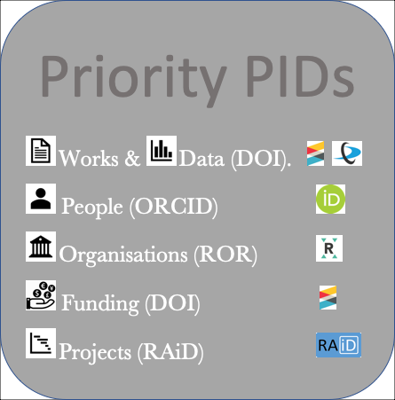
Core PIDs, Workflows and Interconnections
Funding
DOI

Slide 4
PIDs and FAIR
Addressing Inequality
Broadening the benefits of data-driven science
Protect the integrity of research data
Ensuring correct attribution and accountability
Increased efficiency
Making it easier to share and re-use factual metadata
To more and diverse stakeholders
Ensuring the contribution of researchers, their funding, organisations and the narrative of the projects being undertaken are described in a discoverable and reusable
Made accessible to global networks
Through agreed standards.
Enabling recognition of more contributions and roles for researchers
Allowing provenance to be established where lesser-known output is the basis for more established later “keystone” work.
PIDs can free up time to generate more value-additive information

