Slide 1
WheatVIVO AdminApp
Brian Lowe, Ontocale

Slide 2
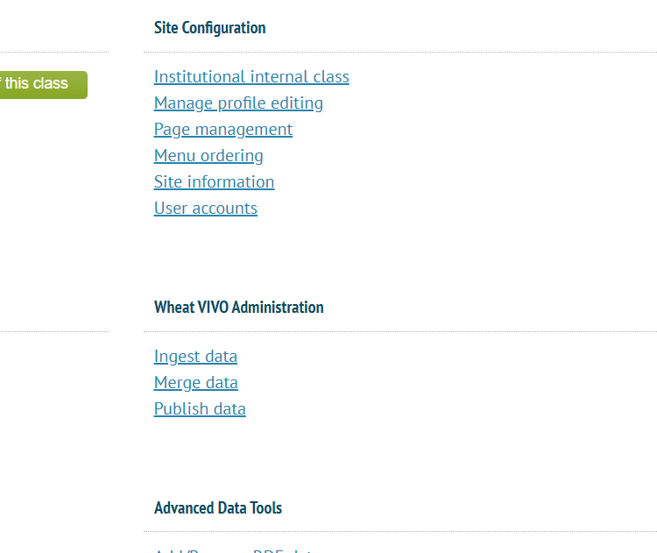

Slide 3
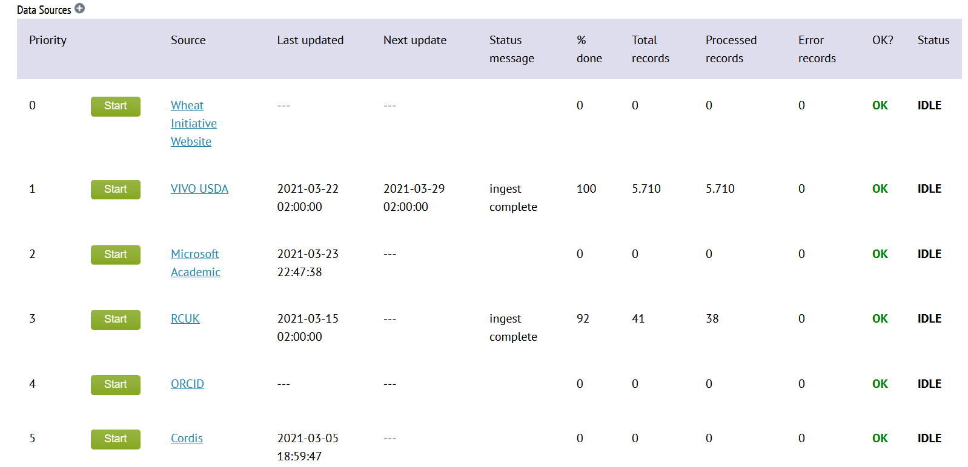

Slide 4
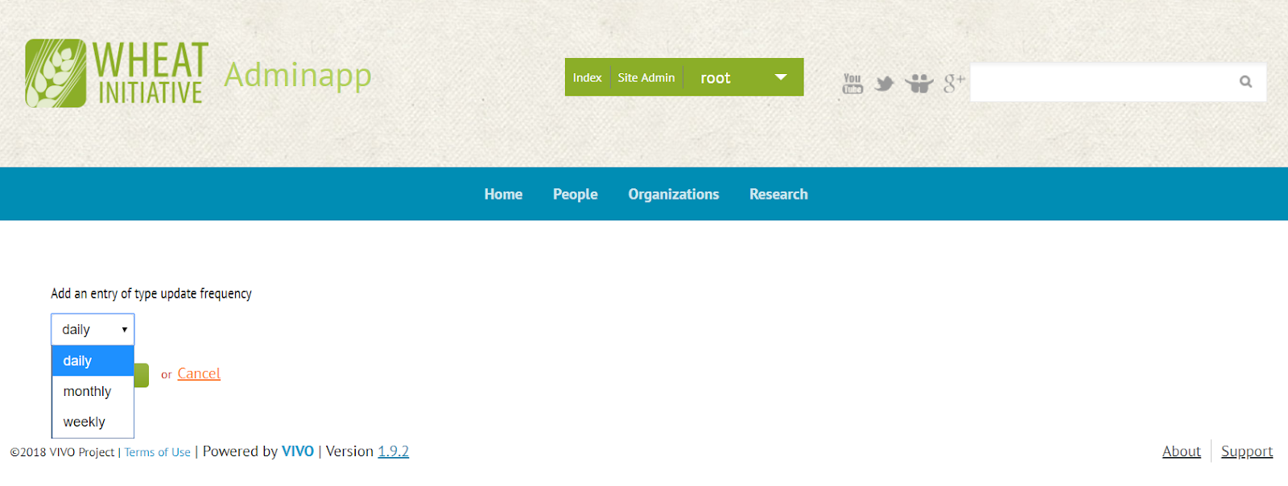

Slide 5
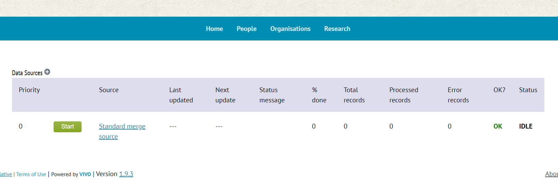

Slide 6
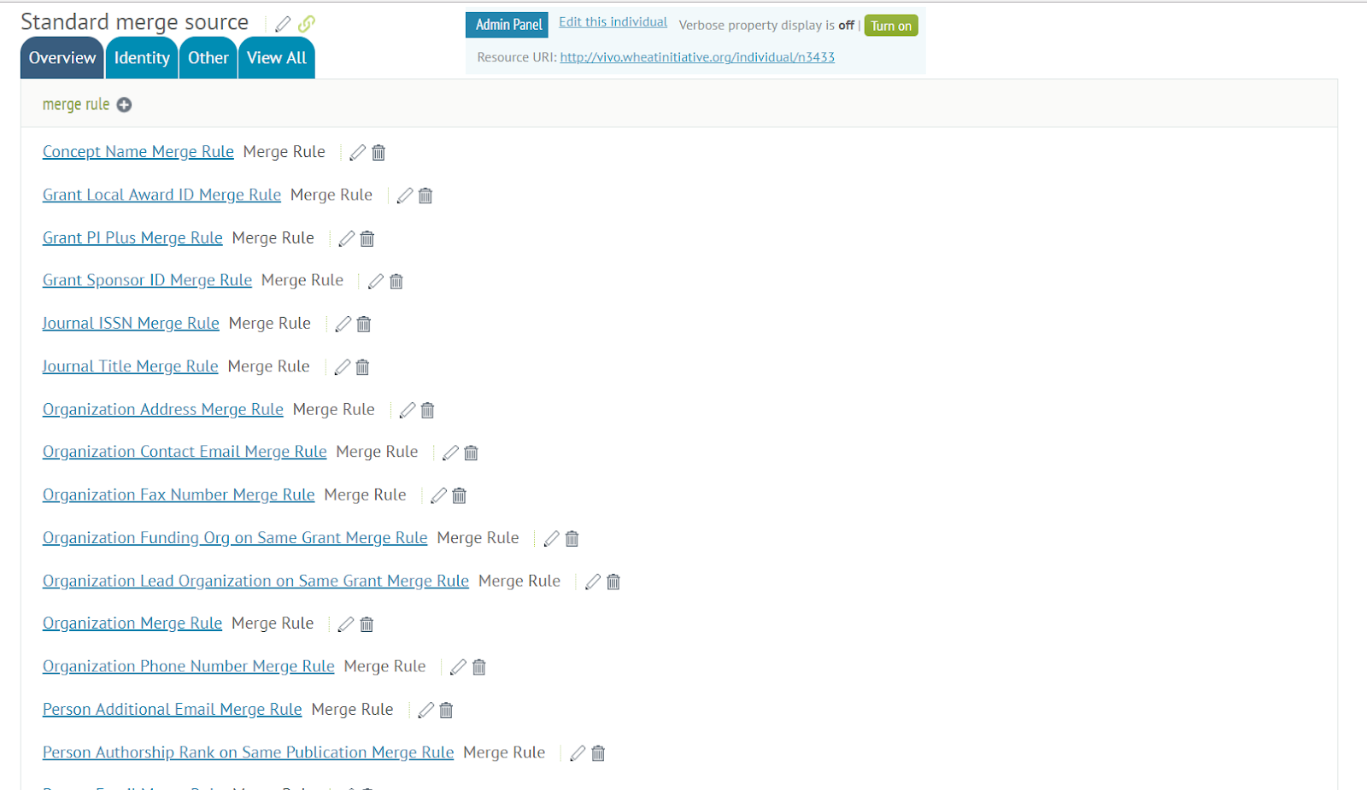

Slide 7
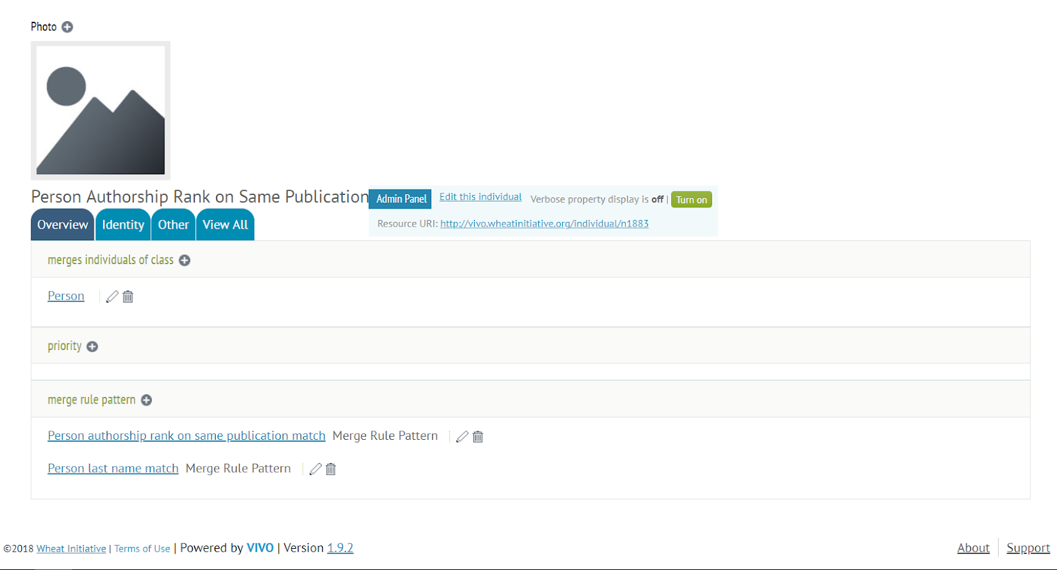

Slide 8
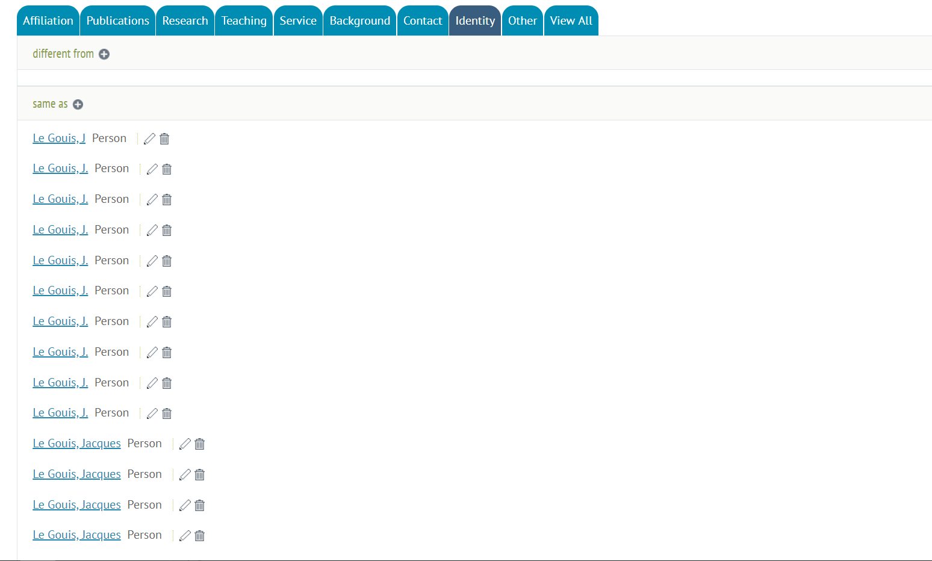

Slide 9
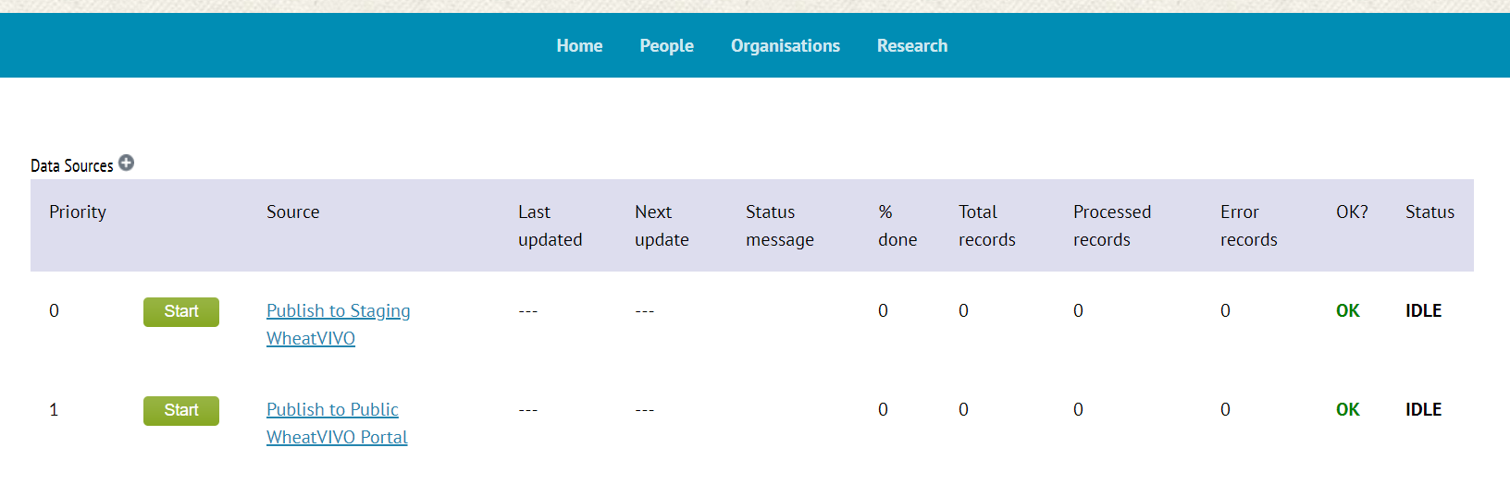

Slide 10
A project of the Wheat Initiative https://github.com/WheatVIVO/ https://github.com/WheatVIVO/adminapp
brian@ontocale.com

