Slide 1







Round Table Brazil
PARSEC Project
General problem of Reproducibility in Data Science
25 March 2021
This work is generously funded through grants from:
Shelley Stall
AGU Senior Director, Data Leadership
sstall@agu.org @ShelleyStall
https://orcid.org/0000-0003-2926-8353
Notes:
We (Michael O.Rourke, Director, Center for Interdisciplinarity, Michigan State University and myself, Marisa Rinkus) are organizing a webinar series for awardees of the US National Science Foundation AccelNet Program - Accelerating Research through International Network-to-Networks Collaboration . Based on your expertise working with international research communities and networks to encourage, elevate, and improve data sharing and integration, we are extending an invitation to you to speak as part of this series. The goal of these webinars is to provide best practices, share lessons learned, and other tools and techniques in the areas of coordination & collaboration, professional development, and evaluation for building international networks of networks.
Specifically, we are requesting your expertise regarding data sharing and open science. The AccelNet awards are focused on building international networks of networks in order to advance scientific discovery. For many teams this involves building trust around data sharing and open science, instituting standardized data collection and management procedures, and exploring unique data integration opportunities. As the project teams work to build their international networks they are interested in approaches and best practices for building a culture of data sharing, policies and the processes that can be used to gain buy-in for such policies, etc.
You were highly recommended by our colleagues and we would be excited for you to speak in this webinar series. If you are available and interested, this would be a one-hour webinar (40-45 minutes presentation/15-20 minutes Q&A) preferably the week of March 22nd, on a day and time of your choosing. We will also compensate you in return for your time and effort.
I would be happy to address any questions or concerns you may have. Thank you for your consideration.
Regards,
Marisa A. Rinkus, PhD (she, her, hers)
Research Associate
Center for Interdisciplinarity, Michigan State University
Toolbox Dialogue Initiative

Slide 2
Reproducibility, rigor, transparency, and independent verification are cornerstones of the scientific method.
Of course, just because a result is reproducible does not necessarily make it right, and just because it is not reproducible does not necessarily make it wrong.
A transparent and rigorous approach, however, can almost always shine a light on issues of reproducibility.
Marcia McNutt, President of the National Academies of Sciences
2014, DOI: 10.1126/science.aaa1724
Notes:
BY MARCIA MCNUTT
SCIENCE07 NOV 2014 : 679
Science 07 Nov 2014:
Vol. 346, Issue 6210, pp. 679
DOI: 10.1126/science.aaa1724
Statistical review
With a goal to improve the reproducibility of its published research, McNutt announced in 2014 that Science had added statistical checks to its peer-review process. Based on collaboration with the American Statistical Association, the journal appointed seven experts to a Statistics Board of Reviewing who are responsible for securing outside statisticians to review potential Science articles.[80]

Slide 3
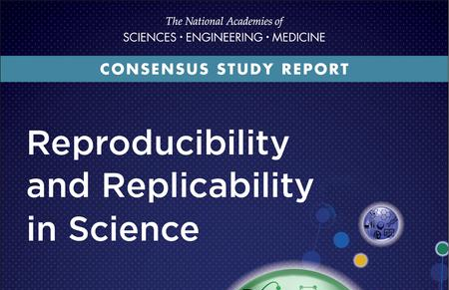
The scientific enterprise depends on the ability of the scientific community to scrutinize scientific claims and to gain confidence over time in results and inferences that have stood up to repeated testing.
RECOMMENDATIONS (Data Related)
Clear computational method and data products [and sampling methods]
Characterize relevant uncertainties
Clear, specific, and complete description of how the reported result was reached
Training in the proper use of statistical analysis and inference
Avoid overstating the implications of research
National Academies of Sciences, Engineering, and Medicine. 2019. Reproducibility and Replicability in Science. Washington, DC: The National Academies Press. https://doi.org/10.17226/25303.
Notes:
National Academies of Sciences, Engineering, and Medicine. 2019. Reproducibility and Replicability in Science. Washington, DC: The National Academies Press. https://doi.org/10.17226/25303.
Reproducibility is obtaining consistent results using the same input data; computational steps, methods, and code; and conditions of analysis. This definition is synonymous with “computational reproducibility,” and the terms are used interchangeably in this report.
Replicability is obtaining consistent results across studies aimed at answering the same scientific question, each of which has obtained its own data. Two studies may be considered to have replicated if they obtain con- sistent results given the level of uncertainty inherent in the system under study.

Slide 4
Definitions
Reproducibility is obtaining consistent results using the same input data, computational steps, methods, and code, and conditions of analysis. This definition is synonymous with “computational reproducibility.”
Replicability is obtaining consistent results across studies aimed at answering the same scientific question, each of which has obtained its own data. Two studies may be considered to have replicated if they obtain consistent results given the level of uncertainty inherent in the system under study.
National Academies of Sciences, Engineering, and Medicine. 2019. Reproducibility and Replicability in Science. Washington, DC: The National Academies Press. https://doi.org/10.17226/25303.

Slide 5
Sources of Non-Reproducibility
Inadequate Recordkeeping
Nontransparent Reporting
Obsolescence of Digital Artifacts
Flawed Attempts to Reproduce Others’ Research
Barriers in the Culture of Research

Slide 6
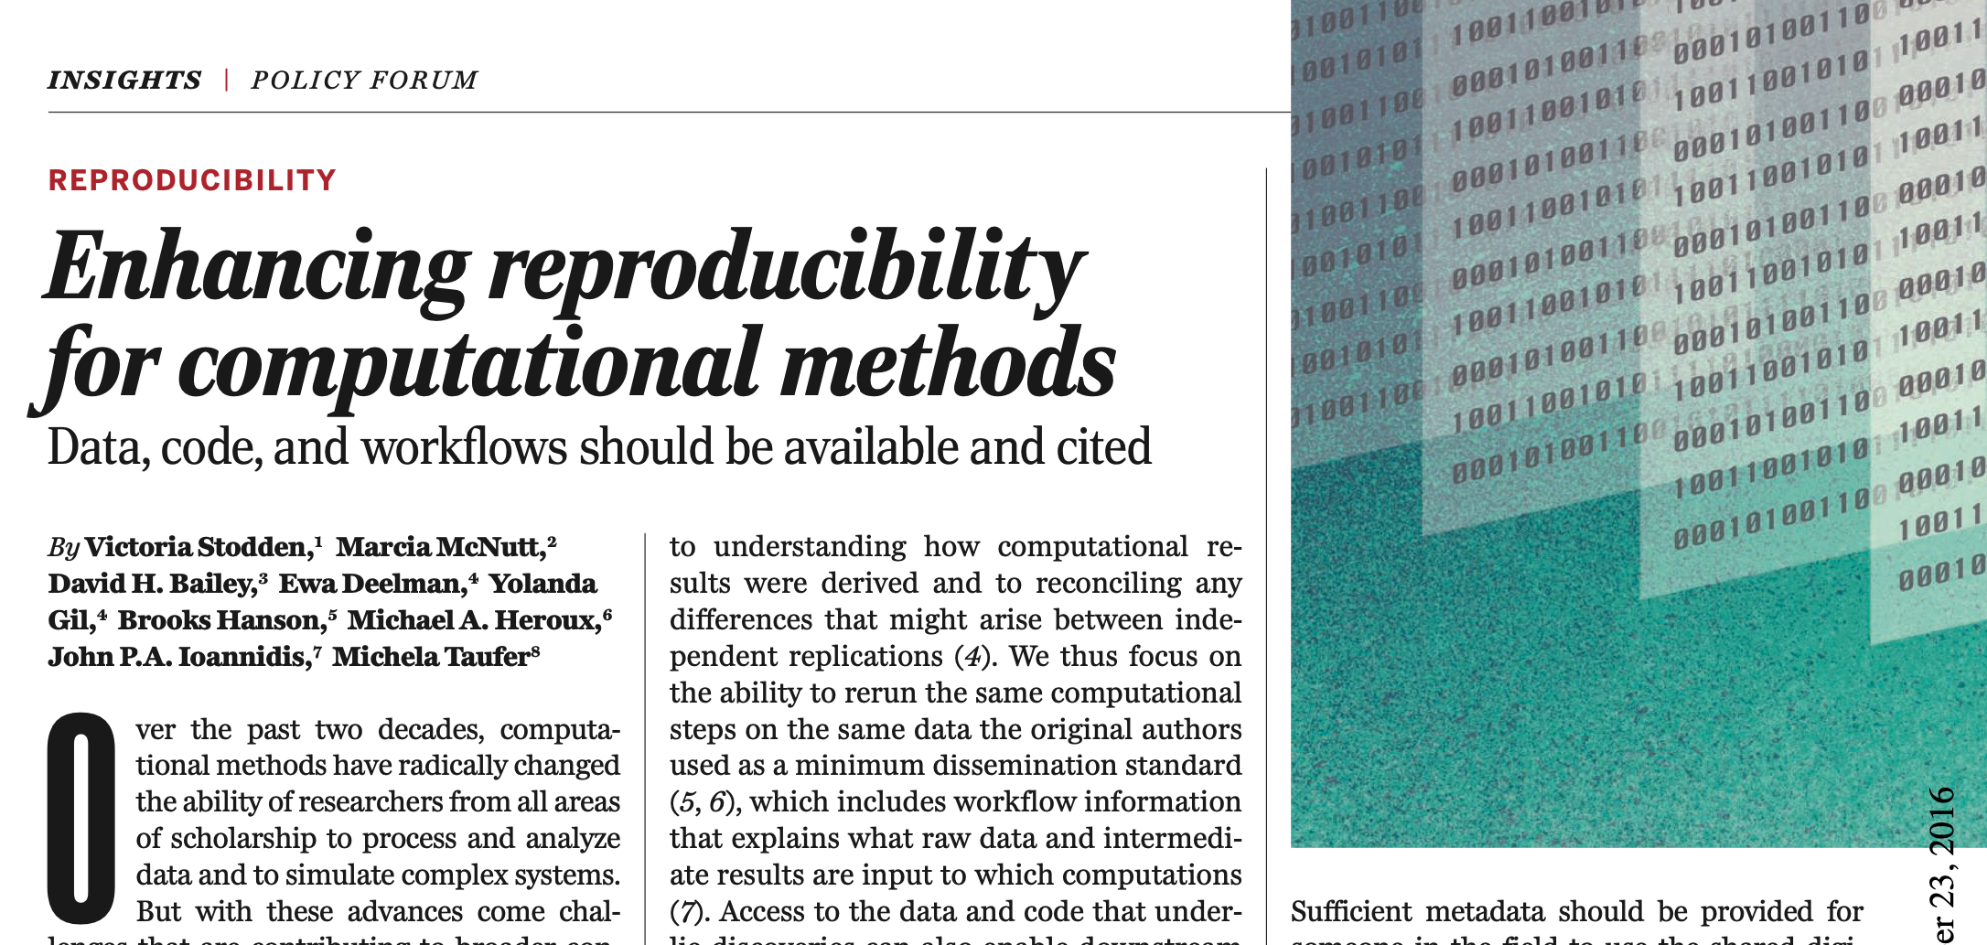
Victoria Stodden, Marcia McNutt, David H. Bailey, Ewa Deelman, Yolanda Gil, Brooks Hanson, Michael A. Heroux, John P.A. Ioannidis and Michela Taufer (December 8, 2016) Science 354 (6317), 1240-1241. [doi: 10.1126/science.aah6168]
Notes:
Victoria Stodden, Marcia McNutt, David H. Bailey, Ewa Deelman, Yolanda Gil, Brooks Hanson, Michael A. Heroux, John P.A. Ioannidis and Michela Taufer (December 8, 2016)
Science 354 (6317), 1240-1241. [doi: 10.1126/science.aah6168]

Slide 7
Enhancing reproducibility for computational methods…
Share data, software, workflows, and details of the computational environment that generate published findings in open trusted repositories.
Persistent links should appear in the published article and include a permanent identifier for data, code, and digital artifacts upon which the results depend.
To enable credit for shared digital scholarly objects, citation should be standard practice.
To facilitate reuse, adequately document digital scholarly artifacts.
Use Open Licensing when publishing digital scholarly objects.

