Slide 1



¹ French Foundation for Biodiversity Research (FRB), Montpellier, France
² Research-Team ICAR, LIRMM, Univ. Montpellier, CNRS, Montpellier, France
³ ESPACE-DEV, Univ. Montpellier, IRD, UA, UG, UR, Montpellier, France
⁴ Univ. Nîmes, France
Challenges in reproducibility of Deep Learning experiments - presentation of an example
Ali Ben Abbes
ali.benabbes@fondationbiodiversite.fr
Ali Ben Abbes¹, Laure Berti-Equille³, Marc Chaumont^{2,4}, Gérard Subsol²
Round Table Brazil: Workflow management and reproducibility, March 25th 2021
Notes:
Hi every body,
1

Slide 2
CONTEXTE & MOTIVATIONS (3/3)
General context
“More than 70% of researchers have tried and failed to reproduce another scientist's experiments, and more than half have failed to reproduce their own experiments” [1]
“Authors willingly submitting code is quickly increasing, from less than 50% in 2018, to nearly 75%” (in 2019) [2]
“The number of participants in the reproducibility challenges continues to increase” [2]
“Just 14.4% of participants had shared code, data, or both” [3]
Reproducibility is an important step to promote research
[1] https://www.nature.com/news/1-500-scientists-lift-the-lid-on-reproducibility-1.19970
[2] Pineau, J., Vincent-Lamarre, P., Sinha, K., Larivière, V., Beygelzimer, A., d’Alché-Buc, F., & Larochelle, H. (2020). Improving reproducibility in machine learning research (a report from the NeurIPS 2019 Reproducibility Program). arXiv preprint arXiv :2003.12206.
[3] Harris, Jenine K.; Johnson, Kimberly J.; Carothers, Bobbi J.; Combs, Todd B.; Luke, Douglas A.; Wang, Xiaoyan (2018). "Use of reproducible research practices in public health: A survey of public health analysts". PLOS ONE. 13 (9): e0202447.
2
Notes:
2

Slide 3
CONTEXTE & MOTIVATIONS (3/3)
Reproducible Research
Reproducibility: regenerate results using original data, software, and parameters
Replicability: arrive at the same results using new data
Repeatability: re-run a published analysis pipeline and arrive at the same results.
Hartley, M., & Olsson, T. S. (2020). dtoolAI : Reproducibility for Deep Learning. Patterns, 1(5), 100073.
Reproducible
Replicable
Data
Data1/Data2
Analysis
SAME DATA
SAME ANALYSIS
Analysis
Analysis
DIFFERENT DATA
SAME ANALYSIS
Analysis
Results
Results
Robust
Generalisable
Data
Data1/Data2
Analysis 1
SAME DATA
DIFFERENT ANALYSIS
Analysis 2
Analysis 1
DIFFERENT DATA
DIFFERENT ANALYSIS
Analysis 2
Results
Results
3
https://the-turing-way.netlify.app/welcome
Notes:
Data
3

Slide 4
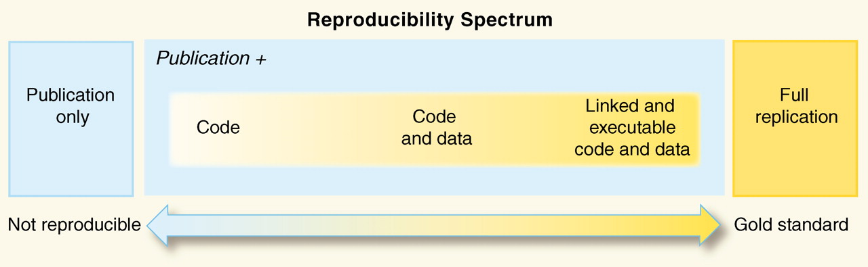
CONTEXTE & MOTIVATIONS (3/3)
Reproducible Research in Computer Science
Levels of reproducibility:
Reproducible Research in Computational Science, R. Peng, Science, Dec. 2011:1226-1227
Motivations:
  More public datasets
  Most method codes are available (major conferences and journals)
  High pressure/workload on researchers to make their work reproducible
4
Notes:
4

Slide 5
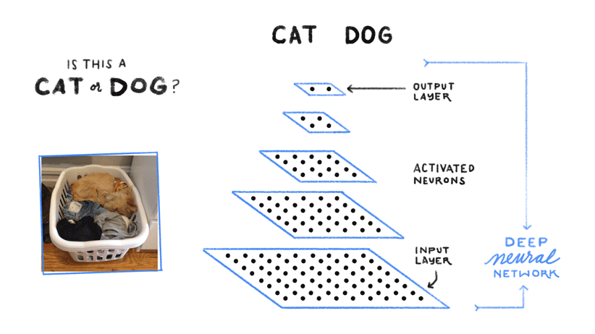
CONTEXTE & MOTIVATIONS (3/3)
How Deep Learning works?
Deep learning is a branch of machine learning algorithms based on a neural network composed of multiple layers to extract high-level features from data and to use them for classification and regression.
5
Notes:
5

Slide 6
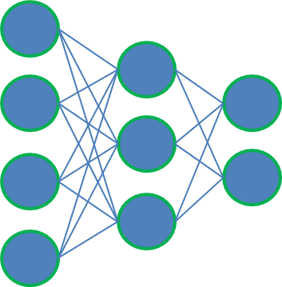
CONTEXTE & MOTIVATIONS (3/3)
A Deep Learning Procedure
Data Set
Data Augmentation
+
Normalization
Training
Test and Evaluation
Neural Network Model
Hyperparameters
6
Notes:
6

Slide 7
The Machine Learning Reproducibility Checklist
  Data collection process
  Detailed description
  Preprocessing steps
  Split Training/Evaluation
  Link to downloadable version of the dataset
Dataset
Algorithm
  Description of mathematical setting, algorithm and model
  Assessment of assumptions
  Analysis of the complexity
ML Reproducibility
Checklist
  Specifications of environment and dependencies
  Link to a downloadable source code
  Detailed documentation
Code
Experimental
results
How samples were allocated for training / validation / testing.
Hyper-parameters
Clear definition of evaluation indicators
Reproduced from: www.cs.mcgill.ca/~jpineau/ReproducibilityChecklist.pdf
7
Notes:
7

Slide 8
Reproducibility difficulties in Deep Learning
Access to the same data set
Misspecification of the model or training procedure
Availability of the code or errors in the code
Insufficient description of the experiments.
Difficult to recreate software environment (libraries, versions) used to generate original results
8
Notes:
8

Slide 9
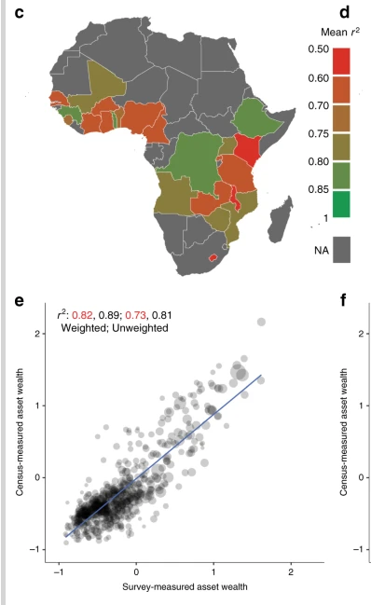
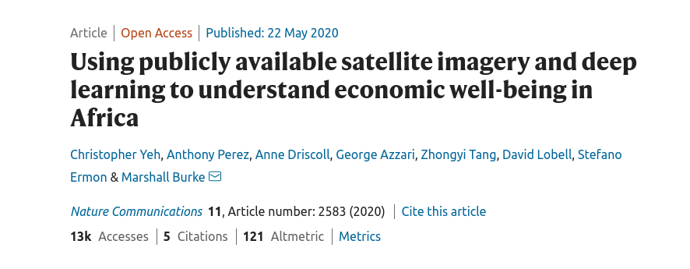
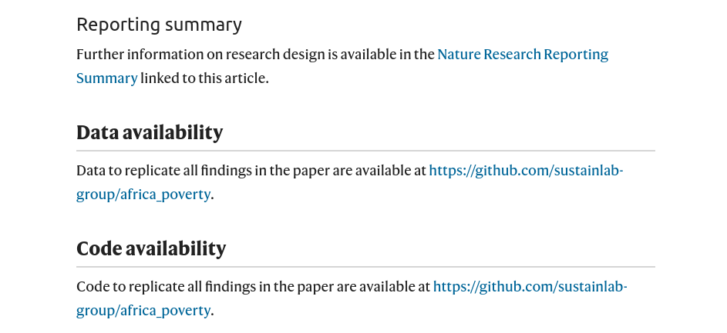
CONTEXTE & MOTIVATIONS (3/3)
A personal experience
Reproducibility of Yeh et al., (2020)
9
Notes:
personal experience
9

Slide 10
CONTEXTE & MOTIVATIONS (3/3)
Reasons to reproduce (Yeh et al., 2020)
Objective of the paper:
  infer well-being indicators from satellite images (multispectral Landsat and nightlight) images by Deep Learning techniques.
High prediction accuracy of 70% at a village level and over 80% when data are aggregated to districts.
Use a very large amount of data (surveys, images) across different time periods and many countries (23 countries Sub-Saharan Africa)
  => A reference paper on this topic.
10
Notes:
10

Slide 11

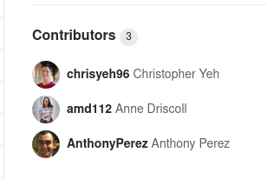
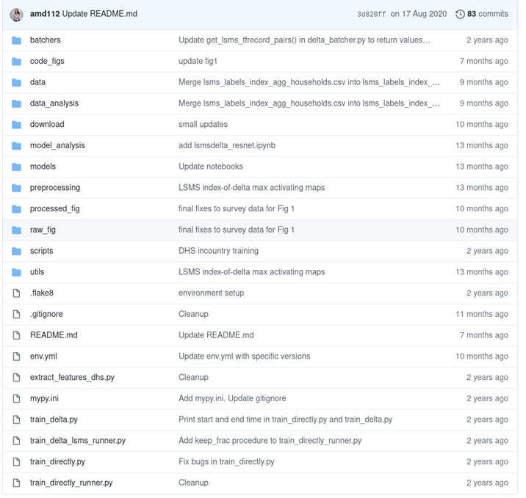
CONTEXTE & MOTIVATIONS (3/3)
Reproducibility of [Yeh et al., 2020]
GitHub link: https://github.com/sustainlab-group/africa_poverty
11
Notes:
Script 1
11

Slide 12
Proposed methodology
5. Train Convolutional Neural Network models
2. Preprocess
satellite images
1. Download satellite
images from GEE
3. Prepare
data files
Model
Wealth indicator
preprocessing
Landsat multispectral images
Train
Create TF-records
Val
Nighlight satellite images
Test
6. Extract learned feature representations
Original DHS
survey data
Extract
locations from
survey data
4. Run a baseline
ML method
7. Run regression between features and indicators
12
Notes:
12

Slide 13
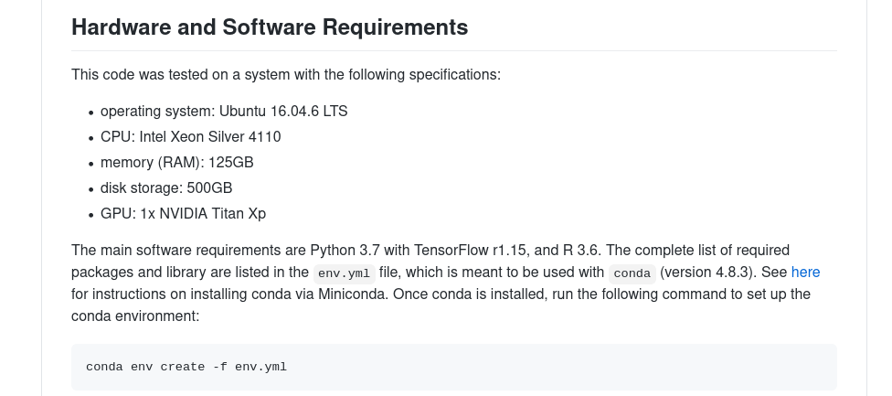
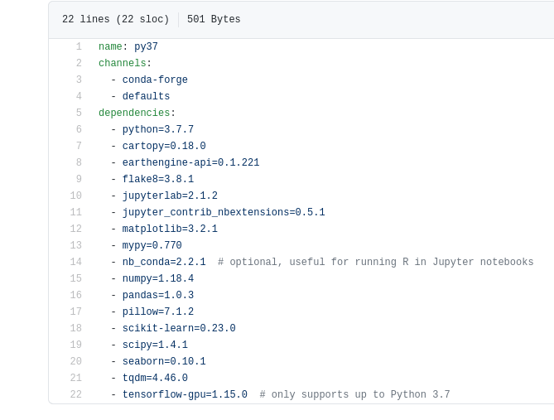
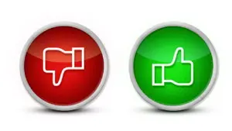
CONTEXTE & MOTIVATIONS (3/3)
Reproducibility [Yeh et al., 2020]
A complete description of hardware and software requirements
13
Notes:
Script 1
13

Slide 14
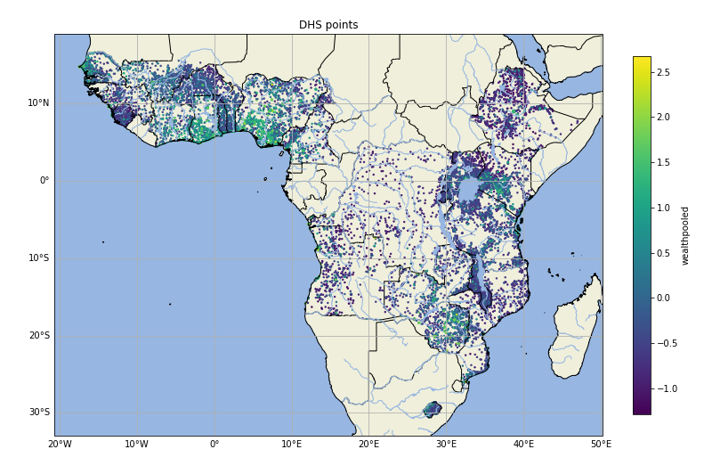
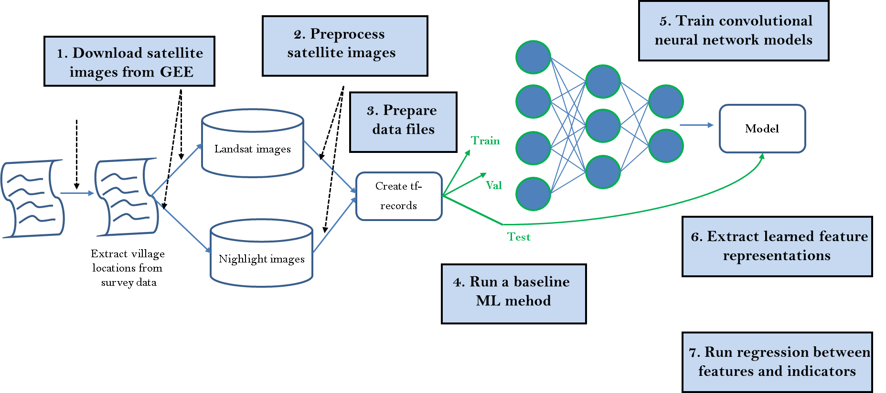
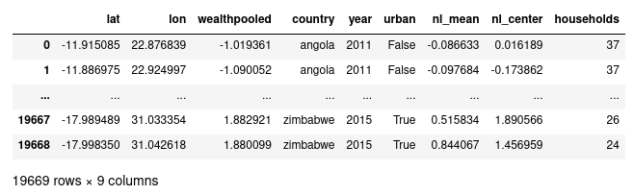
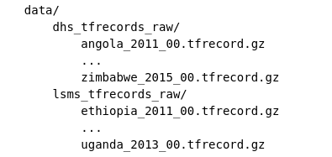
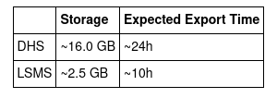
CONTEXTE & MOTIVATIONS (3/3)
1. Download satellite images from GEE
Wealth index
DHS villages
Storage
Images are saved in gzipped TF-Record format.
Original data (DHS surveys) not available
Insufficient description of some parameters
Chunk_size defines the number of satellite images in a record.
14
Notes:
14

Slide 15

CONTEXTE & MOTIVATIONS (3/3)
2. Process satellite images
The format saved in the first step
The format in the second step
A gap between the two steps
Step 1: according to a single country, single year, and a chunk number. ({country}_{year}.tfrecord.gz)
Step 2: combined for a single country “lx_median_{year_range}_{country}_dhslocs_ee_export.tfrecord.gz”
No exact parameter values setting
Insufficient description of the process
15
Notes:
15

Slide 16
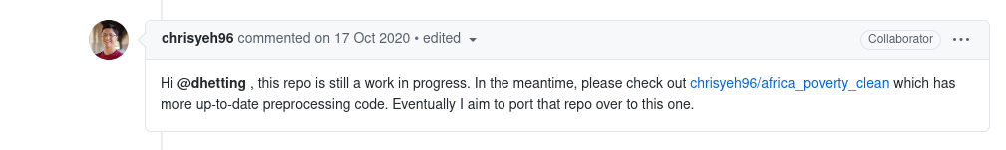
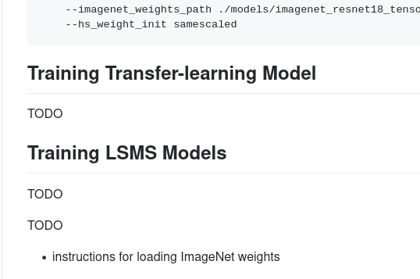
CONTEXTE & MOTIVATIONS (3/3)
A second GitHub link
GitHub 2: https://github.com/chrisyeh96/africa_poverty_clean/
But…. in this second Github, several steps are missing.
No update for the second link
Insufficient description of the experiment
16
Notes:
16

Slide 17
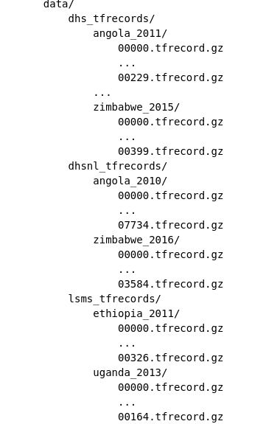
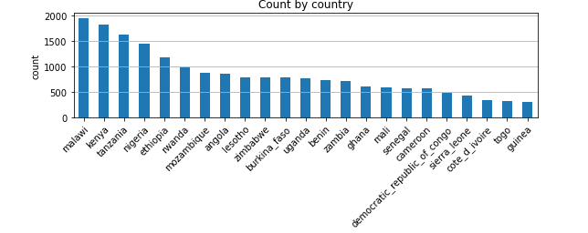
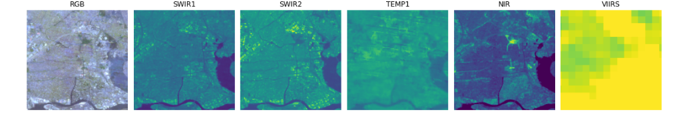
CONTEXTE & MOTIVATIONS (3/3)
2. Process satellite images
Verifies that the TF-Records match the original CSV files.
Splits each monolithic TF-Record file into one file per record.
Example of the Landsat and Nightlight images
Complete description of this step using the second GitHub
17
Notes:
17

Slide 18
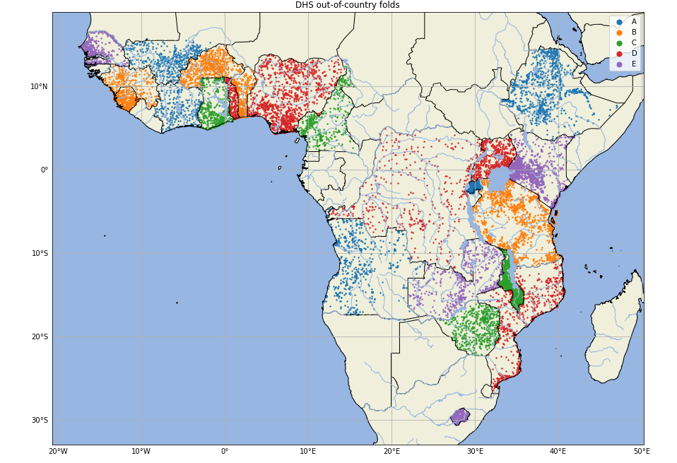
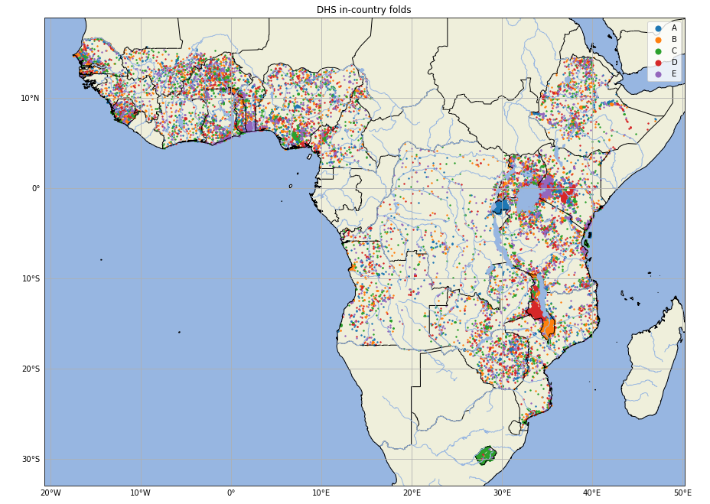
CONTEXTE & MOTIVATIONS (3/3)
3. Prepare data files
Assign the clusters into training (train), validation (val), and test (test) splits.
Out-Of-Country: assign entire countries to a split
In-Country: different clusters within the same country to be assigned to different splits
DHS Out-Of-Country folds
DHS In-Country folds
Complete description of this step using the second GitHub
18
Notes:
18

Slide 19
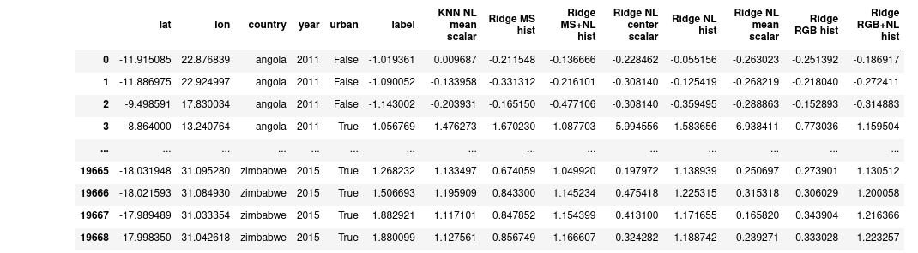
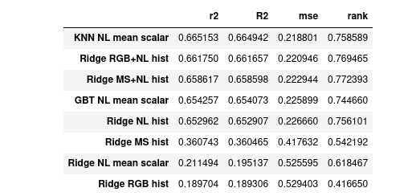
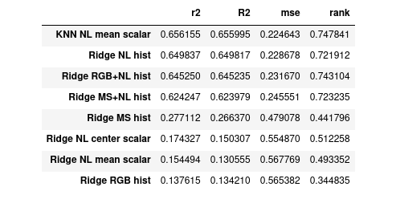
CONTEXTE & MOTIVATIONS (3/3)
4. Run a baseline ML method
DHS out-of-country folds
DHS in-country folds
Insufficient description of the experiment
19
Notes:
DHS OOC
19

Slide 20
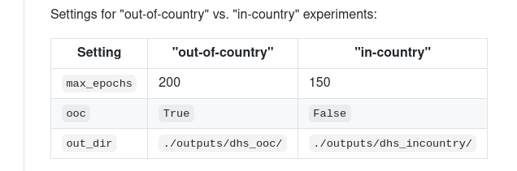
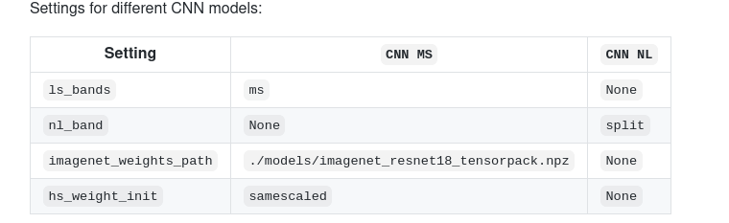
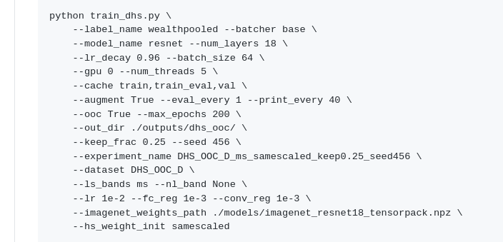
CONTEXTE & MOTIVATIONS (3/3)
5. Train Convolutional Neural Network models
No exact parameter values setting
Insufficient description of the experiment
20
Notes:
20

Slide 21
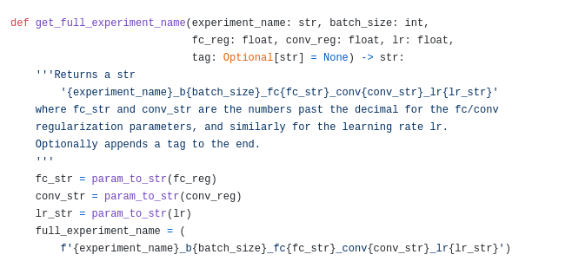
6. Extract learned feature representations
Extract learned feature representations.
Gap between the training script and the extract features scripts.
Extract features script
Training script
Exact parameter values setting.
Insufficient description of the experiment in the GitHub links.
21
Notes:
21

Slide 22
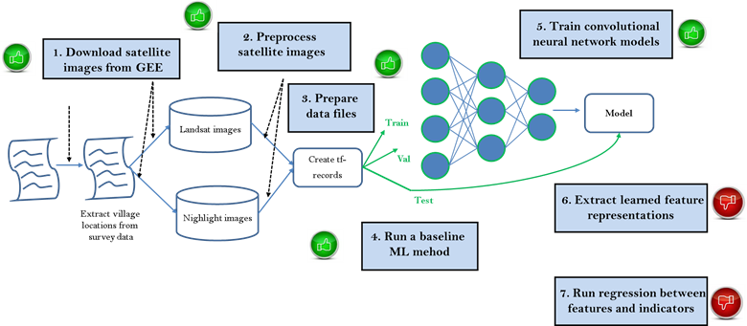
CONTEXTE & MOTIVATIONS (3/3)
Discussion
5. Train Convolutional Neural Network models
2. Preprocess
satellite images
1. Download satellite
images from GEE
Difficulties: Insufficient description of the experiment in the GitHub links.
DHS surveys not publicly available (the wealth index calculated)
Not all figures and table reproduced.
Missing README file (bad code documentation).
Coding style.
No exact parameter values setting
No update for the second script
No response for the authors
3. Prepare
data files
Model
Landsat images
Train
Create tf-records
Val
Nighlight images
Test
6. Extract learned feature representations
Extract village
locations from
survey data
4. Run a baseline
ML mehod
7. Run regression between features and indicators
22
Notes:
22

Slide 23
CONTEXTE & MOTIVATIONS (3/3)
Reproducibility: some considerations
Authors should provide all data code in order to reproduce all results, images and tables with:
  Raw (original) data and preprocessing tools and not only processed data
  A unique and up-to-date repository site
  Results of each step to follow the process and not only final results
  A consistent and detailed documentation about codes (or many comments)
  A possibility to discuss with the authors?
  A different coding style can be disturbing
  Deep-Learning algorithms are based on some random initializations. Results may be not completely identical.
  Concerns about the data and code licences. In particular, “NoDerivatives — If you remix, transform, or build upon the material, you may not distribute the modified material!
23
Notes:
23

Slide 24
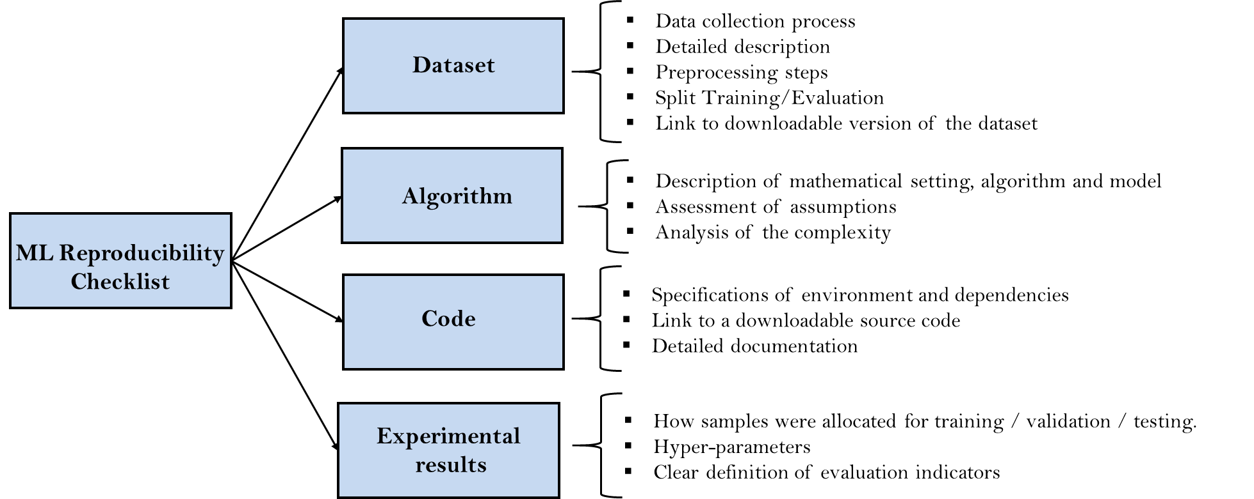
Reproducibility in Deep Learning: some considerations
  A unique repository site
  Detailed documentation
  Up-to-date information
  A possibility to discuss with the authors
General presentation
  Data licence
  Original data and preprocessing method
  Standard coding style
  Code licence
  Details about code/script dependencies
  Initialization procedures
Reproduced from: www.cs.mcgill.ca/~jpineau/ReproducibilityChecklist.pdf
24
Notes:
24

Slide 25
CONTEXTE & MOTIVATIONS (3/3)
Reproducible Research: Challenges
Several open questions:
What is the long-term value of the code submitted?
How can we propose a checklist for a specific field?
What is the benefit of using the checklist for authors?
25
Notes:
25

Slide 26
Thank you for your attention!

