Slide 1
Michael Markie @MMMarksman
Publishing Director, F1000 Research
@OpenResearch_EU

Slide 2
The Vision
Why | Who | What

Slide 3
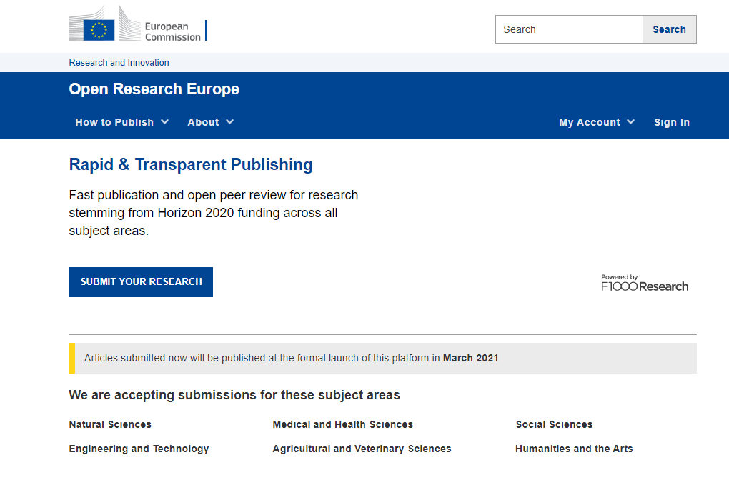
Open Research Europe (ORE)
Public Procurement – 5.8 Million EUR contract signed in March 2020 with F1000 Research for 4 years
GYA, LIBER and Eurodoc as collaborators/subcontractors for communication and sustainability
OpenAIRE are a partner to help with syndication and communication of ORE
https://open-research-europe.ec.europa.eu/

Slide 4
Why a publishing platform?
High-quality, reliable and efficient publishing venue for Horizon research
High scientific standards, and swift and transparent processes
Expert Scientific Advisory Board
No cost to authors/beneficiaries i.e. non-APC platform
Optional, venue where grantees can publish post-grant the results of their work, while respecting their open access obligations

Slide 5
The European Commission’s ambitions
To lead by example in operationalising open science principles e.g. open peer review, open data, early sharing of research, article level metrics and indicators.
Doing this while contributing to transparency and cost-effectiveness – APCs paid for by the Commission are set in procurement (780 euros).
Exploring sustainable open access publishing business models – cost effective publishing, potential to broaden the platform to other European funders and be interoperable with existing infrastructure.

Slide 6
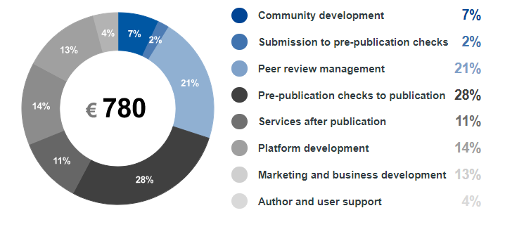
Price Transparency
Transparent about the costs and importantly the breakdown for the price that the Commission pays per article.
https://open-research-europe.ec.europa.eu/for-authors/article-processing-charges

Slide 7
The platform as a publishing service
Original peer-reviewed articles first posted as preprints
Stemming from Horizon 2020-funded research (and later, Horizon Europe)
Immediate open access
With content licensed for re-use
Open peer review
Open reviewer identities, published reviews, post-publication comments
Connected to the scholarly ecosystem
PIDs, connection to repositories, open data and software, interoperable technologies, preservation of content, TDM, etc.

Slide 8
The platform as a publishing service
New generation metrics
Each article will have a dedicated metrics page
Explicit, accessible and transparent on business processes and publication policies
All published on the site for everyone to see
Aligned with the EC policy and principles
Takes burden from researchers as it is fully compliant
Following example of other funders
Such as the Wellcome Trust (Wellcome Open Research) and others

Slide 9
ORE: How it works
The publishing model

Slide 10
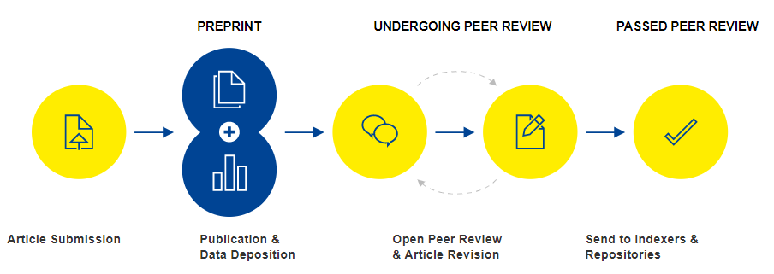
Open Research Publishing Model

Slide 11
Prepublication checks
Upon Submission
Assess author eligibility
Check article scope
Check for plagiarism
Pre-publication Checks
Comprehensive checks on reporting, editorial & ethical guidelines
Check for data availability
Support authors in making data and software FAIR
Production
Converted to text and data-mining formats (PDF, HTML, XML)
Proofs and editing if necessary
Quality checks on citations, references, image resolutions & multimedia
Ensure persistent identifiers are assigned and resolve correctly

Slide 12
Open Research Publishing Model

Slide 13



Data and Software Availability
Open Research Europe requires that, where possible, the source data underlying the results are made available at publication.
However, the sharing of research data must:
Protect the confidentiality, security and privacy of individuals
Respect the terms of consent by individuals who are involved in research
Be consistent with Horizon 2020 legal, ethical and regulatory frameworks
Guard against unreasonable costs
https://open-research-europe.ec.europa.eu/for-authors/data-guidelines

Slide 14
Open Research Publishing Model

Slide 15
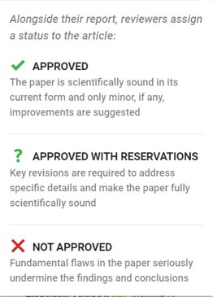


Open Peer Review
Open Identities
Reviewers must provide name and affiliation
Must identify conflicting interests
Open Reports
Reviewer reports will be published alongside the article
These are citable and have viewing metrics
Open Review Status
Reviewers assign a status

Slide 16
Open Research Publishing Model

Slide 17
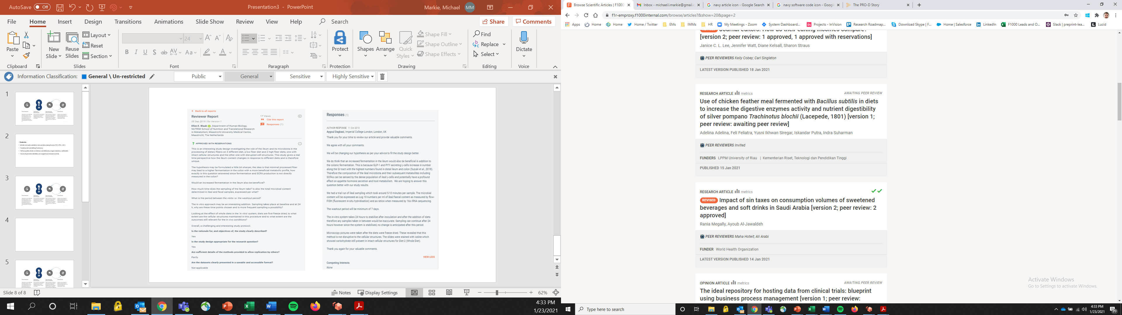

Passing Peer Review
Authors can respond to reviewers and revise their articles based on the comments
Revisions are made through new versions of the article that are linked together (versions are limitless)
Authors need to achieve a certain ‘threshold’ of reviewer status to be pass peer review and be indexed:
2 ‘Approved’ Status
2 ‘Approved with reservations’ and 1 ‘Approved’ Status

Slide 18
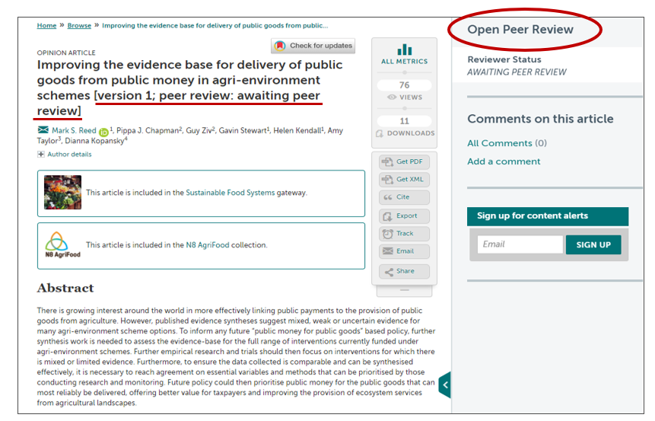
Preprint example
https://emeraldopenresearch.com/articles/2-57

Slide 19
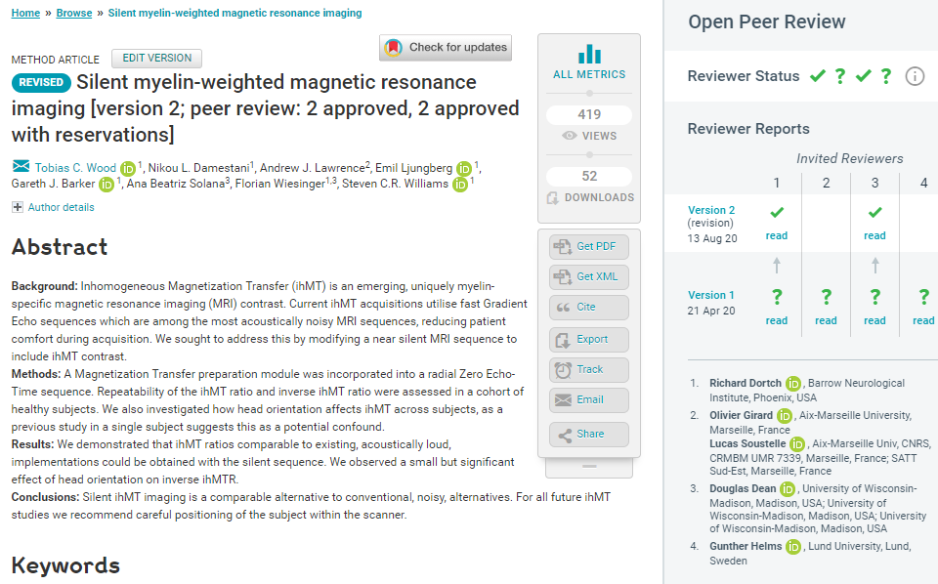
Open peer review example 1
Visibility & credit for reviewers:
Co-reviewing
ORCID ids
DOIs for reports
https://wellcomeopenresearch.org/articles/5-74

Slide 20
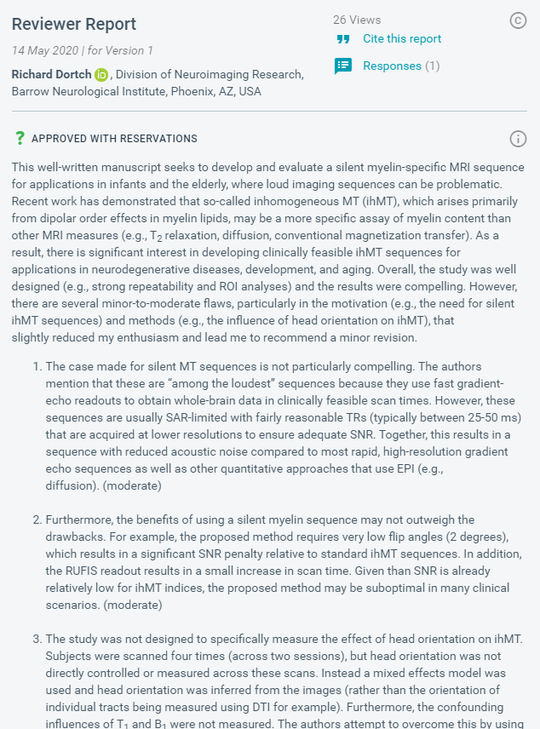

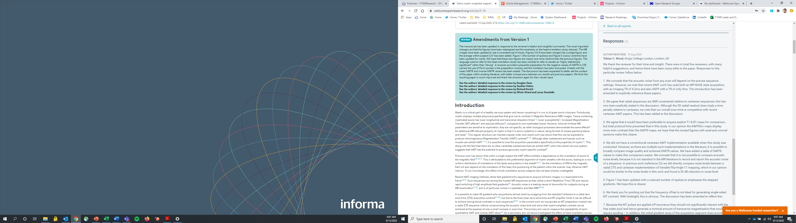
Open peer review example 2

Slide 21
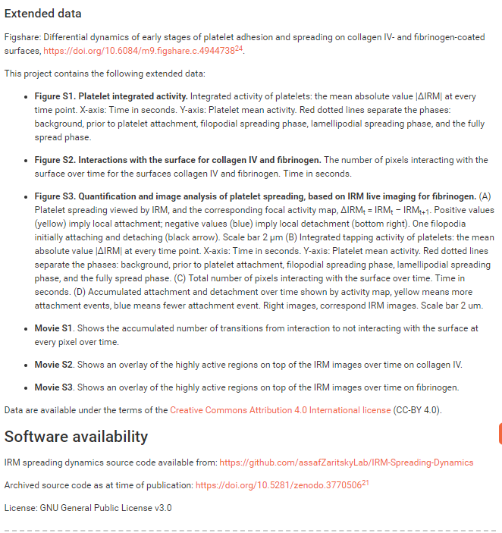
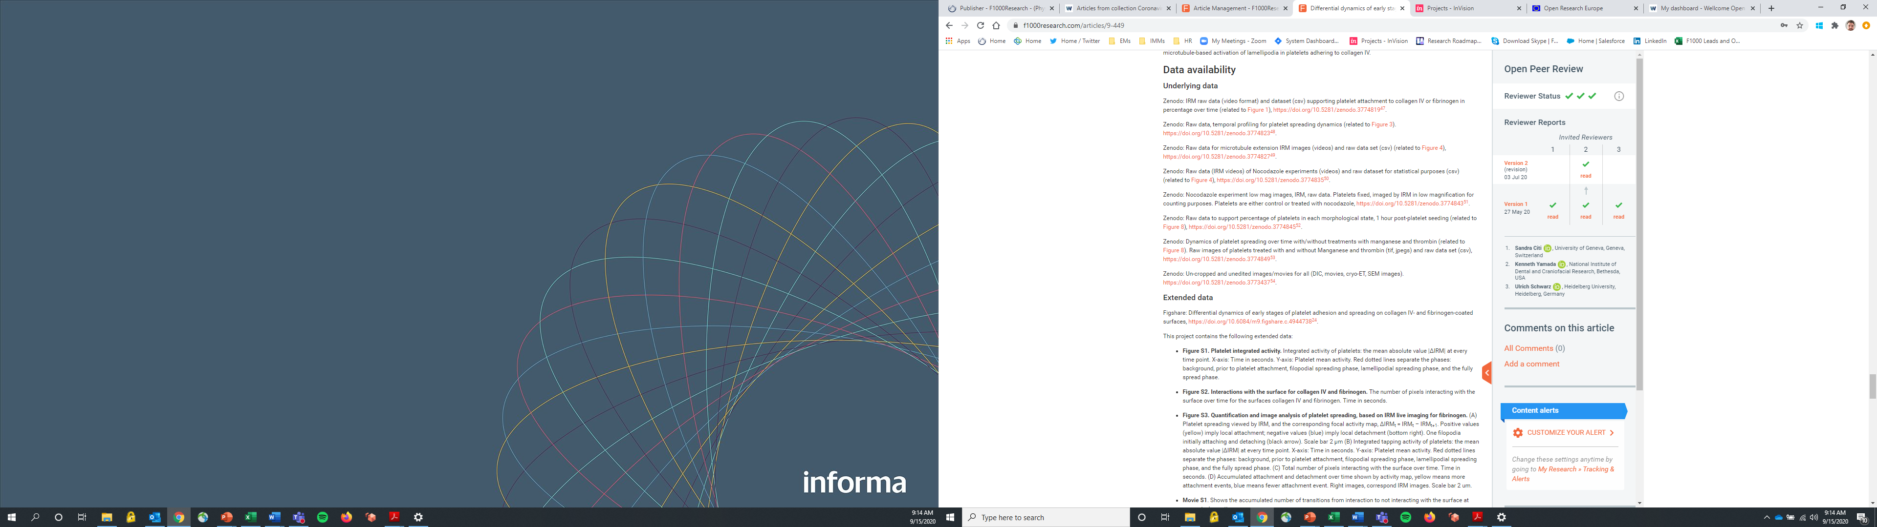
Open data example
https://f1000research.com/articles/9-449

Slide 22
Supporting research across all disciplines
Editorial guidelines and policies specifically for:
  - Science, Technology & Medicine (STM)
  - Social Sciences
  - Humanities
Data guidelines and policies in line with EC policies
We will be supporting many different article types to support disciplinary areas
Content will be searchable by subject areas and by H2020 programme areas.
STM | SS | Humanities
Research Article | Research Article | Research Article
Brief Reports | Essay | Essay
Data Notes | Review | Review
Method Articles | Case Studies
Software Tool Articles | Brief Reports
Study Protocols | Data Notes
Registered Reports | Method Articles
Reviews | Software Tool Articles
Systematic Reviews | Study Protocols
Clinical Practice Articles | Registered Reports
Case Reports | Systematic Reviews
Case Studies

Slide 23
Interoperability and syndication on ORE
From launch:
Zenodo – pushing full text articles and metadata to them via the Zenodo API (once articles have passed peer review).
EPMC – via Crossref we will send life sciences ORE preprints and update them to the full articles once they pass peer review
Over the 4 years:
OpenAIRE – we will be working with OpenAIRE to push ORE content and syndicate with institutional repositories
Institutional Repositories – as part of the sustainability task we will work with LIBER and OpenAIRE to identify and support APIs to directly send content.
Indexing databases – we will apply to all subject specific databases as soon as possible (DOAJ, Scopus, etc.)

Slide 24
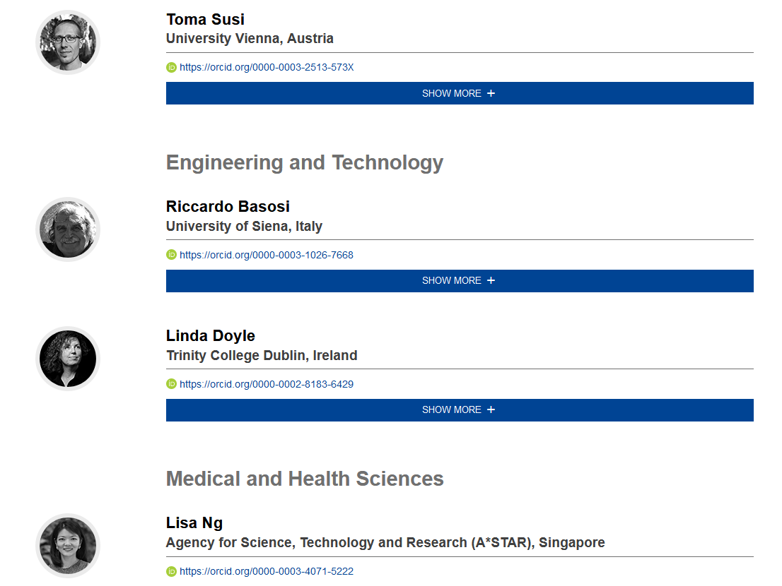
Scientific Advisory Board
Diverse Board, membership covers:
  n=25
  covers STM, Social Sciences and Humanities
  Europe (& beyond)
  researchers across career stages
  diversity
Their role:
  Constructive input and guidance on publishing policies
  Strategic direction and sustainability
  Advising on challenging issues that may arise
https://open-research-europe.ec.europa.eu/advisors

Slide 25
ORE timeline
Submissions Open
December 2020
Social Media Accounts launched
January 2021
Full media launch and publication of articles
March 2021

Slide 26
Grazie! ☺
For questions:
info@open-research-europe.ec.europa.eu
Stay informed:
www.open-research-europe.ec.europa.eu
Follow us:
@OpenResearch_EU

